Slide 1

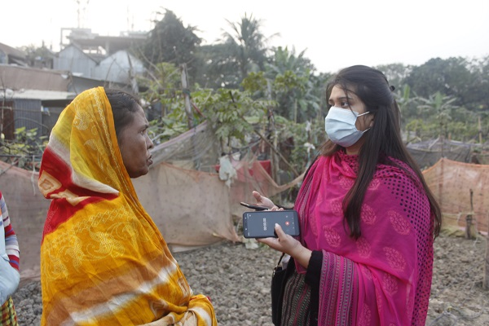
Gender and social inclusion
Assess options for and plan gender-responsive, socially inclusive climate solutions
Image: Bangladesh, ICCCAD & CDKN, Voices from the Frontline

Slide 2
Recap: What the assessment of vulnerability, needs, capacities and risks assessment achieved (module 3)
Combined qualitative and quantitative data in order to understand if, how and why women and men are affected differently within a particular context or sector. Established a baseline.
Climate impacts and adaptation: The analysis should have revealed differences in how climate impacts are felt and how gender-responsive adaptation actions can be formulated in response (which will be elaborated more in this module).
Low emission development : Should have highlighted barriers to women’s participation in climate solutions and green economy and point to ideas on how equitable participation can be supported (which will be elaborated more in this module).
Notes:
When conducted effectively, gender responsive vulnerability, needs, risks assessment should reveal nuances in climate change impacts by determining the socioeconomic, cultural and institutional gaps that prevent men and women from reacting and adapting to these impacts on an equitable basis.

Slide 3
In this module you will learn
How to funnel the assessment of people’s climate-related development needs, risks and capacities (from the last stage/module) into an assessment of possible solutions using complementary methods.
Ideas for taking the range of solutions and mapping them to a project or programme plan that will deliver improved outcomes for women and girls, and for everyone.
Notes:
Facilitator/trainer: This module is an entire day’s worth of training material, with part A requiring a full half-day to undertake proper training and participatory group work as suggested, and part B requiring a further half-day to fully cover and ‘unpack’ in an interactive and participatory way.

Slide 4
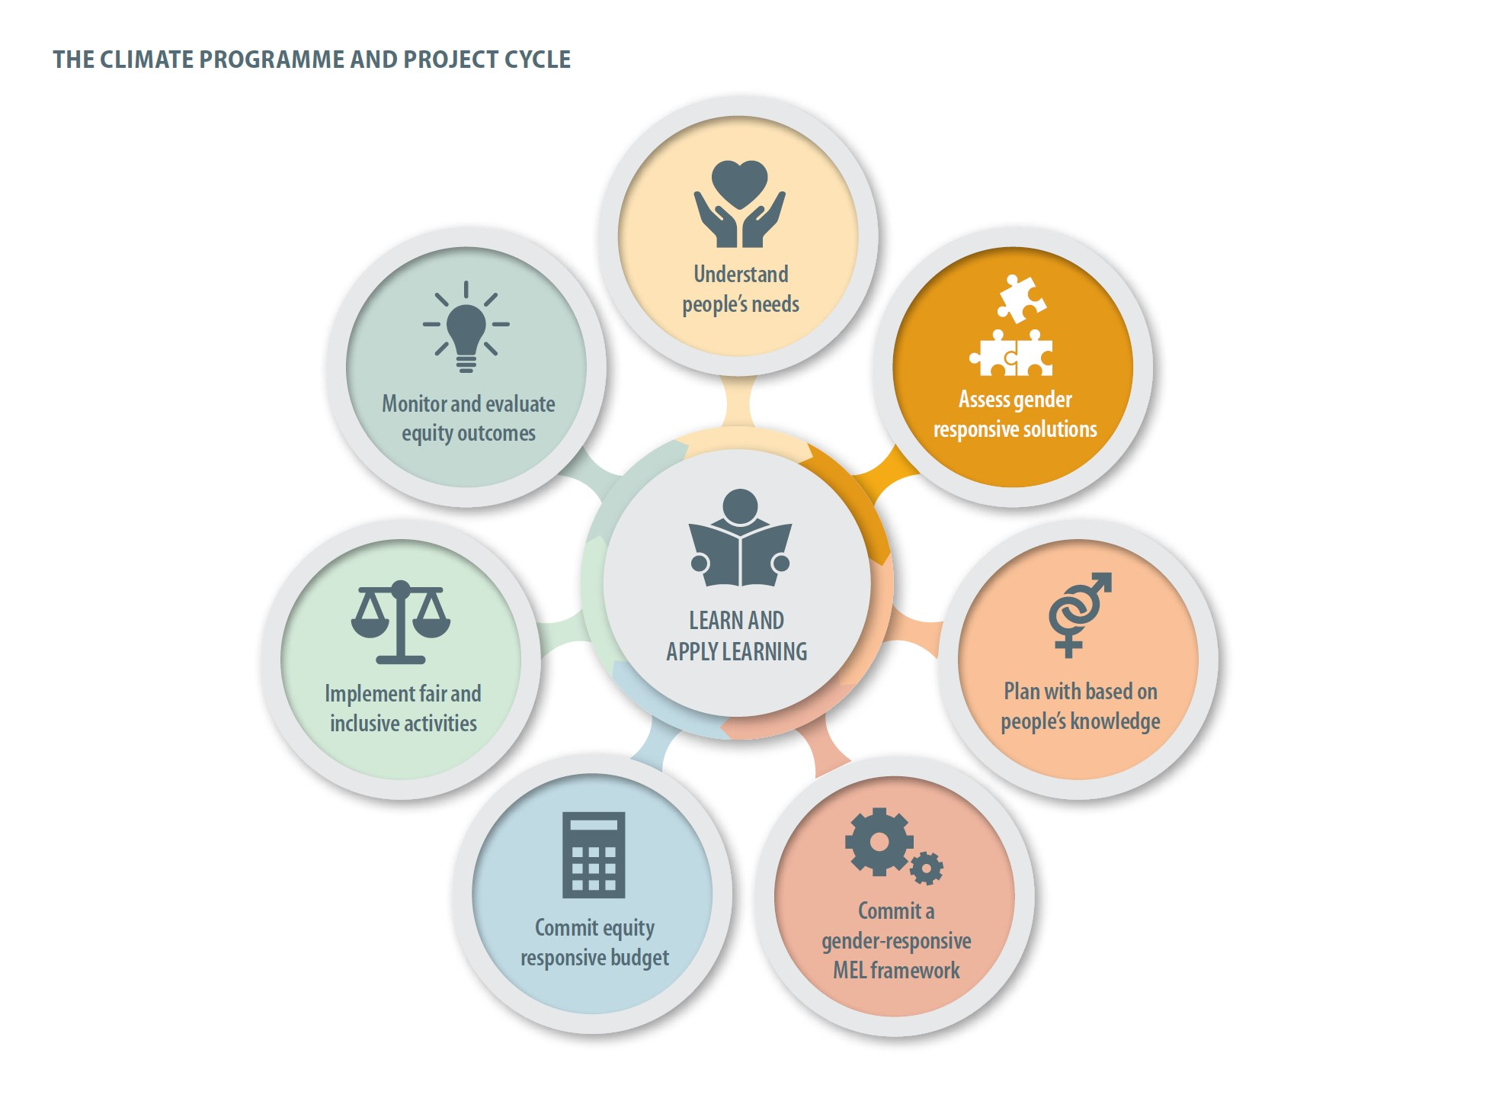
Next step: assess drivers of climate and development problems, and possible solutions

Slide 5
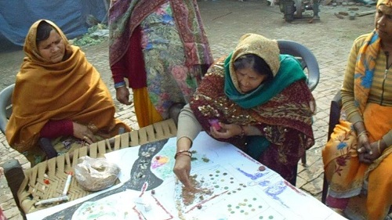
Problem tree method
This is when you unpack the central climate change (and/or associated social-behavioural) issue your project will address and the underlying drivers and root causes of the problem and the impacts it creates.
Problem tree method systematically looks at causes and consequences, helping to reveal solutions
Notes:
Here, a very simple starting analysis
Problem tree analysis The problem tree analysis defines the causal chain in which the central problem is embedded. A problem tree is in effect an analysis which models causes and effects. Problem tree analysis helps to find solutions by visually mapping the causes and effects around a problem and the linkages among them. The central problem does not need to be women-centered or gender-focused, but the gender analysis conducted thus far will inevitably lead to identification of gender specific causes, effects and impacts.
In order to construct a problem tree, the following steps may be useful: • Identify the central problem: the climate change situation that requires attention or the central problem that women face in the sector. It is important to note that there are many potential problems or points for entry.
• Determine the causes of the problem by asking “why” until it is not possible to go further. There are immediate or the most obvious and visible causes, and less evident but important underlying or secondary causes. The fundamental or structural causes of the main problem are the root causes. • Identify the effects of the main problem by asking “what are the consequences?” until it is not possible to go further. • Connect the problem with cause-effect arrows clearly showing key links.
Problem tree analysis provides a more grounded analysis in a particular context

Slide 6
Problem Tree Analysis: Ethiopia Micro-Finance Case Study
Impacts
Low community and national resilience to climate shocks
Gender inequality
Increased poverty
Long Term
Consequences
Minimizes the development opportunity of a community
Communities, esp. women headed HHs become highly vulnerable to disaster risks
Limited coping mechanism/ low resilience as livestock are impacted by climate change
Limited education, capacity building opportunities
Immediate
Consequences
Lack of micro-finance /access to credit lead women to remain financially dependent
Limited HH income and HH food insecurity
Frequent migration in face of climate change
Increased burden on women
Central Problem
Limited opportunities for pastoralist women to engage in climate resilient income generating activities
Immediate
Causes
Climate/development programs that do not consider women’s need – venue, timing etc.
Lack of micro-finance /access to credit
Low access to information, limiting participation of women
Low understanding of the benefit by women and tendency to continue to do what is ‘normal’
Secondary
Causes
Lack of recognition of women’s input to the economy and their burden
Lack of institutional framework to integrate gender in climate/development programs
Lack of policy level gender intervention
Lack of information on gender-climate change and climate compatible livelihood alternatives
Lack of recognition of women’s potential to work and earn money
Gender-blind social and cultural norms
Lack of integration between government departments including gender units
Limited capacity of gender departments to influence action
Insufficient women voice in decision making position to influence programs and polices
Root Causes
Notes:
Lack of recognition of women’s potential to work and earn money (under secondary causes) – this is lack of recognition by everyone including the people who design and deliver credit schemes or development projects; communities etc.
Examples of climate resilient pastoralist income-generating activities

Slide 7
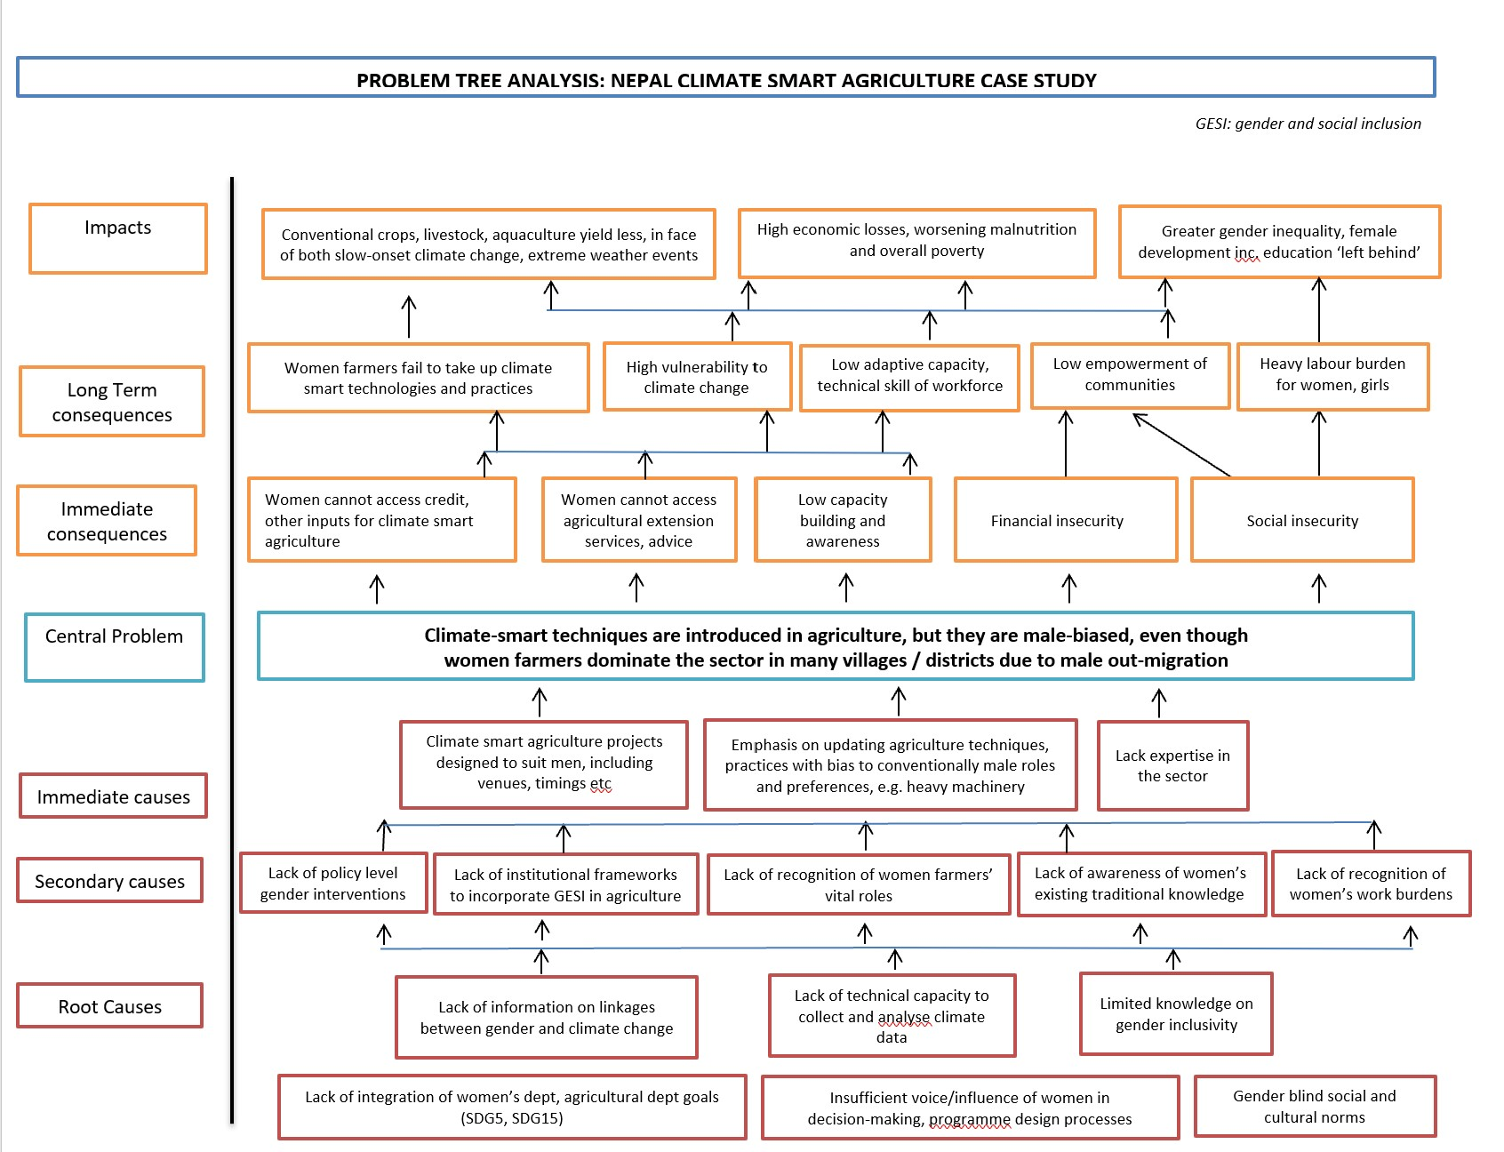
Notes:
Facilitator/trainer:
This is a sample problem tree using the nexus of issues explained in the rural Nepal case study as an example.
Please refer to the handout on gender-responsive, climate-smart agriculture in Nepal (a two page handout which accompanied module 2 also). If possible, trainees should have a copy of this two-page handout.
Please also refer verbally to the coverage of the Nepal case study in module 2.
The facilitator/trainer should verbally talk through how the central problem is defined here on the slide, and what its consequences are.
Then, the facilitator/trainer should go back to what are the immediate drivers of this problem (here: the unsuitable agriculture outreach and extension programme – which had little uptake) and then unpack the deeper underlying root causes that are underpinning it.

Slide 8
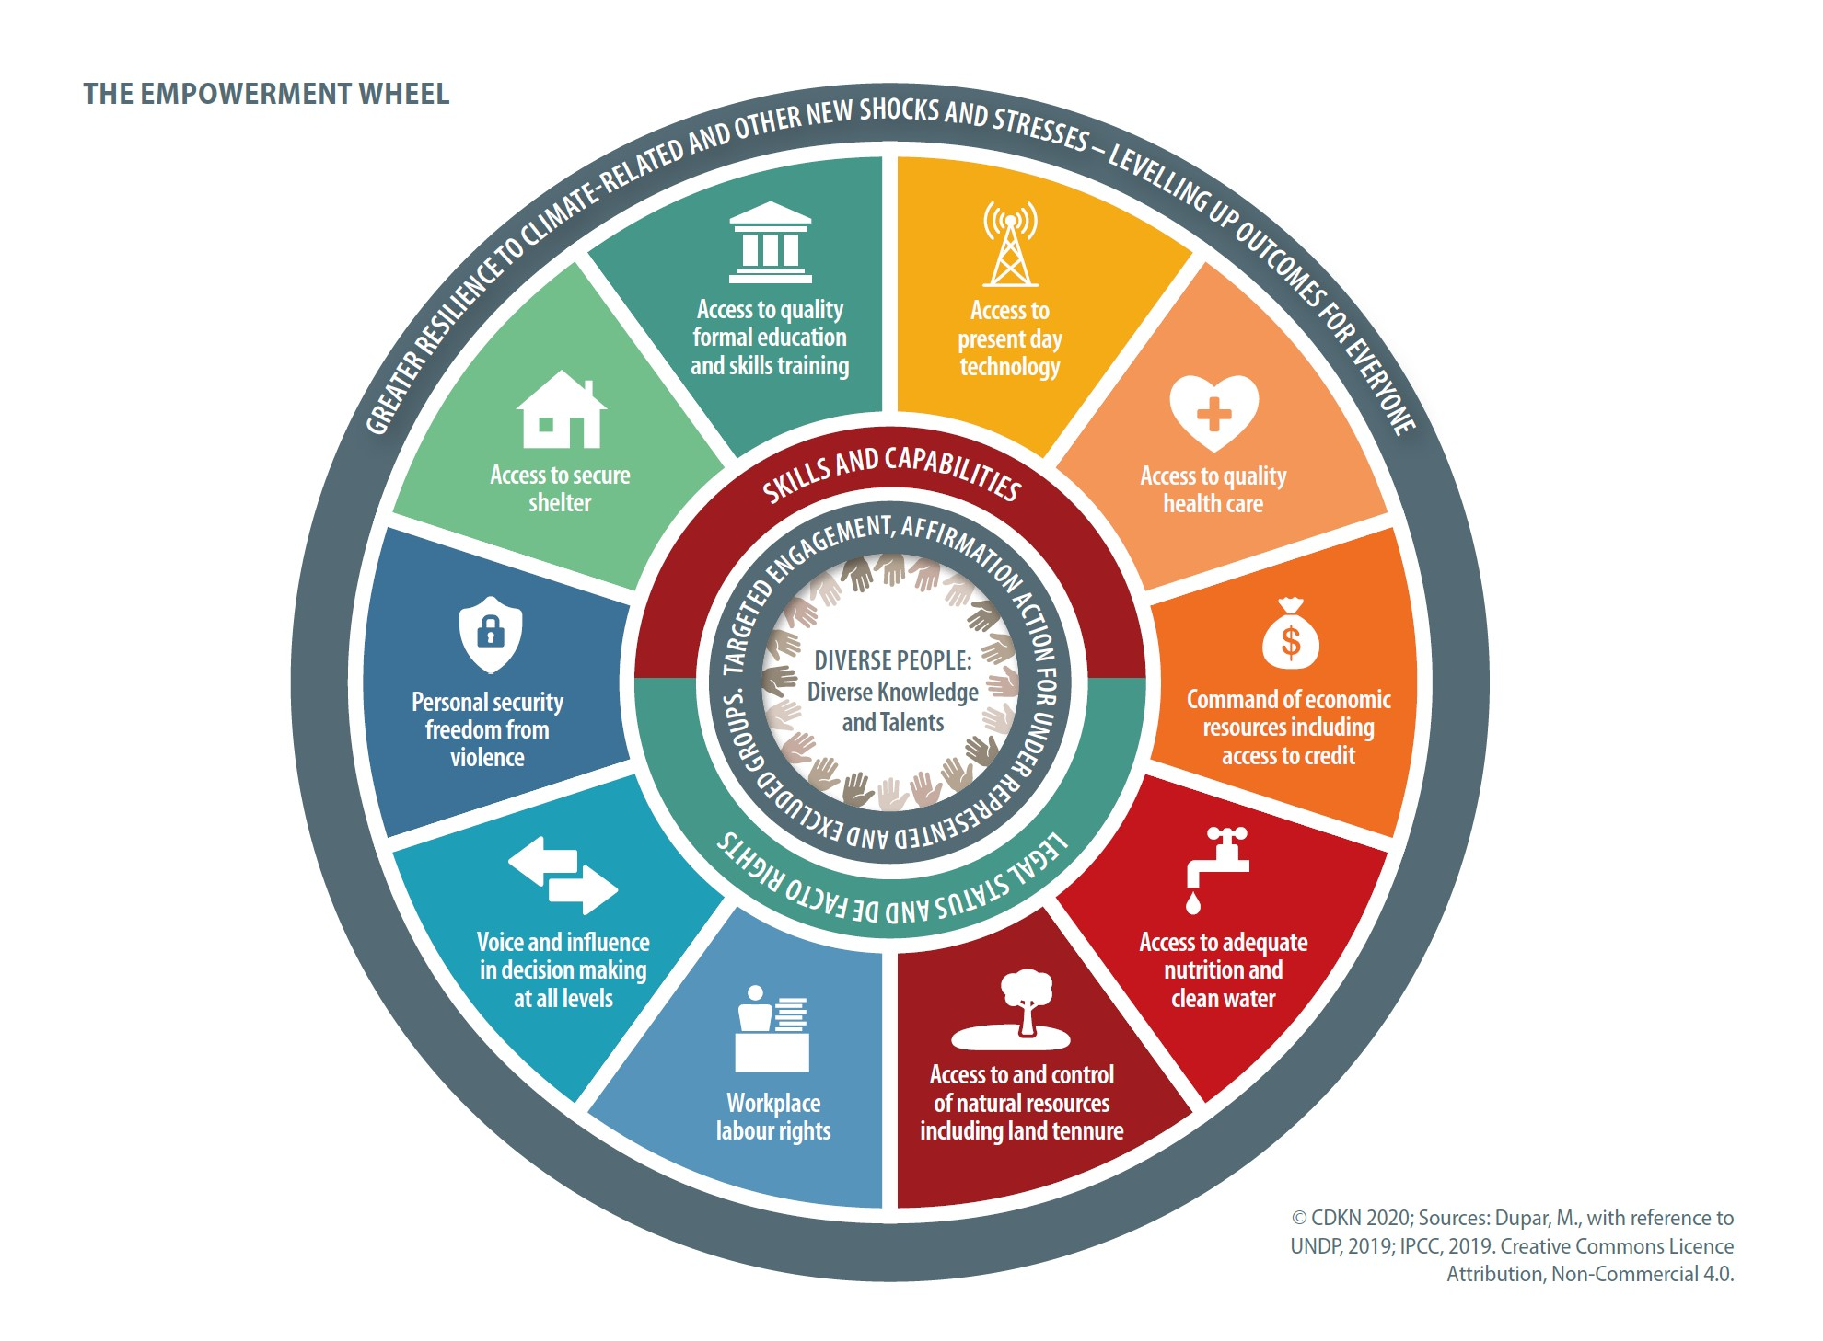
Using CDKN’s empowerment wheel can help pinpoint which capabilities, services, rights, people have or lack that affect their responses to climate change - and give ideas for solutions
Notes:
CDKN has devised the empowerment wheel based on scientific evidence of which capabilities and access to development services people need in order to respond effectively to climate change. The underlying evidence comes from the work of the IPCC (2019 Special Reports, Fourth and Fifth Assessment Reports) and the UNDP (especially Human Development Reports 2018, 2019).
On the empowerment wheel, you see capabilities people need to develop and development services that people need to access, and rights that need to be enacted or enabled, to help people respond effectively to climate change.
Your (trainee’s, participant’s) job as a project or programme manager is to generate solutions that address the underlying causes of the problems you have identified in the problem tree analysis. Where you cannot immediately address the drivers and root causes, you can try to design interventions that alleviate the negative consequences.
Looking at the empowerment wheel may give you ideas– it can act as a prompt for spotting gaps in people’s capabilities and rights and devising solutions.
If you look at the case study from Nepal, the project managers (from the non governmental organisation LI BIRD) identified that the central problem was the lack of effective implementation of a good climate-smart agriculture policy and programme. There was a problem with the design of the climate smart agriculture programme and with elements of its enabling environment, which were preventing its effective uptake by women farmers.
LI BIRD pinpointed for example, that lower caste / ethnic minority women, although important actors in the farming sector, had a gap in agricultural skills training, inadequate voice in decision-making, and insufficient access to and command over economic resources, all of which were hampering them from adopting effective, climate smart agricultural techniques and approaches.
Trainer/facilitator:
Either ask people to work on their own to identify some of measures that LI BIRD took in Nepal (reference the two page handout with the Nepal climate smart agriculture case study).
Match up specific underlying drivers and root causes of the problem, and specific impacts and consequences of the problem on the problem tree diagram with solutions that LI BIRD is making – from the case study. Which solutions match with which part of the problem?
Ask for participants to volunteer their answers back to the plenary.
Or, ask people to work in pairs or small groups to do the above exercise.
Hand outs: it may be helpful to print for all participants (or electronically distribute) the following supporting documentation to do this exercise:
- Problem tree for Nepal climate smart agriculture
- 2 page Nepal climate smart agriculture case study
- The empowerment wheel

Slide 9
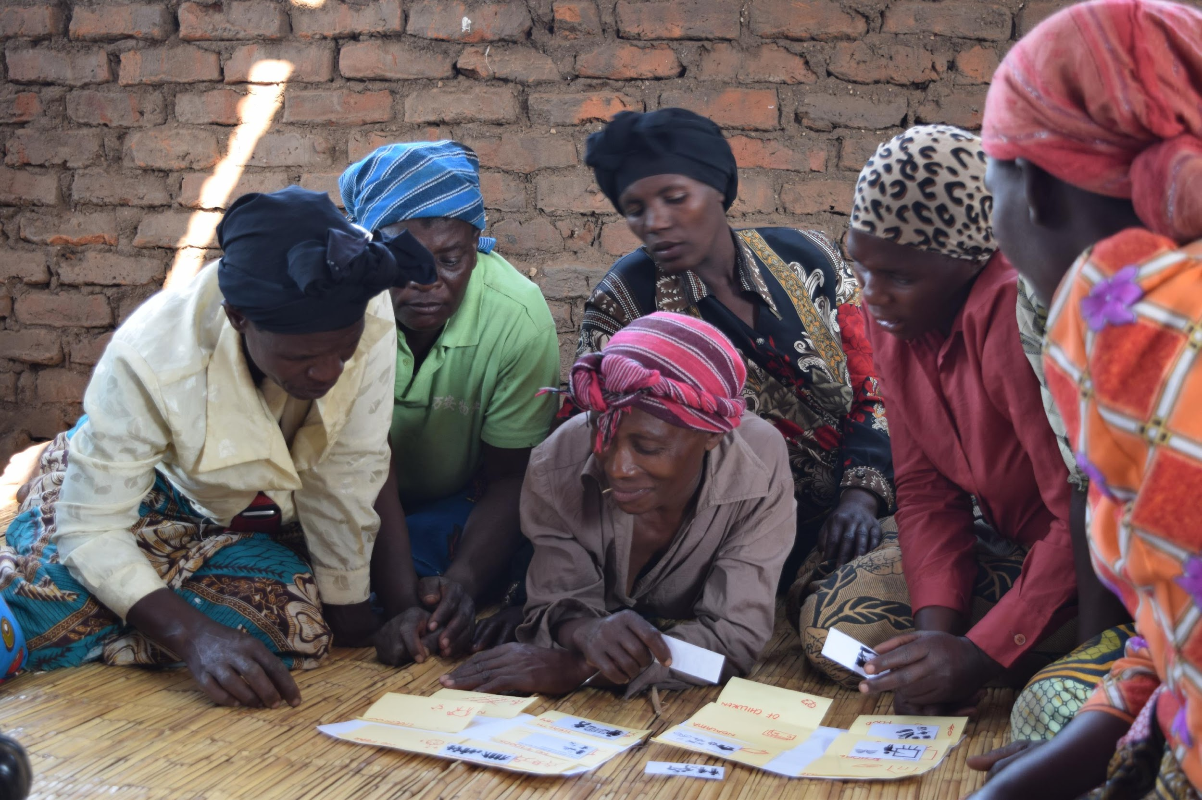
Analysis of solutions, possible interventions
Determines the types of activities needed in the implementation stage;
Points toward the budget and resources necessary for building gender expertise, hiring gender experts, fieldwork, workshops and other necessary gender-responsive activities;
Informs the monitoring and evaluation process.
…ensures that the gaps, barriers and challenges preventing the equitable participation of women as decision-makers and beneficiaries can be overcome rather than reinforced.
Notes:
The information generated by the problem tree analysis is the foundation on which subsequent gender mainstreaming actions rely.

Slide 10
Analysis of solutions, continued…
Budget, resources, institutional mandates/authority, politics, timeframe of a project or programme all constrain its remit and what is possible
Gender-responsive, socially-inclusive climate solutions also need to map to the existing landscape of climate and social development policies and programmes
Draw a line around options ‘in direct control’ and ‘within influence’ of your programme as well as ‘out of scope’
Consider how to push the boundaries of what is within programme ‘influence’ if severe discrimination against women and other social groups is undermining people’s wellbeing and also climate progress
Notes:
The information generated by the problem tree analysis is the foundation on which subsequent gender mainstreaming actions rely – as described on this slide:
Budget, resources, institutional mandates/authority, politics, timeframe of a project or programme all constrain its remit and what is possible
Gender-responsive, socially-inclusive climate solutions also need to map to the existing landscape of climate and social development policies and programmes
Draw a line around options ‘in direct scope’ and ‘in direct control’ and ‘within influence’ of your programme
Consider how to push the boundaries of what is within programme ‘influence’ if severe discrimination against women and other groups is undermining people’s wellbeing, and society’s climate progress
The next two slides provide a case study from the BRACED programme in Chad of how gender based violence was identified as a massive hurdle to women’s effective adaptation to climate change and that this root cause had to be tackled, before progress could be made on women’s and broader societal resilience.

Slide 11
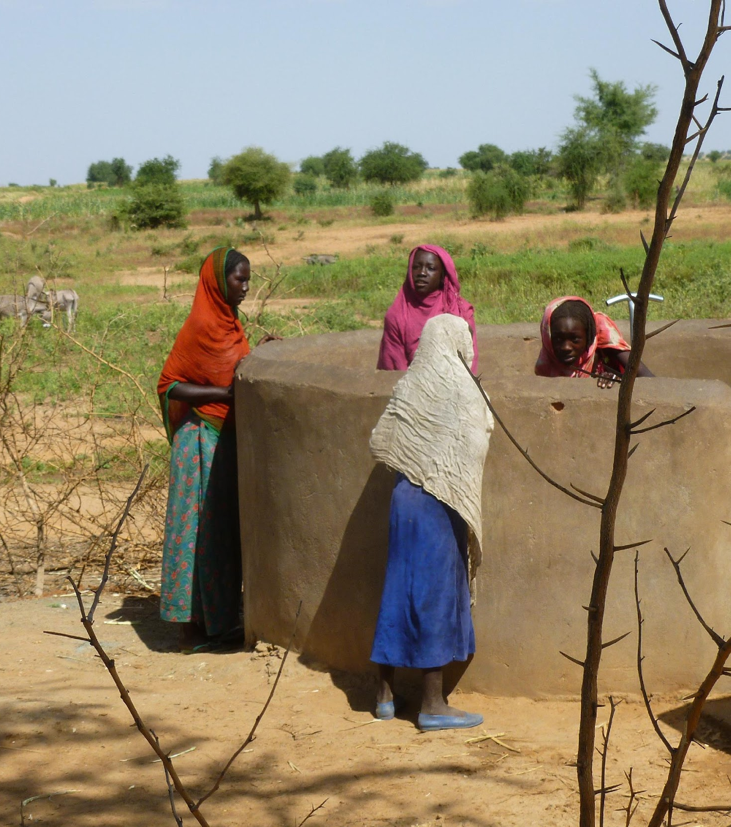
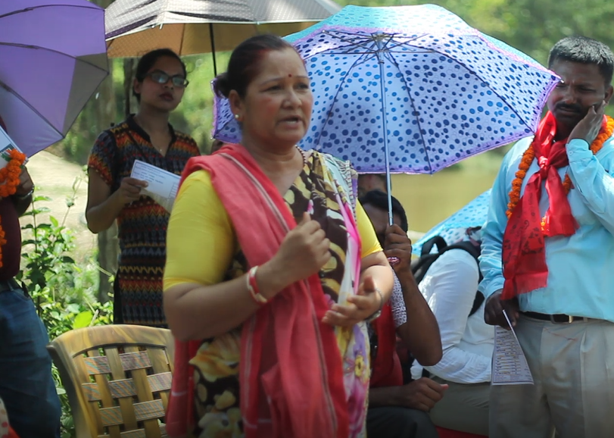
Case study: Gender-based violence as a fundamental block to climate action and social development – the case of Chad
Violence against women and girls hampers climate resilience
Gender-based violence negatively affects the ability of not only survivors but that of their household members to secure livelihoods.
Violence has a negative impact on women’s health, household economic resources and access to basic services.
Notes:
This information comes from BRACED programme, and the specific case study information is courtesy of Colette Benoudji of LEAD Chad.
The broader context is that the BRACED programme went into locations in rural Chad with the objective of running climate resilient, largely agriculture-based, rural development programmes. However, they found that gender based violence was so extreme and so prevalent that it was absolutely hampering their efforts toward climate resilience rural development, as follows:
Violence against women and girls hampers climate resilience efforts in Chad.
Gender-based violence negatively affects the ability of not only survivors but that of their household members to secure and strengthen livelihoods.
Social inequalities diminish the human capital of survivors and exacerbate their vulnerabilities during periods of food shortages.
Violence has a negative impact on women’s health, household economic resources and access to basic services.
This is detrimental for resilience: hampering women’s and girls’ capacities to anticipate, cope with and recover from shocks and stresses from disasters and climate change. How to build societies that are resilient to disaster risks through promoting more just and equitable gender relations and freedom from violence?
Strategies to overcome the climate and social development challenges
Livelihoods of most people in Chad depend on agriculture, livestock and fisheries, which makes them extremely climate-vulnerable.
Communities are affected by irregular rainfall and more extreme events like drought. Lack of water is the main factor limiting agricultural productivity and livestock rearing.
The impacts: decreased crop yields and arable land; more food insecurity and conflicts due to food scarcity for both humans and animals; reinforced ecological and social inequalities.
Inequality exacerbates vulnerability, vulnerability exacerbates violence, and violence limits resilience. Gender inequality is one of the main obstacles to address as it limits the way in which women and girls, men and boys in a community and society can respond and manage change and the ability of the whole society to achieve resilience.
We combined quantitative data on a national scale and the accounts of development practitioners, representatives of the authorities and local communities and inhabitants of Silaand Bahr el Gazelregions, Chad.
We discovered a two-way relationship between resilience and violence: limited livelihoods and people’s lack of resources increase the risk of violence, especially sexual exploitation, by increasing women and girls’ vulnerability. Meanwhile, violence affects the livelihoods of survivors.
A transformative approach is needed to address the structural causes underlying discriminatory inequalities and gender norms.
Recommended mitigation strategies: 1. increase the visibility of the problem of violence, through the documentation of abuse and cases where rights are denied; 2. multi-sectoral collaboration, development programming to contribute to the transformation of unequal power relationships and help build resilience, based on human rights.
Contact for further literature and information about BRACED’s gender work in Chad:
Ms Colette BENOUDJI, Lead Tchad Coordinator: BRACED Gender Team Leader
Telephone: +23566234902 email: colette_issa@yahoo.fr
Ms Virginie LEMASSON, Gender Specialist: Braced, Overseas Development Institute
Telephone:+442079220300 email: v.lemasson@odi.org.uk
www.braced.org

Slide 12
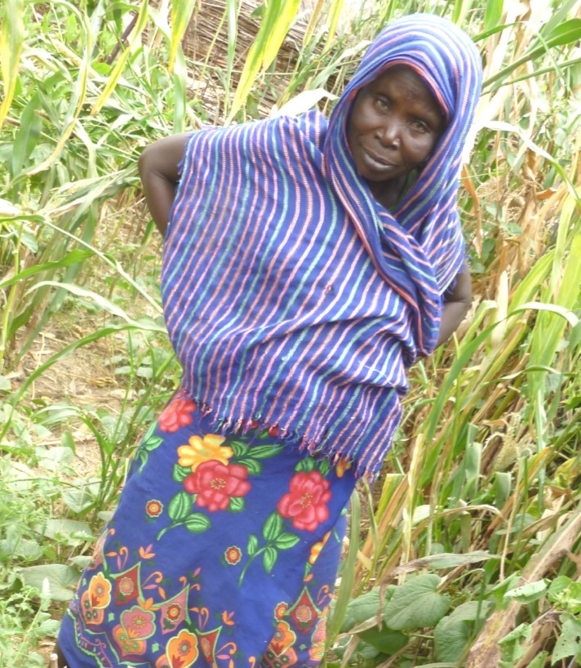
Chad: Climate programme becomes women’s rights advocate to further climate resilient development
Enable women and men to express differential needs for climate-resilient development.
Challenge people to question the assumptions, beliefs, values and interests that underlie structures that contribute to social vulnerability.
Support large-scale awareness of violence against women and girls.
Deliver a holistic response to violence and to help survivors, involving cross-agency, multi-stakeholder collaboration.
Mainstream gender in cross-sectoral resilience programmes.
Notes:
This information comes from BRACED programme, and the specific case study information is courtesy of Colette Benoudji of LEAD Chad.
Key success factors for achieving and scaling up gender-responsive climate action
Enable women and men to express their differential needs for climate-resilient development.
Challenge people to question the assumptions, beliefs, values and interests that underlie structures that contribute to social vulnerability. Support large-scale awareness of violence against women and girls.
Deliver a holistic response to violence and to help survivors, involving cross-agency, multi-stakeholder collaboration.
Mainstream gender in cross-sectoral resilience programmes.
How does a multi-pronged response look, in practice?
Awareness:
40 representatives of government, civil society, NGOs and UN agencies adopted eight recommendations to combat gender-based violence.The booklet 5 things to know about gender-based violence in Chad informs people of laws that condemn gender-based violence and protect women and girls. It was written in collaboration with the Ministry of Women, Protection of Early Childhood and National Solidarity, associations, non-governmental organisations, UNFPA and religious leaders from Chad.The Minister of Women convened an event with other government ministries and high-ranking female officials to discuss the results and recommendations of our action research. Journalists in Chad picked up the story:
The country’s Prime Minister responded that “he was shocked to hear the personal tales of women in his country who had suffered such violence”.
Now the subject is discussed more often in the media by human rights organisations and other actors.
Action:
Coordinated by Chad’s Ministry of Women, current responses include:
medical assistance; data sharing among agencies on gender-based violence;
psycho-social support;
security/protection;
access to justice; access to livelihoods for those affected.
Gender-based violence has become a central and very serious topic for many donors and actors in Chad. The European Union funded the development of the National Gender Action Plan; UK DFID has placed gender among its priorities in Chad. AFD has launched several studies on gender in Chad mentioning gender-based violence specifically.

Slide 13
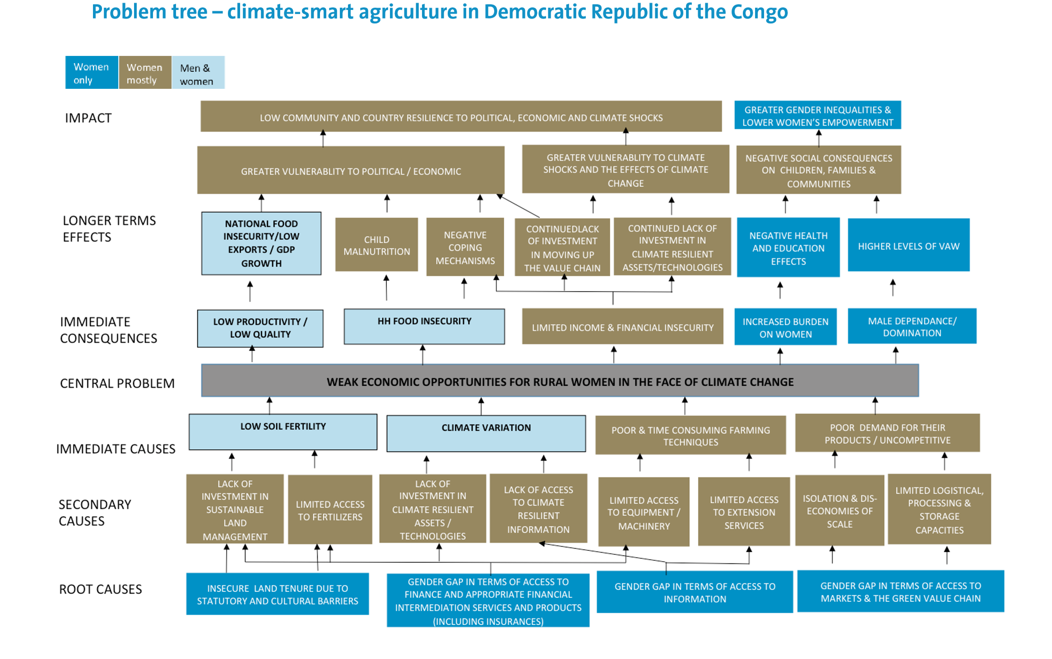
Alternative approach to problem tree (mixed gender example)
Problem tree analysis
From UNFCCC
Notes:
An alternative approach to the problem tree analysis is shown in this example from the UNFCCC ‘Mainstreaming gender in climate change projects’ 2016 guidance.
This shows a core climate and development problem in the centre – again it is concerning the rural, land based sectors. In this example, the problem tree is colour coded and its architects have shown in blue the negative impacts and root causes of the problem that are felt only by women, in brown, the causes and consequences that are felt mostly by women, and in light blue, the causes and consequences that involve women and men.
Facilitator/trainer: if you use this diagram, it’s best to copy and distribute it to participants – the words are small and hard to read, when projected.
Facilitator/trainer discussion question to the participants:
Is there an advantage to doing the analysis this way? If so, what could it be?
Possible answers:
Can help you see where and how everyone benefits from investing in women (helps make the case for a gender responsive approach)
It can highlight specific problematic area which may lend themselves to an actor analysis: ascertaining which actors are active in that space and could make good partners and allies. E.g. for certain issues which are mostly or solely women’s issues, are there sources of partnership and funds with Women’s ministries/departments, NGOs and civil society groups, that would be particularly useful?

Slide 14
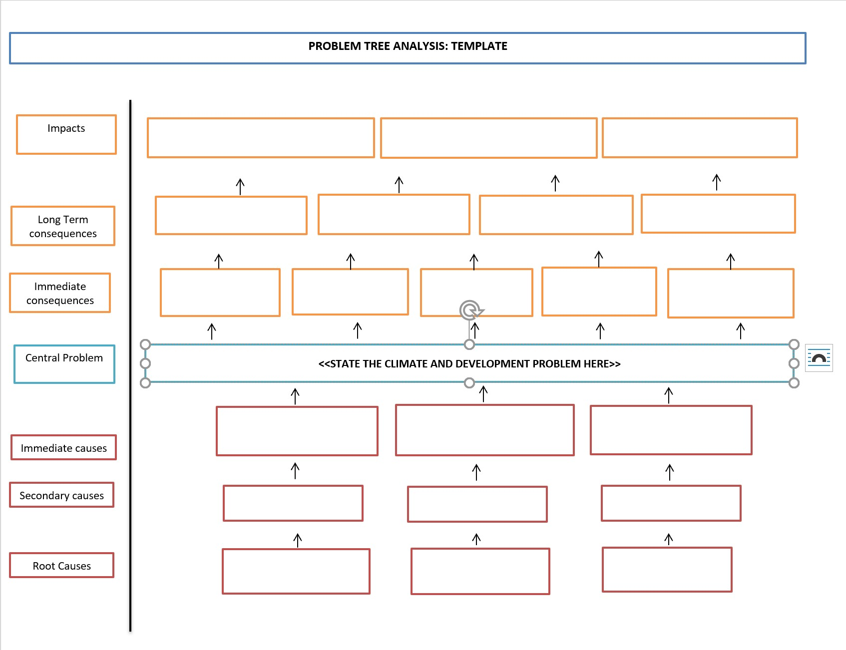
Group exercise: Make your own problem tree for a climate and development problem in your area
What could be in your scope of control, influence to address when it comes to devising solutions?
Notes:
Facilitator/trainer:
Break the group into smaller working groups of 2-5 people (no more than 5).
Encourage them to use the problem tree methodology to define a climate and development problem and to sketch the underlying drivers and root causes
If the participants would not like to draw their own problem tree about a climate and development problem in their area, then alternatively, they could take a set from the ‘Climate and Social Lottery Game’ sets and

Slide 15
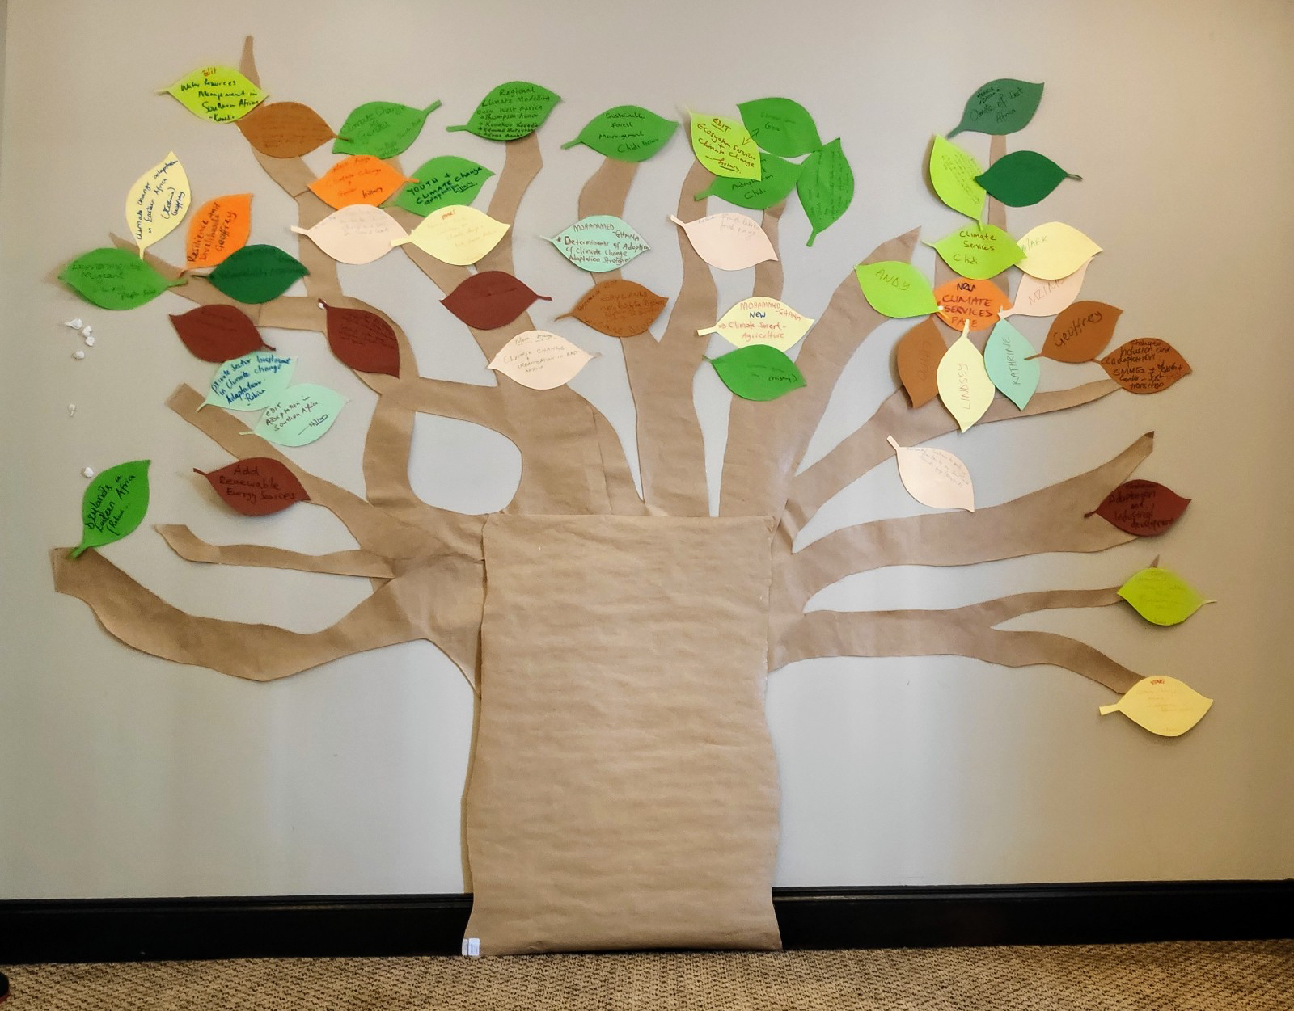
Using leaves, make a ‘tree’ of underlying root problems, consequences, and green shoots of ‘possible solutions’

Slide 16
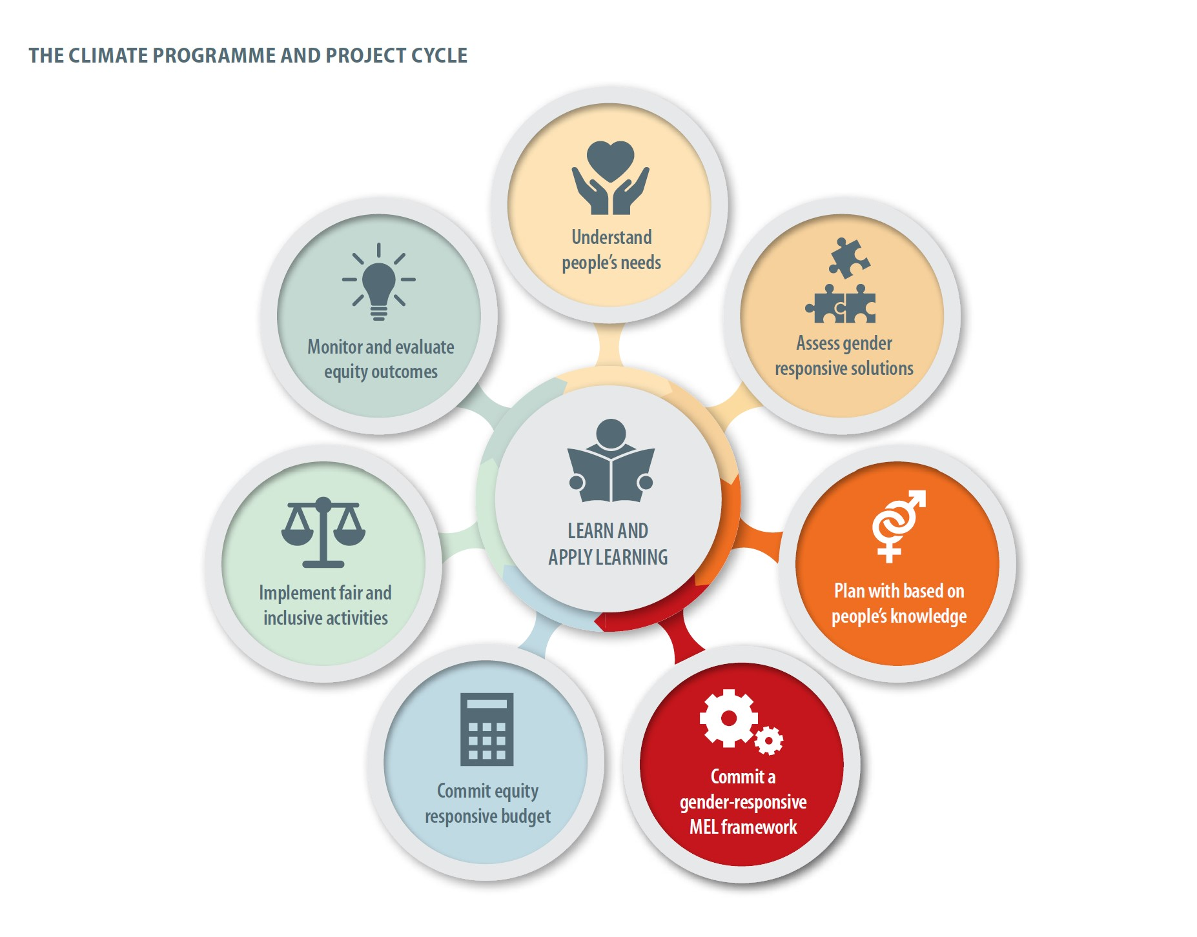
Deep dive into planning gender-responsive and socially-inclusive climate solutions, and set targets

Slide 17
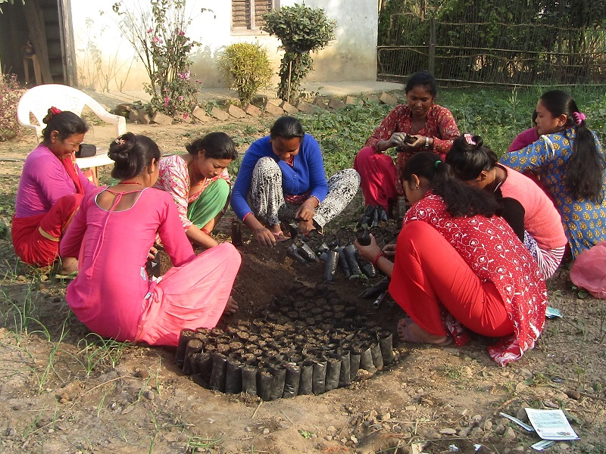
Purpose and goal should reference gender
The purpose and goal of the climate change intervention should include associated gender goals, too
e.g. women and girls’ nutrition improves as well as men’s, and boys’ nutrition; women’s income improves…
Notes:
The purpose and goal of the climate change and also the outcomes/outputs of the climate programme should be defined by their gender-responsive nature.
One example might be to improve indicators of nutrition and income explicitly for women and girls as well as for men and boys and for the overall population
Another example: (Goal/purpose) could be ‘to increase the wellbeing of climate-vulnerable people including women and girls.’
This is what BRACED team did in the case of Chad by using BOTH climate resilience and gender equity as the dual starting point, this influenced the very way that BRACED designed their action research. This approach highlighted, very early on, that gender-based violence was such a significant phenomenon that, if it is not addressed robustly, it will hinder meaningful progress on climate-resilient development.

Slide 18
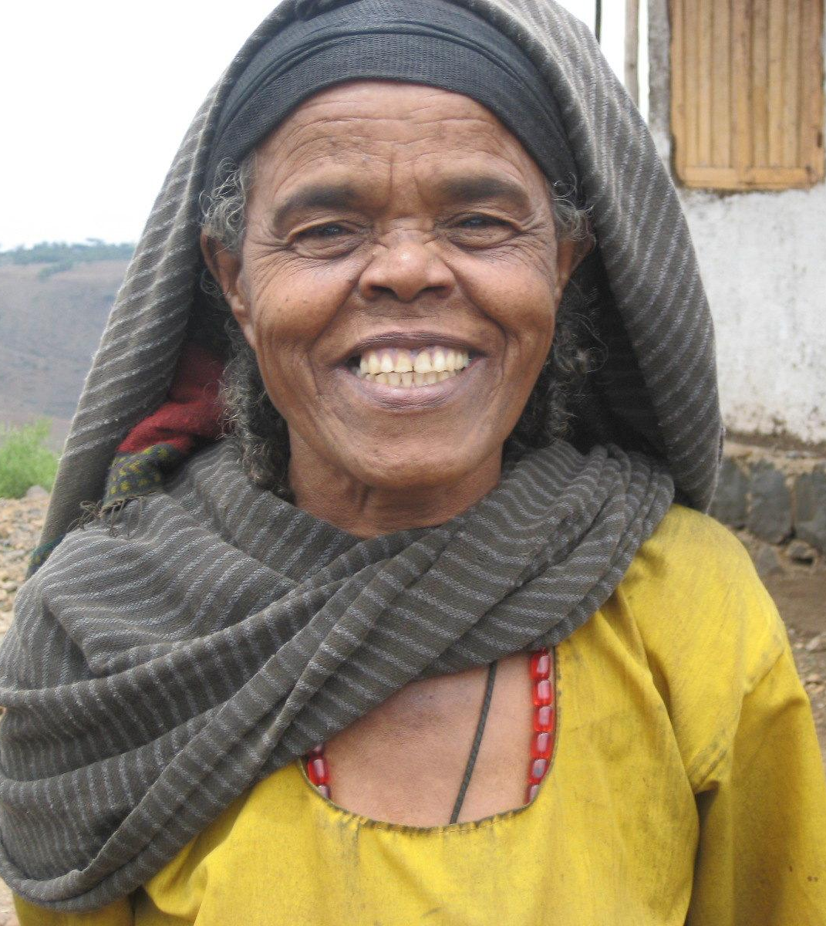
Outcomes should be gender-responsive and gender-specific
Reflected in the development outcome
e.g. increased number of women and gender balance in climate-smart jobs and gaining new income generating opportunities in climate-resilient development.
Reflected in the immediate outcomes and outputs e.g. increased number of women and gender balance in ownership and/or use of climate-smart technologies;
self-reported increased confidence, increased skills after training
Notes:
The outcomes/outputs should be defined by their gender-responsive nature e.g. increased number and % of women in climate-smart jobs; Increased income generating opportunities (by %%) for women in climate-resilient/low-emission development; . (%%) women or ## female headed households have more access to climate-smart technologies
The proposed activities of the climate change intervention: these should have associated gender goals e.g.
The target groups should include named groups of women, girls, e.g. women from all ethnic groups targeted including ….groups/in …languages

Slide 19
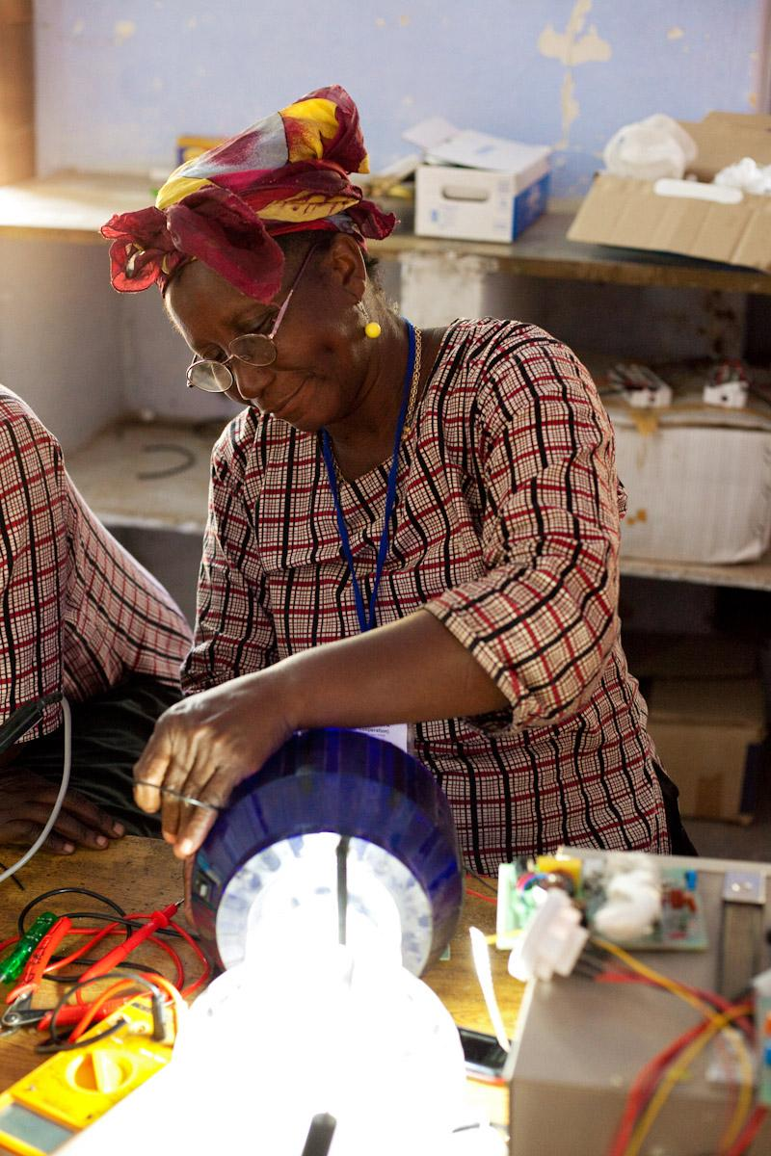
Outputs (and associated activities) should be gender-responsive and gender-specific
The proposed activities leading to/supporting the outcomes
should be gender-specific e.g. increased number of women and gender balance in training for climate-smart vocations, increased number of women and gender balance in access to microfinance to acquire climate smart technologies, agricultural inputs, business capital, etc.

Slide 20
Target specific groups of women and girls
The target groups should include named groups of women, girls;
Example: targeting Dalit (lower caste) women and women from scheduled tribes in Nepal as specific target groups.
Example: Teenage girls’ specific needs, Latin America project
Notes:
Another good example from CDKN’s website (‘stories’ section 2019) is the experience in Latin America where teenage girls had to be targeted specifically for support and empowerment because unwanted teenage pregnancy was significantly affecting the life opportunities of girls in that age group and was often a result of coercion and also led to greater coercion and lack of autonomy in relationships. cut off educational choices and life choices

Slide 21
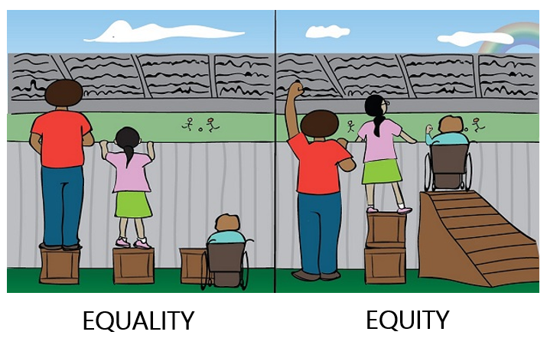
Remember devising interventions involves ‘ramps’ and ‘pillars’!
Climate and development interventions should be aiming for what is shown as ‘equity’ below
‘Equity’ refers to the fact that some groups need more assistance
  historic disadvantage, current social relations
  physical or physiological characteristics which affect their response to climate change and its solutions
Equity is ‘more for those who need it.’
Notes:
A gender approach should go beyond just women’s ‘needs’ and address power imbalances and unequal decision-making
What we are talking about here is equity…. ‘Equity’ refers to the fact that some groups need more assistance to ‘catch up’ and to effectively enjoy equality of outcome. They may suffer from both historic disadvantage, current social relations
They may have physical or physiological characteristics which affect their response to climate change impacts and climate solutions.
But also, let us not forget the many social and cultural attitudes that need to be challenged so that women can have greater resilience and greater opportunity to participate in climate change solutions: because ‘gender’ is also a social construct and gender relations can increase or decrease an individual’s or a group’s vulnerability. Consider what Colette said today about women and girls being forced to marry, their access to healthcare being controlled, psychological threats and physical abuse which are considered the norms in some communities and must be addressed – these gender-based violence issues can cut across wealth and rank.
In India, the ACCCRN team members say that the involvement of men and women together in the research study has helped raise awareness among men regarding issues relating to women and their increased workload during extreme weather events. Some of the men sympathised with women and their workload and other problems during focus groups, but barring a few examples, men have generally not taken it upon themselves to transform gender relations at the household level. While progress was noted in involving women in project activities, the level of actual participation was still low due to the multitude of other roles and responsibilities women have in the household.
It is also important, though, in designing effective climate programmes which also achieve SDG5, the empowerment of women and girls, to assess where historic and current disadvantage due to a person’s gender intersects with other aspects of their status and wellbeing to make them more climate vulnerable, such as the different dimensions of poverty (economic, health/disability, literacy etc and discrimination that is political, ethnic, racial, etc.
Equity is ‘more for those who need it.’

Slide 22
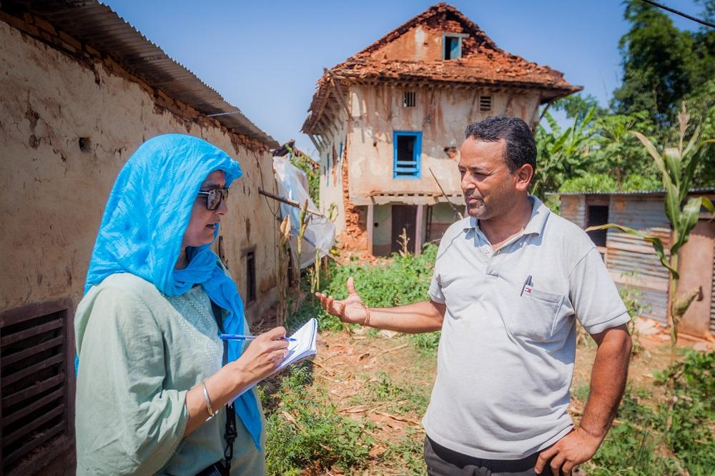
Next: a tool to help prioritise resilience actions in the planning process

Slide 23
Tool introduced in this training | ODI/Actionaid Assessing Resilience toolkit | ICLEI ACCCRN Prioritising Resilience Action | UNFCCC Problem Tree Method | CRiSTAL Climate Risk Assessment Adaptation, Livelihoods
Quantitative assessment of people’s resilience | yes | no | no | no
Qualitative assessment | yes | part | yes | yes
Define project scope and prioritise activities | no | yes | part | yes
Analysis of impact of the climate inter-vention on different groups of people | no | yes | part | yes
Amount of time taken to work through tool | 5-10 days | one day | half day | 2-5 days
In the field, or desk-based? | field | desk (based on field experience) | desk (based on field experience) | field
Does it require training /support to use? | for quantitative part only | no (this training) | no (this training) | preferably, yes
High level of gender expertise needed? (more than this training?) | no | no | no | yes

Slide 24
ICLEI Prioritising resilience tool and method
The ICLEI ACCCRN Process provides a method for assessing the resilience of a proposed intervention/solution to climate change and development.
The key criteria for assessing and prioritising the resilience of interventions is:
Redundancy
Flexibility and diversity
Reorganisation and responsiveness
Access to information
Energy saving and greenhouse gas mitigation potential
(Follow in accompanying handout)
Notes:
Facilitator/trainer
This slide introduces the ICLEI ACCCRN Process, a very thorough and well trialled and documented process for planning and implementing local level climate resilience measures. This slide gives the overarching headings of each of the criteria in the process. The subsequent slides will explain each criterion in more detail and with gender and social inclusion related examples.
Please distribute to trainees the accompanying multi-page handout on ‘Prioritising resilience solutions’.

Slide 25
Redundancy
Redundancy: A resilient system can function and achieve results through multiple paths or nodes when one fails and when performance is critical. In contrast, a “single best solution” is not resilient because if this single option fails, the system collapses.
Example: Hospitals and emergency communications facilities have backup electrical generators
Notes:
Redundancy: A resilient system can function and achieve results through multiple paths or nodes when one fails and when performance is critical. In contrast, a “single best solution” is not resilient because if this single option fails, the system collapses. Back-up systems, or decentralised nodes for service delivery in a linked network, are preferable.
Example:
Hospitals and emergency communications facilities have shared or linked backup electrical generators

Slide 26
Flexibility and diversity
Flexibility and diversity: Essential systems should be able to work under a variety of conditions; they should not be rigid or designed only for one specific situation. Flexibility and diversity criteria do not apply solely to a system’s technological attributes but also its social attributes.
Example: Dikes are designed so that if their capacity is exceeded, they fail in predictable ways, channelling flooding away from populated areas
Example: climate and weather information services (communications) and related Early Warning Systems for extreme weather events are designed and delivered in multiple formats – e.g. audiovisual as well as text-based
Notes:
Flexibility and diversity: Essential systems should be able to work under a variety of conditions; they should not be rigid or designed only for one specific situation. Any system will fail if overloaded beyond its capacity, but it should be designed to fail under stress in a safe and predictable way, rather than suddenly and catastrophically. Flexibility and diversity criteria do not apply solely to a system’s technological attributes but also its social attributes: for instance, if systems require widespread social acceptance and compliance but they are designed from the outset in ways that favour a certain group (e.g. men above women) or create obstacles to a certain social group’s compliance, then they sacrifice considerable flexibility and diversity.
Example: Dikes are designed so that if their capacity is exceeded, they fail in predictable ways, channelling flooding away from populated areas; climate and weather information services (communications) and related Early Warning Systems for extreme weather events are designed and delivered in multiple formats – e.g. audiovisual as well as textual – so that they do not rely solely on the literate members of the household or those owning/controlling mobile phones to receive and react to them.

Slide 27
Reorganisation and responsiveness
Under extreme conditions, systems should be able to respond and change to meet unexpected shocks. This requires flexible organisations and access to different kinds of resources , a high level of coordination and flexible organisational structures
Providing adequate voice and means of influence to diverse people with local and indigenous knowledge enriches decision-making, implementation and course correction, thus helping to create more responsive systems.
Example: Houses in flood-prone areas are designed with flat roofs as emergency refuges for family members and possessions above flood water level
Notes:
Under extreme conditions, systems should be able to respond and change to meet unexpected shocks. This requires flexible organisations and access to different kinds of resources (information, skills, equipment, knowledge and experience). It also means a high level of coordination and flexible organisational structures capable of adjusting to new conditions. Furthermore, it is widely recognised that local and indigenous knowledge is often highly relevant to and supportive of climate resilience and adaptation (IPCC, 2019). However, such knowledge is often untapped and under-appreciated, thus ignoring a rich, important source of insight and innovation potential. Such knowledge may be undocumented, experience-based and dispersed among social and ethnic groups, women and men, including migrants to the city. Providing adequate voice and means of influence to diverse people with local and indigenous knowledge enriches decision-making, implementation and course correction, thus helping to create more responsive systems.
Example: Houses in flood-prone areas are designed with flat roofs as emergency refuges for family members and possessions above flood water level

Slide 28
Access to information
Resilient systems have mechanisms to document, learn from and build on experience, so that past mistakes are not repeated.
Example: Different government agencies share a common monitoring and reporting system of natural resources; local governments develop systems for ‘impact reporting’ from different types of climate hazard
Notes:
Resilient systems have mechanisms to document, learn from and build on experience, so that past mistakes are not repeated and lessons from other cities can be integrated into planning. This requires procedures for monitoring and evaluating performance under stress, and requires multiple sources of knowledge and documentation (strengthening “corporate memory”).
Example: Different government agencies share a common monitoring and reporting system to track groundwater quality and extraction in the face of more frequent drought or sea level rise; local governments develop systems for ‘impact reporting’ from different types of climate hazard – where impact reporting is here defined as the negative and positive effects (and cascades of effects) of climate hazards on different social systems and groups according to their differential exposure and vulnerability to the hazard - cooperating with diverse civil society organisations, research institutions and NGOs where appropriate to identify how society’s most disadvantaged people are affected and how risks may be mitigated.

Slide 29
Greenhouse gas saving potential
Resilient systems have potential to reduce energy consumption and mitigate GHG emissions.
This requires procedures for periodic monitoring and evaluation of performance and adherence to common GHG accounting methodologies.
Example: Providing access to local water sources through rainwater harvesting/ ground water recharge may not only build the resilience of the community (where such water sources are adequate) but also reduce the city’s dependence on transporting water from far distances

Slide 30
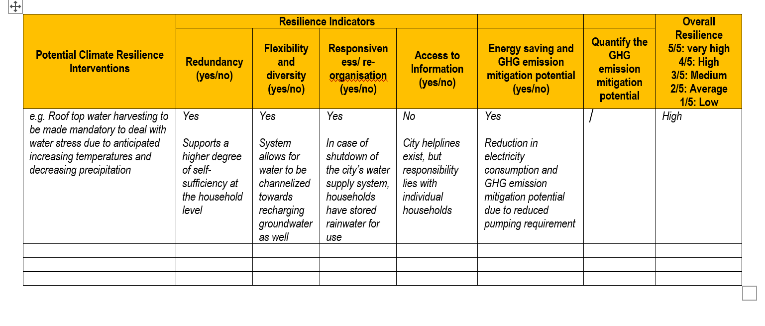
Putting it all together: (1) climate resilience evaluation
Step 1
List the resilience interventions generated during the options analysis
Step 2
Evaluate them on the basis of the above resilience indicators.
Step 3
Complete table by determining the overall resilience score for each intervention on the basis of the number of resilience indicators that the intervention is perceived to fulfil.
Notes:
Facilitator/trainer:
Here, the participants should all have the handout ‘Prioritising resilience actions’ and should all refer to the handout with the worked example (first part of which is shown on this slide), which explains how you score each possible climate resilience intervention according to the resilience indicators along the top,
Note: further information online if desired in the ICLEI-ACCCRN process toolkit for local governments: http://e-lib.iclei.org/iclei-acccrn-process-building-urban-climate-change-resilience-a-toolkit-for-local-governments/
CDKN has developed the tool further here to incorporate enhanced gender responsiveness and social inclusion decision making criteria.

Slide 31
Putting it all together: (2) feasibility checklist
Feasibility:
Technical – local stakeholders have or can access technical expertise needed
Political – the intervention will be seen as acceptable to city leaders and the community and is consistent with the city’s values and vision
Social – in practical terms, the intervention will be socially acceptable including among the diverse groups of people whose adoption is needed to make it a success
Cost-benefit – the cost is within capacity, or the stakeholders can access required funds, and the anticipated benefits of the action will justify the cost
Responsibility - An assessment of has been carried out into which actors will be responsible for delivery and they agree to these roles
Notes:
The criteria used for judging feasibility (shown here: technical, political, social, cost-benefit, responsibility) which constitute a further additional filter and ‘sense-check’ in addition to the resilience criteria in the last slide.

Slide 32
Putting it all together: (3) empowerment, rights and impacts check for women and disadvantaged social groups
Does the project now address the differentiated climate change impacts on men and women? How do those impacts differ?
Does the project address women and men’s differentiated capabilities to address these impacts. How are gender-specific vulnerabilities reduced and women’s and men’s capabilities to adapt increased?

Slide 33
Putting it all together: (3) empowerment, rights and impacts check for women and disadvantaged social groups
Does the proposed project change access to resources (referring not only to material resources such as property or finance but also time, knowledge and information).
How does the project change women’s and men’s access to resources? Where? Why? Will the project’s impact potentially disadvantage women in any way and if so, how can the project be designed to ensure it ‘levels up’ the benefits for better, egalitarian outcomes for everyone?
Who will control and decide what? Are women in any way disadvantaged in decision-making and control? If so, how can the project rectify this?
Notes:
The criteria for women’s and girls’ empowerment should be applied as an additional filter and design specification for the climate resilience options chosen.
As well as applying to women and girls as a disadvantaged groups, these can also be applied to more specific target groups, such as teenage girls, or ethnic minority women, or marginalised classes or castes of people, overall (gender here is given as an example)
Does the proposed project change access to resources (referring not only to material resources such as property or finance but also time, knowledge and information).
How does the project change women’s and men’s access to resources? Where? Why? Will the project’s impact potentially disadvantage women in any way and if so, how can the project be designed to ensure it ‘levels up’ the benefits for better, egalitarian outcomes for everyone?
Who will control and decide what? Are women in any way disadvantaged in decision-making and control? If so, how can the project rectify this?
For instance, any project involving indigenous people’s land or other resources should be subject to obtaining their Free, Prior and Informed Consent.

Slide 34
Check that the proposed project is advancing rights and capabilities not curtailing them

Slide 35
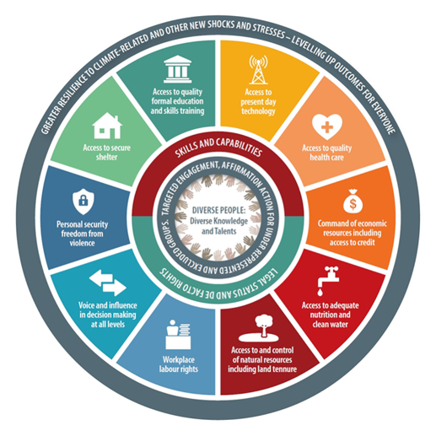
Optional group exercise:
Use the illustrative example of roof top water harvesting given here. It is a proposed climate change adaptation measure that already scores high for overall resilience as it meets the criteria of: redundancy, flexibility and diversity, responsiveness, energy saving and GHG emission mitigation.
Now turn the gender and social inclusion lens on this example. Form pairs or small groups. Discuss: for women, girls and other socially disadvantaged groups where you work, would rooftop water harvesting empower women and girls? Undermine their status and wellbeing? How? Be as specific as you can
Notes:
Facilitator/trainer:
Here, we return to the illustrative example of ‘Prioritising resilience actions’ using the worked example of the ‘roof top water harvesting to deal with water stress due to anticipated increasing temperatures and decreasing precipitation/rainfall’ in a locality
Let’s take as a given that you – participants – are in a scenario where you decide that rooftop water harvesting should be a climate-appropriate intervention to help local people deal with water stress. Let’s imagine it has received this high resilience scoring in your options assessment and seems contextually relevant and also affordable in a general sense.
But now, participants divide into pairs or small discussion groups and shine a gender lens on this example. For your country or culture, consider how implementing rooftop water harvesting could be supportive of women’s and girls’ overall wellbeing and empowerment? Is there any possibility that the project design and delivery could undermine their wellbeing and empowerment? If there are any risks of exclusion, how could these risks be avoided?
As well as considering which parts of the empowerment wheel this project could support, also consider the overarching questions:
Does the rooftop water harvesting project change access to resources (referring not only to material resources such as property or finance but also time, knowledge and information).
How does the project change women’s and men’s access to resources? Where? Why? Will the project’s impact potentially disadvantage women in any way and if so, how can the project be designed to ensure it ‘levels up’ the benefits for better, egalitarian outcomes for everyone?
Who will control and decide what? Are women in any way disadvantaged in decision-making and control? If so, how can the project rectify this?

Slide 36

Remember! Measures to respond to climate change can decrease inequalities or reinforce them. Social and institutional dynamics can create winners and losers.
Notes:
Facilitator/trainer. Here, please screen the ASSAR project video if possible:
Title ‘Adaptation is about people’; link: https://www.youtube.com/watch?v=3OWaO4nGKIE&t=22s

Slide 37
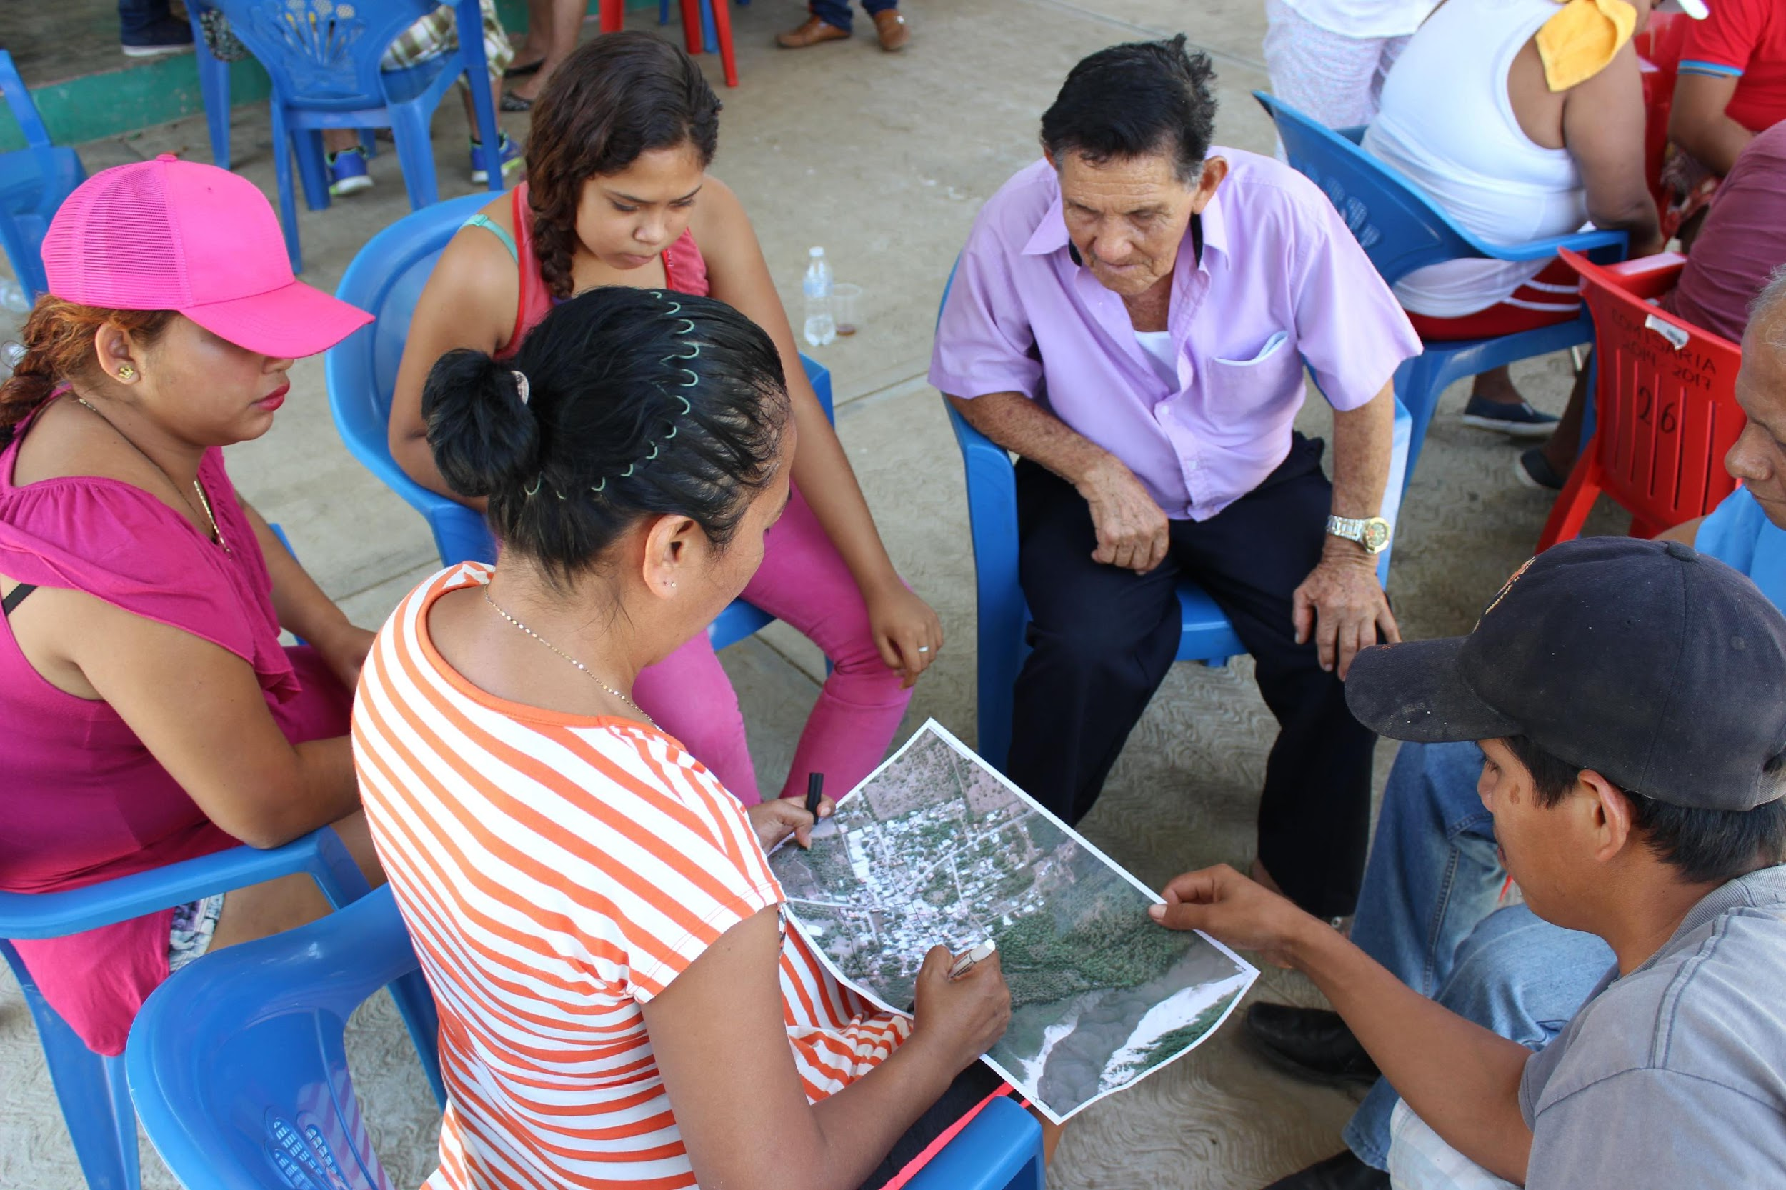
Next: an alternative tool to dive deep – through consultative fieldwork – into people’s climate risks and adaptation options

Slide 38
CRiSTAL Community based Risk Screening Tool Adaptation and Livelihoods
This easy-to-use application can be easily applied in community settings – combining either version 4.0 (Excel spreadsheet and users manual) or version 5.0 (downloadable app and users manual) to compile:
The climate risks – both current and future – in your project area:
The livelihood resources that are important to communities in your project area
The links between climate risks and key livelihood resources in your project area, namely:
  livelihood resources that are strongly influenced by climate hazards
  livelihood resources that are important to coping strategies
  how planned / ongoing project activities influence these key livelihood resources
  how project activities might be adjusted to reduce vulnerability and enhance adaptive capacity (minimize negative influences and maximize positive influences of project activities on key livelihood resources)
Notes:
OPTIONAL addition to the tools
Facilitator/trainer: Another tool that could be introduced – depending on the training context and the amount of time available – as a complementary (additional) training component OR an alternative is the CRiSTAL tool : Community based Risk Screening Tool Adaptation and Livelihoods
The CRiSTAL tool is available for download: www.cristaltool.org
The resources required to apply the CRiSTAL tool can vary according to the objectives and capacities of the users. Typically, the users will need between two and five days to conduct all the steps described in the tool, which includes time for preparation, local consultations, data entry into the tool and data analysis. Costs will vary, but generally it involves the costs associated with the project team meetings and community consultations. It is highly recommended that new users acquire dedicated training to benefit the most from the tool. Please refer to the CRiSTAL website (www.cristaltool.org) to learn about training opportunities.
This slide and the ones following just give a high level overview of what the CRiSTAL tool is capable of doing and how it supports local climate adaptation processes.

Slide 39
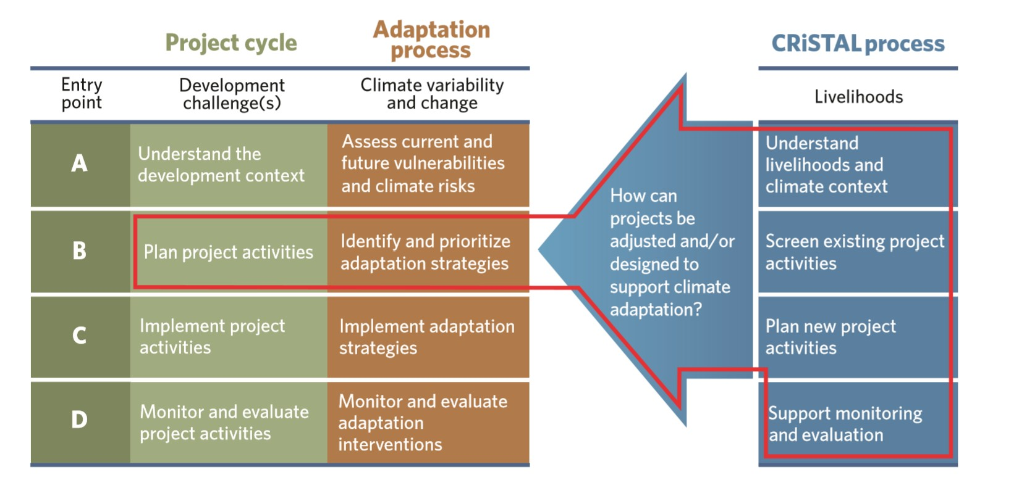
CRiSTAL extends to the planning stage to help identify how to adapt project activities or create new ones
IISD, Helvetas, IUCN, SEI are the core tool developers; CDKN supported and piloted CRiSTAL Food Security tool, www.cristaltool.org
Notes:
CDKN project to develop climate resilience by expansion of the CRiSTAL tool to food security, and its piloting in Nicaragua: https://cdkn.org/project/climate-resilience-and-food-security-in-central-america/
Diagram: Sourced from the CRiSTAL Version 5.0 Users Manual, see www.cristaltool.org

Slide 40
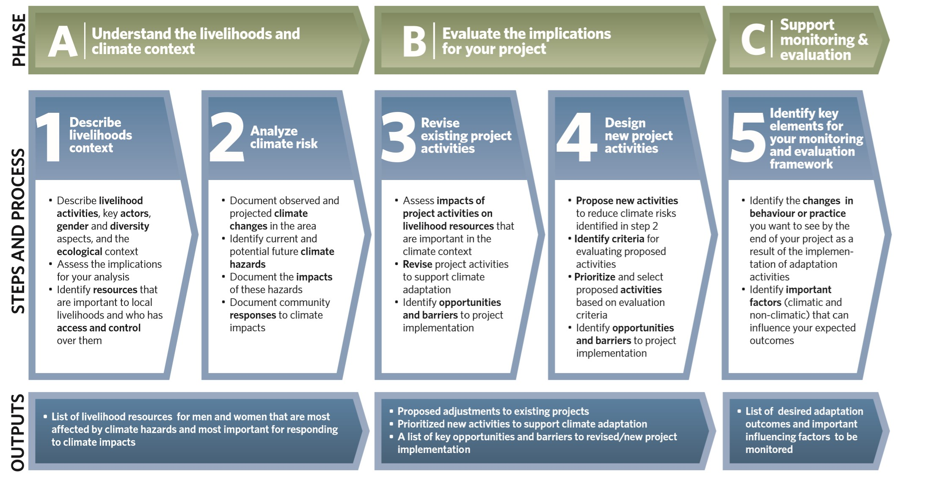
The CRiSTAL process
Notes:
Diagram: Sourced from the CRiSTAL Version 5.0 Users Manual, see www.cristaltool.org

Slide 41
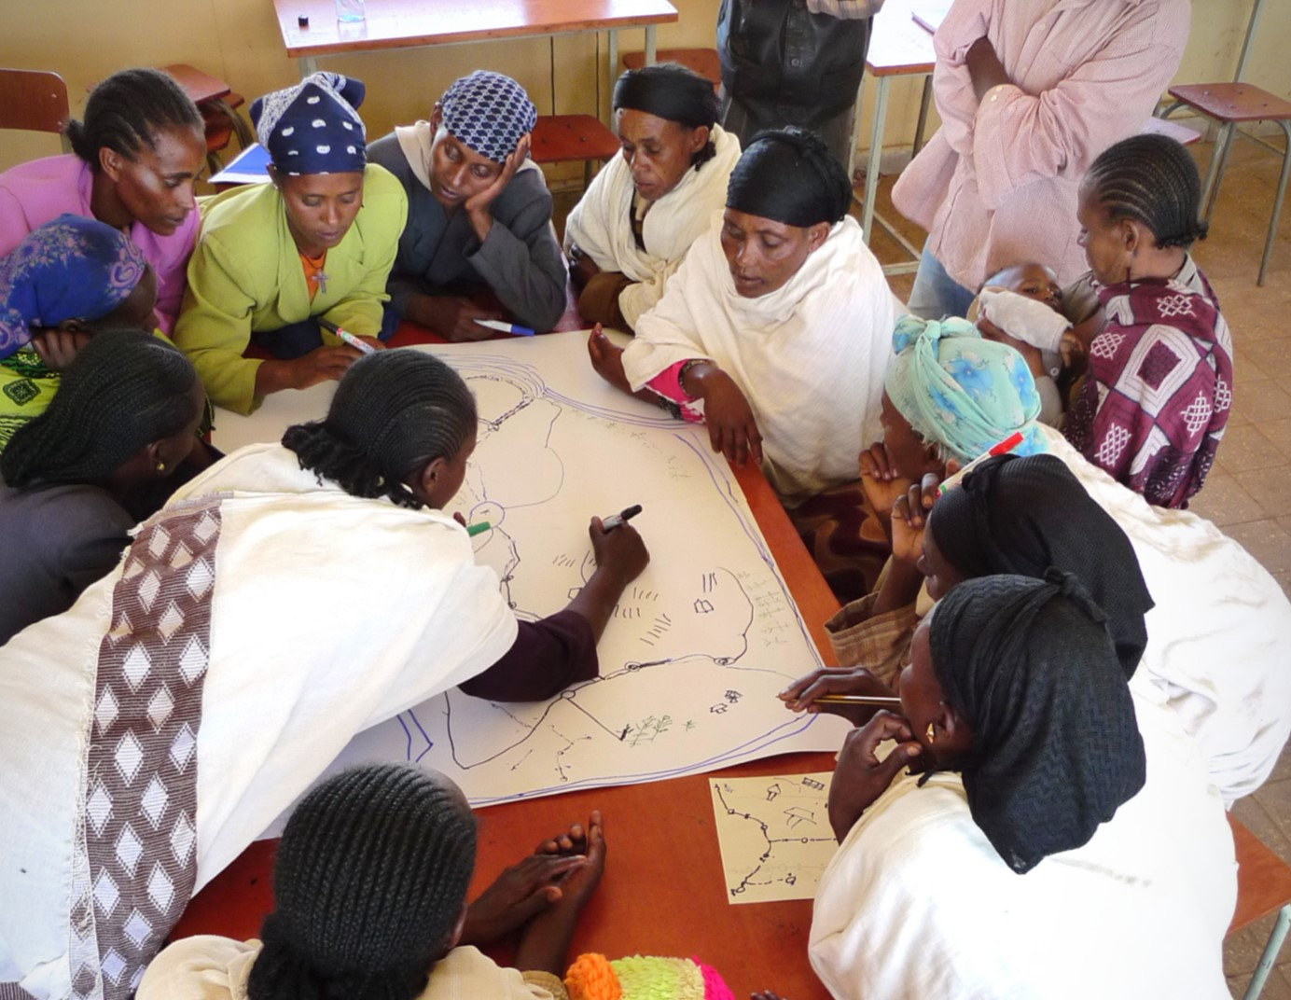
People with gender-sensitive facilitation and analytic skills can optimise CRiSTAL for gender and social inclusion approaches
Anyone who is proactively aware of gender issues and seeks thorough, balanced input from both women and men (and people from the full range of ages, ethnic groups and other relevant social-cultural groups) can use CRiSTAL effectively to highlight climate-ready project activities that are fairer and more equitable for disadvantaged groups.

Slide 42
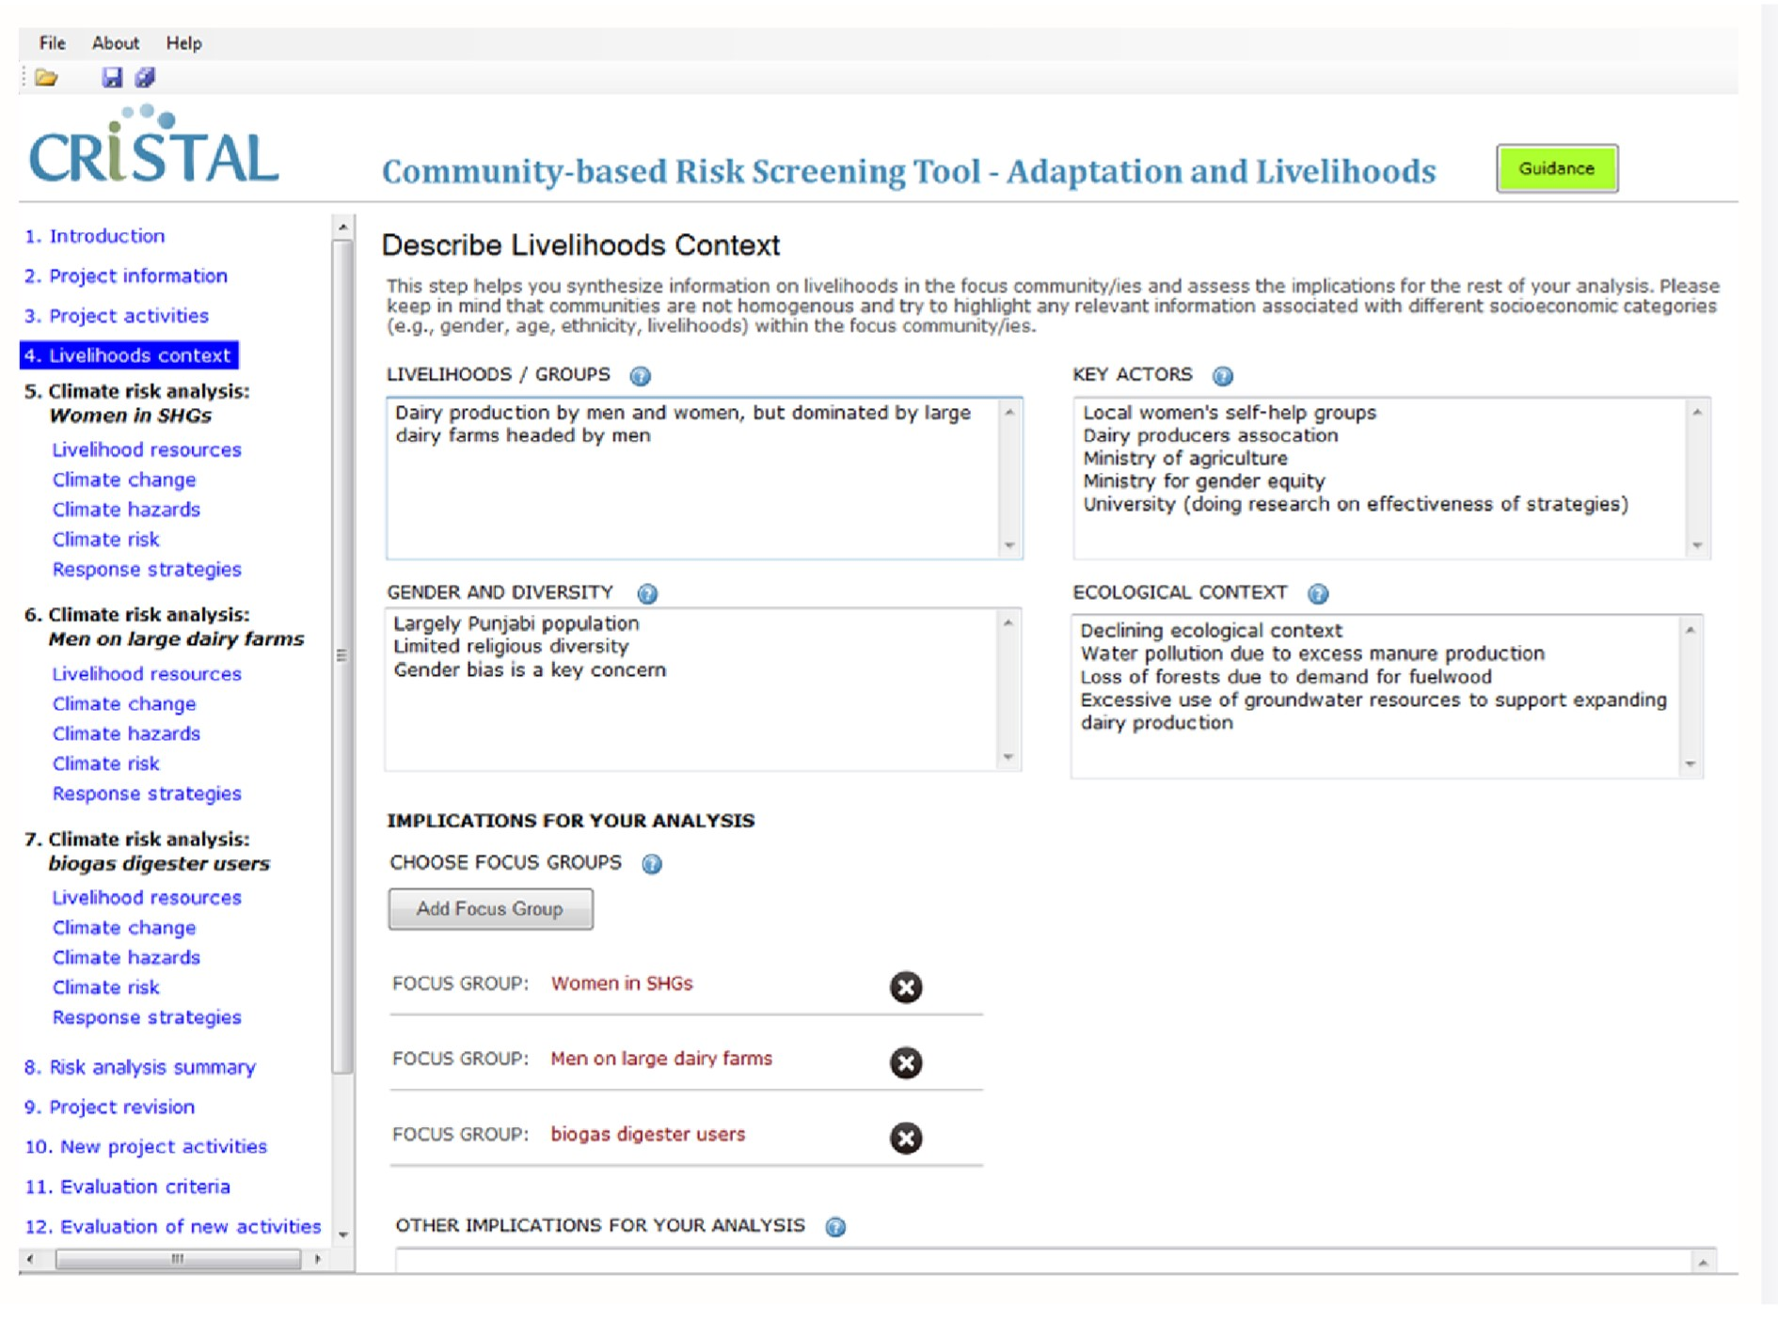
CRiSTAL: Sample work screen with gender-differentiated data entry
based on separate consultation with Women’s Self Help Groups and men’s large dairy herd managers in a community

Slide 43
Outputs
Depending on how many stages of the tool the user follows, CRiSTAL generates:
Climate risk analysis for an area
Report on which project activities are and are not resilient to current and future climate hazards
Report on changes recommended to project activities to make them more resilient to current and future climate hazards
Report on barriers to implementation
Support on prioritising climate resilient options based on criteria including needs of particularly vulnerable groups (criteria are automatically weighted but the weightings can be changed)

Slide 44
www.cdkn.org
@cdknetwork
Notes:
Facilitator: insert your name and email/contact here

