Slide 1
Progress Update
STANDING COMMITTEE ON FINANCE

Slide 2
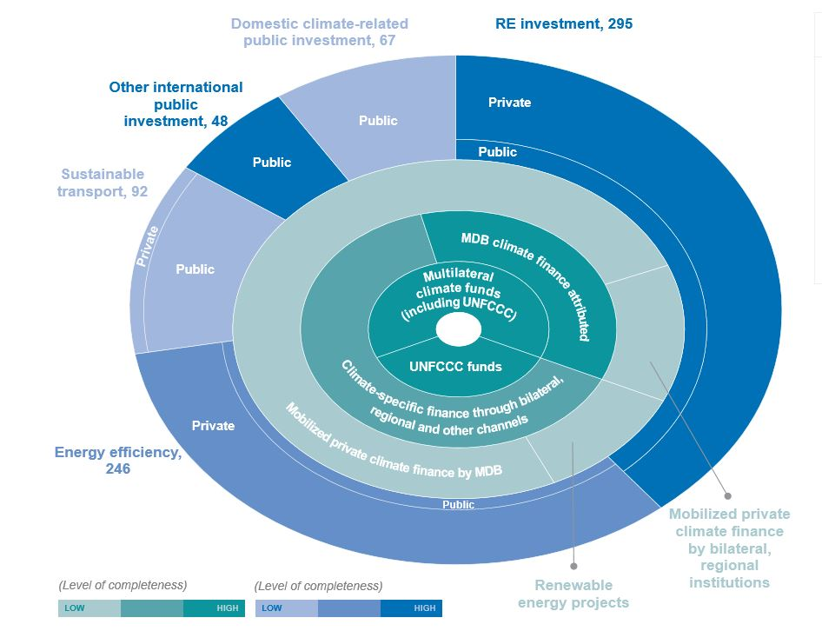
Fourth Biennial Assessment and Overview of Climate Finance Flows
Latest updated information on climate finance.
Technical Report + Summary and Recommendations.
Four Chapters
Methodological issues on climate finance
Updated data of climate finance flows in 2017 and 2018
Assessment of climate finance flows
Mapping information relevant to Article 2.1(c) of the Paris Agreement.

Slide 3
Fourth Biennial Assessment and Overview of Climate Finance Flows
mid 2021
Fourth BA publication
November 2019: Call For Evidence Launched
29 Submissions received from Parties and non-Party stakeholders
First Outreach Webinar
7 April 2020: Webinar for contributors and experts
Series of Outreach Webinars
13 October 2020: Climate finance impacts and results
20 October 2020: Climate finance data quality, methods and effectiveness
6 November 2020: Mapping information on Article 2, paragraph 1(c) of the Paris Agreement

Slide 4
First Report on the Determination of Needs of Developing Country Parties to Implement the Convention and the Paris Agreement
First report of its kind, the report outline, workplan, outreach activities and indicative timeline have been agreed by the SCF.
To include existing information and data based on official national reports to the UNFCCC, as well as other regional and global reports.
As part of the outreach activities, the SCF issued a call for Evidence and hosted informal regional webinars to inform the development of the report.

Slide 5
First Report on the Determination of Needs of Developing Country Parties to Implement the Convention and the Paris Agreement
mid 2021
First NDR publication
November 2019: Call For Evidence Launched
28 Submissions received from Parties and non-Party stakeholders
First Outreach Webinar
7 April 2020: Webinar for contributors and experts
Series of Informal Regional Outreach Webinars
17 September 2020: Africa and Eastern Europe
24 September 2020: Latin America and the Caribbean
14 October 2020: Asia and the Pacific

Slide 6
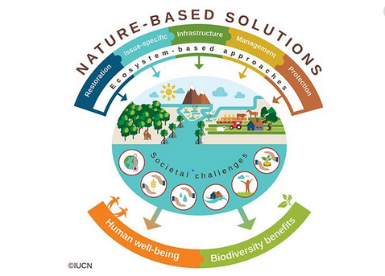
Forum on Finance for Nature-based Solutions
Draft Programme developed based on themes and sub-themes agreed by SCF in 2019.
45 submissions received from the call for inputs.
Virtual consultation held with submitters, Parties and interested stakeholders on 5 November.
Draft Programme to be updated going forward.
Forum to be held in 2021.
Forum dates and location continue to be explored.

Slide 7
Draft guidance to the operating entities of the Financial Mechanism
No guidance will be provided to the operating entities in 2020, as no COP in 2020.
SCF to share with Parties and Constituted Bodies the annual reports of the GCF/GEF once they become available (GEF is already provided).
Remind Parties the invitation by the COP to submit to the secretariat their views and recommendations on elements to be taken into account in developing the guidance.
Submissions can be provided in 2020 and/or 2021;
SCF plans to compile submissions for a consideration by the Committee.
SCF plans to discuss on how it will prepare the draft guidance at its next meeting.

