Slide 1
The IPCC Special Report on Managing the Risks of Extreme Events and Disasters to Advance Climate Change Adaptation
sample

Slide 2
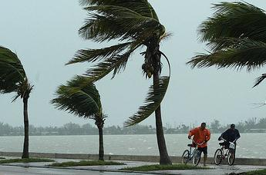
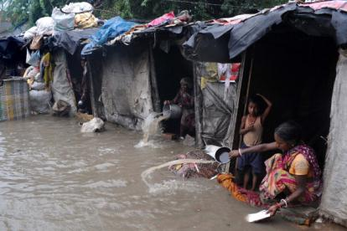
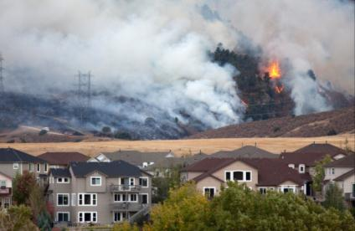
Impacts from weather and climate events depend on
Nature and severity of event
Vulnerability
Exposure
Notes:
SPM: Page 1, line 13-14; Page 2, line 25
Full report: 1.1.2, page 6-7 (Chapter1); 2.2, page 13 (Chapter 2)
Ball, 1975. The Ecologist, 5(10), 368-369. The myth of the natural disaster. http://exacteditions.theecologist.org/exact/browsePages.do?issue=6409&size=2&pageLabel=368
O’Keefe et al. 1976, Nature, 260 (5552) Taking naturalness out of natural disasters. http://www.nature.com/nature/journal/v260/n5552/pdf/260566a0.pdf
Timmerman, 1981
Hewitt, 1983, Interpretations of Calamity, eds: Allen and Unwin.p 3-32. “The idea of calamity in a technocratic age”
Maskrey, 1989 Disaster mitigation: A community based approach, Oxfam.
Mileti, 1999. Disasters by Design: A reassessment of natural hazards in the U.S.
Wisner et al, 2004. At risk: Natural Hazards, People’s Vulnerability, and Disasters. Second edition.

Slide 3
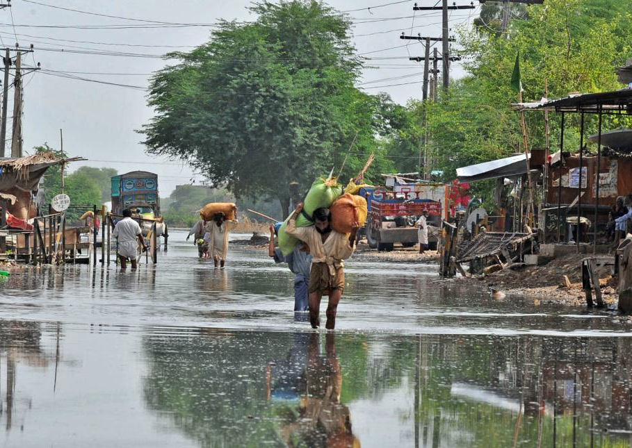
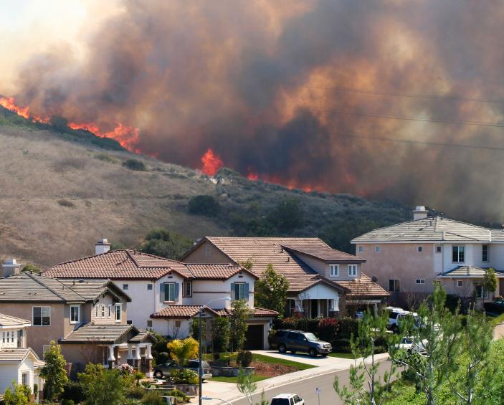
Losses from climate-related disasters
Economic losses have increased Increasing exposure is major cause
Fatalities are higher in developing countries
Notes:
SPM:
Page 3, lines 23, 31-32, 39-40
Page 4, lines 5-6.
Full report:
3.3.1, page 21
Page 23 (specifically, Zweirs et al, 2011)
Summary on page 27
3.3.2
Page 28 (and Trenberth et al, 2007)
Summary on page 33
Page 30

Slide 4
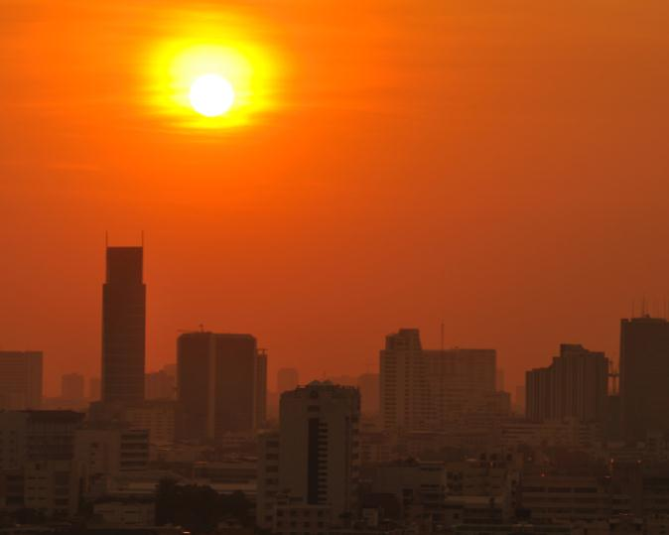
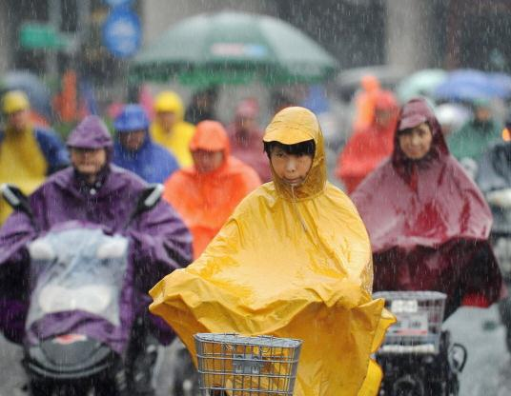
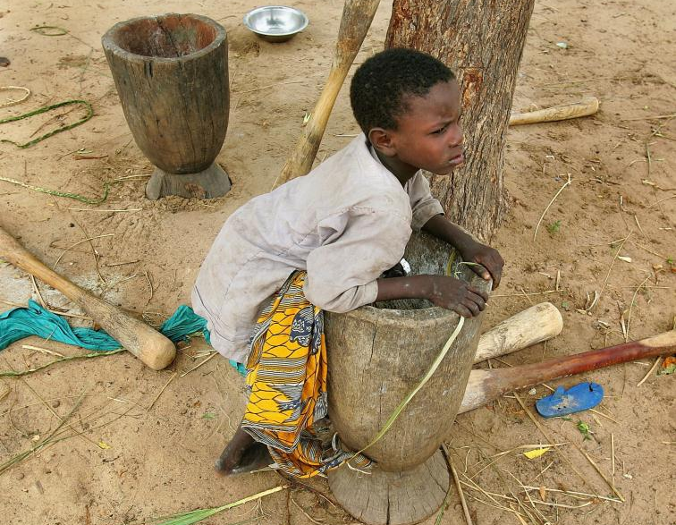
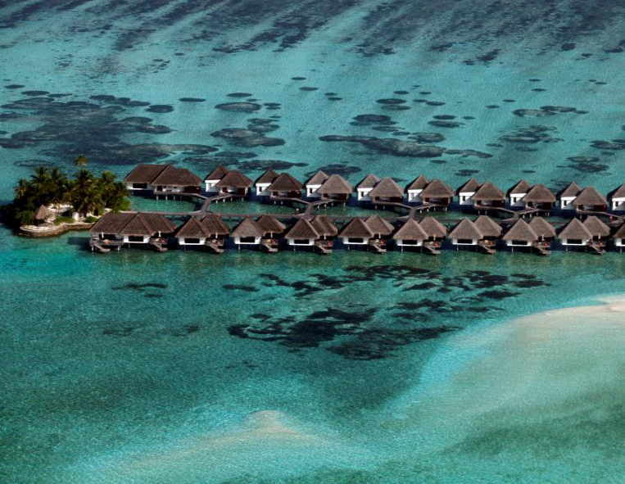
Observed and projected changes in weather and climate extremes
Heat
Heavy precipitation
Drought
Storm surge
Projected:
10-fold increase in frequency of extreme heat events later this century
Notes:
SPM:
Page 3, lines 23, 31-32, 39-40
Page 4, lines 5-6.
Full report:
3.3.1, page 21
Page 23 (specifically, Zweirs et al, 2011)
Summary on page 27
3.3.2
Page 28 (and Trenberth et al, 2007)
Summary on page 33
Page 30

Slide 5
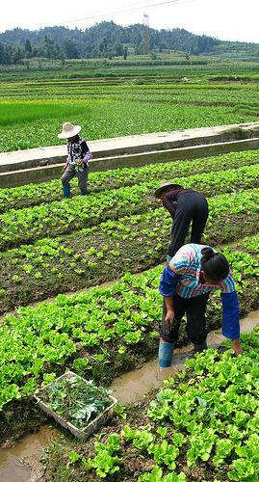
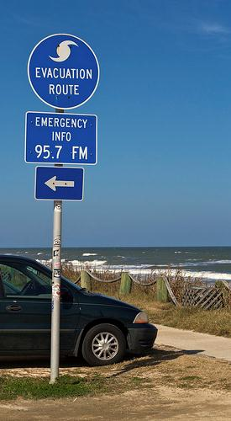
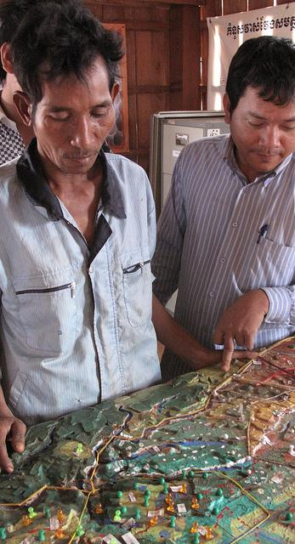
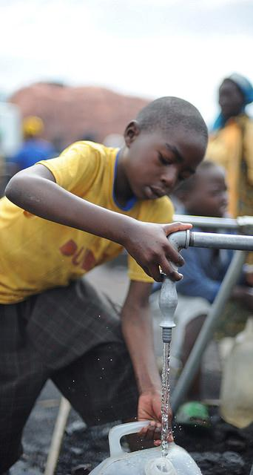
Strategies can help manage disaster risk now and also help improve people’s livelihoods and well-being
The most effective strategies reduce risks now while also providing development benefits
Notes:
HIGH AGREEMENT/MEDIUM EVIDENCE FOR TITLE FINDING
HIGH AGREEMENT/MEDIUM EVIDENCE FOR BOTTOM FINDNG
SPM:
Page 9, line 1-4.

Slide 6
There are solutions
Portfolio of actions
Communicate, Reduce, Transfer, Respond
Multi-hazard management approaches
Benefits from linking local to global scales
Iterative approach
Notes:
HIGH AGREEMENT/MEDIUM EVIDENCE FOR TITLE FINDING
HIGH AGREEMENT/MEDIUM EVIDENCE FOR BOTTOM FINDNG
SPM:
Page 9, line 1-4.

Slide 7
There are solutions
Portfolio of actions
Communicate, Reduce, Transfer, Respond
Multi-hazard management approaches
Benefits from linking local to global scales
Iterative approach
Notes:
HIGH AGREEMENT/MEDIUM EVIDENCE FOR TITLE FINDING
HIGH AGREEMENT/MEDIUM EVIDENCE FOR BOTTOM FINDNG
SPM:
Page 9, line 1-4.

Slide 8
There are solutions
Portfolio of actions
Communicate, Reduce, Transfer, Respond
Multi-hazard management approaches
Benefits from linking local to global scales
Iterative approach
Notes:
HIGH AGREEMENT/MEDIUM EVIDENCE FOR TITLE FINDING
HIGH AGREEMENT/MEDIUM EVIDENCE FOR BOTTOM FINDNG
SPM:
Page 9, line 1-4.

Slide 9
There are solutions
Portfolio of actions
Communicate, Reduce, Transfer, Respond
Multi-hazard management approaches
Benefits from linking local to global scales
Iterative approach
Notes:
HIGH AGREEMENT/MEDIUM EVIDENCE FOR TITLE FINDING
HIGH AGREEMENT/MEDIUM EVIDENCE FOR BOTTOM FINDNG
SPM:
Page 9, line 1-4.

Slide 10
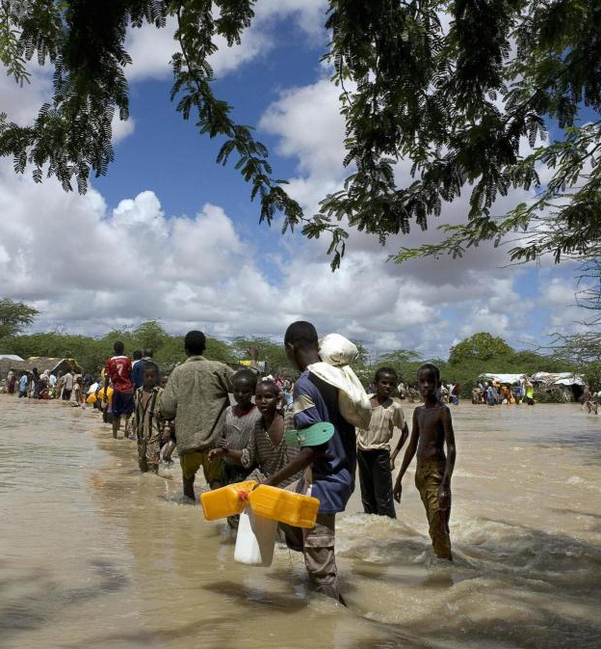
Strategies that integrate:
Climate change adaptation
Disaster risk management
Sustainable development
How can we make these strategies reality?
Notes:
HIGH AGREEMENT/MEDIUM EVIDENCE FOR TITLE FINDING
HIGH AGREEMENT/MEDIUM EVIDENCE FOR BOTTOM FINDNG
SPM:
Page 9, line 1-4.

