Slide 1
Observations and projections of extreme events Carolina Vera CIMA/CONICET-Univ. of Buenos Aires, Argentina
sample

Slide 2
Overview of SREX Chapter 3
Authors: Sonia Seneviratne, Neville Nicholls, David Easterling, Clare Goodess, Shinjiro Kanae, James Kossin, Yali Luo, Jose Marengo, Kathleen McInnes, Mohammad Rahimi, Markus Reichstein, Asgeir Sorteberg, Carolina Vera, Xuebin Zhang
Complexities: variety of extremes, definitional issues, different measures, scale issues
Applied new uncertainty guidance throughout.
More than 50 assessments using uncertainty terms (e.g., “very likely”, “medium confidence”) in Chapter 3 Executive Summary
Most of these are consistent with AR4, but there are a few revisions; one-to-one comparison is not possible (change in uncertainty guidance, differences in aspects being assessed, …)
Provided regional assessments of changes in extremes of temperature, heavy precipitation, drought in tables and figures
Tried to balance needs of policymakers for regional projections, with the need for scientific credibility
>5’000 comments on chapter 3 material; ~4’600 CLA-CLA emails…
More literature: ~ 900 references, ~ 75% of these published since AR4

Slide 3
SREX Chapter 3: Contents
Executive Summary
3.1. Weather and Climate Events Related to Disasters
3.2. Requirements and Methods for Analyzing Changes in Extremes
3.3. Observed and Projected Changes of Weather and Climate Extremes
3.4. Observed and Projected Changes in Phenomena Related to Weather and Climate Extremes
3.5. Observed and Projected Impacts on the Natural Physical Environment
FAQ 3.1: Is the Climate Becoming More Extreme?
FAQ 3.2: Has Climate Change Affected Individual Extreme Events?

Slide 4
SREX: Assessing uncertainty based on evidence & agreement
Assess confidence level
Low confidence
High confidence
Likelihood assessment
Medium confidence
Direction of change only
Likely (66-100%)
More likely than not (50-100%)
About as likely as not (33-66%)
Very likely (90-100%)
Virtually certain (99-100%)
Step 1
Step 2
Notes:
Two levels to the uncertainty assessment:
Assess confidence in the data, models, theories.
Then provide likelihood assessment if we have high confidence in the data, models, theories
If only medium confidence then only provide direction of change
If low confidence do not even provide direction of change

Slide 5
Key messages – observed changes
There is evidence from observations gathered since 1950 of change in some extremes:
Very likely increase in warm days and nights & decrease in cold days and nights on global scale
Likely that more regions have experienced increases than decreases in heavy precipitation events
Likely that there has been an increase in extreme coastal high water related to increases in mean sea level
Medium confidence that some regions of the world have experienced more intense and longer droughts, but in some regions droughts have become less frequent, less intense, or shorter

Slide 6
Key messages – observed changes
Low confidence in any observed long-term (i.e., 40 years or more) increases in tropical cyclone activity
The uncertainties in the historical tropical cyclone records, the incomplete understanding of the physical mechanisms linking tropical cyclone metrics to climate change, and the degree of tropical cyclone variability provide only low confidence for the attribution of any detectable changes in tropical cyclone activity to anthropogenic influences.

Slide 7
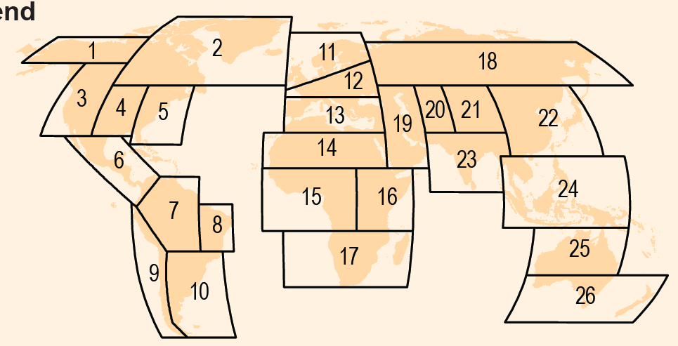
SREX: Regional projections
Large-scale, land only, regions used for temperature & precipitation extremes:
➔ More detail than AR4

Slide 8
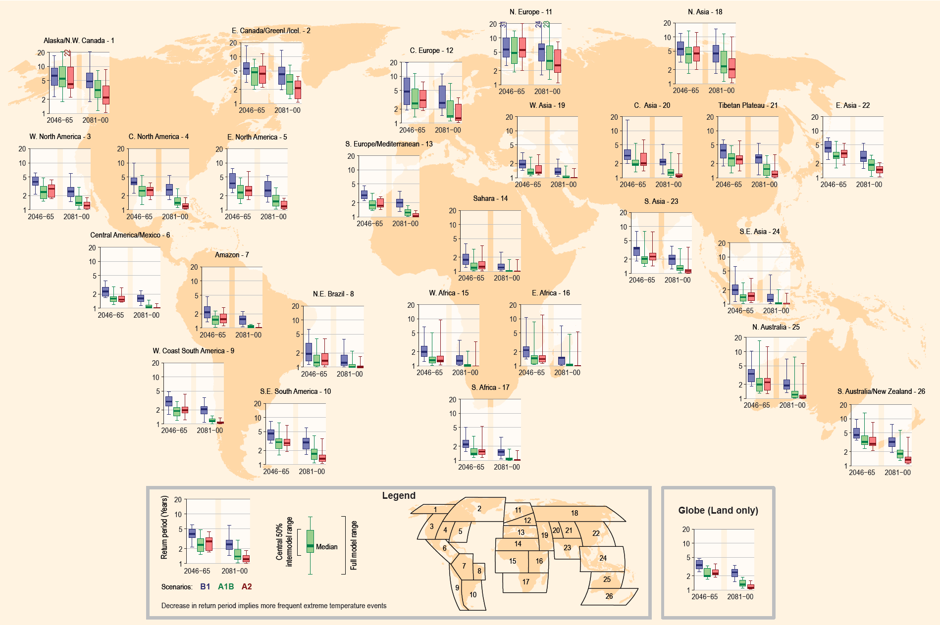
SREX: Regional projections
Projected return period (of hot day with late 20th century return period of 20 years)
B1
A1B
A2

Slide 9
SREX Projections: Temperature extremes
A1B, A2: A (late 20th-century) 1-in-20 year hottest day is likely to become a 1-in-2 year event by the end of the 21st century in most regions, except in the high latitudes of the Northern Hemisphere, where it is likely to become a 1-in-5 year event
B1: likely to become a 1-in-5 year event (1-in-10 in NH high latitudes)

Slide 10
SREX Projections: Precipitation extremes
A (late 20th-century) 1-in-20 year annual maximum daily precipitation amount is likely to become a 1-in-5 to 1-in-15 year event by the end of the 21st century in many regions.
In most regions the higher emissions scenarios (A1B and A2) lead to a stronger projected decrease in return period

Slide 11
Key messages – projected changes
Virtually certain that increases in the frequency and magnitude of warm daily temperature extremes and decreases in cold extremes will occur
Likely that the frequency of heavy precipitation or the proportion of total rainfall from heavy falls will increase over many areas
Medium confidence that droughts will intensify in some seasons and areas
Very likely that mean sea level rise will contribute to upward trends in extreme coastal high water levels

Slide 12
Key messages – projected changes
There is low confidence in projections of changes in tropical cyclone genesis, location, tracks, duration, or areas of impact.
It is likely that tropical cyclone related rainfall rates will increase with greenhouse warming
Average tropical cyclone maximum wind speed is likely to increase, although increases may not occur in all ocean basins.
While it is likely that the global frequency of tropical cyclones will either decrease or remain essentially unchanged, it is more likely than not that the frequency of the most intense storms will increase substantially in some ocean basins.

Slide 13
Small Island States
Small island states represent a distinct category of locations owing to their small size and highly maritime climates, which means that their concerns and information needs in relation to future climate change differ in many ways from those of the larger continental regions that are addressed in SREX chapter 3.
The small land area and often low elevation of small island states make them particularly vulnerable to rising sea levels.
Short record lengths and the inadequate resolution of current climate models to represent small island states limits the assessment of changes in extremes. This is why the Caribbean region is not represented in the maps and tables of SREX.
Notes:
Particular challenges exist for the assessment of past changes in climate given the sparse regional and temporal coverage of terrestrial-based observation networks and the limited in situ ocean observing network, although observations have improved somewhat in recent decades with the advent of satellite-based observations of meteorological and oceanic variables. However, the short length of these records hampers the investigation of long-term trends in the region.
Resolution of GCMs is insufficient to represent small islands and few studies have been undertaken to provide projections for small islands using RCMs

Slide 14
Small Island States
However, based on few available sources it was found in the Caribbean that:
There is medium confidence of observed increases in warm days and nights and decreases in cold days and nights for the period 1951 to 2003.
There is medium confidence in the projected temperature increases.
There is insufficient evidence to assess observed and projected rainfall trends.
The very likely contribution of mean sea level rise to increased extreme sea levels, coupled with the likely increase in tropical cyclone maximum wind speed, is a specific issue for tropical small island states.

Slide 15
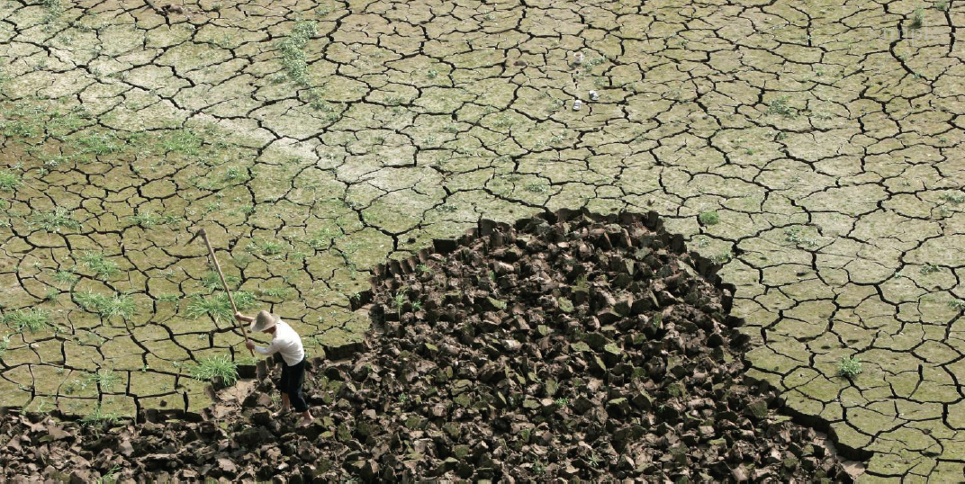
Summary and conclusions
SREX: Significantly expanded information compared to AR4 in particular on regional scale. Limitations to provide information at higher resolutions.
Level of certainty in projection strongly depends on the considered extreme, region and season

