Slide 1
Raising Risk Awareness:
Making informed decisions to prepare for extreme weather events

Slide 2
The Raising Risk Awareness initiative
Raising Risk Awareness (RRA) brings together:
scientists
vulnerability experts
knowledge brokers
to assess the role of climate change in extreme weather events in Ethiopia, Kenya, India and Bangladesh to help prepare for future ones

Slide 3
The team
The Raising Risk Awareness team includes the Climate and Development Knowledge Network (CDKN) and World Weather Attribution (WWA) partners:
Climate Central
Red Cross Red Crescent Climate Centre
Royal Netherlands Meteorological Institute (KNMI)
University of Melbourne
University of Oxford
India partner:
The Indian Institute of Technology Delhi

Slide 4
Why do we seek to attribute extreme weather events?
Attribution analyses allow scientists to make quantitative statements about whether climate change has altered the risk of extreme weather events occurring
These analyses help decision makers and the public to prioritise adaptation solutions and reduce vulnerability

Slide 5
“Global average temperatures do not kill people. What kills people are extreme weather events. This research allows us to get a more comprehensive picture of what climate change actually means […] and allows us to make better planning decisions.” Friederike Otto, deputy director of the Environmental Change Institute at the University of Oxford

Slide 6
Section 1 – How it works

Slide 7
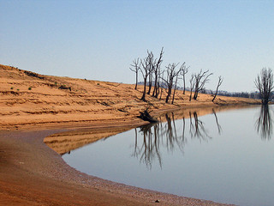
1. Extreme weather event
An extreme weather event, such as a flood, drought or heat wave, occurs somewhere in the world

Slide 8
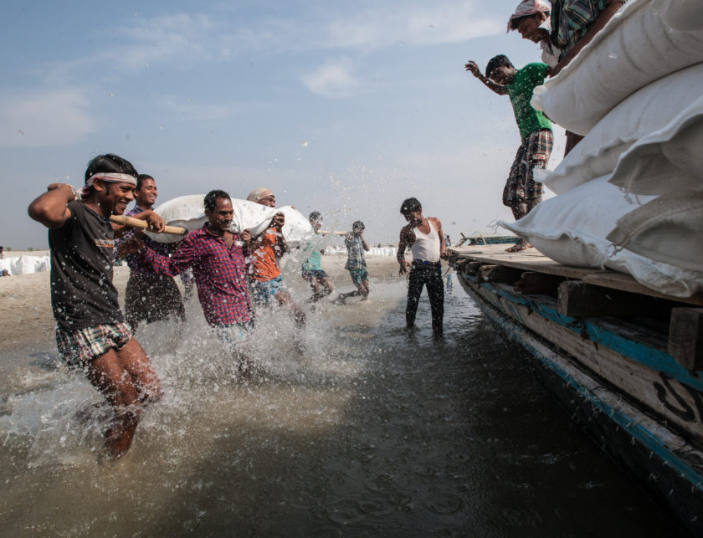
2. Disaster response
Governments, emergency responders and humanitarian actors respond to the event

Slide 9
3. How do we build back better?
Policy makers, humanitarian actors, engineers, community members and others are faced with decisions about how to rebuild and prepare for changing risks

Slide 10
4. Is the past a good indicator of the future?
Many actors wonder if they can use their experience and knowledge about past climate extremes and impacts as good indicators of future risk

Slide 11
5. Determining the influence of climate change
Climate scientists use multiple independent methods to determine whether and to what extent climate change is making some extreme events occur more often and with higher intensity

Slide 12
6. Assessing the event
Climate scientists conduct independent assessments using multiple peer-reviewed approaches of extreme event attribution methodologies, including statistical analyses of the historical precipitation record, the trend in global climate models, and the results of thousands of simulations of possible weather with a regional climate model

Slide 13
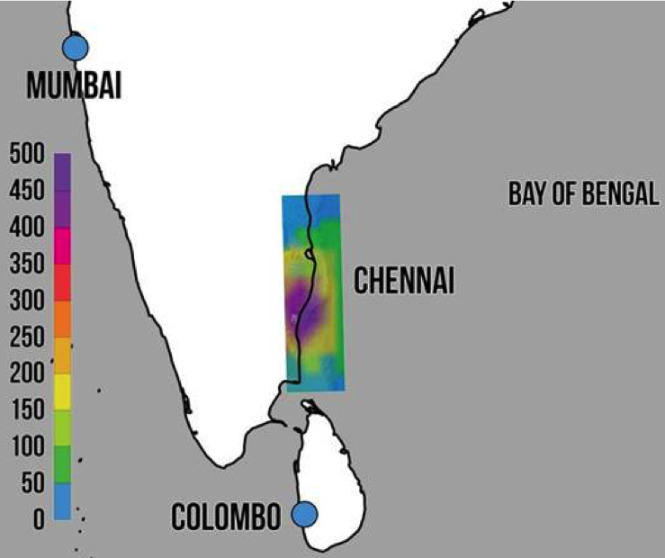
7. Analysing the exposure and vulnerability context
Social scientists examine the underlying exposure and vulnerability within the social, economic and political context of the event

Slide 14
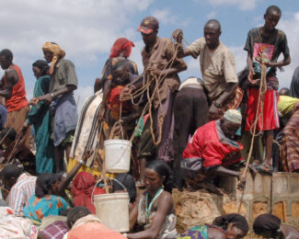
8. Experts communicate message
Scientists inform the media about whether and to what extent climate change influenced the extreme event
The media and other stakeholders then spread that information to decision makers and the public

Slide 15
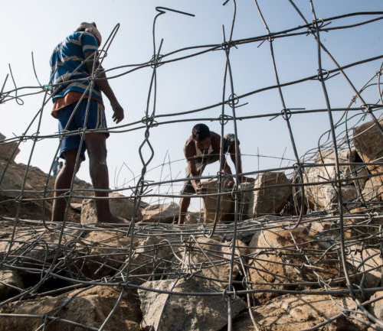
9. Better decisions
People use this information to make better decisions on how to respond to, and build back from, an extreme weather event

Slide 16
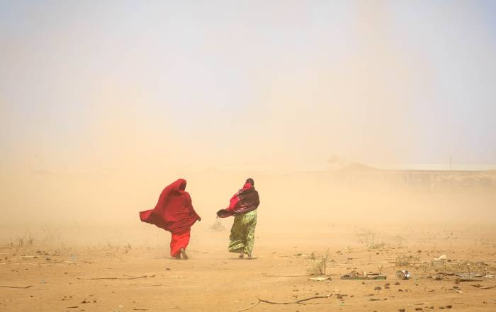
10. Improve resilience
This information will help stakeholders prepare for the risk of future climate change-driven extreme events and ensure that communities, organisations and systems are resilient
.

Slide 17
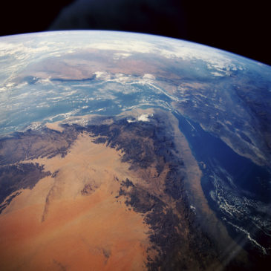
Get in touch
Heather Lynch heather.v.lynch@pwc.com
Suzanne Carter suzanne.carter@cdkn.org

Slide 18
Image credits
Slide 7: Drought. Tim J Keegan/Flickr
Slide 8: Managing flood risk. Asian Development Bank/Flickr
Slide 11:Satellite image of tropical cyclone Mahasen in the Northern Indian Ocean. UWM-CIMSS/William Straka III/NASA/NOAA/Flickr
Slide 14: Sourcing water in the Moyale zone, Ethiopia. Andrew Heavens/Flickr
Slide 15: Building flood defenses, India. Asian Development Bank
Slide 16: Weathering a microburst, Ethiopia. UNICEF Ethiopia/Flickr
Slide 17: Aerial image of Ethiopia. NASA Johnson/Flickr

