Slide 1

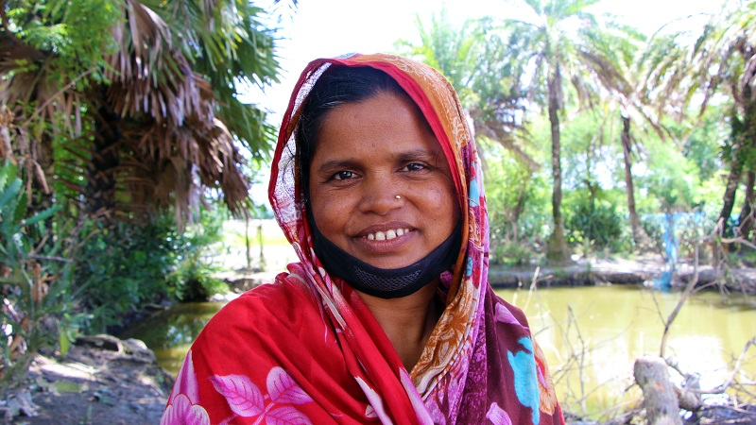
Climate compatible development:
Why is a gender-responsive and socially inclusive approach needed?
Image: ICCCAD and CDKN,
Voices from the Frontline
Notes:
Facilitator/Trainer: We revisit different aspects of poverty and wellbeing, and the different things that make people more resilient or vulnerable to climate change here. We term the slides ‘socially inclusive’ as well as ‘gender responsive’ but the emphasis, overall, in this module is on looking through the gender lens and the ways that women overall, are over-represented among the poorest and most climate vulnerable people, and what can be done specifically to empower women to ‘catch up’ in terms of their personal development and enhanced life chances, within these more vulnerable groups.

Slide 2
What you will learn from this module
How people are differently impacted by climate change
Why gender matters and how to think about the intersection of gender and other forms of social inclusion or exclusion – and what it means for effective climate action
How involving women in climate action includes all people’s skills and knowledge improves outcomes

Slide 3
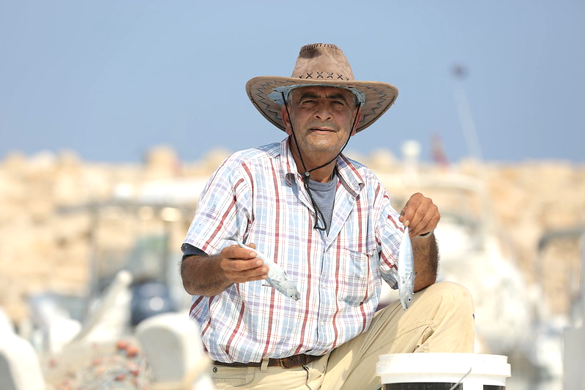
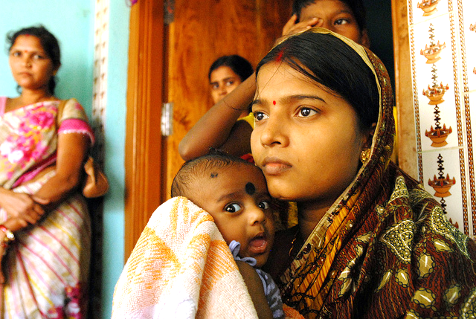
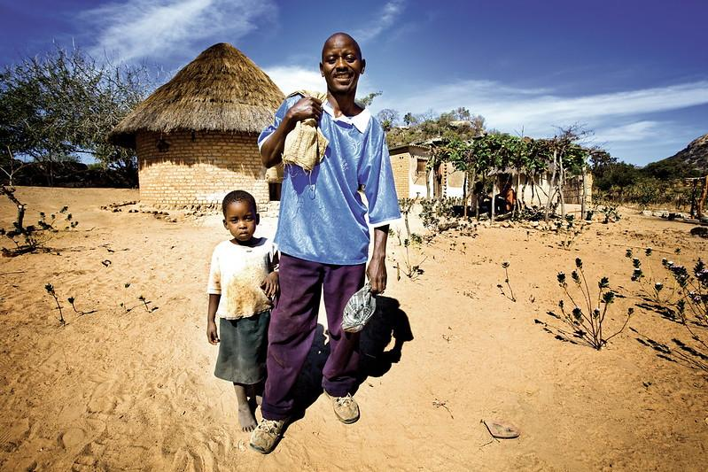
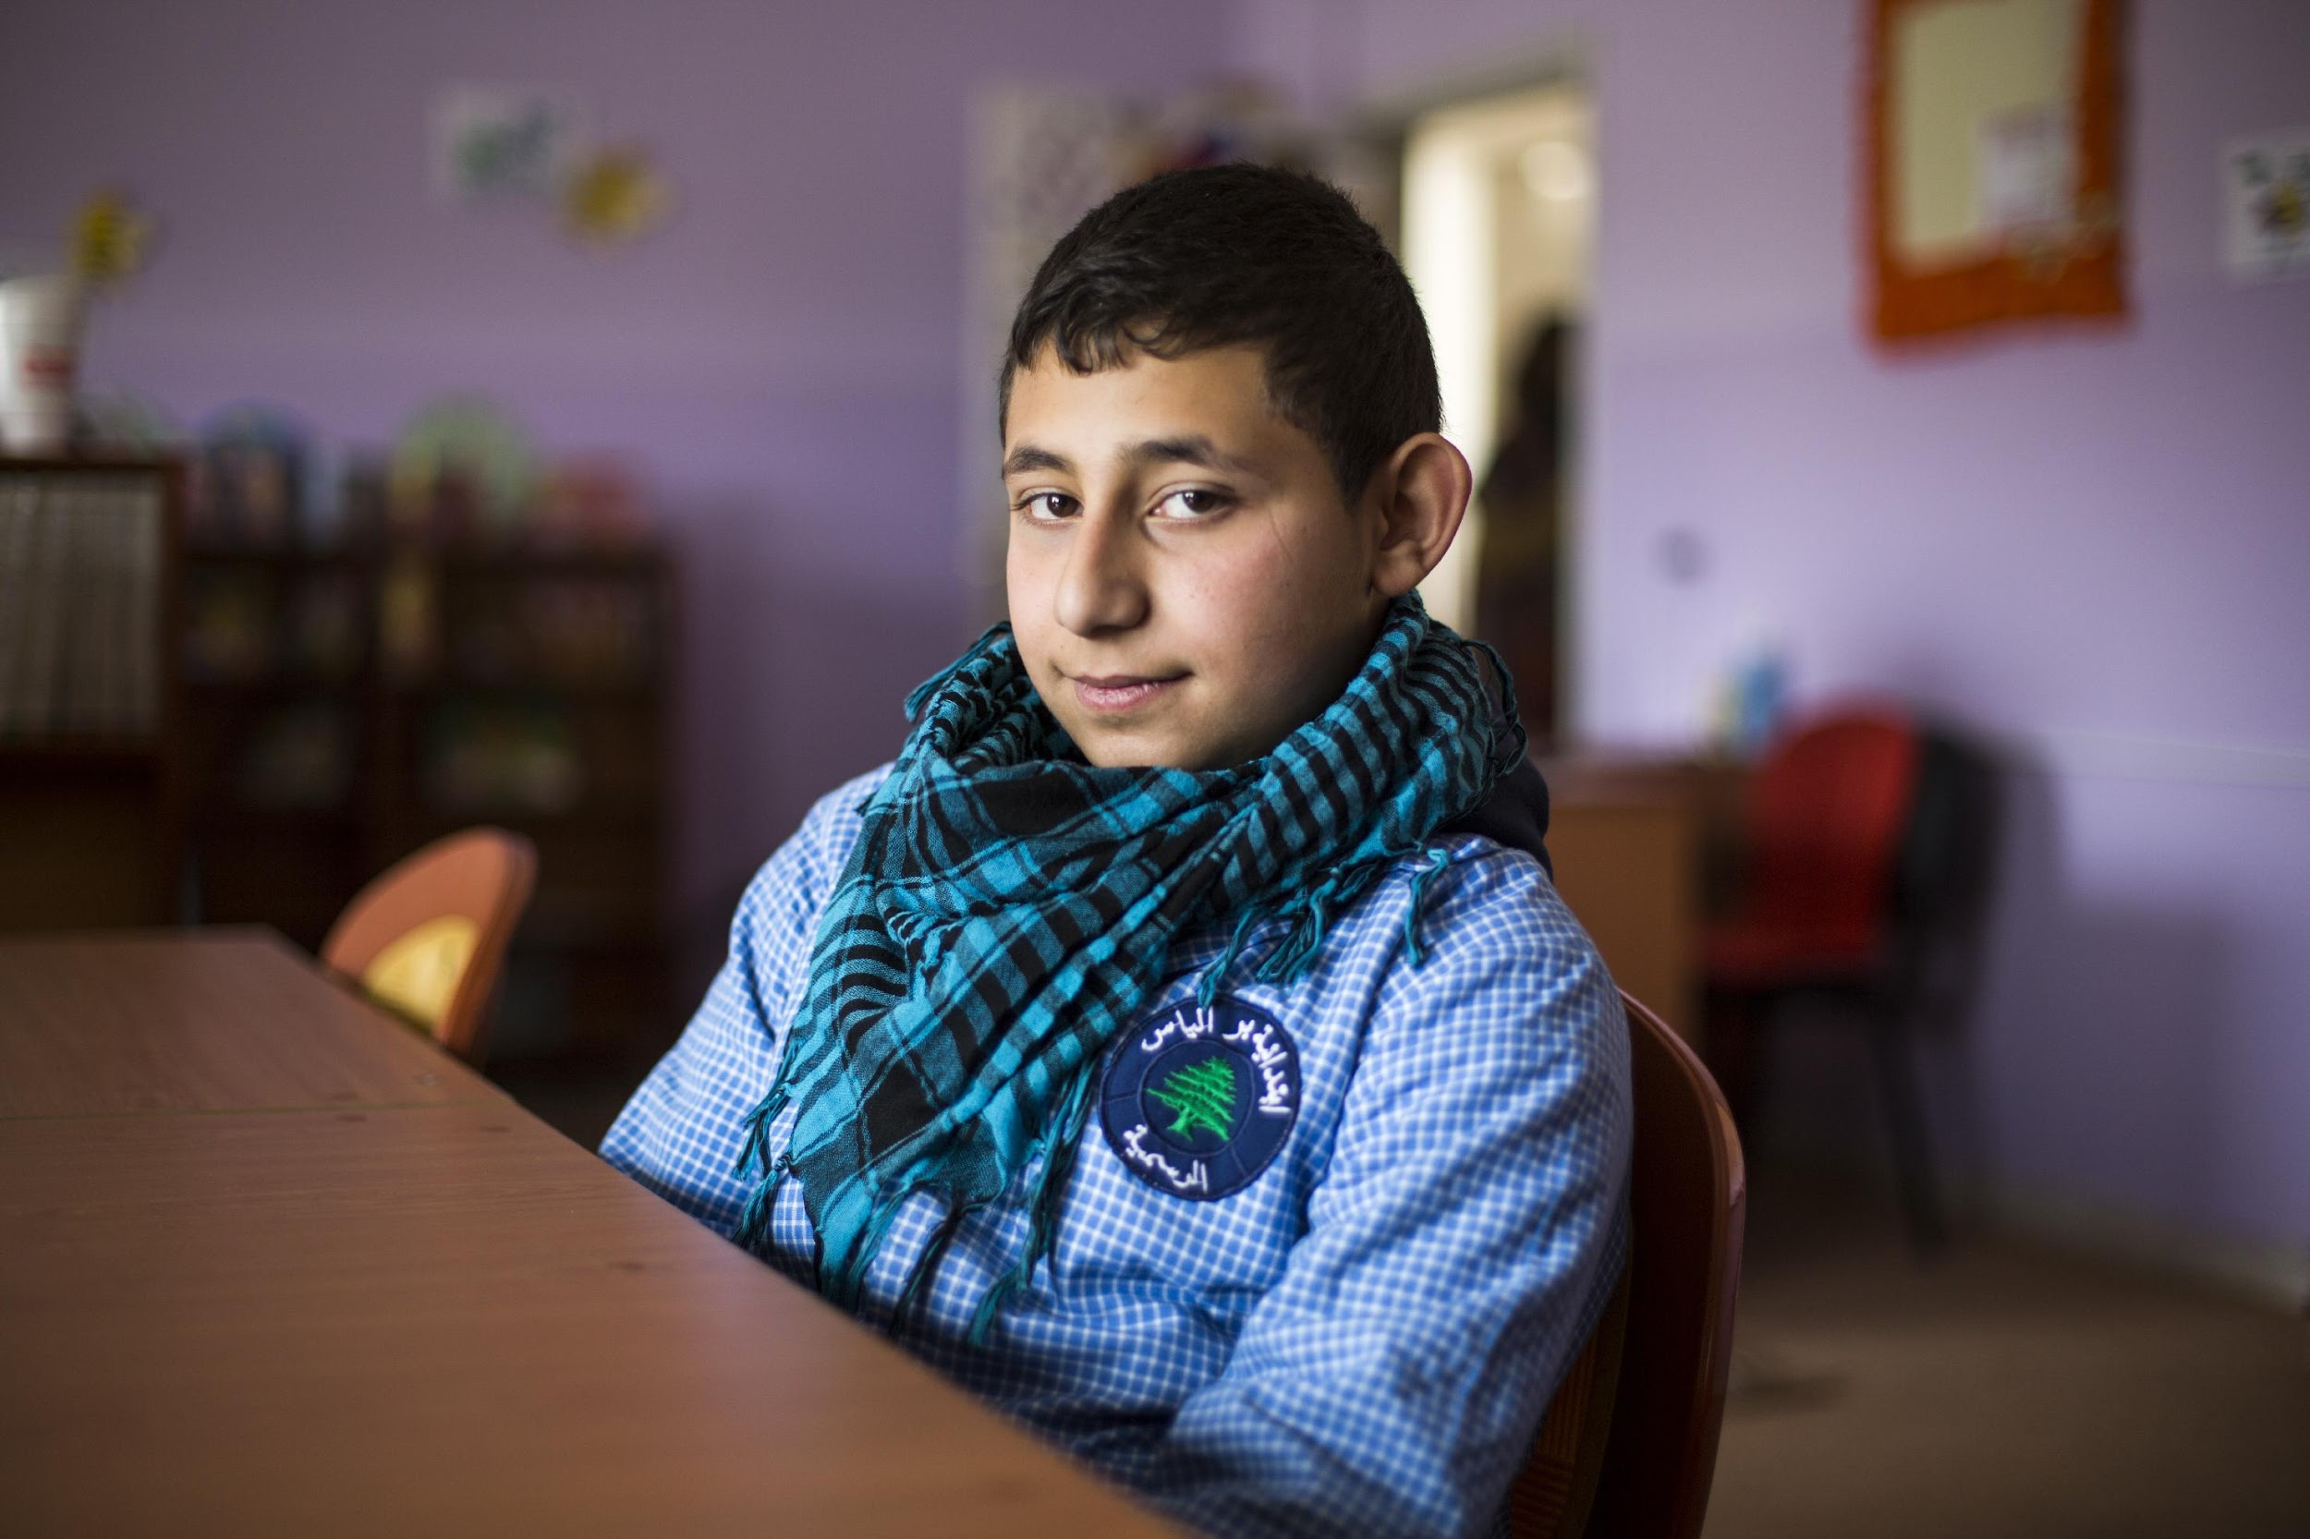
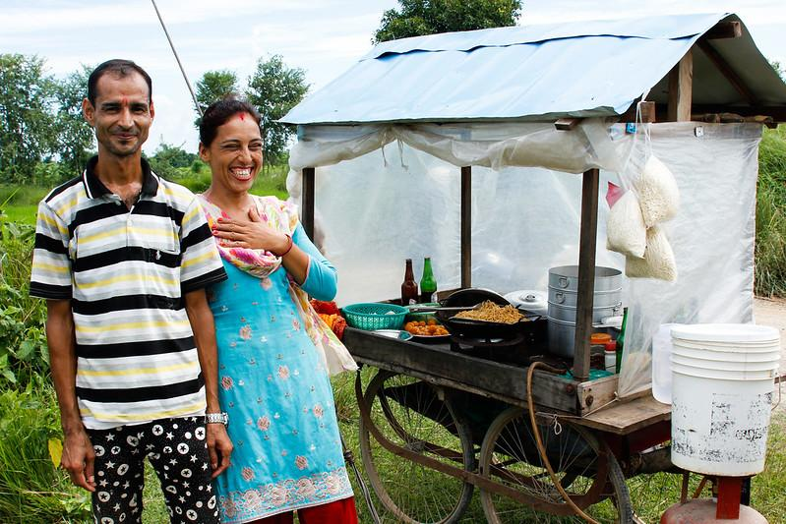
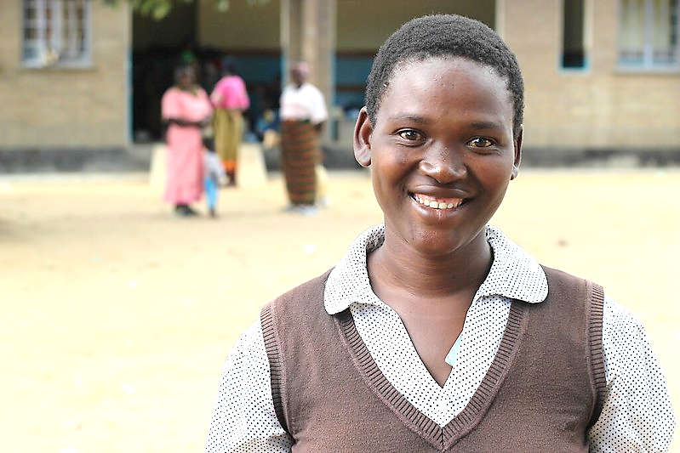
How are people differently impacted by climate change?
Image © DFID
Notes:
All images © UK DFID
Showing people around the world.

Slide 4
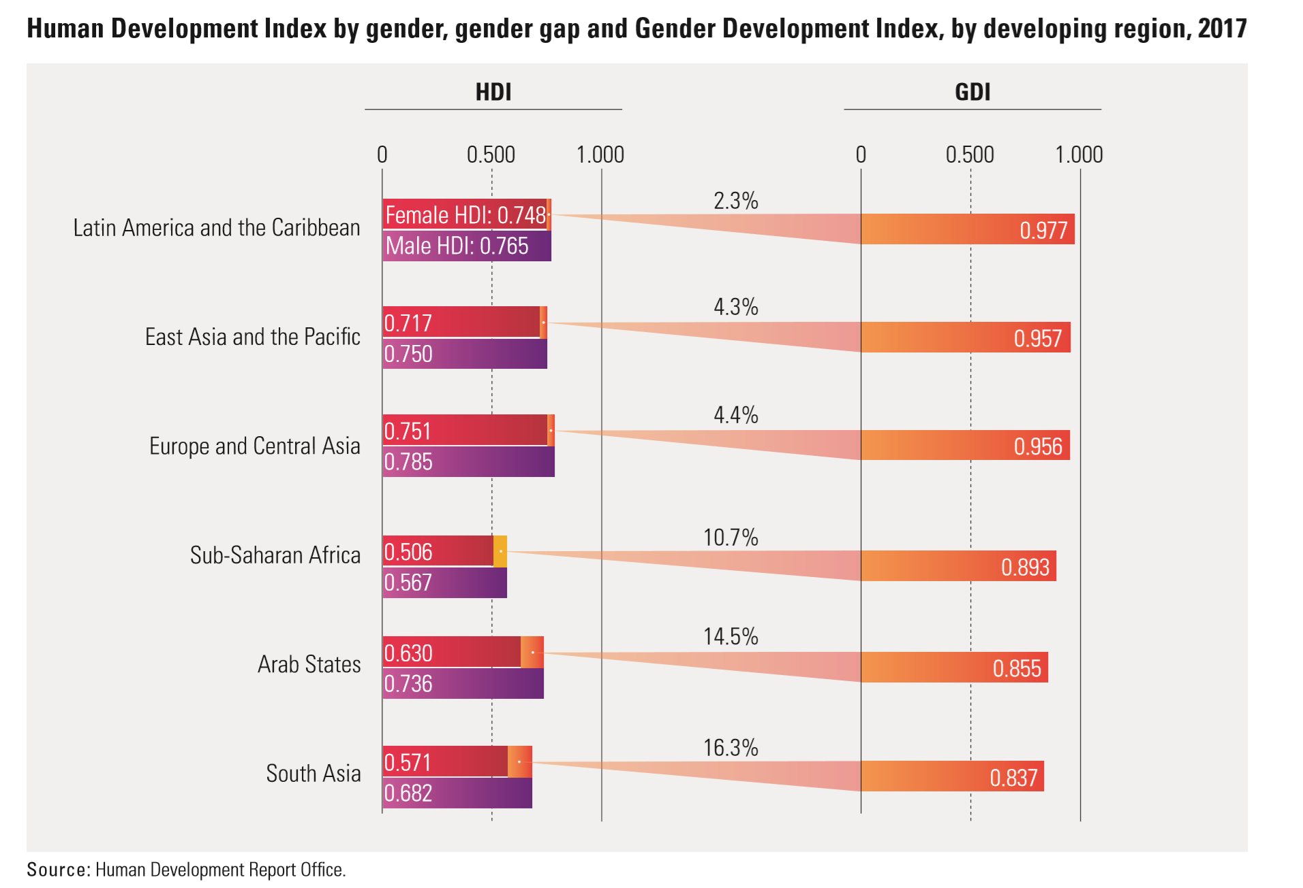
There is a global gender gap in development
Notes:
Much of the gap is due to women’s lower income and educational attainment in many countries. The gender gap is widest in low human development countries where the average HDI value is 13.8 percent lower for women than for men.
Among developing regions the gender gap is narrowest in Latin America and the Caribbean (2.3 percent) and widest in South Asia (16.3 percent)
Sub-Saharan Africa: 13% gender gap (UNDP, 2016). African women achieve only 87 percent of the human development outcomes of men, driven mainly by lower levels of female secondary attainment, lower female labour force participation and high maternal mortality.
Source: UNDP Human Development Report, Statistical Update 2018, http://www.hdr.undp.org/sites/default/files/2018_human_development_statistical_update.pdf
The GDI measures gender gaps in human development achievements by accounting for disparities between women and men in three basic dimensions of human development—health, knowledge and living standards using the same component indicators as in the HDI. The GDI is the ratio of the HDIs calculated separately for females and males using the same methodology as in the HDI. It is a direct measure of gender gap showing the female HDI as a percentage of the male HDI. For more details on computation see Technical Notes.
The GDI is calculated for 166 countries. Countries are grouped into five groups based on the absolute deviation from gender parity in HDI values. This means that grouping takes equally into consideration gender gaps favoring males, as well as those favoring females.
The GDI shows how much women are lagging behind their male counterparts and how much women need to catch up within each dimension of human development. It is useful for understanding the real gender gap in human development achievements and is informative to design policy tools to close the gap.
Among developing regions the gender gap is narrowest in Latin America and the Caribbean (2.3 percent) and widest in South Asia (16.3 percent)
Sub-Saharan Africa: almost 11% gender gap. African statistics are driven mainly by lower levels of female secondary attainment, lower female labor force participation and high maternal mortality.
Source: UNDP Human Development Report, Statistical Update 2018, http://www.hdr.undp.org/sites/default/files/2018_human_development_statistical_update.pdf
Gender Development Index (GDI) http://hdr.undp.org/en/content/gender-development-index-gdi
Download the latest Gender Development Index Data
View the GDI Frequently Asked Questions
The GDI measures gender gaps in human development achievements by accounting for disparities between women and men in three basic dimensions of human development—health, knowledge and living standards using the same component indicators as in the HDI. The GDI is the ratio of the HDIs calculated separately for females and males using the same methodology as in the HDI. It is a direct measure of gender gap showing the female HDI as a percentage of the male HDI. For more details on computation see Technical Notes.
The GDI is calculated for 166 countries. Countries are grouped into five groups based on the absolute deviation from gender parity in HDI values. This means that grouping takes equally into consideration gender gaps favoring males, as well as those favoring females.
The GDI shows how much women are lagging behind their male counterparts and how much women need to catch up within each dimension of human development. It is useful for understanding the real gender gap in human development achievements and is informative to design policy tools to close the gap.

Slide 5
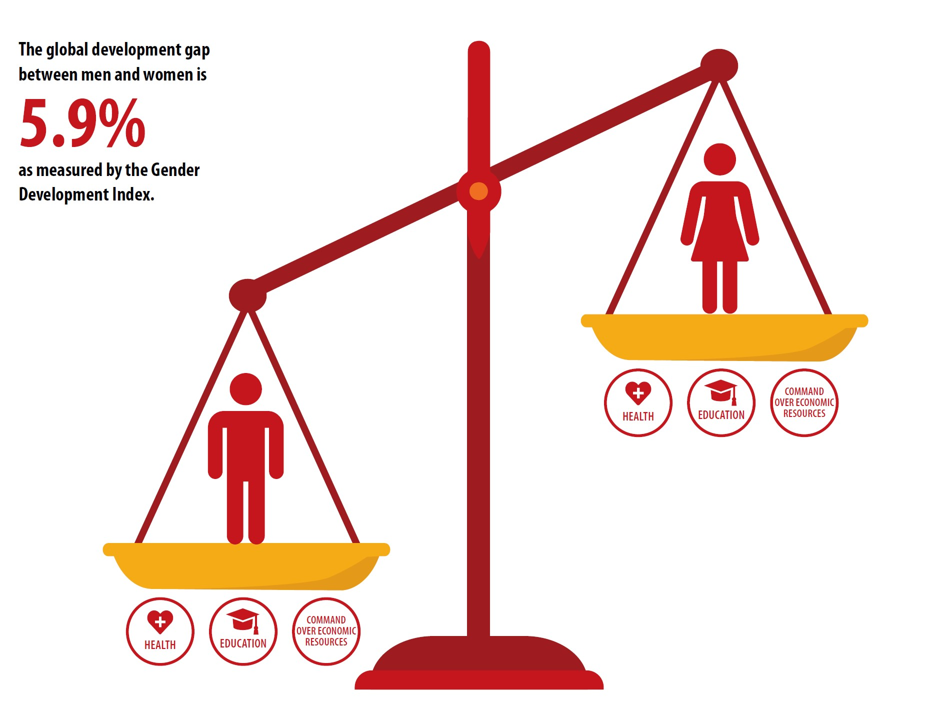
There is a global gender gap in development
Notes:
Worldwide, the average Human Development Index (HDI) value for women (0.705) is 5.9 percent lower than that for men (0.749).
The Human Development Index (HDI) measures:
the ability to lead a long and healthy life, measured by life expectancy at birth;
the ability to acquire knowledge, measured by mean years of schooling and expected years of schooling; and
the ability to achieve a decent standard of living, measured by gross national income per capita.
How the Human Development Index is calculated:
The following three indices are used:
Life Expectancy Index (LEI)
2. Education Index (EI)
2.1 Mean Years of Schooling Index MYS: Mean years of schooling (i.e. years that a person aged 25 or older has spent in formal education)
2.2 Expected Years of Schooling Index (EYSI) EYS: Expected years of schooling (i.e. total expected years of schooling for children under 18 years of age)
3. Income Index
II is 1 when GNI per capita is $75,000 and 0 when GNI per capita is $100. GNIpc: Gross national income at purchasing power parity per capita.
Finally, the Human Development Index or HDI is the geometric mean of the previous three normalised indices.
Human Development Report 2019 reports that progress is slowing in closing the Global Gender Development Gap
“Gender equality: Based on current trends, it will take 202 years to close the gender gap in economic opportunity alone, cites the report. While the silence on abuse is breaking, the glass ceiling for women to progress is not. Instead, it is a story of bias and backlash. “

Slide 6
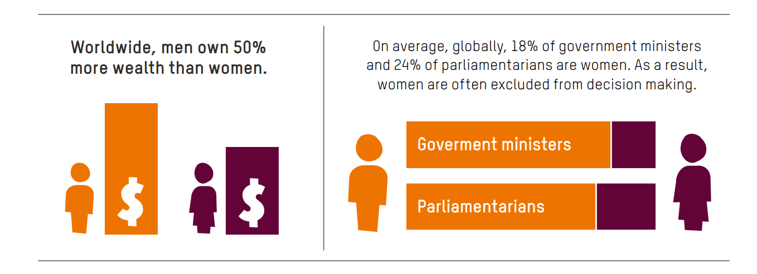
Women’s life opportunities and influence in public decision-making are more constrained
Among women, unemployment rates are higher and labour force participation rates lower.
Yet women provide most unpaid care work in the home—limiting their choices in paid work.
Knock-on effects for women:
Less access to formal pensions
Less access to workplace benefits than men
Diagram © Oxfam
Notes:
Worldwide:
Women hold only 23.5 percent of seats in parliament
Among women, unemployment rates are higher and labour force participation rates lower.
Yet women provide most unpaid care work in the home—limiting their choices in paid work.
Knock-on effects for women:
Less access to formal pensions
Less access to workplace benefits than men
Graphic is © Oxfam 2020.
See: Time to Care: Unpaid and underpaid care work and the global inequality crisis
https://oxfamilibrary.openrepository.com/bitstream/handle/10546/620928/bp-time-to-care-inequality-200120-summ-en.pdf

Slide 7
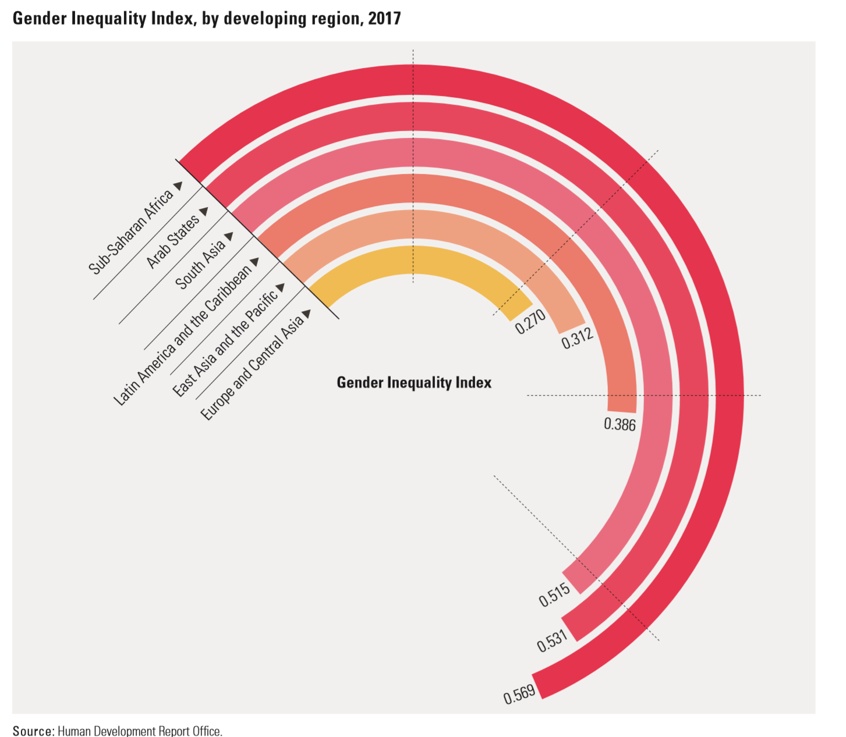
Notes:
Human Development Report 2019 reports that
“at the very time when progress is meant to be accelerating to reach the Sustainable Development Goals (SDGs) by 2030, the report’s 2019 Gender Inequality Index says progress actually is slowing. “
Following from the last slide’s overview of global inequalities, this diagram shows gender inequality by world region.
The Gender Inequality Index measures women’s empowerment via a couple of measures of reproductive health quality (see below) and political and formal workforce participation and finds:
Gender inequality is in all countries. The higher the GII value, the greater the gender inequality—the global average was 0.441. Among developing regions, it is 0.569 in Sub-Saharan Africa (Source: UNDP Human Development Report, Statistical Update 2018, http://www.hdr.undp.org/sites/default/files/2018_human_development_statistical_update.pdf)
Descriptions of the indices that make up the Gender Inequality Index are as follows
Gender Inequality Index is a composite measure reflecting inequality in achievement between women and men in three dimensions: reproductive health, empowerment and the labour market. See Technical note 4 at http://hdr.undp.org/sites/default/files/ hdr2019_technical_notes.pdf for details on how the Gender Inequality Index is calculated.
Maternal mortality ratio: Number of deaths due to pregnancy-related causes per 100,000 live births. Adolescent birth rate: Number of births to women ages 15–19 per 1,000 women ages 15–19. Share of seats in parliament: Proportion of seats held by women in the national parliament expressed as a percentage of total seats. For countries with a bicameral legislative system, the share of seats is calculated based on both houses. Population with at least some secondary education: Percentage of the population ages 25 and older that has reached (but not necessarily completed) a secondary level of education. Labour force participation rate: Proportion of the working-age population (ages 15 and older) that engages in the labour market, either by working or actively looking for work, expressed as a percentage of the working-age population.
(taken from Human Development Report 2019, http://hdr.undp.org/sites/default/files/hdr2019.pdf)

Slide 8
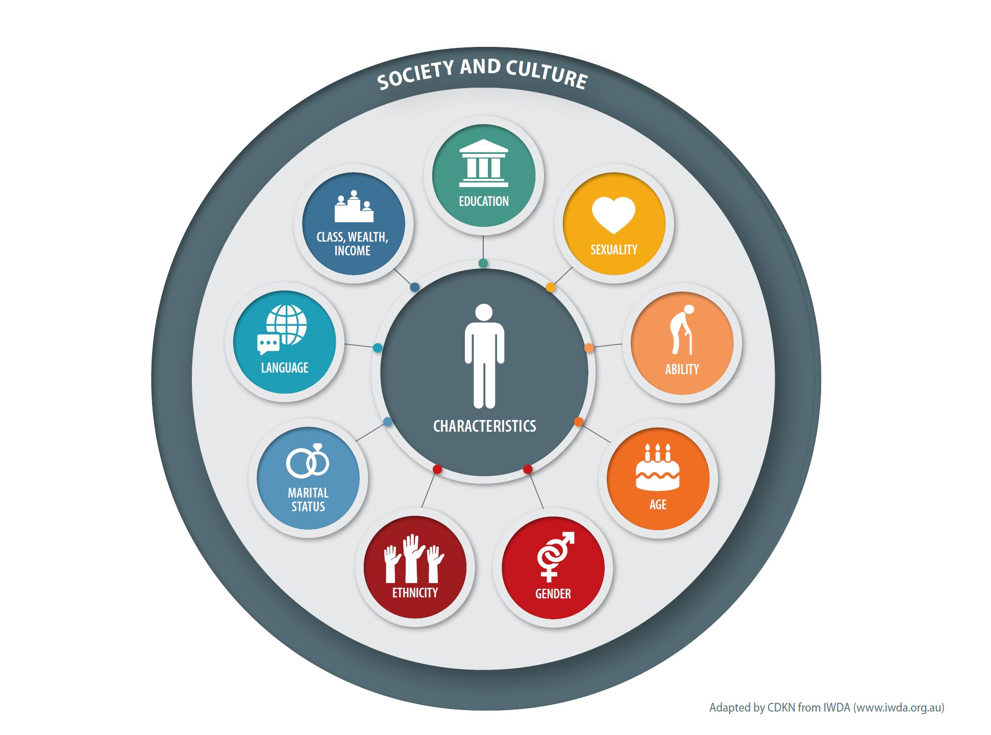
Individual people face different forms of opportunity and discrimination - based on many characteristics (‘intersectionality’)
Notes:
We can acknowledge how everyone has many characteristics and how they are viewed by society (and the opportunities this provides, or discrimination they experience) can be based on the interplay between gender and other forms of discrimination, like age, class, socioeconomic status, physical or mental ability, gender, religion, or ethnicity.
Households are composed of individuals with varying preferences and needs; they are not homogeneous units. Likewise, women are not a homogeneous group. Climate change interventions must differentiate between livelihood types; farming, pastoral and agro-pastoral. It must also consider the different needs and roles within the household: as household heads, as wives within male-headed monogamous and polygamous households and as female youths.
Earlier development interventions have been considering all categories of women to have similar problems and priorities. The reality, however, is that there are differences in development needs and constraints between Female Headed Households (FHH), women in monogamous and polygamous households, and female youths. The issue of resource and benefit control, decision making, access to public resources and participation is not the same for FHH, wives, and youths. Even the problems and development needs of these categories of women largely varies across the highlands, pastoral and agro-pastoral emerging regions. In Ethiopia, among the different categories of women, those from Male Headed Households /MHHs (or wives) have limited access to income control while this issue is not as such a problem for FHHs since they are heading a household. FHHs have better opportunities of controlling incomes and resources than wives. The major problem of FHHs is access to new technologies which is largely constrained by resource limitation. On the other hand, the major problem of wives is income control as this is dominated by their husbands. Married women are particularly disadvantaged as services are often provided to men farmers with the assumption that training will cascade to women.
Therefore, adequate information must be gathered on real circumstances, livelihood status and development needs of these categories of women. This will help to design appropriate and functional policies, strategies, programs, and project towards improvements of livelihood status of all categories of women as blanket approaches to all women do not work.
The barriers faced by a middle class woman living in Melbourne or New York are not the same as those of a poor woman living in rural Fiji or Uganda. Women aren’t just exposed to sexism. “Racism, ableism, ageism, and religious persecution are intrinsically linked to how they experience inequality.” – International Women’s Development Agency (IWDA), Australia, https://iwda.org.au/3-ways-to-be-an-intersectional-feminist-ally/

Slide 9
What is gender identity and why does it matter?
Gender is normally understood as a ‘social construct’
It looks at differential power, well-being, life-chances of different people based on gender
Gender analysis is a key element of good development practice and it focuses on social institutions that promote gender discrimination

Slide 10
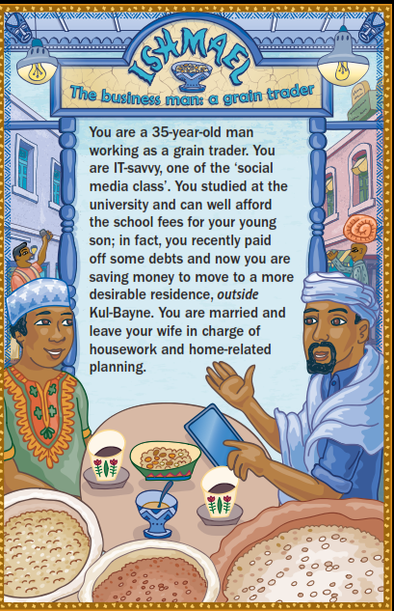
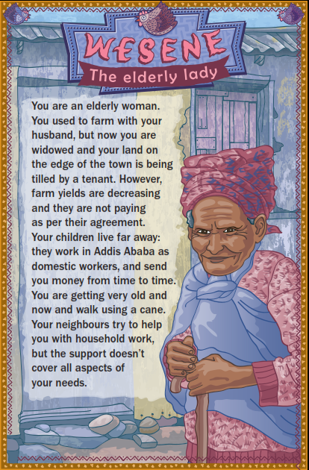
Group exercise: Take a character card
Read about how your character is affected by climate hazards (e.g. drought)
If you feel disadvantaged in facing the droughts step back
If you feel strong in facing the droughts, step forward
Why did you step forward or back?
Notes:
Facilitator:
This is a group exercise to get the participants moving and talking.
Distribute the character cards from the ‘Climate and Society Game’ on www.cdkn.org, but excluding the ‘Environmental Management officer’ and/or ‘Disaster management officer’ cards – use the other ones. There are a total of 20 cards (minus the ‘officer’ cards). They are in three sets: Ethiopia set (8 characters); Ecuador set (6 characters); India set (6 characters). If the workshop is taking place in one of these countries – only distribute cards for that country. If it’s an international workshop with a mix of nationalities/national backgrounds, use them all.
Each participant should read about the character they are assigned and imagine themselves in that character’s shoes.
The participants should make a line down the middle of the room.
They don’t know what the other people’s cards say, they should focus on their own.
Tell the participants that all of them live in a low-income urban neighbourhood and are exposed to climate hazards every year, such as flooding and drought, but some people are better off, and some are relatively worse off. Think about the vulnerabilities and the strengths and skills that their character has, to face the droughts.
Now, each participant should imagine that the middle of the room represents the average status and wellbeing of residents of the fictional low-income neighbourhood.
Call on participants to step towards the front of the room if they have lots of strengths and skills to respond to droughts.
Call on participants to step towards the back of the room if they have fewer strengths and skills to respond to the droughts or they are more discriminated against and they find it more difficult to seek help from others.
Don’t over-analyse it! This is just a warm-up.
Participants move around, stepping forward or backwards.
Now ask for participants to turn to the person next to them. What are their strengths and vulnerabilities in the face of the drought? Why did they step forward or back? Compare notes

Slide 11
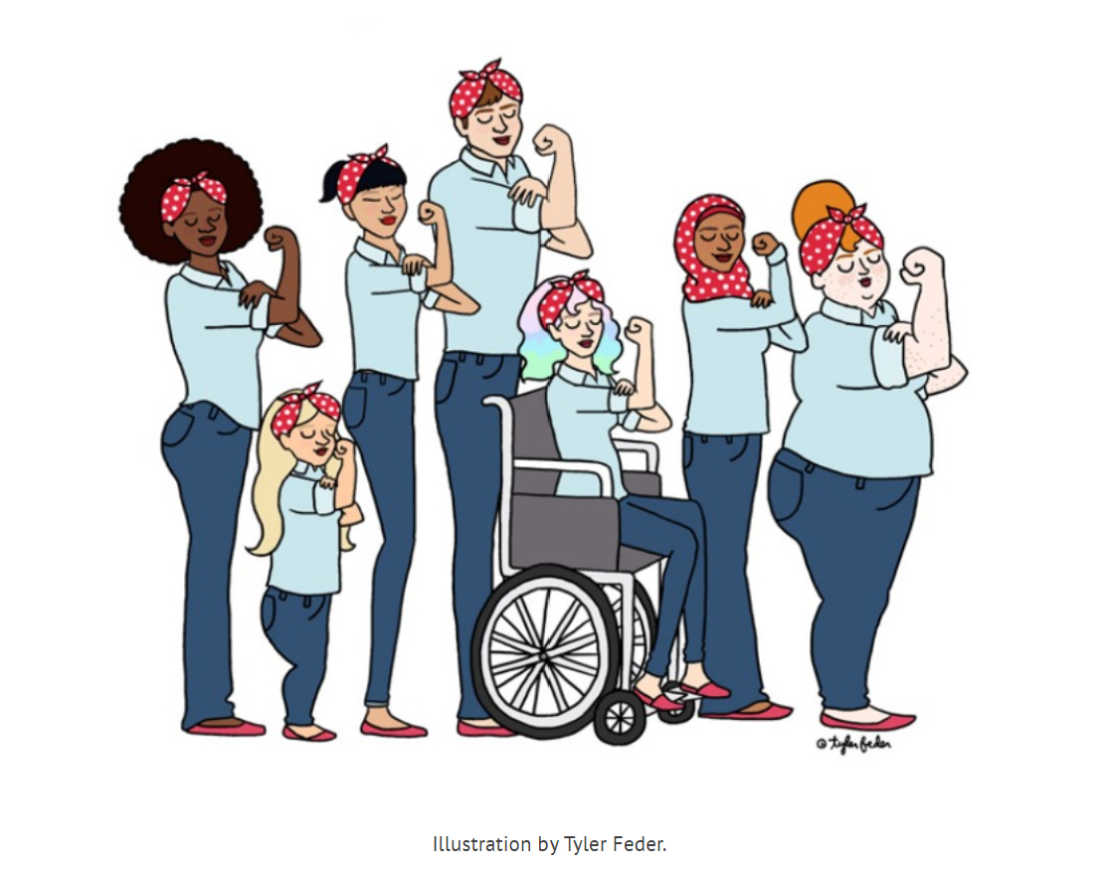
Beyond the numbers: we are all individuals
Our diversity makes each of us special and gives us strength –
as well as influencing how society sees us and treats us.
Notes:
We can acknowledge how everyone has many characteristics and how they are viewed by society (and the opportunities this provides, or discrimination they experience) can be based on the interplay between gender and other forms of discrimination, like race, age, class, socioeconomic status, physical or mental ability, gender, religion, or ethnicity.
The barriers faced by a middle class woman living in Melbourne or New York are not the same as those of a poor woman living in rural Fiji or Uganda. Women aren’t just exposed to sexism. “Racism, ableism, ageism, and religious persecution are intrinsically linked to how they experience inequality.” – International Women’s Development Agency (IWDA), Australia, https://iwda.org.au/3-ways-to-be-an-intersectional-feminist-ally/

Slide 12
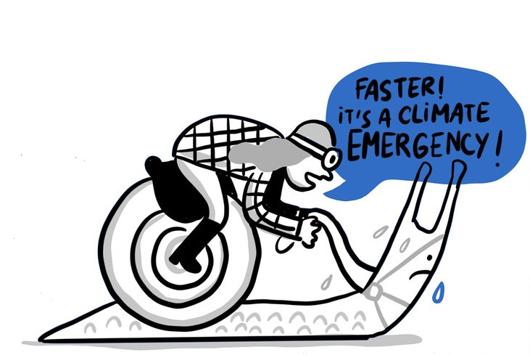
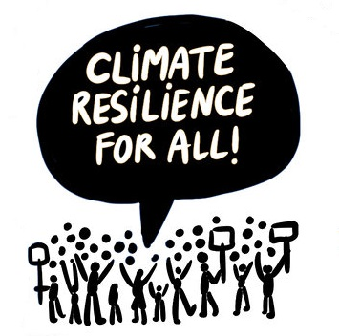
What does it mean for climate action?
Illustrations: © Jorge Martin 2019

Slide 13
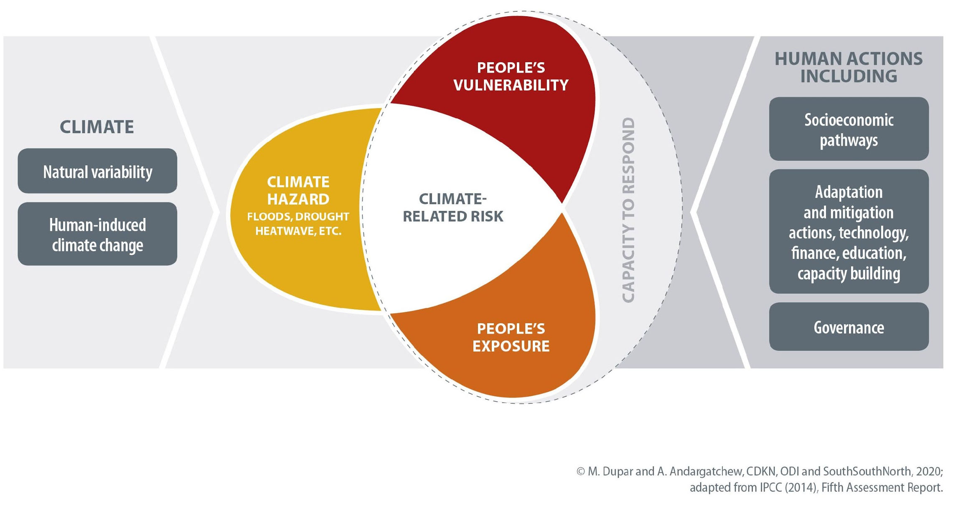
The climate risk formula (IPCC, 2014): hazard – exposure - vulnerability
People’s individual characteristics make them more or less climate-vulnerable and may have a bearing on how exposed to the climate hazard they are

Slide 14
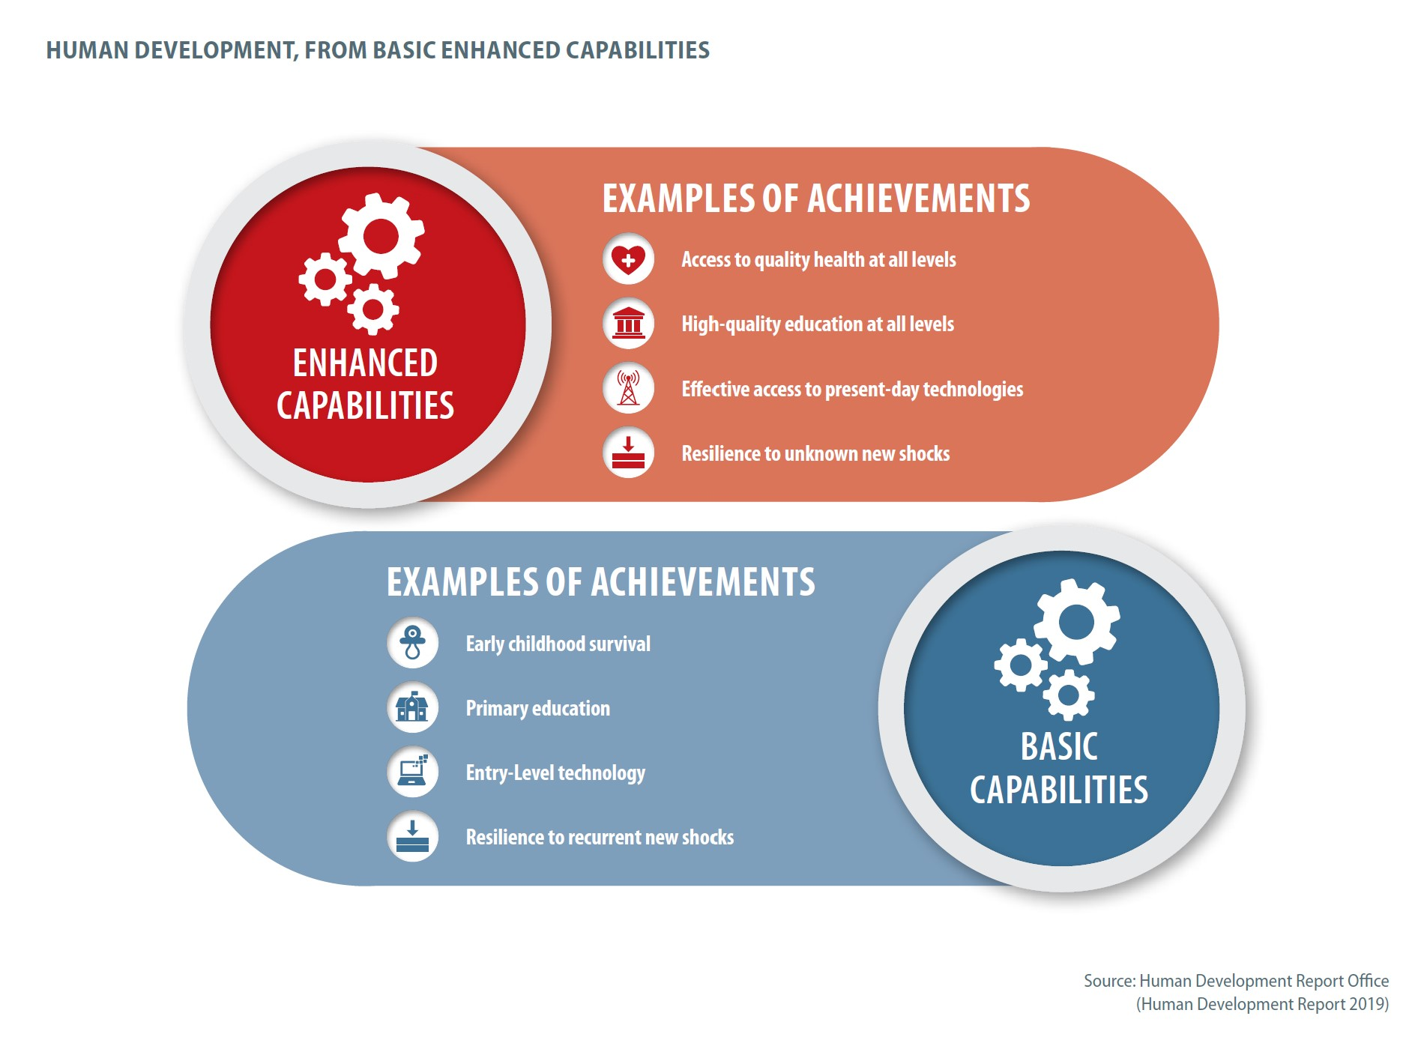
What gives us the ability to adapt and be resilient?
Notes:
The following is a quote from the 2019 Human Development Report which explains the thinking behind the diagram:
“Today, having a set of basic capabilities—those associated with the absence of extreme deprivations—is not enough. Enhanced capabilities are becoming crucial for people to own the “narrative of their lives.” Enhanced capabilities bring greater agency along people’s lives. Given that some capabilities build over a person’s life, achieving a basic set—such as surviving to age 5 or learning to read—provides initial stepping stones to forming enhanced capabilities later in life (figure 5). A similar evolution from basic to enhanced capabilities is reflected in the use of technology or in the ability to cope with environmental shocks, from frequent but low-impact hazards to large and unpredictable events. The distinction is also important when it comes to understanding inequalities across groups, such as the progression from women being able to vote in elections (a basic capability) to participating in politics as national leaders (an enhanced capability). The evolution in ambition from basic to enhanced capabilities mirrors the evolution from the Millennium Development Goals to the Sustainable Development Goals.”
Unequal capabilities – continued (Human Development Report, December 2019: http://report.hdr.undp.org/
There has been some progress worldwide in people’s ability to overcome extreme deprivations (basic capabilities), such as access to basic education, basic health services and basic technology (the left side of the illustration below). Many people at the bottom are now reaching the initial stepping stones of human development. Yet, looking at the right we see that disparities are high or increasing in the areas expected to become more important in the future (enhanced capabilities), including receiving quality education at all levels, access to high-speed Internet or more advanced health services. Under the shadow of the climate crisis and sweeping technological change, people well positioned today appear set to get even farther ahead tomorrow.
If this is what adaptive capacity and the ability to shoulder future shocks looks like – how do you think women and men from different parts of society look like? [advance to the next slide to explore further]

Slide 15
Women and girls often have less access to the things that make people more resilient
We talked about the gender development gap before – globally and in countries;
The gender development gap is measured by the difference in women’s and men’s health outcomes, education outcomes and prospects, and also looks at: economic resources under their command (another element of resilience).
Insights from research on how the gender development gap affects climate vulnerability and action on climate adaptation:
Latin America – women have less formal waged employment, less access to social safety nets/social insurance such as healthcare, pensions (Vazquez et al, 2018)
Africa and Asia – extensive evidence from the CARIAA programme that climate change and more frequent extreme weather events affect women more than men (Rao et al, 2019)
Climate change is a multiplier of existing vulnerabilities in a warming and transforming world
Threatens to reverse hard-earned development gains
Importance of governance, institutions and social accountability for equitable climate action and response measures
Notes:
The previous slide talked about health, education, access to technology as factors that move people beyond basic capabilities to enhanced capabilities and can enable them to cope better with climate related shocks and stresses.
Moving from a position of little resilience to even single shocks toward a position where individuals and households are resilient to multiple shocks is important.
Insights from research describe some of the ways in which the gender development gap undermines women’s and girls abilities to be resilient to multiple shocks – including also the economic resources under their command.
Vazquez et al (2018) documented this for CDKN – this is in Spanish language only
https://www.crclatam.net/documentos/publicaciones/37-revista-medio-ambiente-y-urbanización-fortaleciendo-la-resiliencia-al-clima-en-ciudades-de-américa-latina.html See : Articulo 8. La Perspectiva de Género1 ¿Una consideración necesaria para comprender y transformar estructuras de desigualdad en el contexto del cambio climático?
But summarized in English also in the blog :
https://cdkn.org/2018/10/feature-empowerment-of-women-and-girls-could-transform-latin-americas-climate-resilience/?loclang=en_gb
Women’s unequal access to resources, their almost sole responsibility for care of dependents, and the insecurity and precariousness of their paid labour all contribute to the feminisation of poverty in the Latin America – according to Alexandra Vasquez and co-authors in ‘The gender perspective: A necessary consideration to understand and transform structures of inequality in the context of climate change?’ Their original article has recently been published in Spanish (La Perspectiva de Genero: Una consideracion necesaria para comprender y transformar estructuras de desigualdad en el contexto del cambio climatico?) in a special edition of the journal Medio Ambiente y Urbanizacion.
Vasquez el al. draw their sobering conclusions from the Climate Resilient Cities in Latin America programme, an initiative of CDKN, Fundacion Futuro Latinoamericano and the International Development Research Centre – Canada. Since 2016, the programme has been working to support strategies for more climate-resilient and sustainable growth in intermediate-sized cities of the region. Four of its six research projects have focused explicitly on gender, investigating the questions: what special challenges do women and girls face in building their own climate resilience and contributing their talents to climate resilient development in their communities, as a whole? What opportunities exist to free up women’s and girls’ potential?
The four research projects that explored the gender dimensions of climate resilient development were: Climate resilient Coyuca (Coyuca resiliente al clima, Guerrero state, Mexico), Self-sustaining Amazonian Cities Project (Proyecto Cuidades Auto-Sostenibles Amazonicas – CASA, Iquitos, Peru), Livelihoods and Resilience (Medios de Vida y Resiliencia, Amazon delta region), and Climate resilient Cumbaza (Cumbaza resiliente al clima, Cumbaza basin, Peru).
Capturing lessons from across these projects, Vasquez et al find that a mixture of: gender roles; the use, access and control of resources; and women’s practical needs and strategic interests all shape women’s and girls’ climate-related vulnerability and provide the basis for actions to improve their resilience and wellbeing.
Headlines from Rao et al (2019) A qualitative comparative analysis of women’s agency and adaptive capacity in climate change hotspots in Asia and Africa
Include (abstract)
There is growing concern about sustainable and equitable adaptation in climate change hotspots, commonly understood as locations that concentrate high climatic variability, societal vulnerability and negative impacts on livelihood systems. Emphasizing gender within these debates highlights how demographic, socioeconomic and agro-ecological contexts mediate the experiences and outcomes of climate change. Drawing on data from 25 qualitative case studies across three hotspots in Africa and Asia, analysed using qualitative comparative analysis, we show how and in what ways women’s agency, or the ability to make meaningful choices and strategic decisions, contributes to adaptation responses. We find that environmental stress is a key depressor of women’s agency even when household structures and social norms are supportive or legal entitlements are available. These findings have implications for the effective implementation of multilateral agreements such as the United Nations Framework Convention on Climate Change, the Sendai Framework on Disaster Risk Reduction and the Sustainable Development Goals.
Where examples of environmental degradation that depress women’s agency are (excerpts):
“Sustainable, equitable and effective adaptation is critical in climate change hotspots, locations where climatic shifts, social structures and livelihood sensitivity converge to exacerbate vulnerability^{1,2}. Entrenched social structures create power relations that shape women’s and men’s experiences of vulnerability through access to resources, divisions of work, and cultural norms around mobility and decision-making, all of which determine adaptive capacity3,4,5,6,7,8,9,10,11,12,13,14,15. Involving trade-offs at every level^{6,16,17,18,19}, these contextual factors not only shape vulnerabilities but also create possibilities for adaptation^{20,21}.”
“When examining gendered vulnerability and the way in which it is manifest in unequal patriarchal systems, women’s agency has emerged as key to realizing adaptive capacity, but remains understudied⁵. Drawing on feminist arguments to move beyond simplistic framings of actors in terms of active or passive, victims or perpetrators^{22,23,24}, we conceptualize agency as the ability to make meaningful choices and strategic decisions²⁵. It can take multiple forms, from bargaining and negotiation to subversion and resistance²¹, varying across institutional sites and scales, and drawing differentially on available material or social resources²⁵. Institutions, ranging from the micro (household) and meso (community) level to the more macro levels of markets and states²⁶, interact and intersect with each other, often intensifying or reproducing inequalities. The rules and norms they establish can be formal or informal, complementary or competing²⁷, giving specific meaning to particular activities, resources and relationships. In the context of climate action, while some research explores the role of social capital, especially women’s groups, in supporting women’s agency^{28,29}, a nuanced institutional analysis, linking women’s agency and its implications for adaptive capacity, remains missing^{5,30}. Driven by multiple factors across these institutions, acting in combination with each other²², outcomes in terms of women’s agency are not uniform across contexts.
“Environmental degradation is common in all the climate hotspots with increasing rainfall variability and temperature extremes, land degradation and changing land use, soil salinization, waterlogging and water scarcity^{43,44,45}. Given that most rural livelihoods are natural resource-dependent, climate variability and environmental degradation manifest adversely on livelihoods, with second- and third-order impacts on women’s agency. For example, in case A1 (Kolar district, Karnataka, India), water scarcity is driving low agricultural returns and male outmigration.”
Read the full paper in Nature Climate Change (open access – for free) https://www.nature.com/articles/s41558-019-0638-y
The research shows – overall – that:
Climate change is a multiplier of existing vulnerabilities
Threatens to reverse hard-earned development gains
Importance of governance, institutions and social accountability for equitable climate action and response measures

Slide 16
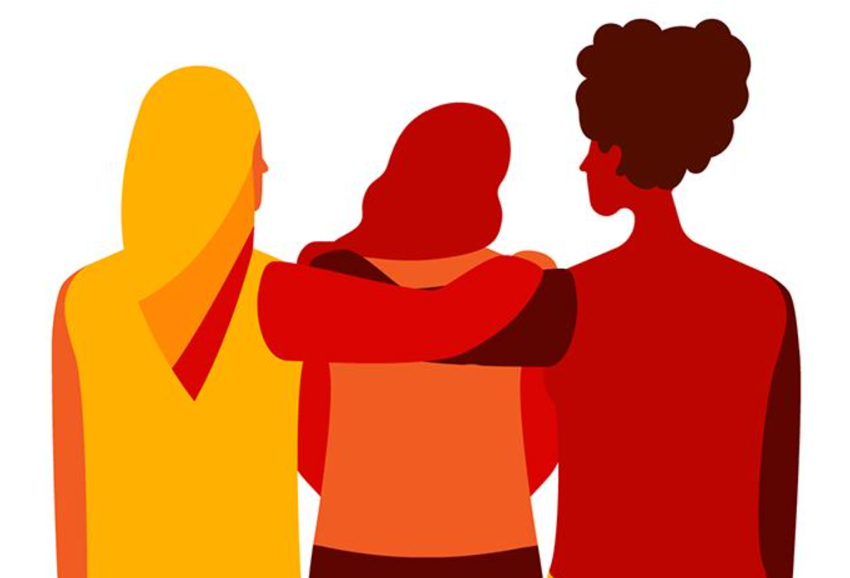
Women and girls often have less access to the things that make people more resilient
A gender gap is especially evident when it comes to the impact of natural hazards (e.g. climate shocks) on different people
Women are more deeply affected by climate shocks
It’s harder – on average – for them to bounce back
Disasters tend to exacerbate social inequalities and existing power divisions
Notes:
Disasters tend to exacerbate social inequalities and existing power dynamics
They constrain people’s ability to escape poverty, and leave those who are poor and the most marginalised at greater risk of being ‘left behind’, and more vulnerable to ongoing and future climate and disaster risks (Diwakar et al., 2018 forthcoming; Lovell and Le Masson, 2014). As more people live and work in areas at risk of natural hazards (including those influenced by climate change), increasing exposure to climate and disaster risk, policies and programmes that aim to build resilience need also to tackle underlying vulnerabilities and intersecting inequalities.
natural hazard-related disasters can reverse years of development gains (ibid ODI, 2018)
Disasters tend to exacerbate social inequalities and existing power dynamics: ODI (2018) Leave Noone Behind Index. London: ODI https://www.odi.org/sites/odi.org.uk/files/resource-documents/12304.pdf (accessed 8 April 2020)
Women face mobility constraints
e.g. social norms expressed through dress codes; gendered skills; responsibility for children, elderly & the sick
Differential vulnerability of men and women to disasters is context-dependent – where women are more empowered they are generally less vulnerable to disaster impacts….
Potential for long-term impacts – e.g. girls’ participation in education may not recover, may be vulnerable to abuse in aftermath…
‘micro-disasters’ – e.g. urban flooding may also have unequal impacts….
A study by Oxfam International of the 2004 tsunami in Asia where 70% more women than men died because they did not know how to swim or climb trees. In addition, women took longer to regain economic independence after the disaster as they took on the resultant rise in unpaid labour. The loss of homes also often translates into the loss of equipment for economic activities such as those for artisans, cooks and seamstresses.
On the other hand, an increase in violence against women after a disaster is a widely documented issue which arises out of unstable living conditions, seeking security from masculine figures, sexual assaults in temporary camps, increased sexual exploitation and maltreatment of women, children and adolescents.
More recent analysis published in Presentación del dossier. Comunidad, vulnerabilidad y reproducción en condiciones de desastre. Abordajes desde América Latina y el Caribe
By : Ana Gabriela Fernández, Johannes Waldmüller, Cristina Vega
DOI: https://doi.org/10.17141/iconos.66.2020.4156
Is summarised in a recent article by SciDev.net (see https://revistas.flacsoandes.edu.ec/iconos/article/view/4156 and in English summary, https://cdkn.org/2020/03/opinion-environmental-disasters-widen-the-gender-gap/)
“Women and children are more likely to die than men during climate disasters according to the UN-Habitat. Also survivors encounter countless social, economic and health assistance inequalities,” says Adriana Noacco, director of the Centre for Education and Environmental Management (CEGA in Spanish) from the University of Buenos Aires.
The research highlights the importance of women’s participation in disaster response teams, as in most cases, they are excluded from the decision-making. It makes reference to experiences such as those of the earthquake in Haiti, Hurricane Katrina in the United States, Hurricane Mitch in Honduras and the 2010 tsunami in Dichato, Chile, where the female leadership was at the forefront of community care and food networks, proving their organisational capacity and specific approach to dealing with situations related to land rights, health, grief and coping with trauma and also their participation in reconstruction processes.
Fernández, Vega and Waldmüller say that improved approaches to gender equality in one place will improve the capacity to deal with natural disasters. An event itself should become a turning point for creating better conditions in terms of equality.
They say that “it is therefore necessary to revise institutional practices, the social value assigned to community and reproductive activities, and the opportunities created for developing skills for both men and women.”
In summary
• Unequal opportunities render women more vulnerable to climate disasters.
• Credit should be accessible to women for continuation of their businesses after natural disasters – among other measures targeted at women.
• This will prevent the relegation of women to socially-imposed roles such as cooking and cleaning and enable them to be more active in the public domain.

Slide 17
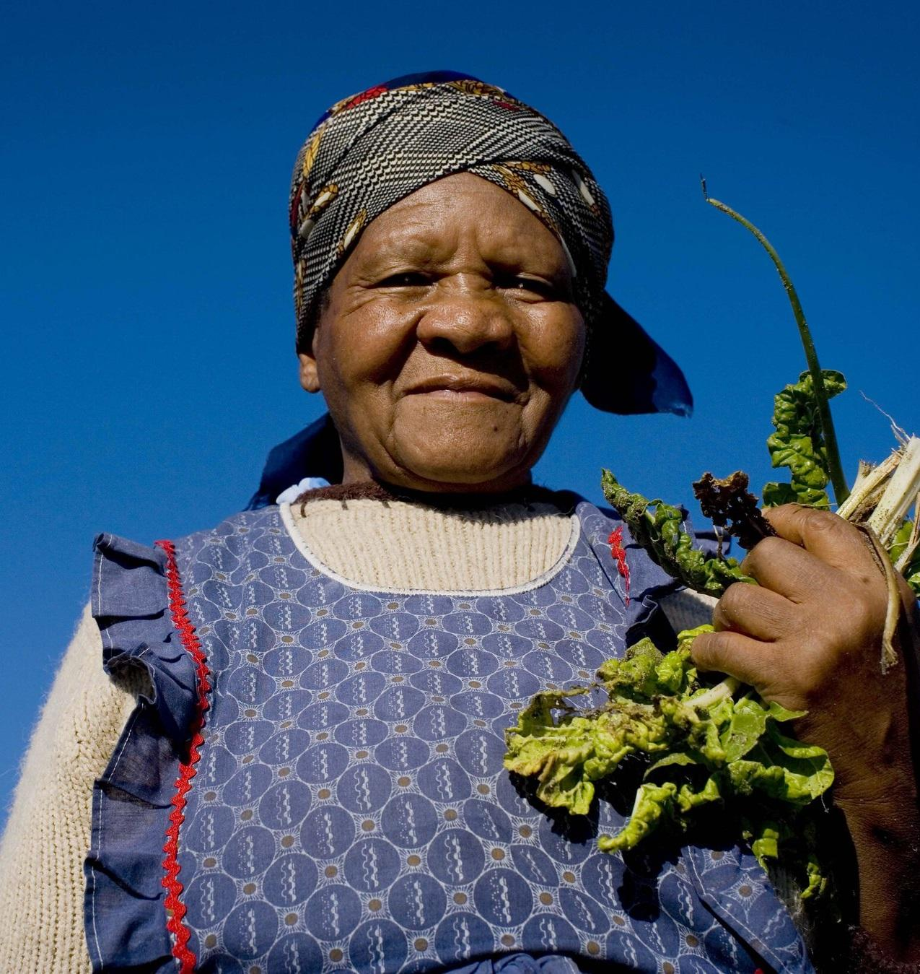
Case studies: How gender-responsive approaches are making climate-smart agriculture succeed
We know agriculture is being affected by climate change
We know women make up a substantial portion – often half the workforce or even more in some communities
In rural communities of Africa, Asia and Latin America, household responsibilities vary – women often responsible for gathering fuel, fetching water
Resource degradation is a challenge for time use – exacerbating time poverty and physical exhaustion (and taking girls away from education)
Women also often critical to management of common property resources
Notes:
We know agriculture is being affected by climate change
We know women make up a substantial portion – often half the workforce or even more in some communities
Household responsibilities vary – women often responsible for gathering fuel, fetching water
Resource degradation is a challenge for time use – exacerbating time poverty/physical exhaustion
Women also often critical to management of common property resources
The following slides will discuss the importance of women in agriculture and land based sectors (facilitator: please select the slides that are relevant to your audience, from the following) and critically, will provide some case studies of how gender-responsive approaches have made a difference to the development – including food security - and climate outcomes for women and the rest of communities.

Slide 18
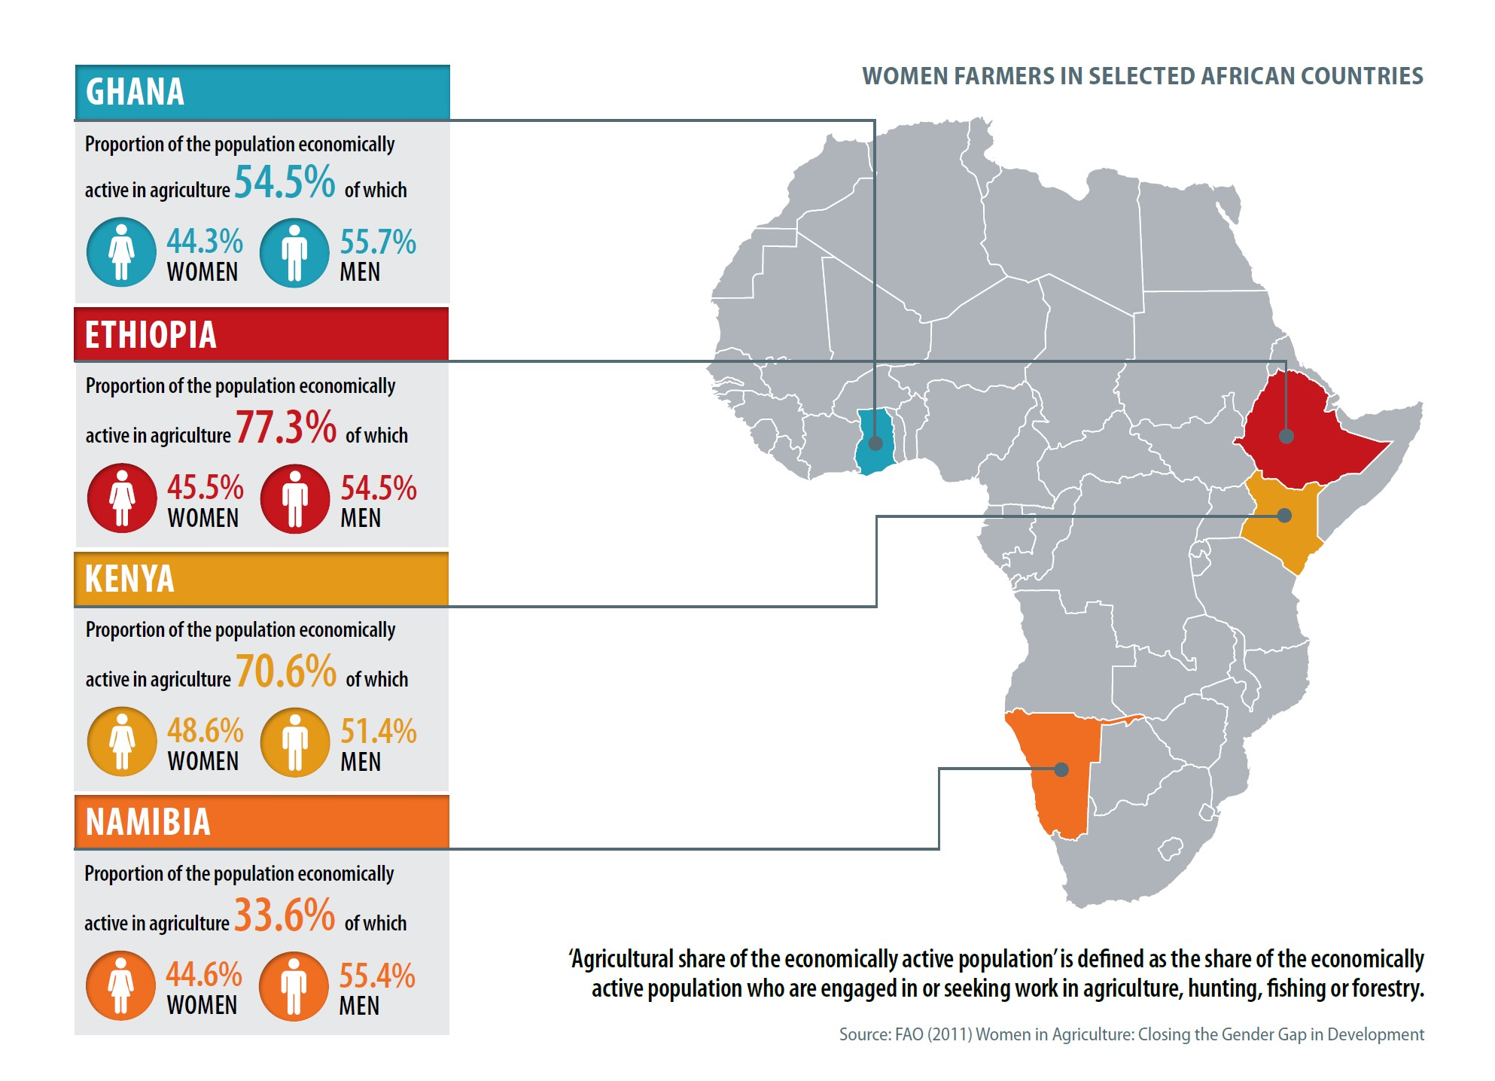

Slide 19
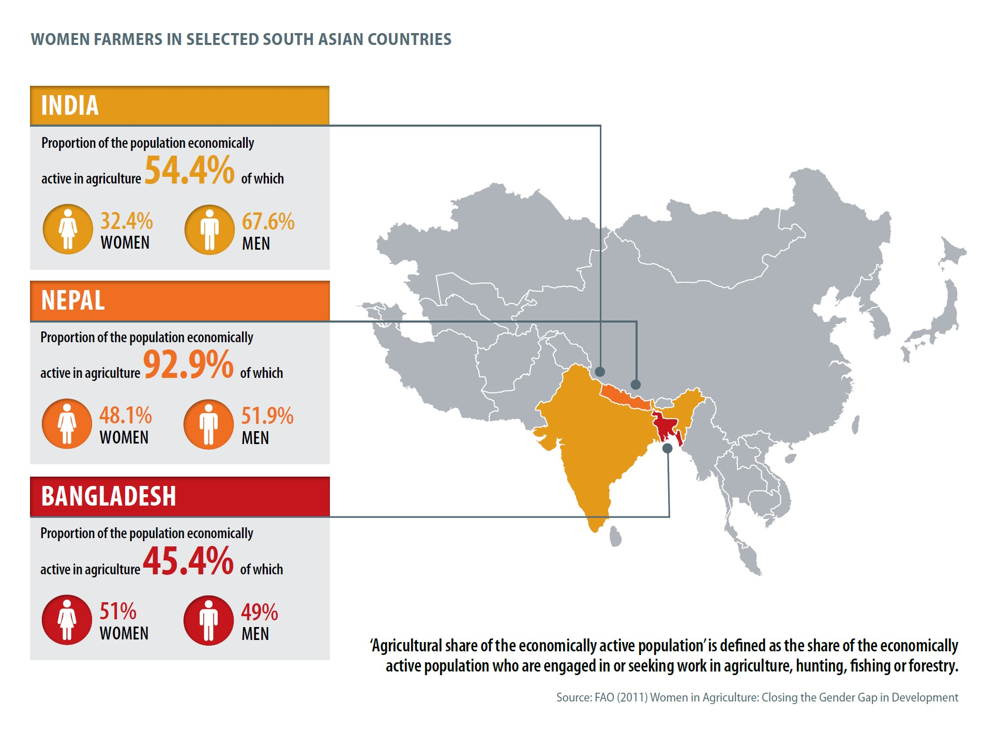

Slide 20
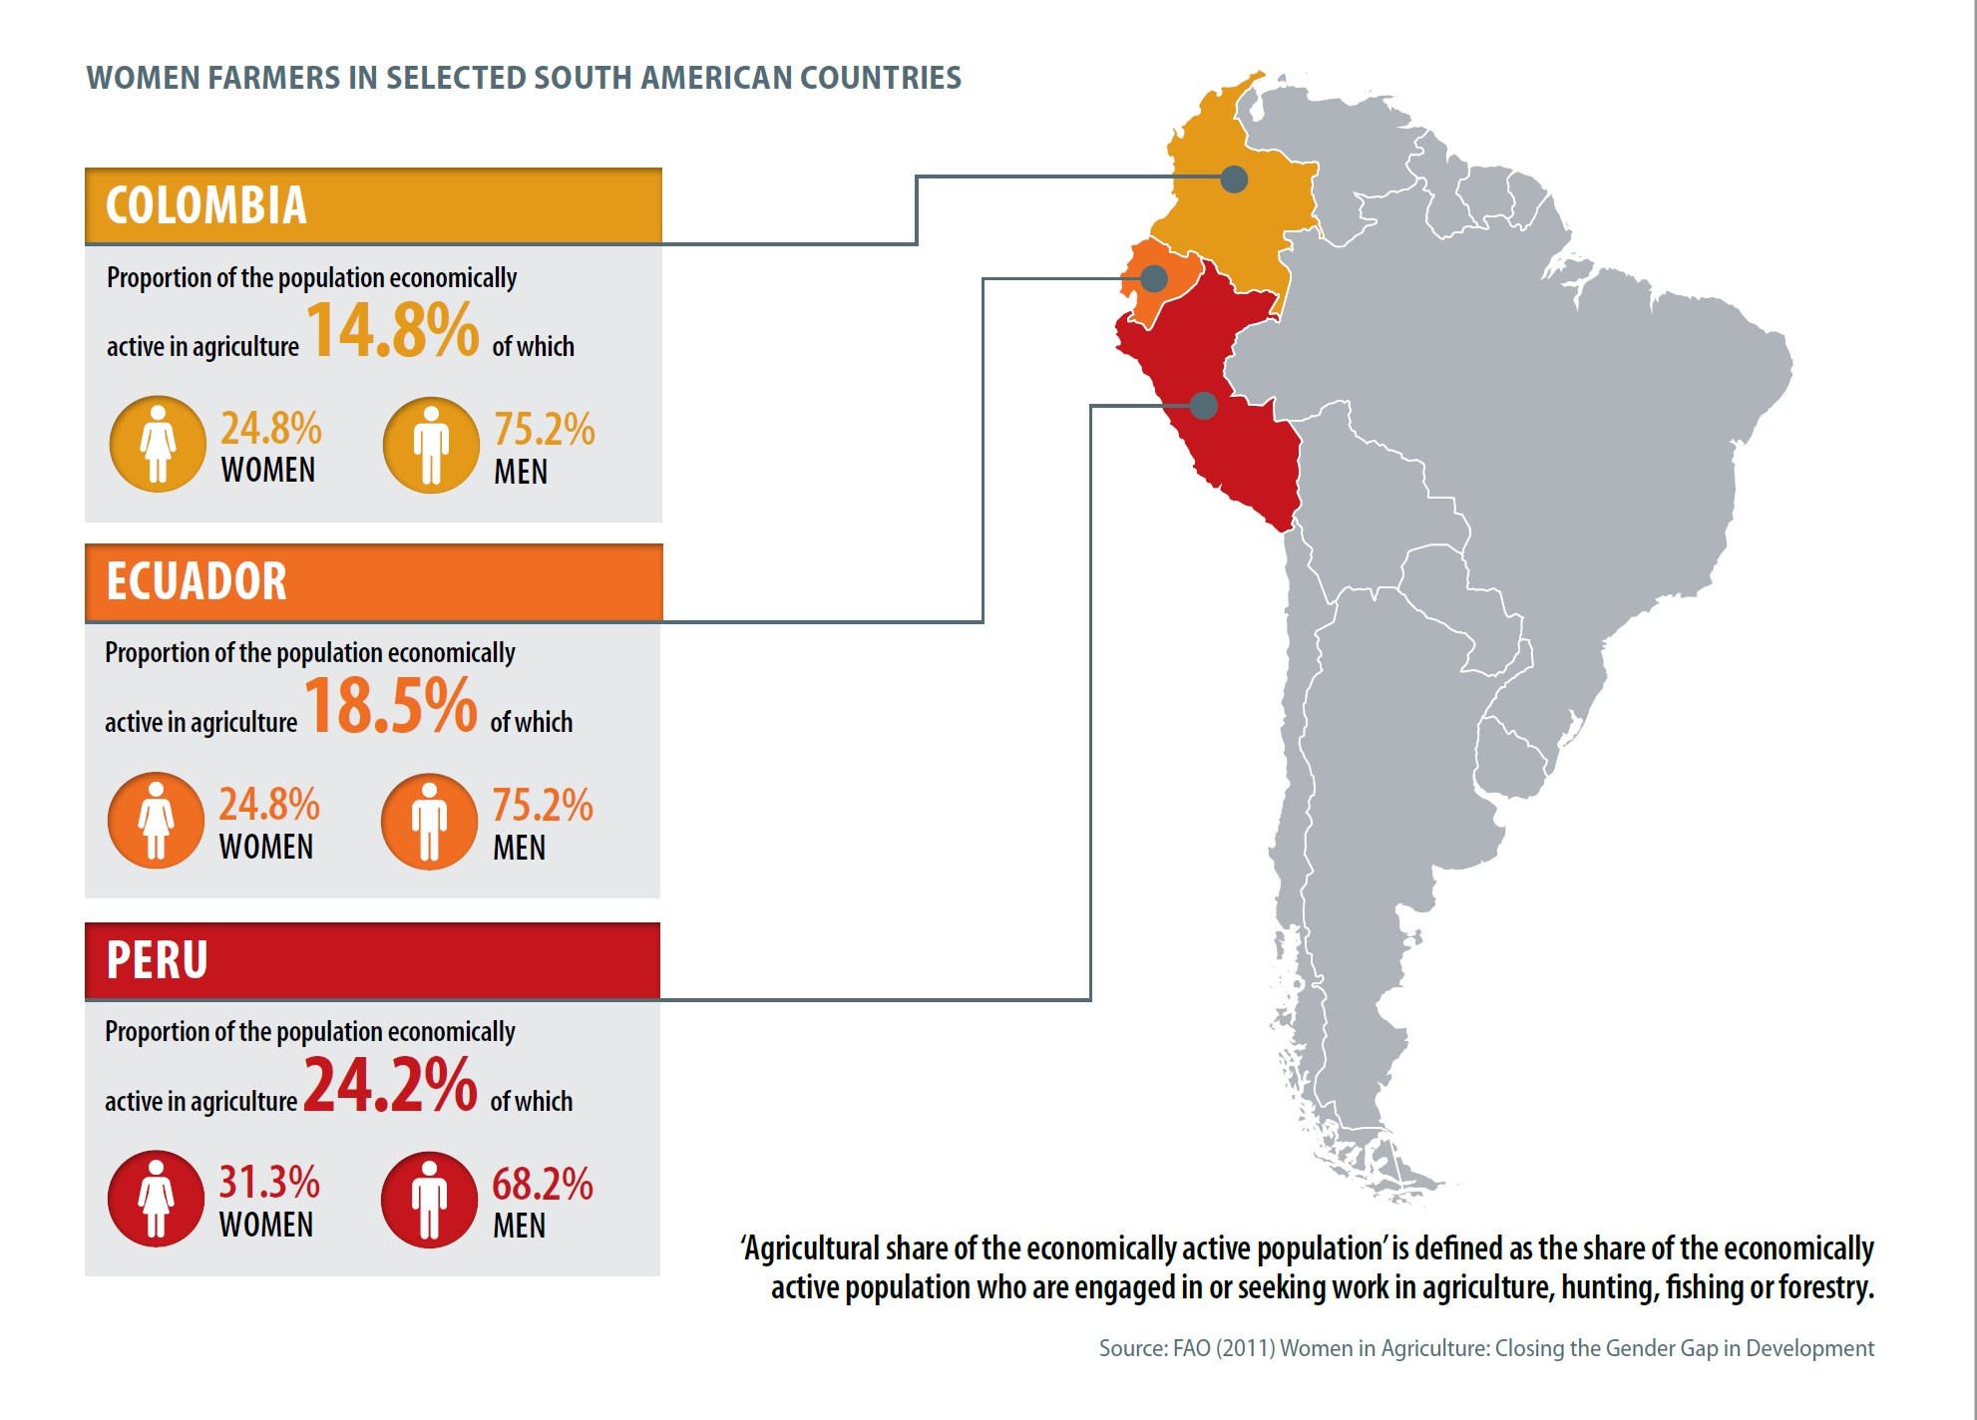

Slide 21
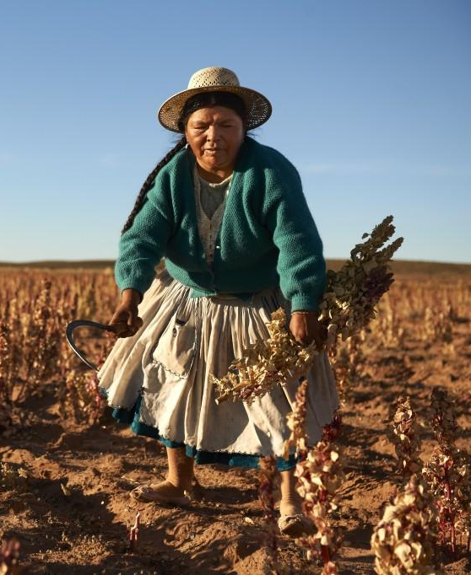
The current picture: Women are missing out on key opportunities (1)
IPCC finds that drivers of land degradation, desertification and their negative impacts on people in a changing climate include:
Land tenure insecurity
Lack of property rights
Lack of access to markets and to agricultural advisory services
Lack of technical knowledge and skills
Poor climate information services
(Agriculture price distortions)
(Lack of agricultural subsidies)
Several of these have a gender dimension – which ones? Why?
Notes:
IPCC finds that drivers of land degradation, desertification* and their negative impacts on people in a changing climate include:
Land tenure insecurity
Lack of property rights
Lack of access to markets and to agricultural advisory services
Lack of technical knowledge and skills
Poor climate services
(Agriculture price distortions)
(Lack of agricultural subsidies)
Several of these have gender dimensions – women face discrimination.
Discussion: in which areas do women face discrimination (of the above drivers of land degradation) and why?
Women’s lack of access to land resources, to knowledge/advisory services, to credit can all be addressed through female empowerment
*desertification = land degradation in drylands

Slide 22
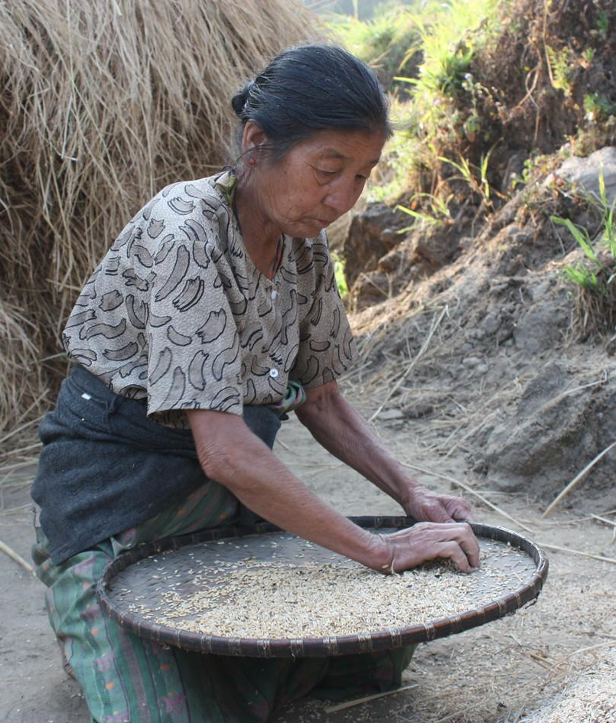
The current picture: Women are missing out on key opportunities (2)
“Skills and knowledge of women and marginalised groups are not yet sufficiently recognised” - IPCC
Avoid calling people ‘victims’ and falling into victim mentality
This mistake means that decision-makers don’t acknowledge and society doesn’t benefit sufficiently from knowledge, wisdom of: marginalised groups, including indigenous peoples, women, including widows and elderly women
Next, let’s explore how inclusive climate-compatible development in rural areas makes for more effective development for everyone….
Image: IIED
Notes:
Many societies are missing on significant knowledge and talent by not including women in decision-making more from the individual farm plot to the community to the landscape level –
IPCC findings
“Skills and knowledge of women and marginalised groups are not yet sufficiently recognised” - IPCC
Avoid calling people ‘victims’ and falling into victim mentality
This mistake means that decision-makers don’t acknowledge and society doesn’t benefit sufficiently from knowledge, wisdom of:
marginalised groups, including indigenous peoples, women, including widows and elderly women
Let’s explore how inclusive climate-compatible development is more effective development for everyone….
Next up: case studies showing how climate compatible development works better when women are empowered as part of the process

Slide 23
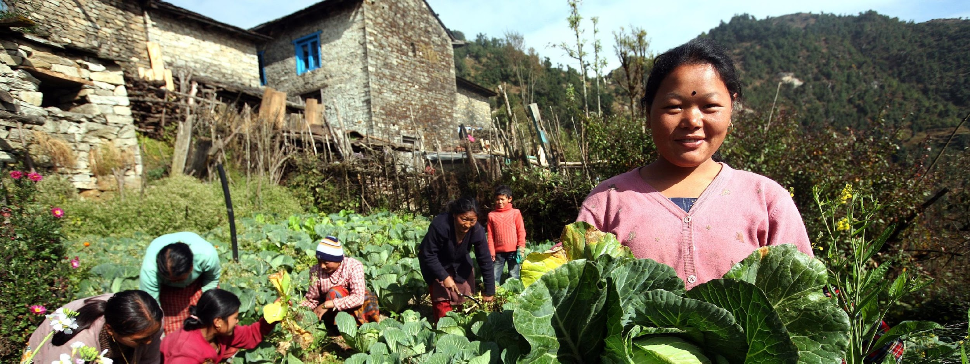
Case study: Climate-smart agriculture, Nepal
Case study of predominantly female farm workers
Farming community is predominantly female due to male migration overseas
Climate change causes rising temperature, drought, intense rainfall
66% of Nepali population involved in agriculture are deeply affected
Woman-focused, climate compatible agriculture is essential!
Notes:
This case study of a rural population when most of the working age men have migrated out to find work and the women are left behind, so most farmers are women, shows how a gender sensitive approach to climate smart agriculture has proven successful.
There’s an urgent need for climate-smart agriculture (CSA) in Nepal. The negative effects of climate change - mainly drought, intense rainfall and rising temperatures - have affected the livelihoods of 60% of the population, who are engaged in agriculture.
Women are facing structural power inequalities as well as poor access to resources and information that could help to bolster their resilience against climate-induced shocks and stresses. A male exodus for foreign employment has aggravated the situation. This is why a gender-responsive approach to climate-compatible development is vital.

Slide 24
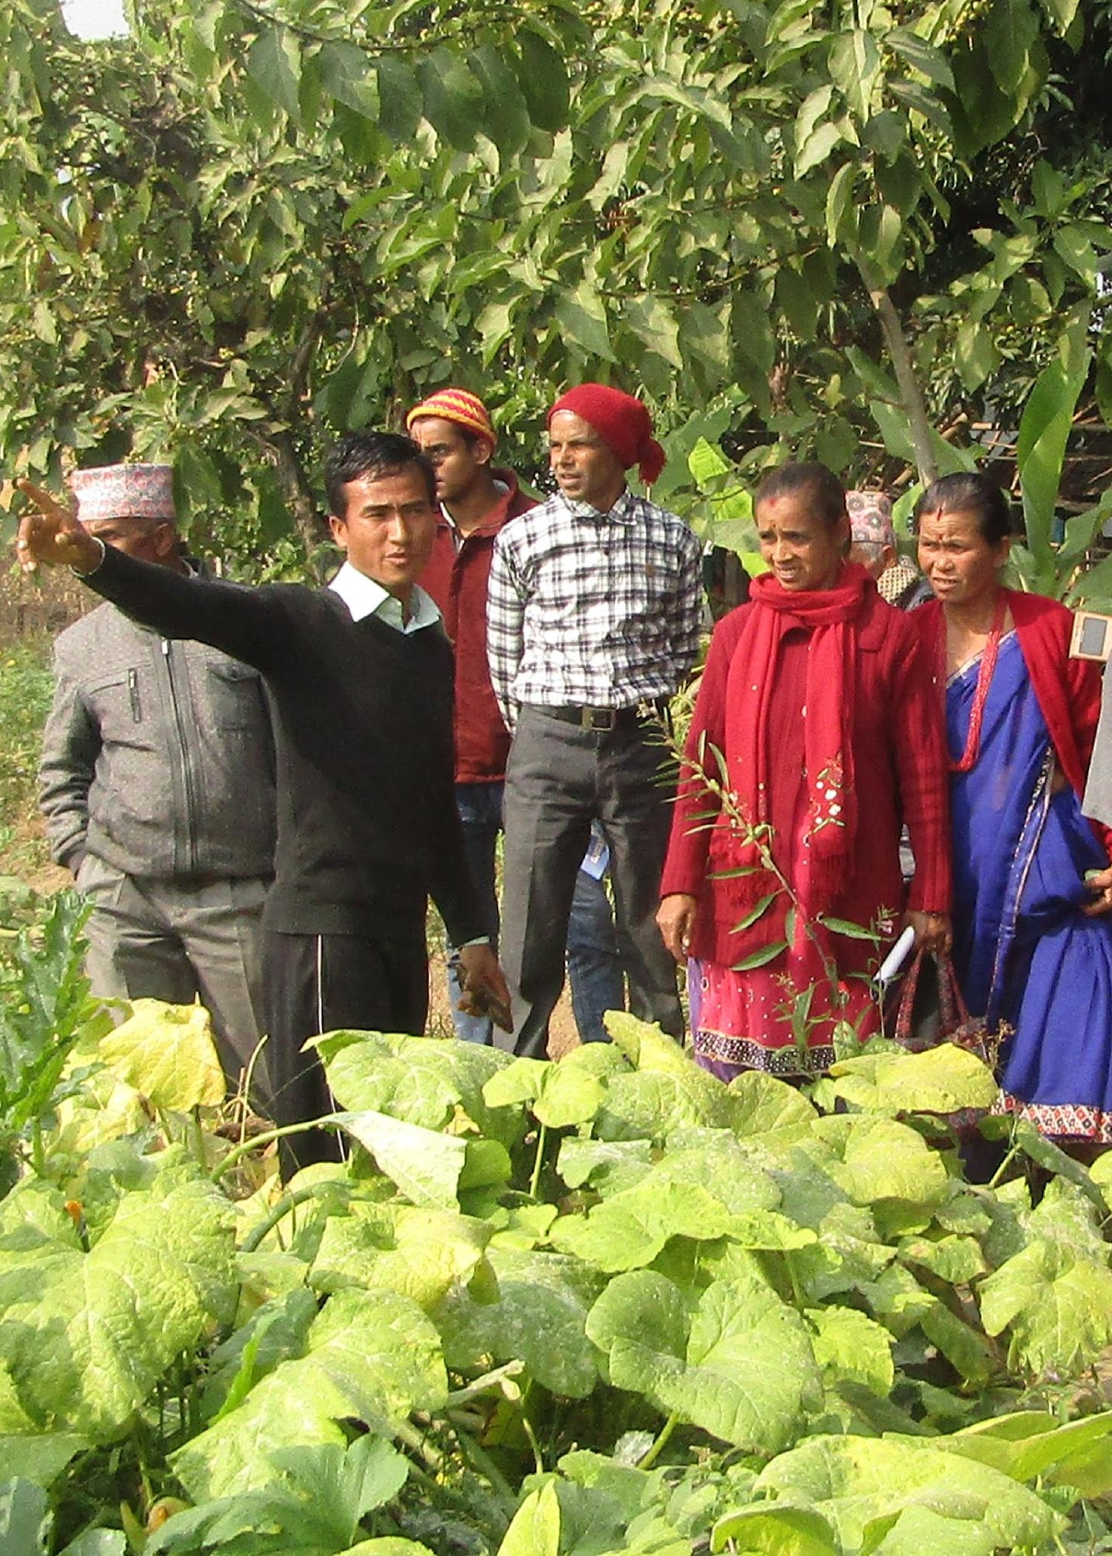
Case study: Climate-smart agriculture, Nepal
Gender-responsive approach is more effective
Challenges
Low capacity of government staff to implement and scale up climate smart agriculture (CSA); limited awareness among political leaders
Successful strategies
Orientations, trainings and exposure visits organised for government staff. Travelling Seminars.
Engage women political leaders in the process.
Notes:
Strategies to overcome key implementation challenges
Low capacity of government staff to implement and scale up climate smart agriculture: Orientations, trainings and exposure visits organised for government staff. Worked jointly to develop guidelines and policies.
Limited awareness on climate change and CSA among political leaders: ‘Travelling Seminars; a field visit associated with round table meeting, have been organized to help local leaders (municipal, provincial and federal) understand CSA.
In more detail:
For example, LIBIRD is working with the national ministry and provincial government to improve uptake of the Chief Minister’s Environment Friendly Model Agriculture Village Programme (CMEFMAVP) in Gandaki province. This focuses on implementing climate-compatible agricultural development strategies and techniques.
Capacity building programmes on climate-smart agriculture– aimed at strengthening the technical knowledge of the CMEFMAVP staff – have raised awareness of locally adaptive agricultural practices among the staff and farmers. The overall methodology has focused on institutional integration, and provided local solutions based on different agro-climatic conditions, women-sensitive agricultural technologies, and techniques to improve communication and dissemination of climate-smart agricultural practices.

Slide 25
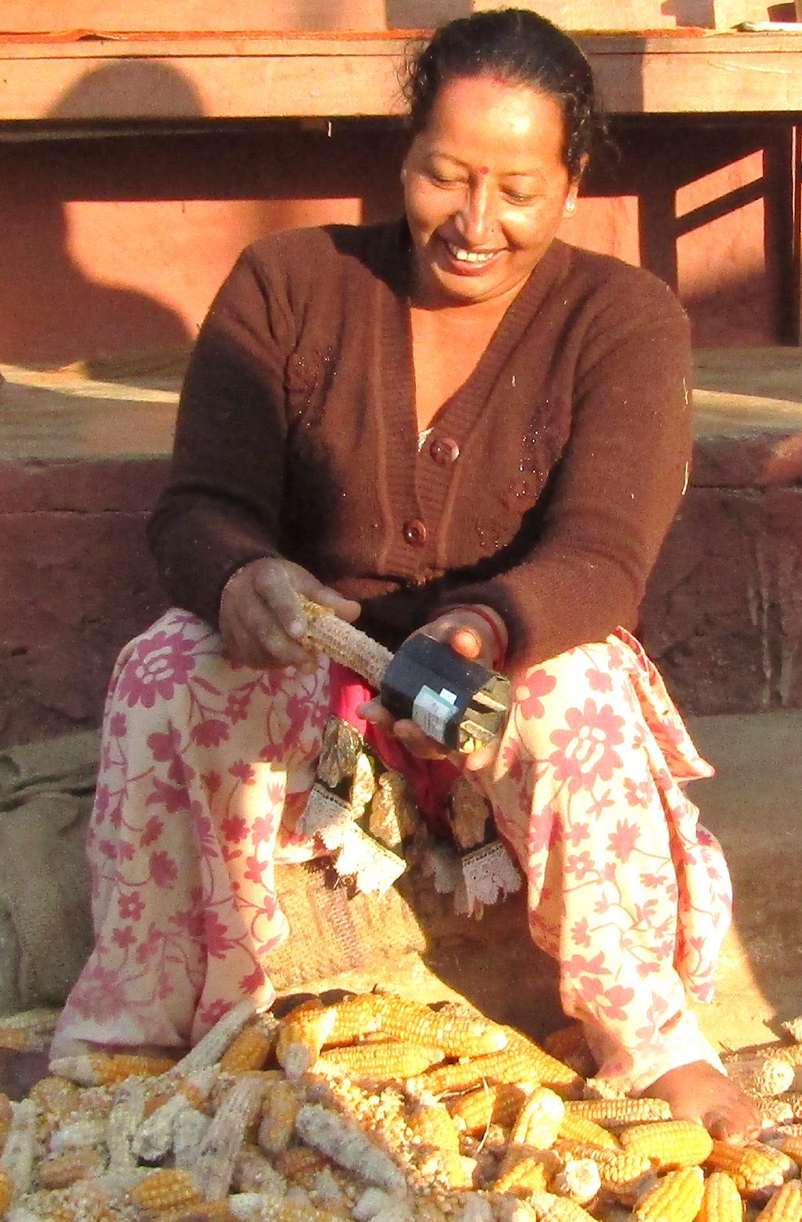
Case study: Climate-smart agriculture, Nepal
Gender-responsive approach is more effective
Challenges
Different locations (agro-climatic and socioeconomic settings) required a different set of CSA approaches and also a specific implementation strategy
Slow pace of CSA technology adoption
Successful strategies
Allow local farmers – women and men - to select technologies for themselves. E.g. women prioritise tools that reduce their drudgery (hand-held corn sheller, jab planter, millet thresher)
Notes:
Strategies to overcome key implementation challenges
Different locations (agro-climatic and socioeconomic settings) requires a variety of different climate smart agriculture (CSA) approaches and also implementation strategies specific to each location: The project jointly worked with the local governments to develop a site specific CSA plan integrated within an agricultural development strategy. Hence planning as well as capacity building of local government happened simultaneously.
Slow pace of CSA technology adoption was slowing implementation of the Chief Minister’s Environment Friendly Model Agriculture Village Programme.
As a result, LIBIRD adopted a more participatory approach of technology testing and evaluation that allowed local farmers including female farmers to select technologies for themselves. This way the selected technologies had higher rate of acceptability to other farmers who were from similar background (ie people from the same village, same gender). Women selected tools that help to reduce their workload (time and energy). These tools include the hand-held corn sheller, jab planter and millet thresher: these reduce the drudgery of women farmers and allow them to work more efficiently and quickly.
Based on LIBIRD’s experience of the most climate-smart practices and technologies in the agriculture sector and on the preferences shown by female farmers, they have promoted the climate-smart and women-friendly technologies more widely to improve CMEFMAVP implementation in the province. Naturally they also take into account the best practices in agriculture and the livestock sector to suit the agro-climatic/ agro-ecological conditions.

Slide 26
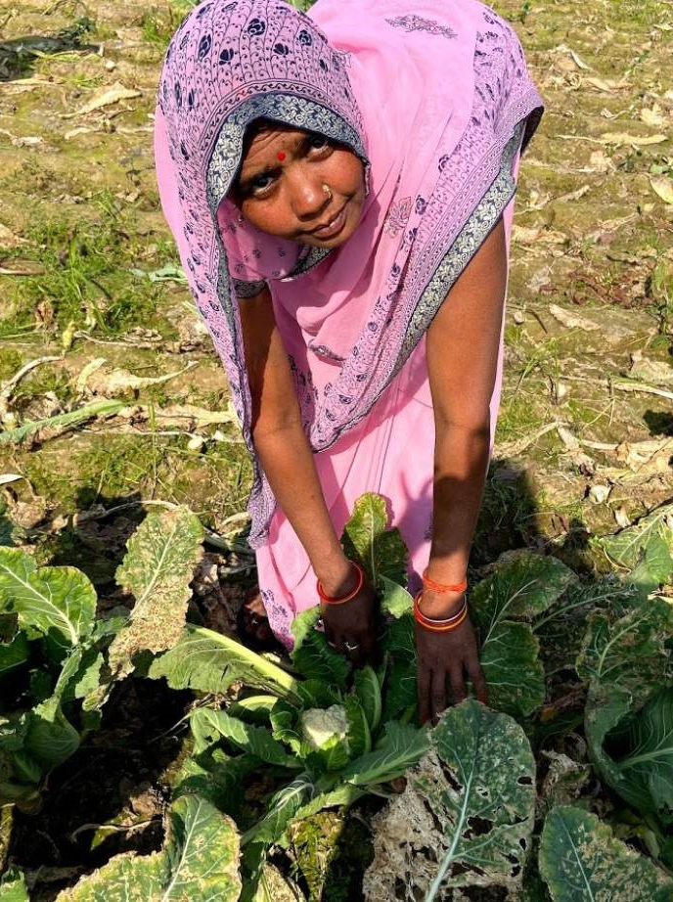
Case study: Climate-smart agriculture, Gorakhpur, India
Case study of more ‘balanced’ male-female demographic profile
In Campierganj, Uttar Pradesh farmers have experienced climate change: longer summers, harsher winters, unpredictable rain.
Area is now prone to damaging flash floods.
Older women, the ‘grandmothers’ had low social status in the past.
This region in India has among the highest child marriage rates and the poorest participation of women in the workforce in the country.
Image: Thomson Reuters Foundation, Campierganj
Notes:
In Campierganj in Uttar Pradesh, northern India there are floods almost every year and villagers plan their farming around them.
Uttar Pradesh is one of India’s poorest states and is farmers have experienced considerable changes in the climate in recent years -- from longer summers and harsher winters to much more unpredictable rain.
For instance, now the area is prone to flash floods, when more rain has fallen in fewer days. These sudden events cause more damage than previous rainfall patterns.
The grandmothers of Janakpur village in Uttar Pradesh had low social status in the past, from the time when they were young women. They married in their teens, bore children soon after and spent much of their lives cooking food and taking care of livestock.
This region in India has among the highest child marriage rates and the poorest participation of women in the workforce in the country.

Slide 27
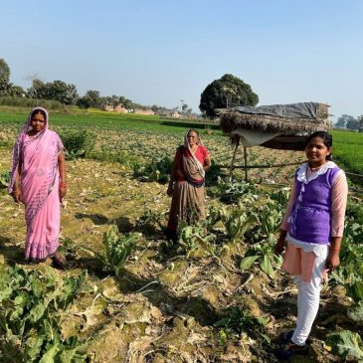
Case study: Climate-smart agriculture, Gorakhpur, India
Gender-responsive approach is more effective
Challenges
Gorakhpur Environmental Action Group (GEAG) has been offering climate smart agriculture training to women farmers
Women are open to new farming methods to increase yields in changing climate but their husbands are derided and even beat them for attending the trainings
Successful strategies
Women farmers persisted in attended trainings and found strength in numbers
Women’s knowledge has increased and as they learned techniques for growing crops even in poor weather, they won new respect and clout in their households and communities
Image: Thomson Reuters Foundation, Campierganj
Notes:
Gorakhpur Environmental Action Group has been offering climate smart agriculture training in Campierganj - administrative centre of about 90 villages, in Uttar Pradesh.
Women are invited to climate smart agriculture training but their husbands deride them and even beat them
Successful strategies
Women farmers persisted in attended trainings and found strength in numbers
Women’s knowledge has increased and as they learned techniques for growing crops even in poor weather, they won new respect and clout in their households and communities

Slide 28
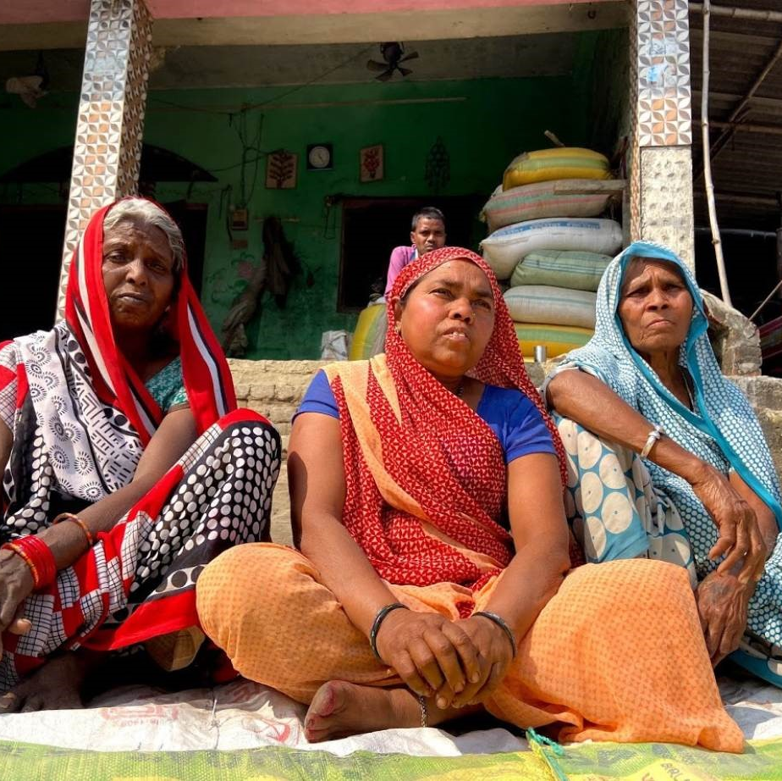
Case study: Climate-smart agriculture, Gorakhpur, India
Gender-responsive approach is more effective
Successful strategies
Women farmers’ income has increased
Women farmers’ confidence has increased
There are more women on decision-making committees in the villages
They help other women get joint land access/ownership
Inadvertently, the climate-smart agriculture programmes have not just tackled their preparedness for changing weather. They have also altered gender relations in the villages and made them more equal.
Notes:
Inclusive steps for more effective climate smart agriculture
Successful strategies
Women farmers’ income has increased
Women farmers’ confidence has increased
There are more women on decision-making committees in the villages
They help other women get joint land access/ownership
Inadvertently, the climate-smart agriculture programmes, by persevering with the inclusion of women farmers (and thanks to women farmers’ own determination and openness to new agricultural approaches – have not just tackled their preparedness for changing weather. They have altered gender relations in the villages and made them more equal.

Slide 29
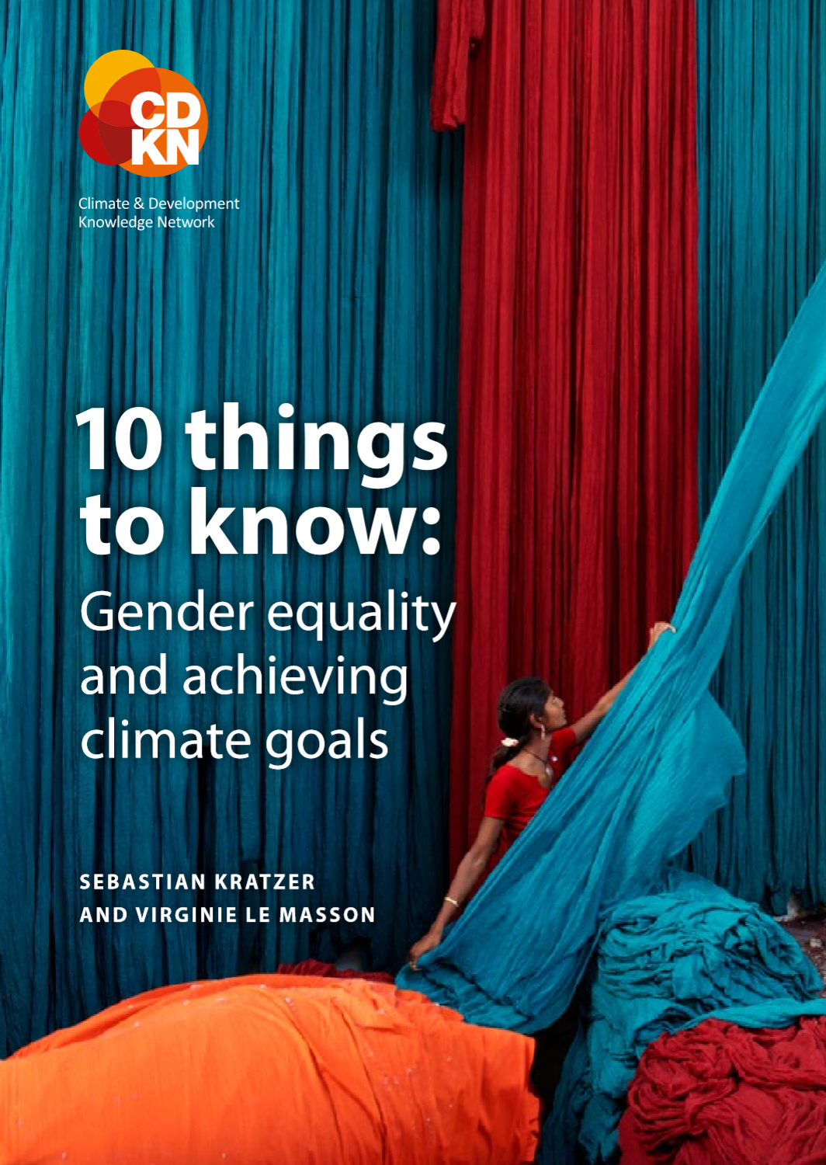
Further evidence on the effectiveness of gender-responsive approaches
Results from an independent qualitative research study elsewhere in northern India had similar findings (CDKN and Practical Action, 2016)
10 Things to Know: Gender equality and achieving climate goals
www.cdkn.org/resource/report-10-things-know-gender-equality-achieving-climate-goals

Slide 30
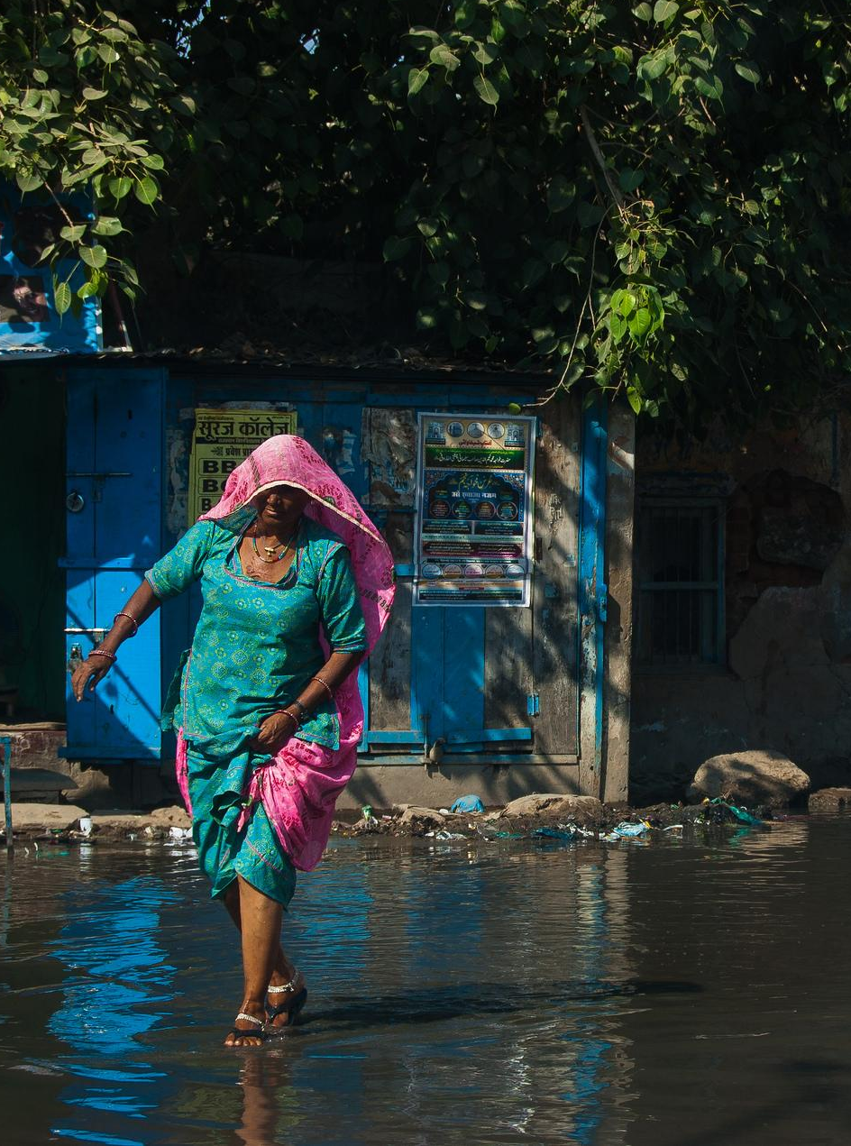
It matters: gender-responsive approaches recognise people’s different needs
Separate urban flood risk management project in northern India (Uttar Pradesh) found:
Floods affected women quite differently and their coping strategies involved greater hardship compared to men and boys
Notes:
This further evidence of why gender responsive approaches are important – because they recognise people’s different needs, is documented in the CDKN ‘10 Things to Know’ report and its supporting research reports.

Slide 31
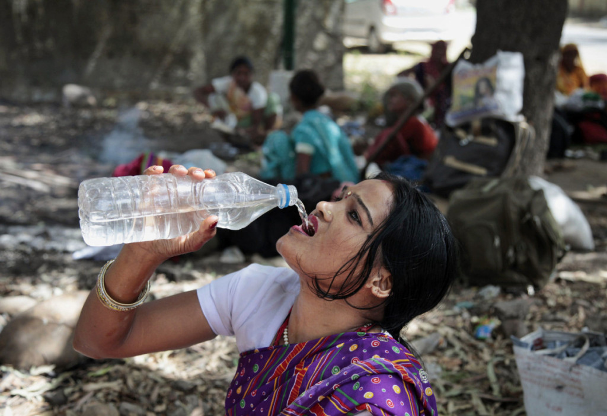
  During floods women have great difficulty going to the toilet due to inadequate sanitation infrastructure.
  One of their coping strategies is to avoid drinking and eating too much.
  Group discussion, Gorakhpur, India
Notes:
(Continued) this further evidence of why gender responsive approaches are important – because they recognise people’s different needs – in this cse, related to sanitation requirements during floods - is documented in the CDKN ‘10 Things to Know’ report and its supporting research reports.

Slide 32
Gender responsive approaches work: they lead to more sustainable outcomes for climate compatible development
Impacts of women’s involvement on the sustainability of neighbourhood committees in Gorakhpur, India
Number of women participating in local committees
Number of committees still functioning
Notes:
This graph also summarises a key finding from CDKN’s ‘10 Things to Know’ Report
When women were given more leadership roles as decision-makers in neighbourhood committees, to look at and respond to flooding risk in urban Gorakhpur, Uttar Pradesh, the committees themselves were more sustainable – lasting for longer.

Slide 33
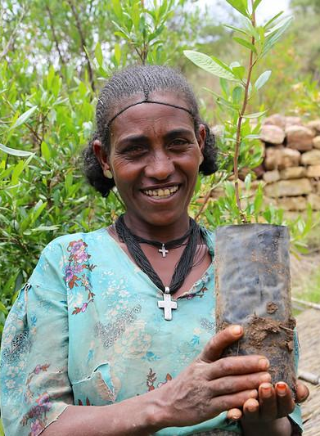
Summary: why gender matters and why inclusive climate compatible development is better for everyone
Women and men experience climate change differently
Differences in adaptive capacity (ability to adapt to the impacts of climate change)
Differences in voice and power mean that women’s priorities may not be recognised – from local to global climate action
We already know that women’s wellbeing, according to standardised development measures, is less than men’s overall
Women may define their wellbeing in different ways than men (‘whose priorities?’)
Image: Ethiopia, CIFOR
Notes:
This slide summarises the findings of the evidence on why a gender-responsive approach to climate change responses and climate-resilient development planning is more effective than a gender-blind approach.

Slide 34
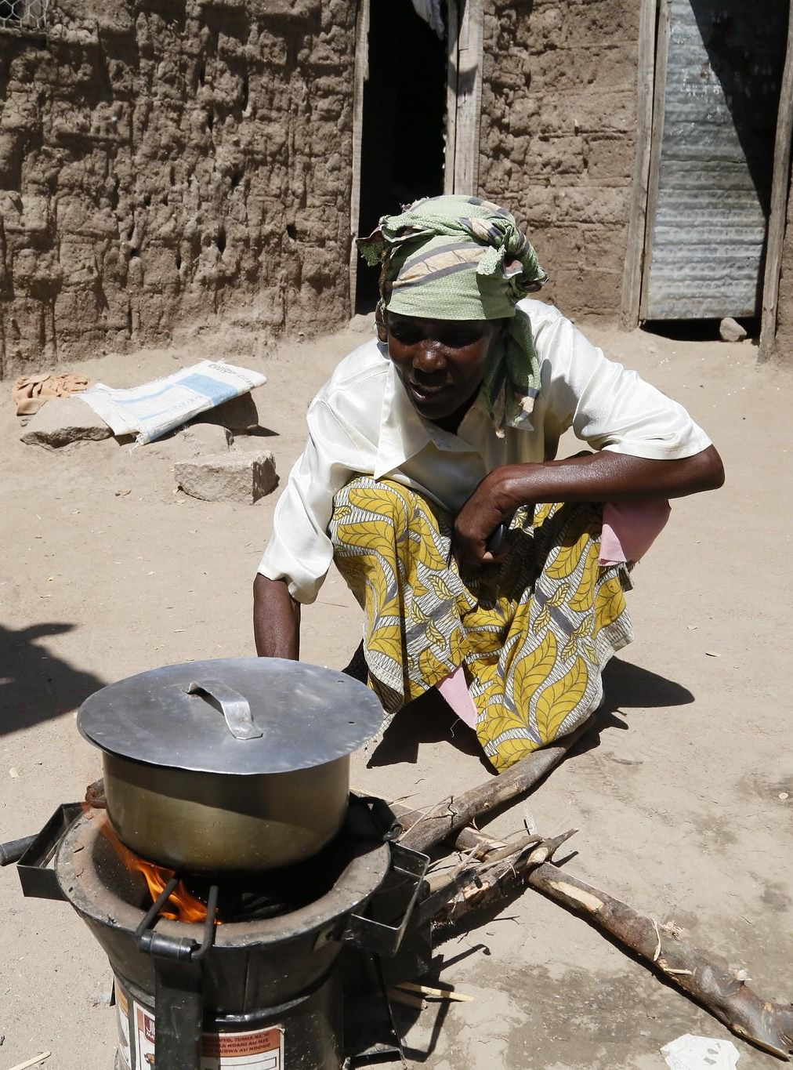
Gender and climate action
Countries will need to make choices about how to be competitive in a de-carbonising global economy
Choice of sectors, investments, development paths will all have gendered consequences
Growing scarcity of key natural resources has the potential for highly unequal gender impacts
Climate mitigation may create livelihood opportunities at the local level – but these may be gendered
Some policy wins for climate are great for women – e.g. safer, cleaner, improved public transport?
Some major wins for climate can also be wins for women’s and children’s health (in particular) and reduce drudgery e.g. clean cooking technologies
Image: clean cookstove, DFID
Notes:
This slide summarises some overarching global points about how climate change related interventions have the potential to empower women or leave women further behind (closing or widening the gender development gap):
Countries will need to make choices about how to be competitive in a de-carbonising global economy
Choice of sectors, investments, development paths will all have gendered consequences
Growing scarcity of key natural resources has the potential for highly unequal gender impacts
Climate mitigation may create livelihood opportunities at the local level – but these may be gendered
Some policy wins for climate are great for women – e.g. safer, cleaner, improved public transport?
Some major wins for climate can also be wins for women’s and children’s health (in particular) and reduce drudgery e.g. clean cooking technologies

Slide 35
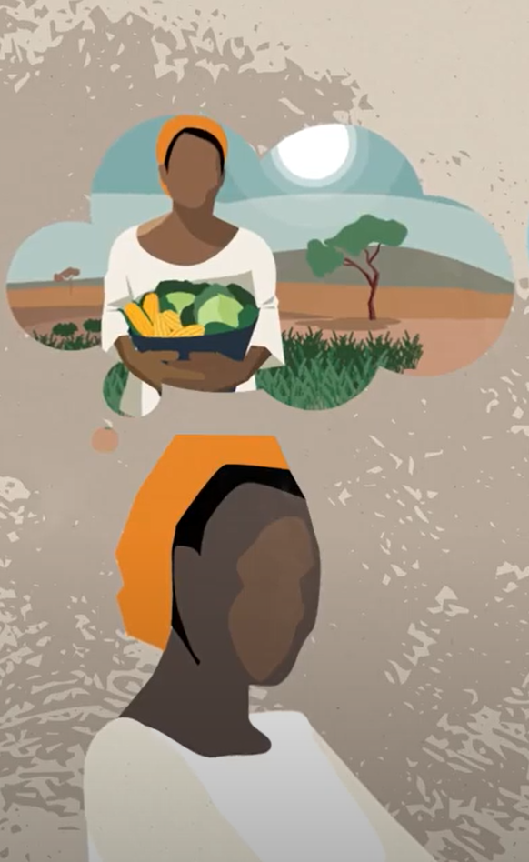
Women are adaptation leaders
Women have been adapting to swift environmental changes for decades
Women are also first responders to disasters
They hold traditional knowledge on which crops to grow in unpredictable weather and have traditional knowledge on how to store food if they receive early warning
Studies show women are better at disseminating early warning information than men
They can highlight gender-specific needs if included in decision-making processes
In semi arid regions, research shows that women are not necessarily victims or powerless: they are often diversifying their livelihoods and increasing their agency in response to climatic pressures (ASSAR)
Image: credit ASSAR
Notes:
On climate change adaptation specifically, which requires very localised responses in order to be effective, we note the important, relevant knowledge that women hold and which can benefit whole communities – if they are given equal voice in decisions and in implementing projects and systems:
Women have been adapting to swift environmental changes for decades
Women are also first responders to disasters
They hold traditional knowledge on which crops to grow in unpredictable weather and have traditional knowledge on how to store food if they receive early warning
Studies show women are better at disseminating early warning information than men
They can highlight gender-specific needs if included in decision-making processes
(Source: UNDP East Africa (2019))
In semi arid regions, research shows that women are not necessarily victims or powerless: they are often diversifying their livelihoods and increasing their agency in response to climatic pressures
Last bullet point on semi-arid regions, ref Adaptation at Scale in Semi-Arid Regions (ASSAR) www.assar.uct.ac.za

Slide 36
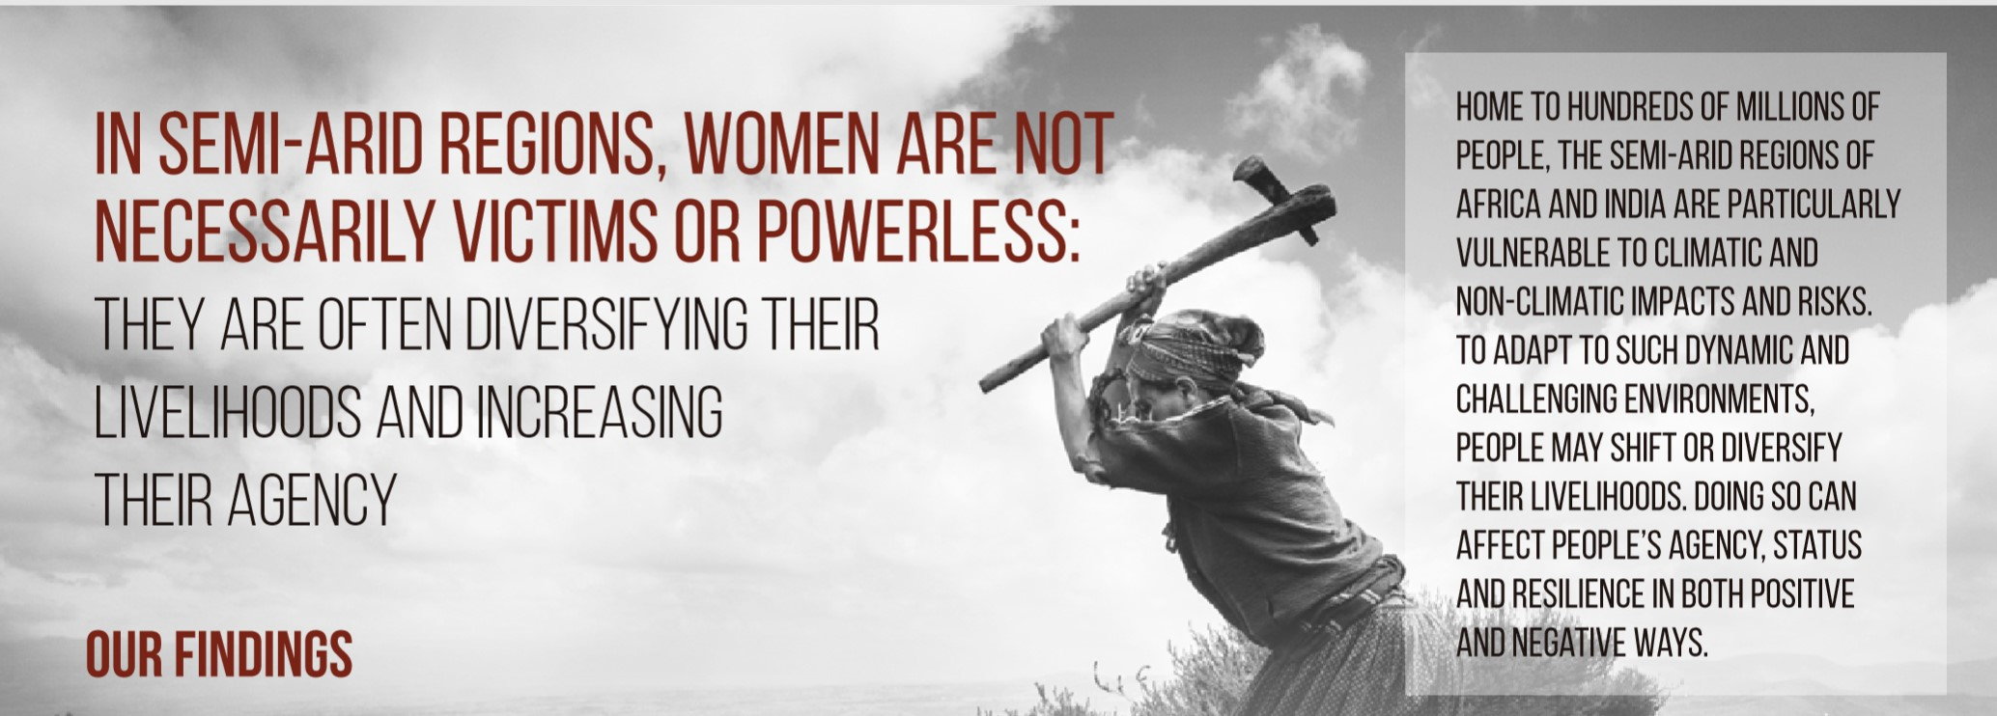
Group exercise: How people are dealing with diverse risks and pressures in semi-arid lands
Consider these findings from the Adaptation at Scale in Semi-Arid Regions programme (www.assar.uct.ac.za)
Notes:
Facilitator: Break participants into smaller discussion groups to do this exercise.
Show the groups these slides and/or the entire accompanying ASSAR handout (which accompanies this slide pack) and ask them to read the material and, in their groups, answer the accompanying questions on the next slide(s).

Slide 37
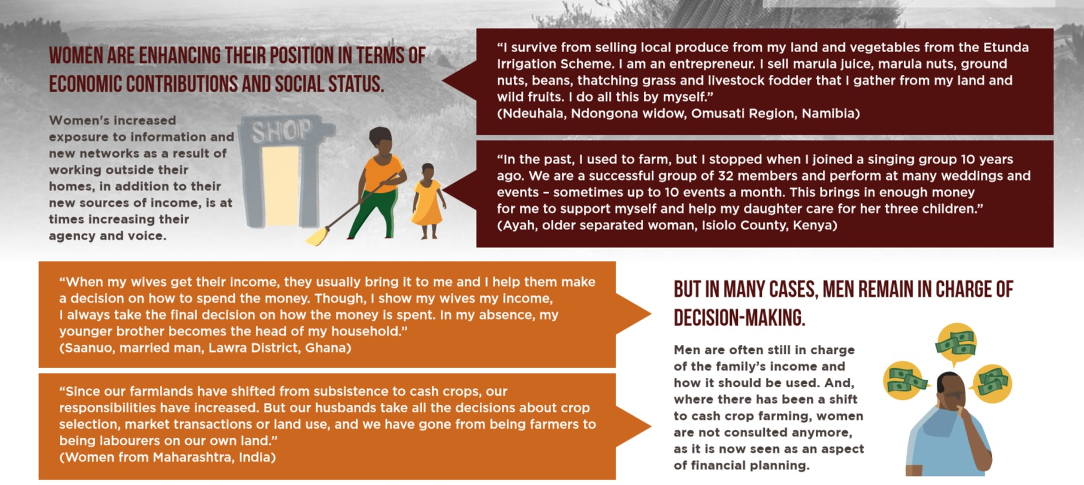
Group exercise: How people are dealing with diverse risks and pressures in semi-arid lands
What surprises you about these findings from semi-arid Sub Saharan African countries and India? What doesn’t surprise you?
How would you design interventions to help people who are struggling to adapt to climatic and other pressures? Brainstorm with your group.
Notes:
The overarching analysis which describes what’s going on in these slides is as follows (from the ASSAR project). Then, please read the quotes from the individual men and women – how they are changing their lives to respond to climate change impacts. Once you have read the quotes, too, answer the discussion questions.
The overarching analysis of changing gender roles and different responses to climate change is:
Gender inequality in rights, resources and voice
Unequal legal status, property rights, education & literacy, health, access to assets
Gender-based differences in economic opportunity
- all reduce women’s adaptive capacity in face of climate and other shocks
However, women should not be seen as victims
It’s complicated: they are often diversifying their livelihoods and increasing their agency (control over different aspects of their lives)
Find the full booklet here: http://www.assar.uct.ac.za/sites/default/files/image_tool/images/138/webinar/gender/INFOGRAPHIC%2002%20Small.pdf
The researchers’ made these recommendations, do you agree?
Recommendations when planning risk management strategies:
Don’t assume all women are victims.
🡪We see that, at times, women are increasing their sense of agency, which makes them critical agents for adaptation.
Consider power relations explicitly.
🡪Women’s increasing agency can lead to the renegotiation of power relationships which are essential for managing risk and improving wellbeing in a more equitable and inclusive manner.
Support processes that increase agency, capacities and long-term wellbeing by:
🡪 Improving access to jobs and resources, concurrently with other forms of support for domestic tasks (e.g. childcare, improved access to water).
🡪 Supporting productive assets (e.g. land, equipment).
🡪 Offering support services and mechanisms that incentivise cooperation.
🡪 Providing direct access to information.
🡪 Working with men and governments to challenge social norms.
Support processes that increase agency, capacities and long-term wellbeing by:
🡪Providing better access to social support, education and technical skills, along with alternative sustainable livelihood opportunities.

Slide 38
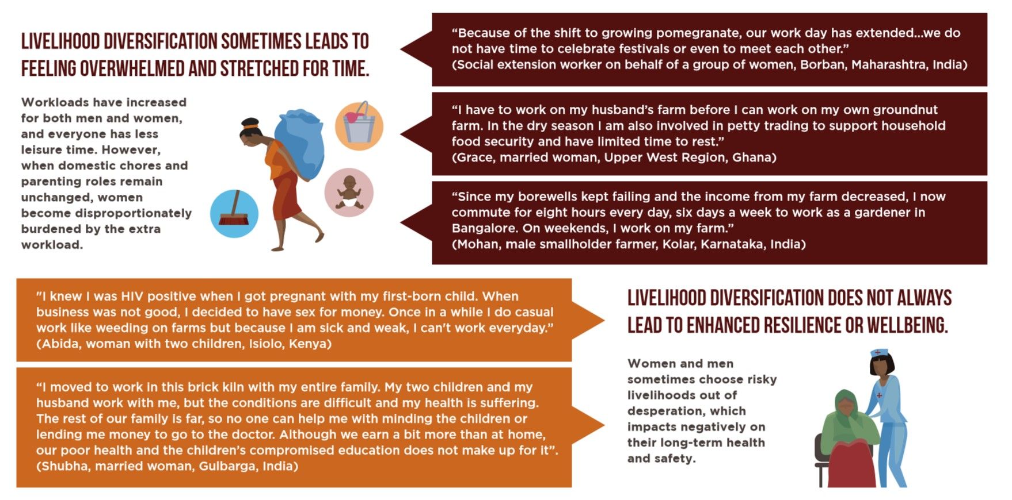
Group exercise: How people are dealing with diverse risks and pressures in semi-arid lands
What surprises you about these findings from semi-arid Sub Saharan African countries and India? What doesn’t surprise you?
How would you design interventions to help people who are struggling to adapt to climatic and other pressures? Brainstorm with your group.

Slide 39
www.cdkn.org
@cdknetwork
Notes:
Facilitator: Here the facilitator can place their own website url and email address too, if anyone wants to contact them later!
Next after this slide pack, advance to ‘Assessing people’s needs’ module and the ‘Climate and Society Game’ (full game play version)

