Slide 1
Raising Risk Awareness:
What’s behind the record rainfall in Chennai, India? A scientific analysis

Slide 2
Section 1 – Raising Risk Awareness

Slide 3
The Raising Risk Awareness initiative
Raising Risk Awareness (RRA) brings together scientists, vulnerability experts and knowledge brokers to assess the role of climate change in extreme weather events in Ethiopia, Kenya, India and Bangladesh

Slide 4
The team
The Raising Risk Awareness team includes the Climate and Development Knowledge Network (CDKN) and World Weather Attribution (WWA) partners:
Climate Central
Red Cross Red Crescent Climate Centre
Royal Netherlands Meteorological Institute (KNMI)
University of Melbourne
University of Oxford
India partner:
The Indian Institute of Technology Delhi

Slide 5
What is extreme weather attribution?
Attribution analyses allow scientists to make quantitative statements about the role of climate change in certain individual extreme weather events to help prepare for future ones
These analyses use the latest methods in science and technology to understand the risks of an individual event happening in a world with and without global warming

Slide 6
Why do we seek extreme weather attribution?
These analyses can help decision makers and the public to prioritise adaptation solutions and reduce vulnerability

Slide 7
“Take the example of heat waves, killing people and destroying harvests. In some cases, such extreme temperatures, which used to happen every 50 years, now occur every 10 to 15 years because of climate change.” Maarten van Aalst, Director Red Cross Red Crescent Climate Centre

Slide 8
Section 2 – Chennai, India

Slide 9
Chennai’s vulnerability
Chennai is a coastal megacity that has encountered explosive and largely unplanned growth over the past 15 years
The city of 8.2 million has an estimated 150,000 illegal buildings

Slide 10
Chennai’s vulnerability
Factors contributing to Chennai’s high vulnerability and exposure to floods include:
land use issues, such as decreased natural areas
loss of water bodies
encroachment of river and streams and drainage channels
uncontrolled proliferation of built-up areas

Slide 11
Section 3 – The Chennai flooding of 1 December 2015

Slide 12
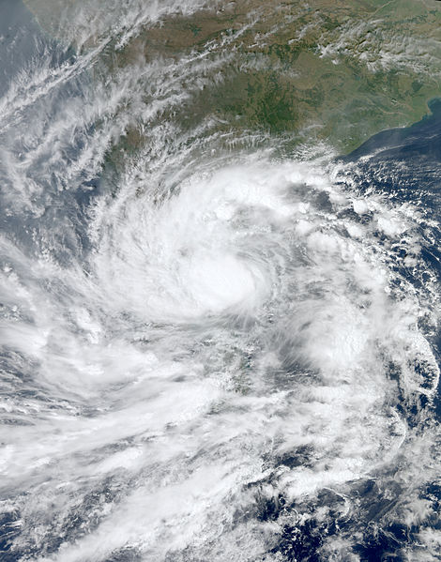
The record rainfall event in Chennai, India 1 December 2015
On 1 December 2015, it rained 494 mm (19.45 inches) within 24 hours in Chennai

Slide 13
The record rainfall event in Chennai, India 1 December 2015
Rain gauge observations from 08:30 on 1 December to 08:30 on 2 December 2015

Slide 14
The record rainfall event in Chennai, India 1 December 2015
The rainfall brought nearly full reservoirs to capacity, prompting local authorities to release water into the rivers, which subsequently overflowed and flooded low-lying areas
It also left more than three million people without basic services, forced tens of thousands from their homes, collapsed roads and bridges, halted air and train travel in and out of the city, and forced the local paper to stop publication for the first time in 137 years

Slide 15
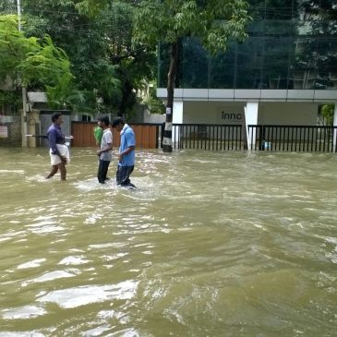
The record rainfall event in Chennai, India 1 December 2015
Chennai was declared a disaster zone after the record rainfall led to catastrophic flooding

Slide 16
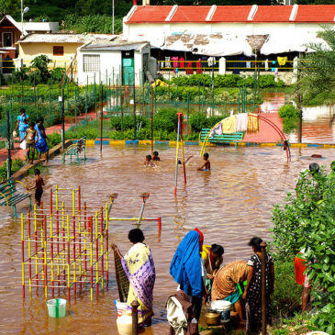
The record rainfall event in Chennai, India 1 December 2015
Costs to India’s economy due to the flood waters in Chennai are estimated at US $3B

Slide 17
The record rainfall event in Chennai, India 1 December 2015
The Parliamentary Standing Committee on Home Affairs acknowledged the lack of timely desilting, inadequate flood zone planning and large-scale developments in low-lying areas as major contributors to the impacts on the city

Slide 18
Section 3 – Assessing the event

Slide 19
Assessing the event
The scientific team assessed whether and to what extent the record rainfall that affected Chennai could, in part, be linked to climate change due to the build-up of greenhouse gases caused by the burning of fossil fuels
They conducted independent assessments using multiple peer-reviewed approaches of extreme event attribution methodologies, including statistical analyses of the historical precipitation record, the trend in global climate models, and the results of thousands of simulations of possible weather with a regional climate model

Slide 20
Conclusion
The highest observed daily rainfall, 494 mm (19.45 inches), was an extreme occurrence meteorologically, with a probability of occurrence in the current climate of one in 600 to 2500 per year (95% level of confidence)
No measurable effect of human-caused emissions was detected in the extreme one-day rainfall in Chennai on 1 December, 2015
What’s behind the record rainfall in Chennai, India? A scientific analysis

Slide 21
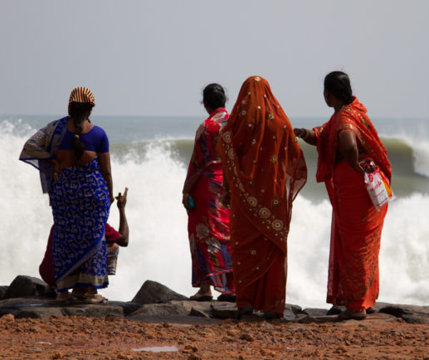
Conclusion
There are two reasons for non-detectable effects of human-induced climate change:
there is no effect with current levels of emissions or
the effect from greenhouse gases is masked by other pollutants, such as aerosols
What’s behind the record rainfall in Chennai, India? A scientific analysis

Slide 22
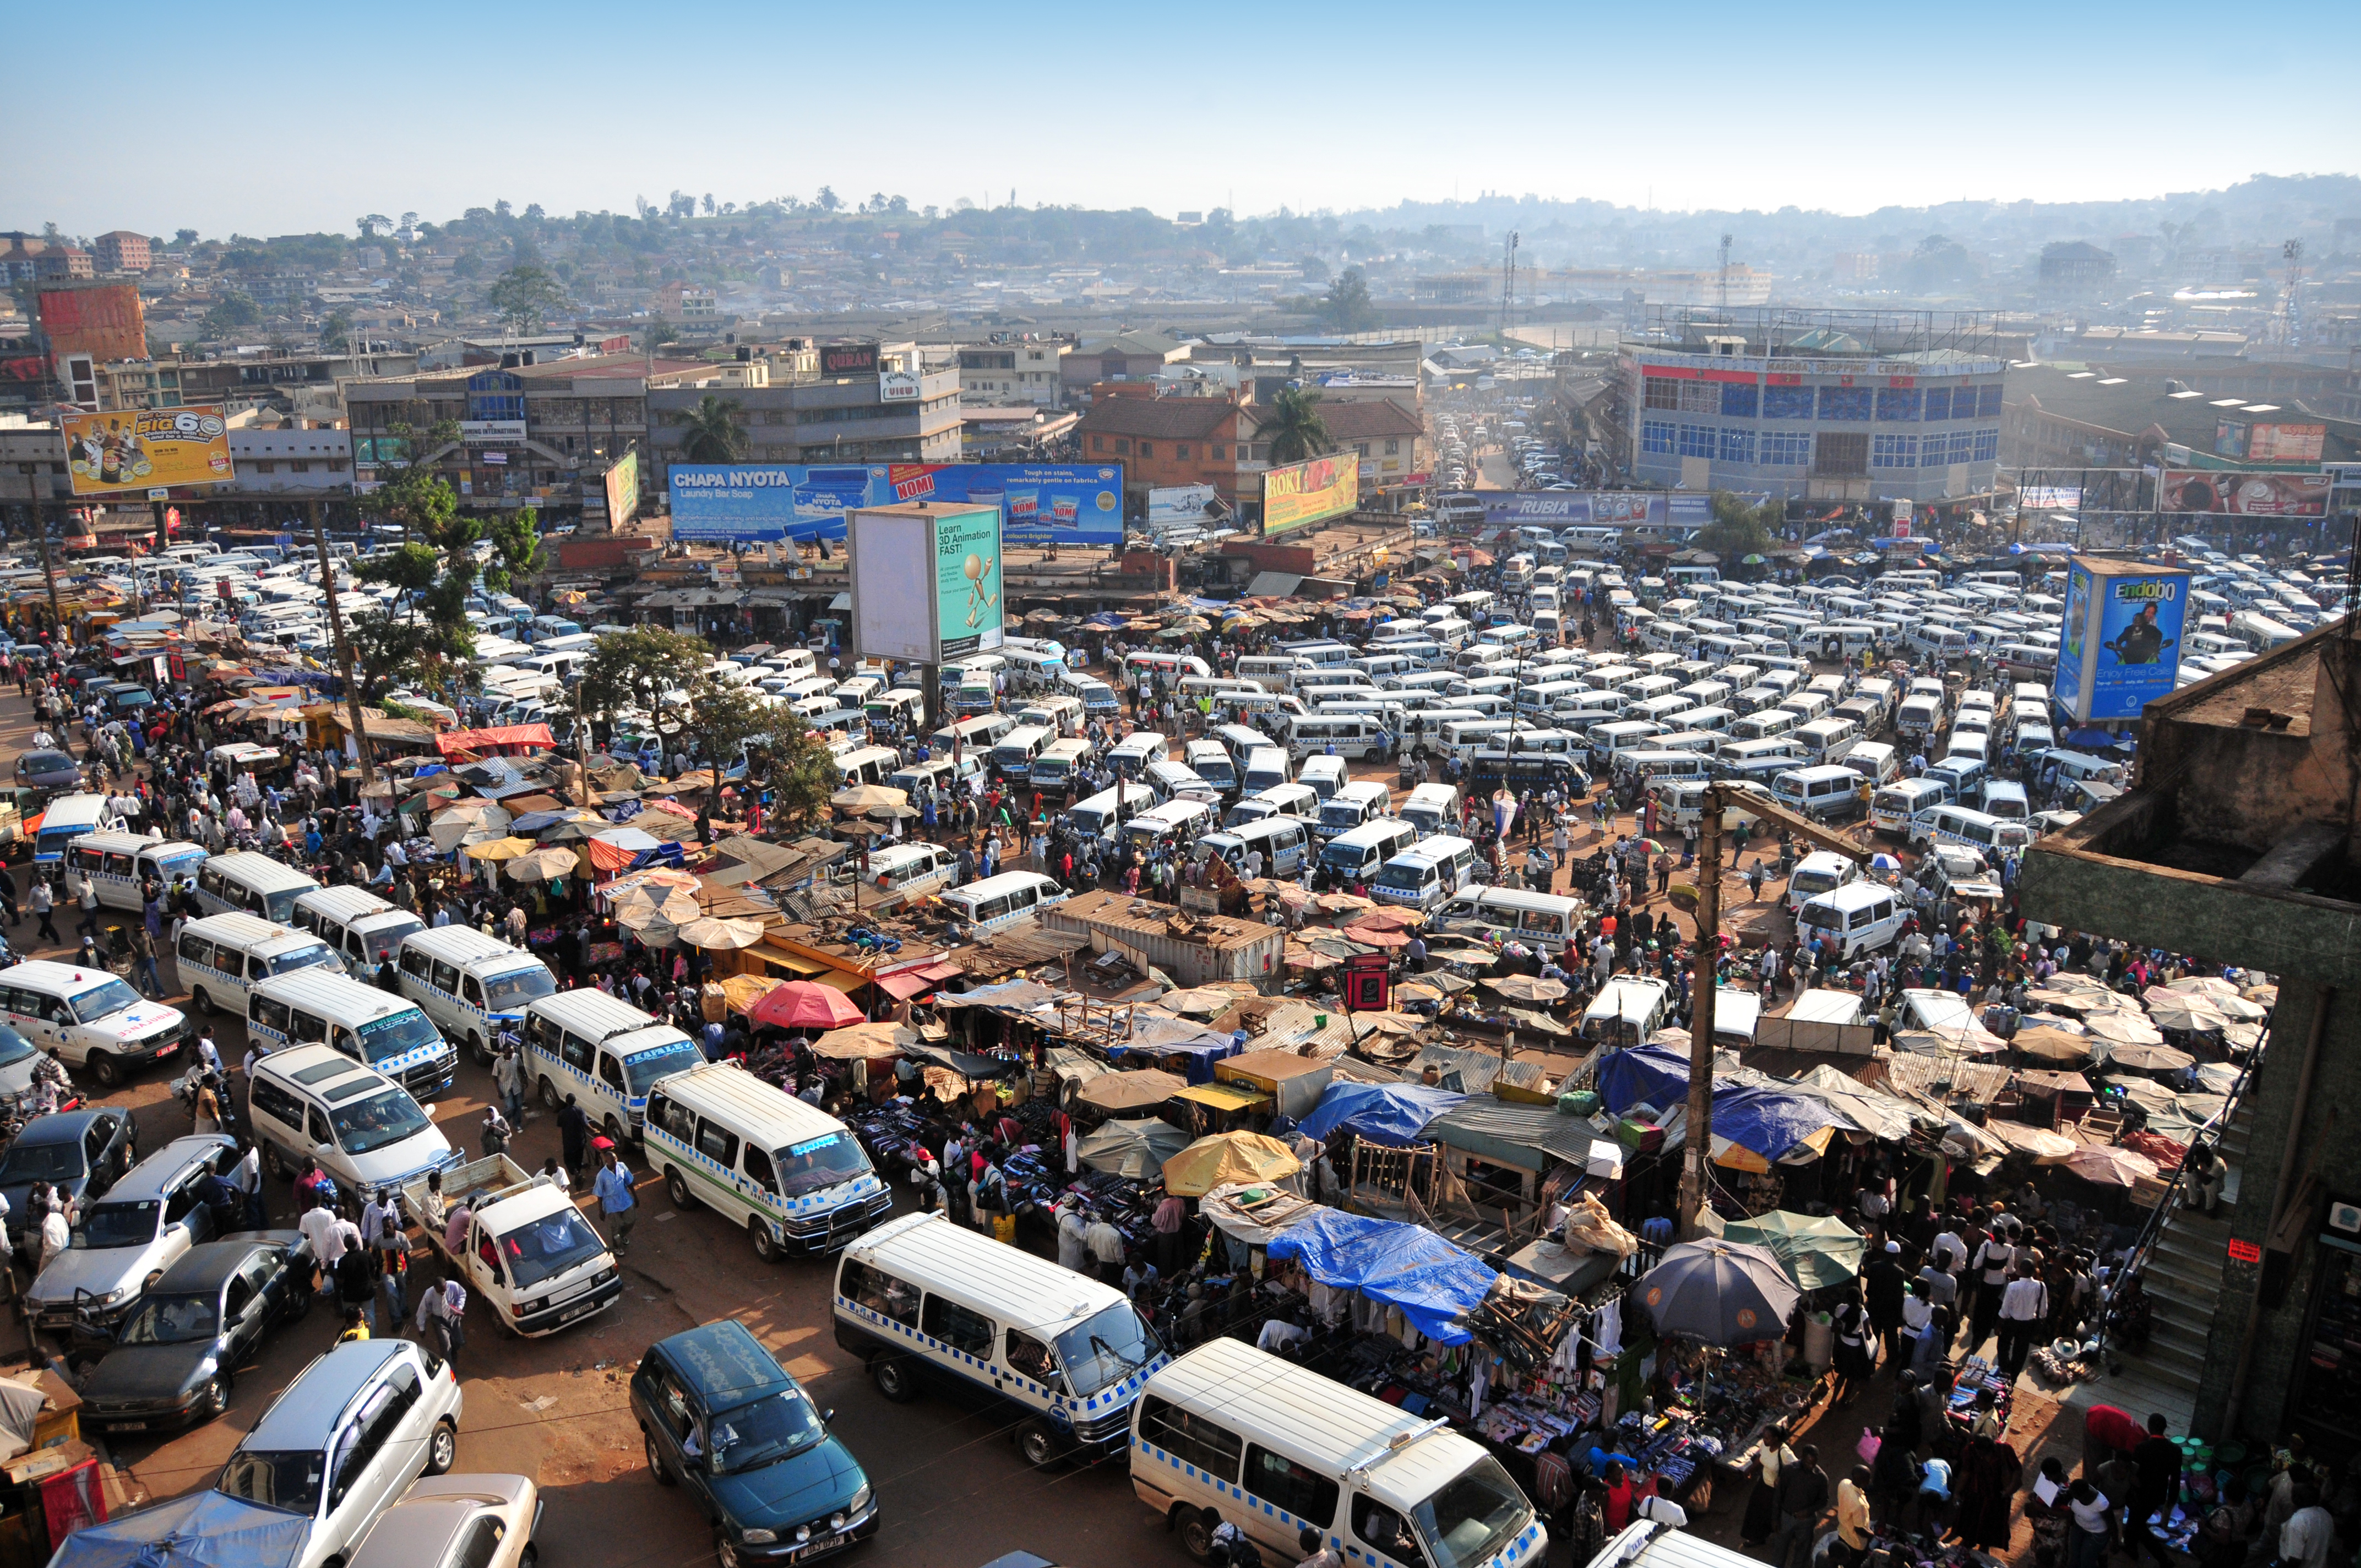
Aerosol pollution
Atmospheric particulates, known as aerosols, such as dust and sea salt that occur naturally, and others from the burning of fossil fuels and biomass, likely have an overall cooling effect

Slide 23
Aerosol pollution
Aerosols affect the Earth’s radiative balance, intercepting solar radiation and either reflecting it back or absorbing it high in the atmosphere, which has a cooling effect on the surface
However, aerosols have many negative impacts on climate and weather patterns, and on human health
The World Health Organization (WHO) estimates that aerosols are one of the leading causes of worldwide mortality, contributing to as many as seven million premature deaths each year

Slide 24
Preparing for the future
An attribution analysis gives us scientific evidence, not simply a guess, of the risk of a similar one-day record rainfall event occurring in Chennai in the future

Slide 25
Preparing for the future
Extreme heat and extreme cold weather events have the strongest links to climate change, followed by record rainfall events and some kinds of drought

Slide 26
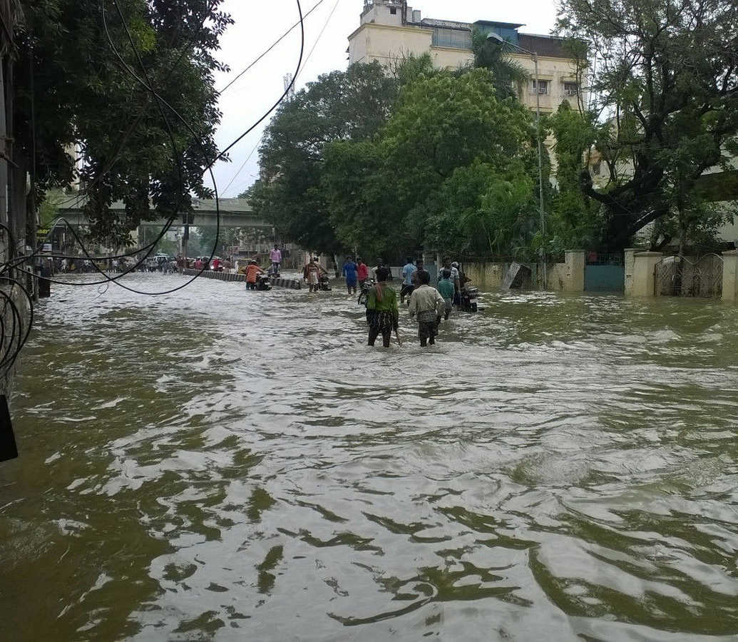
Preparing for the future
Scientific knowledge of the changing nature of the risk of individual extreme weather events helps us put in place plans to keep more people and more places out of harm’s way

Slide 27
Get in touch
Emma Lovell e.lovell@odi.org.uk
Shari Bell sbell@climatecentral.org

Slide 28
Image credits
Slide 6: Flood management, India. Asian Development Bank/Flickr
Slide 12: Tropical cyclone Imani. Jeff Schmaltz, MODIS Rapid Response Team at NASA GSFC/Flickr
Slide 16: Flooding, India. Ben Robinson
Slide 21: Flood management, India. Asian Development Bank
Slide 22: Congestion, India
Slide 26: Flooding, Chennai

