Slide 1
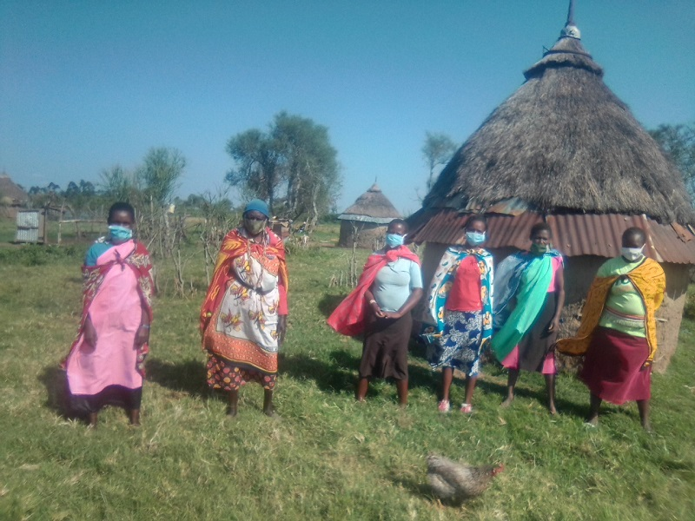
Gender and social inclusion Assessing people’s climate risks and resilience Image: Kenya; from ICCAD & CDKN Voices from the Frontline

Slide 2
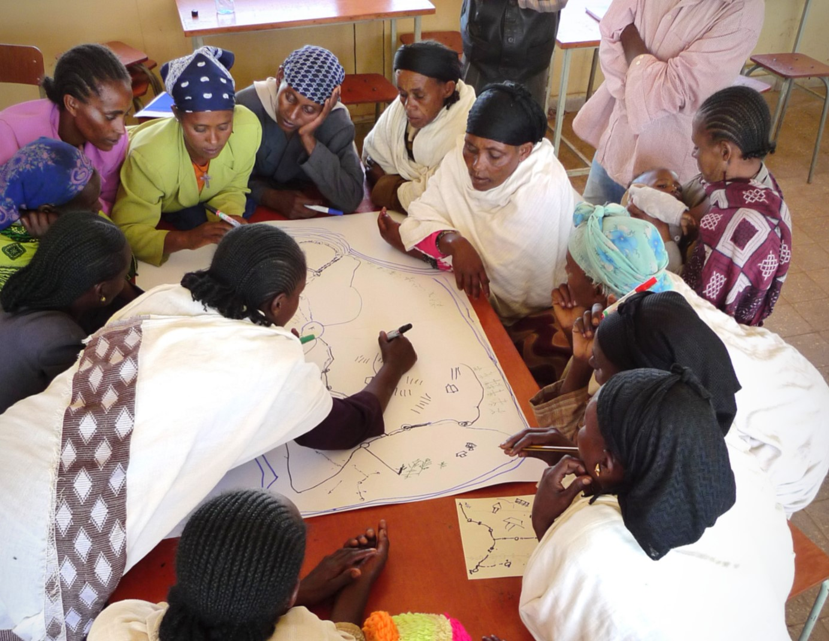
In this module you will learn
A conceptual overview of how we understand and measure people’s vulnerability, risks and resilience associated with climate change
With reference to gender and other forms of social diversity
Introduction to resilience assessment tools
Notes:
This module introduces a conceptual overview of why gender responsive (as well as other forms of social differentiation and inclusiveness) are important to identify when we are doing climate vulnerability and risk assessments
We don’t just think about what makes people vulnerable or gives them risks but also about the capabilities and capacities they have, including honouring and respecting the different forms of knowledge that people have for adapting to and innovating solutions to combat climate change – this is about people’s comparative strengths as well as what could be comparative weaknesses!
We should also make clear that we do not, in this module, introduce in depth any climate vulnerability and risk assessment tools, because these have been developed in depth by others.
Rather, we reference here the tools developed by others that the CDKN programme has found particularly useful and which we would recommend that trainees investigate themselves. We offer one or two case studies of the application of vulnerability and risk assessment tools which have had useful gender dimensions.

Slide 3
Recap: Why gender and social inclusion matters (Highlights from training module 2)
Climate change impacts the poorest disproportionately
The poorest are disproportionately female
Gender-based forms of discrimination hold back women and girls from contributing their talents fully to society including their knowledge, skills and potential to tackle the climate crisis
Empowering women is the right thing to do
Empowering women is also the way to get better climate results
Notes:
This slide recaps the key points and lessons learned from module 2, which was about ‘why gender and social inclusion matter’ for the achievement of development goals, the achievement of climate goals, and the integrated achievement of climate compatible development goals.

Slide 4
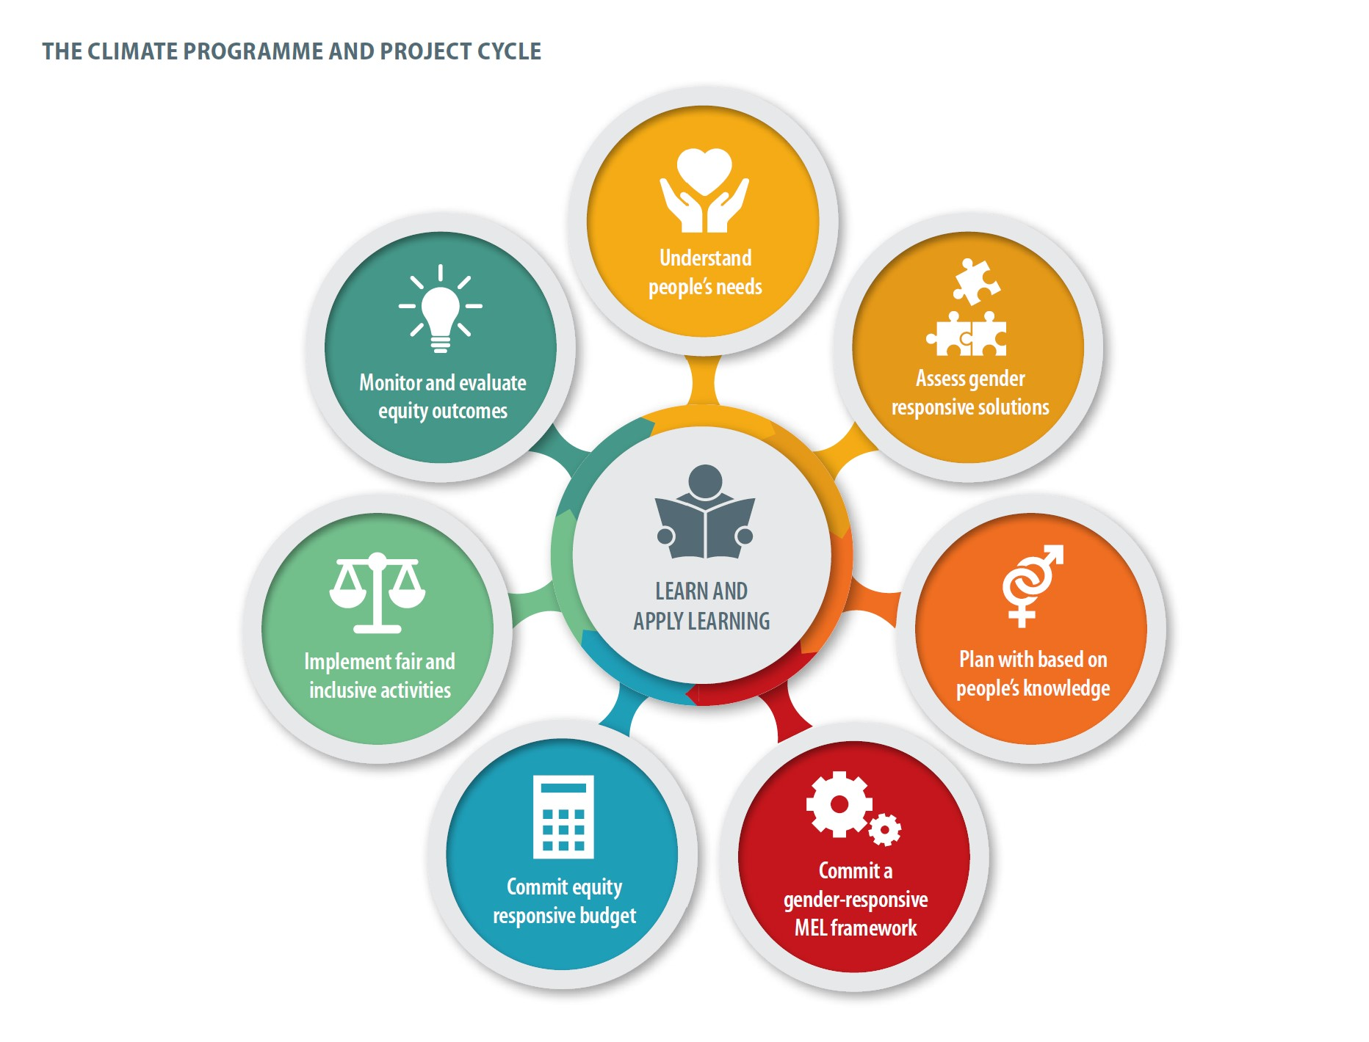
Getting started: the programme and project cycle
Getting started: the programme and project cycle
Notes:
The two modules that came before this one: about gender in the international climate policy processes (module 1) and about why gender matters (module 2) provided general background.
This module, and the ones to follow it, track the cycle for climate programme or project development – in line with the best practice guidance for gender integration proposed by the UNFCCC.
This current module here is about the first step on the journey: understanding people’s needs in the context of climate change. Note that this current training module is generally geared toward climate adaptation and resilience to climate change.
Climate change mitigation / greenhouse gas avoidance projects can also follow these same steps (and should indeed incorporate the climate risks analysis covered in this module even if the focus is more on the low emissions project design aspect).

Slide 5
What is gender analysis?
It is a systematic and comprehensive examination of the roles, responsibilities, expectations, constraints, and opportunities of individuals in a society based on their gender
Aims
to understand and address the ways in which gender dynamics influence social, economic, and political structures, as well as the experiences of individuals within those structures; and
to inform the development of policies that promote gender equality and address existing disparities.
It explores Key components such as:
Social Roles and Responsibilities, Access to Resources, Power and Decision Making, Constraints and Opportunities, and Social Norms and Cultural Practices
It recognizes the Intersectionality of gender with other social categories
Notes:
Key components of gender analysis include:
Social Roles and Responsibilities: Examining the socially constructed roles and responsibilities assigned to individuals based on their gender. This includes understanding traditional and cultural expectations related to caregiving, work, and community involvement.
Access to Resources: Assessing how access to and control over resources—such as education, healthcare, employment, land, and financial assets—vary between genders. Gender analysis explores disparities in resource distribution and its impact on individual well-being.
Power and Decision-Making: Analyzing the distribution of power and decision-making processes in different spheres of life, including the household, community, and workplace. Understanding who has the authority to make decisions and participate in various activities is crucial in gender analysis.
Constraints and Opportunities: Identifying the constraints and opportunities that individuals face based on their gender. This includes recognizing barriers that may limit one's choices and opportunities for personal and professional development.
Social Norms and Cultural Practices: Examining prevailing social norms, cultural practices, and stereotypes that shape and reinforce gender roles. This helps in understanding how societal expectations influence individual behavior and choices.
Intersectionality: Recognizing that gender does not exist in isolation and intersects with other social categories such as race, ethnicity, class, and sexual orientation. An intersectional approach in gender analysis acknowledges the multiple and interconnected aspects of an individual's identity.
Policy Implications: Drawing conclusions about the gender-specific implications of policies, programs, and interventions. Gender analysis aims to inform the development of policies that promote gender equality and address existing disparities.

Slide 6
Gender analysis in the context of climate change
Gender analysis can be applied in climate vulnerability and risk assessment and – as such – is a critical aspect of understanding different people’s needs
Refers to the examination and understanding of how climate change affects individuals differently based on their gender
It involves assessing the distinct roles, responsibilities, vulnerabilities, and opportunities of women, and men in the context of climate change impacts, adaptation, and mitigation strategies
It is essential for developing inclusive and effective strategies that address the diverse needs of all individuals and communities. Recognizing and addressing gender disparities can enhance the overall resilience and sustainability of climate change responses
Key aspects of gender analysis in the context of climate change include: Differentiated Impacts of CC, Access to Resources, Adaptation Strategies, vulnerabilities and Resilience, Participation and Decision making in CC related actions, Policy and Program implications
Notes:
Differentiated Impacts: Examining how climate change impacts may vary based on gender. For example, women may be disproportionately affected due to their roles in resource-dependent activities, caregiving responsibilities, and limited access to resources.
Access to Resources: Analyzing how men and women access and control resources such as land, water, and energy, which are critical in the context of climate change adaptation and resilience.
Adaptation Strategies: Understanding how women and men may have different coping mechanisms and adaptation strategies in response to climate change. This includes considering factors such as access to information, decision-making power, and participation in community-based initiatives.
Vulnerability and Resilience: Assessing the vulnerabilities of different gender groups to climate-related risks and identifying factors that contribute to their resilience. This involves recognizing social, economic, and cultural factors that influence vulnerability and adaptive capacity.
Participation and Decision-Making: Examining the roles of women and men in decision-making processes related to climate change at various levels, from the household to community and national levels. Ensuring the active participation of both genders in decision-making is crucial for effective and equitable climate action.
Policy and Program Implications: Identifying gender-specific considerations that should be integrated into climate policies, programs, and projects. This ensures that interventions are responsive to the needs and priorities of different gender groups.

Slide 7
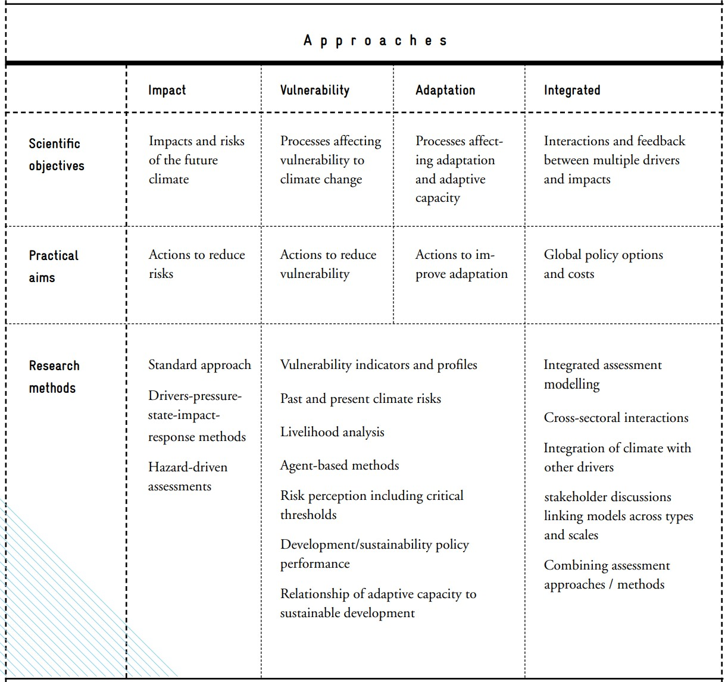
Scope of this training There are approaches of varying complexity to ‘understanding people’s needs’ in the development of climate projects/actions. We focus in this training on the first 3 columns: -impact assessment -vulnerability assessment -adaptation / mitigation actions rather than on integrated assessment modelling (IAM) but the tools and tactics we suggest could be applied to IAM approaches.
Notes:
There are approaches of varying complexity for developing future climate scenarios and related adaptation actions – with gender-smart components In these training modules, we focus more on impact – vulnerability analysis and adaptation (and climate change mitigation) options: first 3 columns.
We don’t go into integrated assessment modelling here (which takes quite a lot of data input, expertise and resource to do well) but the gender-responsive and socially inclusive methods we describe could also be adapted for use in integrated assessment modelling exercises and stakeholder consultations based on them.
This table is from GIZ, on behalf of Federal Ministry for Economic Cooperation and Development (Germany) and Potsdam Institute for Climate Impact Research
‘Climate Change Information for Effective Adaptation – a Practitioner’s Manual’. First published: 2015. Updated: 2017. Berlin: GIZ.
The GIZ work is, in turn, based on:
Climate Change 2007: Impacts, Adaptation and Vulnerability. Report of the Working Group II of the Intergovernmental Panel on Climate Change (IPCC); edited by M. L. Parry, O. F. Canziani, J. P. Palutikof, P. J. van der Linden and C. E. Hanson, Cambridge University Press, Cambridge, UK.

Slide 8
The key steps for ‘understanding people’s needs’ in the context of climate action planning are:
Steps to take | Why do it?
Form a representative stakeholder committee to guide programme and project efforts | To ensure that all relevant social groups have a meaningful voice in the data-gathering and situation analysis phase, and input to decision-making. To ensure plans are socially viable.
Gather gender-disaggregated data on how people are and could be impacted by climate change – their risk | To ascertain whether women and men are differently impacted by climate change at present and which future threats and risks they face and if so, what is the female-male difference.
Understand whether women and men have different development priorities – and what those are | To recognise and respect the differences, and point toward diversity of solutions that will work for different groups.
Notes:
These are the three key steps we will cover in this module:
Recommendations for forming a representative stakeholder committee to guide programme and project efforts.
Assessing climate risk, and specifically, assessing how climate risk could be different for different groups of people in society (the next slide(s) will explain further).
Consulting with women and men to understand how their development priorities may be different and hence, what this means for devising climate change adaptation and mitigation solutions – which recognise and respect the differences in priorities.

Slide 9
Step I: Creating a stakeholder committee
Stakeholders may be individuals and organisations, levels of government, NGOs, research institutions, private sector, community leaders etc.
Stakeholder consultation can effectively engage different groups through participatory processes
Especially necessary in situations where there is controversy or complexity and a need to build consensus around possible solutions.
To identify who should be involved, you can ask:
Which groups may be able to provide information that would contribute to the development of the Climate Action Plan?
Which groups would be involved in the implementation?
Which groups would be able to support the implementation?
Which groups are most likely to be affected by the implementation?
Is it viable for each major stakeholder group/ interest group to send both a female and a male representative, with a specific Terms of Reference to highlight issues from a gendered perspective?
Notes:
Facilitator/trainer: Please see and distribute the handout ‘Stakeholder consultation’.
To identify who should be involved, you can ask:
Which groups may be able to provide information that would contribute to the development of the Climate Action Planning process? (e.g. departments for ground water, transport, fuel supply agencies, meteorological department, etc.)
Which groups would be involved in the implementation of the Climate Action Plan? (e.g. government entities, CBOs? Women associations? etc.)
Which groups would be able to support the implementation of the Climate Action Plan? (e.g. government entities, CBOs? Women associations, financial institutions, etc.)
Which groups are most likely to be affected by the implementation of the proposed Climate Action Plan? (e.g. informal sector workers, low income group dwellers along surface water channels, small scale farmers, residents of the target city, region, intermediate public transport service providers, etc. )
Is it viable for each major stakeholder group/ interest group to send both a female and a male representative, with a specific Terms of Reference to highlight issues from a gendered perspective? Where relevant, representative(s) of minority ethnic groups or religion groups’ or people with disability issues may also need to be represented on the committee in order to account for the diversity of people’s experiences and development needs?
It should be noted that – because of socially- and culturally-differentiated divisions of labour and differentiated benefits from economic activities, according to gender, women and men may have very different views on the positive and negative impacts of development programmes. (Take for instance public transport: women and men may have significantly different views on how accessible and usable different prospective transport options may be, even if they come from the same socioeconomic group and their views on ‘affordability’ are the same; because they may experience personal security and psychological comfort/duress differently depending on their gender; and so discussing the feasibility of alternative options would benefit from having separate gender-specific views.)

Slide 10
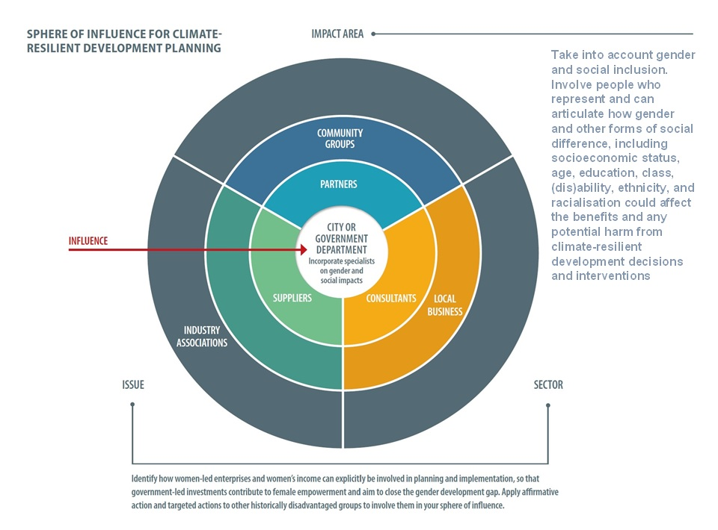
Notes:
Facilitator:
The above diagram may also help you to identify all important groups.
Trainees may need to be guided to identify key stakeholders in the CRGE implementation in Ethiopia or their specific implementation area. The terminologies of the diagram maybe adjusted to accommodate commonly used descriptions such as development partners, sectors, regions, CSOs and the private sector.

Slide 11
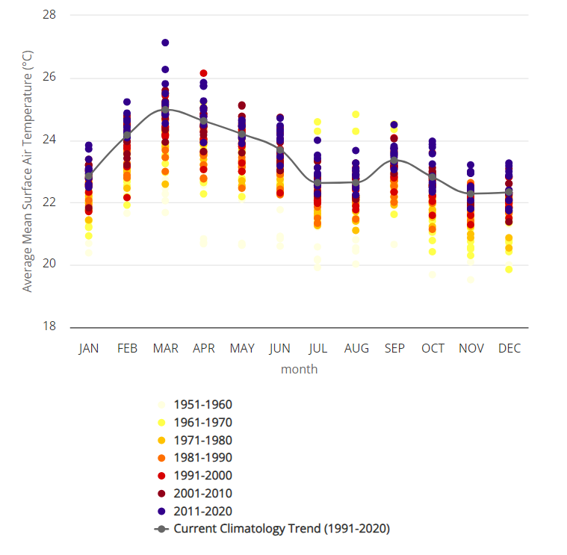
Step II: Gathering Relevant Data
Using information about historic climate variability and change (especially extreme events), as well as adaptation experiences as a starting point.
Trying to gather different regional or national scenarios
Seeking and supporting climate change impact research in order to increase the knowledge base on how climate change affects people.
Seeking climate impacts data that is disaggregated by gender (or capture new data on a gender basis) whenever possible.
The IPCC’s risk formula can guide our analysis (following slides).
Notes:
This slide is purely indicative - showing an example of using information about historic climate variability and change (The graph is an example of Variability and Trends of Average Mean Surface Air Temperature across seasonal cycle, 1951-2020; Ethiopia taken from the World Bank Climate Change Knowledge Portal: https://climateknowledgeportal.worldbank.org/country/ethiopia/trends-variability-historical)
Trying to gather different regional or national scenarios could involve using downscaled climate projections or regional aspects of global models to study what is expected to happen at national and regional levels. And, where possible, climate information may be provided that can tell decision makers how future changes in the climate may be expected to impact/affect human populations and different sectors of the economy.
The CDKN explainer guides to the IPCC science, available at www.cdkn.org/ar5-toolkit (for the regionalised guides to the Fifth Assessment Report) and www.cdkn.org/landreport and www.cdkn.org/oceanreport (for the explainer guides to the impacts of climate change on land and ocean) can also provide more detail.

Slide 12
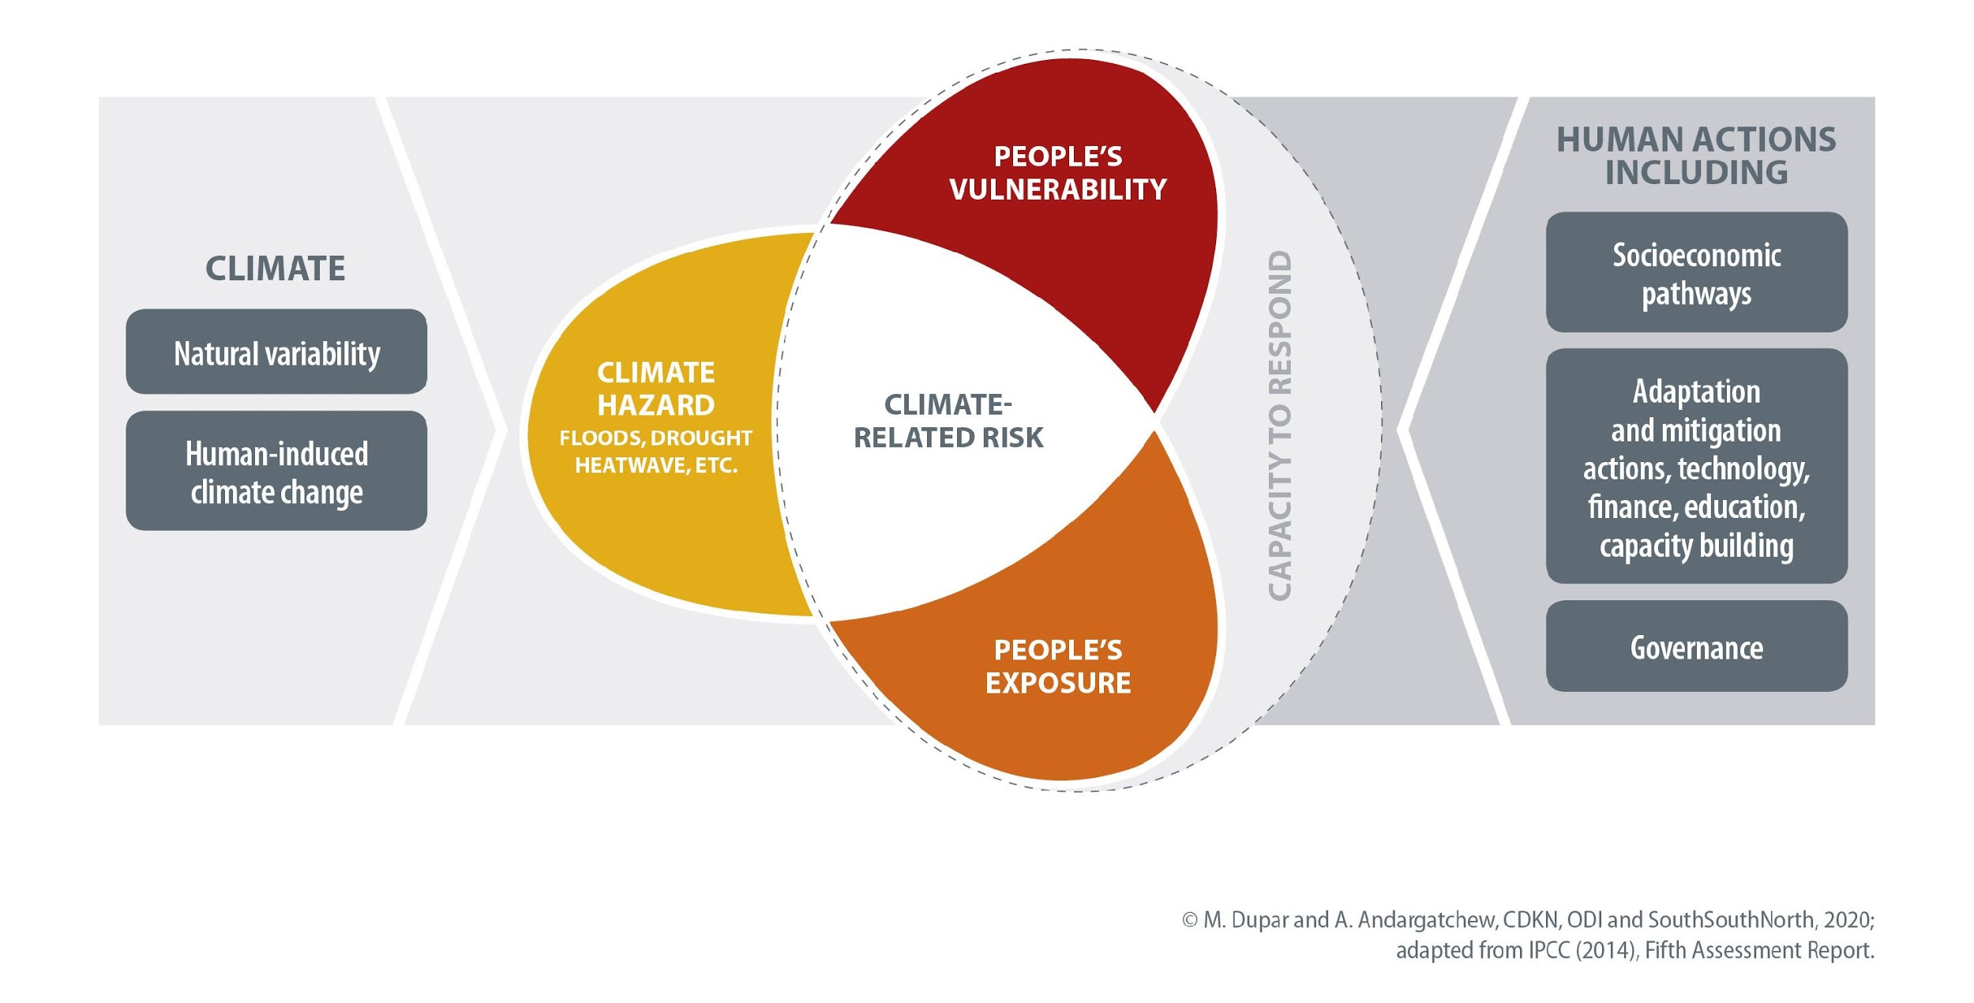
Recap: The climate / disaster risk formula: hazard – exposure - vulnerability
Your risk depends on 1. what the climate hazard is; 2. if you are more or less climate-vulnerable; 3. how exposed you are.
Notes:
Source: IPCC Fifth Assessment Report (2014)

Slide 13
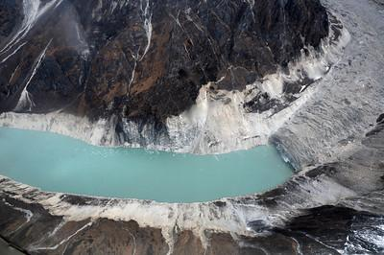
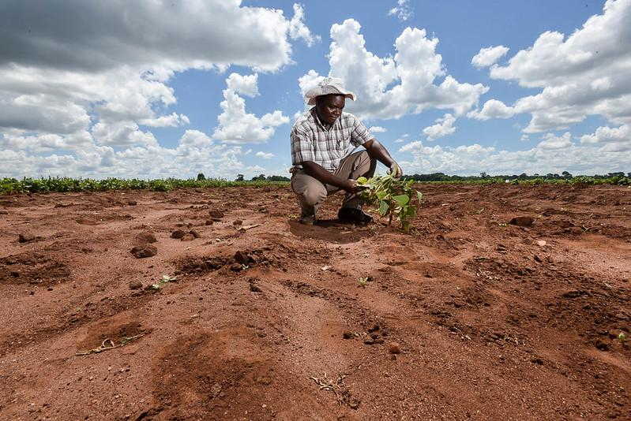
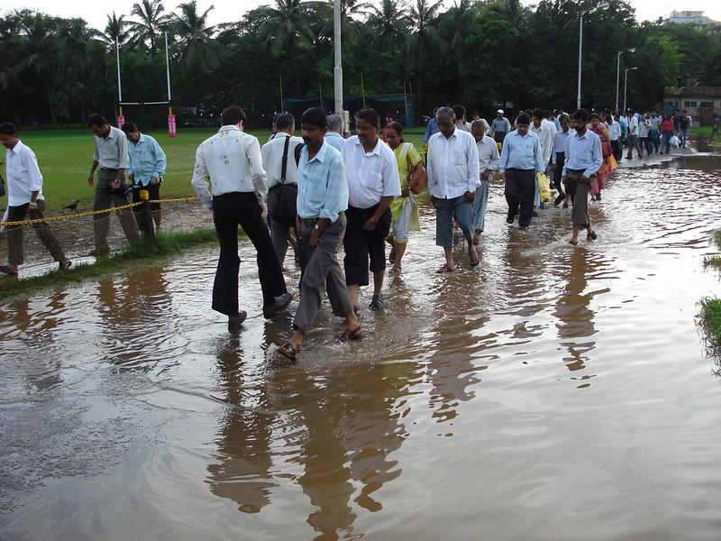
1. Climate hazard
Climate hazards are the physical phenomena in our environment (including, how they are expected to change over time):
Temperatures
Rainfall
Extreme weather events (tropical storms, heatwaves, droughts, dust etc)
Sea level rise (slow onset as well as storm surges)
Thawing ice, glaciers
Secondary cascading events, such as glacial lake outburst floods, landslides, wild fires, etc.

Slide 14
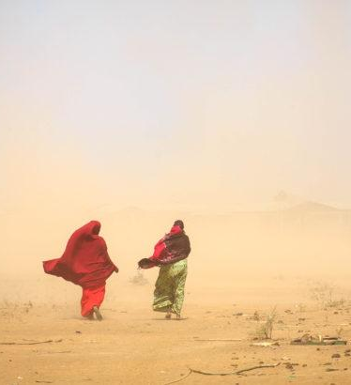
2. Exposure
Where you are affects your climate risk, whether your location is exposed to the climate hazard and its impacts
e.g. low-lying islands and coasts (exposed to sea level rise)
e.g. flood prone river valley (exposed to glacial outburst floods)
e.g. steep hillsides (exposed to landslides, weather-related erosion)
e.g. certain locations are more exposed to heatwaves or monsoonal changes
Also other socioeconomic factors and governance/management affect our wellbeing and interaction with the environment, including our exposure to climate hazards: e.g. poorest people live on degraded land, flood plains, etc
Notes:
Other socioeconomic factors and governance/management affect our wellbeing and interaction with the environment, including our exposure to climate hazards:
e.g. Poorest people live in low-lying areas exposed to floods or on steep, degraded hillsides, as land is cheaper there. (Mis) management of solid waste, irrigation and dam schemes, land zoning, construction, etc, are compounding factors that put people more or less at risk of climate hazards. E.g. On 11 March 2017, a garbage landslide at the Koshe Garbage Dump in Addis Ababa, Ethiopia killed 115 people.

Slide 15
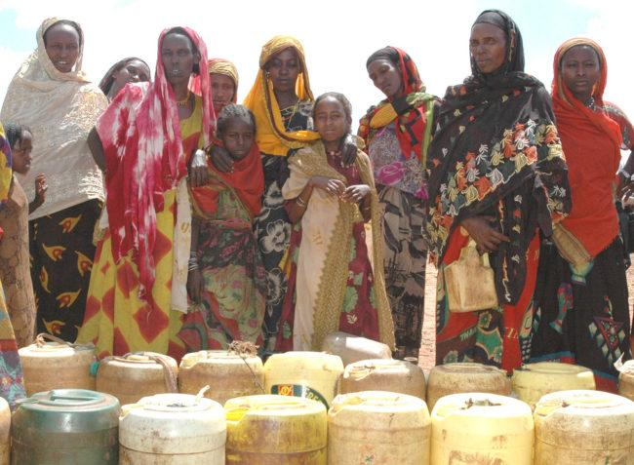
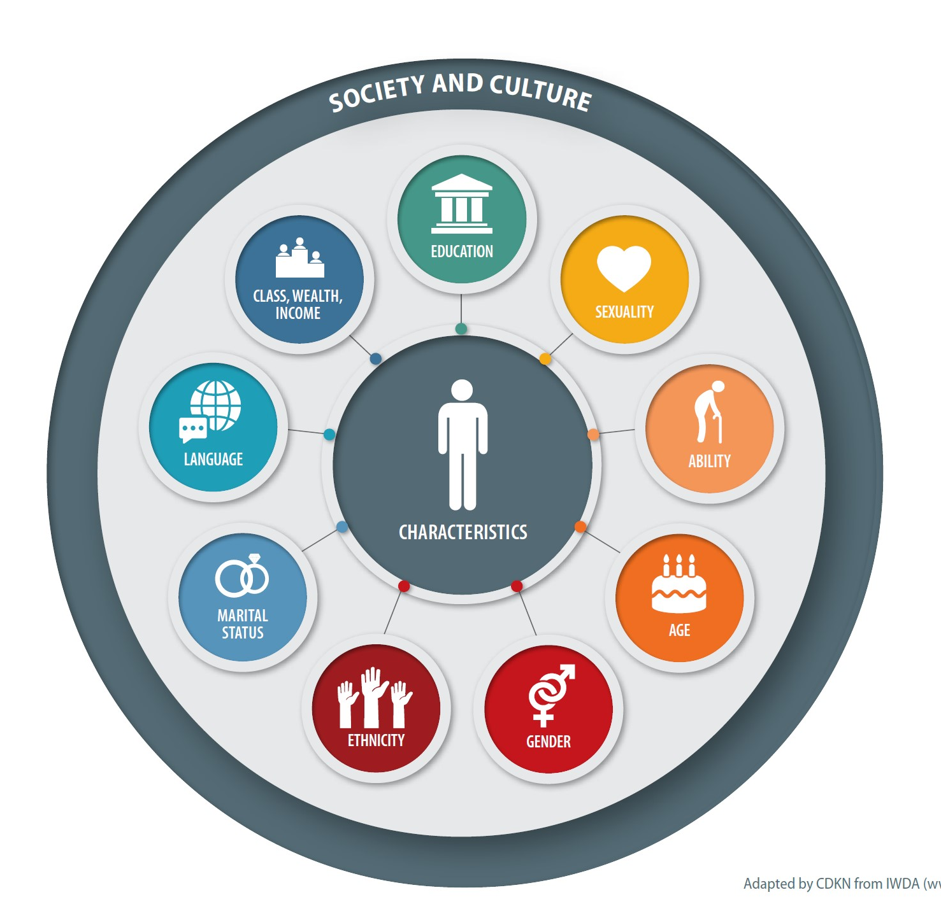
3. Vulnerability
Who you are affects your climate risk
Physical attributes: your age, health, (dis)ability, etc. insofar as they relate to climate action
Socioeconomic status and education: what you can afford to do, what access to information you have; social/cultural attitudes about what you are permitted or expected to do, etc.
Other aspects of your social-economic circumstances affect your climate risk
Women are not homogenous groups, and the issue of women are different in different circumstances e.g. issues in female headed households’ vs male headed households; women in polygamy vs monogamy etc.

Slide 16
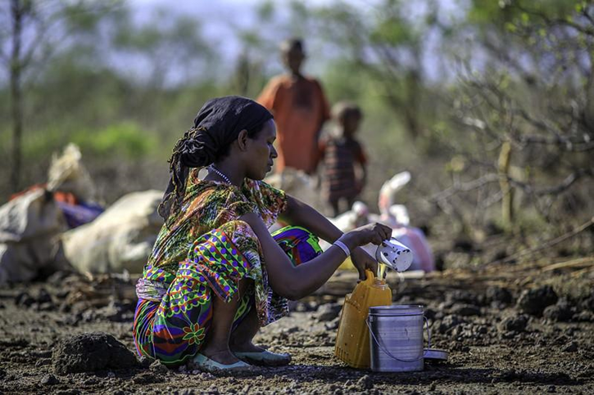
Group exercise
In pairs, pick a climate hazard prevalent in Ethiopia, which has negative impacts on different groups of people.
Discuss what it is about people’s exposure to the hazard (where they are) and their vulnerability / ability to adapt to the hazard (who they are) that makes a difference to their risk.
Hazards common in Ethiopia Drought, Epidemics, Flood, Earthquake, Hailstorm, Pests, Wildfire and Landslide

Slide 17
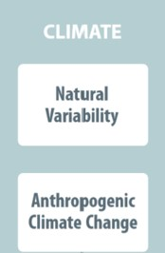
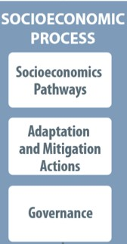
Step III: Understanding people’s different climate risks – questions to ask
Labour:
Who does what? How? Where? When? Why?
Access to productive resources (including natural resources):
Who uses what, how, where? When? Why?
Decision-making and control over productive resources:
Who controls what? How? Where? When? Why?
Knowledge:
Who knows what? How? Where? When? Why?
Benefit sharing:
Who benefits from what? How? Where? When? Why?
Participation:
Who is included in what? How? Where? When? Why?
Adapted from: FAO, 2011.
How is each of these affected by…?
from: IPCC, 2014
Notes:
This first slide into ‘how to’ do a gender analysis to find out how people are differently affected by climate change provides some overarching questions as entry points. (Later slides will provide a more detailed framework that participants could use, which has 36 indicators overall – this is a starting point.)
By doing a robust analysis of gender difference at the start of the project, following the overarching questions outlined in this slide, programme managers can:
Determine the types of activities needed in the implementation stage;
Assign the budget and resources necessary for building gender expertise, hiring gender experts, fieldwork, workshops and other necessary gender-responsive activities;
Have data to inform the monitoring and evaluation process.
…and ensure that the gaps, barriers and challenges preventing the equitable participation of women as decision-makers and beneficiaries can be overcome rather than reinforced.
A gender analysis also provides an insight into the differential perspectives and circumstances of women and men within the targeted policy/project/programme sector, including, but not limited to: their roles, needs, rights, priorities, access to and control over resources and decision making processes, as well as socioeconomic relationships as impacted by, for example, age, ethnicity, income, class and health. Gender analysis should also clarify the potential of the policy/project/programme to either reinforce or reduce the barriers caused by gender inequalities, while also identifying the various types of knowledge that both women and men can contribute in crafting effective and sustainable solutions.
Classic gender analysis questions are:
Who does what? How? Where? When? Why? (labour questions)
Who uses what? How? Where? When? Why? (access to natural resources questions)
Who controls what? How? Where? When? Why? (decision-making control and power)
Who knows what? How? Where? When? Why? (information=power)
Who benefits from what? How? Where? When? Why? (benefit sharing)
Who is included in what? How ? Where? When? Why (participation)
Source: FAO gender and climate change training guide (2011)

Slide 18
Speaking to women and men in separate groups can bring out differences in perspectives and priorities
Methods include
Holding separate women’s and men’s focus groups
Interviewing two or three members of each household
Enhancing discussion with participatory tools – including mapping / picture exercises (if desired)
Would you prefer to switch from normal rice to drought-tolerant rice, or switch to millet – which naturally grows better here in higher temperatures?
How do the floods affect your ability to secure food for the family? Do you have a coping strategy?
How does the drought affect your ability to access water for irrigation? Do you have a coping strategy?
How do marine heatwaves affect the availability of animals and seaweed and what you can use in the household or sell?
Notes:
Women and men may have different priorities for development. Depending on gender-proscribed roles they have in society and in the local economy, climate change may create greater burdens or opportunities for them.

Slide 19
How one study unveiled women’s and men’s different values and priorities
Coastal Kenya, Tanzania ESPA study
Culturally defined gender roles mean women are confined to low income opportunities.
Men are more likely to fish, women are more likely to collect seaweed.
Lesser access to funds, transportation (women), skills and knowledge (both women and men) act as barriers in different activities.
Formal and informal agreements reinforce gender divides e.g. trade is dominated by men.
Understanding difference can lead to gender-responsive development proposals.
Notes:
Facilitator/trainer: This is an example of a gender disaggregated research method – a household survey was used to understand women’s and men’s different resilience and the different ways that they valued the productive uses of natural resources. The researchers insisted on speaking to three people in each household, so this way, they spoke to at least one man and one woman (often wife and husband head of household) and one random other member, which also helped capture generational differences. The data was gender-disaggregated which allowed the researchers and local communities to understand how women and men benefit from different access to and control over natural resources and what this could mean for their resilience to changes in the natural environment.
The Ecosystem Services for Poverty Alleviation (ESPA) SPACES project: Sustainable poverty alleviation from coastal ecosystem services investigated elasticities, feedbacks and tradeoffs in the use of natural resources.
It studied the relationship between ecosystem services and the wellbeing of people living in eight villages along the coast in Mozambique and Kenya.
The research project found that access to and use of natural resources are unequally distributed across social groups in coastal populations. The distribution of benefits is determined by gender, ethnicity/migrant status, wealth/assets and other factors. For example access to, perception of, and aspirations for the use of natural resources are highly gendered. Culture and context influences how benefits are experienced and distributed to different types of people. This distribution can change through time due to social, cultural and economic developments but can also be directed and accelerated by the focus of governance regimes.
Specifically:
The ESPA SPACES team empirically investigated how women and men are able to benefit from natural resources (‘ecosystem services’) across eight communities in coastal Kenya and Mozambique. The results highlight different dimensions of wellbeing affected by the natural resource system, and how these are valued differently by men and women.
However, it is not just the division of costs and benefits that is gendered. Using a ‘ecosystem-wellbeing chain’, the researchers explain patterns within the primary data as an outcome of gendered knowledge systems, gendered behavioural expectations, gendered access to resources and gendered institutions. They conclude that this holistic, gendered understanding of ecosystem services – the natural resources on which the communities depend - is important not just for how the natural environment is viewed by local people, but also for the development and implementation of sustainable and equitable policy and interventions.
Men are more likely to take part in fishing and women are more likely to take part in seaweed collecting. Culturally defined roles for women and men in coastal tropical regions have led to women being confined to low income opportunities.
In general, both men and women place higher value on items that they have harvested themselves and it’s not just about the economic value. In the mangroves, men form social relations associated with collective pole harvesting and house building, so they value poles highly. Whereas for women collecting firewood in the mangrove is an opportunity for autonomy, while the social interaction allows a space for the discussion of taboo topics between them.
When it comes to activities that provide income, such as fishing, things are a little different. Despite not being directly involved in fishing, women place very high value on fish, even though men capture most of the benefits. This suggests that both men and women see female work as secondary - gendered asymmetries exist for fish trading and tourism too.
Traditions and norms create gendered spaces. The sharing of ecological knowledge, for example on medicinal plants, is also gendered with older women teaching girls and older men teaching boys. There are behavioural expectations. For instance, men were constrained from activities like shell collecting, because that was considered as female.
Access to funds, transportation, skills and knowledge act as barriers in different activities. Formal and informal agreements also play a role in reinforcing gender divides in access. Patron-client relations in trade, for example, are dominated by men.
Based on their findings, the authors argue that deeper institutional reforms such as rights-based interventions are needed to allow women to benefit from ecosystem services.
“Understanding the role of gender in ecosystem services helps researchers and practitioners to avoid exacerbating biases, or enhancing gendered vulnerabilities, and to identify where interventions can make a difference,” they conclude.
The above summary is excerpted from: https://stockholmresilience.org/research/research-news/2019-03-17-ecosystem-services-for-men-ecosystem-services-for-women.html
The published peer review article is available here: The Gendered Nature of Ecosystem Services, https://www.sciencedirect.com/science/article/pii/S0921800918301836
For more information: www.espa-spaces.org and http://www.espa-spaces.org/spaces-publication-men-and-women-use-experience-and-value-coastal-ecosystem-services-differently/

Slide 20
Group exercise: Climate and Social Lottery’ Game
In small groups, talk again about a climate hazard and how it affects different people in different ways using the gender analysis questions. E.g. imagine a storm is coming, there is an early warning of floods… who is more resilient and why? Imagine a heatwave is coming, who is more resilient and why?
Questions for gender analysis | How does the climate hazard affect people differently? Why?
Labour and access to productive economic resources including natural resources – who uses what, how, where, when, why? | ?
Decision-making and control over productive resources including natural resources – who uses what, how, where, when, why | ?
Knowledge: who knows what, how, where, when, why? | ?
Benefits: who benefits from what, how, where, when, why? | ?
Participation: who is included in what? how? where? when? why? | ?
Notes:
For the facilitator/trainer: This optional group exercise could be played as a standalone if the level of knowledge about community affairs and different social groups’ resilience/vulnerability is very high in the trainee group and if people all come from the same geographic place, e.g. they all come from the same city or region where the climate hazards and their social/socioeconomic impacts are well known. In this case, choose a climate hazard to discuss which is most relevant to that location and to the trainees.
Temperatures
Rainfall
Extreme weather events (droughts, tropical storms, heatwaves, etc)
Sea level rise (slow onset as well as storm surges)
Secondary cascading events, such as floods, landslides, wild fires, etc.
If it is a mixed group of trainees from diverse places, then this could be played by handing out the ‘Climate and Social Lottery’ cards from the prepared CDKN sets, and doing a quick round, using these questions as prompts. It is a ‘quick’ version of the game that could take up to 15 minutes. Each person reads their character card and describes to the group ‘who’ they are and how they would answer the above questions in the context of the scenario described (note that playing the full ‘Climate and Social Lottery’ Game, with its full two rounds, would take up to 90 minutes.

Slide 21
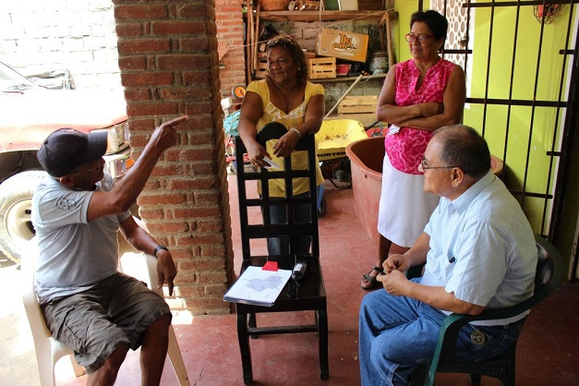
Next: Introduction to Key Tools to help understand people’s resilience and their needs

Slide 22
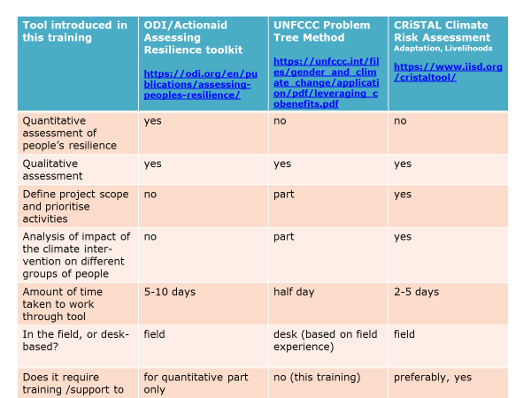

Slide 23
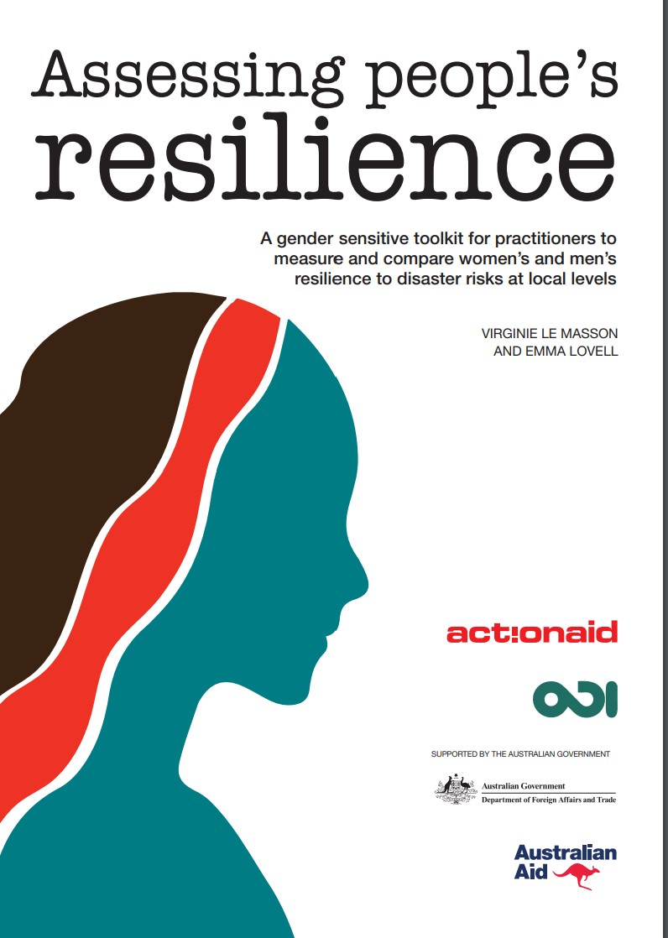
Assessing resilience: ODI-Actionaid tool
The Climate Resilience Index: A tool for measuring people’s resilience and their different vulnerabilities
Workbook takes you step-wise through questionnaire, with same questions for women and men but administered separately. Can also be applied to different social / ethnic groups
Generates quantitative and qualitative results
Notes:
Facilitator/trainer: this is one example of a tool that can be used to assess people’s resilience to climate change impacts – and to do so differentially for women and men in an area. There is also the possibility to apply the tool to different social/socioeconomic, ethnic or caste groups or age groups/generations, and then to collect disaggregated data for women and men within those groups.
This is the first of several tools to assess people’s climate risks, their resilience, and to prioritise interventions that effectively reduce risk and build resilience.
The workbook can be downloaded here: https://www.odi.org/publications/10590-assessing-people-s-resilience
Sharing the slides here may be sufficient for purposes of guiding a high-level discussion about gender and social inclusion in climate programmes and projects and showing generally how the tool works.
Also, using the questionnaire in the workbook and the questions it poses about differential access to and control over economic, social, institutional and infrastructural resources (36 indicators) may – in a qualitative sense - be sufficient to guide project work.
However, if more in-depth support is needed, eg, access to the underpinning Excel spreadsheet with its formulas which would need to be used to provide the quantitative scores that are mentioned in the workbook, then the Excel spreadsheet and any advisory support in using it can be accessed through ODI or Actionaid. Contact m.dupar@odi.org.uk, e.lovell@odi.org.uk and v.lemasson@odi.org.uk for the spreadsheet and for any Q&A.

Slide 24
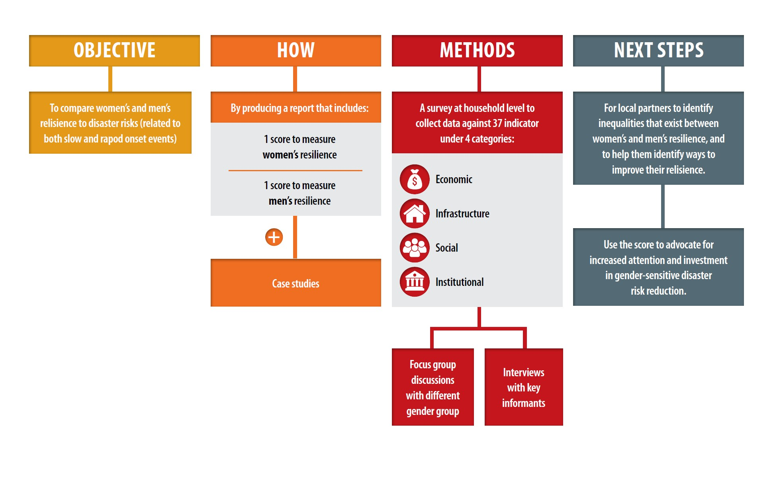
Assessing resilience: ODI-Actionaid tool
Notes:
This is how the tool works:
The objective is to compare women’s and men’s resilience to disaster risks caused by climate change and which are both slow and rapid onset in character. E.g. the tool is equally valid for assessing preparedness for tropical storm risk or sea level rise or drought.
It generates a score to measure women’s resilience and a score to measure men’s resilience and these can be combined with case study narratives that are prepared, in parallel, through field research.
Importantly, the tool can also be used to generate scores for multiple social groups (and the women and men within them) e.g. minority and majority ethnic groups, upper castes and lower castes, and so on. This illuminates how intersectional factors make a difference to people’s resilience.
“Intersectionality is a way of understanding the interaction between categories of social difference and how these affect individuals, social practices, cultures, institutions and power relationships. It provides insights into the ways in which different factors or identities interact, such as gender, age, disability and ethnicity, thereby providing a better understanding of people’s needs, interests, capacities and experiences. Intersectional approaches take historical, social and political contexts into account, recognising that vulnerable and marginalised groups are neither homogenous nor static, and different factors will influence their ability to prepare for, cope with and respond to natural hazards, climate change and climate variability.” – (Source: Emma Lovell, ODI (2019). Read more here: https://www.odi.org/sites/odi.org.uk/files/resource-documents/12696.pdf )
To help generate the quantitative scores a survey at household level is carried out which populates indicators under the four categories shown.
Qualitative data is collected – further – in focus group discussions with different gender groups and interview with key informants.
The ‘generic’ next step is for project partners, which could include local governments, to identify inequalities between women’s and men’s resilience and ascertain whether any special targeted activities are needed to level everyone up to higher levels of climate resilience.
In this training pack, we will be exploring tools for planning climate interventions and prioritising resilience activities in the next module.

Slide 25
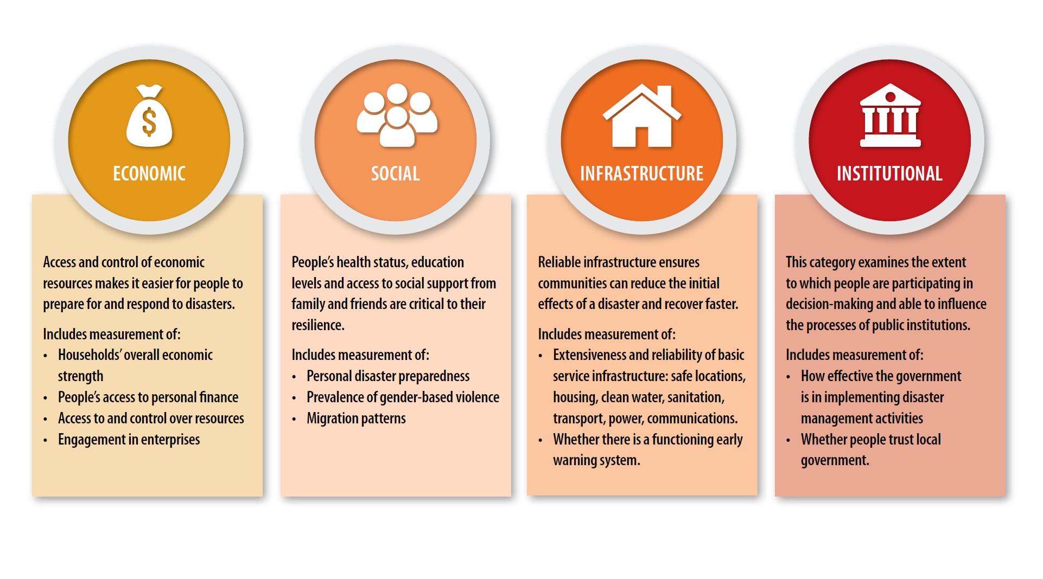
Understanding resilience: ODI-Actionaid tool
Questionnaire investigates the following four areas, to help populate relevant indicators for women and men (and, if desired, different social / ethnic groups)

Slide 26
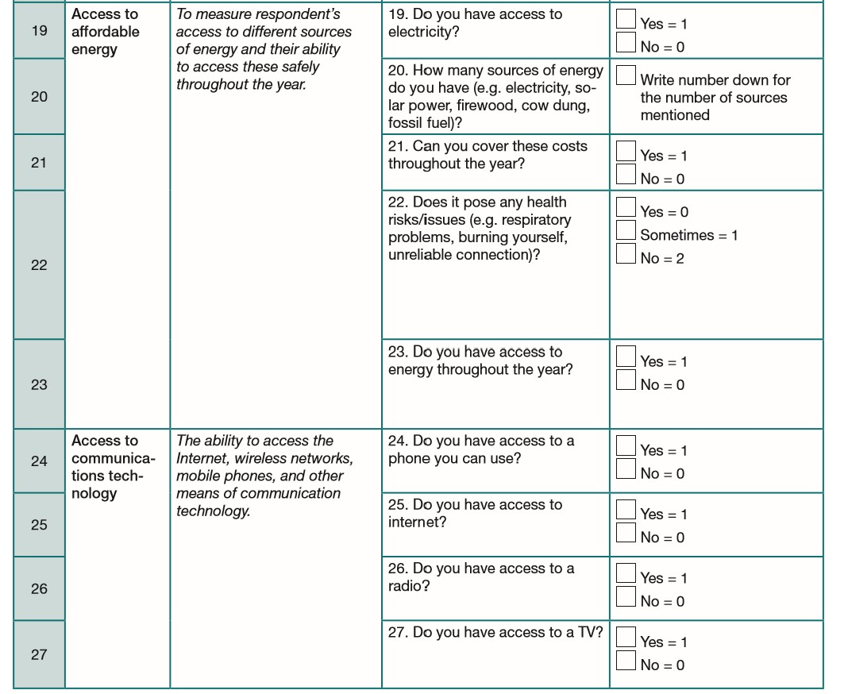
Understanding resilience: Tool
Sample of simple survey questions from the toolkit
Notes:
This toolkit is aimed at scoring the gender sensitive resilience of local communities. It uses four categories (as described in the slide above: Economic, Social, Institutional, Infrastructural) with a set of 36 indicators to assess different aspects of people’s resilience at the community level. Practitioners must collect responses from an equal number of women and men for each indicator. This will result in two resilience scores: one for women and one for men, which can then be compared to demonstrate any inequalities that exist.
The workbook can be downloaded here: https://www.odi.org/publications/10590-assessing-people-s-resilience
Facilitator/trainer: if you would like to take people through the tool as a guidance for qualitative work, then please distribute copies of the whole workbook to them AND/OR if you would like to contact ODI/Actionaid for the Excel spreadsheet into which people can input the data values shown in the workbook, in order to generate resilience scores for different groups of people in a community, then also please distribute copies of the whole workbook to participants.

Slide 27
Case study: Gender and intersectional vulnerabilities
Nepal case study: based on the ‘Measuring people’s resilience’ tool, investigated disadvantaged groups and gender differences. It looked at the resilience of women and men from different ethnicities/castes in relation to flooding in Bardiya district.
Men are more resilient to natural hazards and climate change than women, whichever caste/ethnic group they come from.
Men have more access to economic resources and to information about climate hazards.
Women feel less safe in emergency shelters.
Notes:
Facilitator/trainer: an example of how the tool has been used.
The ‘Measuring people’s resilience’ toolkit described above was used to investigate how intersectional characteristics of groups of people might affect their vulnerability and adaptive capacity to climate change impacts. The Nepal case study investigated disadvantaged groups and gender differences. It looked at the resilience of women and men from different ethnicities/castes in relation to flooding in Bardiya district.
In a case study by the BRACED programme in Nepal the research focused on two intersecting vulnerability factors and aims to understand the different experiences of men and women within different ethnicities/caste: Disadvantaged groups (Disadvantaged groups are the ethnicity/caste groups which belong to the categories of Dalits, disadvantaged Janjatis and disadvantaged Madheshis) and other groups (All caste/ethnic groups which do not fall under the disadvantaged groups, belong to this category). The fieldwork took place in one location - Bardiya - which is exposed to flooding.
The quantitative study indicates that men are more resilient to natural hazards and climate change than women. There is a statistically significant difference between men and women within both disadvantaged and other groups (this is particularly evident in institutional and social components). In general, men have better access to and control over financial resources, as well as higher earning capacity. Women appear to be less able to cope with a disaster or shock. In terms of location and the built environment, there is marginal difference. Men participate more in public decision-making processes, where their views are more likely to be listened to than those of women. The results show no significant difference overall between the resilience scores of the two types of social group. The differences between women and men are larger and more significant within the disadvantaged groups than the other groups (owing mainly to their scores in the social and institutional components of the index), but there are significant differences between women and men in the scores for both types of group.
Economic resilience
Men appear to have better access to, and control over, financial resources and therefore have more economic capacity to anticipate and smooth the economic impact of a shock. Survey evidence suggests there is a significant
gap between the number of women and the number of men who report having the same type of access to financial resources as other family members. The difference between women and men is substantial in the disadvantaged social group: 71% of women report having similar access to others, compared to 91% of men. Women are also less convinced than men that migration gives them and their families a better income.
The survey findings show that the most important difference between men and women is capacity to earn cash on a daily basis. On average, 43% of the sample earn some cash every day, but the difference between women and men is substantial. In the disadvantaged social group, 12% of women and 63% of men can earn cash daily; in the other social group, 27% of women and 72% of men can earn on a daily basis.
There is also a statistically significant difference between women and men in their ability to repay loans on time: 44% of women and 89% of men from the disadvantaged group and 58% of women and 88% of men from the other group can repay loans on time.
Social resilience
The survey results reveal that the difference between women and men in average social resilience is large and statistically significant: women are 10 percentage points (45% compared to 55%) less resilient than men to natural hazards and climate change. In the disadvantaged social group, the difference between women and men is even more pronounced: these percentages are 42% and 57% respectively.
Women are far less likely than men to receive information from official sources (e.g. government announcements) in both groups (scores for those stating they receive such information are 26% and 86% respectively in the disadvantaged group, and 42% and 64% in the other group).
Among women, questions around food security demonstrate differences between social groups. Only 32% of women from the disadvantaged group felt there was enough food in the household to feed everyone adequately throughout the year, against 62% of women from the other group.
Women are less convinced than men that migration gives them and their families a better income (29% and 49% respectively from the disadvantaged group, and 38% and 64% from the other group).
Infrastructural resilience
The survey results show that the difference in average infrastructure resilience between men and women is not statistically significant.
Access to phones and radios and fetching water for the household are the main areas where results differ between women and men. Men have better access to phones than women, which makes them more likely to be the first recipients of early warning messages; 65% of women from the disadvantaged group fetch water for their households, while 46% of women (compared to 32% of men) from the other group do.
Women feel much less safe in public shelters during disasters than men: 18% and 34% respectively from the disadvantaged group, and 27% and 56% from the other group. It is noteworthy that men from disadvantaged groups also feel unsafe: this could perhaps be due to fear of discriminatory practices.
(source document: https://www.odi.org/sites/odi.org.uk/files/resource-documents/12930.pdf)

Slide 28
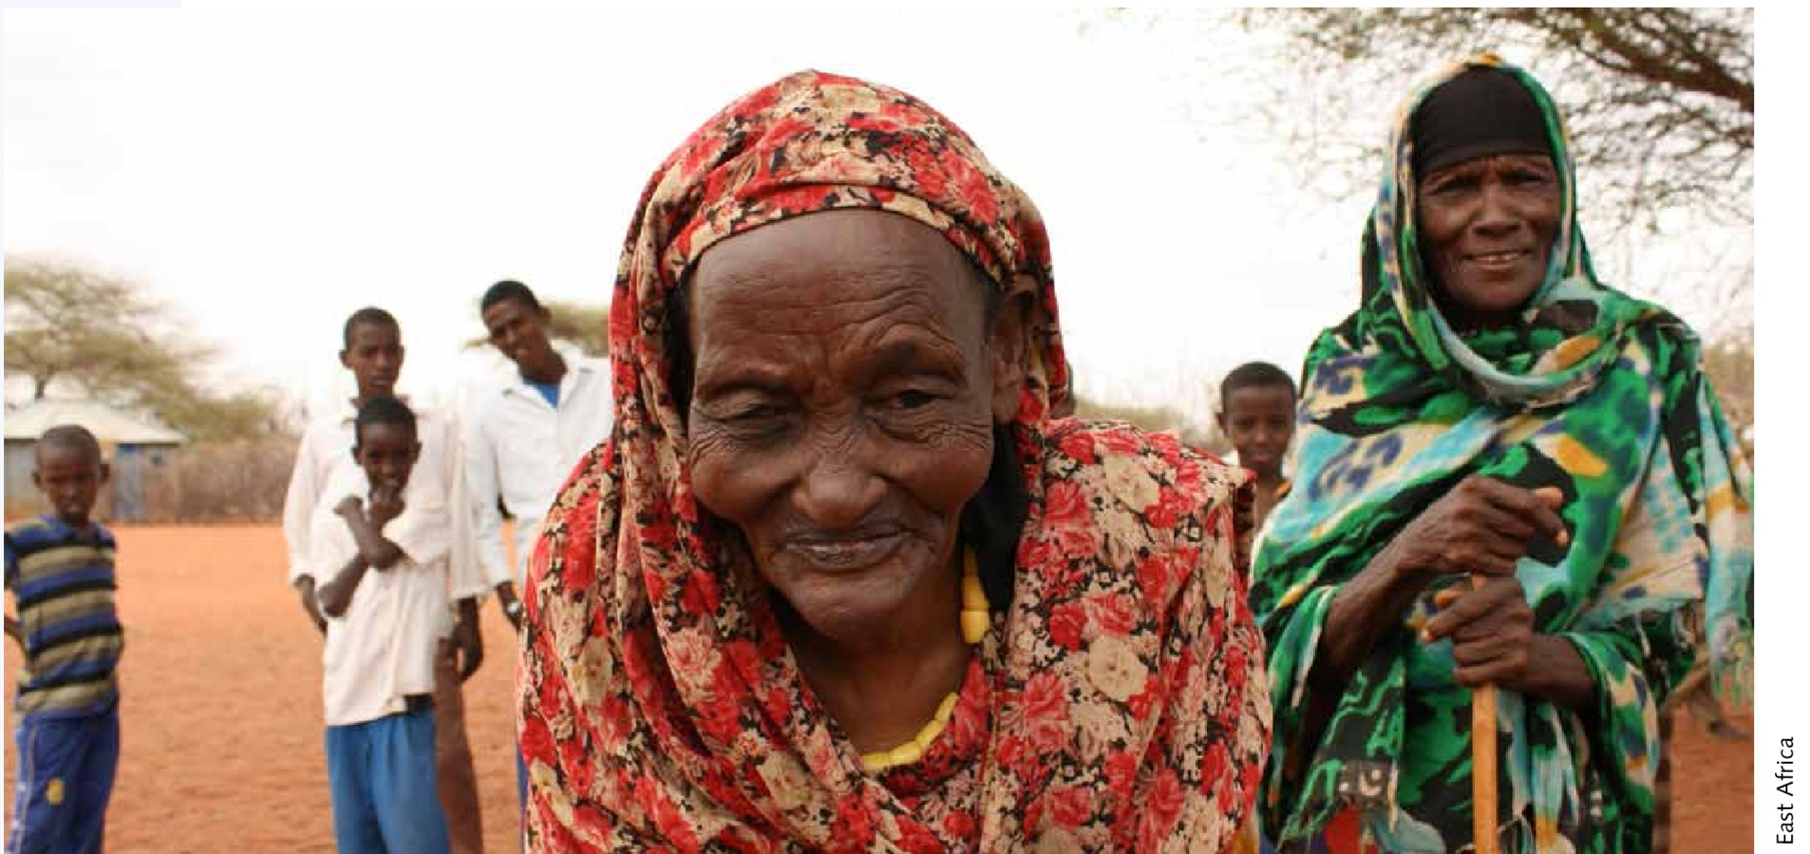
Case study: Gender and intersectional vulnerabilities
Kenya case study: women and men with and without political representation (majority/minority ethnic groups), in the context of drought in Wajir county.
Focus group discussions - qualitative study - highlight gender-based violence, women’s lesser access to economically productive resources.
However, puzzling quantitative results do not show difference in resilience among groups (ethnically or gender based).
Notes:
Facilitator/trainer: an example of how the tool has been used.
The ‘Measuring people’s resilience’ toolkit described above was used to investigate how intersectional characteristics of groups of people might affect their vulnerability and adaptive capacity to climate change impacts. The Kenya case study focused on two intersecting vulnerability factors and aims to understand the different experiences of men and women with and without access to resources and political representation, in the context of recurrent and widespread drought in Wajir County, Kenya.
The qualitative component (interviews, focus groups) shows that gender inequalities are a major constraint facing women in Wajir. They have less access to and control over natural resources; less opportunity to earn an income; less access to education or training; participate less in decision-making processes; they do not enjoy equal rights to inheritance of assets; and their domestic burdens restrict development of other livelihood opportunities. Gender-based violence was identified as a pressing issue, and migration for work was highlighted as a common response to poverty. Ethnic minority groups find it difficult to access assets and political epresentation, particularly in Wajir. There is strong competition for natural resources, leading to disputes and conflict between communities.
The quantitative survey findings were puzzling. Resilience scores (overall and across the four resilience components) do not demonstrate statistically significant differences in average scores between women and men and between the social groups.
This unexpected finding is difficult to explain, especially as a significant proportion of people who participated in the Key Informant Interviews and Focus Group Discussions felt strongly that social inequality (such as clan affiliation, gender and power relations, literacy levels, disability, age, and social ties) was a key factor in adapting to natural hazards and climate change. Men have a slightly higher score regarding social resilience and food security, as well as in terms of access to information through newspapers.
Summary of survey results by components of resilience:
Economic resilience
59% of respondents in the survey felt that economic factors were an important consideration in their resilience, and reported experiencing increased risk as a result of poor natural resource management.
Interviews and focus group discussions linked low adaptive capacity to access to and control of resources. Factors like gender inequalities, lack of diversification of livelihood options, limited political representation.
Differences in engineered infrastructure are driven mostly by gaps between different villages, and therefore those politically represented or not, as opposed to between women and men.
Social resilience
Women from the group without political representation (minority ethnic group) reported having problems with food security. Only 18% of women (compared to 24% of men) from this group thought their diet was sufficiently balanced, and only 28% of women (compared to 38% of men) from this group said it had improved in the previous five years.
Nonetheless, the difference between women and men in average social resilience is not statistically significant.
Infrastructural resilience
There is no difference in average infrastructure resilience between women and men.
There are some differences between social groups. For example, 14%–18% of respondents (variation depending on sex) from the group without political representation, compared to 24%–43% of respondents from the other social group, reported having access to good quality roads.
Similar differences were found in access to electricity (10%–17% from the group without political representation; 47%–55% from the other social group), environmentally friendly inputs and technologies (10%–17% from the group without political representation; 19%–50% from the other social group) and safe toilets (27%–48% from the group without political representation; 60%–74% from the other social group).
Institutional resilience
The overall level of institutional resilience is 47% for women and 49% for men. This gap is small and not statistically significant, suggesting that both women and men are participating in decision-making and public institution processes.
On average, 73% of respondents reported taking part in community decisions.
Source: https://www.odi.org/sites/odi.org.uk/files/resource-documents/12931.pdf

Slide 29
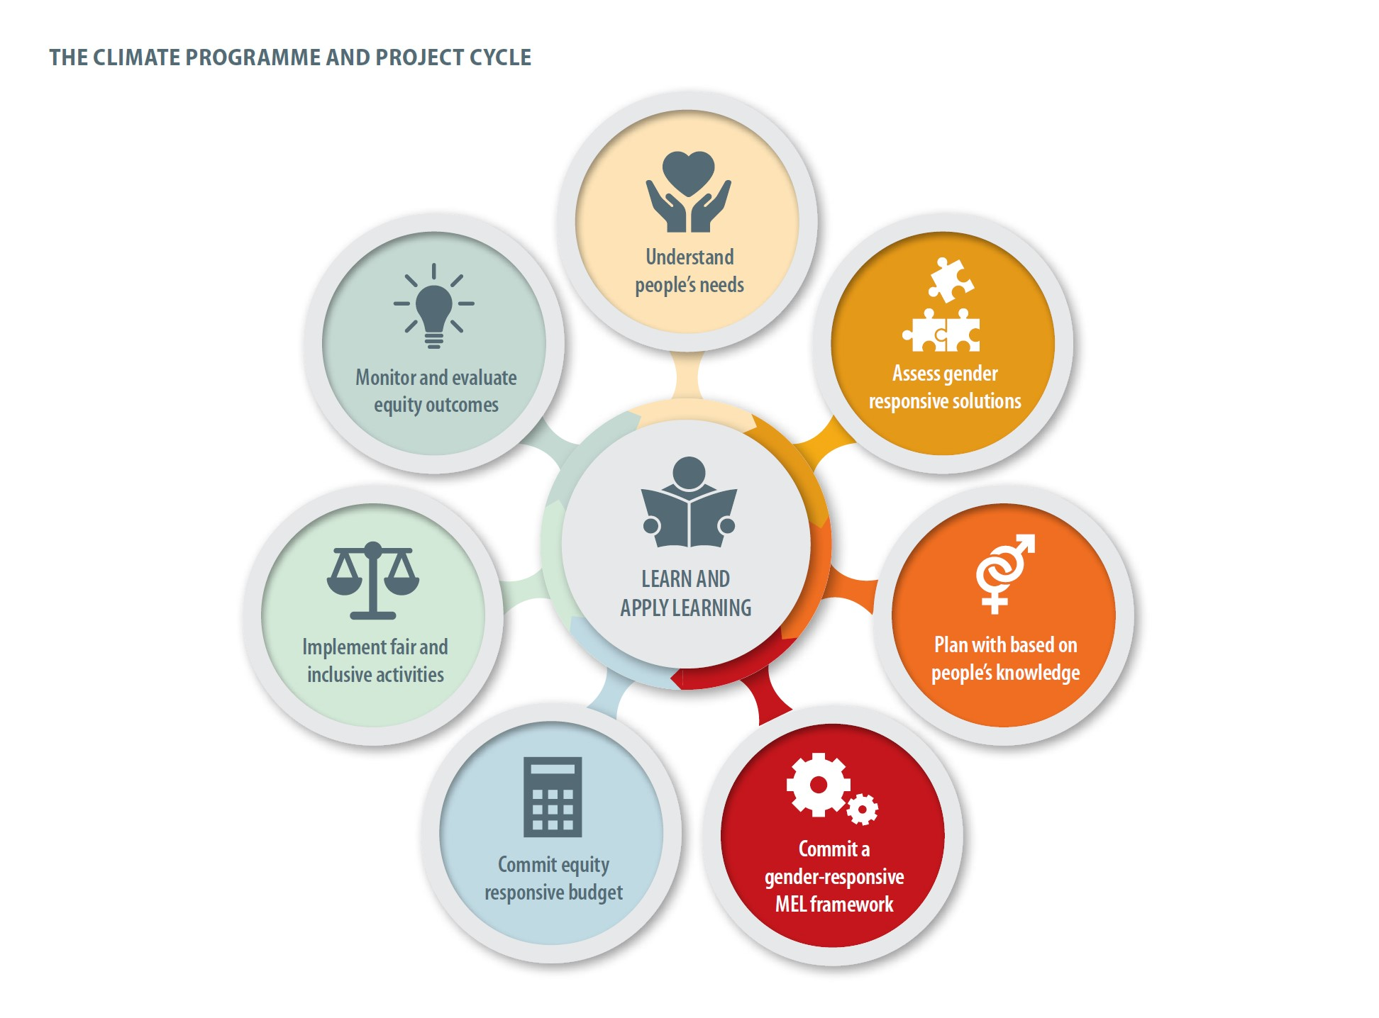
The next step in the project or programme cycle
…is to assess options and plan for gender-responsive and socially inclusive climate action and set targets. Follow the next module.

Slide 30
www.cdkn.org
@cdknetwork
Notes:
Facilitator: insert your name and email/contact here

