Slide 1
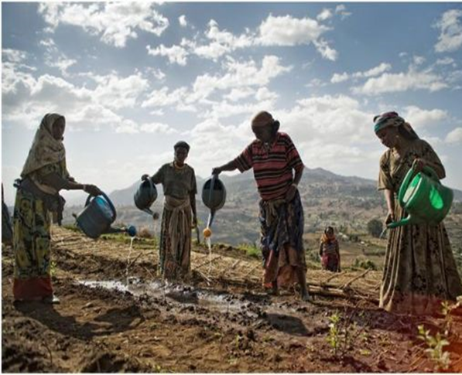
Climate compatible development: Why is a gender-equitable and socially inclusive approach needed? Image: Un Women
Notes:
Facilitator/Trainer: We revisit different aspects of poverty and wellbeing, and the different things that make people more resilient or vulnerable to climate change here. We term the slides ‘socially inclusive’ as well as ‘gender responsive’ but the emphasis, overall, in this module is on looking through the gender lens and the ways that women overall, are over-represented among the poorest and most climate vulnerable people, and what can be done specifically to empower women to ‘catch up’ in terms of their personal development and enhanced life chances, within these more vulnerable groups.

Slide 2
What you will learn from this module
Understand the key concept of Gender Equality and Social Inclusion
How people are differently impacted by climate change
Why gender matters in climate change actions– and what it means for effective climate action
How to think about the intersection of gender and other forms of social inclusion or exclusion in relation to climate change action

Slide 3
Session I Basic GESI Concepts

Slide 4
Sex vs Gender: Exercise
Write on your notebook, using the template, those characteristics or attributes which you consider to be typically female and typically male without pausing to think too long
Share what you wrote on your notebook under each columns
Exchange the title “man” and “woman”. Discuss if all the listed words/phrases still apply for the other party one by one
Discuss on the ones which do not apply for the other party
Typical woman characters | Typical man characters
Notes:
Draw the table on flipchart, and Ask participants to do the following exercise on their notebook.
Ask participants to write on their notebook, using the template, those characteristics or attributes which they consider to be typically female and typically male without pausing to think too long
Ask volunteers to share what they wrote on their notebook under each columns-WRITE IT ON FLIPCHART
Ask them to exchange the title “man” and “woman”. Ask participants to discuss if all the listed words/phrases still apply for the other party one by one.
Now, discuss on the ones which do not apply for the other party In most cases these ones tend to be “natural or biological” characteristics of men and women which cannot be changed.

Slide 5
Gender Stereotype: Group Exercise
Divide into groups.
Half of the group brainstorm on how gender stereotypes are limiting or restrictive to men
The other half brainstorm on how gender stereotypes are harmful to women
Notes:
Divide participants into groups.
Ask half the groups to brainstorm how gender stereotypes are limiting or restrictive to men.
Ask the other half to brainstorm how gender stereotypes are harmful to women.
Show participants these short videos
https://www.youtube.com/watch?v=xerZgFwZgxo&list=PPSV
https://www.youtube.com/watch?v=Ulh0DnFUGsk&list=PPSV

Slide 6
Intersectionality
The interplay of multiple social characteristics (such as gender, race, class, disability, marital status, immigration status, geographical location level of education, religion, ethnicity) increases vulnerability and inequality in privilege and power, and further entrenches inequalities and injustice
Not all vulnerable populations are equally disadvantaged or excluded
Some vulnerable populations may face both gender inequality and social exclusion simultaneously, making them more vulnerable than others
Women with disabilities may face double marginalization because of gender norms, stereotypes and stigma towards persons with disabilities
Adolescent boys living in extreme poverty may be exposed to higher risks of community violence (due to age and socio-economic status)

Slide 7
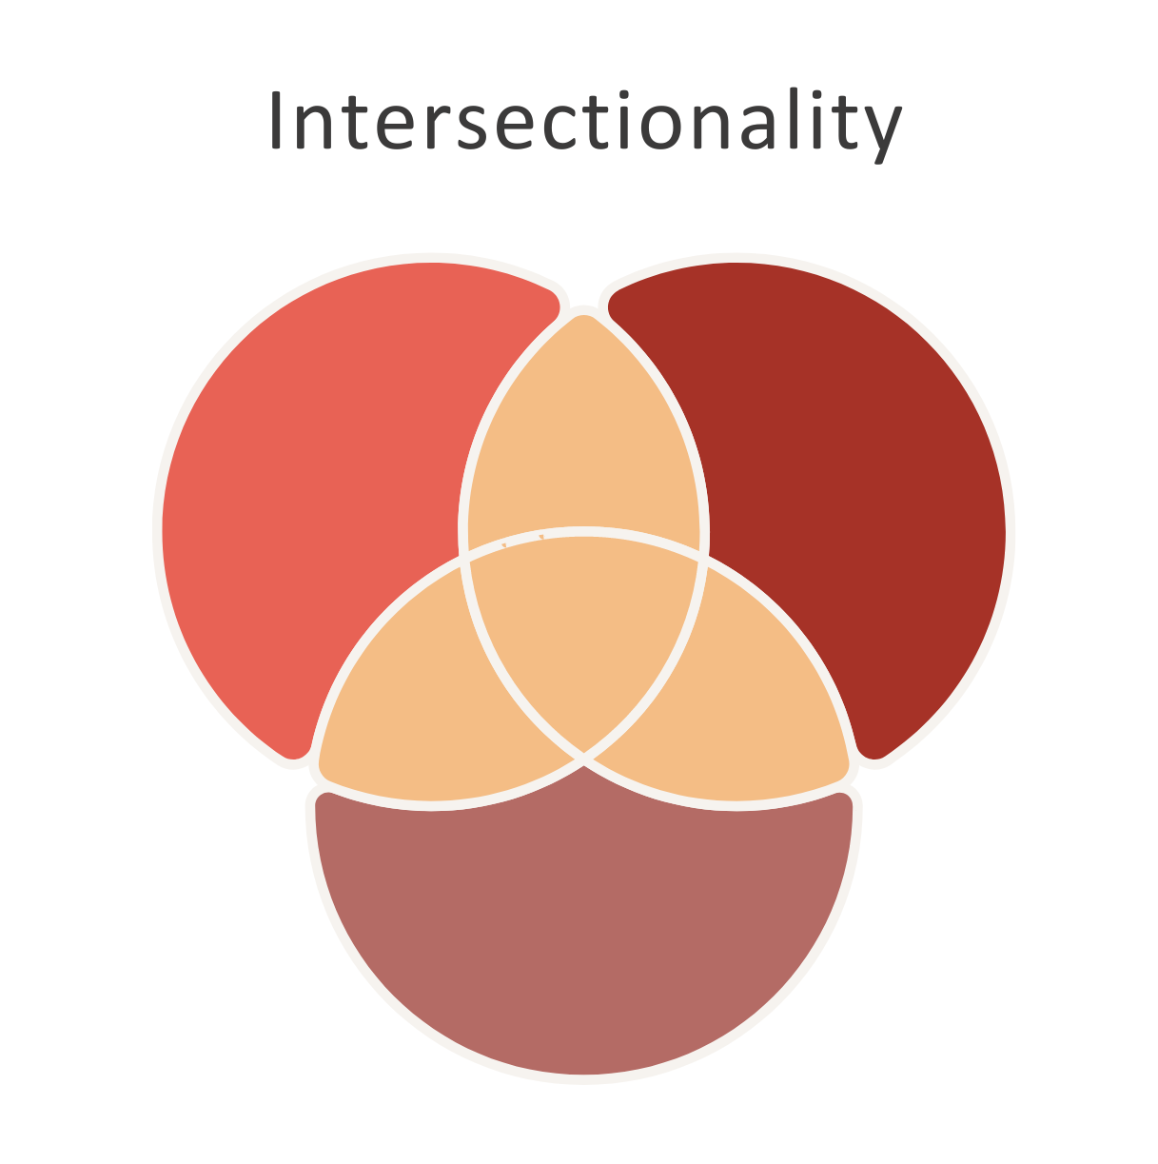
Intersectionality - CASE STORY
Form small groups and read
case story
Discuss the following:
What are Hasab’s vulnerabilities?
Identify the multiple identities involved and how those impact the inequality and exclusion challenges faced by Hasab.
Where does this exclusion come from?
Present your group’s discussion outcomes and key learnings
Notes:
Key Learnings
There are many factors that affect marginalization e.g. sex, age, location, ethnicity, access to different types of power etc.
Gender is one of the basis of discrimination
Power-relations have a huge impact on who we are, and what we can be, how we access opportunities and realise our potential
For those who are left behind it is impossible to catch up without specific targeted assistance.
If we want to bring about EQUALITY among all men and women, we would have to put into place specific mechanisms such as EQUITY MEASURES

Slide 8
Equality and Equity
Equality of Opportunity
Treating everyone the same, regardless of outcomes. E.g. providing everyone a shoe
Is about sameness. It promotes fairness and justice by giving everyone the same thing.
However it can only works if everyone starts from the same place
This can lead to serious inequalities, for groups that have been disadvantaged by a system that fails to take their situation and perspectives into account
Equality, however, is essential at outcome level in development initiatives
Equity
Refers to fairness which may require different treatment, or special measures, for some persons or groups.
Is concerned with equality of outcomes; e.g., providing everyone a shoe that it fits
It is about making sure people get access to the same opportunities by addressing barriers specific to a group through positive discrimination / affirmative action
The Affirmative action is not to discriminate by conferring favours, but to achieve equal outcomes for people who have encountered disadvantage in relation to those people who have not

Slide 9
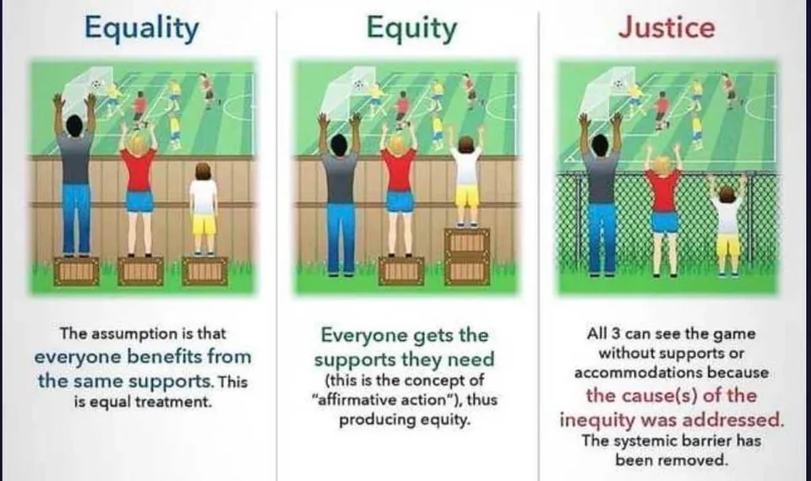

Slide 10
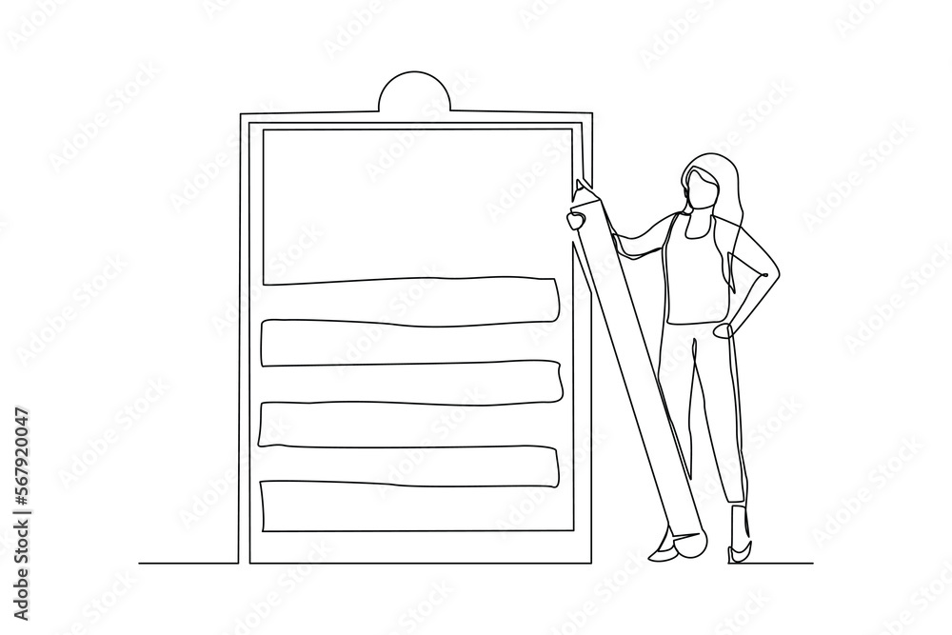
What do you understand about the concepts of GESI?
5 min
5 min
5 min

Slide 11
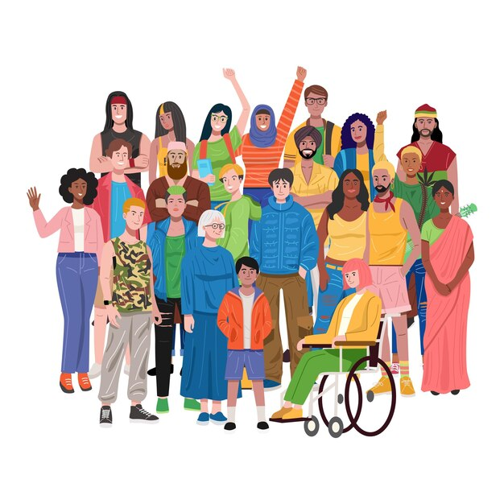
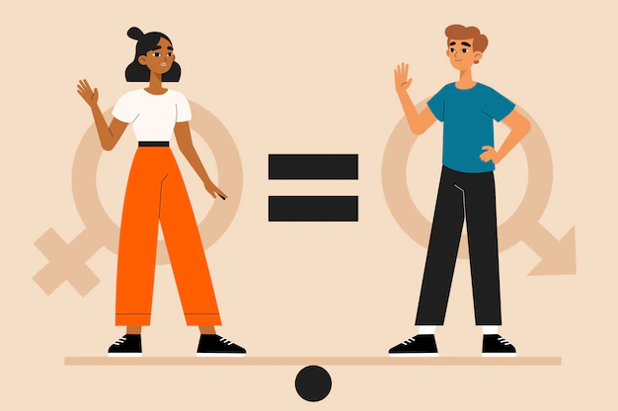
Gender Equity and Social Inclusion (GESI)
Gender Equality
Social Inclusion
Seeks to address inequality and/or exclusion of vulnerable populations by improving terms of participation in society and enhancing opportunities, access to resources, voice, and respect for human rights
The state or condition that affords women and girls, men and boys, equal enjoyment of human rights, socially valued goods, opportunities, and resources
Aims to create enabling environments for all to engage in and benefit equally from development interventions
It is a process of change that addresses the root causes of inequality and exclusion
A process to remove barriers and increase access, decision-making and participation of the most vulnerable groups of the community

Slide 12
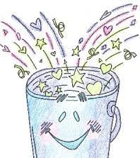
Session Summary – Exercise
Each of you will receive a term or definition of what has been discussed so far
Go around and pair with the person who has the matching word or definition
Come forward and explain the terms and if you believe the definition accurately represent the term

Slide 13
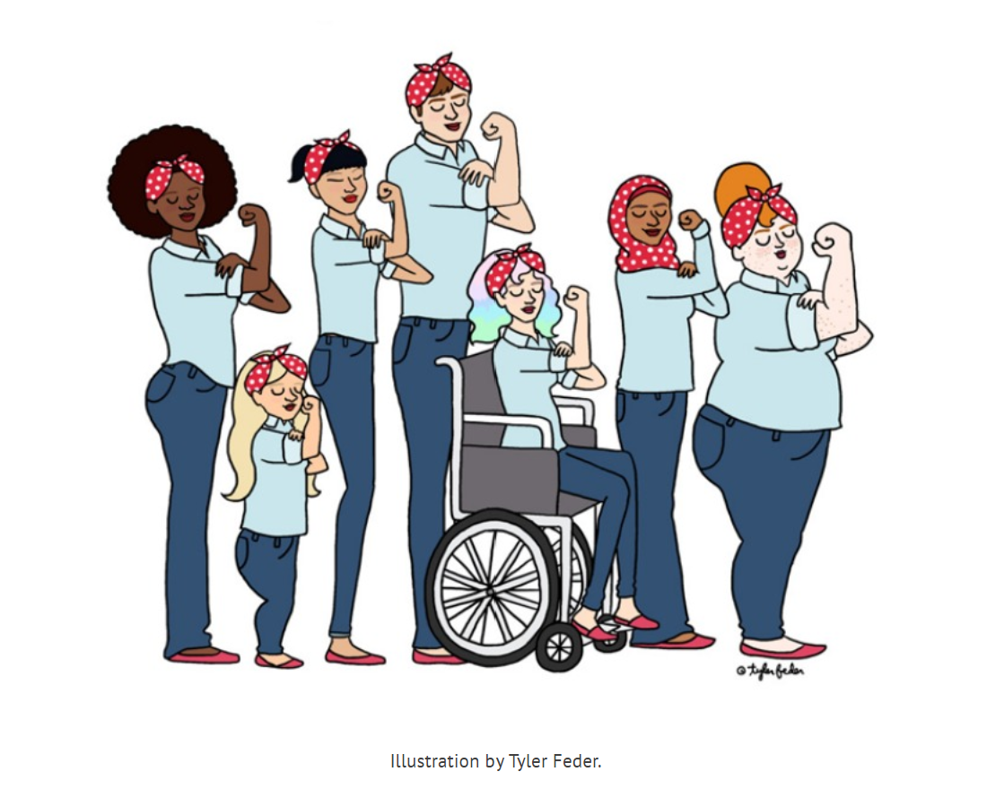
Beyond the numbers: we are all individuals
Our diversity makes each of us special and gives us strength – as well as influencing how society sees us and treats us.
Notes:
We can acknowledge how everyone has many characteristics and how they are viewed by society (and the opportunities this provides, or discrimination they experience) can be based on the interplay between gender and other forms of discrimination, like race, age, class, socioeconomic status, physical or mental ability, gender, religion, or ethnicity.
The barriers faced by a middle class woman living in Addis Ababa are not the same as those of a poor woman living in rural areas of Gambela or Afar. Or the Challenges faced by women in the managerial position are different than that of women participated in the informal economy. Women aren’t just exposed to sexism. “Racism, ableism, ageism, and religious persecution are intrinsically linked to how [women] experience inequality.” – International Women’s Development Agency (IWDA), Australia, https://iwda.org.au/3-ways-to-be-an-intersectional-feminist-ally/

Slide 14
Session II The situation of women

Slide 15
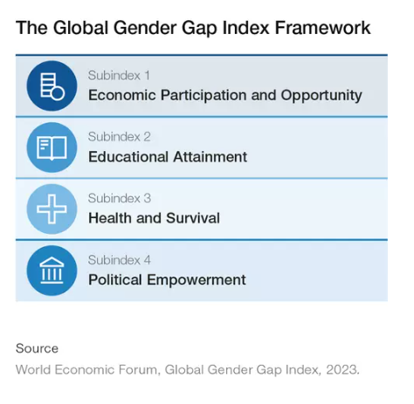
There is a global gender gap in development World Economic Forum (2023) Gender gap calculated annually as follows, visit www.weforum.org :

Slide 16
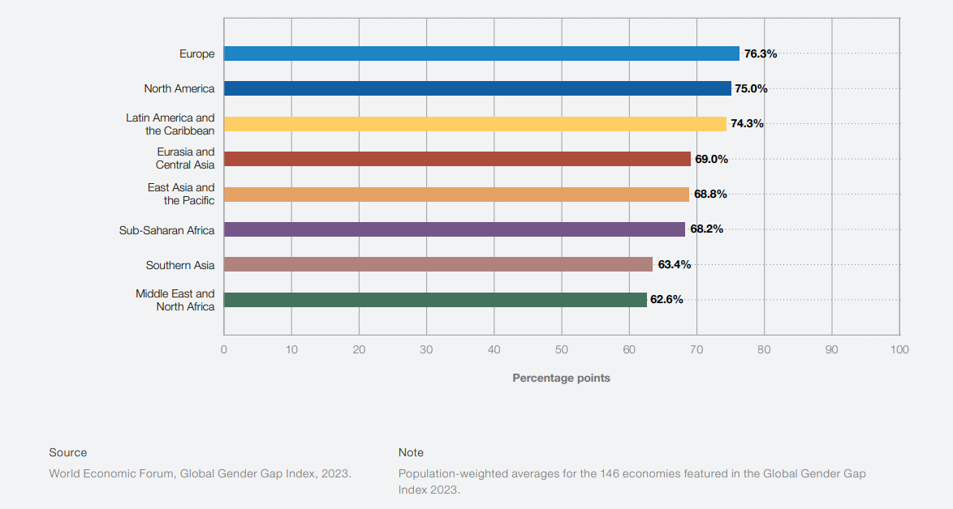
There is a global gender gap in development World Economic Forum (2023) Gender gap by region

Slide 17
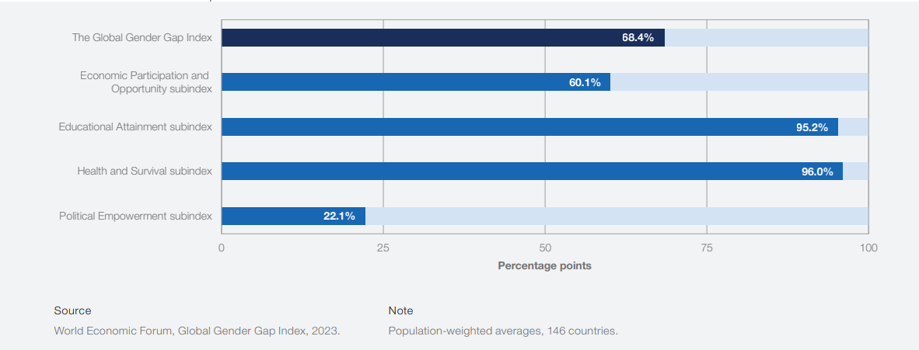
There is a global gender gap in development World Economic Forum (2023) Gender gap by subindex, globally

Slide 18
Ethiopia’s HDI and GDI values, 2021
Ethiopia’s HDI value for 2021 - 0.498
The 2021 female HDI value for Ethiopia is 0.478 in contrast with 0.519 for males
Places it in the low human development category
Positioned at 175 out of 191 countries and territories.
Ethiopia’s GDI value is 0.921, Placing it in group 5
Ethiopia has a GII value of 0.520, ranking it 129 out of 170 countries in 2021
Notes:
Human Development Report 2021/22: hdr2021-22pdf_1.pdf (undp.org)/ Specific country data | Human Development Reports (undp.org)
GDI
Group 1 countries have high equality in HDI achievements between women and men: absolute deviation less than 2.5 percent;
Group 2 has medium-high equality in HDI achievements between women and men: absolute deviation between 2.5 percent and 5 percent;
Group 3 has medium equality in HDI achievements between women and men: absolute deviation between 5 percent and 7.5 percent;
Group 4 has medium-low equality in HDI achievements between women and men: absolute deviation between 7.5 percent and 10 percent; and
Group 5 countries has low equality in HDI achievements between women and men: absolute deviation from gender parity greater than 10 percent.
http://hdr.undp.org/en/content/what-advantage-grouping-countries-five-gdi-groups-instead-ranking-them-according-absolute

Slide 19
The situation of women in Ethiopia described in numbers
Global Gender Gap Index (GGI) (2023): ranked 75th out of 146 countries-HUGE IMPROVEMENT from its 2017 rank but one spot lower than that of 2022. In 2017 it was ranked 115th out of 145 countries. Breaking down this result into sub-indexes,
Economic participation and opportunity: ranked 116th;
Educational attainment: ranked 135th;
Health and survival: ranked 67th and
Political empowerment: ranked 25th
Notes:
Sources: Global Gender Gap Report 2023; World Economic Forum; WEF_GGGR_2023.pdf (weforum.org)
https://www3.weforum.org/docs/WEF_GGGR_2023.pdf?_gl=1*3t48le*_up*MQ..&gclid=CjwKCAiA-bmsBhAGEiwAoaQNmpHwbjerdYyUf0hCVU-1VoX9sMZlHmv5jEyToFf4LJl6kErjnJxUXxoCBU8QAvD_BwE

Slide 20
Notes:
Women-in-politics-2023-en.pdf (unwomen.org)
Out of 22 ministers (including deputy prime minister), 9 were women
In lower level parliament, out of 472 seats, 195 parliamentarians, and in upper level parliament out of 144 seats 44 were women
From the legislators, senior officials, and managers’ positions, females and males held 27 percent and 73 percent, respectively
The share of women in knowledge society decision-making in Ethiopia is low, although the number of Ethiopian women in managerial positions varies by sector. 26% of all managers were women in 2013, but when examining sub-divisions of managers such as chief executives, senior officials, and legislators, women accounted for only 14% and among legislators and senior officials, less than 10%. Unsurprisingly, women fared better in the hospitality and retail sector, making up almost 40% of the managerial employees.
The number of women in technical and professional positions in Ethiopia is low. In 2013 women accounted for a little over 30% of the total professional workers. Women in the health field fared much better, making up almost 47% of health professionals. They even made up approximately 40% of the total number of medical doctors and more than half of the total number of professional paramedics. (Detailed breakdown by profession and sectors given on document).

Slide 21
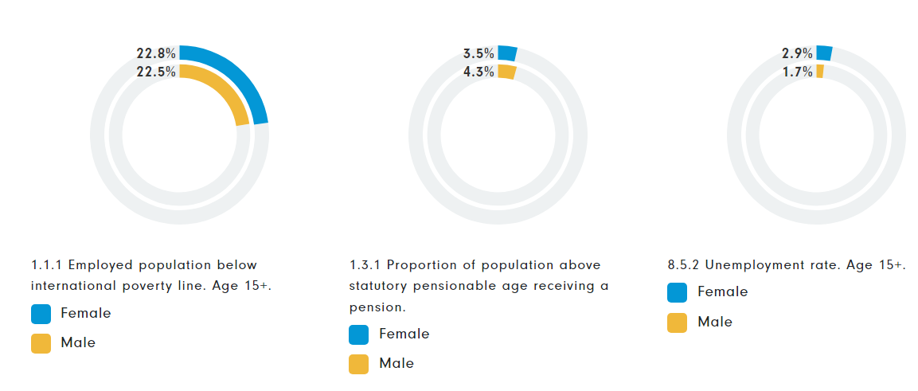
Economic: Inclusive development, shared prosperity and decent work
Notes:
Source: Country Fact Sheet | UN Women Data Hub, December 2020

Slide 22
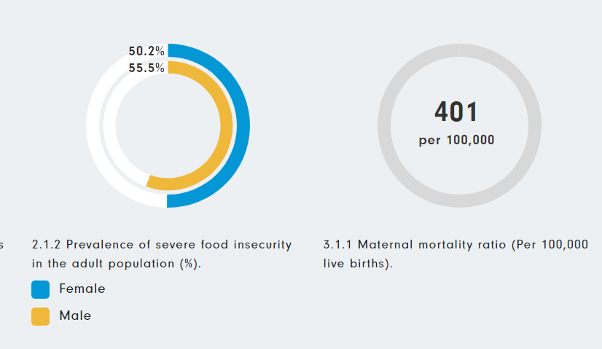
Social: Social protection, poverty and freedom from violence, stigma & stereotypes (I)
It decreased from 871 per 100,000 in 2000 to 401 per 100,000 in 2017
Source: Country Fact Sheet | UN Women Data Hub, December 2020

Slide 23
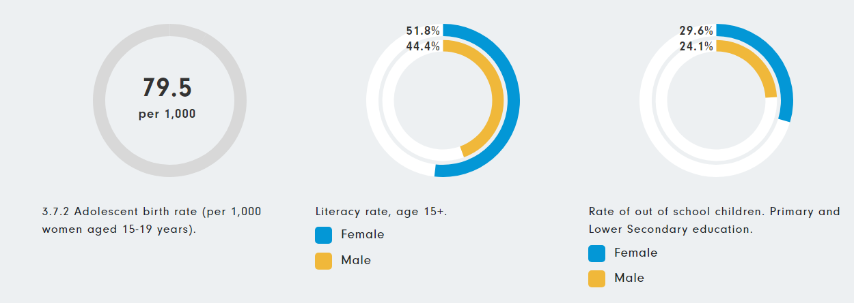
Social: Social protection, poverty and freedom from violence, stigma & stereotypes (II)
Source: Country Fact Sheet | UN Women Data Hub, December 2020

Slide 24
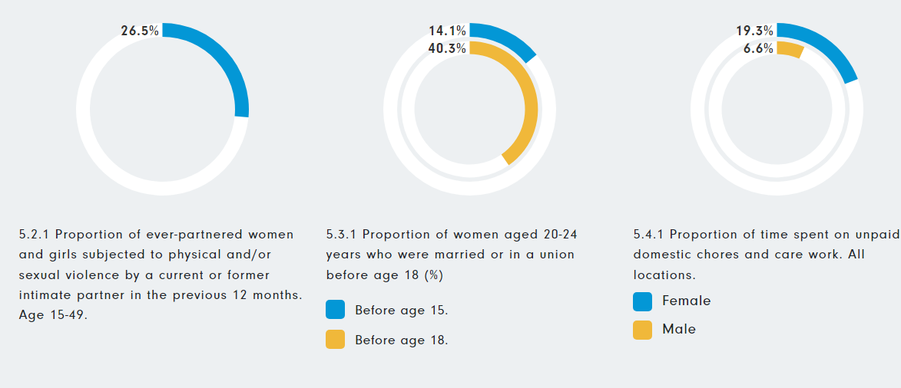
Social: Social protection, poverty and freedom from violence, stigma & stereotypes (III)
Source: Country Fact Sheet | UN Women Data Hub, December 2020

Slide 25
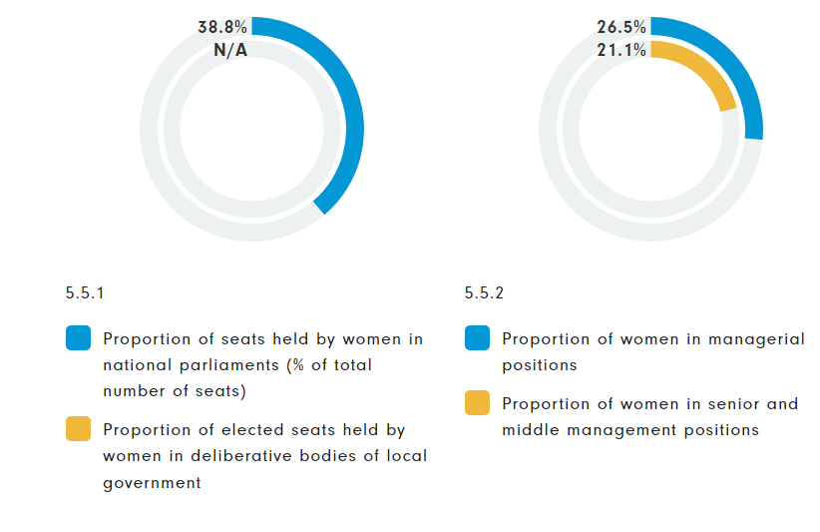
Political: Political participation, accountability and gender-responsive institutions
Source: Country Fact Sheet | UN Women Data Hub, December 2020

Slide 26
The situation of women in Ethiopia described in numbers
Women in Ethiopia are:
17% less likely than men to participate in the labour force
they tend to work 4.4 fewer hours per week when they are employed
less likely than men to work in the wage sector
more likely to work in non-farm enterprise
Women are 20% less likely than men to decide on how to spend their own earnings, 25% less likely to decide their own health expenditure and 31% less likely to decide on major household purchases
Women’s agricultural productivity is on average lower than men’s due largely to differences in factors of production
Notes:
Source: AFRICA GENDER INNOVATION LAB, ETHIOPIA GENDER DIAGNOSTIC, BUILDING THE EVIDENCE BASE TO ADDRESS GENDER INEQUALITY IN ETHIOPIA: https://documents1.worldbank.org/curated/en/229441553233523069/pdf/135476-BRI-PUBLIC-EthiopiaDiagnostic.pdf
Note: On the last bullet which provides a general statement that women’s agricultural productivity is on average lower than men’s due largely to differences in factors of production – please indicate that this point of ag productivity will be discussed / unpacked on later modules with a focus on climate-smart agriculture with greater evidence on women productivity.

Slide 27
The situation of women in Ethiopia described in numbers
Women’s earnings from self-employment and entrepreneurship are considerably lower than men’s, owing mostly to differences in the levels of inputs they use
On average, a female enterprise manager’s monthly revenues are nearly 79 percent lower than a male manager’s revenues, without accounting for differences in the levels of productive factors.¹
34 percent of women in Ethiopia work in informal wage employment compared to 13 percent of men^{1.}
UN Gender Inequality Index (2021): ranked 129th out of 166 countries²
Notes:
Sources:
¹ AFRICA GENDER INNOVATION LAB ETHIOPIA GENDER DIAGNOSTIC: BUILDING THE EVIDENCE BASE TO ADDRESS GENDER INEQUALITY IN ETHIOPIA: https://openknowledge.worldbank.org/server/api/core/bitstreams/4d3c6a84-1863-5d03-a2bf-7aa39a5f0939/content
² HDR21-22_Statistical_Annex_GII_Table.xlsx (live.com)

Slide 28
The situation of women in Ethiopia described in numbers
Economic engagement:
Women spend 2.9 times as much time on unpaid domestic and care work than men.¹
In 2017, 29.1% of women and 40.9% of men in Ethiopia had bank account.¹
Women represented 27% of those employed in senior and middle management in 2021.¹
From the professional and technical positions, 33 percent were held by females. Only 25.4% of senior officers and 34.3% of technical positions are held by women.¹
The estimated earned income (PPP US$) varies with female, 1 139 and males 1 862 (2015).²
Parity on Economic Participation and Opportunity is low, at 58.7%.³
Labour-force participation parity is at 72.7% and women earn 66.1% of men’s estimated earned income.³
Notes:
Sources:
¹ The World Bank Gender Data Portal: Ethiopia - World Bank Gender Data Portal
² Country Gender Assessment Series National Gender Profile of Agriculture and Rural Livelihoods, Ethiopia: FOOD AND AGRICULTURE ORGANIZATION OF THE UNITED NATIONS Addis Ababa, 2019
³ Global Gender Gap Report: 2023: World Economic Forum WEF_GGGR_2023.pdf (weforum.org)
In 2013, women in Ethiopia spent 19.3% of their day and men spent 6.6% of their day on unpaid work.

Slide 29
The situation of women in Ethiopia described in numbers
Women produce 23% less per hectare that men farmers¹ (2014)
Women have lower access to agricultural extension services and formal credit, they use fewer inputs, and they harvest a narrower range of crops
Only 2% of women farmers and 49% of men farmers have access to agricultural extension services²
About 36% male and 8% of females have access to credit (2017)²
Higher proportion of men farmers use improved seed (86% vs 14%) and irrigation (87% vs 13%)³ (2018)
Women agricultural holders constitute 19% of the total. Average holding of women farmers is 0.65 hectares and that of men farmers is 1.1 hectares³
Notes:
Sources:
¹ Levelling the field: Improving Opportunities for Women Farmers in Africa, WB, 2014.
https://documents1.worldbank.org/curated/en/579161468007198488/pdf/860390WP0WB0ON0osure0date0March0180.pdf
² GENDER STATISTICS REPORT 2017, NATIONAL PLANNING COMMISSION CENTRAL STATISTICAL AGENCY OF ETHIOPIA and Unwoman
https://africa.unwomen.org/sites/default/files/Field%20Office%20Africa/Attachments/Publications/2018/12/UN%20Women_Gender%20Statistics%20Report%202017_FINAL-compressed.pdf
³ Gender Analysis for Ethiopia’s Updated Nationally Determined Contribution, Bedaso Taye, 2021
https://www.undp.org/ethiopia/publications/gender-analysis-ethiopias-updated-nationally-determined-contribution

Slide 30
The situation of women in Ethiopia described in Numbers
Education
Gender parity at the primary and secondary schools has reached 0.91 and 0.92, respectively¹ (2020)
Girls have a higher dropout rate for Grades 1-8 (11.4 per cent) than boys (10.9 per cent) in 2017/18²
Though Educational parity across the indicators is gradually improving, Ethiopia has one of the lowest parity levels globally (135th) at 85.4%.³
5.3% of women are enrolled in higher education in Ethiopia compared with 10.9% of men.⁴
In 2019-2020 women held only 10.6% of executive management positions across the 45 public universities in Ethiopia, and made up less than 5% of deans and 3% of department heads.⁵
Notes:
Sources:
¹ Gender Parity In Education In Ethiopia: Gender Parity in Education in Ethiopia - Frontieri Consult
² GENDER ANALYSIS FINAL REPORT EDUCATION SYSTEMS STRENGTHENING PROJECT Ethiopia Performance Monitoring and Evaluation Service, 2019
³ Global Gender Gap Report 2023; World Economic Forum; WEF_GGGR_2023.pdf (weforum.org)
⁴ Global Gender Gap Report 2021: WEF_GGGR_2021.pdf (weforum.org)
⁵ Addressing gender issues in Ethiopian higher education and research institutions – stories from Ethiopian gender champions (part two): Addressing gender issues in Ethiopian higher education and research institutions – stories from Ethiopian gender champions (part two) – INASP Blog

Slide 31
The situation of women in Ethiopia described in Numbers
Health
Notable increase in the rate of SKILLED DELIVERY: it increased between 2016 and 2019, from 27.7% to 49.8%¹
Significant improvement in ANC coverage: coverage of at least four antenatal care visits (ANC 4) 12.2 in 2005 to 43 in 2019¹
The rate of adolescent fertility has decreased since 2010. 69 of every 1,000 girls ages 15-19 gave birth in 2021²
HOWEVER,
One out of every four women aged 15-49 years in Ethiopia is thin (body mass index (BMI)³
Anemia affected almost one out of every four women of reproductive age.⁴
PNC a national coverage rate of only 33.8 per cent⁵, albeit twice that of 2016 coverage (16.5 per cent⁶)
About 35% of women and 27% of men were supportive of conditional wife beating.
Women are 20% more likely to be supportive of wife beating.
Asset ownership would reduce the likelihood of women being supportive of wife beating by up to 28%
Notes:
Sources:
¹ Inequality in Skilled Birth Attendance Service Utilization in Ethiopia across Geographic, Residential Differences and Level of Women’s Education Habtamu Alemay Anteneh* Department of Medicine, Addis Ababa University, Addis Ababa, Ethiopia
² The World Bank Gender Data Portal: Ethiopia - World Bank Gender Data Portal
³ National Situation Analysis of Children and Women in Ethiopia 2019 : UNICEF-Ethiopia-National-Situation-Analysis-Children-Women-2019.pdf
⁴ Prevalence and predictors of anemia among pregnant women in Ethiopia: Systematic review and meta-analysis : https://doi.org/10.1371%2Fjournal.pone.0267005
⁵ Postnatal Care Utilization and Associated Factors among Mothers who gave Birth in the Aysaeta District, Northeast Ethiopia: A Community Based Cross-sectional Study: Postnatal Care Utilization and Associated Factors among Mothers who gave Birth in the Aysaeta District, Northeast Ethiopia: A Community Based Cross-sectional Study - PMC (nih.gov)
⁶ EDHS 2016, Ethiopia Demographic and Health Survey 2016 [FR328] (dhsprogram.com)

Slide 32
Session III GESI and Climate Change
Implications of the response to Climate change for women’s empowerment and inclusion

Slide 33
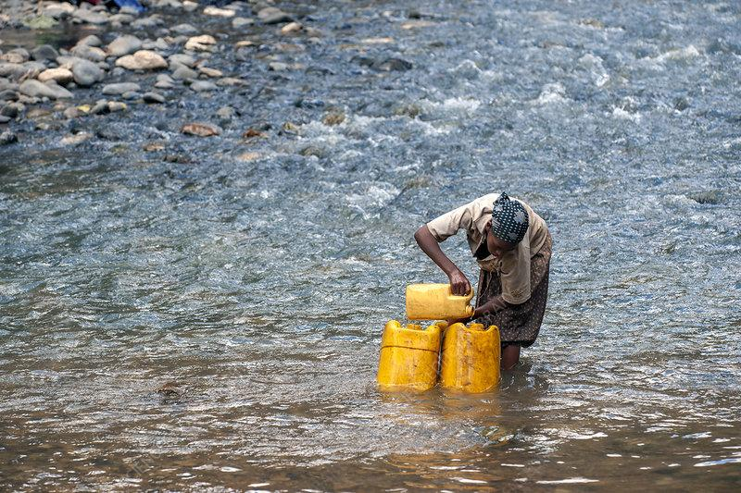
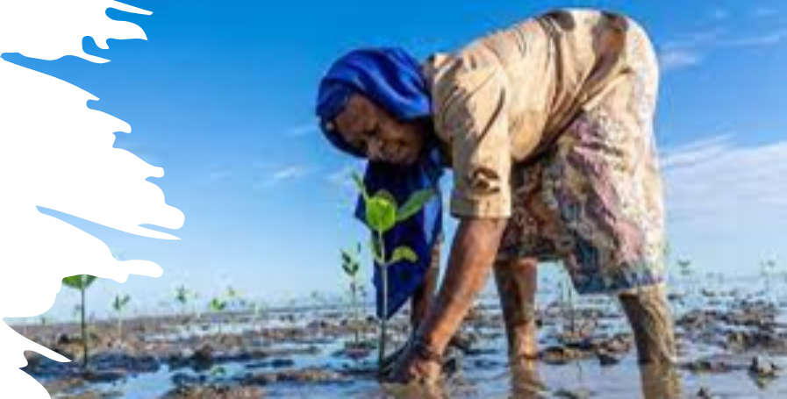
How are people differently impacted by climate change?
Notes:
All images

Slide 34
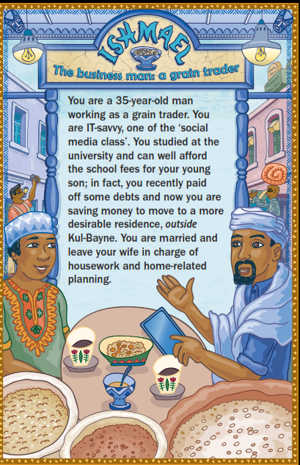
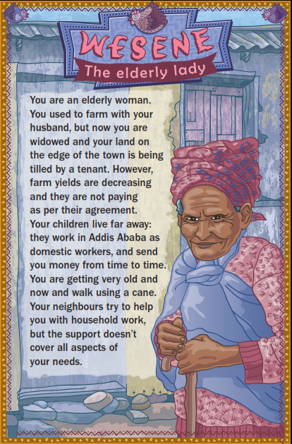
Group exercise: Take a character card
Read about how your character is affected by climate hazards (e.g. drought)
If you feel disadvantaged in facing the droughts step back
If you feel strong in facing the droughts, step forward
Why did you step forward or back?
Notes:
Facilitator:
This is a group exercise to get the participants moving and talking.
Distribute the character cards from the ‘Climate and Society Game’ on www.cdkn.org, but excluding the ‘Environmental Management officer’ and/or ‘Disaster management officer’ cards – use the other ones. There are a total of 20 cards (minus the ‘officer’ cards). They are in three sets: Ethiopia set (8 characters); Ecuador set (6 characters); India set (6 characters). If the workshop is taking place in one of these countries – only distribute cards for that country. If it’s an international workshop with a mix of nationalities/national backgrounds, use them all.
Each participant should read about the character they are assigned and imagine themselves in that character’s shoes.
The participants should make a line down the middle of the room.
They don’t know what the other people’s cards say, they should focus on their own.
Tell the participants that all of them live in a low-income urban neighbourhood and are exposed to climate hazards every year, such as flooding and drought, but some people are better off, and some are relatively worse off. Think about the vulnerabilities and the strengths and skills that their character has, to face the droughts.
Now, each participant should imagine that the middle of the room represents the average status and wellbeing of residents of the fictional low-income neighbourhood.
Call on participants to step towards the front of the room if they have lots of strengths and skills to respond to droughts.
Call on participants to step towards the back of the room if they have fewer strengths and skills to respond to the droughts or they are more discriminated against and they find it more difficult to seek help from others.
Don’t over-analyse it! This is just a warm-up.
Participants move around, stepping forward or backwards.
Now ask for participants to turn to the person next to them. What are their strengths and vulnerabilities in the face of the drought? Why did they step forward or back? Compare notes

Slide 35
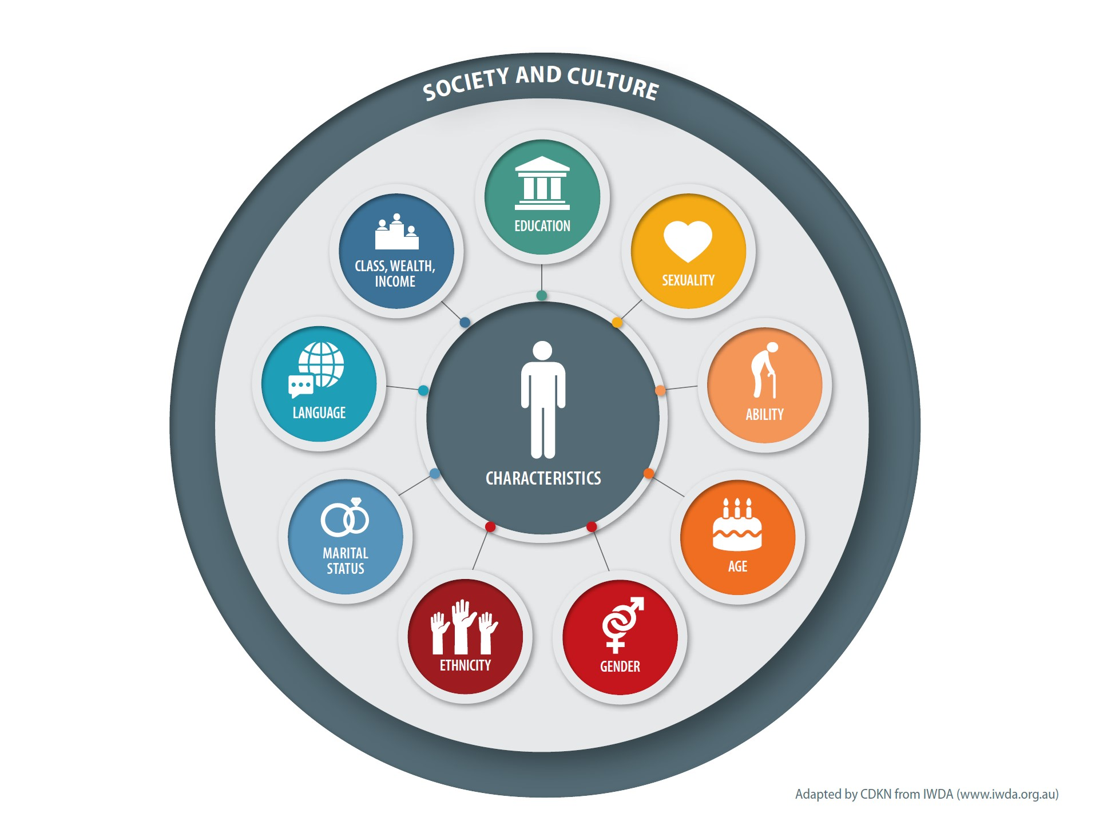
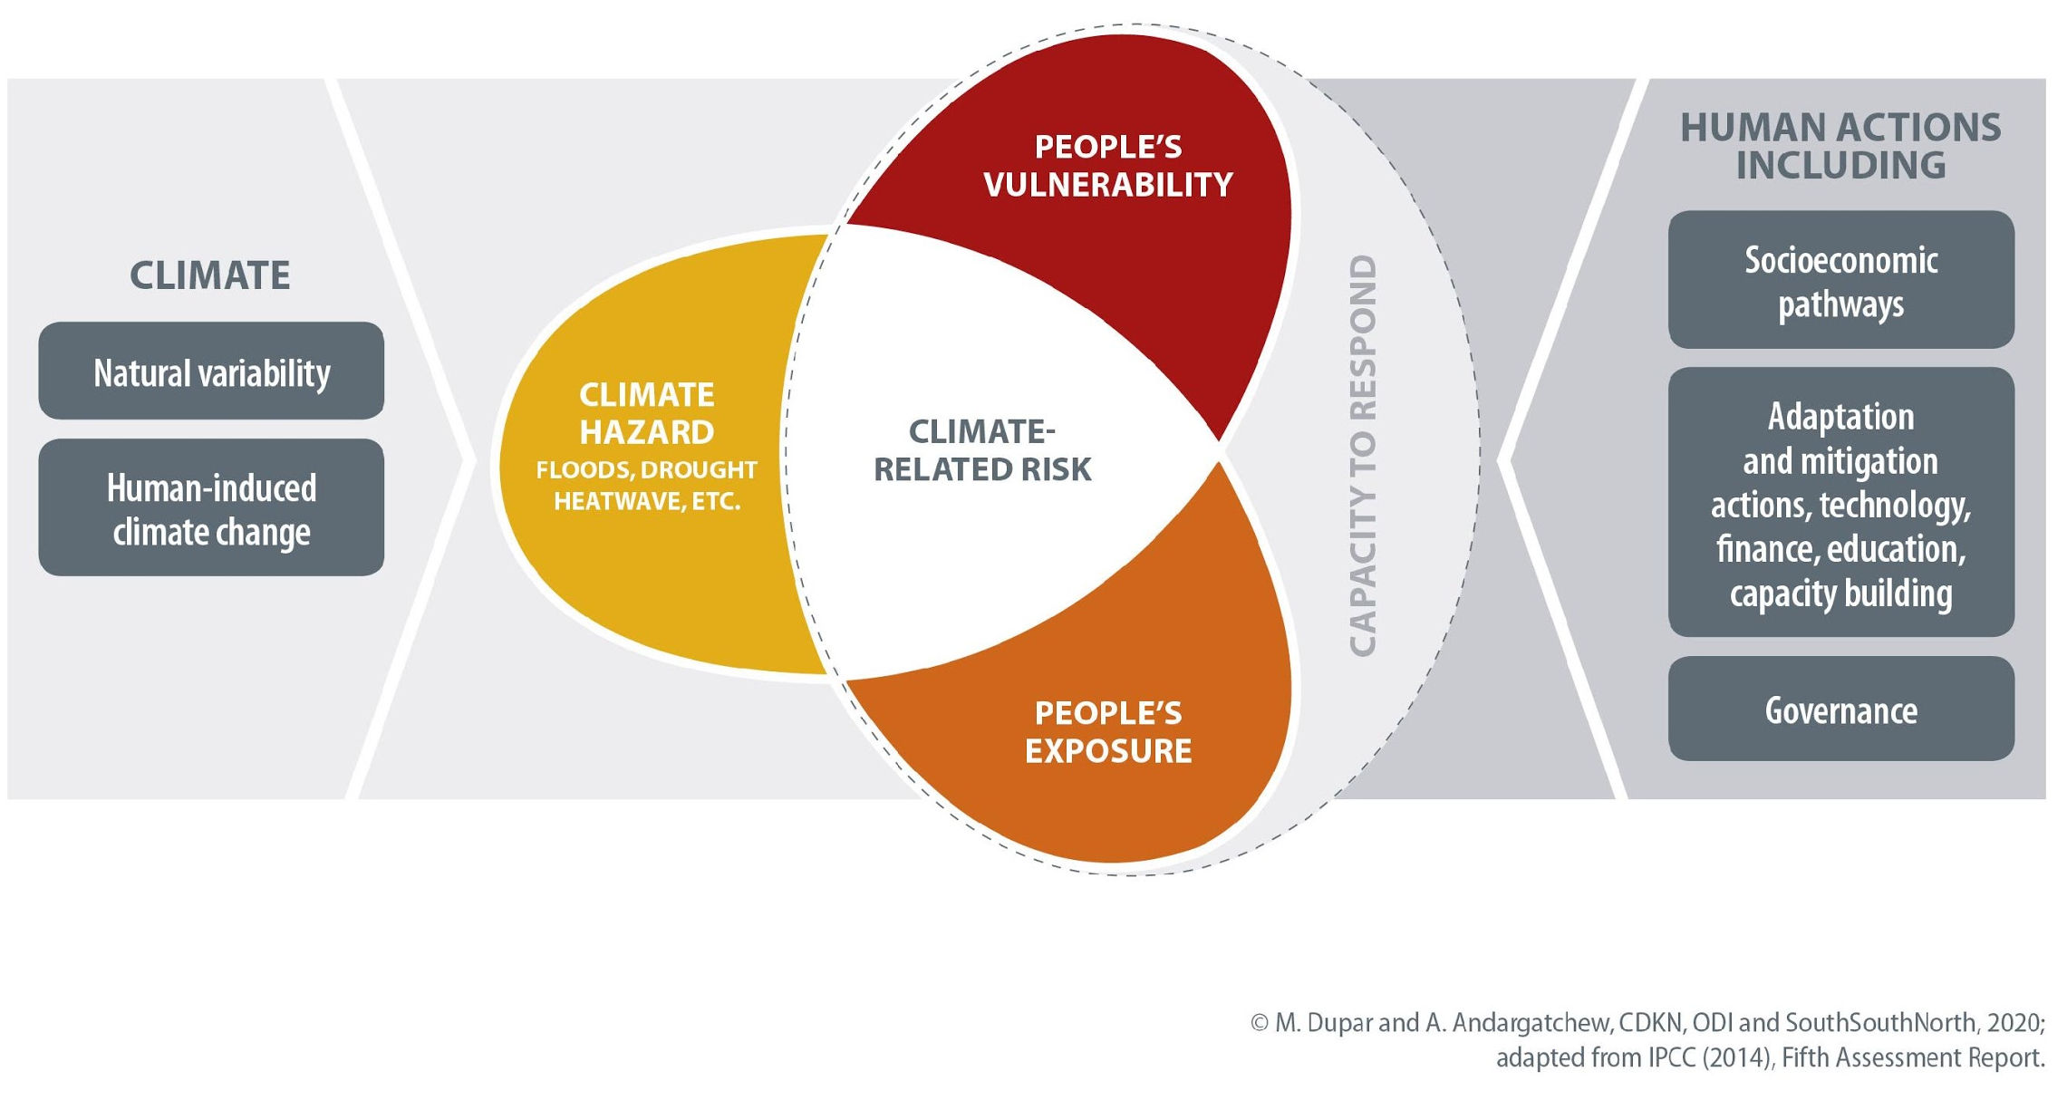
The climate risk formula (IPCC, 2014): hazard – exposure - vulnerability
People’s individual characteristics make them more or less climate-vulnerable and may have a bearing on how exposed to the climate hazard they are

Slide 36
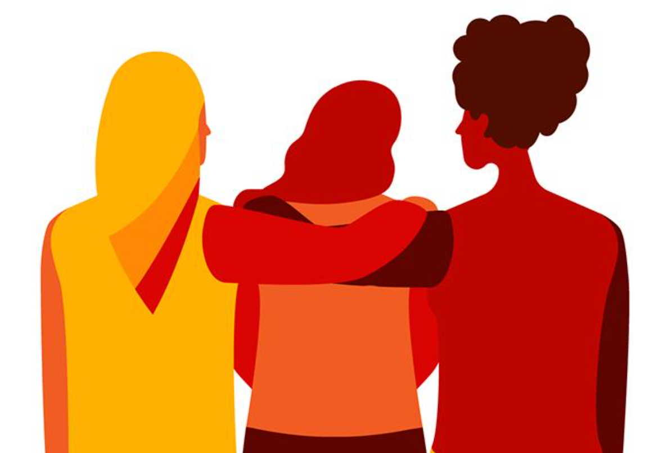
Women and girls often have less access to the things that make people more resilient
A gender gap is especially evident when it comes to the impact of natural hazards (e.g. climate shocks) on different people
Women are more deeply affected by climate shocks
It’s harder – on average – for them to bounce back
Disasters tend to exacerbate social inequalities and existing power divisions
Notes:
Disasters tend to exacerbate social inequalities and existing power dynamics
They constrain people’s ability to escape poverty, and leave those who are poor and the most marginalised at greater risk of being ‘left behind’, and more vulnerable to ongoing and future climate and disaster risks (Diwakar et al., 2018 forthcoming; Lovell and Le Masson, 2014). As more people live and work in areas at risk of natural hazards (including those influenced by climate change), increasing exposure to climate and disaster risk, policies and programmes that aim to build resilience need also to tackle underlying vulnerabilities and intersecting inequalities.
Natural hazard-related disasters can reverse years of development gains (ibid ODI, 2018)
Disasters tend to exacerbate social inequalities and existing power dynamics: ODI (2018) Leave Noone Behind Index. London: ODI https://www.odi.org/sites/odi.org.uk/files/resource-documents/12304.pdf (accessed 8 April 2020)
Women face mobility constraints
e.g. social norms expressed through dress codes; gendered skills; responsibility for children, elderly & the sick
Differential vulnerability of men and women to disasters is context-dependent – where women are more empowered they are generally less vulnerable to disaster impacts….
Potential for long-term impacts – e.g. girls’ participation in education may not recover, may be vulnerable to abuse in aftermath…
‘micro-disasters’ – e.g. urban flooding may also have unequal impacts….
A study by Oxfam International of the 2004 tsunami in Asia where 70% more women than men died because they did not know how to swim or climb trees. In addition, women took longer to regain economic independence after the disaster as they took on the resultant rise in unpaid labour. The loss of homes also often translates into the loss of equipment for economic activities such as those for artisans, cooks and seamstresses.
On the other hand, an increase in violence against women after a disaster is a widely documented issue which arises out of unstable living conditions, seeking security from masculine figures, sexual assaults in temporary camps, increased sexual exploitation and maltreatment of women, children and adolescents.
More recent analysis published in Presentación del dossier. Comunidad, vulnerabilidad y reproducción en condiciones de desastre. Abordajes desde América Latina y el Caribe
By : Ana Gabriela Fernández, Johannes Waldmüller, Cristina Vega
DOI: https://doi.org/10.17141/iconos.66.2020.4156
Is summarised in a recent article by SciDev.net (see https://revistas.flacsoandes.edu.ec/iconos/article/view/4156 and in English summary, https://cdkn.org/2020/03/opinion-environmental-disasters-widen-the-gender-gap/)
“Women and children are more likely to die than men during climate disasters according to the UN-Habitat. Also survivors encounter countless social, economic and health assistance inequalities,” says Adriana Noacco, director of the Centre for Education and Environmental Management (CEGA in Spanish) from the University of Buenos Aires.
The research highlights the importance of women’s participation in disaster response teams, as in most cases, they are excluded from the decision-making. It makes reference to experiences such as those of the earthquake in Haiti, Hurricane Katrina in the United States, Hurricane Mitch in Honduras and the 2010 tsunami in Dichato, Chile, where the female leadership was at the forefront of community care and food networks, proving their organisational capacity and specific approach to dealing with situations related to land rights, health, grief and coping with trauma and also their participation in reconstruction processes.
Fernández, Vega and Waldmüller say that improved approaches to gender equality in one place will improve the capacity to deal with natural disasters. An event itself should become a turning point for creating better conditions in terms of equality.
They say that “it is therefore necessary to revise institutional practices, the social value assigned to community and reproductive activities, and the opportunities created for developing skills for both men and women.”
In summary
• Unequal opportunities render women more vulnerable to climate disasters. • Credit should be accessible to women for continuation of their businesses after natural disasters – among other measures targeted at women. • This will prevent the relegation of women to socially-imposed roles such as cooking and cleaning and enable them to be more active in the public domain.

Slide 37
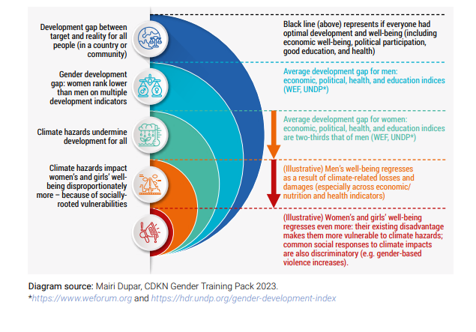
Cascading impacts of climate hazards on women and girls

Slide 38
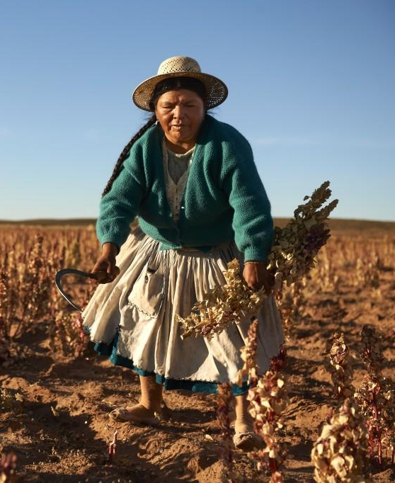
The current picture: Women are missing out on key opportunities (1)
IPCC finds that drivers of land degradation, desertification and their negative impacts on people in a changing climate include:
Land tenure insecurity
Lack of property rights
Lack of access to markets and to agricultural advisory services
Lack of technical knowledge and skills
Poor climate information services
Agriculture price distortions
Lack of agricultural subsidies
Several of these have gender dimensions. Discuss: Which dimensions? How/Why?
Notes:
IPCC finds that drivers of land degradation, desertification* and their negative impacts on people in a changing climate include:
Land tenure insecurity
Lack of property rights
Lack of access to markets and to agricultural advisory services
Lack of technical knowledge and skills
Poor climate services
(Agriculture price distortions)
(Lack of agricultural subsidies)
Several of these have gender dimensions – women face discrimination.
Facilitator: Following is opportunity for pause and group discussion in whole group or breakout:
Discussion: in which areas do women face discrimination (of the above drivers of land degradation) and why?
Women’s lack of access to land resources, to knowledge/advisory services, to credit can all be addressed through female empowerment

Slide 39
The current picture: Women are missing out on key opportunities (2)
“Skills and knowledge of women and marginalised groups are not yet sufficiently recognised” - IPCC
Avoid calling people ‘victims’ and falling into victim mentality
This mistake means that decision-makers don’t acknowledge and society doesn’t benefit sufficiently from knowledge, wisdom of: marginalised groups, including indigenous peoples, women, including widows and elderly women
Next, let’s explore how inclusive climate-compatible development in rural areas makes for more effective development for everyone….
Image: IIED
Notes:
Many societies are missing on significant knowledge and talent by not including women in decision-making more from the individual farm plot to the community to the landscape level –
IPCC findings
“Skills and knowledge of women and marginalised groups are not yet sufficiently recognised” - IPCC
Points to stress:
Avoid calling people ‘victims’ and falling into victim mentality
This mistake means that decision-makers don’t acknowledge and society doesn’t benefit sufficiently from knowledge, wisdom of: marginalised groups, including indigenous peoples, women, including widows and elderly women
Let’s explore how inclusive climate-compatible development is more effective development for everyone….
Next up: case studies showing how climate compatible development works better when women are empowered as part of the process

Slide 40
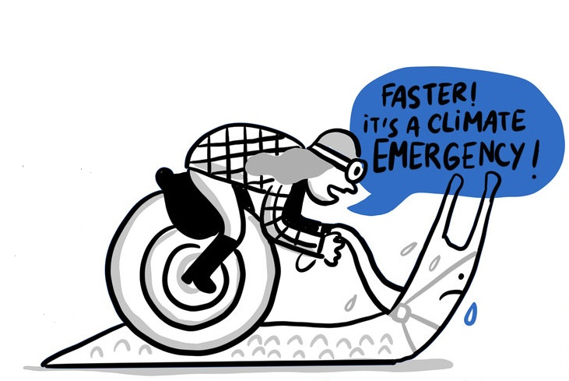
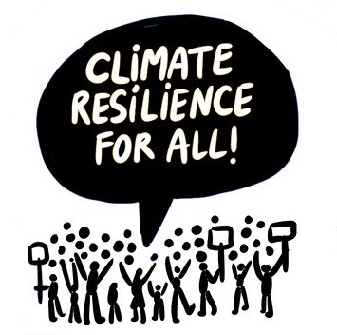
What does gender and people’s diversity mean for climate action?
Illustrations: © Jorge Martin 2019

Slide 41
Integrate GESI into Climate Actions
Human Right
Increase resilience
Decrease impacts of disasters
Coping and relief to experience when damage occurs
Enhances adaptation outcomes in general
Notes:
Source: https://www.ipcc.ch/report/ar6/syr/downloads/report/IPCC_AR6_SYR_SPM.pdf C.5 Prioritising equity, climate justice, social justice, inclusion and just transition processes can
enable adaptation and ambitious mitigation actions and climate resilient development.
Adaptation outcomes are enhanced by increased support to regions and people with the highest vulnerability to climatic hazards.
Integrating climate adaptation into social protection programs improves resilience.
Many options are available for reducing emission-intensive consumption, including through behavioural and lifestyle changes, with co-benefits for societal well-being.
C.5.3 Regions and people (3.3 to 3.6 billion in number) with considerable development constraints have high vulnerability to climatic hazards.
Adaptation outcomes for the most vulnerable within and across countries and regions are enhanced through approaches focusing on equity, inclusivity and rights-based approaches.
Vulnerability is exacerbated by inequity and marginalisation linked to e.g., gender, ethnicity, low incomes, informal settlements, disability, age, and historical and ongoing patterns of inequity such as colonialism, especially for many Indigenous Peoples and local communities.

Slide 42
Gender and climate change adaptation
Adaptation: the process of adjusting and modifying human and natural systems to mitigate the adverse impacts of climate change or to take advantage of emerging opportunities.
Reduces vulnerability and enhance resilience to the impacts of climate change.
may include changes in land use planning, infrastructure development, water management, agricultural practices, and the promotion of sustainable and climate-resilient technologies
Notes:
Gender-responsive and Socially inclusive climate change adaptation strategies recognize and address the different vulnerabilities, needs, and capacities of individuals based on their gender, age, religion, so on
Women, as the managers of household energy and water supplies, must adapt to the changing climate conditions.
Women, as farmers and major producers of food, must also adapt production and growing practices that ensure food security, in spite of climate change.
Yet women in communities continue to have in adequate decision-making with regard to adaptation decision-making at local, sector, national, regional and international levels.

Slide 43
Gender and climate change mitigation
Mitigation actions are efforts and actions taken to reduce or prevent the emission of greenhouse gases and other activities that contribute to the buildup of these gases in the Earth's atmosphere.
The primary goal of mitigation is to lessen the extent of global climate change and its associated impacts.
It aims to address the root causes of climate change by decreasing the overall concentration of greenhouse gases, which trap heat in the atmosphere and contribute to the warming of the planet.
Key components include transition to renewable energy, afforestation and reforestation, and sustainable agriculture.
Notes:
Some mitigation actions, such as the provision of clean and modern energy services, save women’s and men’s time and lives and promote better health.
Other mitigation actions such as those implemented to affect land use, and land-use change can shift the balance of economic and social resource distribution between women and men and among different communities and hence can exacerbate inequality.

Slide 44
Gender and climate change mitigation
Mitigation within the context of sustainable development can help to promote gender equality and social inclusion by addressing at least four issues:
Address the energy needs and uses of men, women and other vulnerable groups
Promote employment and entrepreneurship to vulnerable community members through identifying and implementing sector specific equity measures—though there are potential challenges and constraints in the agriculture, energy and power sectors;
Incorporating women’s and men’s traditional knowledge and practices into mitigation strategies and policy frameworks;
Paying focused attention on ensuring gender equity and social inclusion interventions in the use, conservation and management of forests.
Notes:
Some mitigation actions, such as the provision of clean and modern energy services, save women’s and men’s time and lives and promote better health.
Other mitigation actions such as those implemented to affect land use, and land-use change can shift the balance of economic and social resource distribution between women and men and among different communities and hence can exacerbate inequality.
Further as indicated in above slides:
The Gender Equality in a Low Carbon World review with examples from different African countries states: "Since the signing of the Paris Agreement in 2015, global policy discussions and grey literature have strengthened around the concept of ‘just transitions’. The ‘just transitions’ focus is about compensating workers who are employed in fossil-fuel-extractive or fossil-fuel-dependent industries, by training and redeploying them to more environmentally sustainable jobs. It has tended to be biased toward male-dominated, polluting industries in the Global North. More nuanced analyses have not yet translated adequately into global policy frameworks, such as the UNFCCC decision texts on ‘just transitions’. Hence, until recently, there has been little widespread discussion of how workers who start in the most disadvantaged positions, including women, informal sector, and rural workers in the Global South, can progress into more secure, low-carbon employment. Recently, coalitions of organisations and feminist thinkers based in the Global South have sought to address this gap and reframe the previous biases.”
Source: Full review https://glowprogramme.org/resource/low-carbon-consumers-climate-leaders Policy brief: https://glowprogramme.org/resource/womens-economic-empowerment-missing-piece-low-carbon-plans-and-actions-eng-fr-sp

Slide 45
Summary: why gender matters and why inclusive climate compatible development is better for everyone
Women and men experience climate change differently
Differences in adaptive capacity (ability to adapt to the impacts of climate change)
Differences in voice and power mean that women’s priorities may not be recognised – from local to global climate action
We already know that women’s wellbeing, according to standardised development measures, is less than men’s overall
Women may define their wellbeing in different ways than men (‘whose priorities?’)
Image: Ethiopia, CIFOR
Notes:
This slide summarises the findings of the evidence on why a gender-responsive approach to climate change responses and climate-resilient development planning is more effective than a gender-blind approach.

Slide 46
Gender and climate action
Countries will need to make choices about how to be competitive in a de-carbonising global economy
Choice of sectors, investments, development paths will all have gendered consequences
Growing scarcity of key natural resources has the potential for highly unequal gender impacts
Climate mitigation may create livelihood opportunities at the local level – but these may be gendered
Some policy wins for climate are great for women – e.g. safer, cleaner, improved public transport?
Some major wins for climate can also be wins for women’s and children’s health (in particular) and reduce drudgery e.g. clean cooking technologies
Image: clean cookstove, DFID
Notes:
This slide summarises some overarching global points about how climate change related interventions have the potential to empower women or leave women further behind (closing or widening the gender development gap):

Slide 47
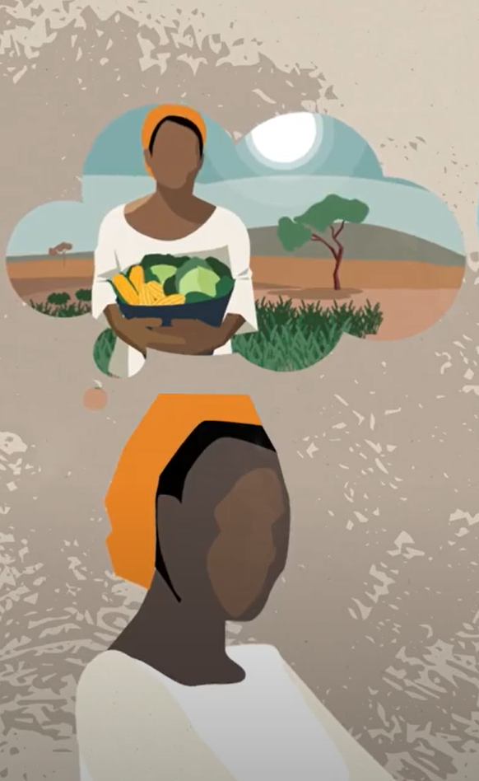
Women are adaptation leaders
Women have been adapting to swift environmental changes for decades
Women are also first responders to disasters
They hold traditional knowledge on which crops to grow in unpredictable weather and have traditional knowledge on how to store food if they receive early warning
Studies show women are better at disseminating early warning information than men
They can highlight gender-specific needs if included in decision-making processes
In semi arid regions, research shows that women are not necessarily victims or powerless: they are often diversifying their livelihoods and increasing their agency in response to climatic pressures (ASSAR)
Image: credit ASSAR
Notes:
On climate change adaptation specifically, which requires very localised responses in order to be effective, we note the important, relevant knowledge that women hold and which can benefit whole communities – if they are given equal voice in decisions and in implementing projects and systems:
Women have been adapting to swift environmental changes for decades
Women are also first responders to disasters
They hold traditional knowledge on which crops to grow in unpredictable weather and have traditional knowledge on how to store food if they receive early warning
Studies show women are better at disseminating early warning information than men
They can highlight gender-specific needs if included in decision-making processes
(Source: UNDP East Africa (2019))
In semi arid regions, research shows that women are not necessarily victims or powerless: they are often diversifying their livelihoods and increasing their agency in response to climatic pressures
Last bullet point on semi-arid regions, ref Adaptation at Scale in Semi-Arid Regions (ASSAR) www.assar.uct.ac.za

Slide 48
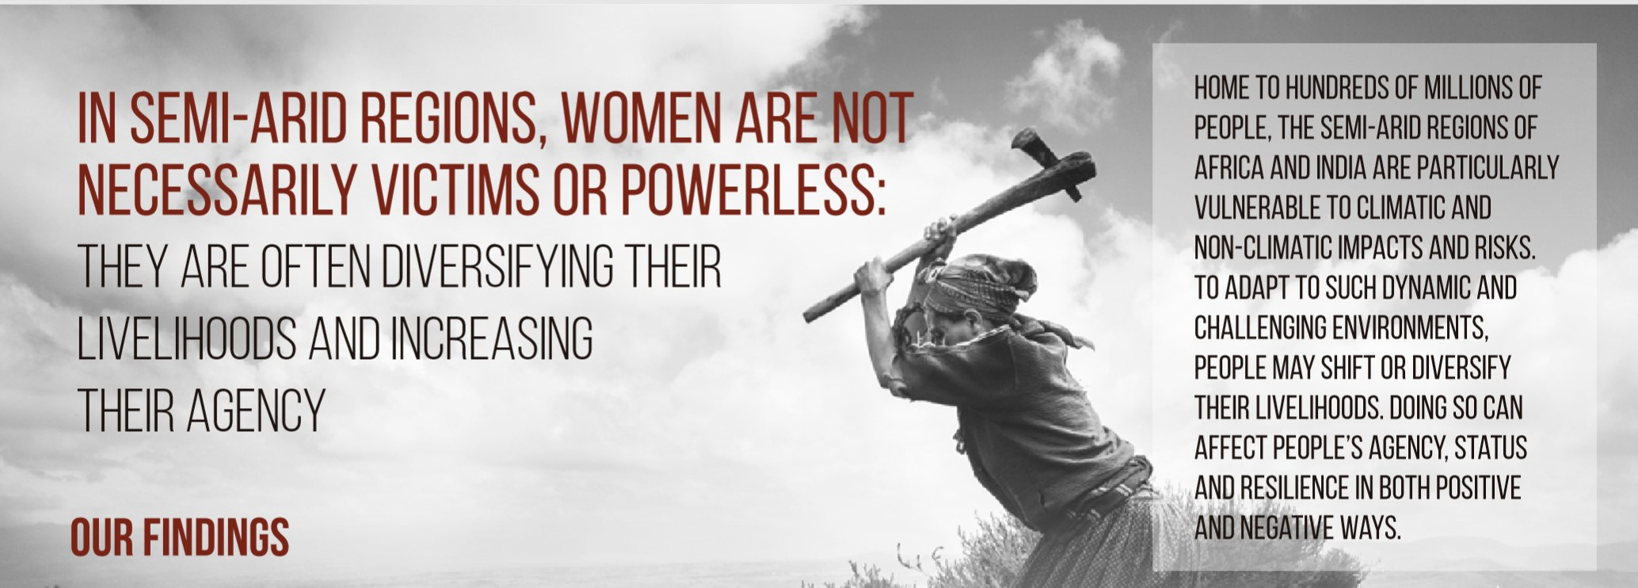
Group exercise: How people are dealing with diverse risks and pressures in semi-arid lands
Consider these findings from the Adaptation at Scale in Semi-Arid Regions programme (www.assar.uct.ac.za)
Notes:
Facilitator: Break participants into smaller discussion groups to do this exercise.
Show the groups these slides and/or the entire accompanying ASSAR handout (which accompanies this slide pack) and ask them to read the material and, in their groups, answer the accompanying questions on the next slide(s).

Slide 49
Group exercise: How people are dealing with diverse risks and pressures in semi-arid lands
What surprises you about these findings from semi-arid Sub Saharan African countries and India? What doesn’t surprise you?
How would you design interventions to help people who are struggling to adapt to climatic and other pressures? Brainstorm with your group.
Notes:
Please read the quotes from the individual men and women – how they are changing their lives to respond to climate change impacts. Once you have read the quotes, too, answer the discussion questions.
The overarching analysis of changing gender roles and different responses to climate change is:
Gender inequality in rights, resources and voice
Unequal legal status, property rights, education & literacy, health, access to assets
Gender-based differences in economic opportunity
All reduce women’s adaptive capacity in face of climate and other shocks
However, women should not be seen as victims
It’s complicated: they are often diversifying their livelihoods and increasing their agency (control over different aspects of their lives)
Find the full booklet here: http://www.assar.uct.ac.za/sites/default/files/image_tool/images/138/webinar/gender/INFOGRAPHIC%2002%20Small.pdf
The researchers’ made these recommendations, do you agree?
Recommendations when planning risk management strategies:
Don’t assume all women are victims.
We see that, at times, women are increasing their sense of agency, which makes them critical agents for adaptation.
Consider power relations explicitly.
Women’s increasing agency can lead to the renegotiation of power relationships which are essential for managing risk and improving wellbeing in a more equitable and inclusive manner.
Support processes that increase agency, capacities and long-term wellbeing by:
Improving access to jobs and resources, concurrently with other forms of support for domestic tasks (e.g. childcare, improved access to water).
Supporting productive assets (e.g. land, equipment).
Offering support services and mechanisms that incentivize cooperation.
Providing direct access to information.
Working with men and governments to challenge social norms.
Support processes that increase agency, capacities and long-term wellbeing by:
Providing better access to social support, education and technical skills, along with alternative sustainable livelihood opportunities.

Slide 50
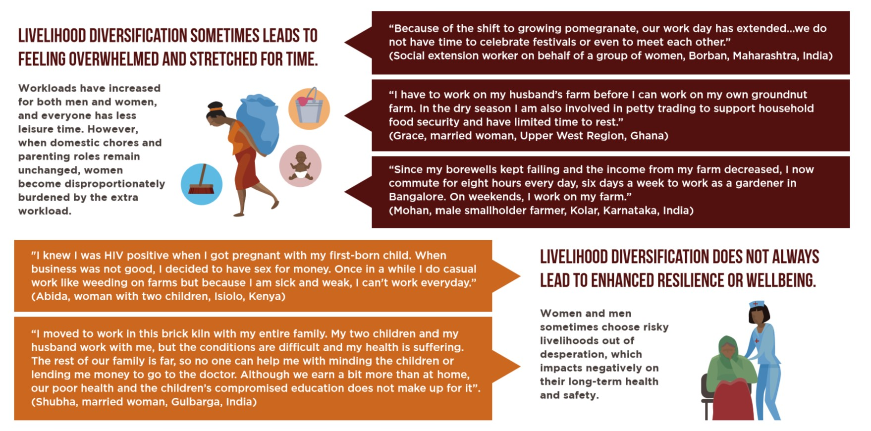
Group exercise: How people are dealing with diverse risks and pressures in semi-arid lands
What surprises you about these findings from semi-arid Sub Saharan African countries and India? What doesn’t surprise you?
How would you design interventions to help people who are struggling to adapt to climatic and other pressures? Brainstorm with your group.

Slide 51
www.cdkn.org
@cdknetwork
Notes:
Facilitator: Here the facilitator can place their own website url and email address too, if anyone wants to contact them later!
Next after this slide pack, advance to ‘Assessing people’s needs’ module and the ‘Climate and Society Game’ (full game play version)

