Slide 1



AFRICA REGIONAL HUB
Hosted by CDKN

Slide 2






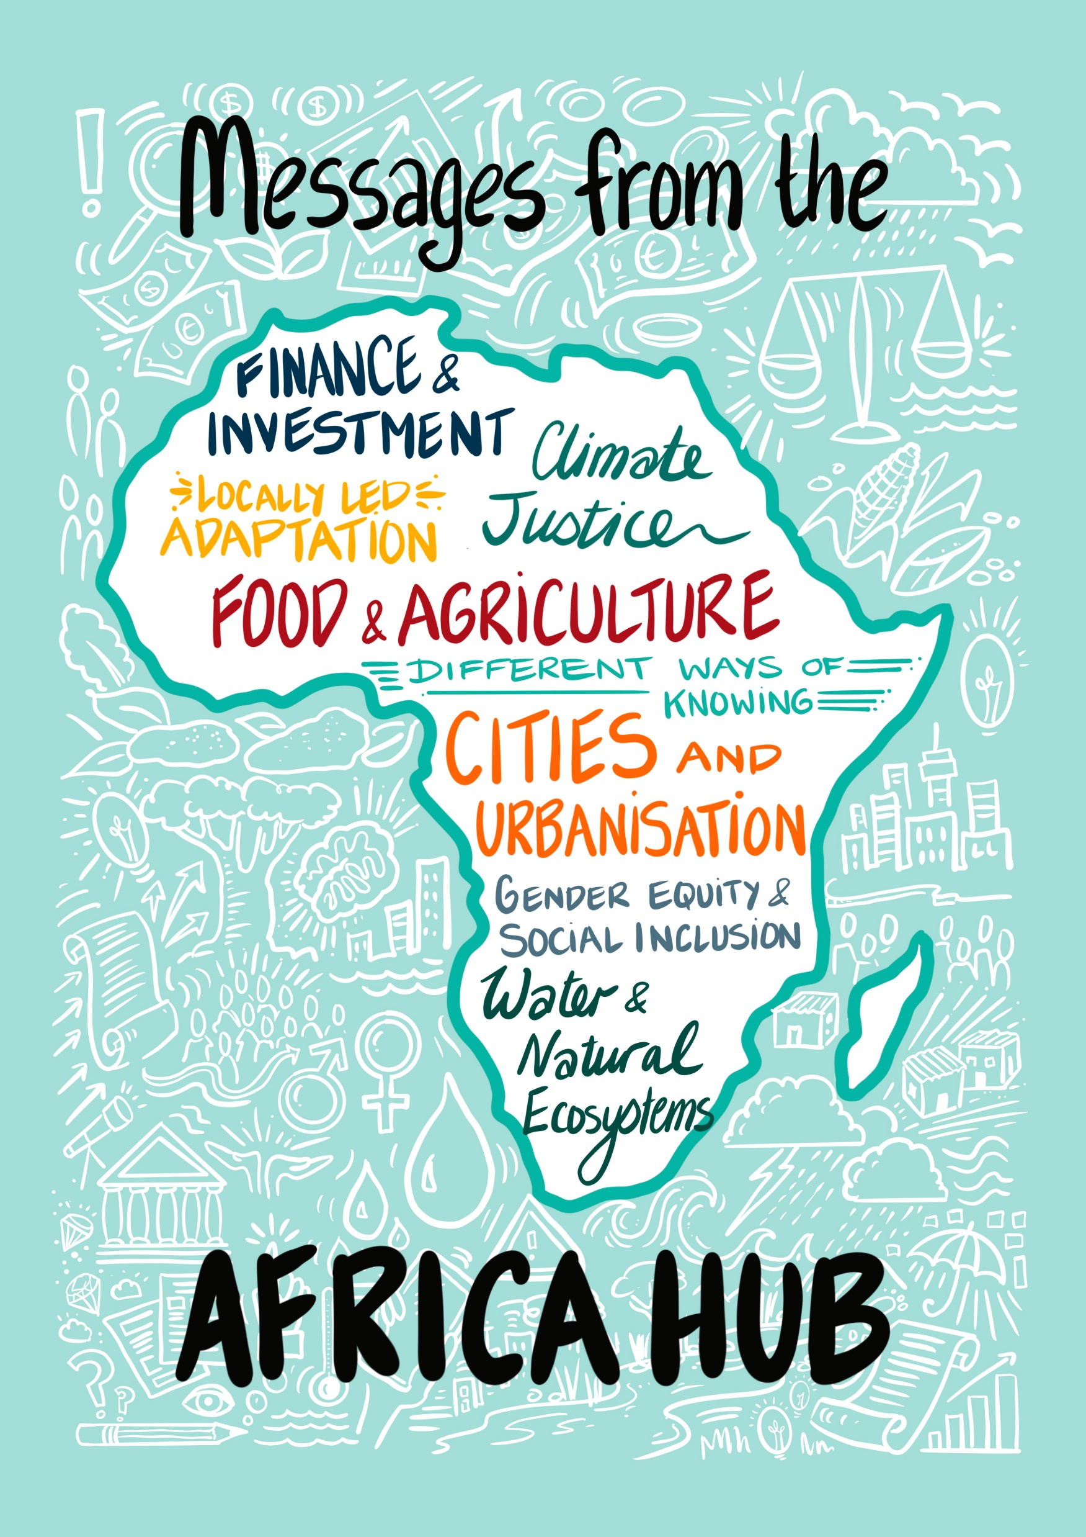










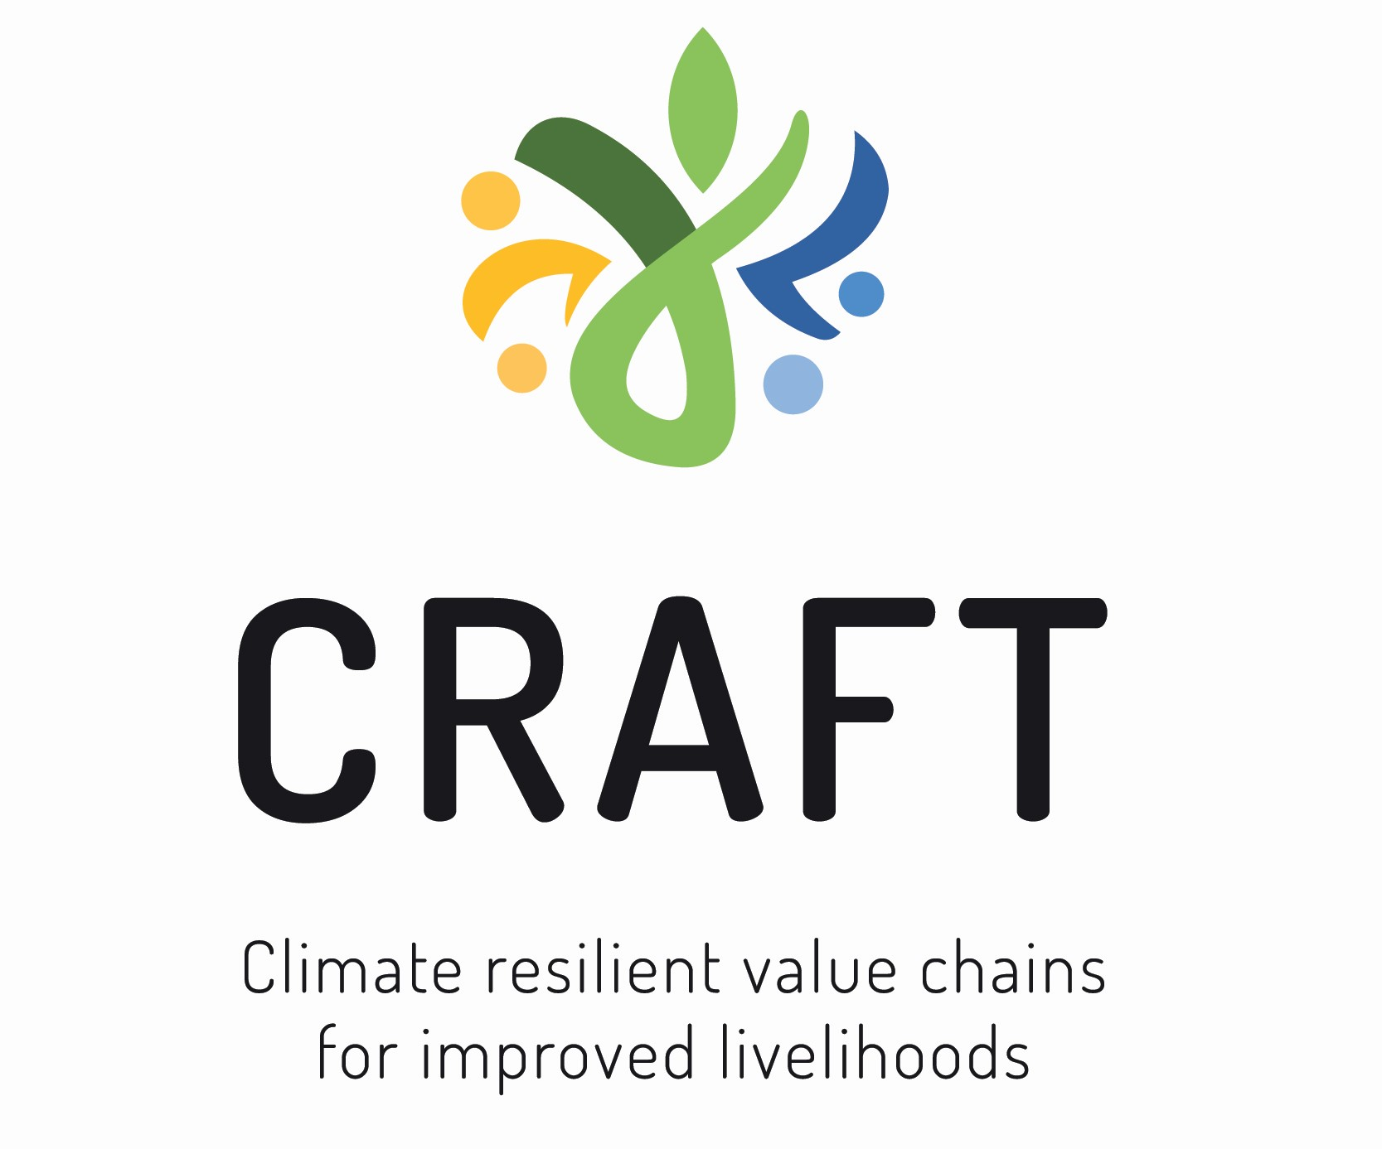

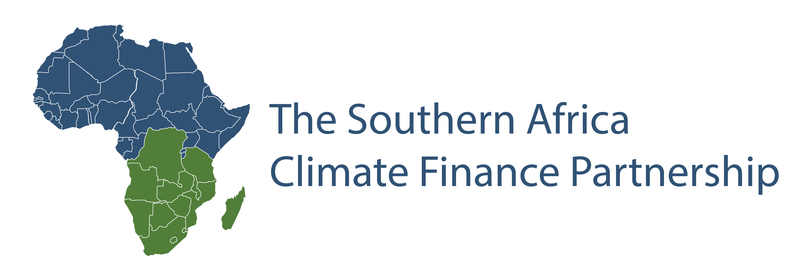







Slide 3
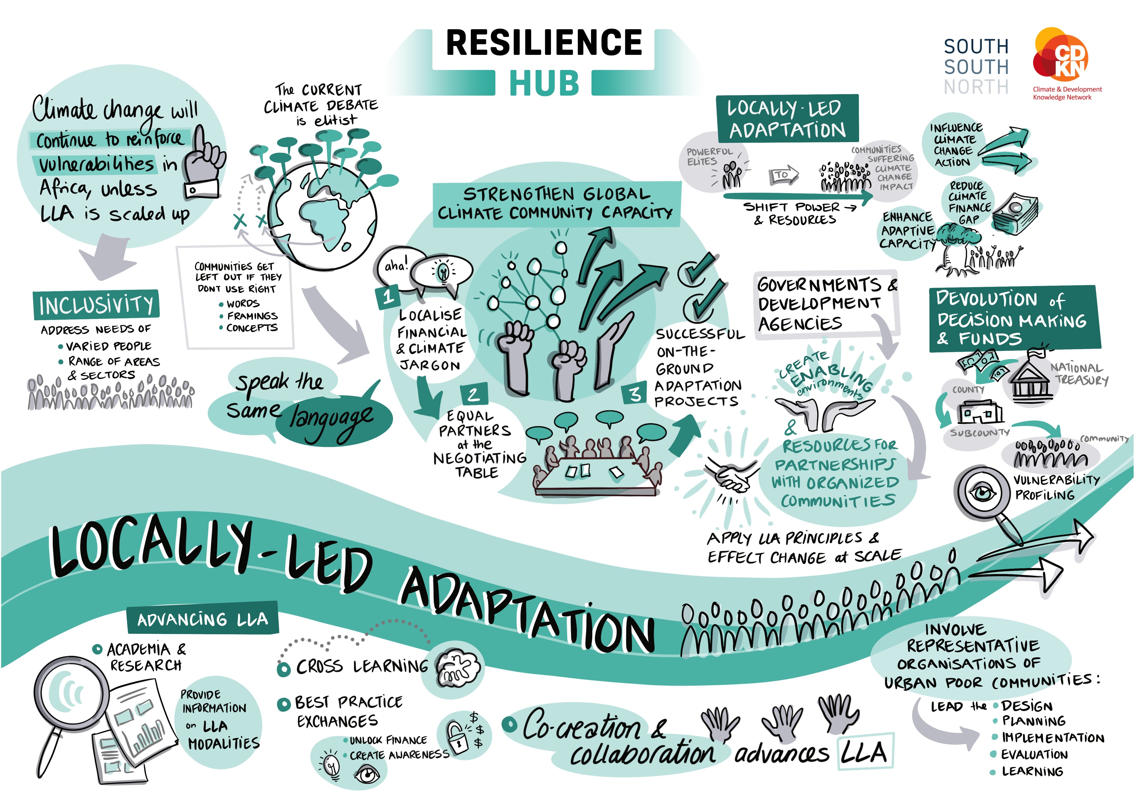
Insert LLA header slide here

Slide 4
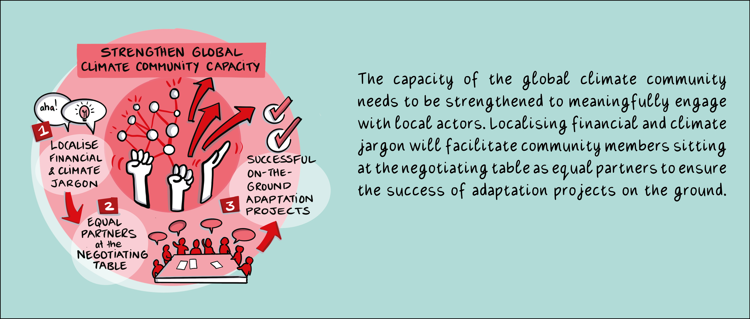
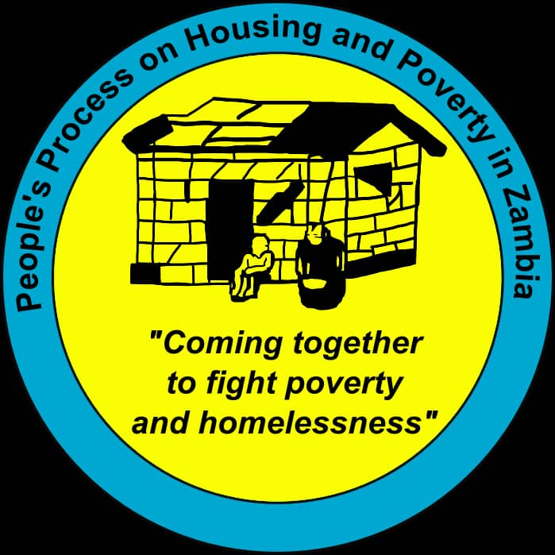



Message 1: Locally-led adaptation

Slide 5

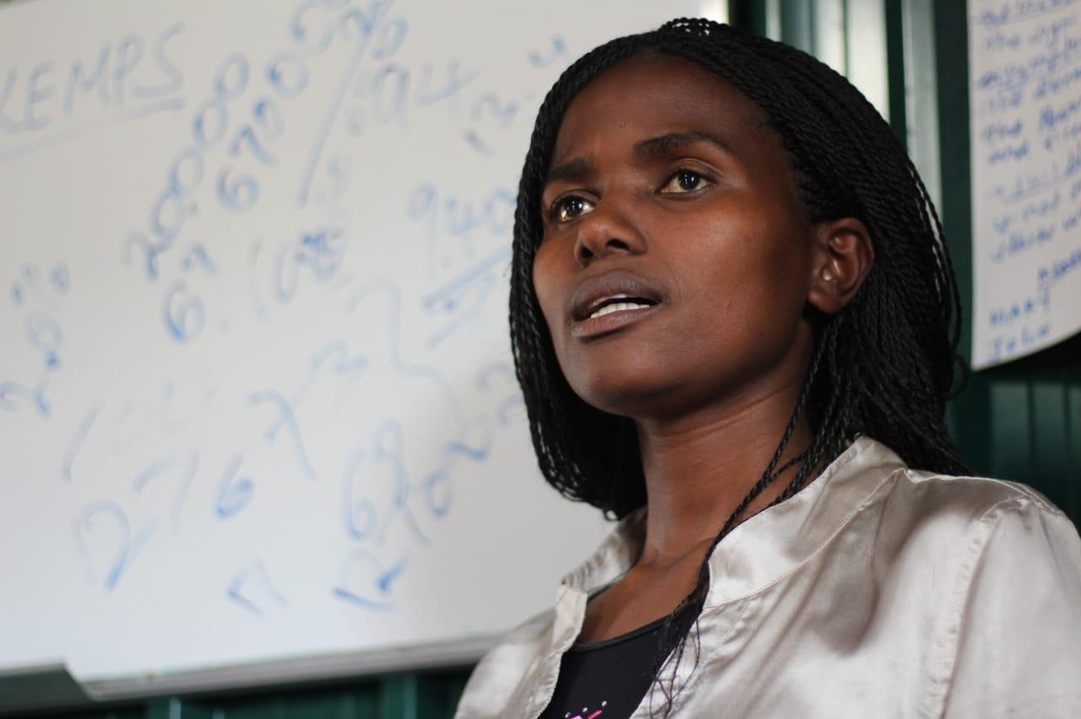
Message 1: Locally-led adaptation
If climate change is so important, why do we make it so difficult to understand? For rural women, slum dwellers, disabled…
Melanie Chirwa, People’s Process on Housing & Poverty in Zambia, Zambia
Nicera Wanjiru image – have asked her
Meaningful partnerships require that we ‘speak the same language’. Can we adapt to communities’ needs and not the other way round?
Nicera Wanjiru, Muungano wa Wanavijiji, Kenya

Slide 6
Locally-led adaptation (LLA) is about shifting power and resources from powerful elites to communities suffering impacts of climate change, with the aim of enhancing their adaptive capacity. Locally-led adaptation provides an opportunity for local voices to influence climate change action and reduce the climate finance gap. Climate change will continue to reinforce vulnerabilities in Africa, unless LLA is scaled up financially and its sustainability enhanced. LLA is a critical tool for African countries to adapt and mitigate.
The climate debate is elitist and concepts being discussed at the global level are not created for people who don’t already have access to global debates.
Community members are left out of relevant processes if they do not use the right words. This language gap is true for climate change financing, localising financing language is required.
To be inclusive the needs of varied people, in a range of areas and sectors need to be addressed, instead of asking them to adjust to the interests of the more powerful system in place.
Locally-led adaptation can benefit more from cross learning and best practice exchanges. Exchange visits (e.g. between different community members, or to other countries, with community representatives accompanying ministers) have helped to unlock finance (e.g. from private sector banks) and created awareness about how impoverished people can address their needs (e.g. in Zambia, Uganda).
Academia and research plays a critical role in providing information on the modalities of LLA. Co-creation and collaboration processes among local communities and key stakeholders advances LLA.
Message 1: Locally-led adaptation

Slide 7
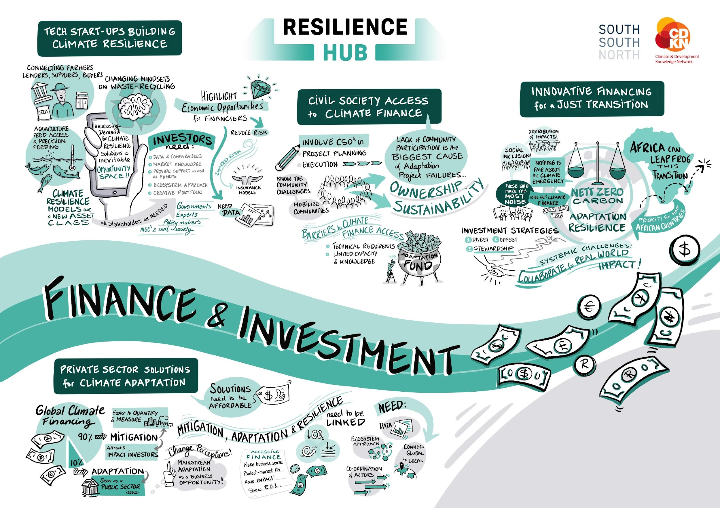

Slide 8
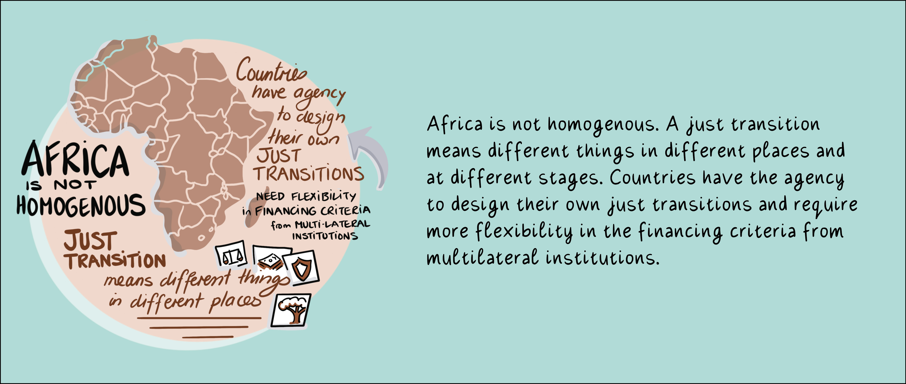

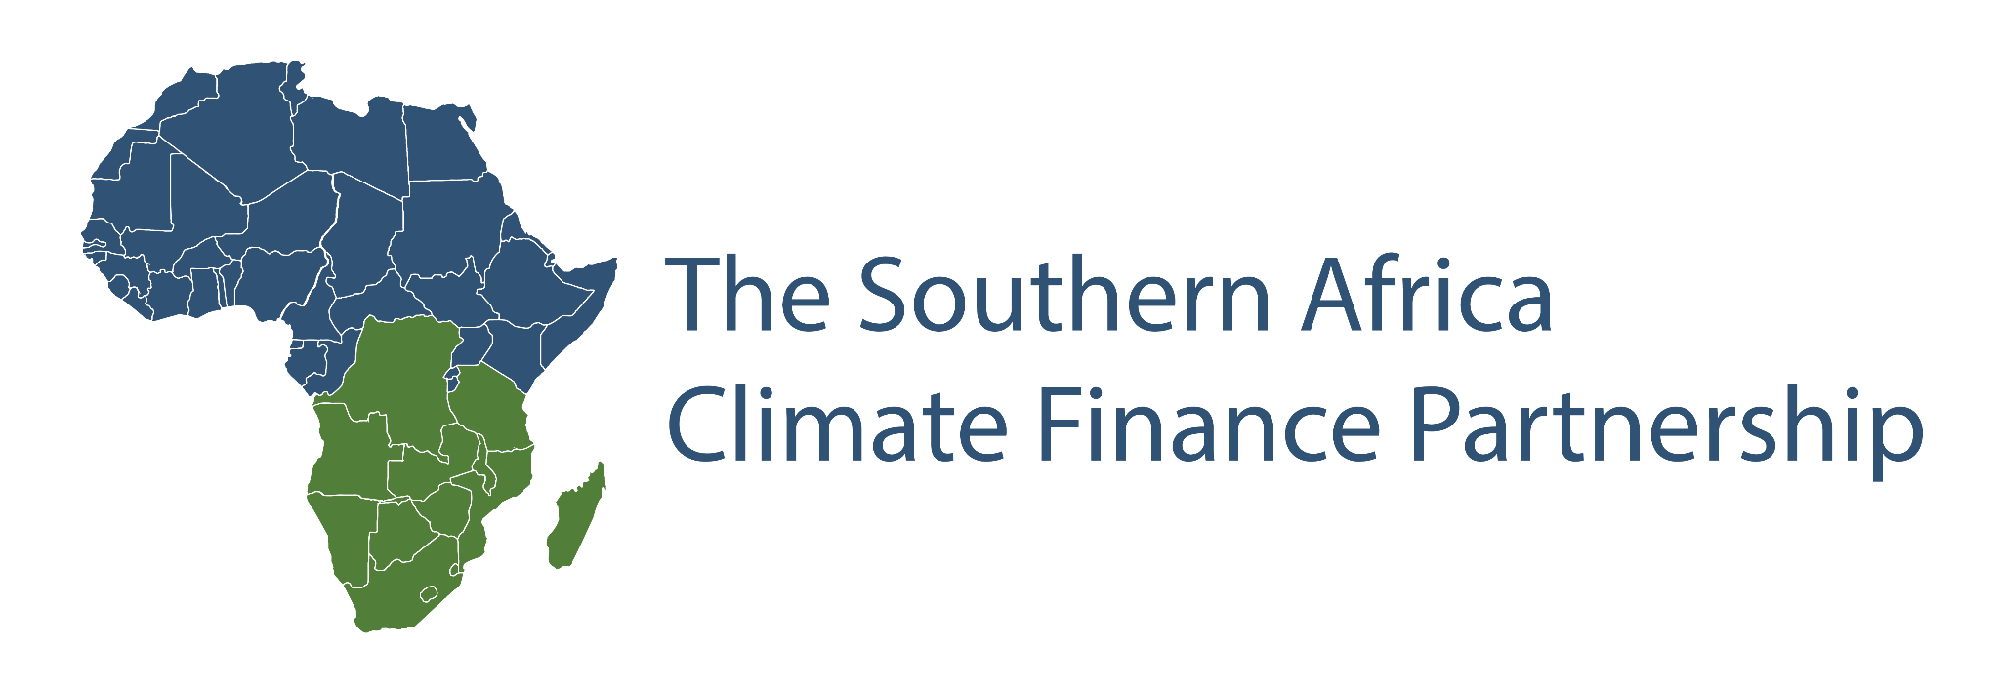
Message 2: Finance & Investment

Slide 9

Message 2: Finance & Investment
You cannot design the transition without the people who are going to be using it. There’s nothing fair about the climate emergency, hoping that it will become fair is not going to happen. We need to demand what we need, Africa is hosting COP this year. We need to start a movement. We can’t let them leave until they deliver what they have promised.
Developed countries have committed to assist developing countries financially but these funds have not been delivered.
Nicole Martens, Old Mutual Investment Group, South Africa

Slide 10
Developing countries require transitional finance and support to move forward in their transitions. Key imperatives from Article 9 of the Paris Agreement must be recognised, stating the obligations for developed countries to provide financial resources to assist developing country parties, with respect to both mitigation and adaptation in their transitions.
Green and sustainability bonds are key instruments for financial institutions to set the path towards and align themselves with the just transition. Sustainability bonds enable the just transition more holistically, by encompassing issues such as gender, health, housing, education in addition to environment.
Funders need to commit to longer-term time horizons, as the just transition is a process not an event, and requires a multitude of investments in all environmental, social, and governance aspects.
Long-term local financiers also have a role to play, to steward infrastructure and investment towards more sustainable outcomes. Long-term local financiers’ investment horizons generally span over decades.
Financial institutions for example, can and are proactively working with clients by assisting with provision of new skills to facilitate transition to greener businesses and careers. This includes provision of start-up capital and capacity-building outreach initiatives among their customers.
Message 2: Finance & Investment

Slide 11
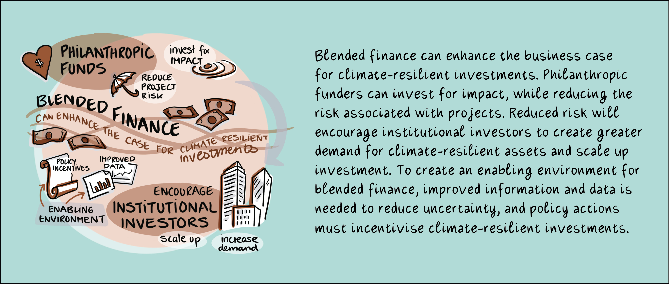


Message 3: Finance & Investment

Slide 12
Mobilising finance is a key element for building resilience and represents action and commitment by all actors. All speakers mentioned a financing gap for adaptation projects. However, they also mentioned that there are existing finance mechanisms that are underutilised.
Currently the focus is on obtaining public and donor finance, resulting in a huge dependence on these financiers. However, investors and financiers state that private sector climate funding is indeed available. Projects need to use the available grant funding to build a case to attract private investment.
Institutional investors in the global South require much higher rates of return than their global North counterparts which seriously impedes private sector investment.
The financial services sector is recognising the systemic risk that climate change poses to the financial system and the economies they operate in, and they are increasing their efforts to mainstream climate risk into their operations.
Adaptation financing is available, but entrepreneurs and projects need to frame their work as building resilience and search for the right opportunities to make it happen.
Blended finance mechanisms are invaluable for bringing philanthropic, public and private sector funders to the table and unlocking significant finance for adaptation and resilience building.
Message 3: Finance & Investment

Slide 13
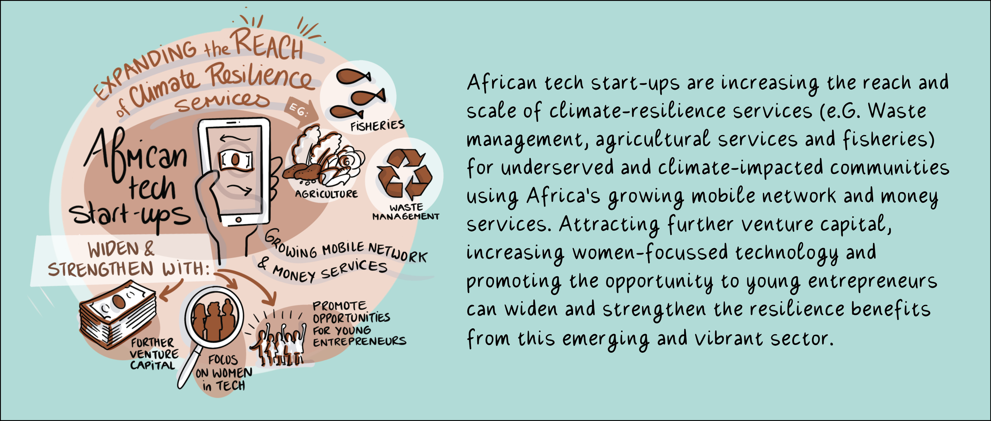
Message 4: Finance & Investment

Slide 14
This is an opportunity to provide solutions for monitoring, reporting, and verification of project data which is key in decision-making processes, and which can also allow for increased traceability of climate finance flows which can bring in additional funds towards innovative solutions.
Start-ups are well placed to respond to these opportunities through mobile payments services, frontier tech, and data assets.
Start-ups can leverage on access to internet and mobile technology which can help scale solutions and increase access, especially for underserved communities.
There is a significant gender gap in access to and use of climate finance and technologies. Women still have substantially less access to and education in the technology space. We must look to increase technology interventions/projects that seek to enhance the digital literacy of and access to technology for women in local communities. We must also track gender equality objectives across climate and Sustainable Development Goals (SDG)-aligned finance.
A variety of restrictions prevent tech start-ups from raising sufficient capital. This includes limited commercial data and cumbersome due diligence processes. This results in a ‘missing middle’ between seed capital and commercial loans. We must also track gender equality objectives across climate and Sustainable Development Goals (SDG)-aligned finance.
There is a range of financing sources which should be leveraged, including investments by established actors in the value chain who can benefit from the success of these tech start-ups.
Message 4: Finance & Investment

Slide 15
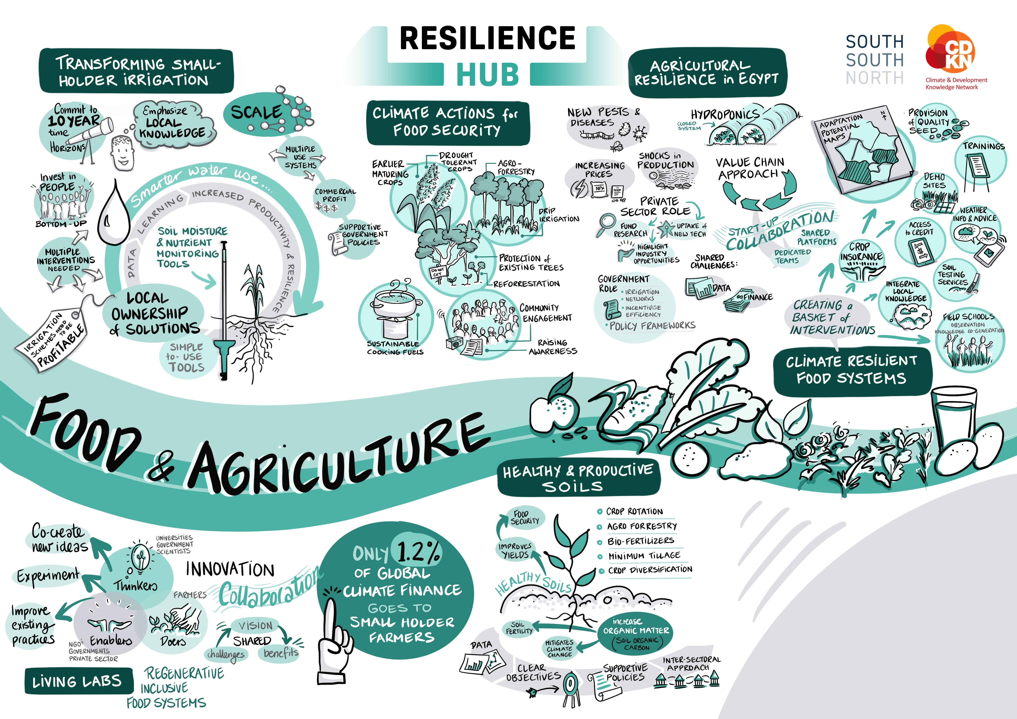
Insert Food & Agriculture header slide here

Slide 16
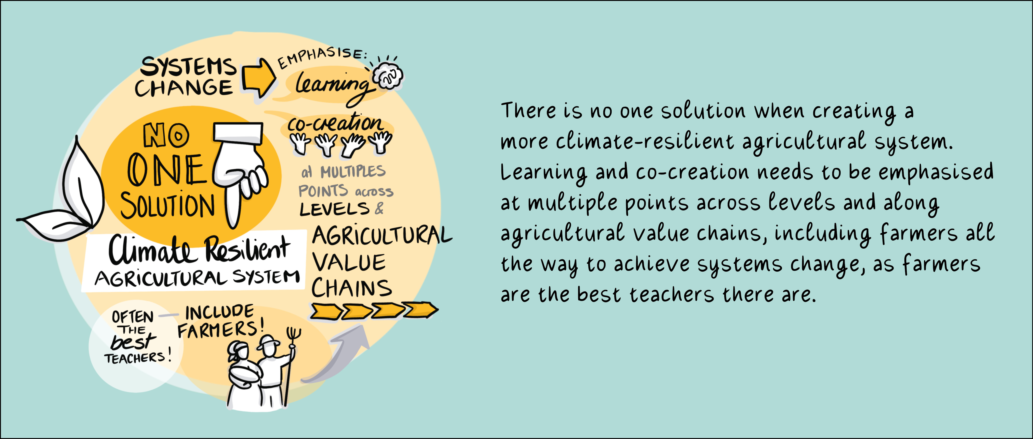
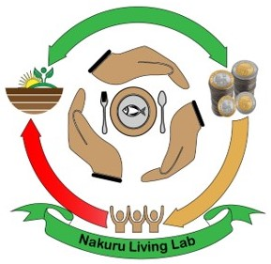


Message 5: Food & Agriculture

Slide 17
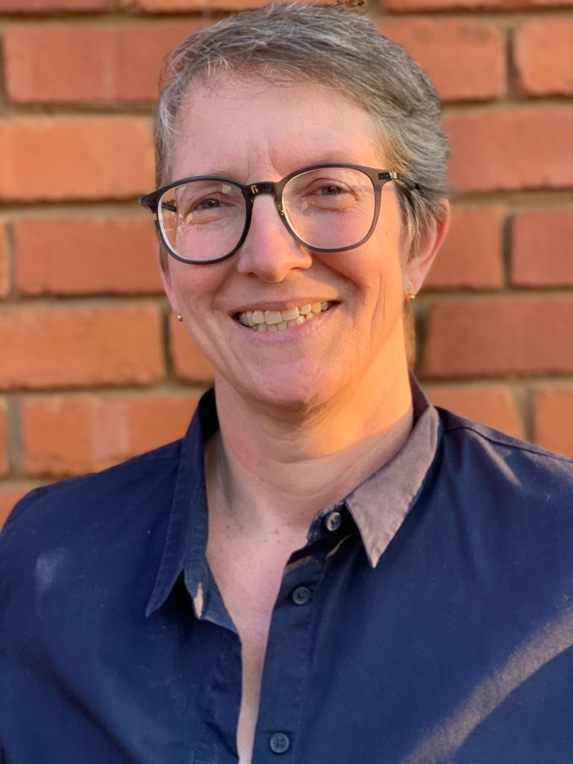
Message 5: Food & Agriculture
Scaling starts with learning as there is no one-size-fits all initiative. Emphasise learning and invest in it, pay for it. The farmers are the best teachers there are, so put the farmers at the centre of the learning, and then they teach other farmers, they teach researchers, they teach policy makers what should be emphasised and addressed
Amy Sullivan, Bridgewater Consulting, South Africa

Slide 18
Message 5: Food & Agriculture
There is general agreement that the current food system is not working for everyone.
There are no silver bullets when it comes to creating a more resilient agricultural system. Interventions at multiple points are needed for systemic change.
To transition to regenerative inclusive food systems that support livelihood resilience, food security and ecosystem health, we need to holistically understand how the food system works all the way up to consumers.
Co-creation platforms can bring about this transition by incorporating diverse knowledges, improving information and resource flow, enabling stronger networks, increasing capacities, and improving and validating products. They can redistribute power and reduce conflicts lessening the gap between science and practice, and by recognising and validating farmer-led research and practice.
Partnerships need to be developed that link producers, users and enablers along value chains and across levels. In particular farmers should be included to participate in decision-making processes that affect them. Farmers’ voices need to be considered from the outset of any project in which they have a stake.
There should be a strong emphasis on learning and adjusting based on that learning. Simple, locally-appropriate monitoring tools and equipment can inform that learning, particularly in decision making and production.
Farmers are the best learners and teachers when something works, even when they are not direct project recipients.
In order to promote systemic change, which is essential given the shortcomings in African agricultural systems, funders need to commit to a ten-year time horizon.

Slide 19
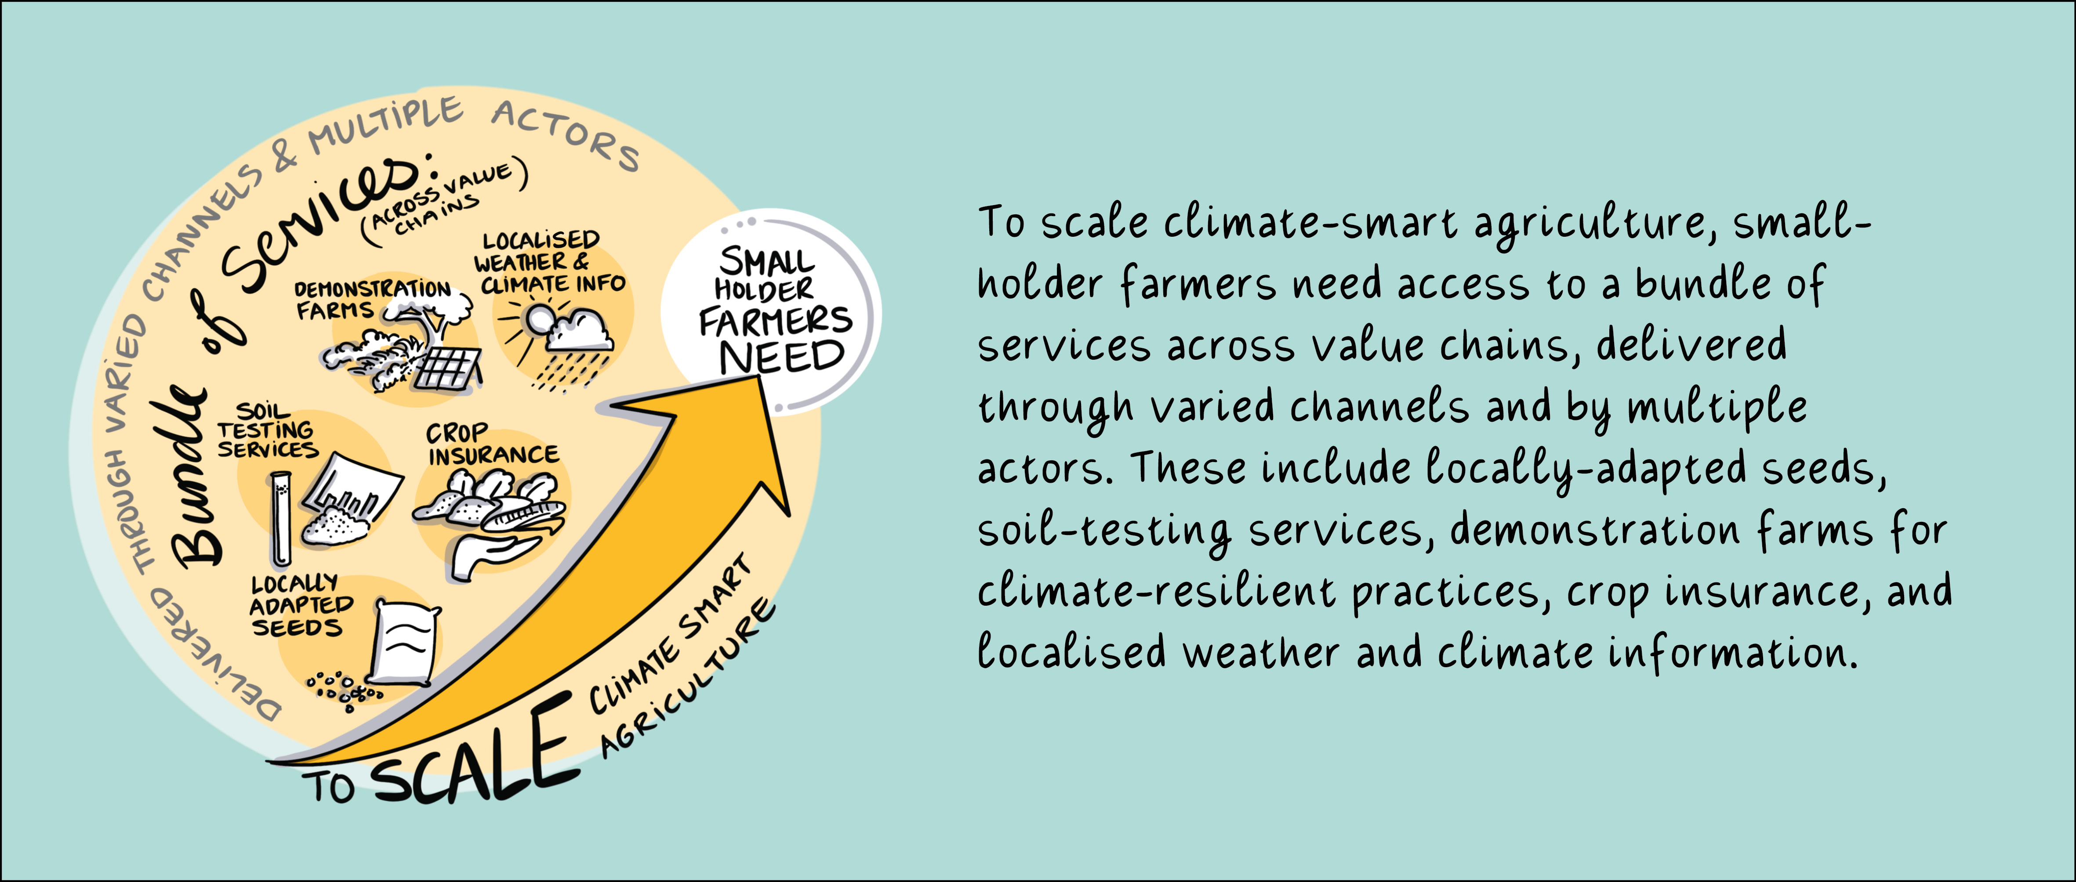
Message 6: Food & Agriculture

Slide 20
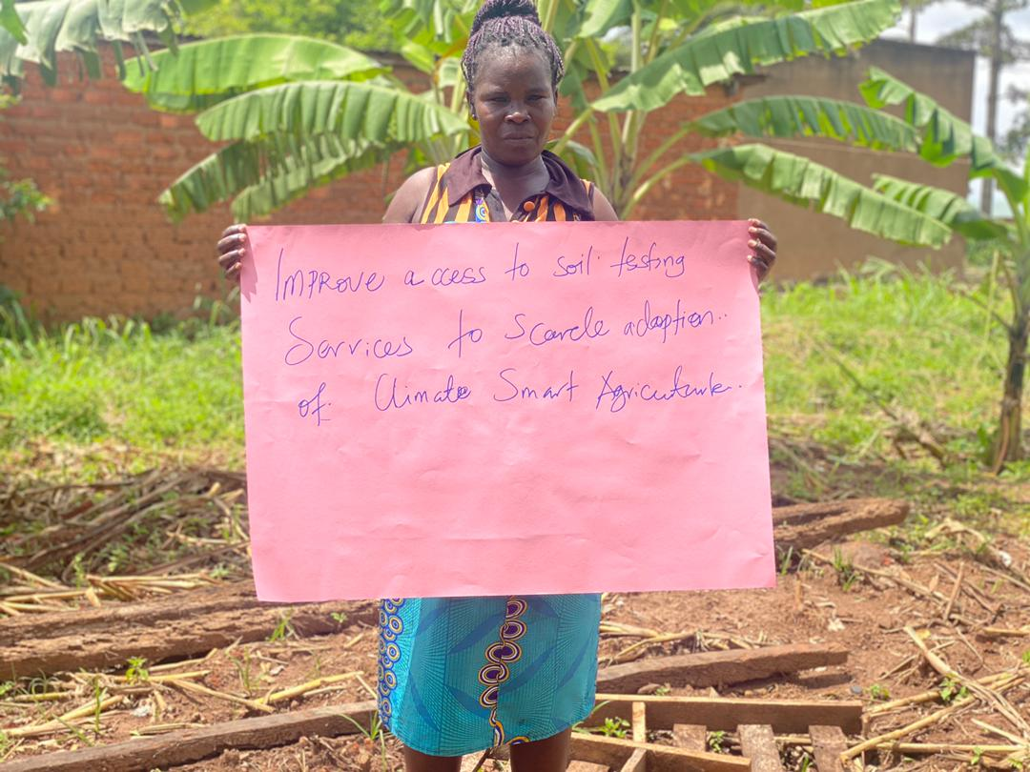
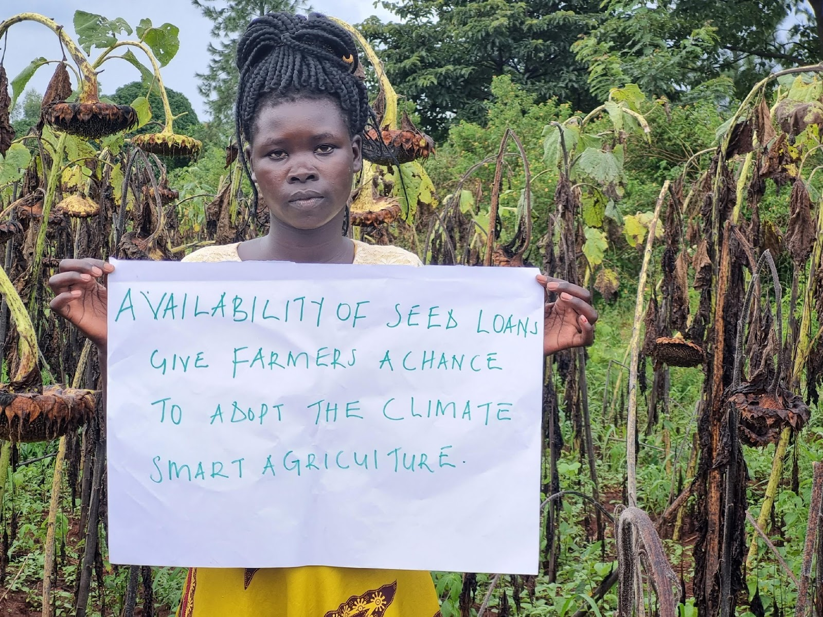
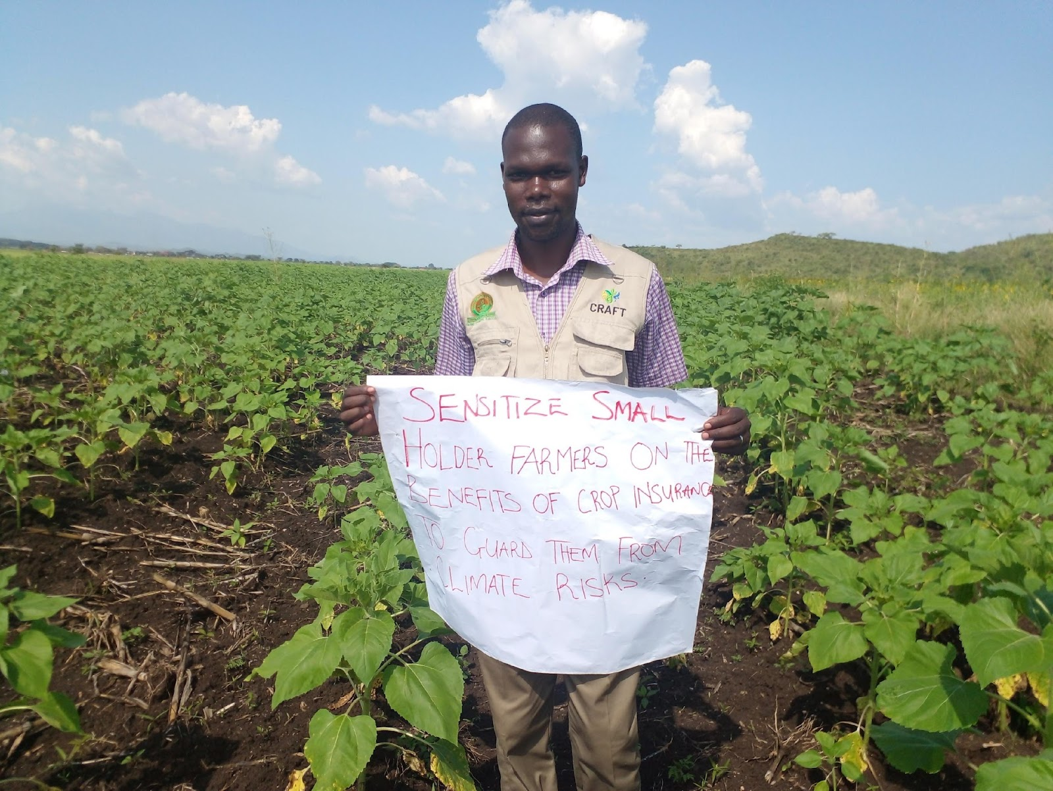
Message 6: Food & Agriculture
Improve access to soil testing services to scale climate-smart agriculture
Amaro Rwot Rose (Farmer Amuru District), TRAFORD, Uganda
Availability of seed loans give farmers a chance to adopt climate-smart agriculture
Akello Florence (Farmer Bukedea District), P’KWI Cooperative, Uganda
Sensitise farmers on the benefits of crop insurance to guard them from climate risks
Limo Jan (Farmer Kween District), Sebei Farmers’ SACCO, Uganda

Slide 21
Message 6: Food & Agriculture
Smallholder farmers have limited market power and less access to information compared with the providers of finance, and buyers. Market power can be increased through subsidies or mobilisation, as well as strengthening local and regional agricultural production systems, which are easier for smallholder farmers to access.
To build resilience, smallholder farmers need access to a variety of services across the supply chain. These should be delivered through multiple channels and by multiple actors, and can include demonstration farms (where rainwater harvesting, mulching and minimum tillage can be promoted), agricultural insurance, and localised weather information.
Tools and equipment must have a simple interface and must be adaptive to local environments. High-tech solutions may not always be appropriate.
Access to climate information services by stakeholders in the entire agriculture value chain (including researchers, policymakers, private sector and civil society) is needed to ensure climate-proof food.
Localised climate risks and vulnerability assessments are needed to explore (physical and transitional risk) impacts of climate change at different stages of agricultural value chains and inform financial institutions’ climate investments.
Climate adaptation provides business opportunities for agri-SMEs and cooperatives. Varying private sector actors need to collaborate to scale and strengthen adoption of climate smart agriculture practices and technologies.
Many financial institutions need guidance on supporting smallholder farmers, such as on how to contribute, and where needs are. Institutional, and regulatory frameworks as well as incentives that attract private sector engagement needs to be set up.
Notes:
More than 75% of food production in sub-Saharan Africa is produced by farms smaller than 20 ha, while in North Africa, it's closer to 60% (Herrero, Thornton, Power, et al., 2017).

Slide 22
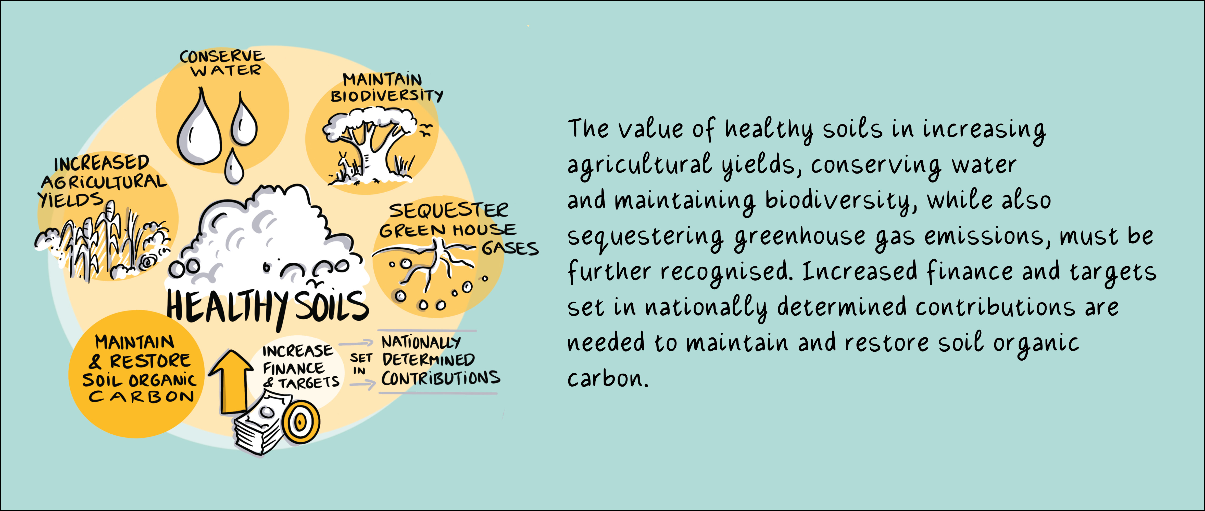




Message 7: Food and Agriculture

Slide 23
Message 7: Food and Agriculture
African soils are considered some of the most degraded globally, with current agricultural practices leading to further losses in soil fertility. Although the percentage of smallholder agriculture is so high in Africa, its GDP contribution is very low, due to low yields.
Investments on soil and land constitute less than 10% of global climate change investments.
Despite healthy soils’ potential to address climate ambitions and food security, very few African countries have set Soil Organic Carbon targets in their nationally determined contributions. Yet, food security and agricultural yields can be improved in a relatively short period (three to five years) through the implementation of good agricultural practices that support restoration and conservation of soil organic carbon.
African countries need to address food security and soil health concerns in a holistic and integrated manner to consider the full range of benefits, which range from food production, water conservation, biodiversity, and livelihoods to climate change mitigation potential. They must recognise the value of healthy soils and set or raise ambitions to maintain and restore soil organic carbon.
Africa requires additional access to soil laboratories, to support soil testing and the monitoring, reporting and validation of soils.

Slide 24
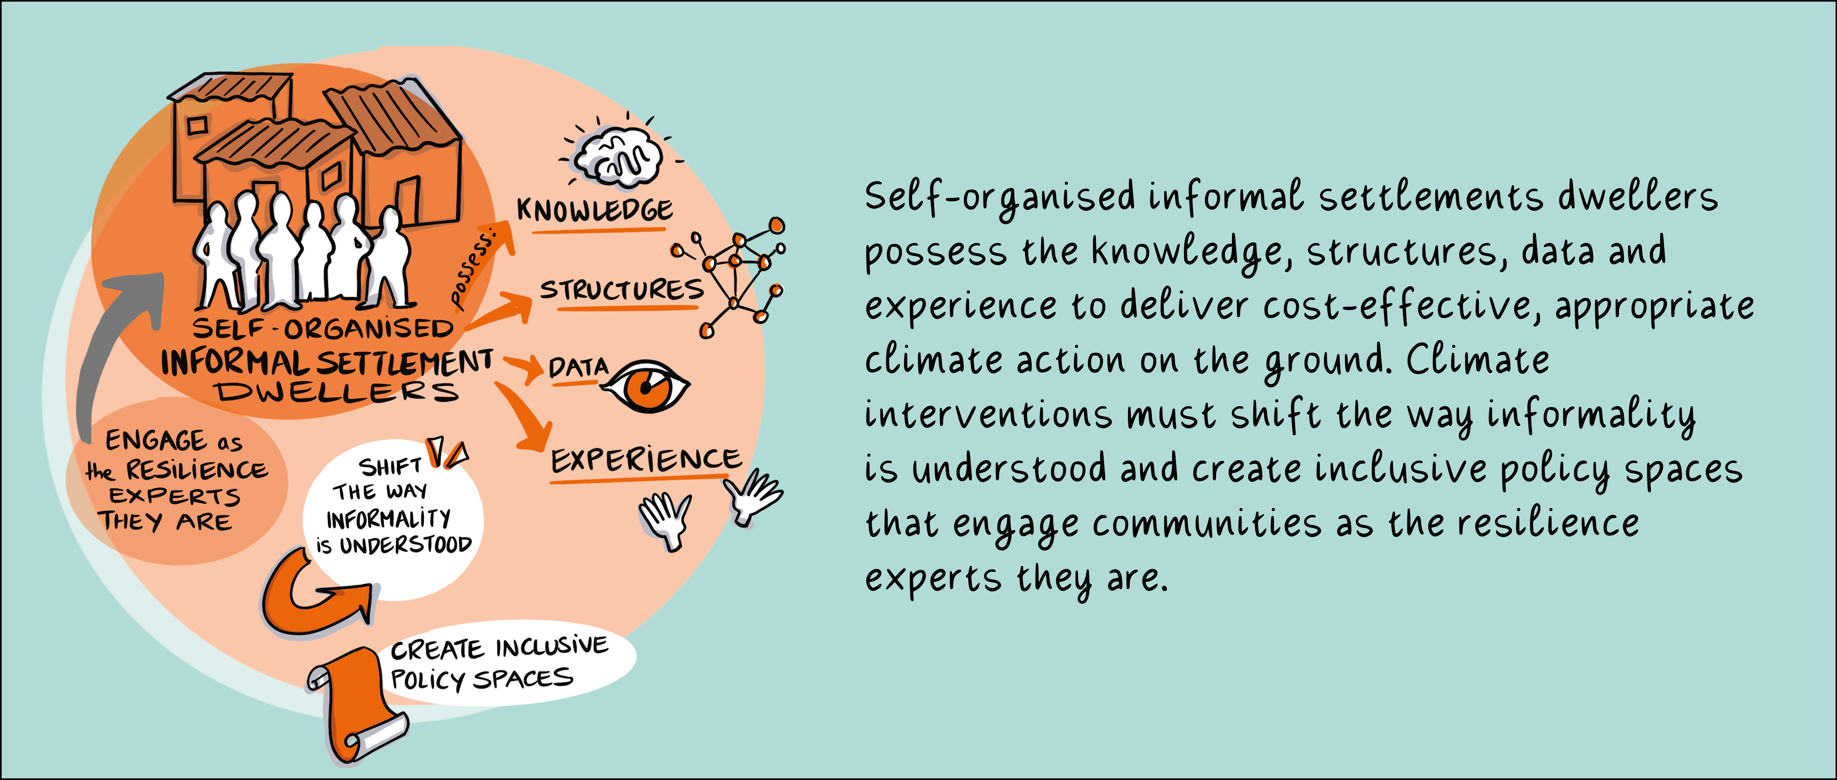

Message 8: Cities and Urbanisation

Slide 25

Message 8: Cities and Urbanisation
When you see people are organised, it is easy to help them. If people are not organised it is very, very difficult. The Federation of the Homeless People, when they come to you they don’t come with an empty plate, they come with a full, half full, three quarter full and then you help each other.
David Tembo, Principal Housing Development Officer, Ministry of Housing and Infrastructure, Zambia

Slide 26
Message 8: Cities and Urbanisation
Self-organised communities are the experts when it comes to adaptation on the ground. They possess knowledge, experience and capacity to implement cost-effective actions, and their networks, savings and organised structures mean that they are able to drive and deliver locally-led adaptation (and channel climate finance) directly to the people who need it most. Various African informal settlements have undertaken data collection processes that provide evidence to inform risk mapping and assessment, and local development and adaptation planning.
Development agencies, governments, and multilaterals must partner with communities (and the organisations that support them) to resource, replicate and scale this work to effect real change.
Participatory adaptation planning paves the way for plan formulation and implementation, enables civil societies to advocate and lobby for adaptation and mitigation to build resilience in the settlements, ensures access to service and climate resilient infrastructure, brings out system change through policy and documentation of the stories of change.
To realise a resilient, climate just future, governments and development agencies must create enabling environments and partner with representative organisations of urban poor communities as stakeholders that lead the design, planning, implementation, evaluation and learning for the changes that are needed so urgently. The establishment of city funds to access climate finance at the local level can empower urban poor communities to apply and advocate for just climate adaptation and mitigation strategies and solutions.

Slide 27
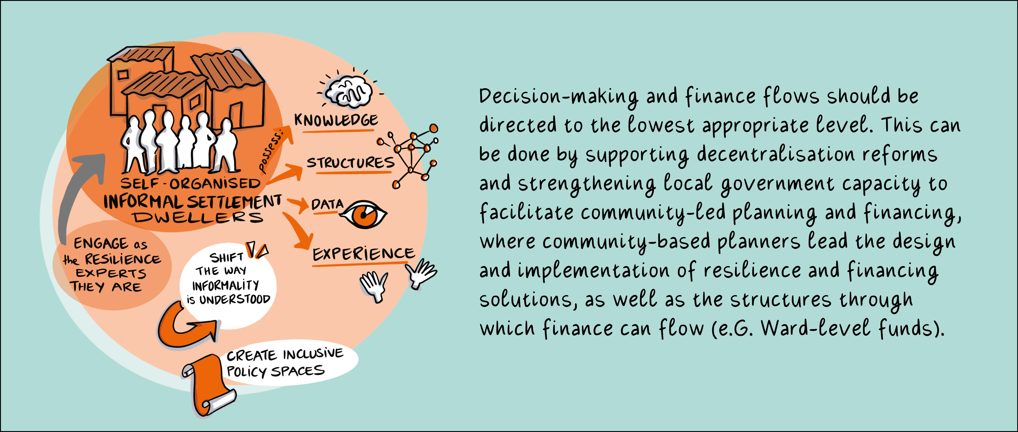
Message 9: Cities and Urbanisation

Slide 28
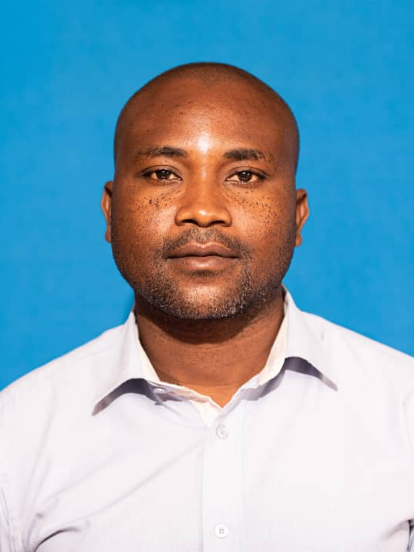
Message 9: Cities and Urbanisation
Meaningful partnerships will come in when people are willing to co-create. Co-creation is the key word we have to focus on. How are we going to co-create in societies where decentralization reforms and local governance is not functional? It will only happen when government is willing to involve communities on the ground. In the absence of improved governance we should forget about building the resilience of the urban poor.
Zilire Luka, Centre for Community Organisation and Development (CCODE), Malawi

Slide 29
Message 9: Cities and Urbanisation
It is a challenge for city planners to keep up with the increasing rate of urbanisation resulting in much of the urban population living in informal settlements. These settlements are often on ecologically fragile lands, such as riparian reserves and public lands, which makes them vulnerable to the effects of climate change such as flooding and landslides.
Cities should plan the macro structure of the city to ensure people don’t settle on inappropriate land, however the rest of the planning, particularly of slum upgrading can be left to supported community-based planners.
Communities prioritise effectively and resources for small-scale infrastructure that is managed by community contractors can result in a greater amount of infrastructure at a higher value for money.
Devolution of decision making to the lowest appropriate level and strong local governance is crucial for the successful implementation of the locally-led adaptation principles. Inclusive policy spaces that engage informal settlement dwellers and address political factors (such as those tied to land evictions and the provision of services) should be created.
Decentralisation reforms used with innovative funding models enable communities to develop ward-level decentralised committees and associated pro-poor financing models, such as used by the Ward Fund of Lilongwe to implement basic services and infrastructure at community level. In Kenya, the Climate change act and policy and climate change plan have facilitated participatory adaptation planning through enabling funds to reach ward-level climate change planning committees.

Slide 30
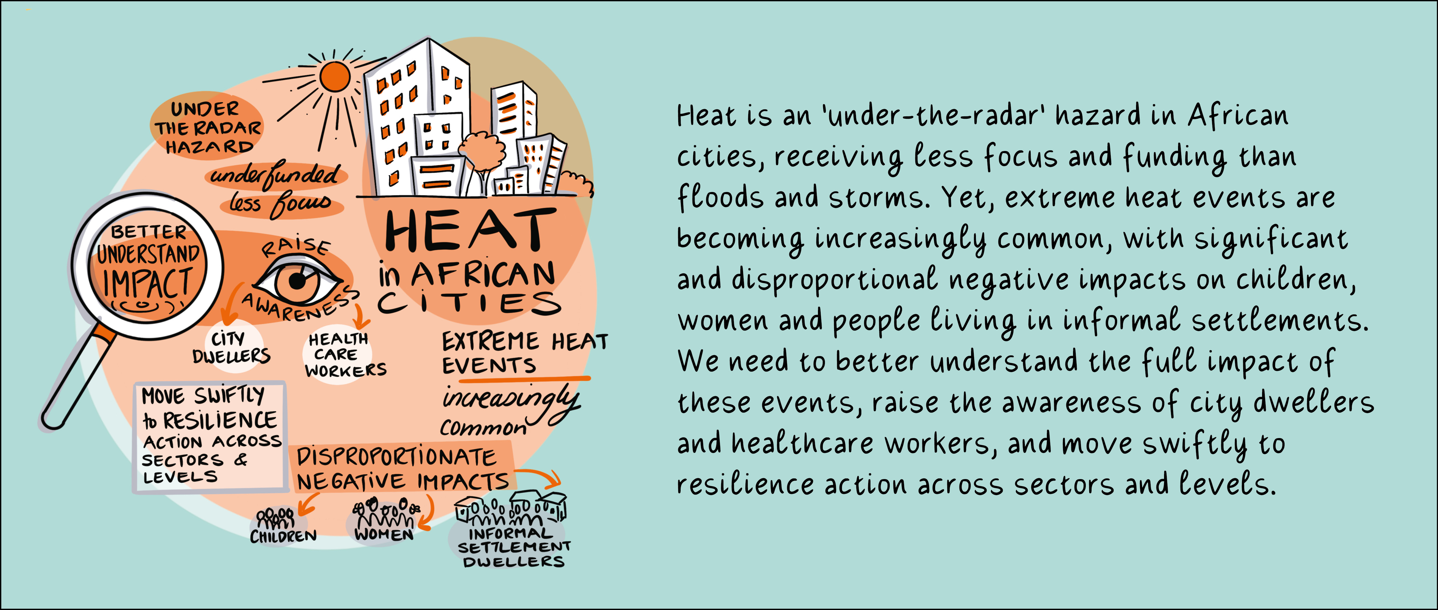







Message 10: Cities and Urbanisation

Slide 31
Message 10: Cities and Urbanisation
Extreme heat is often coupled with other environmental risks, including wildfires, dust and drought.
There is a strong link between climate change and health, seen both directly (e.g. through an increase in diseases) and indirectly (e.g. through climate-related disasters) yet these linkages have not been made explicit.
African countries need to be supported to consider the impact of extreme weather on human health, with a specific focus on cities. We must increase networks and synergies in Africa to accelerate learning and swiftly move to action for impact, acting at different levels and across a number of sectors.
People who live in hot climates may not perceive themselves to be at risk because they are “used to” the heat, have limited access to space cooling and have no options to avoid working in the heat of the day.
National Guidelines on heat must be budgeted for and implemented at municipal level.
More knowledge is needed on how extreme temperatures are affecting people and their livelihoods and where the pressure points are. This includes data and stories from communities on their lived experiences in particular in informal areas. Funding should be provided for research in less accessible areas.
Information needs to be communicated to city dwellers on heat impacts and health such as the signs of heat-related stress. Various methods of communication and engagement should be used for example radio, schools and plays.
Work with CSOs and the media to increase exposure of the topic and for lobbying efforts.

