Slide 1
ATELIER METHODOLOGIQUE IPAR /CECI
Energy transition for women's economic empowerment in the horticultural value in West Africa (Senegal, Guinea)
Laure TALL
Research Director
IPAR think tank

Slide 2
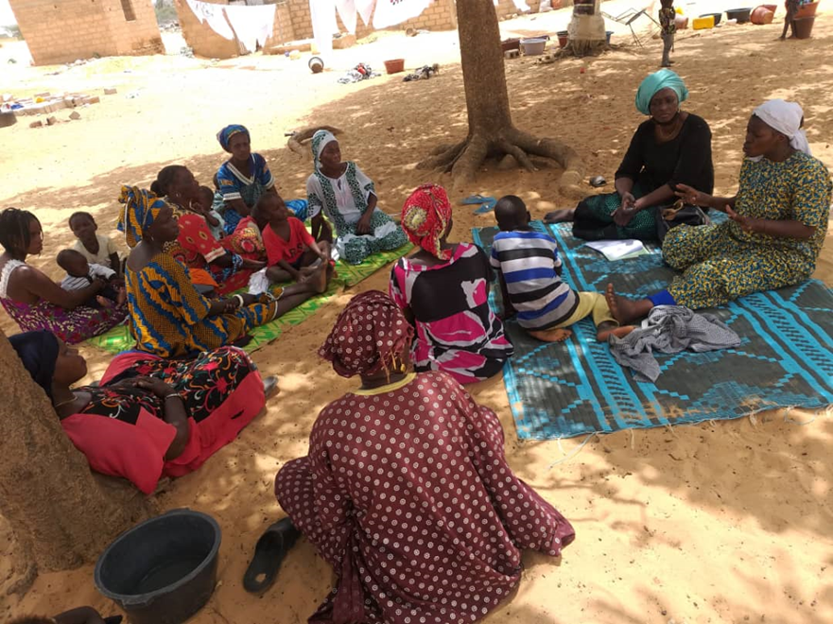
The challenges of African women in the economic development
La transition énergétique pour l’autonomisation économique des femmes à travers la chaîne de valeur horticole en Guinée et au Sénégal
Social challenges
Education
Land and property
Employment
Notes:
Social challenges
the social role of women leads to their exclusion in one way or another from the labor market
Education
Illiteracy rate in sub-Saharan Africa is the highest in the world, and the proportion of women represents about two-thirds of the illiterate in Africa
Land and property
Women own less than 2% of land in Africa
Employment
In Africa, economic implications of gender disparities amounts $ 95 billion/year
In Senegal, women earn 66% of men's work.

Slide 3
The COVID-effect , the case of Senegal
La transition énergétique pour l’autonomisation économique des femmes à travers la chaîne de valeur horticole en Guinée et au Sénégal
Macroeconomic measures
Fiscal policies (>US$2B) injected directly to reduce the budget deficit, cut taxes, pay the government debt to the local companies, maintain wages, boost tourism, health sector, agriculture and export.
BCEAO introduced major monetary policies that kept inflation low, cash flow in banks, and low interest rate in the region
Social protection
Emergency food aid program of the State of Senegal for >100 millions US$ to help 100 millions households
Agriculture and women
Despite these efforts, large parts of the primary sector have suffered specially the horticultural sub-sector due to the mobility restrictions and a sharp decline in demand.
Difficulties in the market and supply sector, with considerable loss of income and significant debt as immediate consequences.
Women in the agricultural sector affected by Covid (IPAR, 2021):
100% of female horticultural producers
100% fish processors,
95% of micro fishers,
92.3% of horticultural traders,
80% of poultry farmers
Notes:
To maintain the same growth rate as previous years, the Senegal government implemented major fiscal policies for more than $2B (1000 B CFA) injected directly to trigger the overall economy, in particular reduce the budget deficit, cut taxes, pay the government debt to the local companies, maintain wages, boost tourism, health sector, agriculture and export. Similarly, the BCEAO introduced major monetary policies that kept inflation low, cash flow in banks, and low interest rate among other measures

Slide 4
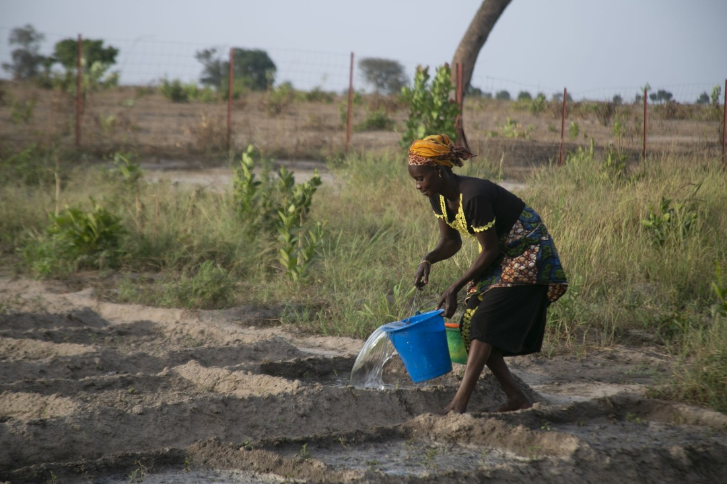
Agriculture, an engine of development
La transition énergétique pour l’autonomisation économique des femmes à travers la chaîne de valeur horticole en Guinée et au Sénégal
The horticultural sector is growing:
16% of GDP in Senegal, 5% in Guinea
A majority of women in the horticultural value chain
Irrigation costs are the first item of expenditure for horticulturists
between 45 and 20% of the costs depending on the speculation
women are the most vulnerable to this increased work
Opportunities for greener, more inclusive economies…

Slide 5
Energy transition
La transition énergétique pour l’autonomisation économique des femmes à travers la chaîne de valeur horticole en Guinée et au Sénégal
Energy poverty is a major obstacle to economic growth and poverty reduction.
In sub-Saharan Africa, 680 million people, the majority of whom live in rural areas, would not have access to electricity
Need to build more shock-resilient and sustainable economic models
In Senegal, the National Rural Electrification Program (PNER) 22% in renewable energy
Guinea is aiming for an energy transition in its Nationally Determined Contributions (NDC) by 2030 for about 30,000 households in hydropower and solar.
Is there a discussion on the access to energy for women?

Slide 6
Energy and women's economic empowerment
La transition énergétique pour l’autonomisation économique des femmes à travers la chaîne de valeur horticole en Guinée et au Sénégal
Access to electricity can increase women's participation in the labour market, human capital development and income-generating activities.
The use of solar energy for agricultural production, especially horticultural watering (exhaure and irrigation), can:
Reduce women’s penibility and working time compared to manual work;
Increase energy efficiency compared to gas pumps;
Increase farm incomes;
Reduce greenhouse gas emissions from petrol/diesel pumps by 95%.

Slide 7
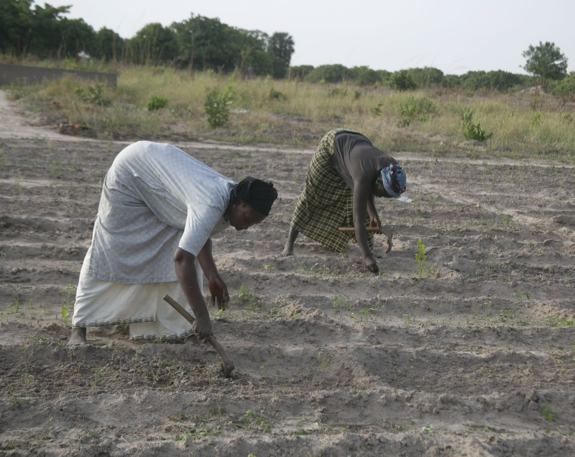
For more information please contact:
laure.tall@ipar.sn
maramecisse@ipar.sn

