Slide 2
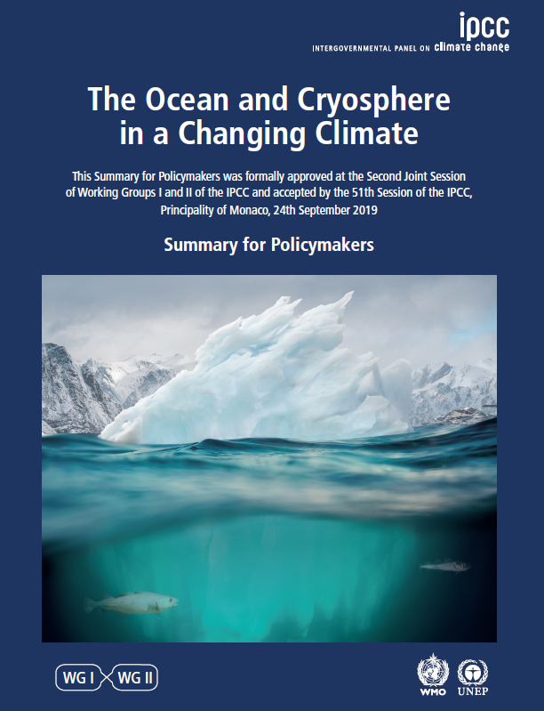
IPCC Special Report on the Ocean and Cryosphere in a Changing Climate
The report assesses:
the existing science to date on observed and projected changes to the oceans and cryosphere; and
the risks, vulnerability, impacts and implications of climate-related ocean and cryosphere change for natural and human systems.
IPCC’s Summary & full report: www.ipcc.ch/srocc
Notes:
The Intergovernmental Panel on Climate Change (IPCC) published its Special Report on the Ocean and Cryosphere in a Changing Climate in 2019 (www.ipcc.ch/srocc).
The Special Report was a response to proposals from governments and observer organisations to the IPCC.
It assesses the existing science to date on observed and projected changes to the oceans and cryosphere, and the risks, vulnerability, impacts and
Implications of climate-related ocean and cryosphere changes for natural and human systems.
This is not an official IPCC publication. This is CDKN’s guide to some key headlines in the IPCC’s report, which may be useful for African audiences.
The IPCC’s own Summary for Policy-Makers, www.ipcc.ch/srocc, focuses principally on global issues and trends.

Slide 3
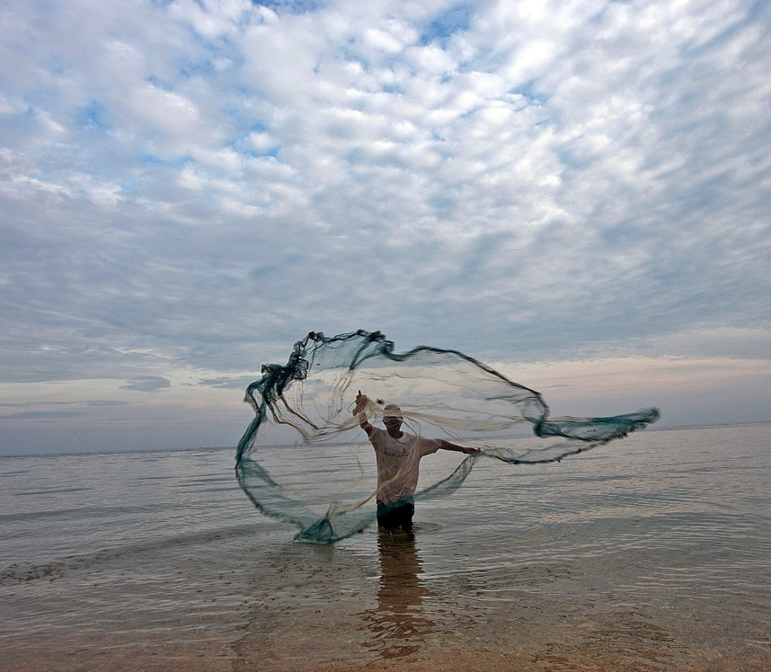
IPCC Special Report on the Ocean and Cryosphere in a Changing Climate
101 Coordinating Lead Authors, Lead Authors and Review Editors, from 41 countries
CDKN report & communications toolkit digests the IPCC’s >1,000 pages into headlines & images for African, Asian and Latin American audiences: www.cdkn.org/oceanreport

Slide 4
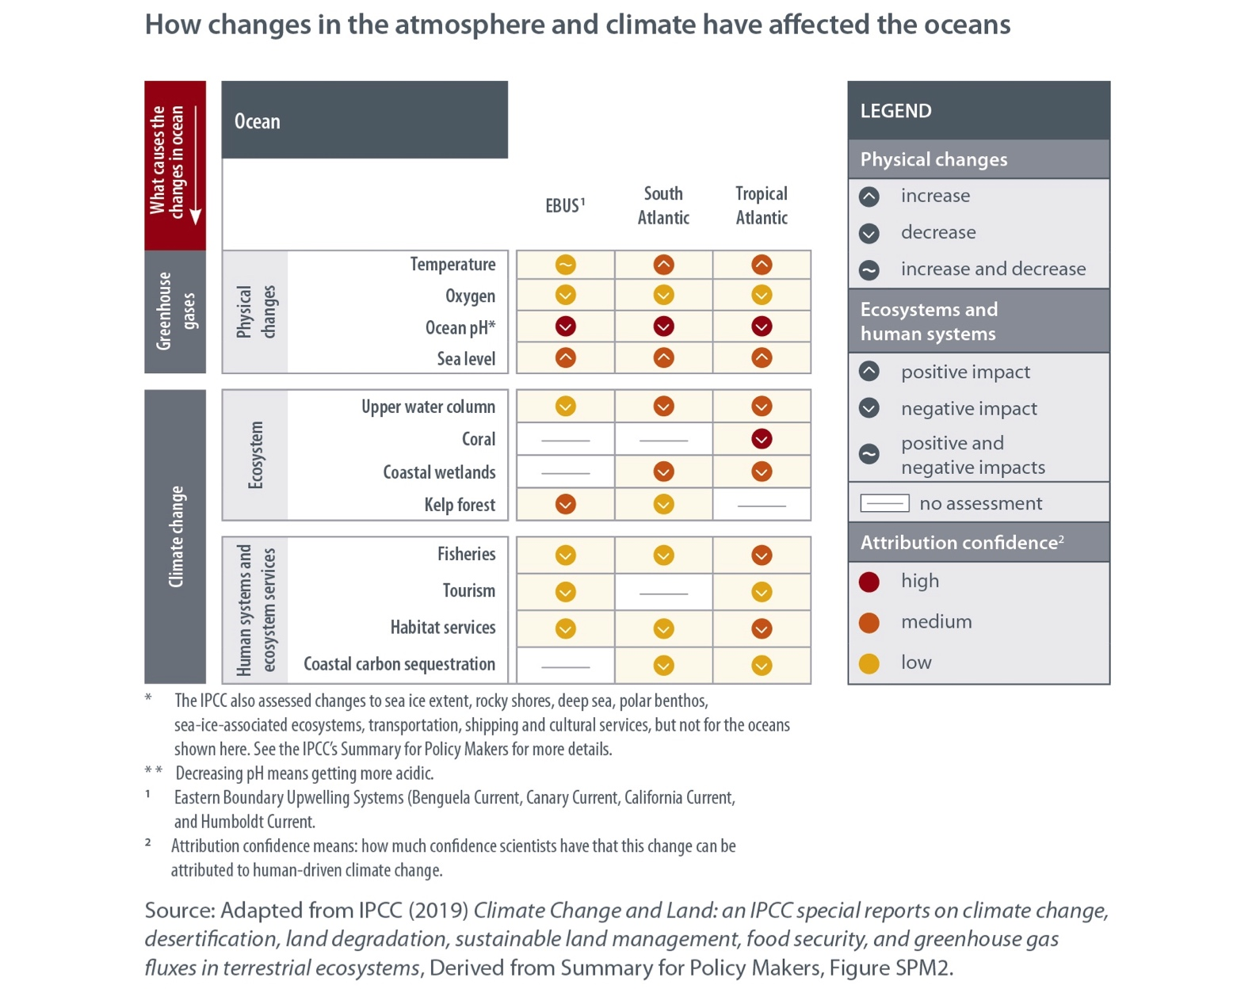
Climate change driven by human activity is changing the temperature and chemistry of the oceans
Notes:
The world’s oceans have taken up more than 90% of the excess heat in the climate system.
Marine heatwaves are becoming longer, more frequent, more far-reaching and more intense.
Ocean acidification is increasing and warming is causing less mixing among layers of ocean water, which means less exchange of oxygen and
Nutrients among layers, resulting in a decrease in the productivity of biological systems.

Slide 5
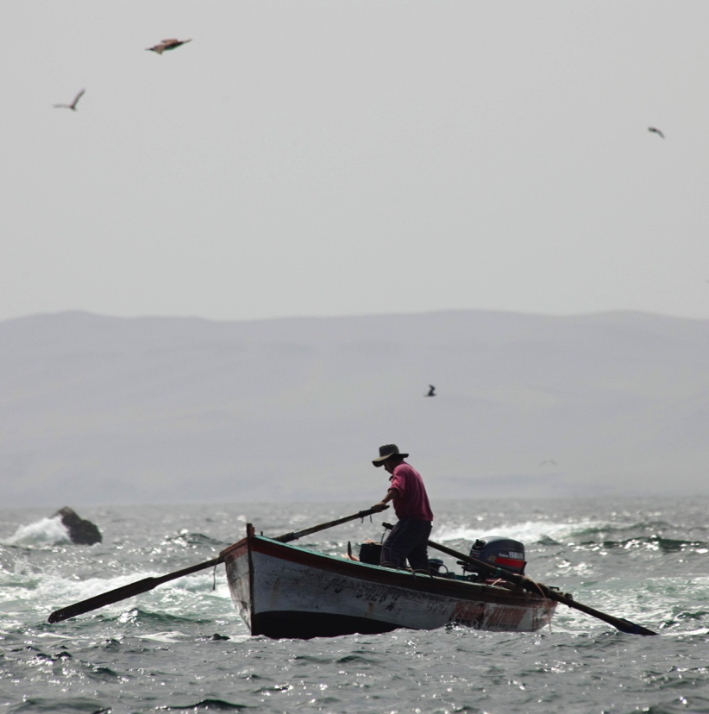
These changes harm marine life and people who depend on it
Warming ocean waters and a more acidic ocean are destroying coral reefs, reducing their contribution to food, coastal protection and tourism.
Marine species are on the move as a result of climate change, so in any one place, the abundance and mix of species is changing.
The distribution of fish populations is shifting, which will impact local people dependent on fish stocks for their livelihoods and their own food supplies.
Climate change will put at risk the ecosystem benefits that the Humboldt Current brings to Latin America.
Notes:
A warmer, more acidic ocean, with less oxygen and changes in available nutrients, is already affecting the distribution and
abundance of marine life in coastal areas, in the open ocean and on the sea floor.
Warming ocean waters and a more acidic ocean are destroying coral reefs and species with calcium-based shells,
such as mussels and barnacles. Coral reefs’ declining health will greatly reduce their contribution to human society,
including to food, coastal protection and tourism industries.
Marine species are on the move as a result of climate change, so in any one place, the abundance and mix of species is changing.
The distribution of fish populations is shifting, which will have particular impacts on local people that depend on fish stocks
for their livelihoods and for their own food supplies. It is thought that future ocean warming will have a particular impact,
by decreasing the fish catches of tropical oceans (causing three times greater decreases than the global average).
Climate change will affect the Humboldt Current, an ocean upwelling system that brings cold, nutrient-rich waters from
the deep water to the surface in the Eastern Pacific, affecting the coasts of Chile, Peru and Ecuador. Scientific models
predict that the Humboldt Current will become de-oxygenated and more acidic by 2100, affecting the health of
marine wildlife that depend on its waters.
These changes will put at risk the ecosystem benefits that these ocean upwelling systems provide to human societies
living near them, such as fisheries and aquaculture.

Slide 6
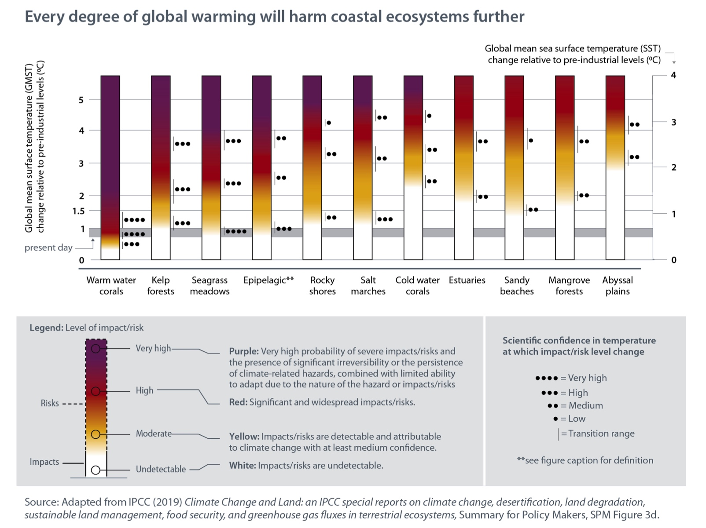
Every degree of global warming will harm coastal ecosystems further

Slide 7
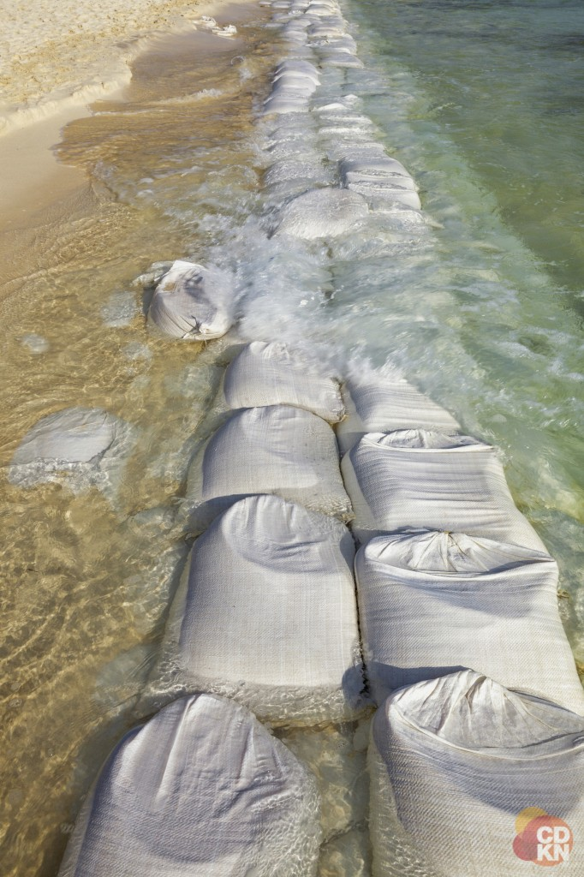
Sea level rise and other climate hazards increasingly affect Latin America
Sea levels are rising at a faster rate than previously.
Extreme weather events are becoming more frequent, which can create cascading impacts on people and the environment.
Notes:
Globally, sea level is now rising at a rate of 3.6 mm per year. That is twice as fast as it rose in the 20th century.
The acceleration in the rate of sea level rise in recent decades is a global phenomenon, driven by increasing rates
of ice loss from the Greenland and Antarctic ice sheets. The continued melting of glaciers and thermal expansion of
the oceans worldwide have also contributed, because water expands in volume as it warms.
In low-lying coastal zones, 680 million people worldwide are now at risk from rising oceans, a figure which will reach a
billion people by 2050. In the coming years, ‘significantly higher risks of human displacement’ can be expected in
low-income, low-lying islands and coasts.
Extreme weather events such as cyclones, flooding and marine heatwaves all have an impact on coastal
communities and will do so in the future. On average, tropical cyclones will become more intense,
wetter, and more frequent (note that this applies to tropical areas, not globally) and will be associated with
higher extreme sea levels.
In addition, extreme El Niño and La Niña events are likely to occur more often with global warming, even with
relatively low levels of warming. El Niño events bring ‘pronounced’ rainfall to the normally dry equatorial areas
of the eastern Pacific, such as Ecuador, Peru and Colombia. La Niña brings below-average rainfall to coastal
Peru and Chile but more rainfall to the central Andes.
Extreme weather events are hazards that can create cascading impacts on people and the environment.
When these are combined with non-climatic issues (such as social inequality or other aspects of unsustainable
development), they can affect people’s exposure and vulnerability and create compound risks.
For example, algal blooms are now increasing in estuaries worldwide, including in Latin America. This is partly
driven by direct environmental pollution, such as nutrient runoff from farms and pollution by factories. It is also
compounded by climate change, because increased temperatures stimulate bacterial respiration.
In addition, climate change increases the way that sea organisms bioaccumulate dangerous substances such
as persistent organic pollutants and mercury. The risks of negative impacts are increasing, both for marine
ecosystems and for people who eat a lot of seafood.

Slide 8
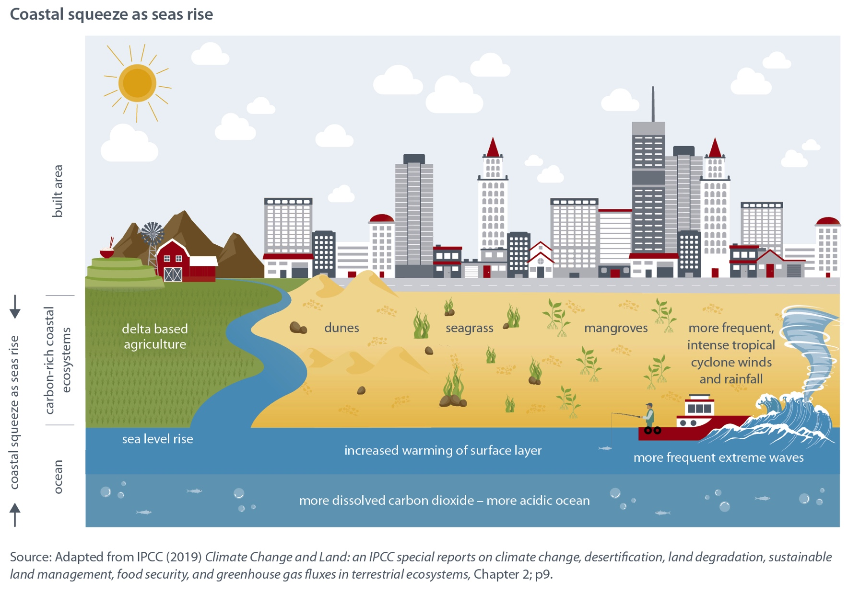
Rising seas and coastal development put a ‘squeeze’ on coastal ecosystems
Notes:
Sea level rise is creating a ‘coastal squeeze’ on important coastal ecosystems which are fertile and biologically
productive and underpin the livelihoods of millions of Latin Americans. These include mangrove forests, seagrass, coastal
wetlands, delta-based agriculture and dune ecosystems. Coastal squeeze describes what happens when the built
environment (e.g. settlements and infrastructure) provide a hard barrier for ecosystems on one side and rising
seas provide a barrier on the other.

Slide 9
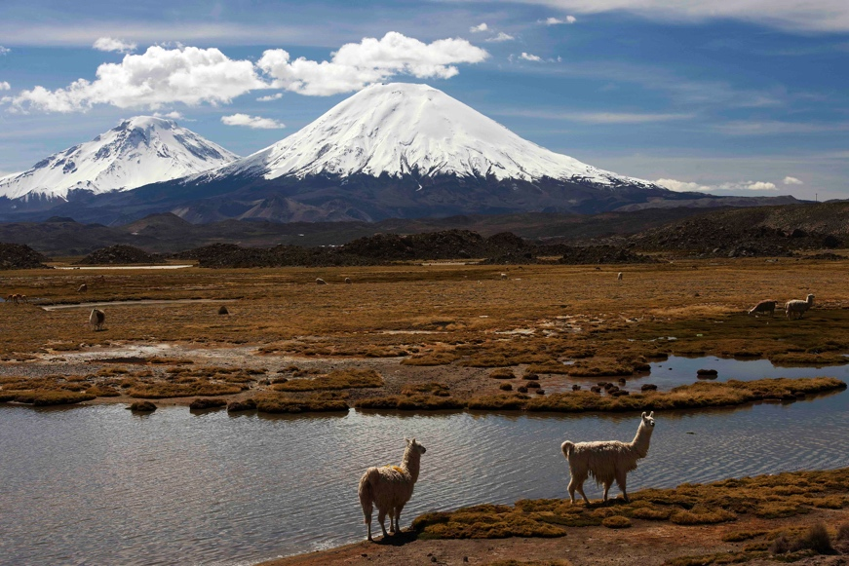
Latin America’s high mountain frozen lands are melting, with implications for society
Frozen lands (the cryosphere) are melting as a result of climate change - with implications for the Andean region.
River runoff is changing.
An environment and way of life is threatened.
Hazards in high mountain areas are increasing.
Notes:
Frozen lands (the cryosphere) are melting as a result of climate change, with implications for the Andean region.
Changes underway in glacier-fed rivers cannot be reversed. In regions with little glacier cover such as the tropical
Andes, most glaciers have already passed their ‘peak levels’ of average annual runoff and summer runoff, and runoff
can now be expected to decline. Small glaciers such as those found in the Andes are projected to lose 80% of their
current ice mass by 2100 under high emission scenarios.
As mountain glaciers retreat, the amount and timing of water runoff into rivers is changing. These changes in
water flows could have implications for hydropower and agriculture in the tropical Andes. The melting of glaciers
and permafrost is expected to release heavy metals, especially mercury, which reduces the quality of water
for freshwater organisms as well as for household and farming use.
The loss of ice and snow in high mountain regions changes the aesthetic and the cultural value of these areas to society,
e.g. in the tropical Andes. There are also implications for tourism and recreation.
People and infrastructure are becoming more exposed to natural hazards such as landslides as a result of changes in
the frozen, high mountain lands. In the coming decades, the retreat of mountain glaciers is projected to make slopes
less stable and the number of glacier lakes is expected to increase. There will be glacial lake outburst floods, landslides
and snow avalanches in new locations and different seasons.

Slide 10
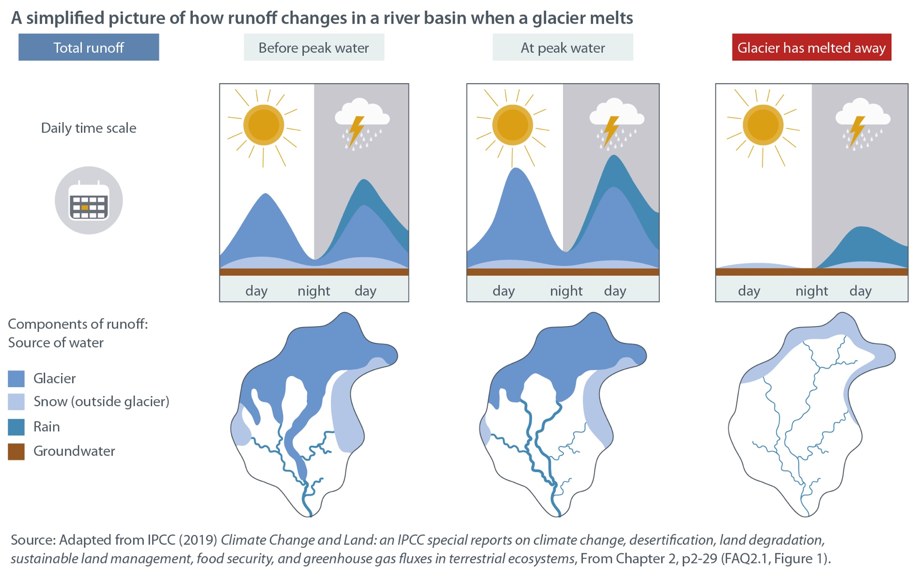
How runoff changes in a river basin when a glacier melts

Slide 11
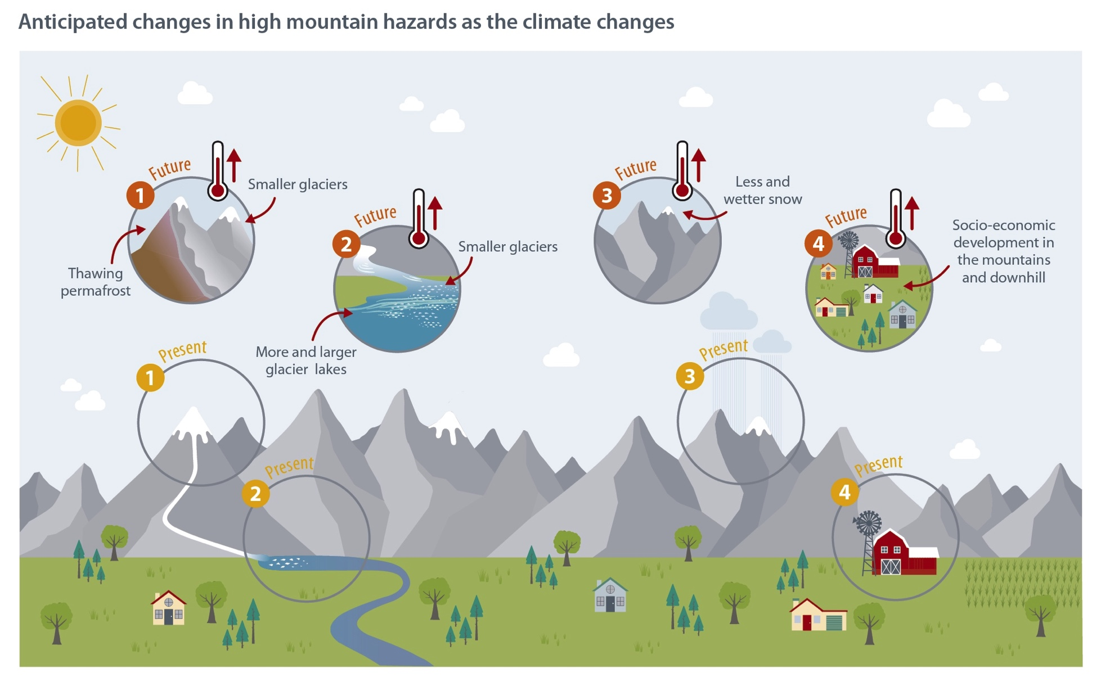
Anticipated changes in high mountain hazards as the climate changes

Slide 12
The best way to limit changes in the oceans and cryosphere is to mitigate climate change
Human society must reduce greenhouse gas emissions urgently in order to limit the damage from global warming to the Earth’s oceans and frozen lands (the cryosphere).
Limiting global warming would help communities downstream of frozen mountain regions to adapt to changes in water supplies and would limit risks related to mountain hazards.
Ocean warming, acidification, oxygen decline and marine heatwaves are all predicted into the late 21st century. However, their rate of change and intensity will be less under a low emissions scenario.
Notes:
Human society must reduce greenhouse gas emissions urgently in order to limit the damage from global warming
to the Earth’s oceans and frozen lands (the cryosphere).
Glaciers are due to keep melting, permafrost will thaw, and snow cover and the extent of Arctic Sea ice will all decline
between now and 2050 as a result of large-scale changes in Earth’s systems that are already underway. This is inevitable.
However, choices we make today about the emissions pathway of the future will make a difference to global
warming and how the oceans and cryosphere respond during the second half of the 21st century. This, in turn, are
expected to make a big difference to people’s lives and other species on Earth.
Limiting global warming would help communities downstream of frozen mountain regions to adapt to
changes in water supplies and would limit risks related to mountain hazards.
Ocean warming, acidification, oxygen decline, and marine heatwaves are all predicted into the late 21st century.
However, their rate of change and intensity will be less under a low emissions scenario.

Slide 13
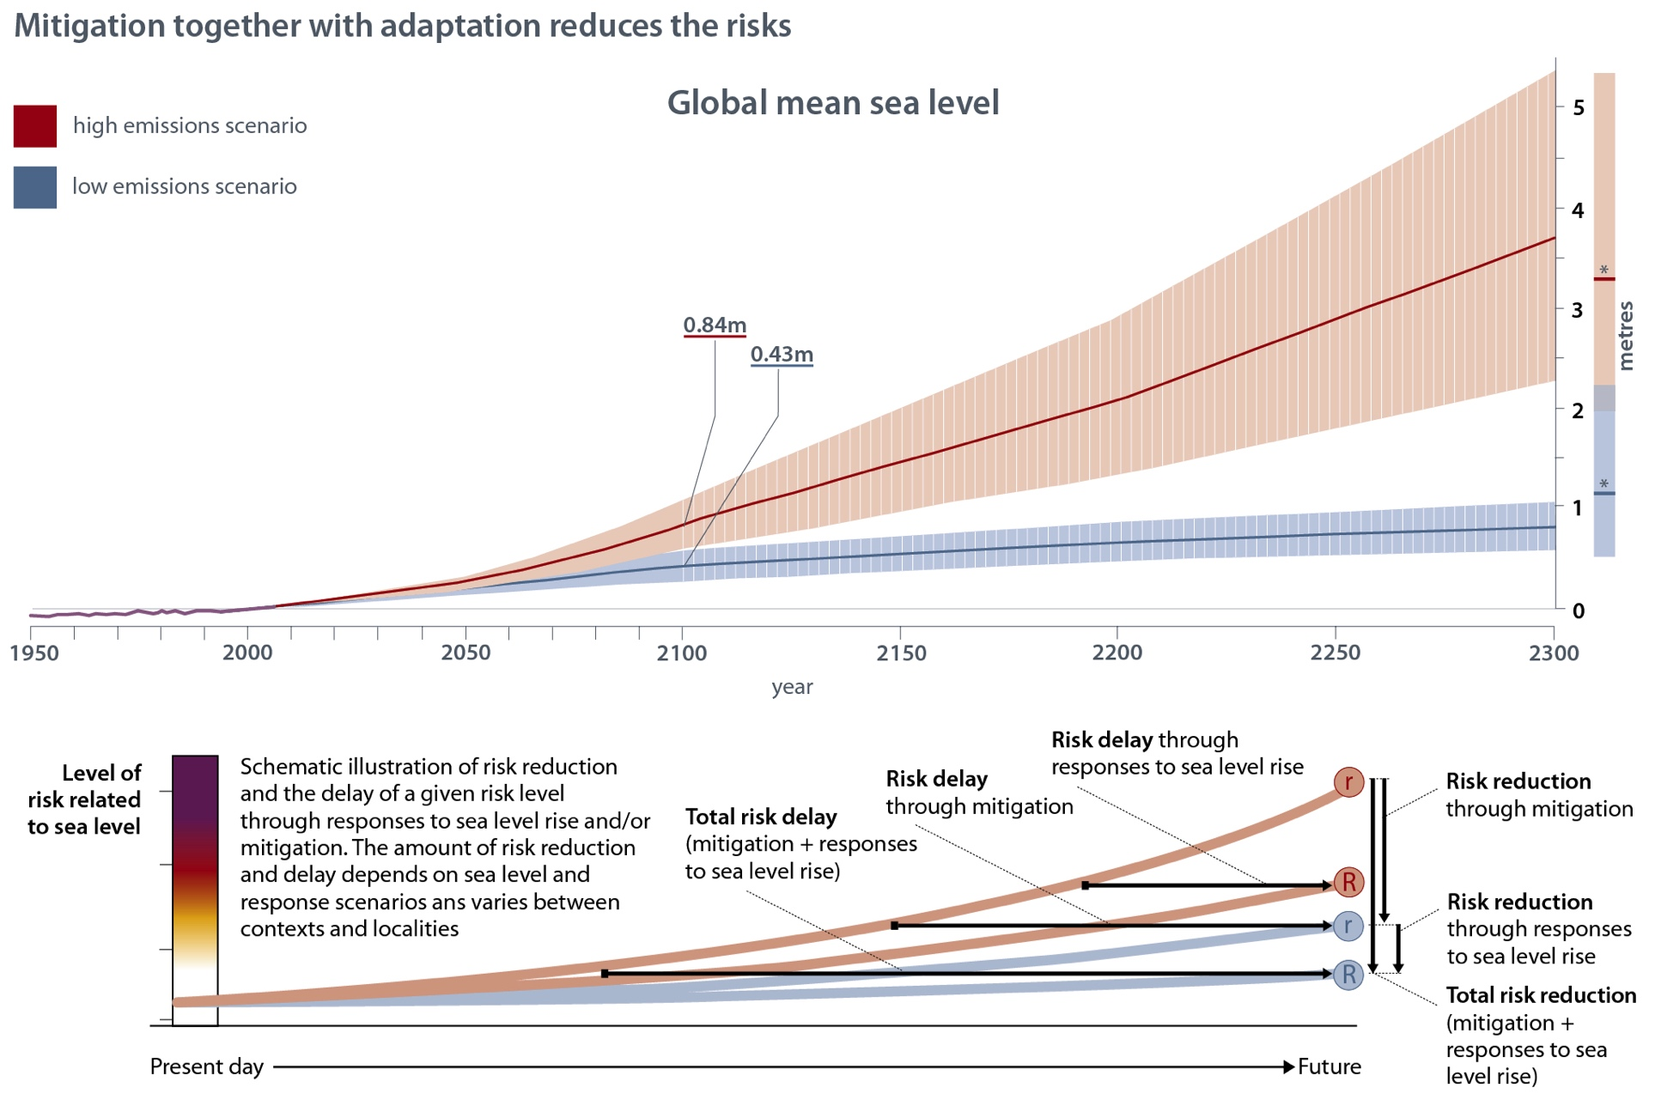
Mitigation together with adaptation reduces the risks

Slide 14
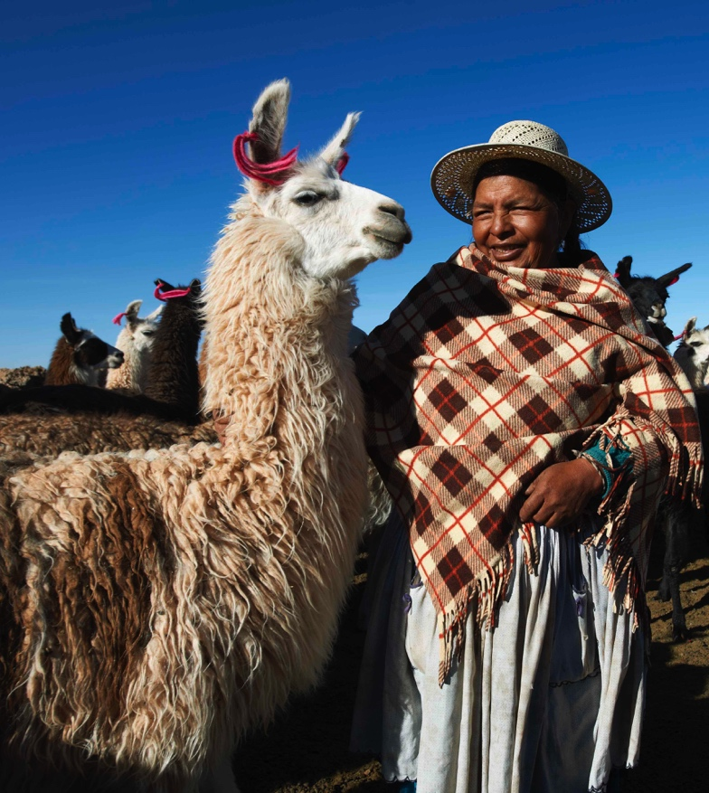
Early action reduces climate risks and costs less than dealing with future damages
Societies, institutions and individuals can all invest in reducing the risks of damage from extreme weather events, thereby reducing the likelihood that an event such as a cyclone or flood will turn into a ‘disaster’.
For tropical and extratropical cyclones, investing in disaster risk reduction, early warning systems and flood management (both ecosystem-based and engineered) all decrease economic losses from extreme weather events.
Notes:
Societies, institutions and individuals can all invest in reducing the risks of damage from extreme weather
events – and so reducing the likelihood that an event such as a cyclone or flood will turn into a ‘disaster’.
Engineered structures, such as breakwaters, sea walls and dikes, are also expected to reduce risks. For tropical and
extratropical cyclones, investing in disaster risk reduction, early warning systems and flood management (both
ecosystem-based and engineered) all decrease economic losses from extreme weather events.
For the extreme El Niño/La Niña events that are expected to affect Latin America increasingly, investments in longterm
monitoring and improved forecasts are highlighted as important. Robust forecast information can be used
to manage risks to human health, agriculture, fisheries, coral reefs, aquaculture, wildfire, drought and flood
management.

Slide 15
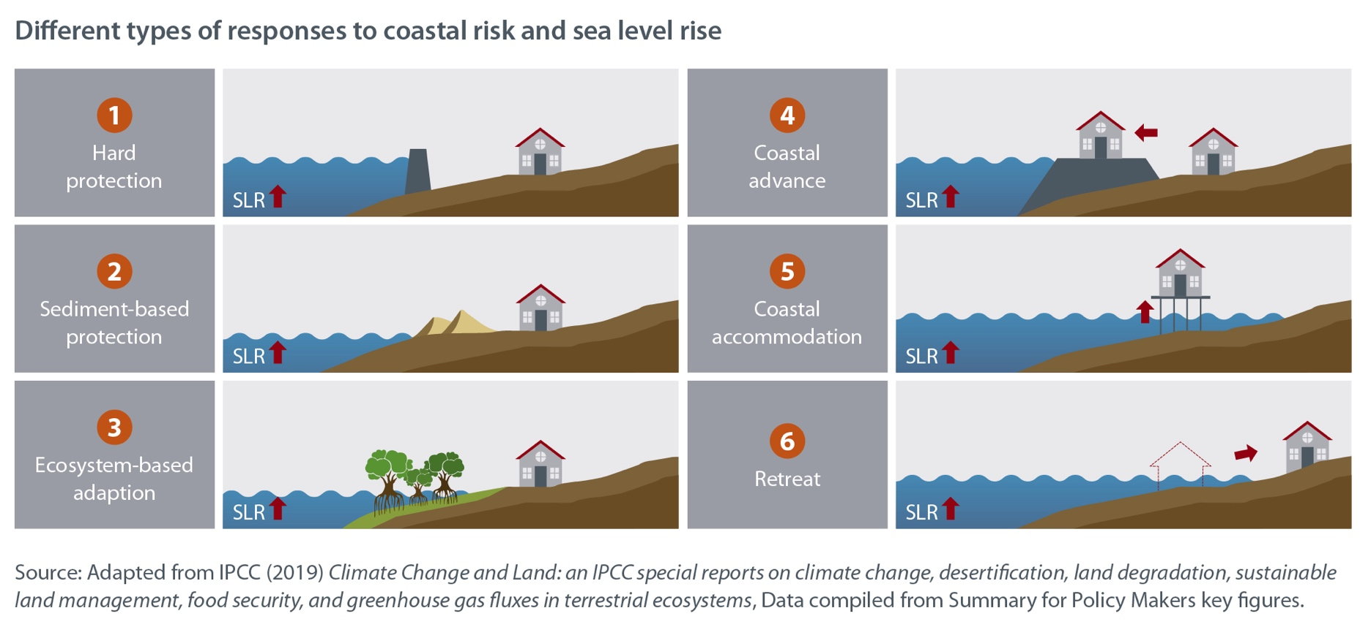
Future-proofing coastal development will be essential
Using ‘hard’ infrastructure like sea walls to protect coastal settlements from sea level rise, storm surges and other climate hazards is popular worldwide.
Nature-based solutions or so-called ‘green grey’ solutions that combine ecosystem approaches and hard infrastructure are growing in popularity.

Slide 16
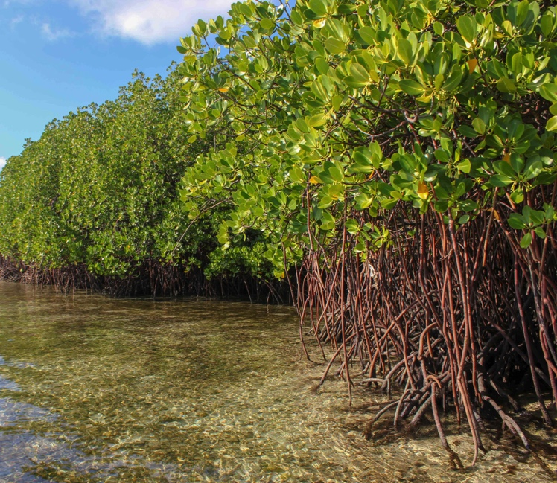
Blue carbon: An opportunity to integrate adaptation and mitigation action
Protecting and restoring what is called coastal ‘blue carbon’ ecosystems such as mangroves, tidal marshes and seagrass meadows can help mitigate climate change by locking up carbon.
At the same time, protecting these ecosystems can provide climate change adaptation benefits and help conserve biodiversity and local livelihoods, by:
providing storm protection
improving water quality
benefiting fisheries

Slide 17
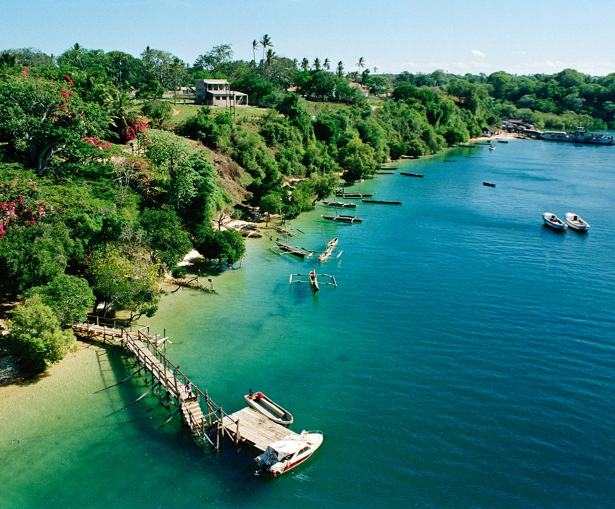
Ecosystem governance and management must join up across scales and address social issues
“Transformative governance [that integrates] disaster risk management and climate change adaptation, empowerment of vulnerable groups, and accountability of governmental decisions promotes climate-resilient development pathways (high confidence).” - IPCC
Notes:
Adapting to changes in the oceans and cryosphere calls for effective governance across scales and boundaries.
Extreme events such as floods and landslides, or tropical cyclones, pose less risk to people if climate change
adaptation and disaster risk reduction approaches are well integrated. Climate-affected sectors and disaster
management agencies need to coordinate their activities well – both in policy-making and on-the-ground delivery.
The Sendai Framework for Disaster Risk Reduction (2015–2030) provides a framework with targets for countries
to address climate and other risks. The Sendai Framework has technical guidelines to address changes in the high
mountain frozen lands and the compound risks and cascading impacts on people and the environment.
However, there is limited evidence that countries are using the framework and guidelines to monitor high mountain
changes, including the root causes of disasters, and to report on Sendai targets.
At sea, the movement of species means that improved marine protected areas and spatial plans and even entire
networks of protected areas will be needed to support species movement. This implies far more ambitious
management responses than governments have achieved to date.

Slide 18
Methods for dealing with future uncertainty
There are methods for developing and analysing options that are designed to deal with future uncertainty. These methods emphasise:
keeping the ability to be flexible over time
using criteria to gauge robustness and to establish
the usefulness of investments across a range of circumstances
adjusting decisions periodically as consequences become known
considering social vulnerability and equity
creating safe community spaces for public deliberation of options and conflict resolution.
Notes:
In coastal areas, choosing and putting in place measures to respond to sea level rise presents societies with tough
governance challenges and potentially difficult social choices.
In spite of this, there are methods for developing and analysing options that are designed to deal with future
uncertainty. These methods emphasise:
● keeping the ability to be flexible over time
● using criteria to gauge robustness and to establish the usefulness of investments across a range of circumstances
● adjusting decisions periodically as consequences become known
● considering social vulnerability and equity
● creating safe community spaces for public deliberation of options and conflict resolution.
Participatory scenario-building processes, collaborative landscape planning and co-design of ecosystem-based
management are all promising, emerging approaches for engaging people on low-lying islands and coasts, enabling
them to work together to develop future adaptation scenarios and climate resilience.

Slide 19
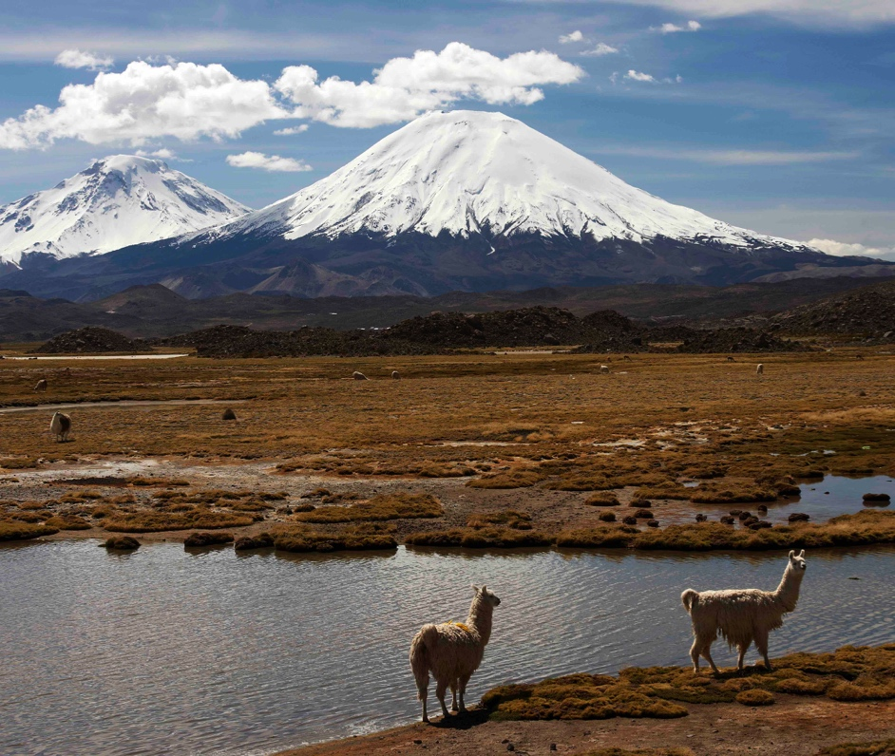
Communication, education and capacity-building are critical
‘Climate literacy’ is needed at all scales to build people’s ability to act.
Education and capacity-building can draw on indigenous and local knowledge in ways that resonate with people and encourage understanding and action.
Notes:
Human society needs to adapt to profound changes in the world’s oceans and cryosphere in the coming decades
and take ambitious action in cutting greenhouse gases to stop catastrophic changes later this century. This will
require a vast effort to educate people and communicate about climate change and build people’s capability to act.
‘Climate literacy’ is needed at all scales.
Education and capacity-building can be context-specific and support local efforts to become more resilient. They
can draw on indigenous and local knowledge in ways that resonate with people and encourage understanding and action.

Slide 20
This document is an output from work carried out with the aid of a grant from the International Development Research Centre, Ottawa, Canada and the Directorate-General for International Cooperation (DGIS), the Hague, the Netherlands, as part of the Climate and Development Knowledge Network (CDKN) programme, for the benefit of developing countries. The views expressed and information contained herein do not necessarily represent those of, or an endorsement by, the IDRC or its Board of Governors, DGIS or the entities managing CDKN, who can accept no responsibility for such views or information or for any reliance placed on them.
Copyright © 2020, Climate and Development Knowledge Network. All rights reserved.

