Slide 2
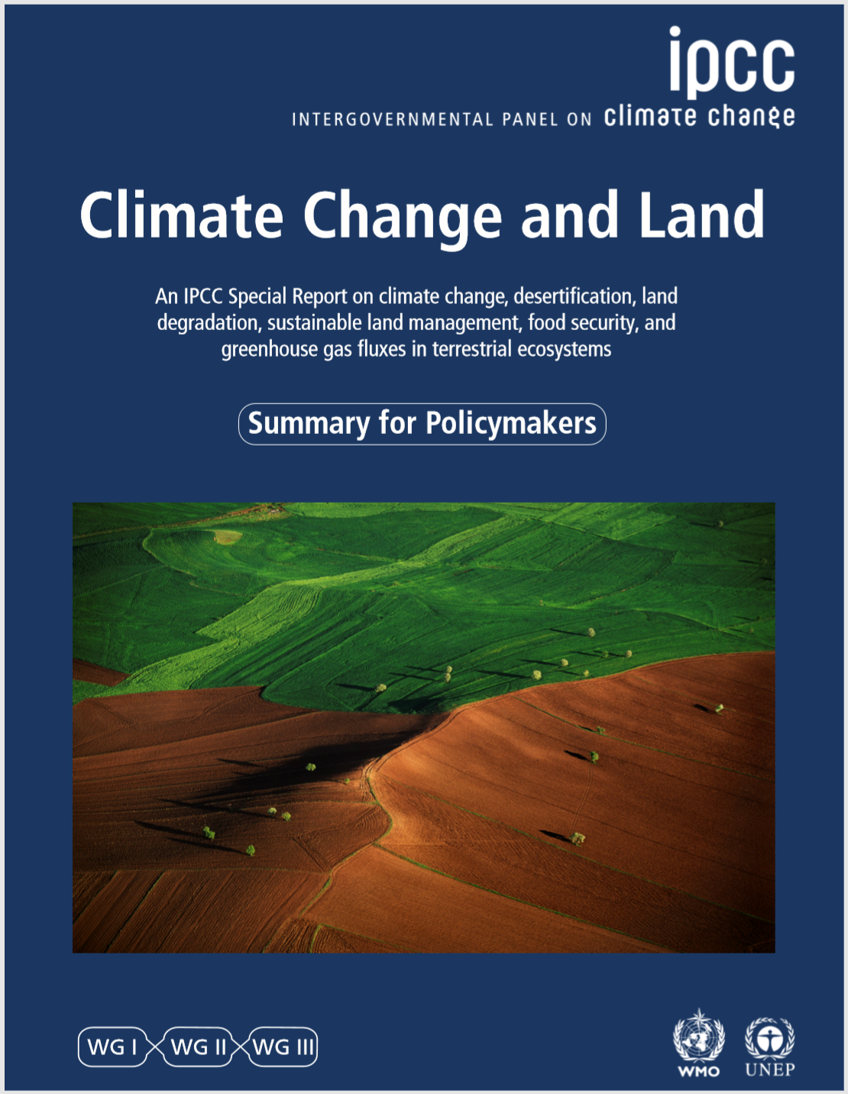
IPCC Special Report on Climate Change and Land
The report assesses:
the existing science to date on how greenhouse gases are released and absorbed by land-based ecosystems, and
the science on land use and sustainable land management in relation to climate change adaptation and mitigation, desertification, land degradation and food security.
IPCC’s Summary & full report: www.ipcc.ch/srccl
Notes:
The Intergovernmental Panel on Climate Change (IPCC) published its Climate
Change and Land: An IPCC Special Report on climate change, desertification, land
degradation, sustainable land management, food security, and greenhouse gas fluxes
in terrestrial ecosystems in 2019 (www.ipcc.ch/srccl).
The Special Report was a response to proposals from governments and observer organisations to
the IPCC.
It assesses the existing science to date on how greenhouse gases are
released and absorbed by land-based ecosystems, and the science on land use
and sustainable land management in relation to climate change adaptation and
mitigation, desertification, land degradation and food security.
This is not an official IPCC publication. This is CDKN’s guide to some key headlines in the IPCC’s report, which may be useful for African audiences.
The IPCC’s own Summary for Policy-Makers, www.ipcc.ch/srccl, focuses principally
on global issues and trends

Slide 3
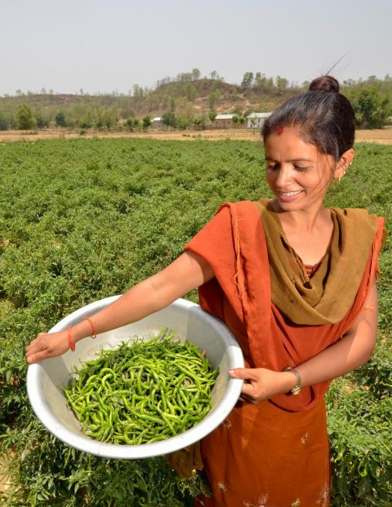
IPCC Special Report on Climate Change and Land
First IPCC report with more authors from developing countries than authors from developed countries
107 Coordinating Lead Authors, Lead Authors and Review Editors, from 52 countries
CDKN report & communications toolkit digests the IPCC’s 1,300 pages into headlines & images for African, Asian and Latin American audiences: www.cdkn.org/landreport

Slide 4
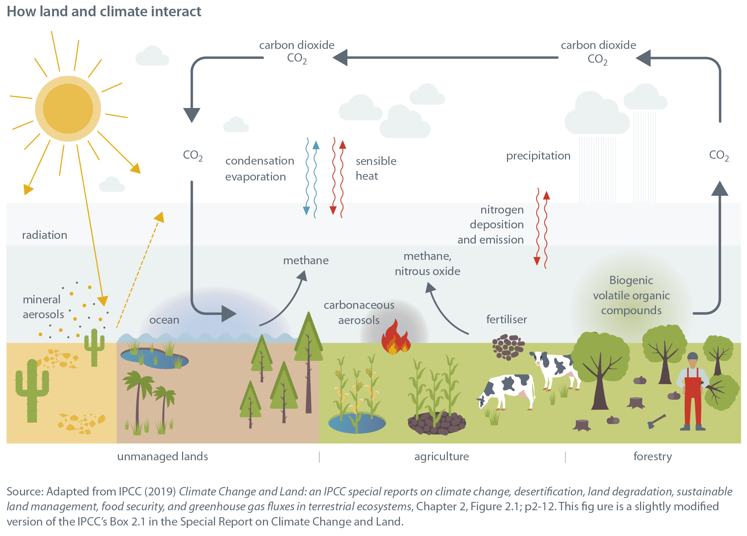
The climate and land interact with and influence each other

Slide 5
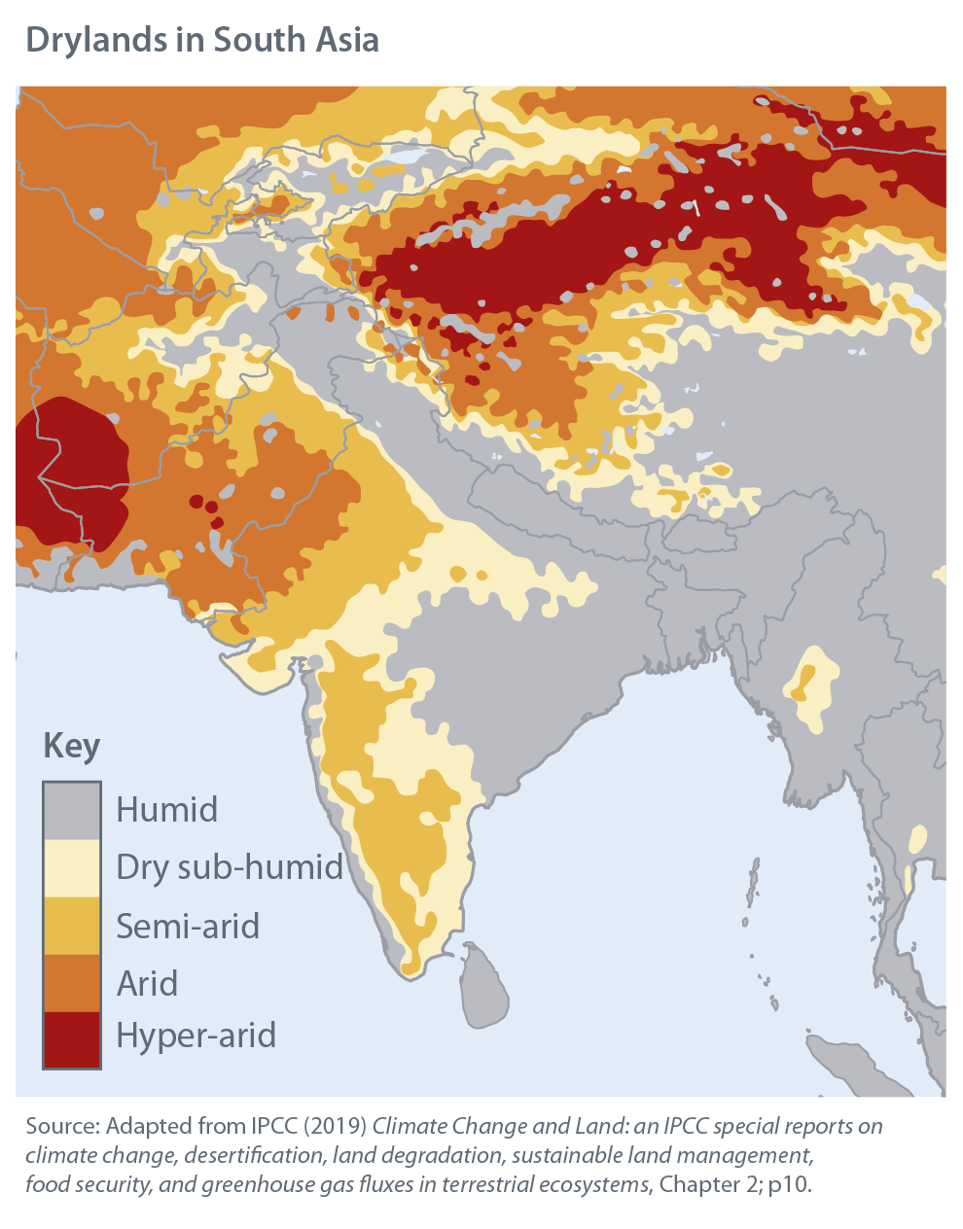
Dryland areas are expected to become more vulnerable to desertification in South Asia – affecting many people (1)
‘Desertification’ refers to degradation of drylands.
Future climate change will increase the frequency, intensity and scale of extreme weather events such as droughts and heat waves.
This will worsen the vulnerability of people and ecosystems to desertification.
Notes:
Desertification is the term for land degradation in drylands.
Drylands are often classified based on aridity.
Aridity is a long-term feature of the climate, when there
is low average rainfall or available water in a region. It is
different from drought; drought is a temporary event.
Latin America is already affected by desertification:
●● Desertification costs between 8% and 14% of gross
agricultural product in many Central and South
American countries.
●● Parts of the dry Chaco and Caldenal regions of Argentina
have undergone widespread degradation over the last
century.
●● Vieira et al found that 94% of Northeast Brazilian
drylands were susceptible to desertification. It is
estimated that up to 50% of the area has been degraded
due to frequent prolonged droughts and the clearing of
forests for agriculture.
This land use change threatens
the extinction of around 28 native species.
Future climate change will increase the frequency, intensity
and scale of extreme weather events such as droughts and
heat waves. This will worsen the vulnerability of people
and ecosystems to desertification. Drought and aridity are
both predicted to increase in a world where average global
warming is 1.5oC to 2oC. There is a risk of increased drought
hazards in the Amazon region in all future climate scenarios.

Slide 6
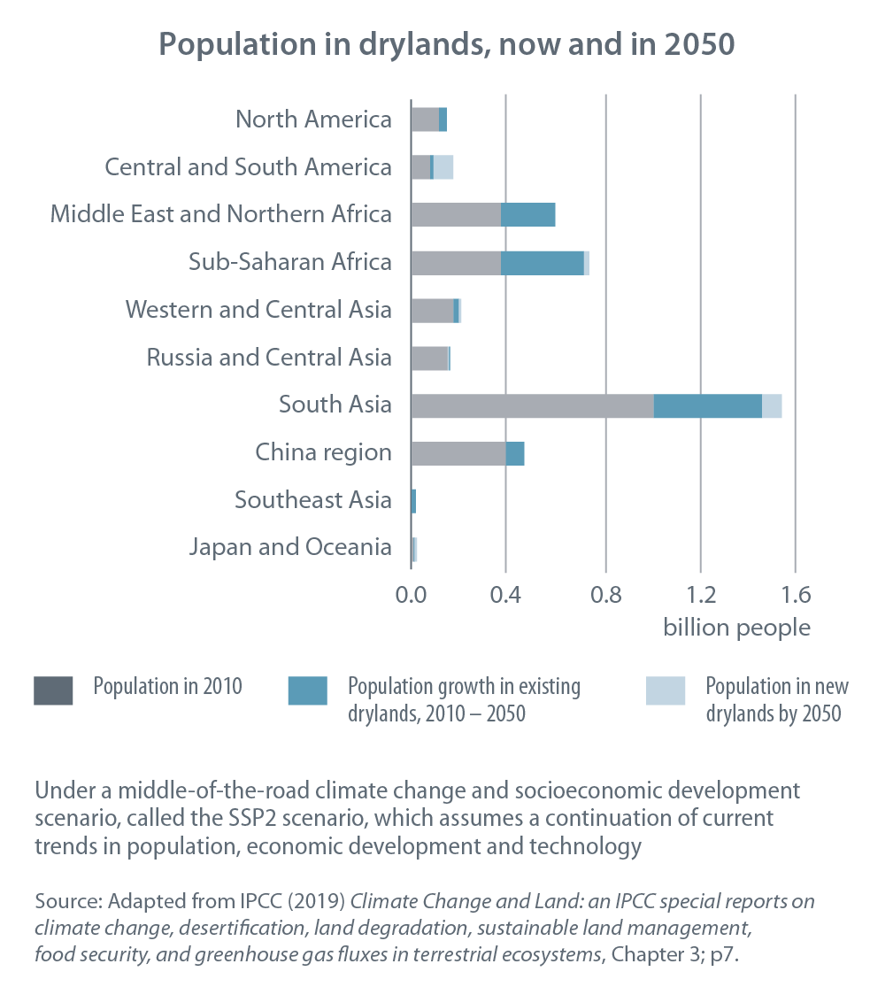
Dryland areas are expected to become more vulnerable to desertification in South Asia – affecting many people (2)
The dryland population in South Asia is expected to keep increasing

Slide 7
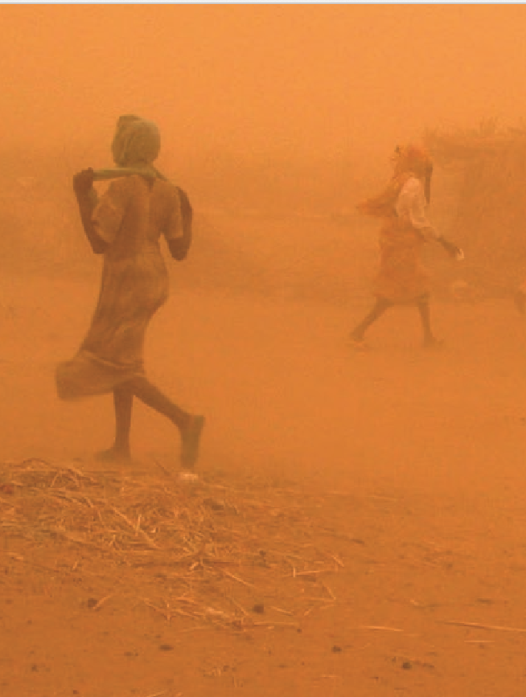
Desertification has implications for food security and poverty in South Asia (1)
“There is high evidence and high agreement that both climate change and land degradation can affect livelihoods and poverty through their threat multiplier effect.” - IPCC
Notes:
Land degradation and climate change, both individually
and in combination, have deep implications for people
who depend on natural resources for their livelihoods.
People who directly depend on natural resources for
subsistence, food security and income, including women
and youth with limited adaptation options, are especially
vulnerable to land degradation and climate change.
Because land degradation reduces the productivity of land,
when land is degraded, the workload for managing the
land increases. This affects women disproportionally in
many places.
Land degradation as a result of sea level rise and
more intense cyclones – to which climate change is
contributing – is imperilling lives and livelihoods in cyclone-prone
areas. Extreme weather and climate, including slow-onset
climatic changes such as sea level rise, could threaten
livelihoods and lead to more displacement of people.
Where livelihoods are already precarious, land degradation
and climate change act as ‘threat multipliers’. Already vulnerable
people are highly sensitive to extreme weather
and climate events, which are likely to tip them into
increased poverty and food insecurity.

Slide 8
Desertification has implications for food security and poverty in South Asia (2)
Climate change will reduce the mean yields of 11 major crops – millet, field pea, sugar beet, sweet potato, wheat, rice, maize, soybean, groundnut, sunflower and rapeseed – by 18% in South Asia by the period 2046 – 2055 compared with 1996–2005.
Notes:
The World Bank projects that climate change will reduce
the mean yields of 11 major global crops – millet, field
pea, sugar beet, sweet potato, wheat, rice, maize, soybean,
groundnut, sunflower and rapeseed – by 18% in South Asia by 2046 – 2055 compared with
1996–2005.
The specific impacts of climate change on poverty and
food security vary significantly, depending on whether the
household is a net agricultural buyer or seller. As reduced
crop yields drive up agricultural prices, urban dwellers
and rural households who are ‘net food buyers’ suffer the
greatest losses in food security. Those who are ‘net food
producers’ are less worse off.

Slide 9
Community and policy responses can combat land degradation (1)
Stopping and reversing land degradation involves:
● improving the carbon content of soils; and
● retaining and restoring soil nutrients (including through soil and water management techniques and land-livestock interactions).
Also:
● reducing deforestation and forest degradation and sustainable forest management.
Notes:
Primary (natural, undisturbed) forests can be converted to sustainably managed forest ecosystems that deliver more economic and social benefits to people. However, some carbon emissions are released in the transition and the transition often comes at the expense of biodiversity.

Slide 10
Community and policy responses can combat land degradation (2)
Reversing land degradation is worthwhile:
Implementing sustainable land management increases the productivity of land and provides good economic returns on investment around the world. A study of 363 sustainable land management projects found:
● three quarters of sustainable land management projects had positive cost-benefit returns in the short term
● 97% of the projects had positive or very positive cost-benefit ratios in the long term.
Certification schemes have been shown to improve the sustainability of forest management in tropical areas.

Slide 11
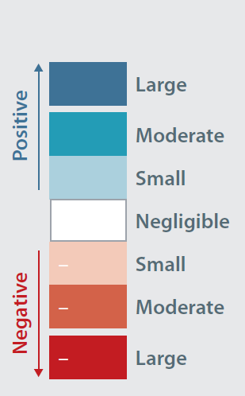
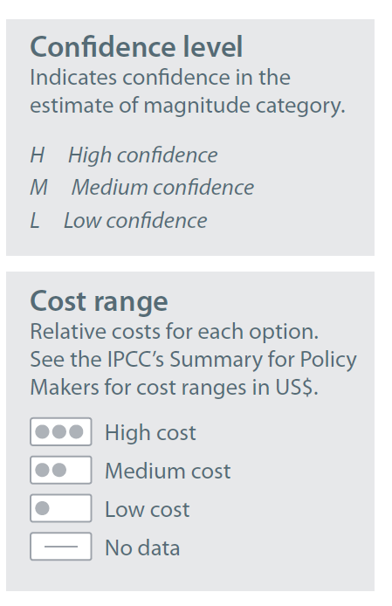
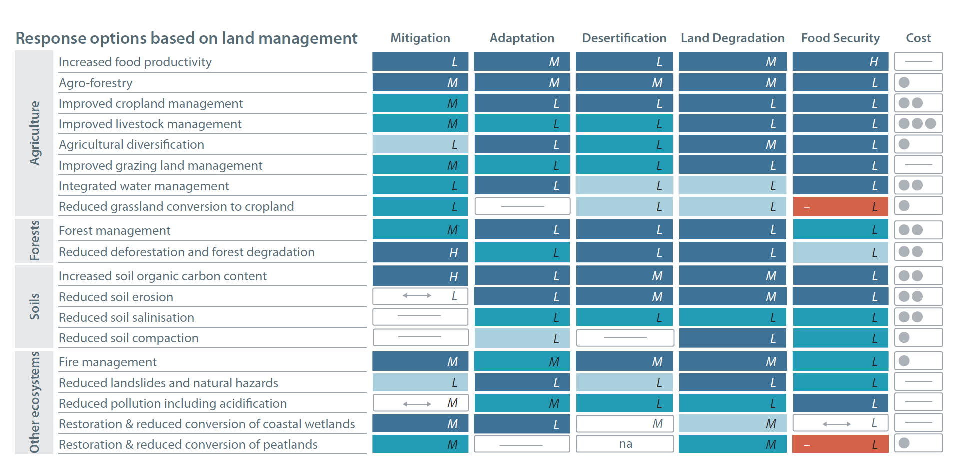
Improved land management can deliver climate adaptation, mitigation and development
These actions can minimise pressure on land
(colours illustrate positive-negative impact)

Slide 12
Improved value chain and climate risk management can deliver climate adaptation, mitigation and development
These actions can minimise pressure on land
(colours illustrate positive-negative impact)

Slide 13
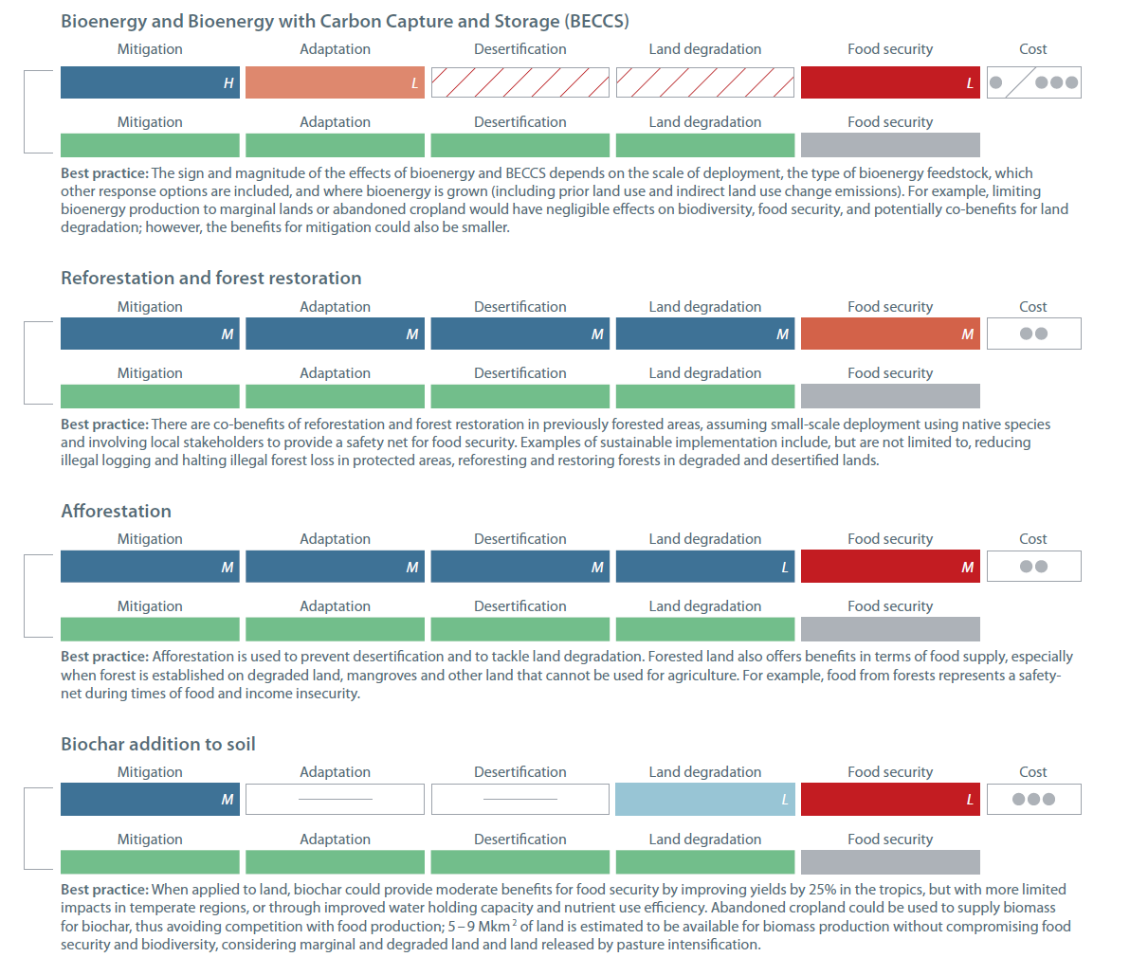
Other options for climate adaptation, mitigation and development
These could increase pressure for land but best practices can reduce the pressure
(colours illustrate positive-negative impact)

Slide 14
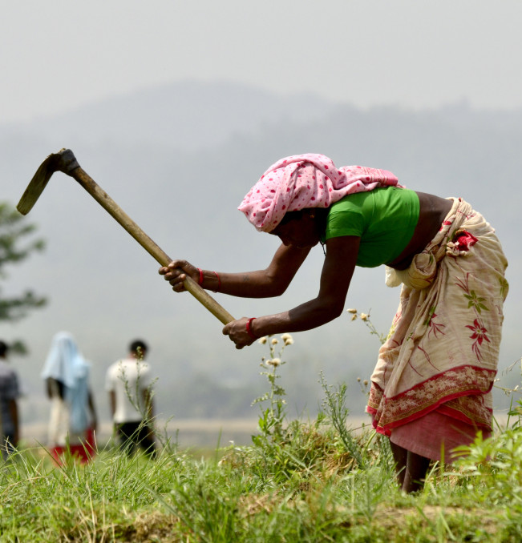
Insecure property rights and lack of access to tenure and land advisory services hamper progress – especially by women
Women’s lack of access to these services (for social and cultural reasons), in particular, hampers their ability to be more effective agents of sustainable change.
Notes:
Land tenure insecurity, lack of property rights, lack of access
to markets and to agricultural advisory services, lack of
technical knowledge and skills, agricultural price distortions,
and lack of agricultural support and subsidies contribute to
desertification and drive unsustainable land management.
Women’s lack of access to these services (for social and
cultural reasons), in particular, hampers their ability to be
more effective agents of sustainable change.
Tackling this range of knowledge gaps and distorting
policies will be key to the sustainable stewardship of land,
which will, in turn, be key to successful climate adaptation
and mitigation.
Policy responses to land degradation, which are widely
discussed in the literature, particularly in the context of
climate change, are:
● improving market access
● increasing gender empowerment
● expanding access to rural advisory services
● strengthening land tenure security
● payments for ecosystem services89
● decentralising natural resource management – but only
when done in a democratic way that does not further
concentrate power in the hands of local elites
● investing in research and development
● investing in monitoring of desertification and
desert storms
● developing modern renewable energy sources
(especially those which replace fuelwood/biomass); and
● diversifying dryland economies – including by investing
in irrigation and agricultural commercialisation and
structural transformations.

Slide 15
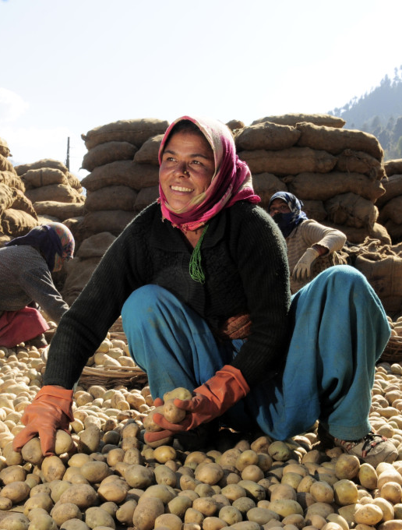
The skills and knowledge of marginalised groups – especially women – are not yet sufficiently recognised
Most literature focuses on women’s, marginalised groups’ greater vulnerability. However, it is important not to frame people as ‘victims’.
Recognise real strengths and ingenuity of women, indigenous people, marginalised groups, particularly in adaptation.
Women often assume new leadership roles when adapting to climate change.
Notes:
It is well recognised that people are differently affected by
the impacts of climate change and by society’s responses
to climate change, and that women may be particularly
affected. Women, indigenous people and other typically
marginalised groups have vital knowledge and are
demonstrating ingenuity in land management practices to
adapt to climate change.
Most of the literature focuses on the greater vulnerability
of women and other socially marginalised groups to the
negative impacts of climate change. However, it is important
not to fall into framing people as ‘victims’. Narratives should
recognise the real strengths and ingenuity of women,
indigenous people and other marginalised groups,
particularly in adapting to climate change. Also, it should be
recognised that women often assume new leadership roles
when adapting to already-felt impacts of climate change.
A broad approach to gender issues
There is insufficient research to date on how climate
mitigation activities are empowering or disempowering
women and affecting women’s and girls’ wellbeing. This is
a priority area for further enquiry. For land-based climate
mitigation, there is some evidence that these activities
‘may interfere with traditional livelihoods in rural areas,
cause conflicts, lead to a decline in women’s livelihoods and
reinforce existing inequities and social exclusions if elite
capture is not prevented.’ These include cultivating biofuel
crops, Reduced Emissions from Deforestation and forest
Degradation and related forest conservation activities for
financing on global markets (REDD+) and other policies such
as developing large solar farms requiring large areas of land.
Although women’s needs in a changing climate often call
for special attention to ensure that climate policies and
programmes are not designed for a ‘man’s world’, it is useful
to understand issues through the lens of gender more
broadly. Gender approaches recognise that some climate
change impacts and responses to climate change affect men
and masculinity in ways that need to be better understood.
Despite known differences between women and men, land
restoration and rehabilitation efforts have tended to be
‘gender-blind’.
Tackling inequality
Inequality is one of the greatest overall challenges in the
context of land management and sustainable development
in a changing climate. Effective and reliable social safety
nets are required to address the impacts of climate
change on the poorest. Social protection coverage is
currently low, especially for poor rural people. Here, social
protection refers to policies and programmes to decrease
the poverty and vulnerability of targeted populations,
such as state assistance for people who are pregnant,
elderly, unemployed or suffering from long-term sickness
or disability. There is a need to explore how local support
institutions could be strengthened to extend social
protection.
People’s diverse needs and talents
Intersectional approaches are growing in importance as a
more nuanced way of looking at how climate policies and
programmes affect the agency and wellbeing of different
groups of people. This means looking at the many ways in
which people could be vulnerable to climate change and
are able to respond effectively – based not only on gender
but also on income, age, ethnicity, (dis)ability and other
social and physical attributes.

Slide 16
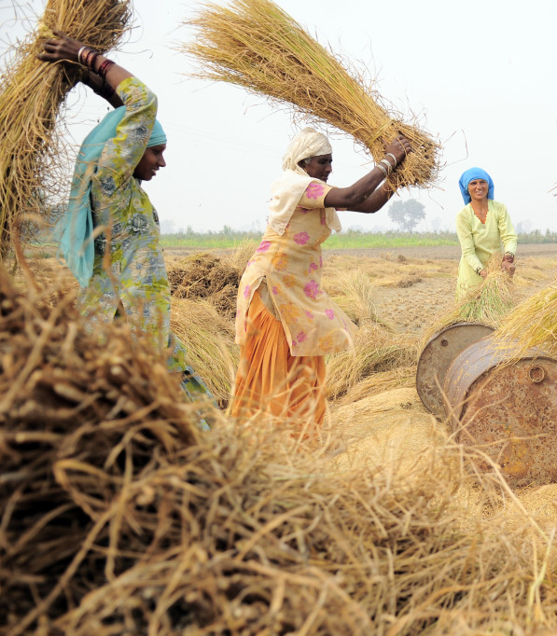
“Many sustainable development
efforts fail because of lack
of attention to societal
issues including inequality,
discrimination, social exclusion
and marginalisation … citizen
engagement is important in
enhancing natural resource
service delivery.” – IPCC
Notes:
It is well recognised that people are differently affected by
the impacts of climate change and by society’s responses
to climate change, and that women may be particularly
affected. Women, indigenous people and other typically
marginalised groups have vital knowledge and are
demonstrating ingenuity in land management practices to
adapt to climate change.
Most of the literature focuses on the greater vulnerability
of women and other socially marginalised groups to the
negative impacts of climate change. However, it is important
not to fall into framing people as ‘victims’. Narratives should
recognise the real strengths and ingenuity of women,
indigenous people and other marginalised groups,
particularly in adapting to climate change. Also, it should be
recognised that women often assume new leadership roles
when adapting to already-felt impacts of climate change.
A broad approach to gender issues
There is insufficient research to date on how climate
mitigation activities are empowering or disempowering
women and affecting women’s and girls’ wellbeing. This is
a priority area for further enquiry. For land-based climate
mitigation, there is some evidence that these activities
‘may interfere with traditional livelihoods in rural areas,
cause conflicts, lead to a decline in women’s livelihoods and
reinforce existing inequities and social exclusions if elite
capture is not prevented.’ These include cultivating biofuel
crops, Reduced Emissions from Deforestation and forest
Degradation and related forest conservation activities for
financing on global markets (REDD+) and other policies such
as developing large solar farms requiring large areas of land.
Although women’s needs in a changing climate often call
for special attention to ensure that climate policies and
programmes are not designed for a ‘man’s world’, it is useful
to understand issues through the lens of gender more
broadly. Gender approaches recognise that some climate
change impacts and responses to climate change affect men
and masculinity in ways that need to be better understood.
Despite known differences between women and men, land
restoration and rehabilitation efforts have tended to be
‘gender-blind’.
Tackling inequality
Inequality is one of the greatest overall challenges in the
context of land management and sustainable development
in a changing climate. Effective and reliable social safety
nets are required to address the impacts of climate
change on the poorest. Social protection coverage is
currently low, especially for poor rural people. Here, social
protection refers to policies and programmes to decrease
the poverty and vulnerability of targeted populations,
such as state assistance for people who are pregnant,
elderly, unemployed or suffering from long-term sickness
or disability. There is a need to explore how local support
institutions could be strengthened to extend social
protection.
People’s diverse needs and talents
Intersectional approaches are growing in importance as a
more nuanced way of looking at how climate policies and
programmes affect the agency and wellbeing of different
groups of people. This means looking at the many ways in
which people could be vulnerable to climate change and
are able to respond effectively – based not only on gender
but also on income, age, ethnicity, (dis)ability and other
social and physical attributes.

Slide 17
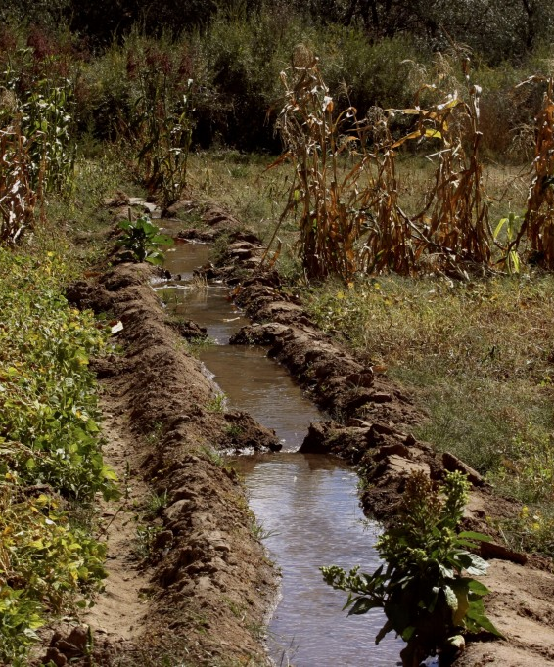
Integrated governance is needed to maximise the benefits of land and water
Integrated governance across sectors and scales is needed to manage pressure on land and water, to meet the requirements of people and biodiversity and relieve the increased pressures caused by climate change.
Integrated governance is especially important at national, river basin and ecosystem levels.
Coherent policies and adaptive management are important.
Notes:
A mix of coherent policies helps deliver sustainable
development in the context of natural resource pressures
and a changing climate. The importance of a mix of
coherent policies is shown when farmers are helped to
respond to drought. A mix of crop insurance, sustainable
land management practices, bankruptcy and insolvency
measures, co-management by communities for water and
disaster planning, and water infrastructure programmes
have proven effective when combined.
Similarly, a mix of coherent policies was found to be
effective for responding to floods: flood zone mapping, land
use planning, flood zone building restrictions, business and
crop insurance, disaster assistance payments, preventative
instruments such as soil and water management measures
for farms and farm infrastructure projects, and bankruptcy
measures to help farmers recover from debilitating
economic losses.
Adaptive, iterative decision-making is increasingly in use
to explore synergies and trade-offs between goals and
targets.
Adaptive approaches can help tackle the negative
impacts of land use change and climate change.

Slide 18
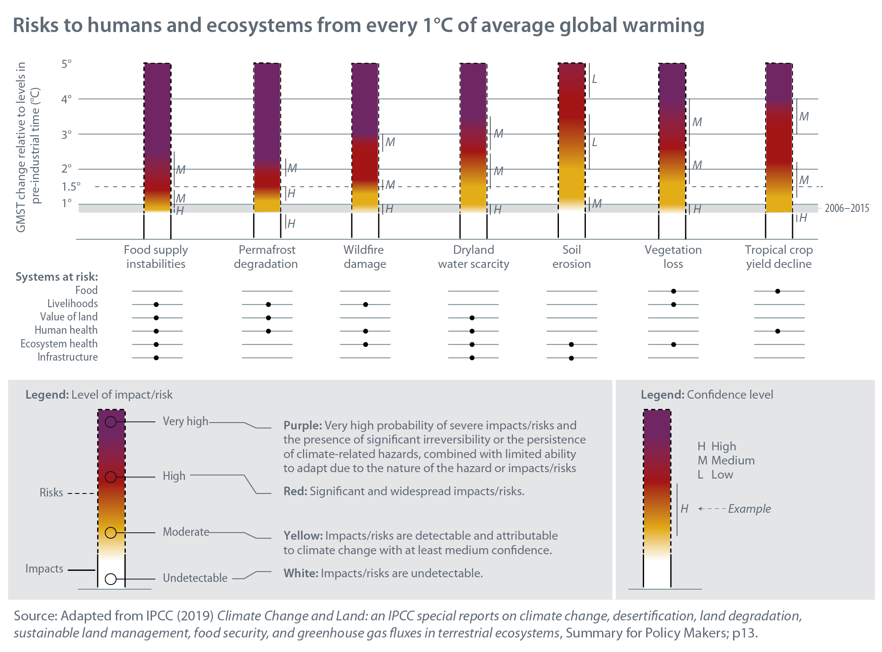
Every degree of increase in average global warming brings more risks to people and the environment

Slide 19
Emissions reductions in other sectors are vital to relieve pressure on land
Bioenergy crops and tree plantations are used to take up greenhouse gases from the atmosphere and mitigate climate change. However, without sustainable land management, using these approaches at large scale could jeopardise the achievement of Sustainable Development Goals (SDGs), including food security and livelihoods.
Bioenergy and afforestation need to be carefully managed to avoid these risks. Good outcomes depend on locally appropriate policies and governance.
Lowering greenhouse gas emissions in other sectors and areas of human behaviour (e.g. cutting waste, cutting energy use, dietary change) can ease pressure on land. “Land cannot do it all.”
Notes:
Land must be managed to provide food security as
the world’s population increases and to support other
sustainable development goals. This means there are limits
to the contribution of land to climate change mitigation
by, for example, cultivating bioenergy crops and afforesting
land to sequester carbon dioxide from the atmosphere.
It also takes time for trees and soils to store carbon
effectively.
If bioenergy crops and trees were planted on a scale
that delivered millions of gigatons per year of carbon
sequestration, then land conversion would increase greatly.
This could lead to adverse side effects for climate change
adaptation, desertification, land degradation and food
security.
Without the widespread uptake of sustainable land
management, the deployment of bioenergy crops and tree
plantations at this scale could jeopardise the achievement
of Sustainable Development Goals (SDGs) that depend on
land-based ecosystem services.
Bioenergy and afforestation need to be carefully managed
to avoid these risks. Desirable outcomes will depend on
locally appropriate policies and governance systems.
Lowering greenhouse gas emissions in other sectors and
areas of human behaviour can ease the pressure on land.
“Land cannot do it all.

Slide 20
This document is an output from work carried out with the aid of a grant from the International Development Research Centre, Ottawa, Canada and the Directorate-General for International Cooperation (DGIS), the Hague, the Netherlands, as part of the Climate and Development Knowledge Network (CDKN) programme, for the benefit of developing countries. The views expressed and information contained herein do not necessarily represent those of, or an endorsement by, the IDRC or its Board of Governors, DGIS or the entities managing CDKN, who can accept no responsibility for such views or information or for any reliance placed on them.
Copyright © 2019, Climate and Development Knowledge Network. All rights reserved.

