Slide 1
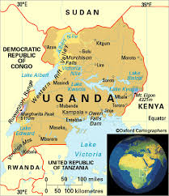
Uganda: Economic Impacts of Climate Change
Four Sector Studies and Five Case Studies

Slide 2
Introduction
Study commissioned by the Uganda’s Ministry of Water and Environment’s Climate Change Department
Funded by CDKN and DFID
Started in January 2014, and will be finalised in June 2015
4 main components:
Downscaling of climate change scenarios over Uganda
Economic modelling at national/sectoral and district levels through case-studies
Recommendations for policy development and implementation, and priority investments
Communications & outreach
12/12/2014
2

Slide 3
Sector and case studies
Sectors looked at are: water, agriculture, infrastructure and energy.
We have drafts of these
Case studies under way are: urban areas (Kampala), coffee region (Mt. Elgon), agriculture and livestock region (Karamoja), water and energy conflict region (Mpanga) and a case study of regions where health impacts of climate change could be important.
Some preliminary results are available for Kampala

Slide 4
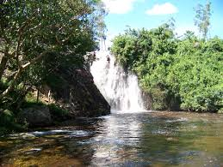
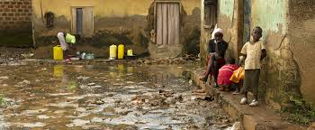
The Water Sector
12/12/2014
4

Slide 5
past impacts and structure of the analysis
Climate change and variability are already affecting the availability of water in Uganda. Recent extreme events such as the La Nina drought of 1998-2000 and floods, including the ENSO 1997-1998 event, have caused significant losses.
This study has assessed:
The impacts of climatic and socio-economic changes on water supply and demand;
The size of economic losses due to unmet demand in money terms;
The costs of water shortage due to extreme events
12/12/2014
5

Slide 6
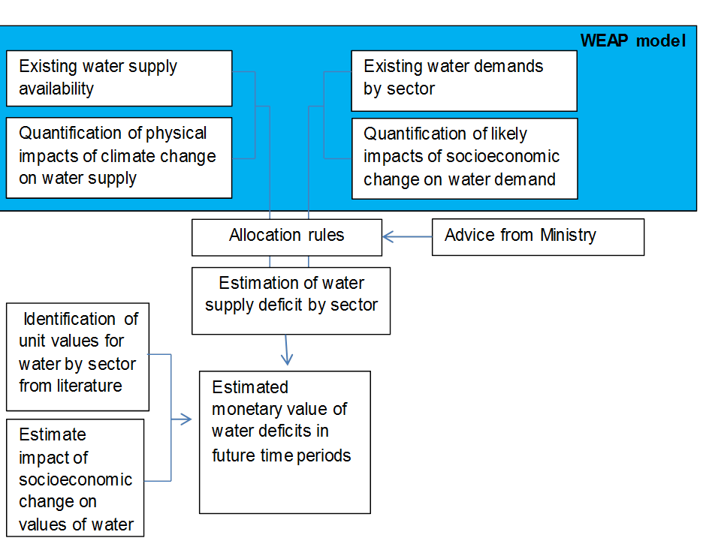
Methodology

Slide 7
Climate Change Impacts
Changes in Internal Renewable Water Resources for Uganda (RCP8.5 - SSP5). Source: Water2Invest.

Slide 8
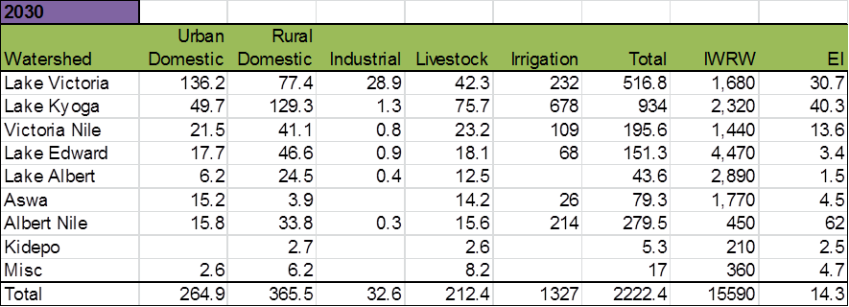
Expected demand in 2030 by basin
Notes: IRWR = Internal renewable water resources, EI = exploitation index (= demand/IRWR)*100.

Slide 9
Expected demand in 2050 by basin
Notes: IRWR = Internal renewable water resources, EI = exploitation index (= demand/IRWR)*100.

Slide 10
Allocation rule for water
For the purposes of this study, based on discussions with the Ministry of Water and Environment, we assume a hierarchy of allocation, with the following demands being met sequentially:
Consumption demand – urban and rural;
Irrigation water demand;
Industry water demand; and
Livestock consumption demand.

Slide 11
Unmet demand by user and by basin in 2050

Slide 12
Valuation of unmet demand

Slide 13
Estimated Economic Losses due to water shortages in 2050 under climate change (Billions of shillings)
Overall we estimate 14,558 billion shillings ($5.5 billion) due to water shortages.

Slide 14
Costs of droughts in uganda
Summary of damage and losses caused by the 2010-2011 rainfall deficit

Slide 15
Net benefits of different adaptation options

Slide 16
summary
Climate and socioeconomic change will lead to deficits in water supply without adaptation. A conservative estimate puts losses at US$5.5 billion by 2050, and it could be as high as $50.2 billion if income elasticity is taken into account.
Extreme weather events give an indication of the potential costs of climate change – and there have been significant economic costs associated with such events. For example, the 2010-11 drought cost Uganda $1.1 billion.
Adaptation of the water sector, taking into account the needs to adapt to climate change and socioeconomic development, is likely to yield significant welfare gains.

Slide 17
The Agriculture Sector
12/12/2014
17

Slide 18
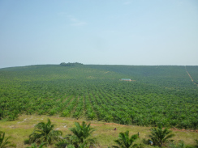
Background
The agricultural sector is a fundamental part of the Ugandan economy, employing about 66 percent of the working population in 2009/10 and contributing about 22 percent to total GDP in the year 2012.
The study assessed:
Potential economic impacts of climate change on: (i) food crops (ii) livestock and (iii) export crops.
Current and future economic impacts of droughts and floods on agriculture.
Adaptation priorities

Slide 19
Food crops
Study estimated changes to future production and value of food crops due to climate change impacts on yield and cultivation area.
Results for production and value changes show great divergence between different climate models and different regions for 11 crops.
Most crops show reductions in total production under almost all climate change scenarios to 2050 (e.g. cassava, maize, millet, groundnuts); but some show both increases and decreases depending on the model (e.g. maize).
For some crops the impacts are quite significant (e.g. cassava, potato and sweet potato show around 40% reductions). In other cases, reduction is less than 10% (e.g. millet, sorghum and pigeon peas).
Largest impacts in the East and North.
Overall losses for food crops by 2050 are likely to be up to US$1.5 billion. Under assumed growth this is less than 0.2 percent of GDP in that year.

Slide 20
Food crop production with Climate Change as % of production without Climate Change in 2050

Slide 21
Food Crops value change due to Climate Change compared with no Climate Change in 2050 (USD 1000 at 2000 prices)

Slide 22
Estimated Impacts: Livestock Products
Impacts of climate change scenarios on livestock production were estimated for Beef, Lamb, Pork, Poultry, Eggs, Poultry and Milk.
In all cases impacts were quite small (1 or 2 percent).
This modeling was only for yield and area whereas the key impacts on livestock may come from other climate change factors, in particular droughts, floods and diseases.

Slide 23
Estimated Impacts: Agricultural Exports
Agricultural exports represented about 50% of the total export value of Uganda in 2013.
Coffee production (18% of total exports) is a key area of concern under climate change.
Significant negative impacts on Arabica coffee growing areas due to climate change are forecast. Estimates for Robusta are less well developed but preliminary studies show impacts
Illustrative estimate of value of potential losses of Arabica and Robusta coffee combined: about US$1,235mn. in 2050 (50 percent reduction in production).

Slide 24
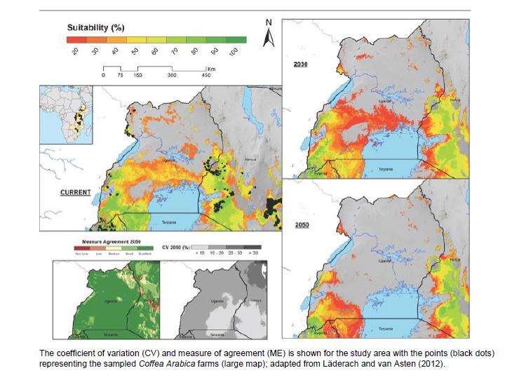
Predicted suitability for coffee production in Arabica coffee-producing area in Uganda (Current, 2030, and 2050).

Slide 25
Estimated Impacts: Agricultural Exports
Estimates of impacts on tea growing areas (over 3% of total export revenues for Uganda) also indicate significant losses of value under climate change scenarios.
Some potential losses of cotton production (also over 3% of total export revenues for Uganda) are projected.
These results indicate the potential for Uganda agricultural export production and value to be strongly affected by climate change in the absence of adaptation actions.
Estimated value of losses due to a 50 percent reduction in production of coffee and tea combined would be about US$1,400 million in 2050.

Slide 26
Estimated Impacts: Extreme Weather Events
For some agricultural products the threat from droughts and floods are greater than the threat from decreased yields.
Extreme weather events have been increasing and becoming more severe in recent years in Uganda.
Divergence in estimates of magnitude of current losses.
Estimated loss of about US$470 million to food crops, cash crops and livestock from the 2010-11 drought (OPM, 2012).
This equates to about 16% of total value of these items in GDP for 2011.
Annual damage figure of US$47million to crops from the 2008 drought (NEMA, 2008) is equal to approximately 3 per cent of the value of all cash and food crops.

Slide 27
Adaptation Priorities
The immediate priority for adaptation action is the threat from droughts and floods.
Agricultural export production of coffee and tea would be strongly affected by climate change without adaptation.
Threats also exist to some food crops (e.g. cassava, potato and sweet potato) due to changes in yield and cultivation areas.
Largest impacts on food crop production are estimated in the East and North of Uganda.
Increased risks from the above threats are greater in areas of existing poverty and, without adaptation, will have serious consequences for local economies and food security.

Slide 28
Adaptation Priorities
Government of Uganda has identified eight areas of adaptation for the agricultural sector, with a proposed budget over the next 15 years of about US$297 million:
Promote highly adaptive & productive crop varieties and cultivars in drought-prone, flood-prone and rain-fed farming systems.
Promote highly adaptive and productive livestock breeds.
Promote conservation agriculture and ecologically compatible cropping systems.
Promote sustainable management of rangelands and pastures
Promote irrigated agriculture by encouraging irrigation systems that use water sustainably.
Promote agricultural diversification and improved post-harvest handling, storage and value addition.
Support community-based adaptation strategies through expanded extension services and improved climate information systems.
Develop innovative insurance schemes (low-premium micro-insurance policies) and low-interest credit facilities.

Slide 29
Infrastructure
12/12/2014
29

Slide 30
Main issues
Uganda’s infrastructure is currently subject to major impacts from climate variability: this is not a problem only for the future but very much something that urgently needs to be addressed today. We estimate :
The costs of making the country’s infrastructure more resilient in the face of increased climate stress such as increased rainfall and changes in temperature; and
The cost of damage to infrastructure from extreme events.

Slide 31
Making infrastructure climate resilient
Infrastructure comprises residential buildings, non-residential private buildings, social infrastructure (including schools, hospitals, ports, airports, government offices) and roads, railways and bridges.
Total annual costs for ensuring climate resilient infrastructure in Uganda are estimated at US$52-66 million for the period 2015-2020; and US$638-1,157 million for the period 2045-2050.
New construction accounts for around 37% per cent of total costs; the rest is additional maintenance.

Slide 32
Making infrastructure climate resilient
Costs depend on which climate scenario we take, especially later on. Total costs to 2050 could be 50% higher if the RCP8.5 scenario is realized compared to the RCP 4.5 scenario.
The most affected sector is residential buildings, which accounts for around half of all costs. Next are public buildings, which account for a quarter and then comes other private non-residential infrastructure with 16%. In fact it is buildings that account for most of the costs (92%). Transport only accounts for 8%.

Slide 33
Extreme events
Damages from flooding are already significant.
If there is no increase in frequency or intensity to 2050 then the damages, currently between $20-130 million a year (depending on how you value the loss of life), rise to $39-234 million by 2025 and to $189-838 million by 2050.
Some increase in frequency can be expected though we don’t know how much.
Assuming a doubling of frequency every 25 years would result in damages of around $77-467 million by 2025 and $738-3294 million by 2050.

Slide 34
Adaptation priorities
Highest priorities in the infrastructure adaptation programme are for climate proofing public buildings, developing standards for transport and infrastructure planning and climate change-resilient standards into existing infrastructure risk assessment guidelines.
The projected adaptation program for disaster risk reduction is only a fraction of the damages estimated from disasters. Hence if the programmes can reduce damages by even a small amount (i.e. around 7%) they will, under the most conservative assumptions, generate a rate of return of at least 10 percent.

Slide 35
Energy
12/12/2014
35

Slide 36
Main issues
Energy use in Uganda is dominated by traditional biomass, with electricity and other fuels playing a very small role. With the exception of transport, biomass is the main energy resource not only for household but all the other sectors.
Electricity access in Uganda is about 15 percent and it constitutes about 1.4 percent of the total energy.
The present situation is one where demand and supply for each type of energy is in a precarious balance. For biomass supply is being met in an unsustainable way through deforestation. Uganda has a total of 3.6 million hectares of forest land. The total deforestation rate per year is 1.8%. Although deforestation has been declining, studies indicate that with growing biomass demand and constant rates of deforestation there will be a deficit of around 16 percent by 2016.

Slide 37
Projections without climate change
If no action is taken there will be a huge deficit of biomass (1,710 million tonnes) over the period 2010-2050.
This is not sustainable, so we consider an alternative where biomass demand is much lower and is replaced by LPG, greater efficiency in biomass and greater use of electricity.
With this alternative scenario the biomass demand can be met but there is a deficit in electricity based on current generation plans of 9%.
One way to reduce this deficit could be to import biomass or import electricity.

Slide 38
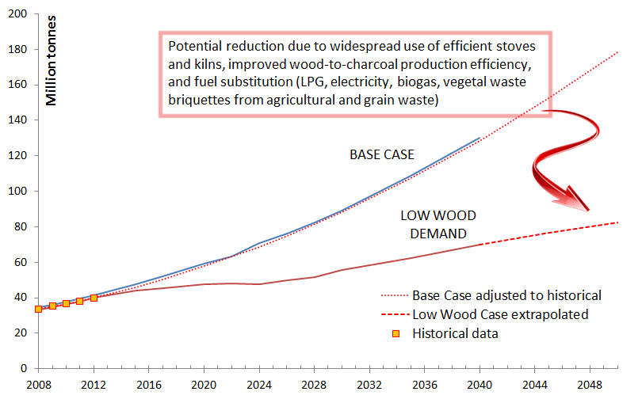
Biomass demand forecasts

Slide 39
Impacts of climate change
When climate change impacts on the energy sector are evaluated, two things stand out.
The first is that such change will almost certainly reduce biomass availability.
We estimate that a plausible loss of 5 to 10 percent of domestic wood between 2020 and 2050 would imply the need for additional expenditures of $5-11 billion on LPG to meet demand.

Slide 40
Impacts of climate change
The second main impact of climate change is on availability of water for hydropower generation.
There is a possibility that hydropower potential will decrease due to a reduction in precipitation. A possible decline of 26 percent by 2050 has been estimated in the water sector study.
Under that scenario, the government’s current expansion programme for the power sector is sufficient to cover the hydropower deficit, as long as the other components of the programme are implemented according to the proposed schedule.

Slide 41
Power generation expansion plan
A very ambitious programme, which will demand large financial resources as well as highly skilled manpower.
The estimated additional capital investment in hydro, nuclear and other generation from now to 2050 is around $83 billion.
In the period 2015-2020 the country will need to invest around one billion dollars in the electricity system, or around $200 million per year, which is equal to about one percent of national GDP. In future years the amounts increase very sharply.

Slide 42
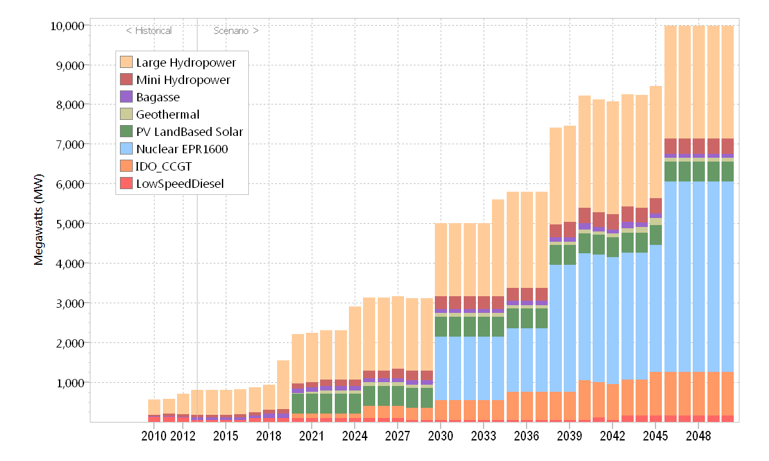
Installed (historical 2010-13) and projected (up to 2050) electricity capacity

Slide 43
adaptation
The Government’s Adaptation Strategy focusses heavily on reducing dependence on biomass, but it also gives importance to promoting energy conservation and efficient utilisation of energy to reduce GHG emissions.
It does not have much on increased use of LPG or expanding access for electricity.
The government programmes aiming to increase energy efficiency are similar to those in many developing countries. Reviews of such programmes indicate a high level of cost effectiveness in promoting energy efficiency and reducing GHG emissions.

Slide 44
adaptation
The main difficulties arise when the program requires an up-front expenditure by users with limited resources.
In Uganda similar considerations will apply: energy efficiency programmes designed with care, taking account of lessons learnt from other countries in a similar situation, should yield high benefits relative to costs.
Detailed estimates of the benefits and costs of individual components in the adaptation programme require more data. Hence they will have to wait for case studies to be undertaken in the future.

Slide 45
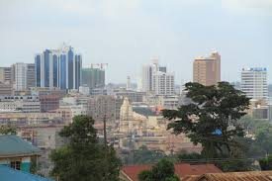
Kampala case study
PRELIMINARY RESULTS

Slide 46
Main issues
A crucial demographic, social, economic and political pole in East Africa, the city faces problems from climate variability and climate change with respect to flooding, water supply, infrastructure resilience.
Local climate scenarios developed for the city and used to assess the effects in these areas.
The urban poor suffer most the impacts of climate change. Informal settlements, 60% of Kampala’s population (about 700.000 people), especially in wetlands, are particularly hit, especially from flooding
The shallowness and low topographic gradients of Lake Victoria make it particularly sensitive to changes in water levels, and temperatures favour vector-borne diseases.

Slide 47
Main findings
The damages from extreme events leading to flooding could rise from between $1.3 and $7.3 million in 2013 to between $3.7 and $17.6 million by 2025 and between $33.2 million and $101.7 million by 2050, if the frequency and intensity of these events does not change
Damges would be between $5.6 and $26.3 million by 2025 and between $66.5 and $203.3 million by 2050 if the frequency of these events doubles and increases linearly between 2013 and 2050.
Cost of climate proofing buildings and roads are significant: between $3,259 million (under RCP4.5) and $3,699 million (under RCP8.5) over the 2015-2050 period, between $560 million (under RCP4.5) and $600 million (under RCP8.5) only over the period 2015-2030

Slide 48
Main findings
Cost benefit analysis of proposed 4 flood schemes indicates a high net benefits for two of them even with no climate change. The other two have a positive net benefit if frequency of flooding rises, as is possible.
More work on local projects is needed to value them more accurately.

Slide 49
Thank you
Contacts:
Anil Markandya: anil.markandya@bc3research.org
Study coordinator: : olivier.beucher@baastel.com

