Slide 1
Managing Climate Extremes &Disasters in Asia: LESSONS FROM THE IPCC SREX REPORT
With CC impact becoming more dramatic; the effects of climate extreme will become more important & will play significant in disaster impact and DRM.
The capacity of the Asian countries to meet this challenge to be determined by national DRM system (including ADAPTATION & MITIGATION).
Need to reassess vulnerability, exposure & investment for effective DRM
NEEDS A NEW BALANCE to be struck between
Measures to reduce and transfer RISK &
Effectively prepare for and manage Disaster Impacts in Changing Climate

Slide 2
Integration of DRM, CCA & Resilience Building: Critical Factors
MANAGE RESIDUAL RISKS & UNCERTAINTIES
REDCUE RISKS
REDUCE VULNERABILITY | REDUCE HAZARD & EXPOSURE
Poverty reduction Health improvements Access to services and productive assets enhanced Livelihood diversification Access to decision making increased Community security Improved | Mainstream risk management into development processes Building codes and Retrofitting Defensive infrastructure & environmental buffers Land use planning Catchment and other ecosystem management Incentive mechanisms for individual actions to reduce exposure
POOL, TRANSFER- SHARE RISK
Mutual and reserve funds Financial insurance Social networks and social capital Alternative forms of risk transfer
PREPARE & RESPOND EFFECTIVELY | INCREASE CAPACITY TO COPE WITH SURPRIZES
Early warning and communication Evacuation plan Humanitarian: relief supplies Post-disaster livelihood support and recovery | Flexibility in decision making Adaptive learning and Management Improved knowledge and skills Systems Transformation over time.

Slide 3
SAARC CLIMATE RELATED
DISASTER MANAGEMENT INITIATIVES
SAARC DISASTER MANAGEMENT CENTRE
IIPA Campus, I.P. Estate,
Mahatma Gandhi Road, Delhi- 110002

Slide 4
CONTENTS:
SDMC: At A Glance
Climate Change and SAARC Countries
Climate Change Risk Management and SAARC
Climate Change Risk Management and SDMC Initiatives
TOR for the SAARC Inter- governmental Climate Related Disaster Initiatives

Slide 5
SDMC: At a Glance:
13th SAARC Summit in Dhaka approved Indian proposal to set up a SAARC Disaster Management Centre (SDMC) in New Delhi
Modalities for setting up the Centre was decided by an Expert Group and approved by Council of Ministers
It started functioning since January 2007.
Vision
The SAARC Disaster Management Centre would be a vibrant
CENTER OF REGIONAL COOPERATION FOR HOLISTIC MANAGEMENT OF DISASTERS IN SOUTH ASIA.

Slide 6
Functions:
Collect, compile, document and disseminate data, information, case studies and good practices on every aspect of disaster management in the Member Countries;
Analyze information and undertake research on different aspects of disaster management;
Develop educational materials and conduct academic and professional courses on disaster management;
Organize training programmes for various stakeholders on disaster management in the Member Countries;
Contd-------

Slide 7
Contd…….
Develop training modules and conduct ToT programmes;
Provide assistance in the formulation of policies, strategies and framework by the Member Countries
Organize workshops, conferences, seminars, lectures etc on various aspects of disaster management in the Member Countries;
Undertake publication of journals, research papers and books and maintain online resource centers in furtherance of the aforesaid objects.

Slide 8
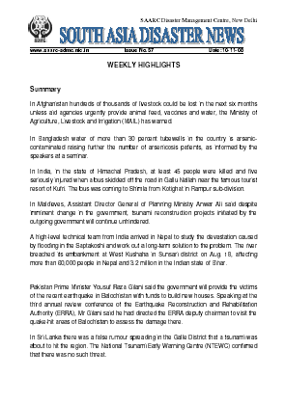
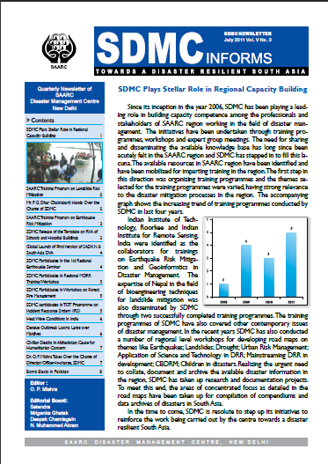
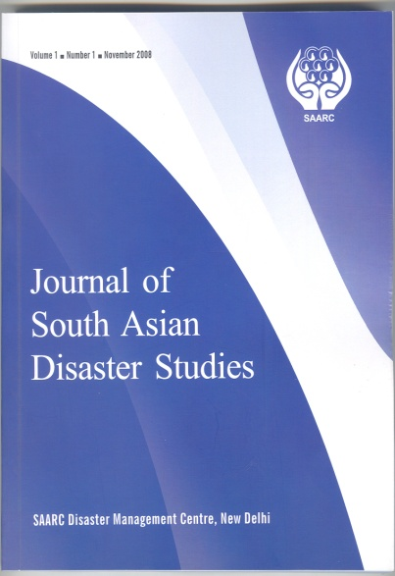
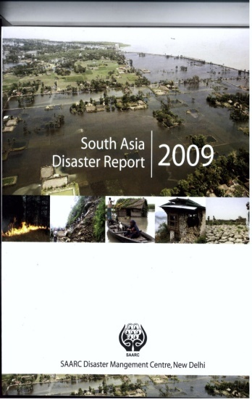
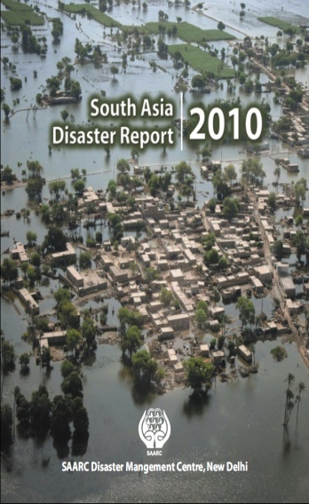
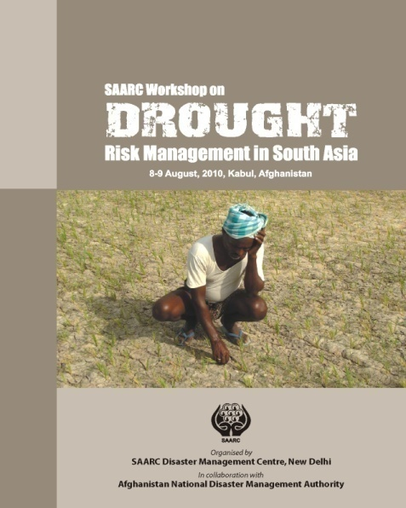
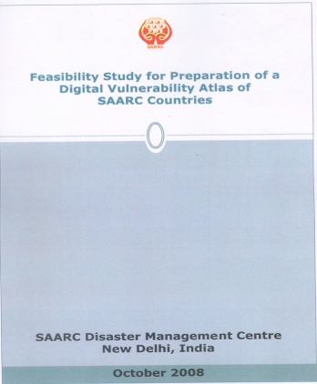
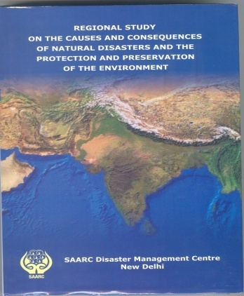
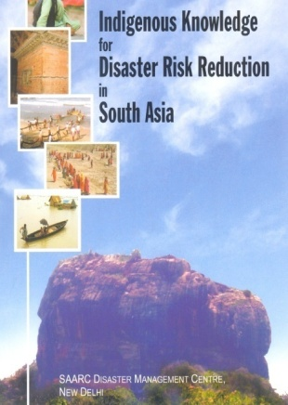
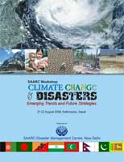
SDMC PUBLICATIONS
Weekly
South Asia Disaster News
Bi-annual
Journal of South Asian
Disaster Studies
Annual
South Asia Disaster Report
Quarterly SDMC Informs
Road Map
Documentation
Feasibility Study
Studies

Slide 9
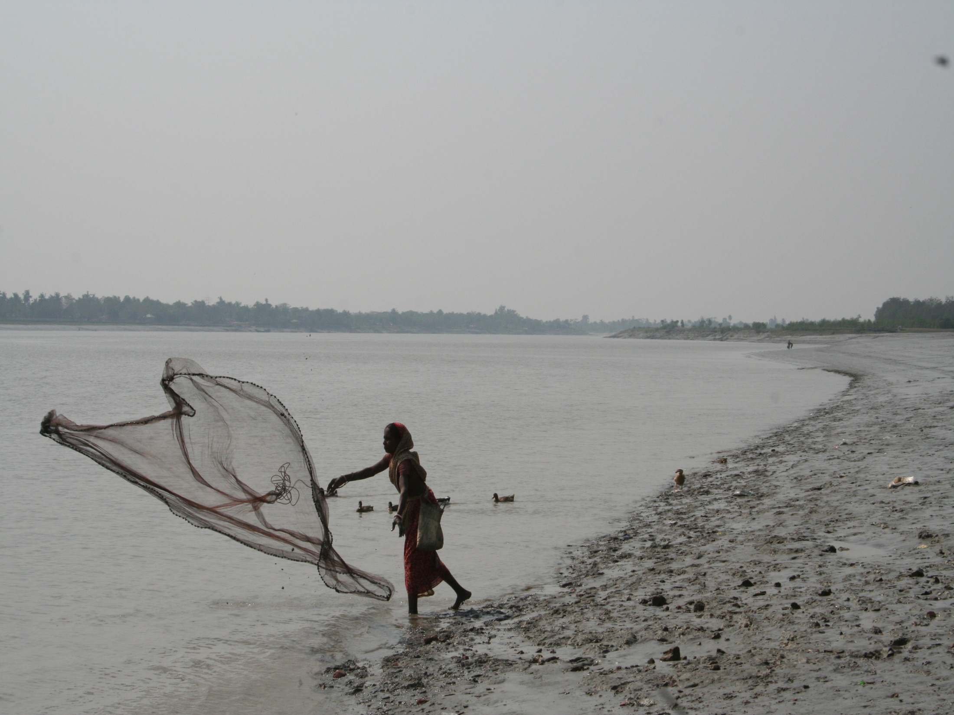
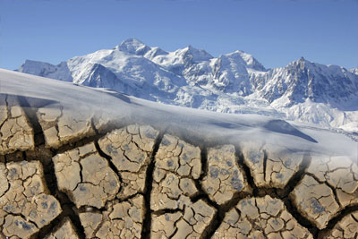
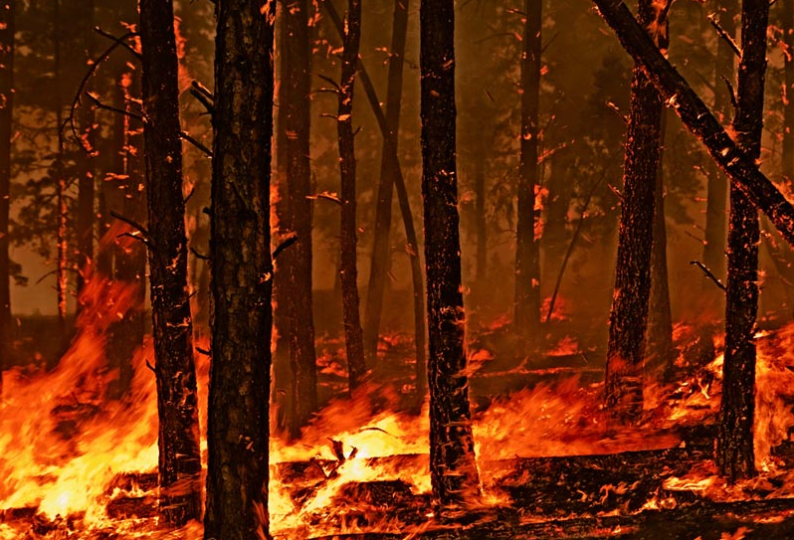
CLIMATE CHANGE AND
SAARC COUNTRIES
Notes:
9
Phenomena like increased natural hazard threats, sea level rise, causing salinization of soils and drinking water, and on changing cropping seasons do not leave any doubts indeed that impacts of CC are already visible.
The poorest are the first to be hit, and due to their basically high vulnerability they are also likely to be hit hardest by climate change.
. Hydrometrelogical disasters at increase as a result of climatic change and affecting livelihood worst. In case of Bdesh ( where > 80% population dependent on agr and allied sectors) livelihood sector is mainly represented these sectors. Thus there is need to give this issue a special attention. Taking this strategic issue into consideration LACC projects initiated, in drought prone and coastal areas as pilot projects.

Slide 10
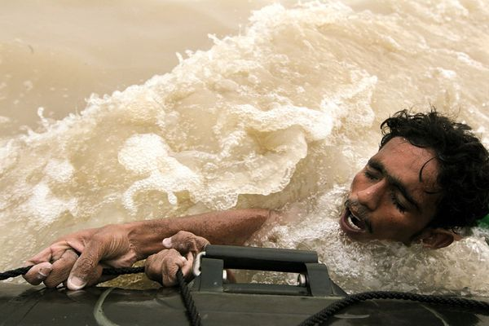
Climate Change Impact in SAARC Region:
Worst effect due to specific geo-climatic conditions, poor development, more population density and socio- economic conditions.
Glaciers in Himalayan region receding; water scarcity in rivers and ground water; 750 million people residing downstream are at risk.
Frequent flood and droughts in India, Pakistan, Nepal and Afghanistan.
Frequent disastrous cyclone in Bay of Bengal, Orissa and Bangladesh
Severe heat waves frequent phenomenon, even in coastal region .
Adverse impact on crop production and other livelihood resources.

Slide 11
Climate Change : Food Security is Major Threat in South Asia
Resulting into---
Impact on livelihood and other resources
Change in RAINFALL
Frequent & Severe Flood,
Higher river erosion
Increased sedimentation
Agr; land inundation & erosion
Damage to crop, fishery. livestock
Agr. Input loss ( fert, seeds etc.)
Scarce water resources
Nutrition deficiency
Increased poverty
Poor health
Scarce Livelihood
Migration
GLACIAR MELTING
Increased River flow ( warm season)
Lower flow (once glacier melted)
Increased saline intrusion
Agr. Land inundation
Scarcity of water for irrigation
Soil degradation ( more salinity)
Direct loss to crop, fishery, & livestock
Soil becomes infertile
Scarcity of fresh water (irrigation)
MORE CYCLONE
More storm surge
Higher wind speed
Saline water intrusion
CLIMATE CHANGE
HUMID / WARM CLIMATE
Rise in Temperature.
More wet climate
Rise in insect infestation
Crop and cattle disease
Less evapo-transpiration
POOR
NATIONAL
DEVELOPMENT
&
FOOD INSECURITY
SEA LEVEL RISE
Land inundation
Salt water intrusion
Increased soil salinity
Agriculture land loss
Scarcity of irrigation water
Soil degradation (moresalinity)
LOWER RAINFALL
Droughts condition
Soil degradation
Fall in water table
Irrigation water scarcity
Soil nutrient deficiency
More Disease (cattle/crop)

Slide 12
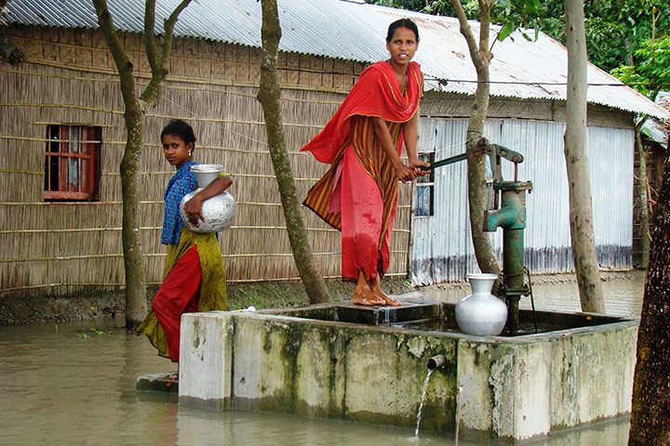
CLIMATE CHANGE
RISK MANAGEMENT:
SAARC INITIATIVES

Slide 13
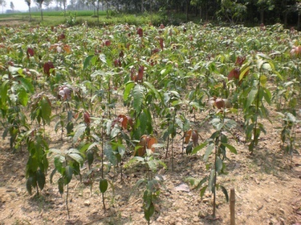
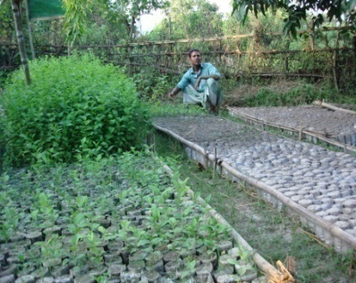
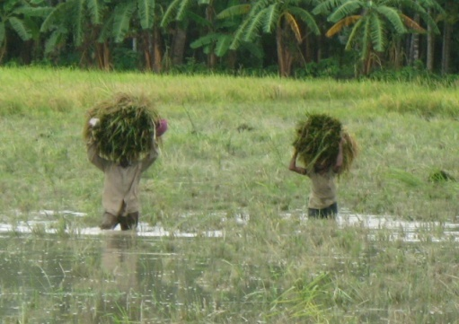
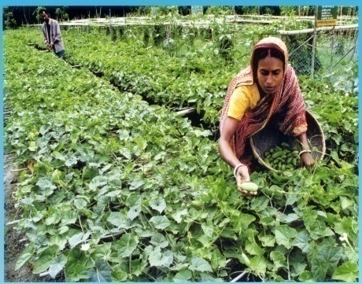
Climate Change Mitigation and Adaptation :SAARC Initiatives
The 14th SAARC Summit (New Delhi, Apr 2007) expressed “deep concern” over the global climate change
29th session of the SAARC Council of Ministers (New Delhi, December 2007), the issue of climate change were discussed.
Dhaka declaration : July 2008
SAARC Action Plan on Climate Change- July 2008
Thimphu Statement: April 2010
SAARC Inter-governmental Climate Related Disaster Initiatives on Integration of CCA with DRR.
IGEG Meetings-CC June 2011 & April 2012

Slide 14
SAARC ACTION PLAN ON CLIMATE CHANGE (Ministerial meeting at Dhaka July 2008 endorsed by 15th SAARC Summit at Colombo Aug- 2008)
OBJECTIVES:
To identify and create opportunities for activities achievable through regional cooperation and south- south support in terms of technology and knowledge transfer.
To provide impetus for regional level action plan on climate change through national level activities.
To support the global negotiation process of the UNFCCC such as the Bali Action Plan, through a common understanding or elaboration of the various negotiating issues to effectively reflect the concerns of SAARC Member States.

Slide 15
SAARC Action Plan on Climate Change: Main Thematic Areas
Adaptation to climate change
Policies and Actions for Climate Change Mitigation
Policies and Actions for Technology transfer
Finance & investment
Education & Awareness
Management of Impact & Risks due to Climate Change
Capacity building for International negotiations and media mgt.

Slide 16
Thimphu statement 2010:
Key issues related to SDMC
Undertake advocacy & awareness programs on climate change
Incorporate Science based material in educational curricula related to CC
Establish institutional links; sharing of knowledge
Commission a SAARC Inter-Governmental Disaster initiative to integrate CCA with DRR; to be supported by SDMC

Slide 17
CLIMATE CHANGE RISK MANAGEMENT
AND
SDMC INITIATIVES

Slide 18
Roadmaps developed by SDMC in context of Climate Change:
Coastal and Marine Risk Mitigation Plan – March 2008
Community Based Disaster Risk Management – 2008
Application of Science & Technology for DRR - 2008
Climate Change Adaptation and Disaster Risk Reduction – August 2008
Urban Risk Management in South Asia – June 2010
Drought Management in South Asia – August 2010
Flood Risk Management –Scheduled for 2012 in Pakistan

Slide 19
Training /Workshops/Expert Gp meetings/ Awareness Generation: (on CCM & CCA)
Training on Urban Risk Management in Nov 2011, Sri Lanka.
Drought Management in South Asia in August 2010 – Kabul.
Urban Risk Management in South Asia in June 2010 New Delhi (in collaboration with UNISDR).
Expert Group Meeting on "Regional Drought Monitoring and Early Warning System", December, 2011 at Hyderabad, India.
Regional Drawing Competition being held among the children in the SAARC region in collaboration with the UNISDR.
SAARC Charter day Celebrations

Slide 20
Knowledge Management Products
South Asia Disaster Knowledge Network:
South Asia Disaster Knowledge Network, conceptualized to develop a Network of Networks of scientific, technical, research and practicing organizations within and outside government at national and regional levels.
One stop source of information on Disaster/ Climate Change Risk Management in South Asia.
Establishing an environment in South Asia to create, earn, organize, share and reuse DDR and CCM/CCA knowledge.
The portal was globally launched on 9th May 2011 at Geneva in 3rd Global Platform for Disaster Risk Reduction ( GPDRR).
Hosted at www.saarc-sadkn.org

Slide 22
Digital vulnerability Atlas of South Asia:
Digital Vulnerability Atlas of South Asia, preparation of Digital Vulnerability Atlas of South Asia of Five SAARC Member Countries of Afghanistan, Bhutan, India, Maldives, Nepal on a GIS Platform integrating physical, social and economic vulnerability to Disaster and Climate Change.
The portal was globally launched on 9th May 2011 at Geneva in 3rd Global Platform for Disaster Risk Reduction ( GPDRR)
Hosted at www.saarc-dva.org

Slide 23
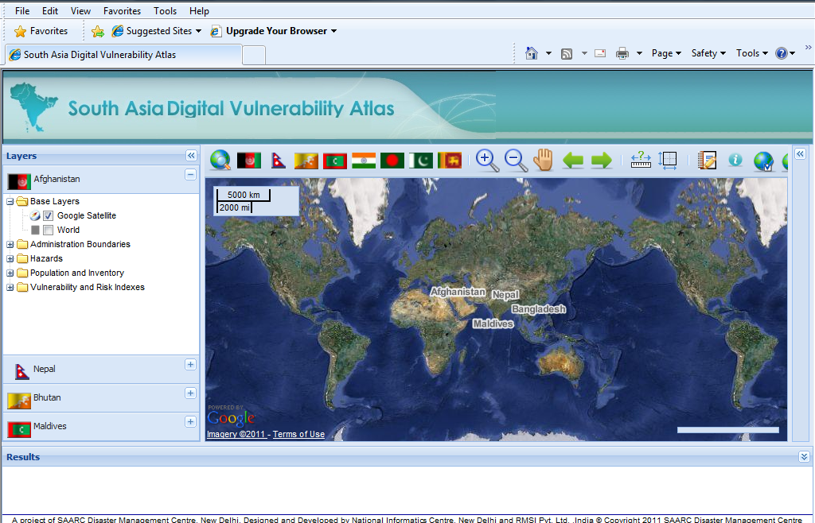

Slide 24
SDMC Activities Proposed to CC Mitigation & Adaptation (2012)
Training and Awareness programmes:
Training Programme for Climate Change and Water Resources Management for Drought-Prone Areas of South Asia
Training Programme on River Erosion and Embankment Safety Management in South Asia
Training Programme on Forest Fire Management in Bhutan
Strengthen SADKN and DVA with more information related to Climate Change Risk Mitigation and Adaptation.
Create Awareness about CCM & CCA among Member Countries.
Contd……..

Slide 25
Contd……..
Research & Documentation:
District Level emergency Plans for Drought management for SAARC Countries
Structural Measures Adopted for Coastal Zone Management in SAARC Region
Development of regional road map for GLOF Risk Management in South Asia

Slide 26
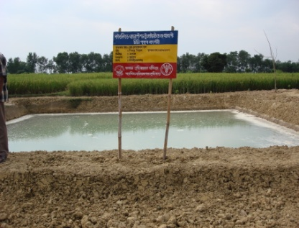
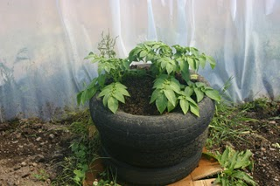
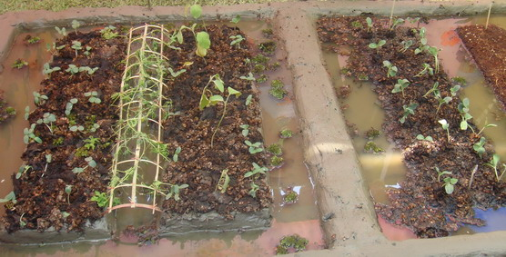
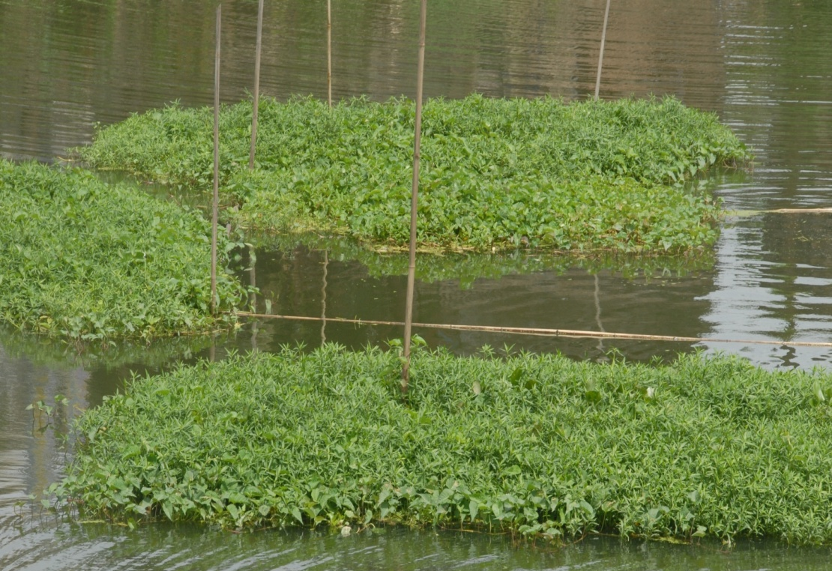
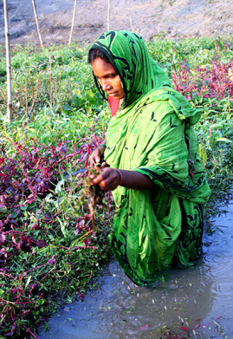
Development of a Compendium on Lessons learnt and best practices of Climate Change Adaptability

Slide 27
TOR for SAARC Inter Governmental Climate Related Disaster Initiatives on Integration of CCA with DRR
Comprehensive study of the policy, institutional landscape & resource allocation for DRR
Comprehensive study of the policy, institutional landscape & resource allocation for CCA
Analyse the convergence & divergence of DRR & CCA issues
Recommendations for integration for reducing risk
Inventory of DRR projects, implemented & under implementation
Inventory of CCA projects, implemented & under implementation
Analyse the similarities & dissimilarities in two types of projects
Recommendation how to integrate CCA & DRR projects
Develop tools, methodologies & guidelines for CCA integrating with DRR

Slide 28
THANK YOU

