Slide 1
SREX Chapter 8: Toward a Sustainable and Resilient Future
Asuncion Lera St.Clair
Research Director, Center for International Climate and Environmental Research-Oslo (CICERO)
sample

Slide 2
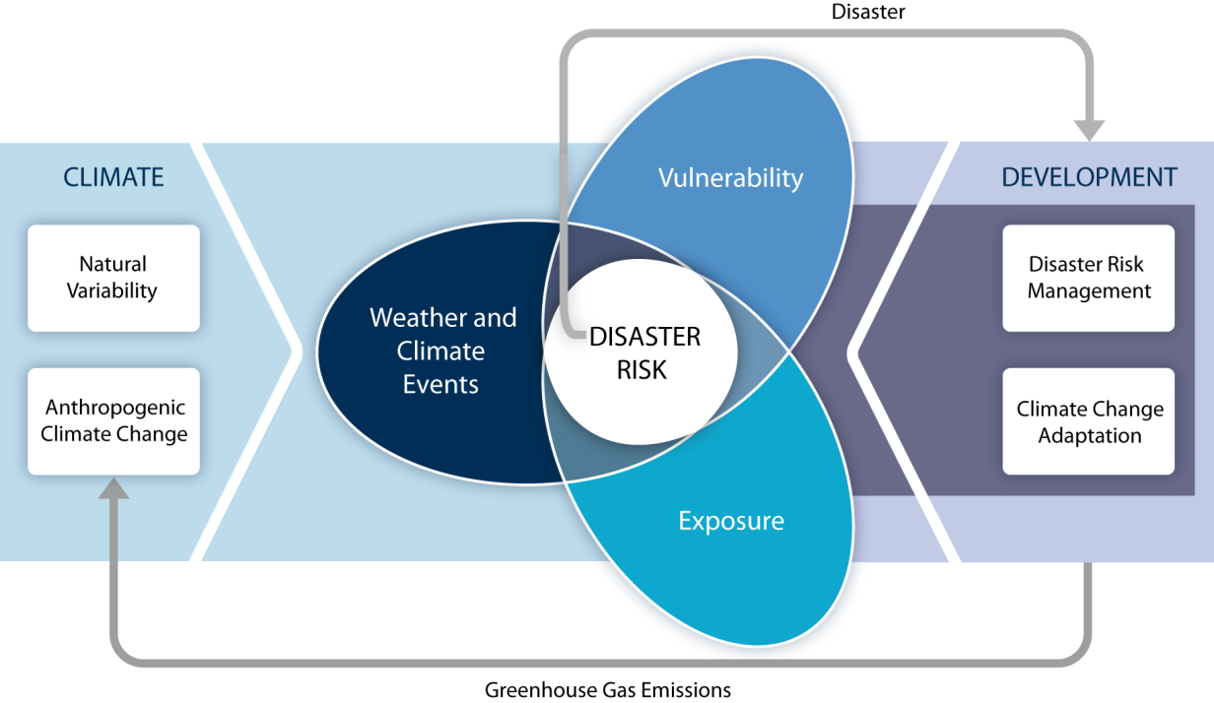
Evidence indicates that disaster risk management and adaptation policy can be integrated, reinforcing, and supportive . Emphasis on
Multi-hazard risk management approaches
Links disaster risk and development pathways

Slide 3
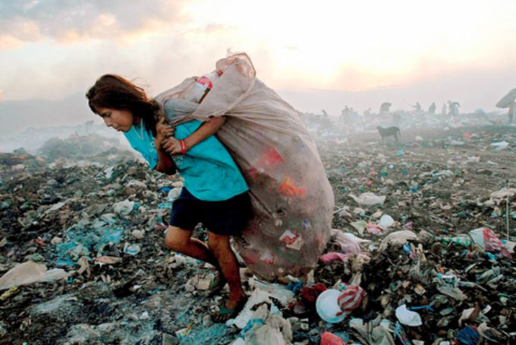
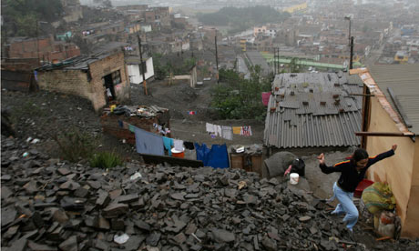
  There is robust evidence that addressing
  the underlying causes of vulnerability, including
  structural inequalities that create and
  perpetuate poverty and
  constrain access
  to resources
  is a prerequisite for sustainability

Slide 4

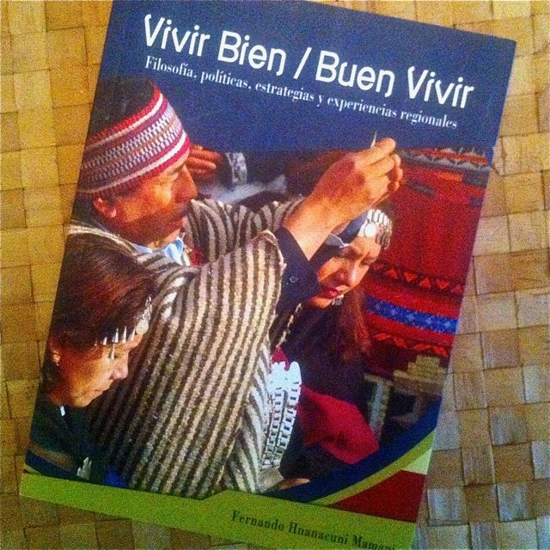
Development planning and post-disaster recoveryy have often prioritized strategic economic sectors and infrastructure over livelihoods and well-being of the poor and marginalized communities.
There are many approaches and pathways to a sustainable sustainable future. This multiplicity can increase resilience
.

Slide 5
progress toward resilient and sustainable development benefits from:
  questioning assumptions, paradigms, and stimulating innovation to encourage new patterns of response
  making transparent values and interests that underpin development options
  who wins and who loses from current practices and policies?
  And what are the implications for human security

Slide 6
From incremental steps to transformational changes
Transformation is defined in the SREX as:
  The altering of fundamental attributes of a system (including value systems; regulatory, legislative, or bureaucratic regimes; financial institutions; and technological or biological systems).

Slide 8
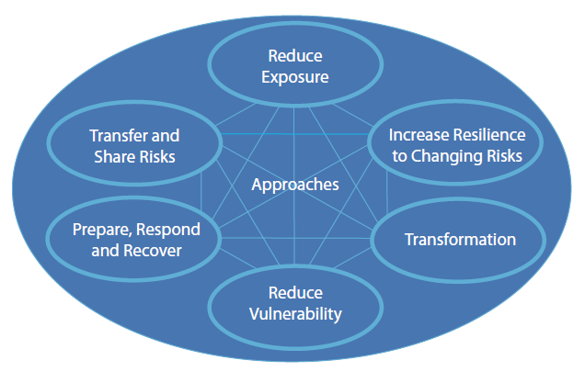
The solution space

