Slide 1
SREX Lessons on Community Action + RRR towards Sustainability
IPCC SREX Regional Outreach Meeting
Bangkok, 4 May 2012
Asian Disaster Preparedness Center (ADPC)
Ph.D. Ravsal Oyun Lead Author, SREX Chapter 9
Director, JEMR LLC, Mongolia

Slide 2
Contents
SREX Lessons on:
Linking Local to Global
DRR & CCA at local
Limitations of DRR & CCA at local
Learning & transformation
Responding climate change with RRR

Slide 3
SREX Lessons on Community Action
1.

Slide 4
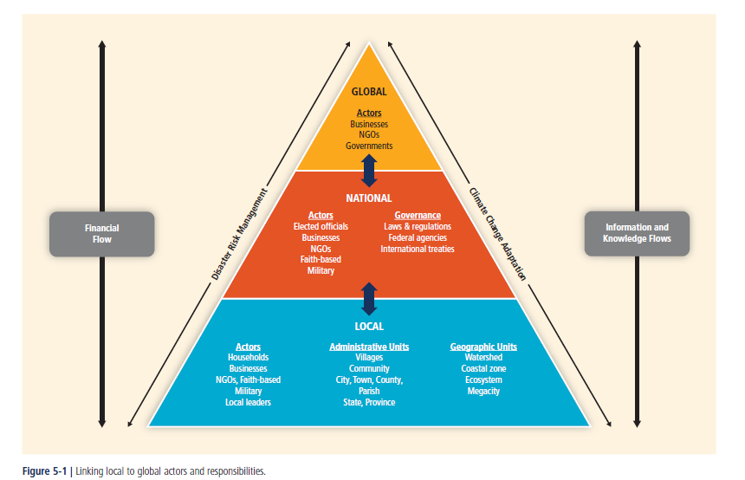
Linking Local to Global Actors and Responsibilities

Slide 5
Effective DRM & CCA at the local scales
Approaches and responses:
To focus on integrating information about CC risk into disaster planning and scenario assessments of the future.
Setting up plans in advance, enabled communication systems to be strengthened before the extreme event struck.
Community-based adaptation (CBA) helps to define solutions for managing risks while considering CC.
CBA responses provide increased participation by locals and recognition of the local context and the access to adaptation resources and promote adaptive capacity within communities.
A critical factor in CBA is that community members are empowered to take control of the processes involved.
Scaling up CBA poses a challenge as well as integrating climate information and other interventions such as ecosystem management and restoration, watershed rehabilitation, agroecology, and forest landscape restoration.
These types of interventions protect and enhance natural resources at the local scale, improve local capacities to adapt to future climate, and may also address immediate development needs.

Slide 6
Limits to adaptation at the local level
Traditionally, local RM focused on short-term climatic events. It is more crucial now to focus on building the resilience of communities, cities, and sectors .
Actions can be taken at the levels of individual or households are often event-specific and time-dependent.
They are constrained by location, adequate infrastructure, socio-economic characteristics, and access to disaster risk information.
Increased urban vulnerability due to urbanization and rising population exacerbates disaster risk by the lack of investment in infrastructure as well as poor environmental management, and can have spillover effects to rural areas.
Obstacles to information transfer and communications are diverse, ranging from limitations in modeling the climate system to procedural, institutional, and cognitive barriers in receiving or understanding climatic information and advance warnings and the capacity and willingness of decision makers to modify action.
Within many rural communities, low bandwidth and poor computing infrastructure pose serious constraints to risk message receipt. Such gaps are evident in developed as well as lesser-developed regions. Constraints exist in locally-organized collective action because of the difficulties of building effective coalitions with other organizations.

Slide 7
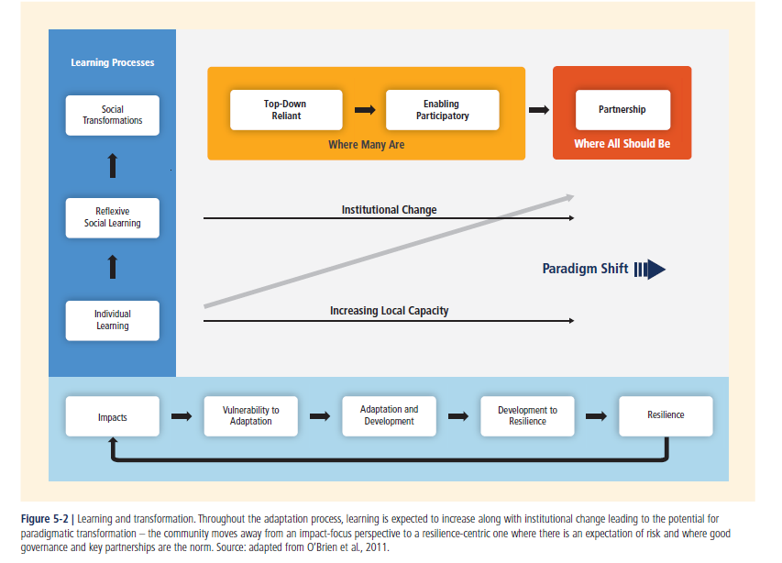
Learning and transformation

Slide 8
Responding climate change with RRR
2.

Slide 9
Responding climate change with RRR
In addition to current policy of adaptation and mitigation of climate change there is a need for global and national strategy, and supporting investment policy that promote initiatives to:
Renovate technology (for greening) and
Re-engineering of economic and social systems (of scales from local to worldwide) towards
Rehabilitation and/or restoration of nature, the environment and natural renewable resources.
These 3 Rs (or RRR) will encourage:
actions and creativity of engineers and researchers,
active participation of businesses, community, households
increase job opportunity and alleviate poverty at local.

Slide 10
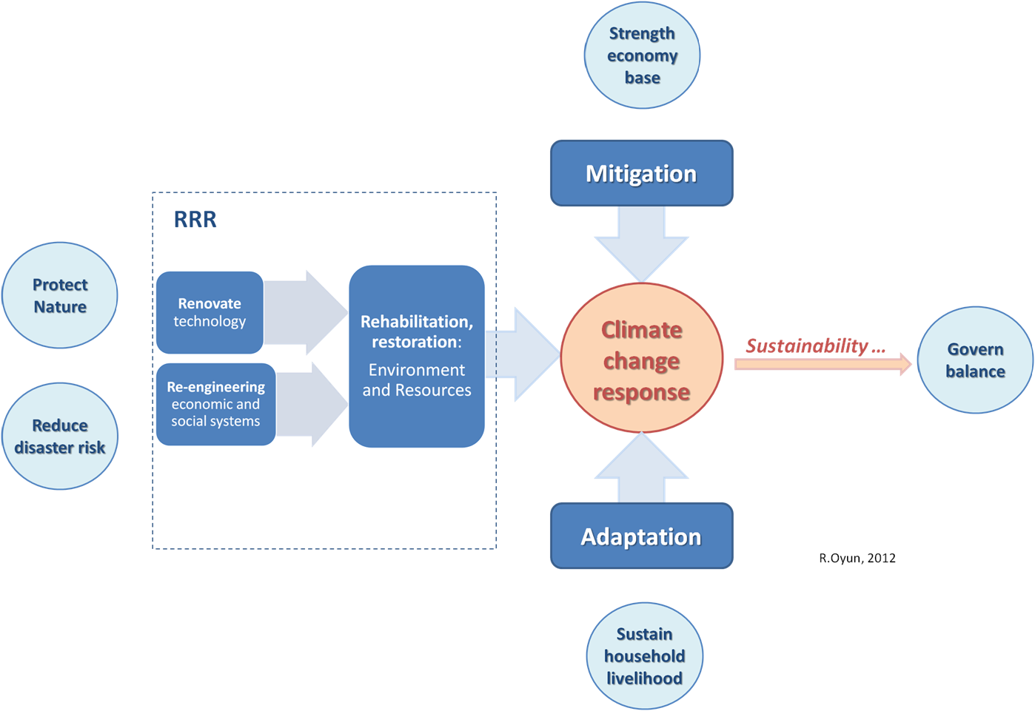
Challenges …

Slide 11
Thank you for attention!
Ph.D. Ravsal Oyun, Mongolia
oyun@jemr.mn

