Slide 1
Impacts of Climate and Land Use Change on Belize’s Water Resources
Emil Cherrington¹, Elma Kay², and Ivanna Waight²
¹CATHALAC & ² UB Environmental Research Institute
9th Annual NRM Symposium
Belmopan, Belize
25 March 2015

Slide 2
Presentation Outline
Study Context
Goal and Objectives
Study Area
Methodology
Results
Conclusions & Recommendations
Acknowledgements

Slide 3
Context
Central America and Caribbean especially vulnerable to climate change (CC) impacts especially on water resources
Regional assessments at a broader scale exist
Need for national assessment identified as priority in 2010 National Environmental and Natural Resources Management (NRM) Research Agenda

Slide 5
Goals & Objectives
Determine climate and land use change impact on the supply and demand for water in Belize
Estimate the cumulative impacts of climate and land use change on the runoff and erosion components of the hydrological cycle in Belize’s major watersheds
Estimate the impacts of climate change on runoff and erosion
Estimate the impacts of land use change on runoff and erosion
Estimate changes in demand for human consumption

Slide 6
Methodology
Hydrological modeling with Non-Point Source Pollution and Erosion Tool (N-SPECT)
DATA TYPE | SOURCE | RESOLUTION
Land Use | Belize: Cherrington et al. (2010) Mexico: GlobCover/European Space Agency (2009) Guatemala: INAB (2011) | 30 m 300 m 30 m
Elevation | Shuttle Radar Topography Mission (SRTM) | 90 m
Precipitation | Historical norm and IPCC AR-5 RCP scenarios / WorldClim consortium | 1,000 m
Soil Type | FAO Soil & Terrain database of Latin America & the Caribbean (SOTERLAC) | 1,000 m

Slide 7
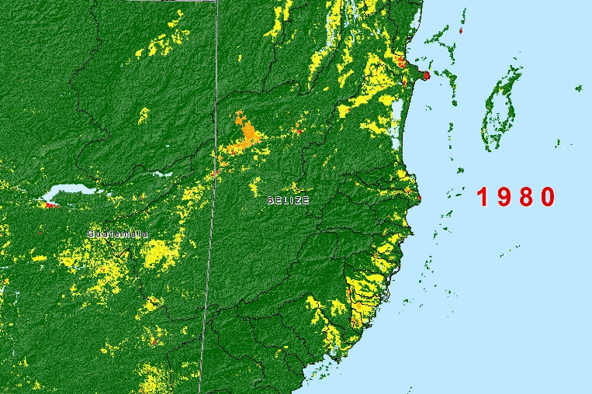
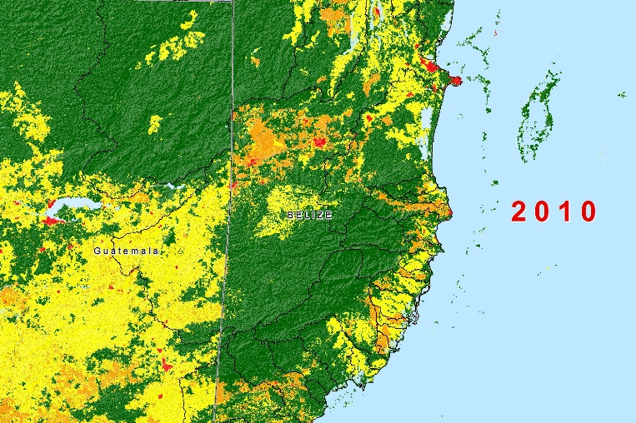
Methodology: Land-use Modeling
Spatial regression modeling (IDRISI Selva) to assess 3 future land use scenarios based on 2010 land use maps:
‘Business as usual’ scenario (i.e. maintaining 2000-2010 deforestation rate)
Deforestation rate halved
Deforestation rate doubled
2010 – 2100
but only 2050 used for hydrological modeling
Notes:
Would it be worthwhile to take a look at how decreased or increased deforestation scenarios changes with PA constraint?
Personally, I think that it would merely add to the # of scenarios and not necessarily contribute to more information. And as you can probably see from the scenarios for 2100, and your question regarding that slide gets at it, there will also come a time where land demand will start eating into protected areas, even if we have considered them ‘inviolable,’ b/c the model needs to allocate somewhere. So the scenario for 2100 w/ BAU and no protected areas, and 2100 w/ doubled deforestation AND protected areas looks similar.

Slide 8
Methodology: Climate Change Models
IPCC AR5 global climate change models:
CNRM-CM5
HadGEM-2 ES
MIROC5
MRI-CGCM3
NorESM1-M
Used downscaled outputs of these; of all 4 available representative concentration pathways (RCP’s) for these models, only best and worst case scenarios were used (RCP 2.6 and RCP 8.5)
Notes:
Why did these specific models over others?
In the case of the 3 AR4 models, b/c these were the only ones available from WorldClim. In the case of the 5 AR5 models, as per the April 2014 report, 4 of these were proposed by CATHALAC based on their relevance to the region. The HadGEM-2 ES model was selected by us to allow for some comparability w/ the AR4 model (HadCM3).
Do the arrows and years in the slide mean that these models are built around predictions for those given years or that we would test these models to make predictions for the years listed?
The periods shown are for which average data are available. For the AR4 models, data for mean year 2020, 2050, and 2080 are available, but in that case, 2020 refers to 2010-2039, while 2050 refers to 2040 – 2069, and 2080 refers to 2070 – 2099. For the AR5 models, the periods covered differs somewhat, where 2050s refers to 2041-2060, and 2070s refers to 2061-2080.

Slide 9
Methodology
Runoff and erosion calculations were run under 4 sets of conditions (44 total runs):
Baseline (historical norm): using 2010 land use data and 1950-2000 rainfall average
CC and land use change scenarios: using 2050 land use change scenarios and RCP CC scenarios for 2050s
CC only scenario: using 2010 land use data in combination with RCP climate change scenarios for 2050s
Land use change only scenario: using 2050 land use change scenarios and 1950-2000 rainfall average

Slide 10
Methodology
Estimates of changes in demand for human consumption
Used data from the 2010 LandScan database from the U.S. Oak Ridge National Laboratory (ORNL) to estimate no. of people in project area in 2010
Projected increase in population
Combined population with average per capita water consumption in Belize estimated at 52.3 m³ (13,816.2 gallons) (MNRA 2010)*
Factors water consumption and abstraction losses

Slide 11
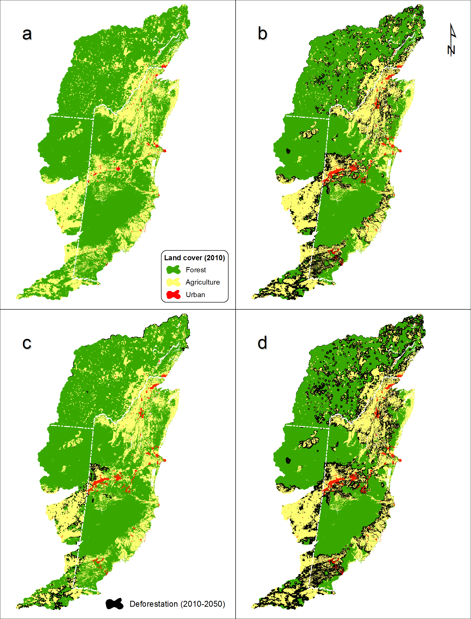
Results:
Land use change modeling
2010 (70.6 forest cover)
2050, business as usual scenario (54.6% forest cover)
2050, deforestation rate halved (69.3% forest cover)
2050, deforestation rate doubled (48% forest cover)

Slide 12
Results: Rainfall across all watersheds
Model | Scenario (RCP) | Period | Origin | Rainfall (mm) |  |  | % change (mean)
 |  |  |  | Min | Mean | Max
Baseline |  | 2000 | WorldClim | 1,051 | 1,750 | 4,126 | N/A
CNRM-CM5 | 2.6 | 2070 | France | 1,057 | 1,711 | 4,070 | -2.2%
CNRM-CM5 | 8.5 | 2070 | France | 1,072 | 1,745 | 3,991 | -0.3%
HadGEM2-ES | 2.6 | 2070 | UK | 983 | 1,699 | 4,157 | -2.9%
HadGEM2-ES | 8.5 | 2070 | UK | 892 | 1,496 | 3,601 | -14.5%
MIROC5 | 2.6 | 2070 | Japan | 924 | 1,508 | 3,603 | -13.9%
MIROC5 | 8.5 | 2070 | Japan | 993 | 1,614 | 3,668 | -7.8%
MRI-CGCM3 | 2.6 | 2070 | Japan | 924 | 1,724 | 4,254 | -1.5%
MRI-CGCM3 | 8.5 | 2070 | Japan | 815 | 1,508 | 3,827 | -13.8%
NorESM1-M | 2.6 | 2070 | Norway | 1,076 | 1,770 | 4,037 | 1.1%
NorESM1-M | 8.5 | 2070 | Norway | 851 | 1,361 | 3,031 | -22.3%
Notes:
Overall drier climate expected; when run 13 models the overall average change indicated by the 13 GCMs indicated is -3.2% for RCP 2.6 (best case scenario) and -11.3% for RCP 8.5 (worst case scenario), although this is at the level of all of Belize’s watersheds, including the transboundary sections. At the level of the individual watersheds, the changes are much more variable.

Slide 13
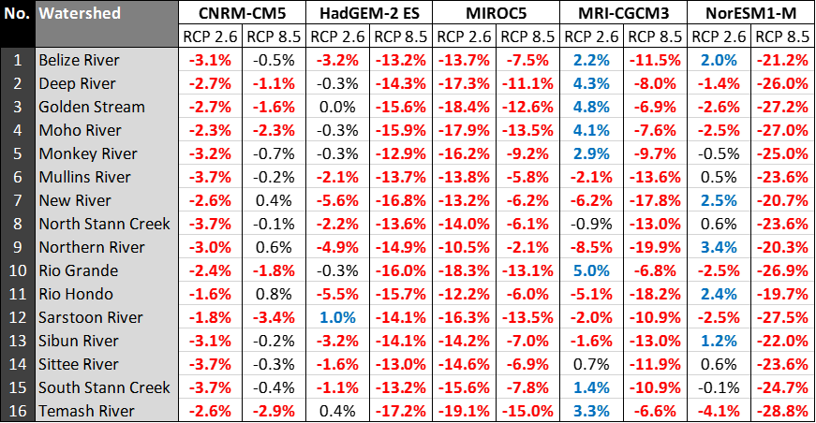
Results: Rainfall in specific watersheds
Notes:
As can be observed, some of the climate scenarios indicate extremely drastic reductions in rainfall – e.g. RCP 8.5 of the NorESM1-M model, which would indicate across the board reductions of rainfall by 19.7% to 28.8%. Watershed by watershed, the most optimistic of this subset of models would be the MRI-CGCM3 model (specifically RCP 2.6), which shows some of the major watersheds receiving increases in rainfall.

Slide 14
Results: Cumulative Changes in Runoff
Across 3 land use change scenarios, changes in runoff variable and dependent on the climate change scenarios
HadGEM-2 ES, MRI-CGCM3, and NorESM1-M models show a reduction in runoff under RCP 8.5, and an increase in runoff under RCP 2.6
The main exceptions to that trend are CNRM-CM5, which indicate an overall increase in runoff, and MIROC5, which indicates an overall decrease in runoff
Notes:
What do the figures in the four columns of the table represent? These results are only for one climate change scenario right?
Each column is an RCP or scenario. We’re showing that depending on whether ‘best case’ (RCP 2.6) or ‘worst case’ (RCP 8.5) scenarios occur, we might see increases (bad) or decreases (good?) in surface runoff.
The results tell us about average run off right but throughout the year, can seasonality be examined to determine things like vulnerability to flooding events?
While we’ve only examined annual runoff, one can infer sub-annual patterns from the annual data. For watersheds like the Belize River, we already see flooding events based on current rainfall patterns. So if we were to have increased runoff (b/c of deforestation and consequent reduction of ability of water to infiltrate into soils), then we’d likely see more floods. Under RCP 8.5, however, even w/ less forest cover, we have less runoff, likely b/c the rainfall has decreased so dramatically.

Slide 15
Results: Cumulative Changes in Runoff
By individual watersheds
Northern River watershed is estimated to experience the largest overall increase in runoff
Sittee River watershed is estimated to experience the largest overall decrease in runoff
Belize River watershed, largest watershed in Belize (not taking into account the transboundary sections) as well as the most populated watershed, is overall estimated to experience an increase in runoff.
Notes:
What do the figures in the four columns of the table represent? These results are only for one climate change scenario right?
Each column is an RCP or scenario. We’re showing that depending on whether ‘best case’ (RCP 2.6) or ‘worst case’ (RCP 8.5) scenarios occur, we might see increases (bad) or decreases (good?) in surface runoff.
The results tell us about average run off right but throughout the year, can seasonality be examined to determine things like vulnerability to flooding events?
While we’ve only examined annual runoff, one can infer sub-annual patterns from the annual data. For watersheds like the Belize River, we already see flooding events based on current rainfall patterns. So if we were to have increased runoff (b/c of deforestation and consequent reduction of ability of water to infiltrate into soils), then we’d likely see more floods. Under RCP 8.5, however, even w/ less forest cover, we have less runoff, likely b/c the rainfall has decreased so dramatically.

Slide 16
Results: Cumulative Changes in Erosion
In comparison with estimated changes in runoff, overall tendency is for increased erosion, with a few exceptions
Trend holds irrespective of GCM or RCP
Golden Stream watershed estimated to experience the greatest increase in erosion
Rio Grande watershed estimated to experience a small decrease in erosion
Notes:
What do the figures in the four columns of the table represent? These results are only for one climate change scenario right?
Each column is an RCP or scenario. We’re showing that depending on whether ‘best case’ (RCP 2.6) or ‘worst case’ (RCP 8.5) scenarios occur, we might see increases (bad) or decreases (good?) in surface runoff.
The results tell us about average run off right but throughout the year, can seasonality be examined to determine things like vulnerability to flooding events?
While we’ve only examined annual runoff, one can infer sub-annual patterns from the annual data. For watersheds like the Belize River, we already see flooding events based on current rainfall patterns. So if we were to have increased runoff (b/c of deforestation and consequent reduction of ability of water to infiltrate into soils), then we’d likely see more floods. Under RCP 8.5, however, even w/ less forest cover, we have less runoff, likely b/c the rainfall has decreased so dramatically.

Slide 17
Results: Decoupling Climate Change and Land Use Change Impacts
Runoff and climate change only
Overall tendency is a decrease in runoff but under RCP 2.6 for GCMs MRI-CGCM3 and NorESM1-M, there are instances of localized increases in runoff
Few cases where the changes in runoff patterns do not differ much from the historical norm
Golden Stream watershed under the RCP 2.6 of the HadGEM-2 ES model
North Stann Creek watershed under RCP 8.5 of the CNRM-CM5 model)
South Stann Creek watershed shows most pronounced decrease in runoff across GCMs and RCPs
Notes:
What do the figures in the four columns of the table represent? These results are only for one climate change scenario right?
Each column is an RCP or scenario. We’re showing that depending on whether ‘best case’ (RCP 2.6) or ‘worst case’ (RCP 8.5) scenarios occur, we might see increases (bad) or decreases (good?) in surface runoff.
The results tell us about average run off right but throughout the year, can seasonality be examined to determine things like vulnerability to flooding events?
While we’ve only examined annual runoff, one can infer sub-annual patterns from the annual data. For watersheds like the Belize River, we already see flooding events based on current rainfall patterns. So if we were to have increased runoff (b/c of deforestation and consequent reduction of ability of water to infiltrate into soils), then we’d likely see more floods. Under RCP 8.5, however, even w/ less forest cover, we have less runoff, likely b/c the rainfall has decreased so dramatically.

Slide 18
Results: Decoupling Climate Change and Land Use Change Impacts
Erosion and climate change only
Erosion also expected to decline across Belize’s major watersheds
Main exception is under RCP 2.6 for MRI-CGCM3, which indicates an increase in erosion in half of Belize’s major watersheds
In other cases, such as RCP 8.5 of the CNRM-CM5 model, RCP 2.6 of the HadGEM-2 ES model, and RCP 2.6 of the NorESM1-M model, the estimated changes in erosion do not differ significantly from the historical norm
Rio Grande watershed would experience the most pronounced decline in erosion across GCMs and RCPs but this is not substantial
Notes:
What do the figures in the four columns of the table represent? These results are only for one climate change scenario right?
Each column is an RCP or scenario. We’re showing that depending on whether ‘best case’ (RCP 2.6) or ‘worst case’ (RCP 8.5) scenarios occur, we might see increases (bad) or decreases (good?) in surface runoff.
The results tell us about average run off right but throughout the year, can seasonality be examined to determine things like vulnerability to flooding events?
While we’ve only examined annual runoff, one can infer sub-annual patterns from the annual data. For watersheds like the Belize River, we already see flooding events based on current rainfall patterns. So if we were to have increased runoff (b/c of deforestation and consequent reduction of ability of water to infiltrate into soils), then we’d likely see more floods. Under RCP 8.5, however, even w/ less forest cover, we have less runoff, likely b/c the rainfall has decreased so dramatically.

Slide 19
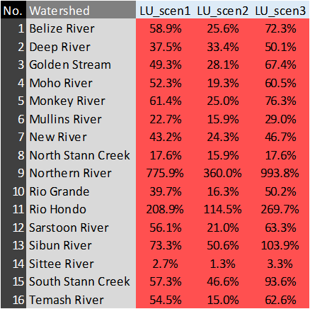
Results: Decoupling Climate Change and Land Use Change Impacts
Runoff and land use change only
Increase in runoff expected across all major watersheds
Changes coincide with changes in deforestation rate
Northern River watershed would experience the largest increase in runoff
Notes:
What do the figures in the four columns of the table represent? These results are only for one climate change scenario right?
Each column is an RCP or scenario. We’re showing that depending on whether ‘best case’ (RCP 2.6) or ‘worst case’ (RCP 8.5) scenarios occur, we might see increases (bad) or decreases (good?) in surface runoff.
The results tell us about average run off right but throughout the year, can seasonality be examined to determine things like vulnerability to flooding events?
While we’ve only examined annual runoff, one can infer sub-annual patterns from the annual data. For watersheds like the Belize River, we already see flooding events based on current rainfall patterns. So if we were to have increased runoff (b/c of deforestation and consequent reduction of ability of water to infiltrate into soils), then we’d likely see more floods. Under RCP 8.5, however, even w/ less forest cover, we have less runoff, likely b/c the rainfall has decreased so dramatically.

Slide 20
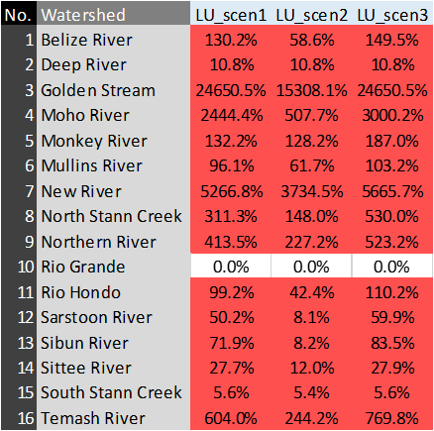
Results: Decoupling Climate Change and Land Use Change Impacts
Erosion and land use change only
Increase in erosion expected across all major watersheds
Rio Grande watershed - no significant change in terms of erosion
Golden Stream watershed – significant increase in erosion, across all land use change scenarios examined
Notes:
What do the figures in the four columns of the table represent? These results are only for one climate change scenario right?
Each column is an RCP or scenario. We’re showing that depending on whether ‘best case’ (RCP 2.6) or ‘worst case’ (RCP 8.5) scenarios occur, we might see increases (bad) or decreases (good?) in surface runoff.
The results tell us about average run off right but throughout the year, can seasonality be examined to determine things like vulnerability to flooding events?
While we’ve only examined annual runoff, one can infer sub-annual patterns from the annual data. For watersheds like the Belize River, we already see flooding events based on current rainfall patterns. So if we were to have increased runoff (b/c of deforestation and consequent reduction of ability of water to infiltrate into soils), then we’d likely see more floods. Under RCP 8.5, however, even w/ less forest cover, we have less runoff, likely b/c the rainfall has decreased so dramatically.

Slide 21
Results
Estimates of changes in demand for human consumption
629,225 people inhabited the project area of interest in 2010, with 48.2% (303,422 persons) inhabiting the mainland Belize segment of the area of interest
For Belize 2010 population = 303,422 and 2050 = 1.017 million
For Belize 2010 demand against supply = 0.073% and 2050 = 0.581 % based on worst case CC and land use change scenario (RCP 8.5 of NorESM1-M)

Slide 22
Conclusions
By 2050, less rainfall is expected across Belize’s 16 major watersheds but especially in Northern Belize
Implications for sugar industry or potential displacement of agriculture to South
Estimated water demand for human consumption would be 2-8.3X current demand
Estimated supply would be sufficient for human consumption needs but it is imperative we quantify current demand for agricultural and industrial use

Slide 23
Conclusions
Declining rainfall and consequent declines in water yield may in turn increase concentrations of sediments in rivers
Rainfall harvesting may be needed if drinking water quality is affected and since it has potential to reduce runoff from flooding
Overall, increased deforestation will lead to more erosion, and cause declining water quality
Need to decrease deforestation and increase reforestation in Belize, New River and Rio Hondo watersheds especially

Slide 24
Conclusions
Simulating changes in the hydrological cycle based solely on climate change scenarios but in absence of land use change, it would appear that a drier climate under stable land use would actually decrease runoff and erosion
Parallel hydrological modeling simulations which take into account land use change but exclude changes in the rainfall regime indicate increases in runoff and erosion (similar to when climate change is also factored in)
Both of the above highlight the importance of land management

Slide 25
Conclusions
Approximately 53.7% of the surface area of Belize’s watersheds lie outside of Belize’s national territory, in Mexico and Guatemala
Transnational cooperation with national and municipal governments is needed to address high deforestation especially in Guatemala’s portion of Belize River watershed
Scope of the present study is limited
Need to start looking at level of watersheds; quantifying impacts by sector e.g. agriculture, energy etc.; assessment of groundwater resources and cimate and land use impacts on these

Slide 26
Acknowledgements
CARIBSAVE and CDKN
Betzy Hernandez supported the conceptualization of this work
Dr. Freddy Picado, CATHALAC’s Director General, and Marcelo Oyuela, Miroslava Moran, and Alejandro del Castillo
A debt of gratitude is owed to the WorldClim Consortium for making the downscaled climate scenario data free and openly available (www.worldclim.org)

Slide 27
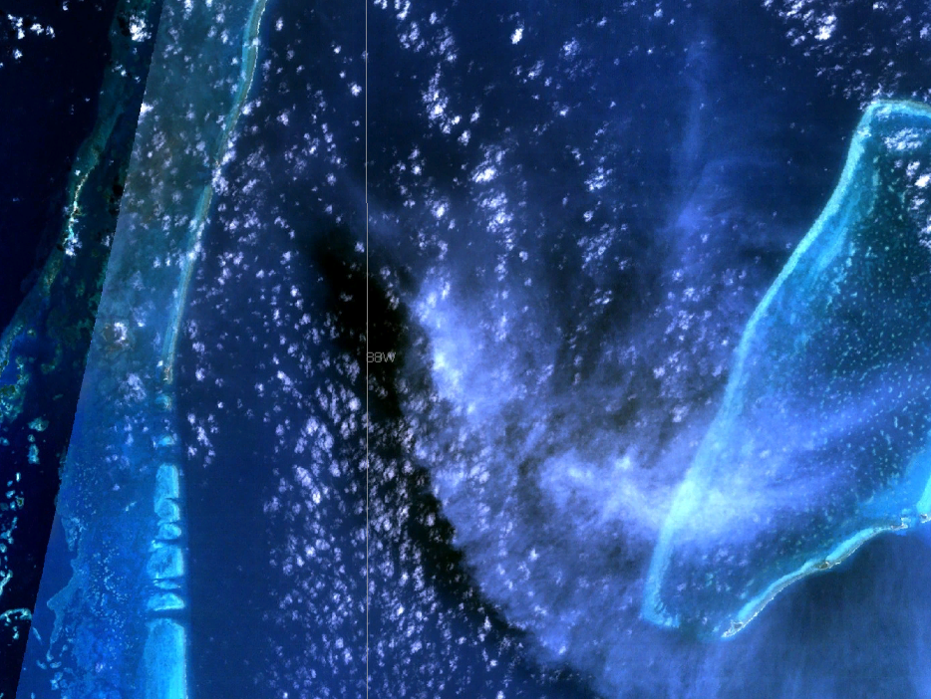
Thank You Questions?

