Slide 1
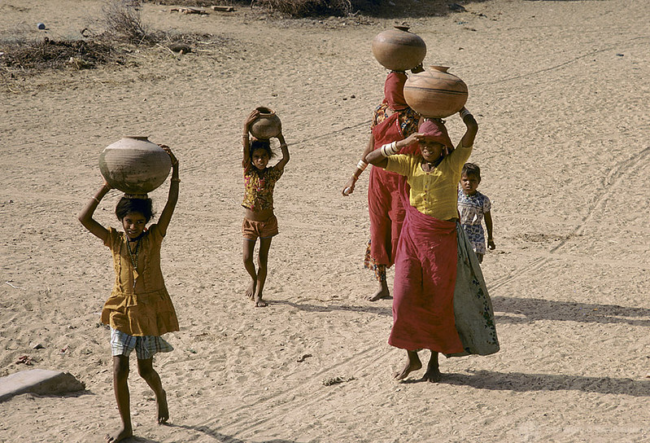
Gender and social inclusion training The international framework for gender in climate action Image : World Bank

Slide 2
In this module you will learn
About international policy frameworks that relate to climate action and women’s and girls’ empowerment:
The Sustainable Development Goals
The Sendai Agreement on Disaster Risk Reduction (climate-related disasters)
The Paris Agreement on Climate Change
Beijing Platform for Action
Commission on the Status of Women

Slide 3
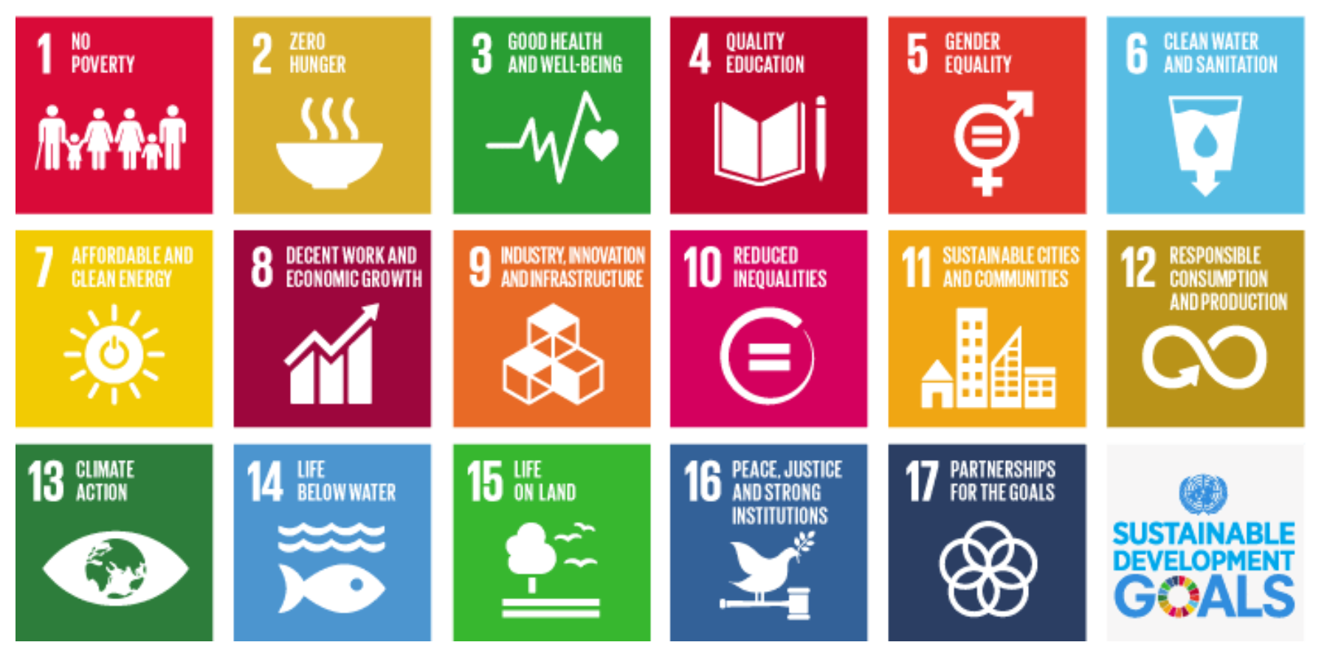
Agenda 2030 and the Sustainable Development Goals (2015-2030)
“Implementation and success will rely on countries’ own sustainable development policies, plans and programmes, and will be led by countries. …All stakeholders: governments, civil society, the private sector, and others, are expected to contribute to the realisation of the new agenda.” - https://www.un.org/sustainabledevelopment/development-agenda/
Notes:
How is the Agenda 2030 was agreed in New York by world leaders in 2015. It is expected to be implemented over 15 years, to 2030.
It comprises the 17 Goals shown here. These were adopted by all UN Member States.
Implementation is envisioned to be a ‘whole of society’ affair as shown by the quote here on the slide.
A stocktake in late 2019 found that there is insufficient progress against the global goals.
World leaders at the SDG Summit in September 2019 called for a decade of action and delivery for sustainable development, and pledged to mobilise financing, enhance national implementation and strengthen institutions to achieve the Goals by the target date of 2030, leaving no one behind. For more details and links, follow: https://www.un.org/sustainabledevelopment/development-agenda/
Gender is a standalone goal, SDG5 for Gender Equality. It is also expected to be integrated across all of the SDGs (see next slide).

Slide 4
Agenda 2030 and the Sustainable Development Goals (2015-2030)
In numbers:
17 Goals
169 targets
232 indicators
193 UN member states
Need to know:
UN High Level Political Forum every year hosts thematic discussions on progress (reports from governments)
Independent trackers include https://sdg-tracker.org/

Slide 5
SDGs: Mainstreaming gender across all goals
The meeting of the Commission on the Status of Women in 2016 adopted a roadmap on how to implement the 2030 Agenda for Sustainable Development in a gender-responsive manner, so as to ensure that no one – no woman or girl – is left behind.
Notes:
The ‘Agreed conclusion’ of the 60th Session of the Commission on the Status of Women (CSW60) is known as : decision E/2016/27.
The detailed roadmap reached by the CSW60 is found online here:
https://www.unwomen.org/-/media/headquarters/attachments/sections/csw/60/csw60%20agreed%20conclusions%20conclusions%20en.pdf?la=en&vs=4409
The roadmap comprises the follow priority areas for action, which are elaborated in the above document:
Strengthening normative, legal and policy frameworks (for women’s and girls’ empowerment);
Fostering enabling environments for financing gender equality and the empowerment of women and girls
Strengthening women’s leadership and women’s full and equal participation in decision-making in all areas of sustainable development
Strengthening gender- responsive data collection, follow-up and review processes
Enhancing national institutional arrangements.
Background information about the Commission on the Status of Women:
The Commission on the Status of Women (CSW), a functional commission of the United Nations Economic and Social Council (ECOSOC), is a global policy-making body dedicated exclusively to promoting gender equality and the empowerment of women. The Commission was established in 1946 with a mandate to prepare recommendations on promoting women’s rights in political, economic, civil, social and educational fields. It is also responsible for monitoring, reviewing and appraising progress achieved and problems encountered in the implementation of the 1995 Beijing Declaration and Platform for Action at all levels, and to support gender mainstreaming.
Representatives of Member States, United Nations entities, and non-governmental organizations (NGOs) in consultative status with ECOSOC and other stakeholders participate in the Commission’s annual session at United Nations Headquarters in New York. The session, which is usually held for ten days in March, provides an opportunity to review progress towards gender equality and the empowerment of women, identify challenges, and set global standards, norms and policies to promote gender equality and women’s empowerment worldwide. (Please note that an annual session, CSW64, due to incorporate a major review of progress and scheduled for March 2020, had to be cancelled because of the coronavirus outbreak.)
The session includes plenary meetings, high-level round tables, interactive dialogues and panels, as well as many side events. Its principal outcome are the “agreed conclusions” on the priority theme, negotiated by all States. UN Women serves as the substantive Secretariat for the Commission and in that capacity, supports all aspects of the Commission’s work. UN Women prepares policy analysis and recommendations that form the basis for the Commission’s deliberations on the themes selected for each session, as well as for negotiated outcomes. UN Women reaches out to stakeholders to create awareness and build alliances around the topics under consideration, and also facilitates the participation of civil society representatives in the Commission’s sessions.
Image: Copyright CIFOR

Slide 6
SDG5: The gender goal and its targets
5.1
End all forms of discrimination against all women and girls everywhere
5.2
Eliminate all forms of violence against all women and girls in the public and private spheres, including trafficking and sexual and other types of exploitation
5.3
Eliminate all harmful practices, such as child, early and forced marriage and female genital mutilation

Slide 7
SDG5: The gender goal and its targets
5.4
Recognise and value unpaid care and domestic work through the provision of public services, infrastructure and social protection policies and the promotion of shared responsibility within the household and the family as nationally appropriate
5.5
Ensure women’s full and effective participation and equal opportunities for leadership at all levels of decision-making in political, economic and public life
5.6
Ensure universal access to sexual and reproductive health and reproductive rights …

Slide 8
SDG5: The gender goal and its targets
5.A
Undertake reforms to give women equal rights to economic resources, as well as access to ownership and control over land and other forms of property, financial services, inheritance and natural resources, in accordance with national laws
5.B
Enhance the use of enabling technology, in particular information and communications technology, to promote the empowerment of women
5.C
Adopt and strengthen sound policies and enforceable legislation for the promotion of gender equality and the empowerment of all women and girls at all levels

Slide 9
SDG5: The gender goal and its targets What progress has the world made?
Good news:
The world is a better place for women today than it was in the past.
Fewer girls are forced into early marriage
More women are serving in parliament and positions of leadership
Laws are being reformed to advance gender equality.
Notes:
The good news is:
The world is a better place for women today than it was in the past.
Fewer girls are forced into early marriage
More women are serving in parliament and positions of leadership
Laws are being reformed to advance gender equality.
Source: United Nations (2019), SDG Report 2019. https://unstats.un.org/sdgs/report/2019/The-Sustainable-Development-Goals-Report-2019.pdf

Slide 10
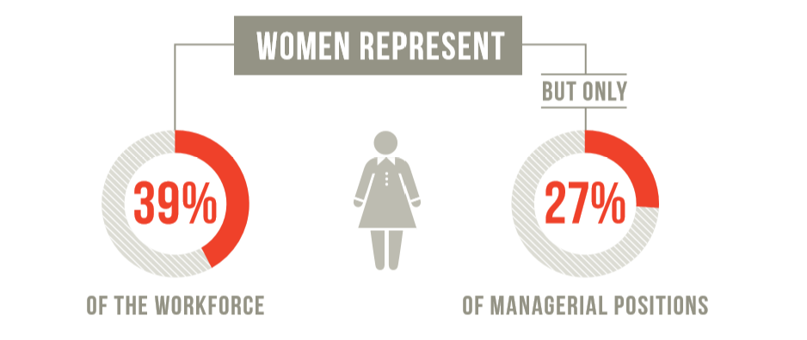
SDG5: The gender goal and its targets What still must be done?
Despite these gains, women continue to be underrepresented at all levels of political leadership.
Across the globe, women and girls perform a disproportionate share of unpaid domestic work.
They continue to face barriers with respect to their sexual and reproductive health and rights, including legal restrictions and lack of autonomy in decision-making.
Notes:
Source: United Nations (2019), SDG Report 2019. https://unstats.un.org/sdgs/report/2019/The-Sustainable-Development-Goals-Report-2019.pdf

Slide 11
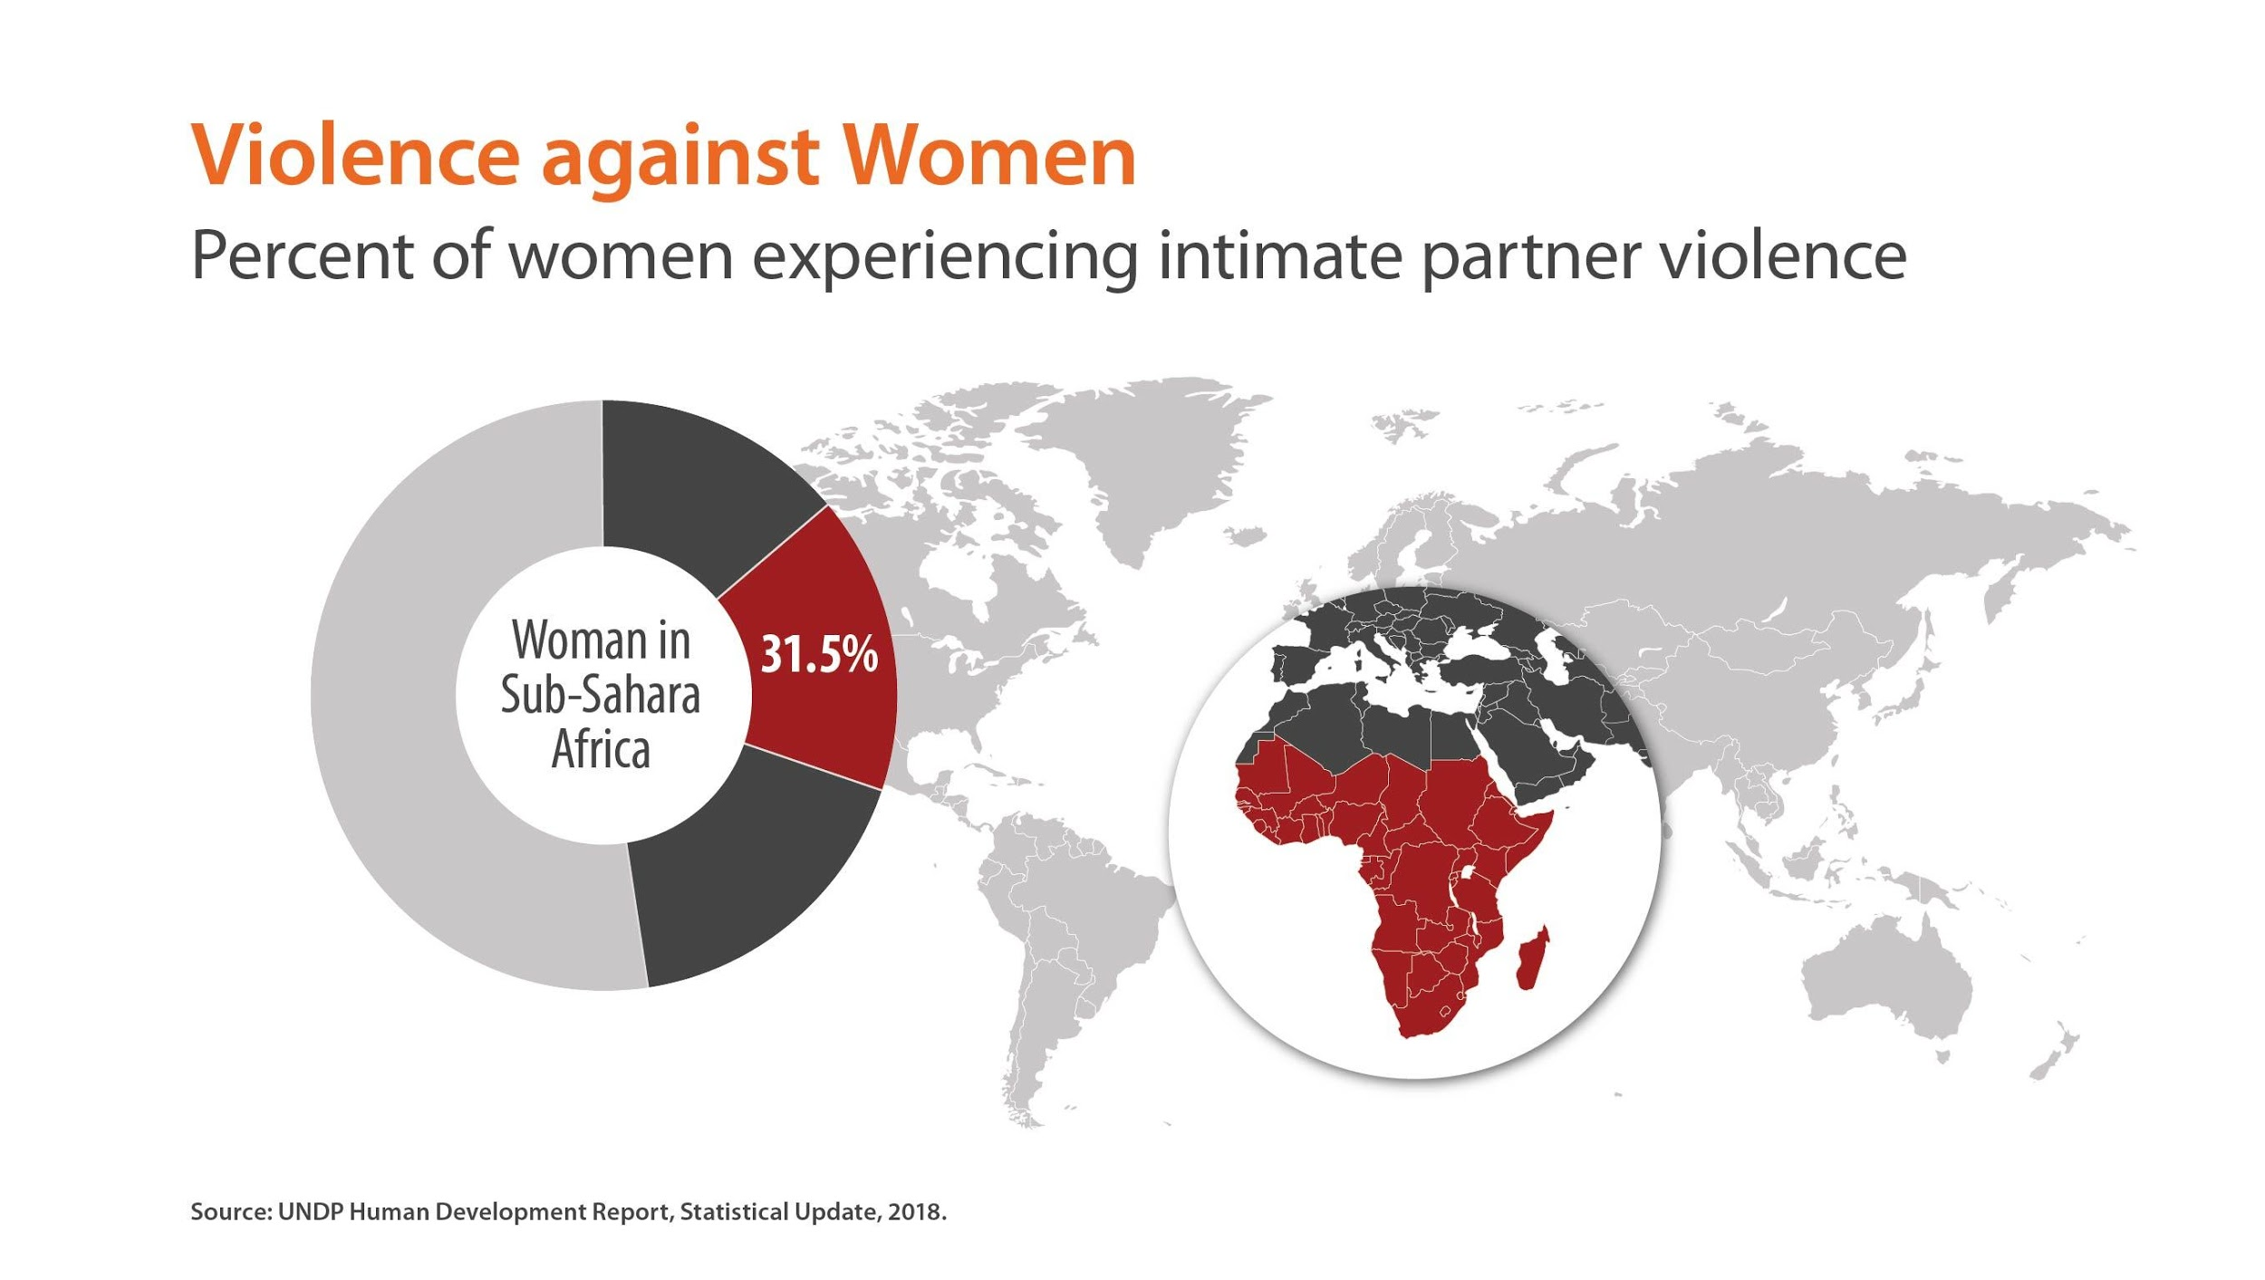
SDG5: The gender goal and its targets What still must be done? “Eliminate all forms of violence against all women and girls in the public and private spheres”
Notes:
Facilitator: Choose to show the regional data that is most appropriate for your training group. Note that the UNDP did not include Latin American data because it was incomplete
Data source: UNDP Statistical Update 2018
Artwork: © CDKN 2020. Creative Commons Licence Attribution Non-Commercial 4.0.
From the UN Office for Disaster Risk Reduction (UNDRR), 2020: ‘Words into Action: Engaging children and youth in disaster risk reduction and resilience building’
https://www.preventionweb.net/files/67704_wiachildyouthdrr202067704undrr.pdf
A companion for implementing the Sendai Framework for Disaster Risk Reduction 2015-2030
Sexual and gender-based violence includes sexual violence, forced marriage, sexual exploitation and sex trafficking. SGBV is rooted in gender inequality, and violence against women and girls is one of the most prevalent human rights violations in the world. It knows no social, economic or national boundaries. Worldwide, an estimated one in three women will experience physical or sexual abuse in her lifetime and violence against LGBTQI2S and trans youth is on the rise in many countries. Sexual and gender-based violence undermines the health, dignity, security and autonomy of its survivors, yet it remains shrouded in a culture of silence. Survivors of sexual and gender-based violence can suffer severe sexual and reproductive health and psychological consequences, including forced and unwanted pregnancies, unsafe abortions, traumatic fistula, sexually transmitted infections, including HIV, violent reprisals, stigmatisation and even death.

Slide 12
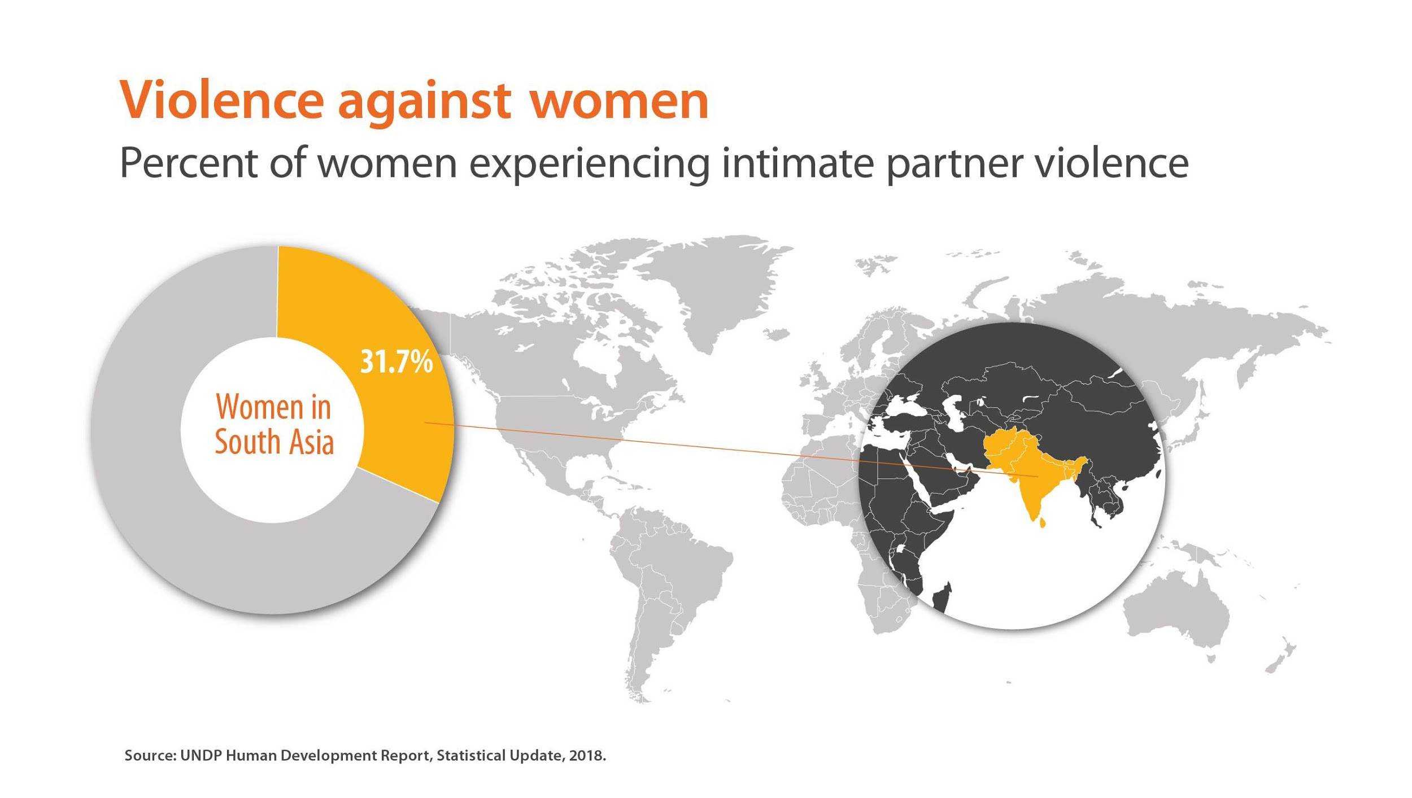
SDG5: The gender goal and its targets What still must be done? “Eliminate all forms of violence against all women and girls in the public and private spheres”
Notes:
Facilitator: Choose to show the regional data that is most appropriate for your training group. Note that the UNDP did not include Latin American data because it was incomplete
Data source: UNDP Statistical Update 2018
Artwork: © CDKN 2020. Creative Commons Licence Attribution Non-Commercial 4.0.
From the UN Office for Disaster Risk Reduction (UNDRR), 2020: ‘Words into Action: Engaging children and youth in disaster risk reduction and resilience building’
https://www.preventionweb.net/files/67704_wiachildyouthdrr202067704undrr.pdf
A companion for implementing the Sendai Framework for Disaster Risk Reduction 2015-2030
Sexual and gender-based violence includes sexual violence, forced marriage, sexual exploitation and sex trafficking. SGBV is rooted in gender inequality, and violence against women and girls is one of the most prevalent human rights violations in the world. It knows no social, economic or national boundaries. Worldwide, an estimated one in three women will experience physical or sexual abuse in her lifetime and violence against LGBTQI2S and trans youth is on the rise in many countries. Sexual and gender-based violence undermines the health, dignity, security and autonomy of its survivors, yet it remains shrouded in a culture of silence. Survivors of sexual and gender-based violence can suffer severe sexual and reproductive health and psychological consequences, including forced and unwanted pregnancies, unsafe abortions, traumatic fistula, sexually transmitted infections, including HIV, violent reprisals, stigmatisation and even death.

Slide 13
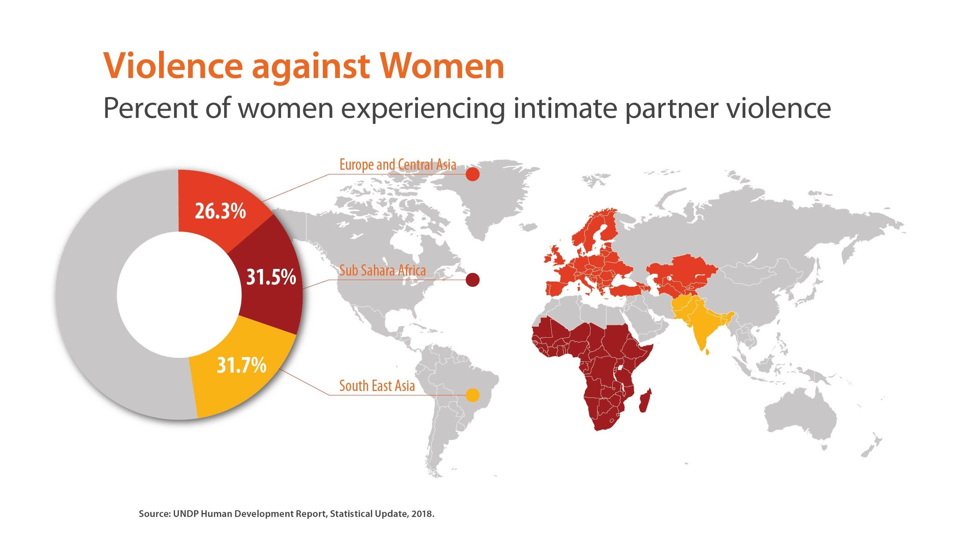
SDG5: The gender goal and its targets What still must be done? “Eliminate all forms of violence against all women and girls in the public and private spheres”
(incomplete data for Latin America)
Notes:
Facilitator: Choose to show the regional data that is most appropriate for your training group. Note that the UNDP did not include Latin American data because it was incomplete
Data source: UNDP Statistical Update 2018
Artwork: © CDKN 2020. Creative Commons Licence Attribution Non-Commercial 4.0.
From the UN Office for Disaster Risk Reduction (UNDRR), 2020: ‘Words into Action: Engaging children and youth in disaster risk reduction and resilience building’
https://www.preventionweb.net/files/67704_wiachildyouthdrr202067704undrr.pdf
A companion for implementing the Sendai Framework for Disaster Risk Reduction 2015-2030
Sexual and gender-based violence includes sexual violence, forced marriage, sexual exploitation and sex trafficking. SGBV is rooted in gender inequality, and violence against women and girls is one of the most prevalent human rights violations in the world. It knows no social, economic or national boundaries. Worldwide, an estimated one in three women will experience physical or sexual abuse in her lifetime and violence against LGBTQI2S and trans youth is on the rise in many countries. Sexual and gender-based violence undermines the health, dignity, security and autonomy of its survivors, yet it remains shrouded in a culture of silence. Survivors of sexual and gender-based violence can suffer severe sexual and reproductive health and psychological consequences, including forced and unwanted pregnancies, unsafe abortions, traumatic fistula, sexually transmitted infections, including HIV, violent reprisals, stigmatisation and even death.

Slide 14
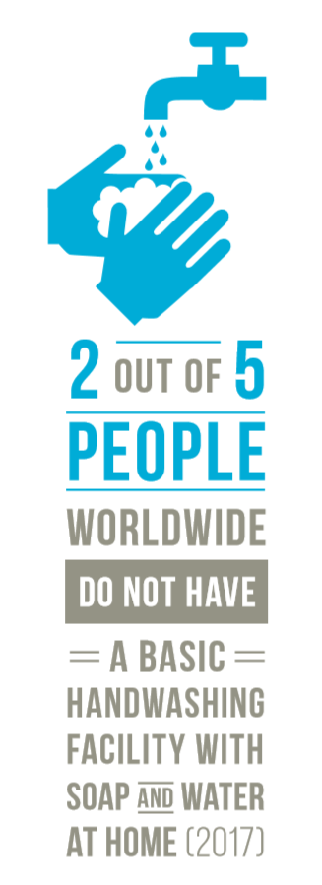
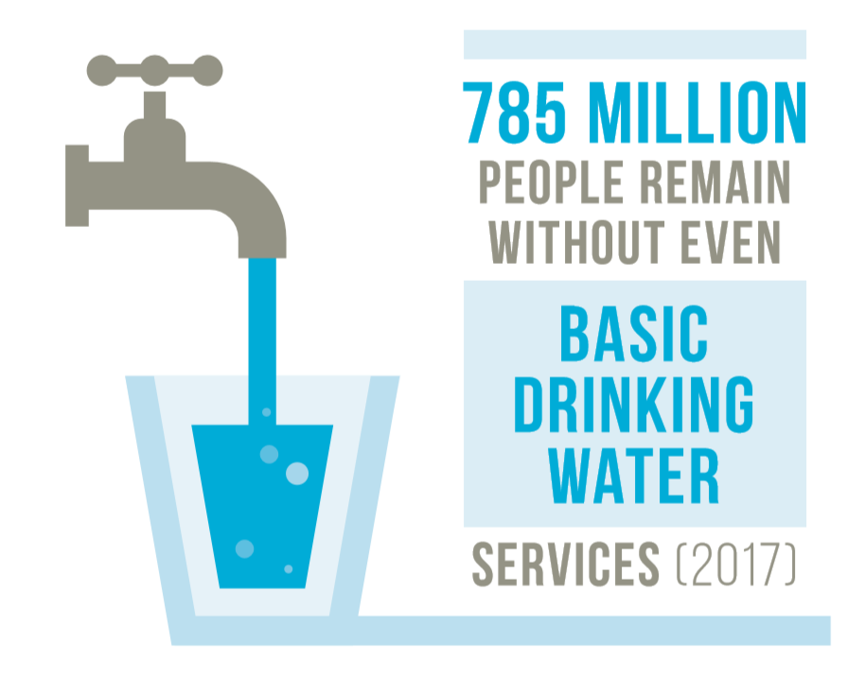
Group exercise: How do gender issues apply ?
Are women’s and men’s, girls’ and boys’ roles different in managing water in the household? In society? How?
Could there be more equality in the way water resources are managed and how decisions are made? What would be gained from a more equitable situation?
Infographics from (UN, 2019) SDG Report 2019
Notes:
Facilitator:
Break the trainees into smaller discussion groups to consider how gendered roles (the different social and cultural expectations of women and girls, men and boys, could affect their relationship to water management.
Each small group takes this one sector only, to discuss, not all of them.
Instruct groups to look first through a gender lens.
Once they have done this, take a few minutes to drill deeper into sub-groups of females and of males who experience particular opportunities for leadership, access and control in this sector already, and who experience particular development gaps (lack of decision-making, access and control) in this sector (especially at individual, household and community level).
At the end of small group discussion, invite each small group to report their key points back to the larger group.

Slide 15
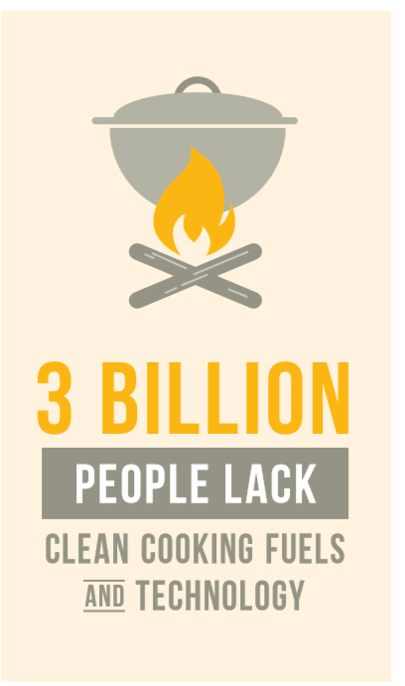
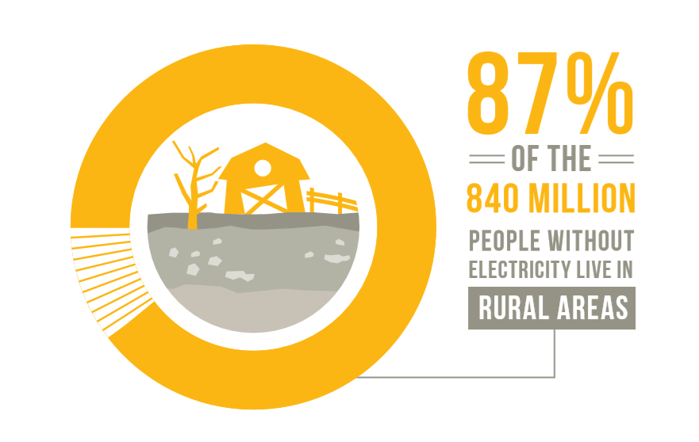
Group exercise: How do gender issues apply ?
Are women’s and men’s, girls’ and boys’ roles different in managing energy in the household? In society? How?
Could there be more equality in the way energy resources are managed and how decisions are made? What would be gained from a more equitable situation?
Infographics from (UN, 2019) SDG Report 2019
Notes:
Facilitator:
Break the trainees into smaller discussion groups to consider how gendered roles (the different social and cultural expectations of women and girls, men and boys, could affect their relationship to energy.
Each small group takes this one sector only, to discuss, not all of them.
Instruct groups to look first through a gender lens.
Once they have done this, take a few minutes to drill deeper into sub-groups of females and of males who experience particular opportunities for leadership, access and control in the energy sector already, and who experience particular development gaps (lack of decision-making, access and control) in this sector (especially at individual, household and community level).
At the end of small group discussion, invite each small group to report their key points back to the larger group.
Below are further data from the United Nations 2019 SDG update on populations’ electricity access by region, for information, if desired.
Proportion of population with access to electricity, 2017:
Sub-Saharan Africa: 44%
Oceania except Australia and New Zealand: 63%
Central and Southern Asia: 91%
North Africa and West Asia: 95%
East and Southeast Asia: 98%
Latin America and Caribbean: 98%
Europe and North America: 100%
Australia and New Zealand: 100%
World: 89%

Slide 16
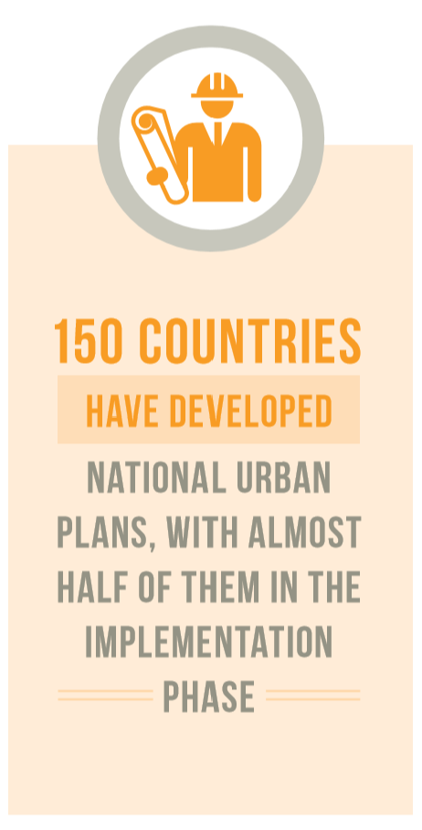
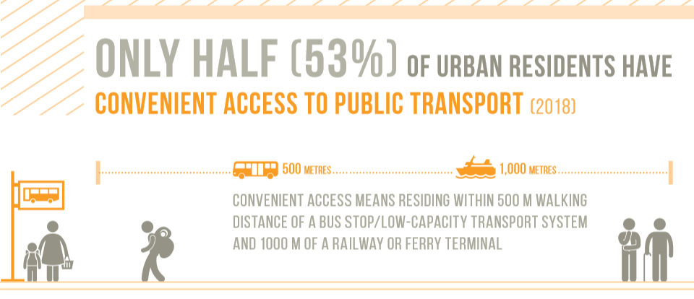
Group exercise: How do gender issues apply ?
Are women’s and men’s, girls’ and boys’ roles different in decision-making about city planning and municipal services?
Could there be more equality in the way cities are managed and how decisions are made? What would be gained from a more equitable situation?
Infographics from (UN, 2019) SDG Report 2019
Notes:
Facilitator:
Break the trainees into smaller discussion groups to consider how gendered roles (the different social and cultural expectations of women and girls, men and boys, could affect their experience of living and working in cities.
Each small group takes this one sector only, to discuss, not all of them.
Instruct groups to look first through a gender lens.
Once they have done this, take a few minutes to drill deeper into sub-groups of females and of males who experience particular opportunities for leadership and access to municipal services and free and safe use of city spaces, and those who experience particular development gaps (lack of decision-making, access and use of municipal services, city spaces).
At the end of small group discussion, invite each small group to report their key points back to the larger group.

Slide 17
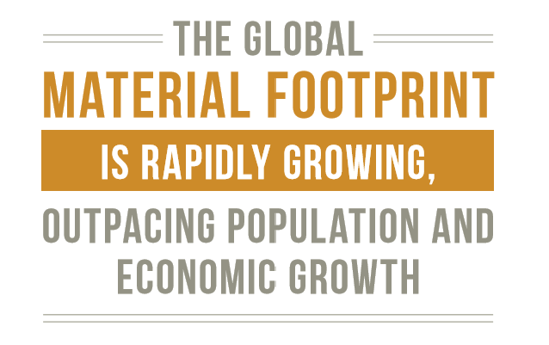
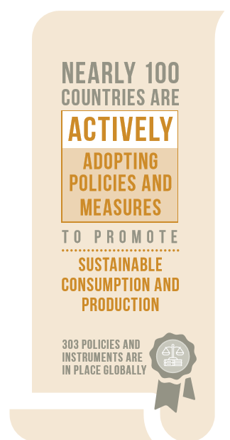
Group exercise: How do gender issues apply ?
Are women’s and men’s, girls’ and boys’ roles different in managing the goods and services consumed by the household? In business, government, supply chains in business – all of which affect societies’ consumption of material resources? How?
Could there be more equality in the way consumption decisions are made? What would be gained from a more equitable situation?
Infographics from (UN, 2019) SDG Report 2019
Notes:
Facilitator:
Break the trainees into smaller discussion groups to consider how gendered roles (the different social and cultural expectations of women and girls, men and boys, could affect their experience of sustainable use of material resources, production and consumption.
Each small group takes this one sector only, to discuss, not all of them.
Instruct groups to look first through a gender lens.
Once they have done this, take a few minutes to drill deeper into sub-groups of females and of males who experience particular opportunities for leadership, access and control of the use of material resources in the economy, and those who are at the forefront of sustainable production and consumption. Do the spheres of control differ for different groups of women and girls, men and boys? What opportunities for individual choice and for broader leadership are there, among these different groups of people?
At the end of small group discussion, invite each small group to report their key points back to the larger group.
NOTE: for countries where this exercise will take place and there are coastal environments/marine resources, then a further slide and related breakout group could be formed around SDG14: Life Below Water: Conserve and sustainably use the oceans, sea and marine resources for sustainable development – I will add this to the pack later. It is not relevant for Ethiopia and Nepal, where this pack will first be trialled.

Slide 18
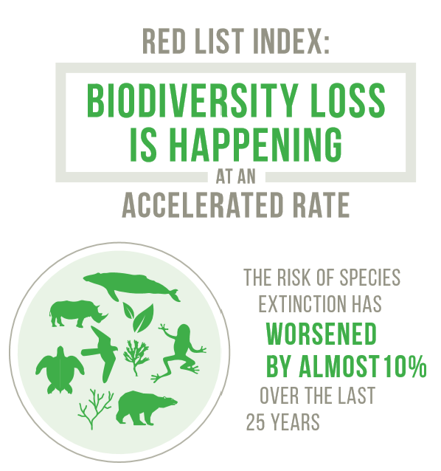
Group exercise: How do gender issues apply ?
Are women’s and men’s, girls’ and boys’ roles different in managing biodiversity and other land- and freshwater-based resources? How?
Could there be more equality in the way these resources are owned/accessed/managed and how decisions are made? What would be gained from a more equitable situation?
Infographics from (UN, 2019) SDG Report 2019
Notes:
Facilitator:
Break the trainees into smaller discussion groups to consider how gendered roles (the different social and cultural expectations of women and girls, men and boys, could affect their relationship to land management, land- and freshwater-based biodiversity and terrestrial ecosystems
Each small group takes this one sector only, to discuss, not all of them.
Instruct groups to look first through a gender lens.
Once they have done this, take a few minutes to drill deeper into sub-groups of females and of males who experience particular opportunities for leadership, access and control in the land sector already, and who experience particular development gaps (lack of decision-making, access and control) in this sector (especially at individual, household and community level).
At the end of small group discussion, invite each small group to report their key points back to the larger group.

Slide 19
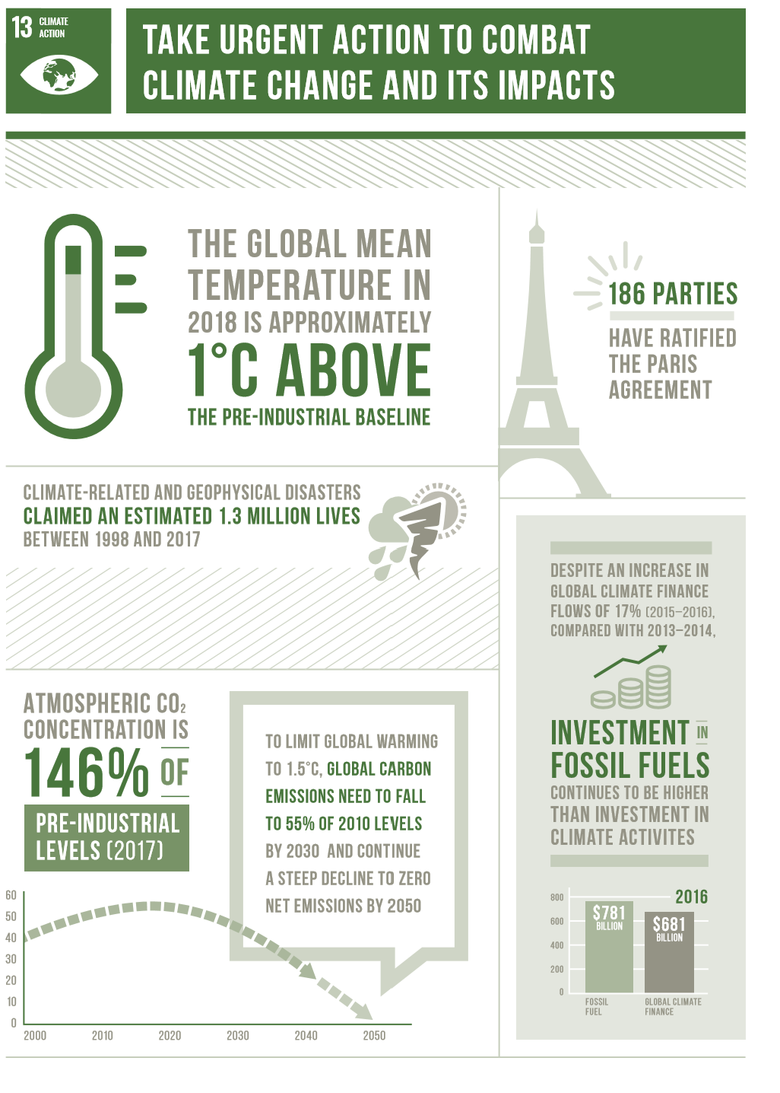
If gender issues cut across the SDGs and many sectors and aspects of human development and planetary health… …so also climate change is a cross-cutting issue
Notes:
Climate change also has its own dedicated Sustainable Development Goal: Goal 13
Like gender (the need for gender responsive approaches), climate change will affect the attainment of many of the SDGs.
Climate change cuts across many forms of development.

Slide 20
How climate change is affecting the region and what it means for people’s development prospects
Notes:
Facilitator: this placeholder slide marks where you should use the appropriate presentational slides and group exercise slides for your region:
In this case for Ethiopia – see Africa exercise pack (separate slide pack) and use it to guide the group exercise if you have time.

Slide 21
Introducing the international framework for managing disaster risk: the Sendai Framework – and how to think about climate-related risk and different people’s vulnerabilities
Calibri
Image – Sendai, Albert, flickr

Slide 22
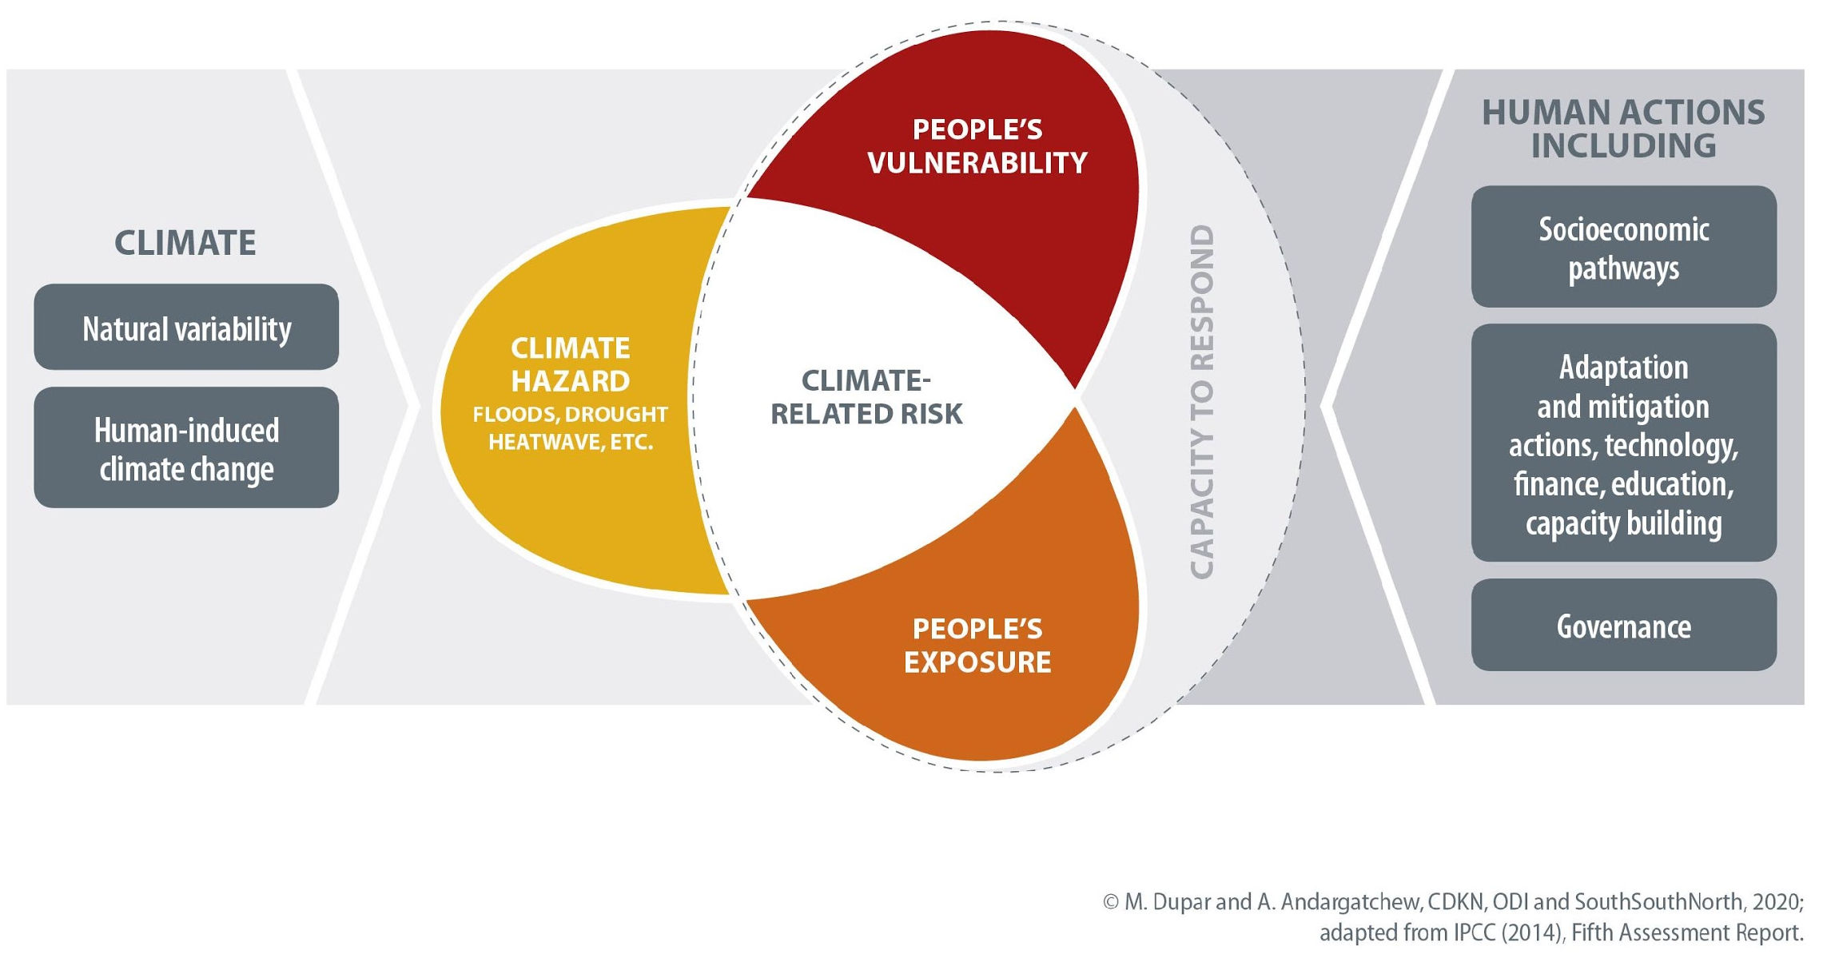
Hazard, risk and vulnerability

Slide 23
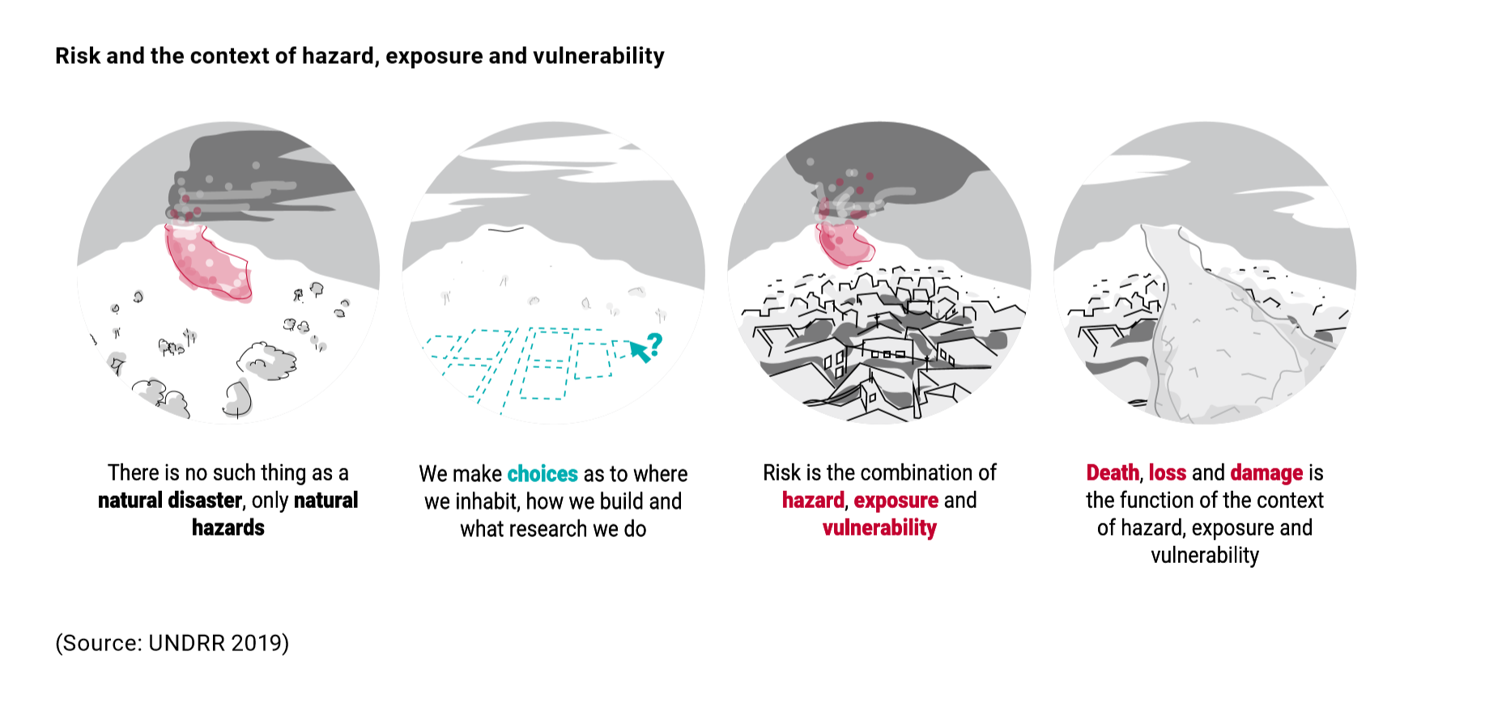
What turns a ‘hazard’ into a ‘disaster’?
Climate is one of the hazards that can drive disaster risk
Notes:
Disasters are commonly defined as ‘a serious disruption of the functioning of a community or a society at any scale due to hazardous events (such as a drought or earthquake) interacting with the underlying vulnerability, exposure and capacity contexts of various groups, and the infrastructure, services and ecosystems they rely on, leading to one or more of the following: human, material, economic and environmental losses and impacts’ (adapted from UNDRR, 2017). It is the intersection of multiple factors that turns a climate-related or other natural hazard into a disaster.

Slide 24
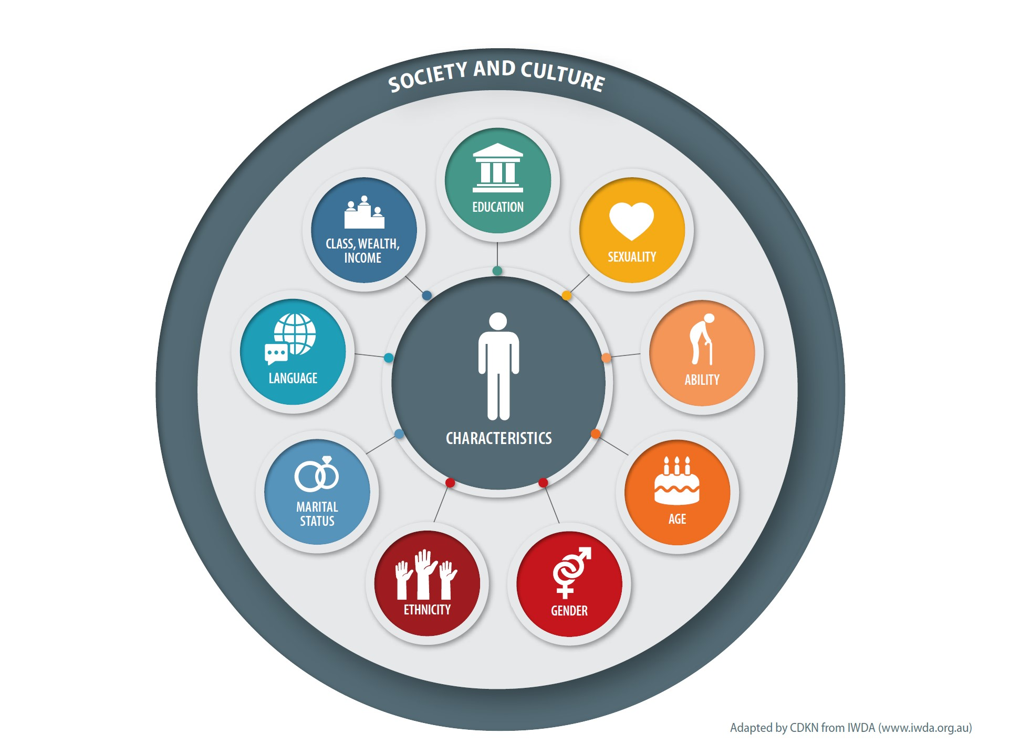
Our different characteristics not only create certain vulnerabilities in social and cultural context but give us strengths too (skills, talents, knowledge)

Slide 25
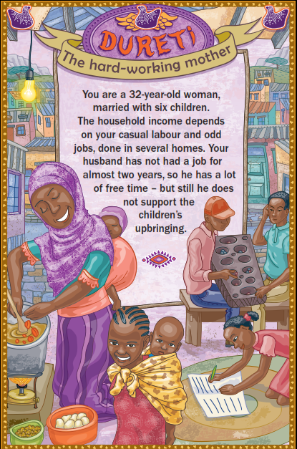
Group exercise: Hazard, risk and vulnerability
The climate hazard in this story is drought.
How might Dureti be exposed to drought?
How might Dureti be vulnerable to drought?
What knowledge, skills, talents might she have to share with others?

Slide 26
Sendai Framework for Disaster Risk Reduction (2015-2030)
What | Reduce disaster-related deaths and losses to physical, economic, social, cultural , environmental assets of people, businesses, communities and countries by 2030 through the implementation of seven targets over four priority areas (next slide)
When | 2015-2030 commitment period
Who | 187 country representatives adopted it at the World Conference on DRR As a non-legally-binding or ‘soft law’ agreement, there is no ratification process
How | Countries report on progress against 38 agreed indicators via the Sendai Monitor process (first implementation period for this system was 2018-19). There are also periodic regional meetings where countries and agencies share progress, e.g. biennial Asian Ministerial Conference on DRR, Africa-Arab Platform on DRR, Latin America Regional Platform

Slide 27
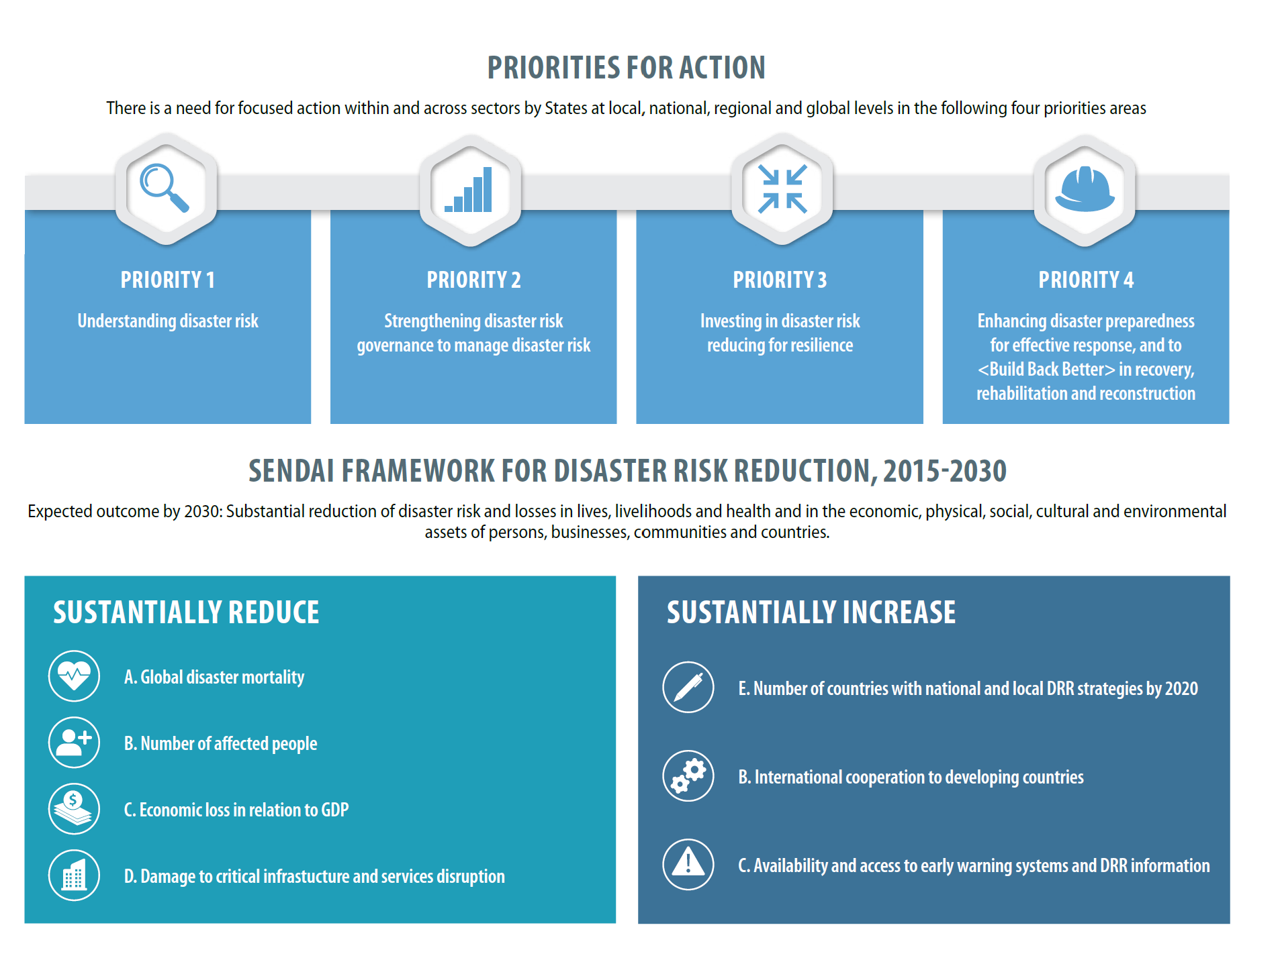
Notes:
(Note that in this version of the infographic there is a small typo in the bottom right that we will get fixed: it should read
F. International cooperation…
G Availability and access…

Slide 28
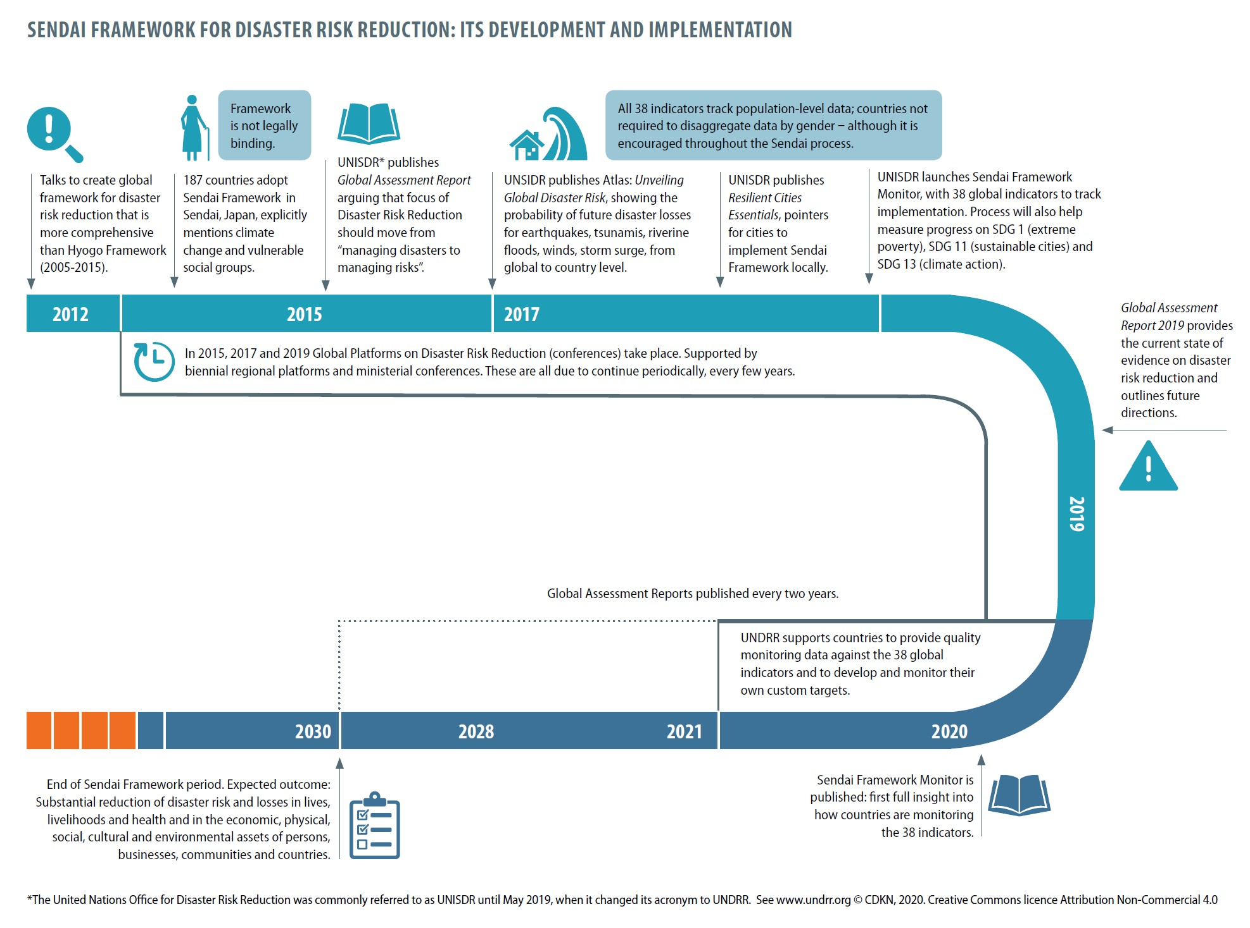
Sendai Framework for Disaster Risk Reduction
Notes:
Sendai DRR Framework speaking points to accompany the timeline infographic:
What is the United Nations disaster risk agency called? It has always been called the United Nations Office for Disaster Risk Reduction, but before May 2019 the acronym used was UNISDR (the ‘IS’ stood for a previous reference to the ‘international strategy’; and after May 2019, the more straightforward acronym UNDRR began to be officially used. See www.undrr.org
What is a disaster? The UNISDR definition of a disaster is: “A serious disruption of the functioning of a community or a society involving widespread human, material, economic or environmental losses and impacts, which exceeds the ability of the affected community or society to cope using its own resources.”
From 2012: Three years of talks to create global framework for disaster risk reduction that is stronger, more comprehensive than Hyogo Framework (2005-2015). It was thought that the Hyogo Framework had too many shortcomings, by focusing too much on managing disasters, that is, the negative impacts (losses etc) suffered by societies, whereas the new focus should be more on avoiding disasters by reducing risks in the first place.
March 2015: 187 countries adopt Sendai Framework for Disaster Risk Reduction (DRR) in Sendai, Japan. – at the World Conference on DRR (https://www.undrr.org/news/world-conference-adopts-new-international-framework-disaster-risk-reduction-after-marathon)
The Sendai Framework addresses many different types of hazards that may cause disasters. It includes climate/extreme weather events as one of the hazards with the potential to cause disaster, as follows:
“Addressing climate change as one of the drivers of disaster risk, while respecting the mandate of the United Nations Framework Convention on Climate Change, represents an opportunity to reduce disaster risk in a meaningful and coherent manner throughout the interrelated intergovernmental processes.” – Sendai Framework, point 13, available online at: https://www.preventionweb.net/files/43291_sendaiframeworkfordrren.pdf (Other ‘natural hazards’ are, for instance, earthquakes, volcanic eruptions, tsunamis.)
Framework is not legally binding and does not require countries to ratify it. As such, it’s a ‘soft law’ instrument. (This is different from the UNFCCC’s Paris Agreement, the core text of which is a legally binding agreement and was submitted for ratification of the Parties.)
2015: UNISDR publishes Global Assessment Report arguing that focus of DRR should move from “managing disasters to managing risks”. The full title of the report is Global Assessment Report: The Future of Disaster Risk Management. The Global Assessment Reports are publications that are issued every two years by the UNISDR/UNDRR.
2017: UNSIDR publishes Atlas: Unveiling Global Disaster Risk, showing the probability of future disaster losses for earthquakes, tsunamis, riverine floods, winds, storm surge. These show data at global level and the user can drill down to national level resolution data. The Atlas is published online in an interactive format that makes it easy to select or extract and view the data. (This was the Global Assessment Report 2017.)
2017: UNISDR publishes ‘Essentials’, pointers for cities to implement Sendai Framework locally. For more information about the Resilient Cities ‘Essentials’ guidance, visit https://www.unisdr.org/campaign/resilientcities/toolkit/article/the-ten-essentials-for-making-cities-resilient
2017 UNISDR launches Sendai Framework Monitor, with 38 global indicators to track implementation. Process will also help measure progress on SDG 1(extreme poverty), SDG 11 (sustainable cities) and SDG 13 (climate action).
The Sendai Framework Monitor was developed in three phases, following recommendations of the Open Ended Intergovernmental Working Group (OEIWG): starting with the ‘Global Targets and Indicators’ launch and the reporting process. The ’Custom Targets and Indicators’ were then rolled out, providing countries a fully adaptable monitoring mechanism to support their respective national disaster risk reduction strategy implementation. Progress is demonstrated by targets and indicators customized for their national and local context. The ‘Analytics’ module was developed in the third phase and enables better data analysis to comprehend how countries are achieving the Sendai Framework targets and indicators.
All 38 indicators track population and country-level data. However, the indicators are not gender-disaggregated which means that it falls upon country governments and agencies to themselves commit and follow through on analysing gender-disaggregated data. This is an important point, because – as we will see later in our slides and training module, women tend to suffer greater losses and greater secondary impacts (e.g. gender based violence) from disasters than men and boys do.
(Information above derived from: 2020-21 Work Programme of UNDRR https://www.unisdr.org/files/68235_undrrworkprogramme20202021.pdf)
A further milestone is the UNISDR 2018 economic study (not shown on the infographic timeline but included in the notes for the sake of completeness) October 2018: UNISDR publishes data showing dramatic rise of 151% in direct economic losses from climate-related disasters over 20 years (compared to previous 20 year period) https://www.preventionweb.net/publications/view/61119
2019: Global Assessment Report 2019 reports on Sendai Framework implementation and advises on how to recognise, measure and monitor risk, and move towards systemic risk governance. It includes case studies of how countries integrate DRR with climate change adaptation and development planning.
2020 Sendai Framework Monitor is published: the first full insight into how countries are applying the monitoring framework. As we have noted above, though, the monitoring framework fails to require disaggregation of data by gender.
2020-2021: UNDRR supports countries to provide quality monitoring data against the 38 global indicators and to develop and monitor their own custom targets.
2030: Sendai Framework period ends

Slide 29
Natural disasters affect women and men differently
Year | Event | Proportion of fatalities that were female
2004 | Tsunami – Aceh, Indonesia | 77%
2004 | Tsunami- Tamil Nadu, India | 73%
2008 | Cyclone Nargis - Myanmar | 61%
2009 | Tsunami – Tonga and Samoa | 70%
2014 | Solomon Islands Floods | 96% & children
2014 | Ebola Outbreak (SL, Lb, Guinea) | 55-60%
2015 | Nepal Earthquake | 55%
2015 | Myanmar Floods | 42%
2016 | Fiji Cyclone Winston | 50% (92% iTaukei)
Notes:
Source of this data:
Cecilia Aipira - Disaster Risk Reduction Regional Advisor for Africa – UNDP @ BRACED Winter School, July 2019, Cape Town.

Slide 30
Measuring difference
The Sendai Framework itself mentions the importance of disaggregating data:
Sendai Framework Priority 1: Understanding disaster risk
(Item 24) Nationally and locally, “…it is important:
a) To promote the collection, analysis, management and use of relevant data and practical information and ensure its dissemination, taking into account the needs of different categories of users, as appropriate;…..
n) To apply risk information in all its dimensions of vulnerability, capacity and exposure of persons, communities, countries and assets, as well as hazard characteristics, to develop and implement disaster risk reduction policies…”
However, the 38 indicators of the Sendai Framework Monitor against which governments must report, do not require gender-disaggregated data
It is up to individual governments and disaster agencies to collect disaggregated data – for gender and other key variables that influence vulnerability and inclusion/exclusion

Slide 31
Acting on difference
The Sendai Framework text recognises that disaster preparedness and risk reduction efforts should explicitly be geared to empowering and assisting those disproportionately affected by disasters
Sendai Framework Priority 3: Investing in disaster risk reduction for resilience
“(item 30) Nationally and locally…to achieve this, it is important:
(j) To strengthen the design and implementation of inclusive policies and social safety-net mechanisms, including through community involvement, integrated with livelihood enhancement programmes, and access to basic health-care services, including maternal, newborn and child health, sexual and reproductive health, food security and nutrition, housing and education, towards the eradication of poverty, to find durable solutions in the post-disaster phase and to empower and assist people disproportionately affected by disasters”
Notes:
Sendai Framework, p19
https://www.unisdr.org/files/43291_sendaiframeworkfordrren.pdf
There is also an item, following, under investment, that draws attention to those with chronic disease
(k) People with life-threatening and chronic disease, due to their particular needs, should be included in the design of policies and plans to manage their risks before, during and after disasters, including having access to life-saving services;

Slide 32
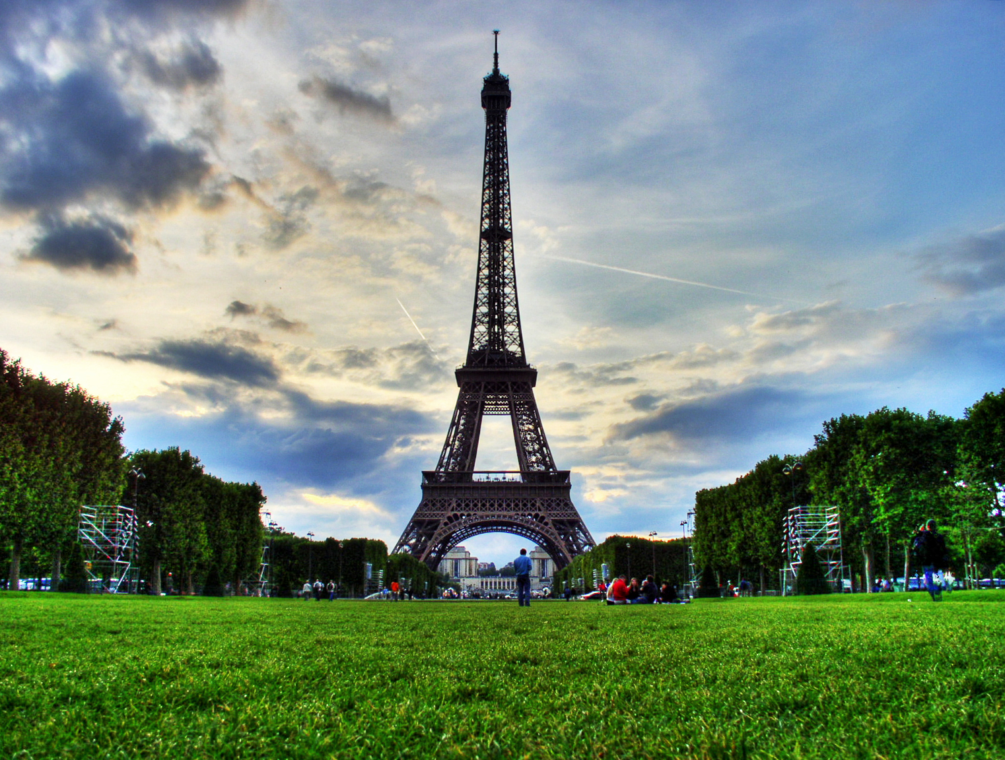
Introducing the international framework for climate ambition: the Paris Agreement – and how it links to gender and social inclusion
Image – Paris, Alfi Ianni, flickr

Slide 33
UN Framework Convention on Climate Change (UNFCCC) Paris Agreement
What | Climate change mitigation (mitigation of greenhouse gas emissions) Climate change adaptation Loss and damage Means of implementation: finance, technology transfer, capacity building
When | 2015
Who | 196 country representatives approved it 185 have ratified or acceded to it
How | Each country must plan and report regularly. Nationally Determined Contributions (voluntary commitments, annex to the Paris Agreement) outline what all countries will do to reduce or avoid greenhouse gas emissions. All developing countries have stressed their climate change adaptation needs as well. No backsliding on voluntary targets.

Slide 34
Gender and social inclusion in the Paris Agreement
“Climate change is a common concern of humankind, Parties should, when taking action to address climate change, respect, promote and consider their respective obligations on human rights, the right to health, the rights of indigenous peoples, local communities, migrants, children, persons with disabilities and people in vulnerable situations and the right to development, as well as gender equality, empowerment of women and intergenerational equity” (UNFCCC, 2015: 2)
Notes:
The Paris Agreement acknowledges that: Climate change is a common concern of humankind, Parties should, when taking action to address climate change, respect, promote and consider their respective obligations on human rights, the right to health, the rights of indigenous peoples, local communities, migrants, children, persons with disabilities and people in vulnerable situations and the right to development, as well as gender equality, empowerment of women and intergenerational equity (UNFCCC, 2015: 2). It also recognises the need to take into consideration: Vulnerable groups, communities and ecosystems, and should be based on and guided by the best available science and, as appropriate, traditional knowledge, knowledge of indigenous peoples and local knowledge systems, with a view to integrating adaptation into relevant socioeconomic and environmental policies and actions, where appropriate (UNFCCC, 2015: 9).

Slide 35
Gender and social inclusion in the Paris Agreement
Article 7 on adaptation is more explicit:
“Parties acknowledge that adaptation action should follow a country-driven, gender-responsive, participatory and fully transparent approach, taking into consideration vulnerable groups, communities and ecosystems, and should be based on and guided by the best available science and, as appropriate, traditional knowledge, knowledge of indigenous peoples and local knowledge systems, with a view to integrating adaptation into relevant socioeconomic and environmental policies and actions, where appropriate.”

Slide 36
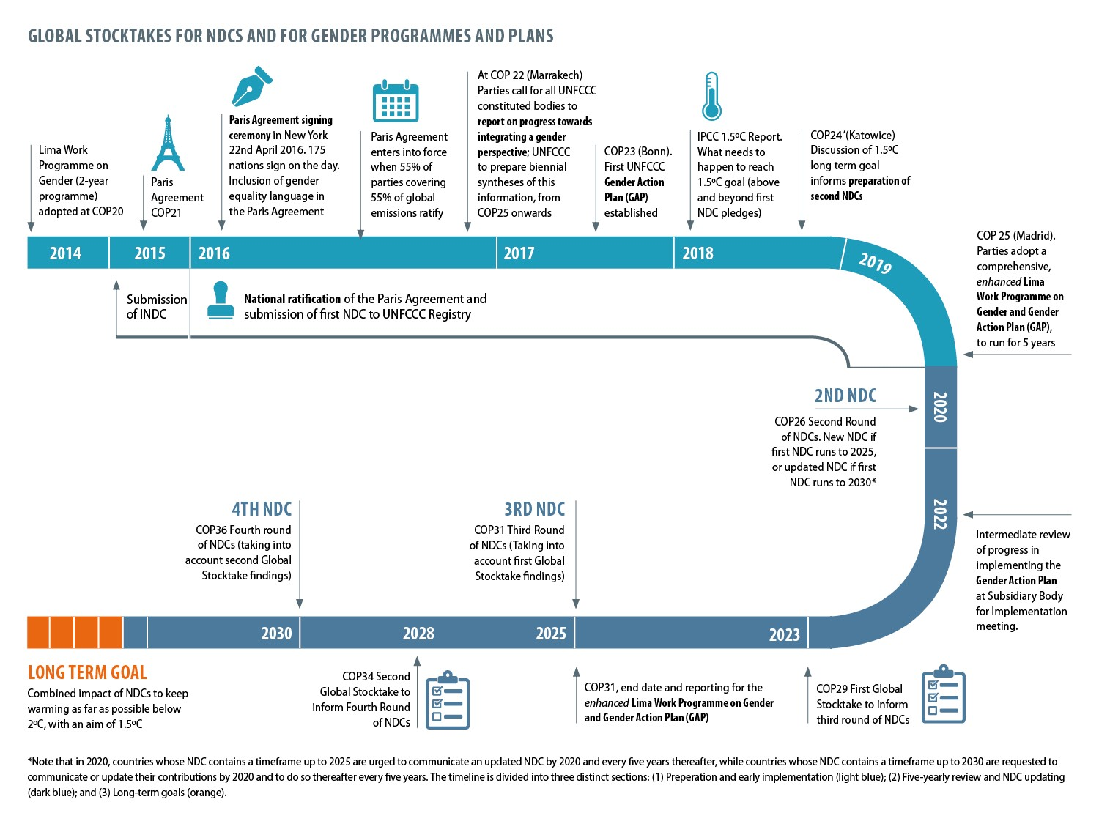
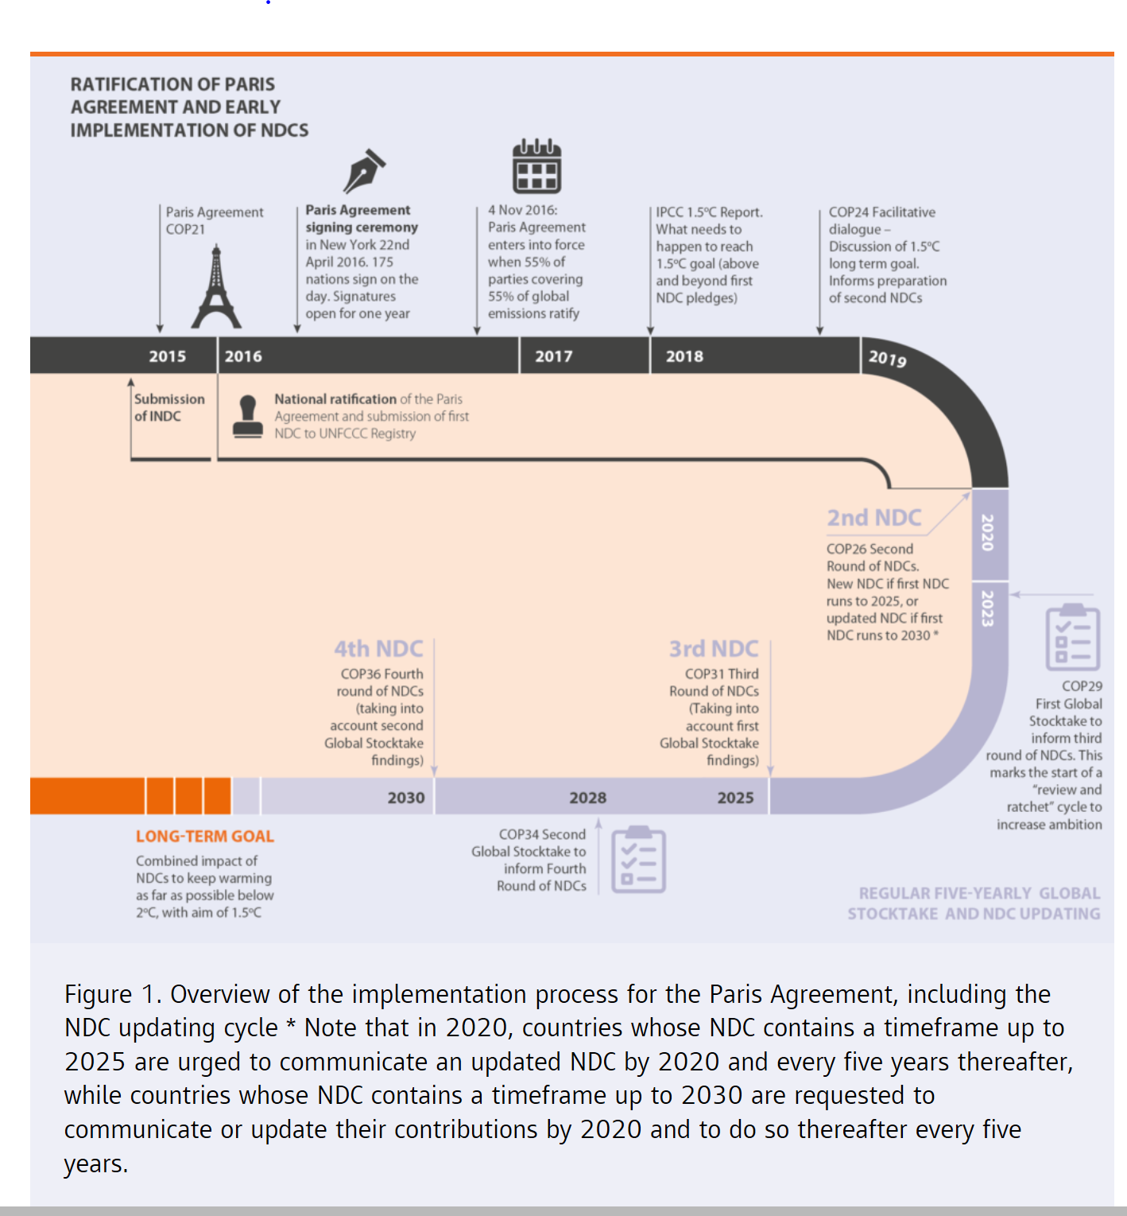
Timeframe for ‘global stocktake’ on Paris Agreement and NDC updates www.cdkn.org/ ndc-guide

Slide 37
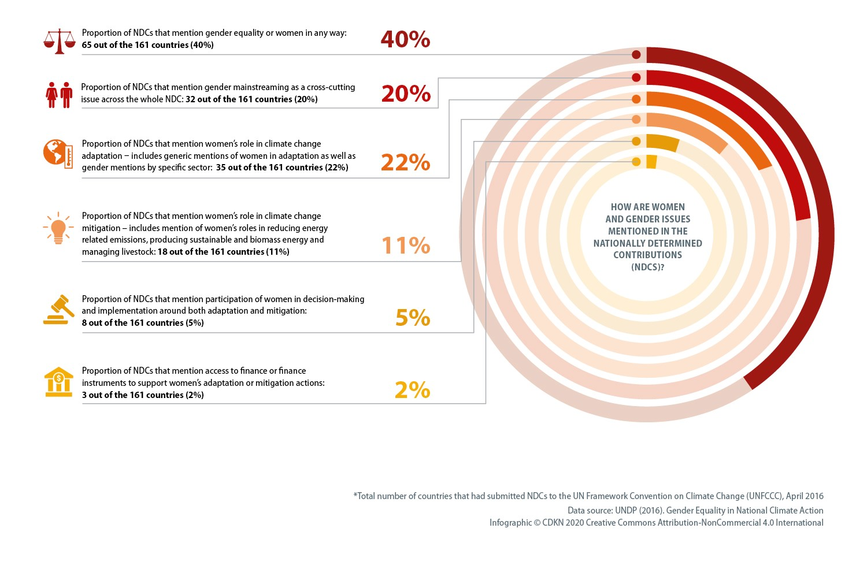
Need for more specific targeting in the NDCs
Areas or sectors where women are referenced within NDCs
Source: Gender Equality in National Climate Action: Planning for Gender-Responsive Nationally Determined Contributions
https://www.undp.org/content/undp/en/home/librarypage/womens-empowerment/gender-equality-in-national-climate-action--planning-for-gender-.html
Notes:
So why gender equality in NDCs
Out of 161 NDCs submitted, as of April 2016, 40% countries made at least one reference to gender equality or women.
A critical oversight in the INDC process becomes an opportunity for enhancing the NDC by 2020
Integration of gender equality into climate change policies is critical to successful climate action. We cannot build sustainable and resilient societies without addressing structural constraints to women’s empowerment and gender equality.
And without taking into account that women play important roles in core sectors affected by climate change and yet are not always actively participating in decision making processes equally as men. For instance, in agriculture, women comprise an average of 43 percent of the agricultural work force in developing countries.
But globally, less than 15 percent of all landholders are women. The distribution of women landholders ranges from 5 percent in Middle East and North Africa to 18 percent in Latin America and the Caribbean.
In livestock management, they make up two thirds of the world’s 600 million small livestock managers. In energy, women in Africa are responsible for managing 90% of all household water and fuel-wood needs.
In a study done in 2016, UNDP found that only 40% of countries made at least one reference to gender equality or women in their INDCs.
35 countries referred to women’s role in adaptation but without specific mention of key sectors or women’s roles, only 18 countries recognized the role of women in mitigation primarily in relation to energy emissions, sustainable or biomass energy, and livestock.
Countries indicated that some of the gaps to better integrate gender were:
the emerging coordination or lack of coordination between climate change units/ ministries of environment and gender institutions
The lack of not readily available gender information during the development of the INDCs
The limited participation of women’s organizations and gender machineries within the climate change process.
As a result there was an insufficient, non-specific inclusion of gender equality.
The NDC process, which requires an alignment of climate change efforts at the national level, can open the opportunity for countries to advance gender equality and women’s empowerment into climate action more comprehensively.
and to improve, embed and start building the blocks to ensure gender integration is well addressed for future enhancement cycles of the NDCs.

Slide 38
Parties to the UNFCCC agreed a 5-year Enhanced Lima Work Programme on Gender and its Gender Action Plan, 2019-2024 (Decision 3/CP.25)
Lima Enhanced Work Programme on Gender
Long-term, open ended action
Secretariat for regular functions
Gender action plan as an annex
Review of progress and discussion of further actions to be undertaken in November 2024
Gender Action Plan
5 priority areas with objectives (next slide)
20 activities
35 outputs
Intermediate review of implementation in June 2022
Notes:
The Gender Action Plan under the Lima WP on Gender https://unfccc.int/resource/docs/2017/cop23/eng/11a01.pdf#page=13
The Gender Action Plan aims for both an equal UNFCCC itself (climate negotiations) and for infusing gender responsive approach through the entire programme to support the Paris Agreement.
Please turn to the next slide for a visual presentation of what is contained in the Gender Action Plan.
The Lima Enhanced Work Programme on Gender and Gender Action Plan full texts are available in all United Nations languages, including English, Spanish and French, at: https://unfccc.int/documents/204536
In the full text, you can see the 35 outputs listed out.

Slide 39
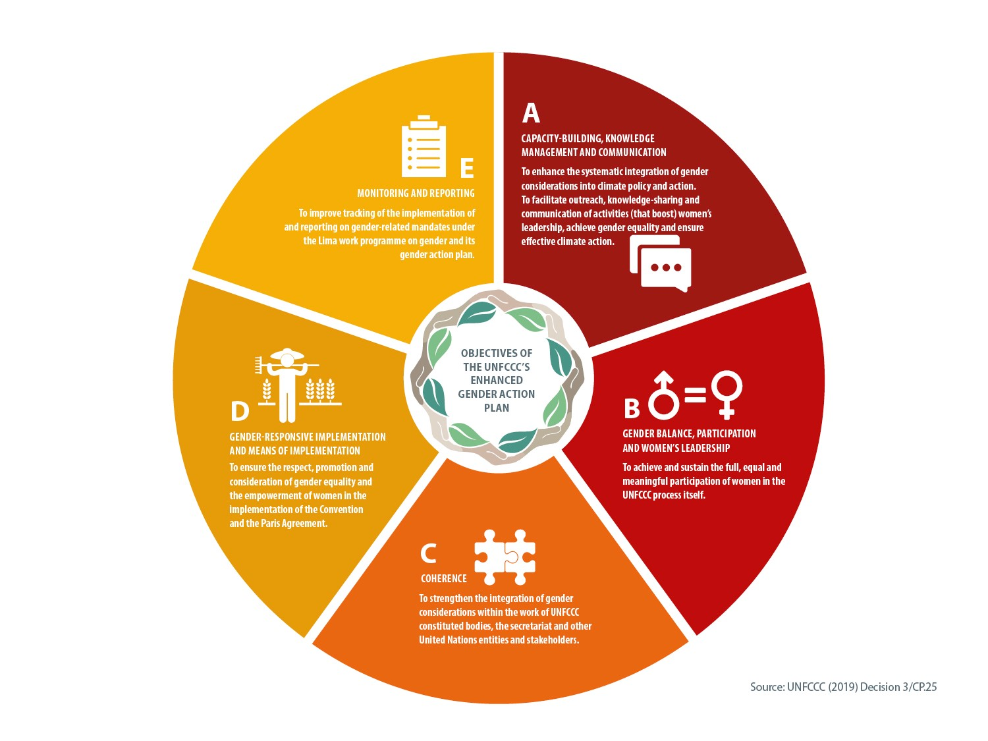
Notes:
The Gender Action Plan 2019-2024 calls for…
A. Capacity-building, knowledge-sharing and communication The GAP seeks to enhance the understanding and expertise of stakeholders on the systematic integration of gender considerations and the application of such understanding and expertise in the thematic areas under the Convention and the Paris Agreement and in policies, programmes and projects on the ground.
B. Gender balance, participation and women’s leadership. The GAP seeks to achieve and sustain the full, equal and meaningful participation of women in the UNFCCC process.
C. Coherence The GAP seeks to strengthen the integration of gender considerations within the work of UNFCCC bodies, the secretariat and other United Nation entities and stakeholders towards the consistent implementation of gender-related mandates and activities.
D. Gender-responsive implementation and means of implementation. The GAP aims to ensure the respect, promotion and consideration of gender equality and the empowerment of women in the implementation of the Convention and the Paris Agreement. E. Monitoring and reporting The GAP seeks to improve tracking in relation to the implementation of and reporting on gender-related mandates under the UNFCCC.
The Lima Enhanced Work Programme on Gender and Gender Action Plan full texts are available in all United Nations languages, including English, Spanish and French, at: https://unfccc.int/documents/204536
In the full text, you can see the 35 outputs listed out – as they pertain to the five action areas, above.
Also see https://unfccc.int/workshop-on-gender-and-climate-change-june-2019

Slide 40
How action on gender is generally referenced in global policy frameworks
Generally understood in the global policy frameworks to be specific and special action needed to tackle sex-based discrimination against women and girls
- Mention women and girls specifically
- When we talk about ‘gender’ we are talking about the social relations between women and men and people of other gender identities
- The global policy frameworks still need to ‘catch up’ as regards broader definitions of gender and sexual identity, their place in society and implications for development, climate action, disaster risk reduction
- Data is poor on people of different gender identities in a climate and development and disaster context. We will revisit this issue in later modules and understand why it’s important to disaggregate data and monitor the development progress of different groups.

Slide 41
www.cdkn.org
@cdknetwork
Notes:
Facilitator: insert your name and email/contact here

