Slide 1
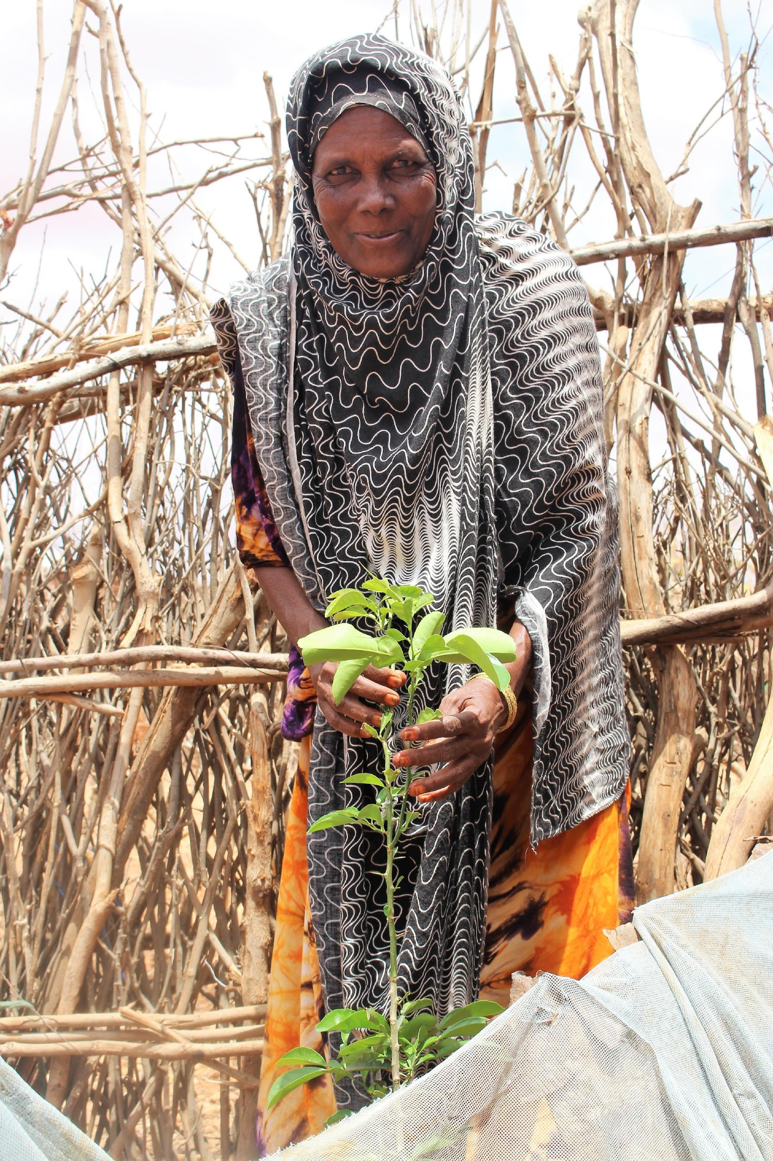
Case study: Achieving both female empowerment and more climate resilience in remote, rural Ethiopia
Market Approaches to Resilience (MAR) project extended credit and savings to remote communities, providing means to diversify assets and livelihoods, for climate resilience.
It had specific targets for women’s participation including disadvantaged sub-groups of women (pastoralists).
Giving microfinance to women created ‘multiplier effect’ – boosting wellbeing of women themselves and also of families.
To consolidate the project’s short-term achievements, it was essential to work on strengthening the enabling environment: e.g. financial institutions’ willingness to serve poor women and work with pastoralists.
Notes:
This case study example references the ‘CDKN Essential’ produced for this training pack by Farm Africa and CDKN By Medhanit Gebremichael and Befikadu Ayele, Farm Africa; and Arsema Andargatchew and Mairi Dupar, CDKN ‘Rural Ethiopian women diversify livelihoods and boost entire communities’ climate resilience
(2020)
The Market Approaches to Resilience project extended credit and savings facilities to communities in remote rural areas of Ethiopia, providing them with the means to diversify their assets and livelihoods. This helped to buffer them from climate-related stresses and shocks.
The communities were lacking in the most basic services, and people’s survival was precarious. Each week’s food and water for people and livestock depended on unpredictable rains and a degraded natural environment.
The MAR project set specific targets for women’s participation in the programme, reaching out intentionally to women beneficiaries, some of whom suffered additional forms of social disadvantage, such as widowhood.
The project found that extending microfinance services to women in these marginal communities created a powerful ‘multiplier effect’ – not only considerably improving the wellbeing of the women themselves but also of their families.
To consolidate the project’s short-term achievements, the MAR team found it was essential to work simultaneously on strengthening the enabling environment. This ensured that project gains would be locked in, for the longer term.
One of the enabling factors was financial institutions’ willingness to serve poor women and work with pastoralists.

Slide 2
Case study: Achieving both female empowerment and more climate resilience in remote, rural Ethiopia
“In the past I constantly quarrelled with my husband. Now, whenever our child is sick he says do what you can and take him for treatment. Nowadays, I am doing well, if I face any problem, I would be ready to pay and I have already managed to tackle my problems.” - Muna Mohammed, Market Approaches to Resilience participant
Notes:
This case study example references the ‘CDKN Essential’ produced for this training pack by Farm Africa and CDKN By Medhanit Gebremichael, Farm Africa; and Arsema Andargatchew and Mairi Dupar, CDKN
‘Rural Ethiopian women diversify livelihoods and boost entire communities’ climate resilience
(forthcoming, 2020)
Quotes from the research, slide above.

