Slide 1
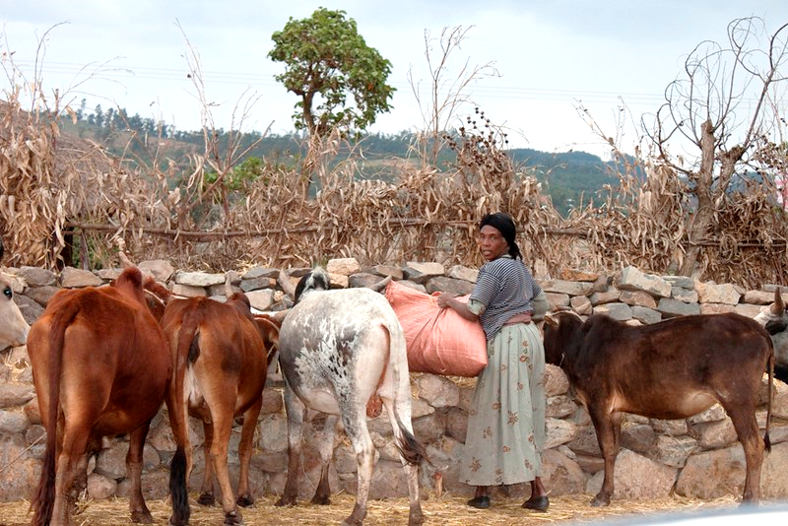
Committing equity-responsive budgets to climate programmes and projects
Notes:
Image credit: ILO, flickr

Slide 2
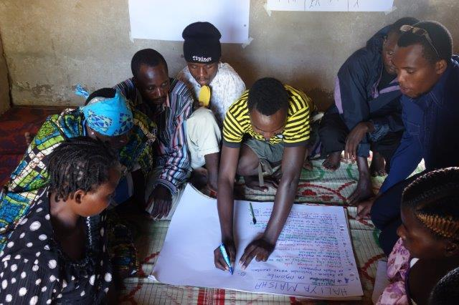
In this module, you will learn
Frameworks for allocating resources to achieve climate-smart gender-responsive objectives
How you could apply these frameworks to your programmes and projects

Slide 3
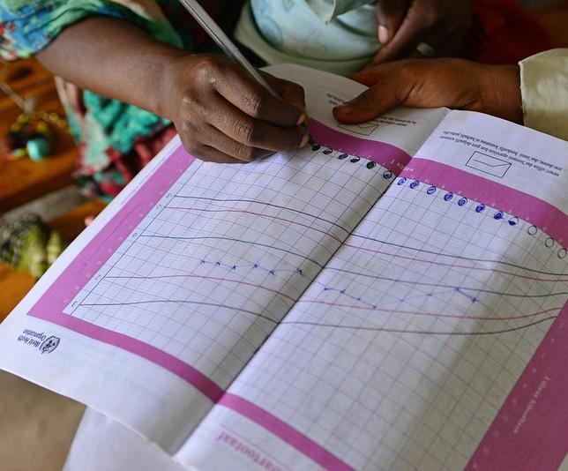
Defining a gender responsive budget
A gender responsive budget is a budgeting process to translate gender objectives into financial commitments
Assess the project budget through a gender lens: identify the impact of the various expenditures on women and men with the aim of creating more equitable delivery of services (outcomes) and more equitable opportunities.
Notes:
Image credit: UNICEF Flickr

Slide 4
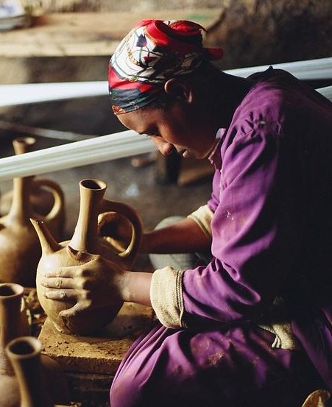
Creating a gender responsive budget
Ensure that there is sufficient flow of resources to activities that address women's needs and perspectives and reduce the structural barriers that impede their participation.
Important to do it from the beginning because if gender responsive budget not assigned, hard to get it later.
Notes:
Image credit: ILO, flickr

Slide 5
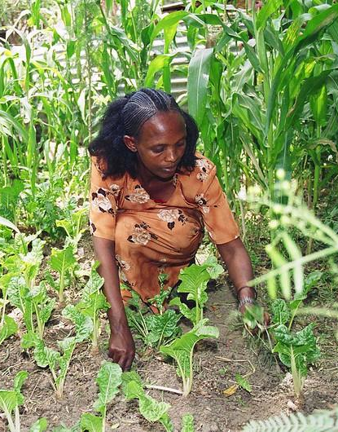
Ethiopia’s framework
National Guidelines for mainstreaming gender perspectives in budgetary processes of Ethiopia (2012).
Objective ‘to support the ongoing efforts of the Government to promote gender equity and equality’
The Guidelines provide budgetary actors ‘with instruments for gender mainstreaming in budgeter process’
Notes:
Its main objective is to support the on-going efforts of the Government to promote gender equity and equality as well as poverty elimination for sustainable development. The Guidelines provides budgetary actors such as planners, budget officers and gender experts with instruments for gender mainstreaming in budget process.
Devised by Ministry of Finance and Economic Development (MoFED), in collaboration with Ministry of Women, Children and Youth Affairs (MoWCYA) and UN Women
Supplementary information:
The 1995 Constitution of the Federal Democratic Republic of Ethiopia (FDRE) affirms equality of all persons and prohibits discrimination based on sex. It guarantees peoples‟ rights and affirmative action to promote gender equality and women’s empowerment.
The National Policy on Ethiopian Women (1993) is laid the foundation in protecting women’s rights and is mandated to establish Women Affairs Directorates (WADs) at all levels of administration in each sector ministry for follow-up and coordination of gender mainstreaming including engendering the budget.
Image credit: ILO, flickr

Slide 6
Ethiopia’s framework, cont.
“Gender responsive budgeting helps to decide how budget and policies need to be adjusted to achieve maximum impact and where resources need to be reallocated to achieve human development and gender equality.”
Government of Ethiopia, National Gender Responsive Budgeting Guidelines (2012)
Notes:
Comprehensive, step-by-step guidelines for Ethiopian Public Bodies to follow are provided in the above 2012 document (56 pp)
However, in this training module, we focus on the specific programme- and project-level steps and their budgetary allocations, which planners and managers should consider. See next slide.

Slide 7
Ethiopian law supports equality
Article 35 of the Constitution provides for affirmative measures* to be taken to ensure women participate and compete equally with men in the political, social and economic spheres
Ethiopian law also provides for:
Equal pay for equal work: Women shall not be discriminated against in employment and payment on basis of their sex
Equal rights of women to land
*Definitions of affirmative measures include:
- an active effort to improve the employment or educational opportunities of members of minority groups and women
Notes:
Article 35 of the Constitution provides for affirmative measures to be taken to ensure women participate and compete equally with men in the political, social and economic spheres; it also provides for the prevention and eradication of Harmful Traditional Practices(HTPs). Articles 25, 34, and 89/7 also affirm gender equality in all spheres of society by protecting the fundamental rights of women.
b) Labour Proclamation Number 377/2003 stipulates that women shall not be discriminated against employment and payment on the basis of their sex. It also prohibits employment of women on a type of work that may be harmful to their health.
c) The Federal Civil Servants Proclamation Number 515/2007 stipulates that all positions of equal value shall have equal salary. Article 13(1) of the Proclamation prohibits discrimination among job seekers on the basis of sex. The proclamation also incorporates an affirmative action by stating that preference shall be given to female candidates who have equal or close scores to that of male candidates; it also guarantees women‟s constitutional right to affirmative action in relation to recruitment, promotion, deployment, training and provision of a working environment free from sexual violence.
d) The Rural Land Administration and Land Use Proclamation Number 455/2005 has provisions on equal rights of women to land.
e) The Proclamation of Executive Organs of the Federal Democratic Republic of Ethiopia Number 691/2010 gives the mandate to all sector ministries, government agencies and government development enterprises to integrate gender issues according to their powers and duties.

Slide 8
Five-part checklist for gender-responsive budgeting (Government of Ethiopia, 2012)
Step (from GoE Guidelines, 2012) | Where to learn about it
(i) Analysing the situation of women, men, girls and boys in a given sector | See modules 1-4 of this course
(ii) Assessment of the extent to which policies address the gendered situation (gender responsiveness of the policy) | See module 4 of this course – applies to project design too
(iii) Assessment as to whether budget allocations are adequate, in order to implement gender-responsive policy | In this module
(iv) Assessment of short-term outputs of expenditure, in order to evaluate how resources are actually spent, and policies and programmes implemented | In this module
(v) Assessing the outcomes | In this module
Notes:
Comprehensive, step-by-step guidelines for Ethiopian Public Bodies to follow are provided in the above 2012 document (a 56 pp document)
The five steps toward achieving gender-responsive budgeting, as outlined by the Government of Ethiopia guidelines, are:
(i) Analysing the situation of women, men, girls and boys in a given sector (we have already done this in the previous modules of this training, and particularly, we have done this in some depth and with support of different tools, in modules 3-4)
(ii) Assessment of the extent to which policies address the gendered situation (gender responsiveness of the policy). In module 4 of this course, we have considered how specific elements of programme or project design can address gendered elements of the climate and development problems with which the programme/project is concerned.
However, in this training module, we focus on the specific programme- and project-level steps and their budgetary allocations, which planners and managers should consider – as concerns the bottom three points:
(iii) Assessment as to whether budget allocations are adequate, in order to implement gender-responsive policy – or, as the case may be, to implement the gender-responsive measures in the project/programme.
(iv) Assessment of short-term outputs of expenditure, in order to evaluate how resources are actually spent, and policies and programmes implemented
(v) Assessing the outcomes

Slide 9
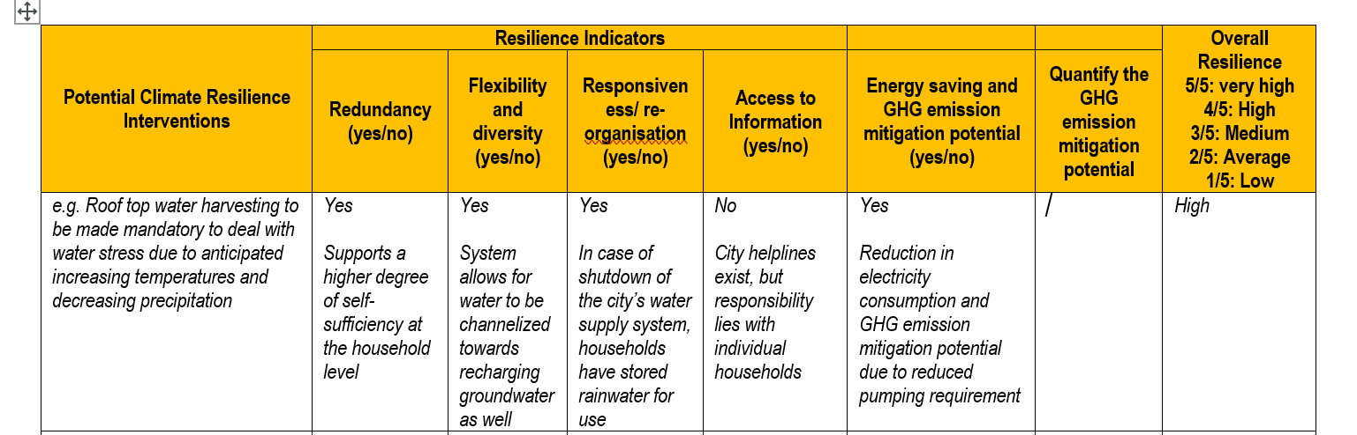
Are budget allocations adequate in order to implement the gender-responsive policy and activities?
The previous options assessment exercise (module 4 of this course) looked at how to shortlist activities/outputs to meet climate, development and gender goals.
Exercise: In the last module, you imagined how this water harvesting project could benefit females and males equally, any risks of exclusion and how to overcome exclusion. Now imagine what specific activities you would need to budget for, to ensure equitable outcomes and female empowerment. Be as specific as possible.
Notes:
Facilitator: If the participants have already done the optional exercise in module 4, they have already thought about activities to make this project activity more gender-responsive. If not, then they should at first sketch out the gender responsive activity ideas here. Then, participants consider the budget implications for the gender-responsive activities in this case.
Sample answers (solicit participants’ own responses too):
Is water harvesting equipment being given for free by the project or do participants need to pay? Can women afford to pay (including female headed households)? Is extended loan provision or subsidy required for women in order to facilitate their participation in the scheme? (this could require some budget allocation)
How is the scheme planned to be marketed? Do the marketing plans have provision to reach women as well as men, eg using media and channels they can access? If not, e.g. if women are more likely to be illiterate etc, how do the marketing plans need to be expanded or changed to reach women as well as men? (this could require some budget allocation)
Is training/instruction required in order for participants in the scheme to optimise use? If so, are training/instruction plans geared to reach women as well as men? What modifications/expansion might be required to reach everyone equally? (this could require some budget allocation)

Slide 10
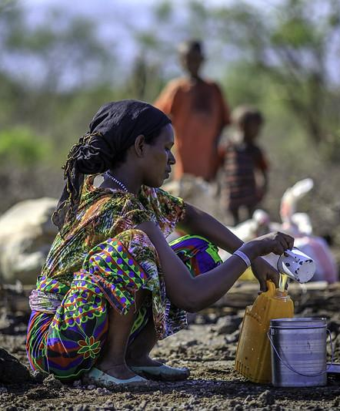
Case study: How the Agricultural Climate Resilience Enhancement Initiative (ACREI) is planning and budgeting for gender equity (Ethiopia, Kenya, Uganda)
Project design integrates gender equity and women’s empowerment:
Gender disaggregated baseline data
Gender responsive community consultation
Women to make up 50% of project participants and to receive special targeting
Plans to foster gender-equal decision-making
Notes:
1) Baseline with sex disaggregated data and gender specific questions
2) Use of participatory tools for gender sensitive community consultation
3) Use of tools developed by FAO and partners for integrating gender in climate-smart agriculture (http://www.fao.org/3/a-i5299e.pdf and http://www.fao.org/3/a-az917e.pdf)
4) Aim for 50% participation of women in project activities and 50% of project direct beneficiaries to be women, while also targeting specific project activities at women or women groups (for example the integrated savings and lending).
5) Foster equal participation of men and women in institutions and decision-making processes related to the project.
See
https://www.adaptation-fund.org/wp-content/uploads/2017/01/1430ACREIFullProposalCLEAN2Feb2017.pdf
https://www.adaptation-fund.org/project/agricultural-climate-resilience-enhancement-initiative-acrei-ethiopia-kenya-uganda/
Image credit: UNICEF, flickr

Slide 11
Case study: Agricultural Climate Resilience Enhancement Initiative (ACREI) (Ethiopia, Kenya, Uganda)
Target outcome and output | Target performance measures
OUTCOME: Strengthened resilience to climate change impacts in agriculture | Percentage change in household incomes disaggregated by gender of household heads | % change for female headed households
 | Percentage of extension workers (male and female) who are integrating adaptation strategies in their work at the community level | target 50% of extension workers should be women
 | Number of Agro Pastoralist Field School (APFS) groups in place and applying climate change adaptation knowledge | target 50% of APFS group participants should be women
OUTPUT: Targeted population groups participating in adaptation and risk reduction awareness activities | Number of APFS groups in place and applying climate change adaptation knowledge | target 50% of APFS group participants should be women
 | Number of extension actors who demonstrate an increase in knowledge and skills on climate-sensitive extension methodologies | target 50% of extension workers should be women
Notes:
This slide is showing how – for Agricultural Climate Resilience Enhancement Initiative (ACREI) in Ethiopia, Kenya, Uganda– the project has set some output (which we also refer to in this module as ‘activity’ level) targets for how many project participants are engaged and what percentage of them are women. See https://www.adaptation-fund.org/project/agricultural-climate-resilience-enhancement-initiative-acrei-ethiopia-kenya-uganda/
This slide is also showing how these translate to the ‘outcome’ level – how things would change as a result of this project’s intervention – how would people be doing things differently? The overall outcome here is about the uptake of the adaptation measures and climate risk reduction processes over time.
Discussion questions:
In order to make sure that these targets are made for 50% of beneficiaries to be women, what kind of activities do you think would be needed to bring women fully into the programme? Would these measures require budget allocations to make them happen?
E.g would specially trained gender experts be needed in certain implementing bodies, to steer the activities? Or all implementing staff to have more ‘gender responsiveness’ training? Would you need to budget for this?
Are there barriers to women’s full and equal participation as project beneficiaries that funded solutions could help resolve? Such as childcare arrangements? Would you need to budget for this?
Would training materials for the field schools need to be diversified in order to make them accessible by women and people of diverse abilities e.g. less literate etc, and would you need to budget for this?

Slide 12
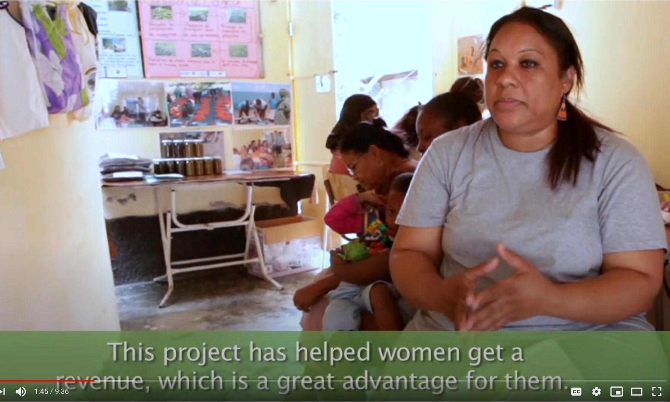
Short-term outputs : how to make sure budget allocations lead to gender-responsive outputs The case of Mauritius
Exercise: Watch this video about a project in Mauritius. How did the activities respond to climate change? How were the activities gender-responsive? How do you imagine budget was allocated to activities in this case? Do you expect ‘women’s activities’ had a special budget line?
Notes:
Facilitator:
Play the video by the Adaptation Fund up to minute 2:17. Stop at minute 2:17, which is the end of the Mauritius segment.
The url of the video is: https://www.youtube.com/watch?v=mdmuVf9mEoA
Ask the participants the questions. Answers follow:
How did the activities respond to climate change? Answer: Climate change impacts are reducing incomes. Families need climate-resilient means of livelihood. The project has provided women with the means to start their own sewing and other businesses.
How were the activities gender-responsive? Answer: 50% of the project beneficiaries are women. As described in the video, they managed to start their own climate resilient income generating activities to make up for the socioeconomic impacts of climate change to date. They were further ‘trained to reduce socioeconomic and environmental risks’ as it says in the video.
How do you imagine budget was allocated to activities in this case? Do you expect ‘women’s activities’ had a special budget line? Answer: from the story told in the video, you can see that the women-centred activities, which were designed to empower women and enable their meaningful participation in climate resilient economic activities, were not additional and therefore did not call for ‘extra’ budget. They were, rather, integral to the entire project’s design.
The Adaptation Fund includes the following in its list of proven factors for successful project design, in order to achieve for equitable activities and outputs:
LESSON 1: To promote gender empowerment, it is important to ensure that gender considerations are explicitly spelled out in the project document where women are active members of the project with well defined livelihood opportunities and roles.
LESSON 2: To ensure meaningful participation and encourage empowerment, a project can benefit from tailoring activities to the economic needs of women, involving them in all committees, improving their skills in business planning and designing assessments to understand how women view themselves in intra-household gender relationships.
LESSON 3: Gender sensitisation and empowerment is one of the key added values of a project and must be better mainstreamed at all levels- from the implementing entity level to the beneficiaries. Projects benefit from having crosscutting and sectoral integration with gender as an expected result.
LESSON 4: It is recommended to have gender focal points in each of the levels of work – international (e.g. regional implementing entity/fund manager if it’s an international project), national (e.g. the execution partner/(s)), subnational (provincial, district and municipal) and community levels (local champions of women). Additionally, …gender commitments in the project/programme design should be translated into budgetary commitments in the form of adequate budget allocations to address men’s and women’s differentiated adaptation needs.
These are from the Adaptation Fund’s ‘Lessons Learned from Project Portfolio Monitoring Missions’ document (which draws from other countries in the Fund’s portfolio but the lessons appear to hold true for Mauritius, too).
The last point from the Fund’s lessons learned, that “budgetary commitments need to be allocated to address men’s and women’s differentiated adaptation needs,” reminds us not to think of male centred needs as the ‘normal’ and women’s as ‘additional’ – women’s and men’s needs should all be central to the main design and budget.
Discussion question for participants: How would the role of ‘gender champion’ at all levels of a project or programme work in your professional context?
Image: Adaptation Fund, vimeo

Slide 13
Mauritius Adaptation Fund project example, from its results matrix:
Longer-term outcomes: how to make sure budget allocations lead to gender-equitable outcomes The case of Mauritius
Target outcome and output |  | Target performance measures at completion
OUTCOME: Strengthened awareness and ownership of adaptation and climate risk reduction processes | Indicator : Increase in application of appropriate adaptation responses | % of population applying adaptation measures
 |  | 30%*
OUTPUT: Targeted population groups participating in adaptation and risk reduction awareness activities | Indicator : Percentage of targeted population awareness of predicted adverse impacts of climate change, and of appropriate responses | Number of targeted beneficiaries | % of participants targeted who are female | Level of awareness
 |  | 50,000 | 50% | “Mostly aware”
*Discussion: How would you design this target so that the gender-specific outcomes were measured?
Notes:
This slide is showing how – for a related set of activities funded by Adaptation Fund in Mauritius – the project has set some output (which we also refer to in this module as ‘activity’ level) targets for how many project participants are engaged and what percentage of them are women.
This slide is also showing how these translate to the ‘outcome’ level – how things would change as a result of this project’s intervention – how would people be doing things differently? The overall outcome here is about the uptake of the adaptation measures and climate risk reduction processes over time.
Discussion questions:
1. What would be an appropriate further target to add, that is gender-specific, under ‘outcomes’? Sample answer: 30% of population apply adaptation measures, of which, half are women.
2. What would be some appropriate questions to investigate about project outcomes - if one were to do a later impact assessment to find out the gender-related outcomes of the project?
Sample answers (solicit participants’ views also):
How many of the women project participants are applying adaptation measures and reducing climate risk (at project completion, one, two years later)?
How many of the men project participants are applying adaptation measures and reducing climate risk (at project completion, one, two years later)?
How are communities benefiting from uptake of the adaptation and climate risk reduction measures (at project completion, one, two years later)?
Who in the communities are benefiting? (old, young, male, female, able bodied, disabled, etc)?
Who is showing leadership and taking decisions about adaptation and climate risk reduction measures (at project completion, one, two years later)?

Slide 14
www.cdkn.org
@cdknetwork
Notes:
Facilitator: insert your name and email/contact here

