Slide 1
Achieving Triple-wins In the Agricultural Sector: Some Experiences From CDKN
Ari Huhtala,
CDKN Director of Policy and Programmes
LCES3, Xian, 28 September 2013

Slide 2
Contents
Introducing CDKN: who we are and what we do
Agriculture as a useful entry point for CCD? Drivers and barriers
CDKN project: “Climate compatible development for food security through national climate change strategies”
Case studies from Kenya, Bangladesh and Honduras
Some common lessons and findings
Concept of the ‘gatekeeper’

Slide 3







1. Introducing CDKN
Notes:
Brief introduction on CDKN is:
Funded from British and Dutch governments to support decision-makers in delivering ‘climate compatible development’ .
Windows for research, TA, knowledge management, partnerships and negotiations support.
Managed by 6 organisations in alliance across 4 regions
Established and recognised development programme in over 30 countries.
A talented team from 6 institutions working across 3 regions and a London hub
Overall strategy and vision
Project cycle, procurement and financial systems in place
Rapid speed up of project pipeline
Impressive spread of projects
CDKN voice and visibility emerging
We are South and North led: our regional leadership and hubs in Cape Town, Quito, Islamabad and London are close to the clients and the need. The CDKN alliance of PwC, ODI, SSN, FFLA, LEAD and INTRAC combines leading NGOs (southern and northern), a think-tank and a large private sector company working. This allows us unprecedented breadth and depth of expertise on climate change and development. We focus around four areas: climate compatible development planning; climate finance; disaster risk management; and climate negotiation. These are supported by work on climate-smart agriculture, energy, water security, coastal zones, and urban and sub-national areas. It is underpinned by core in-house expertise in programme planning and management, quality control and impact.

Slide 4
HOW? We combine research advisory services and knowledge sharing in support of locally owned and managed policy processes.
WITH WHOM? We work in partnership with decision-makers in the public, private and NGO sectors (nationally, regionally, globally)
WHERE? Global, Africa, Asia, LAC + 13 deep-engagement countries
Research
Technical Assistance
Knowledge Management
Partnerships
Advocacy
Climate Compatible Development Planning
Access to finance
Risk management and resilience
Capacity building for climate negotiators

Slide 5
Three key features of CDKN
It is demand-led, BUT with a particular niche: delivering ‘climate compatible development’.
It is about research AND policy
It is about climate AND development
Notes:
5

Slide 6

Climate Compatible Development
  ‘Climate compatible development means reducing poverty and securing human development in a way which reduces the extent of climate change, and also helps societies to adapt to inevitable change’
Development Strategies
Low carbon development
Climate resilient development
Climate Compatible Development
Mitigation Strategies
Adaptation Strategies
Co- benefits
Source: adapted from Zadek (2009) and informal communication with staff from the UK Department for International Development

Slide 7
Therefore CCD:
Is a conceptual framing (umbrella concept)
Is an inclusive approach (recognises complex interplay between climate and development)
Promotes cross-sectoral and multi-scalar linkages and solutions

Slide 8
Agriculture as a useful entry point for CCD
Climate change will especially affect agriculture (greater crop water demand, more variable rainfall and extreme climate events, …): at the same time agriculture is a major source of GHG emissions.
Opportunities for climate change adaptation, mitigation, and development towards increased food security
CLIMATE-SMART AGRICULTURE
CSA is not a NEW approach to agriculture, but comprises better agricultural practices and risk management – potential to bring about some synergies such as income diversification, reducing landscape vulnerability, improving soil fertility. But TRADE-OFFS (e.g. biofuels)
Notes:
The agricultural sector is a useful entry point for CCD strategies, as it presents opportunities for addressing mitigation, adaptation and food security (in turn, key to address poverty and development issues) in a synergetic way.
In fact, climate change will affect agriculture through higher temperatures, greater crop water demand, more variable rainfall and extreme climate events such as heat waves, floods and droughts. A pessimistic assumption about global warming estimates that, by the 2080s, the world agricultural productivity will decline by 3-16%. The loss in Africa could be of 17-28%. Adaptation, therefore, will be essential. Yet, whilst largely negatively affected, the agricultural sector bears an immense potential for CO₂ emission reductions as it is a major source of global anthropogenic greenhouse gas (GHG) emissions. According to the 4th IPCC Assessment Report, agricultural activities accounted for about 5.1 to 6.1 Gt CO₂-eq/yr in 2005, a global share of 10-12% of total emissions. Major gases are methane (CH₄) with 3.3 Gt CO₂-eq/yr, nitrous oxide (N₂O) with 2.8 Gt CO₂-eq/yr and to a minor extent CO₂.
In light of these considerations, major international actors in the agricultural sector, such as the FAO, have started looking at agriculture as a way to support adaptation and mitigation efforts to climate change, while improving food security and rural livelihoods: this type of agricultural systems are called “climate smart”. They comprise a combined policy, technology and financing approach to enable countries to achieve sustainable agricultural development under climate change. The CSA approach thus involves the direct incorporation of climate change adaptation and mitigation into agricultural development planning and investment strategies.
CSA is not a new approach to agriculture, but simply comprises better agricultural practices and risk management. It includes existing approaches such as conservation, agriculture, agroforestry, residue management and low-tillage, post-harvest storage, market links. Clearly, CSA bears the potential to bring about some synergies such as income diversification, tree/forest products, reducing landscape vulnerability, improving soil fertility, conservation of forest/riparian corridors, wetlands and mangroves, reductions in waste, some agriculture intensification.
But some trade-offs are also evident: there is the whole debate on biofuels, the risks linked to tree planting in water-scarce areas, and the trade-off between climate smart agroforestry versus intensification of agriculture for food production. Therefore, careful, site-specific design with participatory project development is needed.

Slide 9
To address this research question: project on “Climate compatible development for food security through national climate change strategies”
Project team: Perspectives GmbH, Germany – in partnership with Germanwatch, Bangladesh Centre for Advanced Studies, African Centre for Technology Studies, Fundacion Vida Honduras
Locations: Bangladesh, Honduras and Kenya
Duration: Sept 2011 – Aug 2013
OBJECTIVE: To assist policy makers in developing countries to harness climate finance for food security related elements in national climate change strategies

Slide 10
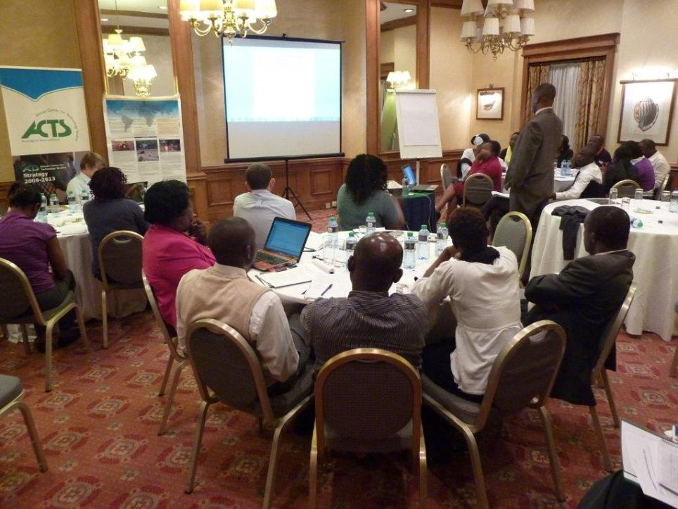
Case study from Kenya
Problems identified:
Proliferation of funding initiatives – non-coordinated and lack of alignment to development priority areas.
Insufficient information about specific funds dedicated to food security in the context of mitigation and adaptation projects.
Challenges in mobilising and allocating funds to climate-related projects
Silo working-style, limited financial resources and institutional leadership, lack of technical expert knowledge and policy incentives.
Preference of mitigation activities by donors
Launch of National Climate Change Action Plan (NCCAP) in March 2013 to implement the National Climate Change Response Strategy and ensure adaptation and mitigation measures are integrated in all governmental planning processes + collaborative and joint action (participatory approach)
Agricultural Sector Coordinating Unit includes 10 ministries with tasks relevant for food security + Climate Change Units + community-based programmes to respond to food insecurity.
Notes:
Agriculture is the mainstay of Kenya’s economy. PROBLEMS IDENTIFIED:
The workshop participants, policy makers and stakeholders consulted agreed that the funding initiatives for supporting mitigation and adaptation activities in the country appear to be uncoordinated and there is lack of alignment to priority areas.
They appreciated that there is proliferation of funding initiatives, both from bilateral and multilateral sources. There is insufficient information about specific funds dedicated to food security in the context of mitigation and adaptation projects.
The government has experienced challenges in mobilizing and allocating funds to climate related projects in its ministries and departments. Limited access to international climate finance in relation to projects in agriculture: Kenya has 32 funded projects under the LDCF and SCCF of GEF, some of them have agricultural related elements such as sustainable water management. Two are focusing specifically on agriculture (Scaling up Sustainable Land Management and Agrobiodiversity Conservation to Reduce Environmental Degradation in Small Scale Agriculture in Western Kenya (no. 5272) and Agricultural Productivity and Sustainable Land Management (no. 2355). Kenya has 16 registered CDM projects, one is related to sugar processing (bagasse cogeneration: http://cdm.unfccc.int/Projects/DB/TUEV-SUED1193228673.11/view). None of the three countries has communicated NAMAs so far.
The existing insufficient integration of climate change into the agriculture sector, lack of sufficient local and international climate finance, lack of cross-sectoral approaches, insufficient sharing of concrete case studies among the governments, private sector, donors and stakeholders, bureaucracy in government and insufficient expertise hinders efficient and effective implementation of synergies between mitigation and adaptation in the agriculture sector. The insufficient cross-sectoral integration can also be a challenged in ensuring that the National Implementing Entity (NIE) supports the priority areas of the agricultural sector. The workshop participants identified that the National Environment Management Authority (NEMA) does not have the sufficient expertise to administer the mitigation and adaptation funds as well as coordinate the activities to ensure synergies are achieved.
(The National Environment Management Authority (NEMA) which is the Designated National Authority (DNA) for approval of Clean Development Mechanism (CDM) projects has accepted renewable energy projects utilizing biofuel from sugarcane. NEMA also has been accredited the National Implementing Entity (NIE) by the Adaptation Fund Board to receive and transfer finance for carrying out adaptation projects and programmes in the country. The adaptation project areas identified include arid and semi-arid regions. The proposed adaptation strategies include dry land agriculture. Potentially the proposed adaptation option will enhance food security in arid and semi-arid regions but the challenge is the slow pace at which the available adaptation funding is being disbursed to reach the target countries on time. )
Continuous consultation with the policymakers and stakeholders revealed that mitigation activities are preferred by donors and other development partners compared to adaptation. The latter has received less financial support. INTERESTING – DIFFERENCE WITH RESPECT TO OTHER COUNTRIES. This is also shown by the energy sector that receives more funding support than agriculture sector at the national level. The government is implementing large energy related projects in the country, for example geothermal and co-generation ones. So there is the requirement to review Kenya’s priorities regarding climate finance as currently food security is not sufficiently supported through the available funds.
GOVERNANCE STRUCTURE
To address climate change, the government of Kenya has developed the National Climate Change Response Strategy with its primary focus to ensure that adaptation and mitigation measures are integrated in all governmental planning processes. Further, it calls for a collaborative and joint action with all stakeholders and has proposed a number of adaptation as well as mitigation measures.
The launching of the National Climate Change Action Plan (NCCAP) in March 2013 by the government and key stakeholders was a required guideline on how to implement the strategy with a view of achieving synergies between mitigation and adaptation while advancing climate compatible development. It provides policymakers and stakeholders in the agricultural sector with tools to integrate food security elements and guidance for effective and efficient access to climate finance.
The government enacted the Agriculture, Fisheries and Food Authority Act 2013 with support from the agriculture stakeholders. The act consolidates laws on regulation and promotion of agriculture. and enables national and county governments to ensure that farmers conserve the environment, ensure ecologically sustainable development and sustainable use of natural resources, as defined in the Kenya’s Constitution. At least ten government ministries and departments providing agricultural services have been established under the Agriculture Sector Coordination Unit (ASCU). The Authority will be mandated to borrow money or make investments that foster agricultural activities in the country while the ASCU is mandated to coordinate and harmonize agricultural related policies.
To date, Kenya has several successful community-based programmes that can be scaled up to respond to food insecurity.

Slide 11
FINDINGS AND CONTRIBUTION FROM CDKN PROJECT:
Workshop and subsequent consultations with policy makers (agricultural sector unit, Ministry of Environment and natural resources) and civil society, private sector and donor agencies.
How to administer mitigation and adaptation funds at national level between NEMS, NIE and Ministry of Finance? Concerns about lack of knowledge on climate change and food security.
Some stakeholders proposed autonomous body (Climate Change Authority) – but not agreement yet.
NGOs and private sector prefer consortium of institutions as gatekeeper for climate finance (to mitigate management inefficiencies)
Decentralisation after general elections on 4th March 2013 – easier to reach local farmers, but need for capacity-building of agriculture extension officers and other stakeholders to ensure integration of CCD (trainings, knowledge sharing).
Ministry of Environment has developed a training strategy for capacity-building of county stakeholders.
Optimism that county governments will allocate finance towards supporting climate change mitigation and adaptation.
NCCAP launch: enthusiasm among stakeholders to integrate mitigation and adaptation elements into national and county development
Notes:
How to administer mitigation and adaptation funds at the national level is still negotiated between the government and the stakeholders. The National Environment Management Authority (NEMA) is the Designated National Authority (DNA) for approval of CDM project. The National Implementation Entity (NIE) is managing some mitigation and adaptation funds from the international sources. The Ministry of Finance has the capacity to administer national and international funds due to its developed structure but there are concerns whether the staff involved might be lacking sufficient knowledge on climate change and food security to ensure equitable distribution of finance to priority projects. Some stakeholders proposed that an autonomous body need to be formed to guarantee the objectives of climate stakeholders. In the draft Climate Change Authority Bill 2012, the stakeholders proposed the establishment of a Climate Change Authority but it is yet to receive sufficient political support to be approved by the executive arm of government. The Climate Change Unit at the State Department of Environment, Water and Natural Resources still remains the coordinator of climate change activities in the country. Non-governmental organizations and the private sector mostly prefer a consortium of institutions to be some kind of gatekeeper for climate finance. This is based on the argument that in such a diverse framework inefficiency in fund management can be mitigated while building of trust among stakeholders, transparency and accountability can be achieved.
“Stories of Change”
After the General Elections on 4th March, 2013 Kenya’s Government is realigning itself to the new Constitution 2010 which requires the central government to devolve some state functions to the county governments. This approach aims to ensure that services including agricultural extension services reach the local needy farmers and vulnerable groups in the country. The consulted stakeholders emphasize the need for building capacity of both the national and county agriculture extension officers and related stakeholders to ensure integration of climate compatible development into the county master plan . The stakeholders expressed the unsatisfactory level of farmers due to inconsistent or lack of extension services at local communities. The workshop participants from the Ministry of Agriculture pledged to train and share knowledge with their colleagues on how to ensure that food security elements are sufficiently integrated during the implementation of the climate change action plan. Additionally the Ministry envisages allocating more resources to the local farmers.
The Ministry of Environment, Water and Natural Resources has developed a training strategy for facilitating capacity building of county stakeholders on integration of climate change into their country development plans as well as realigning county activities with the NCCAP. The Ministry and stakeholders are optimistic that the county governments will allocate finance towards supporting climate change mitigation and adaptation from the recently developed County Allocation.
The NCCAP is the key tool that will guide the government and stakeholders to integrate and achieve synergies between mitigation and adaptation. The launching of the action plan indicated enthusiasm among stakeholders to integrate mitigation and adaptation elements into the national and county development while ensuring food security. The Action Plan has captured the framework on how to achieve such synergies. This will take time and support from stakeholders .

Slide 12
Case study from Honduras
Problems identified:
Limited access to international climate finance in relation to projects in agriculture.
Silo working-style, limited financial resources and institutional leadership and capacity on environmental issues.
Difficult for farmers to apply new production techniques.
Government of Honduras has developed National Climate Change Strategy (NCCS): establishes Regional Development Councils (CDRs) – But challenges during implementation phase, particularly in relation to agriculture, soil and food security.
Notes:
Agriculture is an important source of income for people living in Honduras.
However, research conducted in the country has demonstrated that:
Honduras has only one approved project under the Adaptation Fund related to improved access to water resources, also for agricultural activities. Its total volume is about 5.6 million USD (https://www.adaptation-fund.org/project/1330-addressing-climate-change-risks-water-resources-honduras-increased-systemic-resilience-). Additionally the country has 20 funded projects under SCCF and LDCF of GEF, none is specifically aiming on agriculture (see http://www.thegef.org/gef/gef_projects_funding).
Silo working-style and limited awareness towards building synergies
Limited institutional leadership and capacity on environmental issues and financial resources to develop project proposals.
No awareness to carry out mitigation and adaptation measures
For local farmers it is difficult to apply new production techniques.
To respond to projected climate change impacts the Government of Honduras developed the National Climate Change Strategy (NCCS). Built on 7 priority areas, sets 17 strategic objectives, of which 15 are related to adaptation and 2 to mitigation. The NCCS will create Regional Development Councils (in line with Country Vision and Nation’s Plan Law) for each region so that strategies can be potentiated at the local level. But implementation challenges

Slide 13
FINDINGS AND CONTRIBUTION FROM CDKN PROJECT:
Workshop and subsequent consultations with officials of the Ministry of Agriculture and the Ministry of Natural Resources and Environment revealed that:
CDRs as an ideal platform for channelling technical and financial support to vulnerable communities (multiple stakeholders, participatory approach) – A thematic platform on agriculture, food security and climate change has been established within CDR and engaging different stakeholders.
→ Future engagement of Inter-Institutional Technical Committee on Climate Change (ITCCC) and institutions from central government?
3 key Ministries working together as a coordinating entity and international focal point within the framework of CDRs: to promote implementation of articulated processes for adaptation and mitigation in agriculture sector: integration of governmental/public/private actors to ensure transparency and effective management of resources.
Next steps: improve the organisational and participatory capabilities within CDRs.
Notes:
Discussions during the last workshop in the context of the joint research project in May 2013 and subsequent consultations with officials of the Ministry of Agriculture and the Ministry of Natural Resources and Environment revealed that the ideal platform for attracting and channelling technical and financial support to most vulnerable communities are the Regional Development Councils (CDR’s in Spanish) because of their close link with the local population. The CDR’s are consisting of multiple stakeholders from the central government, local government, private enterprises, development agencies, civil society and international cooperations. A thematic platform on agriculture, food security and climate change plays a crucial role within CDR and stakeholders from different levels of society are participating. Regional Development Councils (CDRs) were identified and proposed as the feasible private/public local platform to become the gatekeeper institution responsible for the management of potential resources from climate funds. Within the Subcommittee on Agriculture and Food Security, the CDRs have been identified as the institution responsible for the management of processes and activities to address the impacts of climate change in the agricultural sector with particular focus on the most vulnerable communities.
It is further expected that CDRs have the potential to successfully link the Inter-institutional Technical Committee on Climate Change (ITCCC) and institutions from the central Government. The ITCCC is a unique dialogue platform in Central America. It consists of about 40 public and private organizations that discuss in a subcommittee responses to climate change impacts on agriculture and food security.
During the workshops and events organized by the CDR’s it was proposed by several institutions that the Secretary of Planning, the Ministry of Natural Resources and Environment and the Ministry of Agriculture and Livestock will be involved. This way the three ministries would become the coordinating entity and international focal point for the gatekeeper institution embedded in the operating public/private framework of the Regional Development Councils. This approach integrates governmental as well as private and public/private actors to ensure transparency, efficient management of resources and technical assistance aiming to promote the implementation of articulated processes for adaptation and mitigation in vulnerable areas of Honduras. As a next step it will be required to improve the organizational and participatory capabilities within the Regional Development Councils.
The project has supported the evolution of the National Node for Agriculture and Food Security, originally conceived as an instance of academia. Also due to findings and outcomes from the project it has become the Subcommittee on Agriculture and Food Security. This established a joint platform for public and private stakeholders within the Inter-institutional Technical Committee on Climate Change of Honduras.

Slide 14
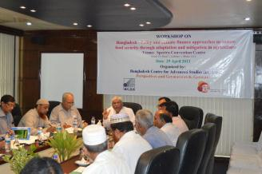
Case study from Bangladesh
Problems identified:
Limited access to international climate finance in relation to projects in agriculture.
In agriculture, focus has been on adaptation, but lack of policy incentives on how to harness synergies between adaptation and mitigation (no feeling of obligation to GHG emissions reduction and limited awareness of mitigation needs).
Lack of awareness at community level about solutions of agriculture and food-related problems.
Lack of transport and communication infrastructures, as well as skilled manpower.
Bangladesh has a National Climate Change Strategy and Action Plan (formulated by multiple stakeholders) and has established the Bangladesh Climate Change Resilience Fund – focus on adaptation and resilience needs of vulnerable communities. On-budget activities through ministries and departments, off-budget activities accessible for civil society organisations and private sector.
Notes:
In Bangladesh, agriculture is the mainstay of the majority of people. To counter global warming, a dozen of ministries are involved in addressing climate change.
Limitations to the current situation are:
Limited access to international finance: Bangladesh has 19 funded projects under the LDCF and SCCF of GEF. Hereby none is specifically aiming on agriculture and food security. Regarding mitigation, Bangladesh has 4 registered CDM projects, none is agriculture specific. Honduras has 29 CDM projects, some of them are related to methane capture and usage but not directly related to agriculture.
The country does not feel obliged to reduce GHG emissions: lack of policy incentives and how to harness synergies between adaptation and mitigation
Lack of skilled manpower and clarity on how to reduce GHG emissions within agriculture sector. In particular, lack of awareness at community level about solution of the problems (i.e., adaptation and mitigation). There is need for social mobilization, motivation and capacity building at local level for collective actions to cope with the impacts, reduces risks and vulnerability and ensuring food insecurity as well as mitigation measures at individual, family and community level for offsetting carbon and GHG reduction.
Lack of transport and communication infrastructures.
In the case of Bangladesh, the country also developed the Bangladesh National Climate Change Strategy and Action Plan as its framework to guide mitigation and adaptation policies and then established the Bangladesh Climate Change Resilience Fund. As the name indicates, this fund will focus on adaptation and resilience needs of the country particularly focusing on vulnerable communities and the agricultural sector. A very interesting feature of the fund’s governance structure is that part of the funding is being disbursed through ministries and departments (on-budget activities), while the other part (off-budget activities) will be accessible for civil society organizations and the private sector.
TO NOTE:
Multi-stakeholder formulation of climate change action plan
Adaptation is the highest priority, via: climate resilient crops, short duration crops, change in cropping patterns, risk management and increased R&D.
Mitigation: less water dependent crops, local varieties, efficient farming machinery, renewable energy in irrigation, agro-forestry.
Wider development: Gov. of Bangladesh establishing USD$100m Bangladesh Climate Change Trust Fund (BCCTF), focusing on food security and social protection.

Slide 15
FINDINGS AND CONTRIBUTION FROM CDKN PROJECT:
Workshop and subsequent consultations with officials of the Ministry of Agriculture and the Ministry of Natural Resources and Environment revealed that:
The Government of Bangladesh should assume a key role as “gatekeeper”, but it would be useful to have an international organisation (e.g. UNDP) in charge with fiduciary standards management and procurement services.
The gatekeeper should include political, technical and agricultural committees that are made out of experts from different institutions to draw on as much knowledge as possible.
Project proposals (to be funded by the gatekeeper) should derive from farmers and bi- or international organisations, and then ensure that approved projects align to the BCCSAP and effectively address needs of most vulnerable.
More inter-disciplinary, participatory and applied research could be undertaken to generate new and applicable knowledge on the approach and potentials of CCD – gatekeeper should find ways to incorporate NGOs and research/academic institutions.
Notes:
Since there is lack understanding about the approach and potentials of CCD, more inter-disciplinary, participatory and applied research could be undertaken to generate new and applicable knowledge on the issues. There is gap in scientific knowledge and prediction about climate change trends and impacts at regional and local level for taking adaptation and mitigation actions. Information and knowledge is to be generated for planning, decision making and implantation of adaptation, mitigation and social protection measures for addressing climate change and food security. Farmers and community people also need new and updated knowledge about climate change impacts, adaptation and mitigation measures for local action.
Integration of climate change issues (impacts, risk, vulnerability, adaptation and mitigation) in agricultural policy, strategies and programmes
Improving knowledge generation, technology, scientific research, R&D and information dissemination structure at all levels
Improving capacity for planning and implementation of adaptation and mitigation projects in agriculture and food systems as well as find synergies and co-benefits
Improving negotiation capacity of the government delegations to access international funding and technology supports under the UNFCCC and multi-lateral funding mechanism
Increasing national investment in research and action on CCD, climate resilient and sustainable agriculture and food security
Developing and implementation of adaptation and mitigation programmes with the vulnerable communities living in climate hotspots, and
Reformulation of social protection and safety net programmes in the context of greater intensity of climatic disasters and strengthening the humanitarian aid and actions for the poor, marginal and vulnerable communities
Formulation of appropriate climate resilient policy and regulatory frameworks
Development of climate resilient physical science, attribution and detection
Development of tools for climate vulnerability and disaster risk assessment
Identification of adaptation strategies and options
Capacity development and institutional strengthening
Development of economics and financing aspects of climate adaptation
Identify legal aspects of climate adaptation
The workshop also put forward the following recommendations in relation to potential institutional structure of the gatekeeper:
To ensure a clear mandate it was suggested that instead of being made up of a network of institutions the gatekeeper should be comprised of only one organization. With regard to taking advantage of existing capacities in other institutions, most policy makers however see the need to establish some kind of procedure to involve NGOs and academia.
While the Government of Bangladesh should become be a key player in the gatekeeper institution, an international organization such as UNDP should be in charge of undertaking fiduciary standards management and procurement services. (difference with respect to Honduras, where gatekeeper was seen as constituted by multiple organisations)
Many policy makers see the need of having 2-3 committees (political, technical and agricultural committee) that are made out of experts from different institutions. This way, it was expressed, the gatekeeper would draw as much knowledge as possible.
The gatekeeper institution should be open to project proposals that directly derive from farmers as well as to proposals from bi-or international organizations. It should then make sure that approved projects on the one hand align to the BCCSAP and on the other hand effectively address the needs of the most vulnerable.

Slide 16
Some common lessons learned:
Access to information is critical to set common objectives, as well as communication and coordination across scales and approach development projects holistically.
Promoting the co-benefits of combining adaptation and mitigation measures in the context of agriculture and food security could represent an incentive for developing countries to work towards reducing their GHG emissions as well.
Due to limited technical and institutional capacity, as well as lack of financial resources, developing countries are constrained to access international climate funding: international community should provide capacity-building and support on project proposals.
Projects for improving agricultural productivity and climate resilience need to consider farmers’ preferences to indigenous crops and difficulties in applying new production techniques (take traditional practices and knowledge into account).
Green Climate Fund should take into account country-level experience generated through this research.
Notes:
Access to information is critical for all stakeholders so that a common objective can be defined and development projects are approached holistically.
As developing countries often see little obligation to reduce their GHG emissions it is important to promote the co-benefits of combining adaptation with mitigation measures, especially in the context of agricultural and food security issues.
Climate change and agriculture are two very interdisciplinary matters that are being addressed from different ministries and at different political levels. Communication and coordination across all scales are therefore key to address developmental issues in a holistic interdisciplinary manner and to prevent a silo approach which creates duplication or gaps in efforts.
Due to limited technical and institutional capacity as well as a lack of financial resources, developing countries are often constrained to develop project proposals and access international climate funding. This contradiction needs to be addressed by the international community, e.g. by capacity building or providing support in terms of the form and content of the proposals.
The majority of small scale farmers in developing countries apply traditional practices and knowledge within the agricultural sector. Projects that target to improve agricultural productivity and make it more resilient to climate change therefore need to consider the farmers' preferences to certain indigenous crops and also that local farmers might have difficulties to apply new production techniques.
The Green Climate Fund as the (potentially) main future multilateral funding source for climate finance has the mandate that "an integrated approach to funding mitigation and adaptation will be used to allow for cross-cutting projects and programmes." (GCF 2012). When designing its modalities it should take into account country-level experience such as that generated through this research.
In order to overcome these barriers, it is required to explore options for innovative institutional approaches within developing countries that are able to link the international funding level and related negotiation platforms to the domestic implementation level, most notably the smallholders.
Thus we propose the establishment of a new institutional set-up to address climate change in agriculture, namely a domestic gatekeeper. Design elements of such a gatekeeper are outlined in the following chapter.

Slide 17
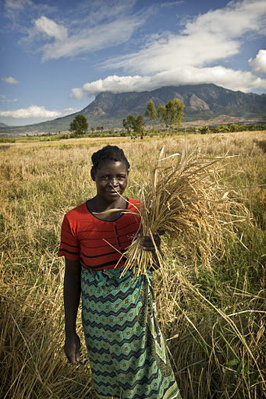
Main findings from the project:
Because global finance architecture is made up of various international finance institutions and bilateral initiatives, in-country coordination and national-policy coherence is often missing: risk of competing activities.
Strict separation of funding channelled towards climate change mitigation, adaptation and food security: no funding agency to date looks at triple-wins in an integrated way.
In developing countries, agriculture is fragmented: smallholder farmers are not reached by national policy-makers and international donors.
Notes:
Some concrete facts to support discussion on barriers:
In terms of climate finance for adaptation in the field of agriculture and food security it can be noted that 52% of the projects approved by the Adaptation Fund relate to one or both issues. For the LDCF the ratio is 28% while the PPCR only approved 11% of agriculture and food security relevant projects (status July 2012).
Regarding mitigation, the CDM Executive Board has approved 8 methodologies in the agricultural and related sectors, three of them covering methane avoidance. These small and large-scale methodologies have been applied by more than 90 registered projects. Furthermore about 160 registered activities make use of two methodologies tackling manure management and biogas production. Overall they have reduced about 0.75 Mt CO2-eq until mid of 2012.
Up to 40 unilateral NAMA concepts exist in the agricultural sector in more than 15 countries. These approaches cover a broad range of activities outlined in chapter 4 such as no-tillage farming (Brazil), promotion of nitrogen-fixing species or improved farming seeds (Central African Republic), implementation of agro-forestry systems (Ethiopia), uncontrolled burning practises (Ghana) or irrigation efficiency (Indonesia). Some supported NAMA concepts in the agricultural sector exist as well (see our report Task3 for a detailed overview).

Slide 18
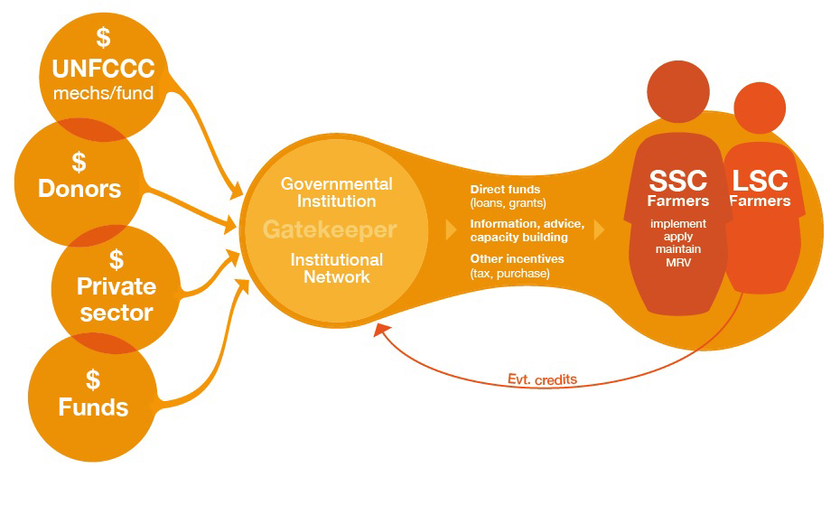
Conclusion
Establishment of a new institutional set-up that takes advantage of existing synergies that allow a climate-resilient and low-carbon development in the agricultural sector while incentivising continuous investments in food security: the GATEKEEPER INSTITUTION
Notes:
The figure illustrates the institutional set up and potential responsibilities. On the international level the gatekeeper attracts funding from the variety of existing bi- and multilateral sources. It acts as a focal point for communication with donors or the UNFCCC. Furthermore provides monitoring results and, in case the carbon market is involved, transfers generated credits. On the domestic level the gatekeeper disseminates information about potential activities and incentives, builds capacity of smallholders and monitors project results. Required funds are channeled to small- and large-scale farmers by applying different financial instruments such as loans, grants or insurances as well as market based approaches like carbon credits or taxes.
The following requirements for the gatekeeper institution are laid out:
It is crucial that the gatekeeper institution has sufficient institutional and organisational capacity to manage the funds according to high fiduciary standards, such as anti-fraud policies, independent audits, etc. If a fund should attract external resources, this aspect seems to be even more important than particular expertise in climate change mitigation, or adaptation, or agriculture.
Ability to use different financial instruments, as addressing adaptation and mitigation in the context of food security may involve the management of more complex financial instruments such as loans, risk insurance, etc.
Ability to advocate for smallholders interests and to manage the complex nexus between mitigation, adaptation and food security: A gatekeeper institution should have a very good understanding and record of dealing with the agricultural sector and its diverse players, with a particular attention to small-scale farmers. Furthermore, specific expertise related to climate change mitigation and adaptation and the international climate finance landscape is required.
Capacity to build on existing institutions: This means that the starting point for the establishment of a gatekeeper institution would be to screen existing institutional portfolios in a given developing country to see to what extent they meet the required qualifications.
Ability to involve multiple stakeholders: taking into account country-specific conditions, as well as being able to prioritise target groups.
Capacity to identify projects and programmes: that harness synergies between adaptation and mitigation and enhance food security at the same time. .
It is recommended to build gatekeepers in existing institutions in order to make use of existing capacity and not to increase institutional fragmentation. Depending on the country’s institutional structure, gatekeepers can be established as a single, centralised institution, or as a network of several partner organisations

Slide 19
Contact us
ari.huhtala@cdkn.org
Web www.cdkn.org
Twitter @cdknetwork

