Slide 1
Analysing climate change policy and institutions in Saint Lucia and Trinidad and Tobago: Piloting a Caribbean process
Key findings from the Coastal Zone Priority Area for Trinidad and Tobago
Presentation for the Institute of Marine Affairs’ Climate Change Adaptation and ICZM Policy Development Workshop
September 22, 2014
Notes:
CANARI will coordinate a Caribbean Green Economy Action Learning Group to help facilitate sharing and collaboration across the Caribbean on green economy ideas and initiatives.

Slide 2
1 year project
Funded by the Climate and Development Knowledge Network (CDKN): US$90,000
Implementation partners:
Caribbean Natural Resources Institute (CANARI) – lead regional NGO
World Resources Institute (WRI) - international capacity building and comparative research, ARIA tool
Saint Lucia National Trust - lead NGO in Saint Lucia.
Pilot countries: Saint Lucia and Trinidad and Tobago

Slide 3
Goal and Objectives
Goal: to improve the capacity of Caribbean islands to develop and implement effective climate change adaptation policy and action.
Overall objective: to pilot a rigorous and participatory research process in Saint Lucia and Trinidad and Tobago that builds understanding of effective climate change adaptation policy, institutions and actions, and improves capacity for participatory climate change policy design and adaptation implementation in Caribbean SIDS.
Specific Objectives, such as:
facilitate and support participatory research by civil society on climate change adaptation policy, institutions and actions
analyse the current state of policy, institutions and actions
identify high-priority and low-cost “next steps”
develop island-specific approaches to vulnerability assessment

Slide 4
Rationale
Climate change adaptation is a complex issue and requires action from a variety of actors.
The strongest efforts for planning and action for climate change adaptation have taken place at the international and, to a more limited extent, at the community level .
Because it has been internationally driven and at the national level, government led, civil society tends to lack ownership for adaptation policy and action
To be effective, adaptation actions must focus on the national and sectoral levels, where institutional and legal frameworks shape the quality of decisions at all levels.

Slide 5
Pioneering the WRI’s ARIA Toolkit
The World Resources Institute’s (WRI) Adaptation: Rapid Institutional Assessment (ARIA) toolkit is an indicator-based toolkit designed to help CSOs assess national-level institutional quality and governance in climate change adaptation. The toolkit provided a two-phased approach:
Phase I: assessment of the current policy, institutions and actions for climate change adaptation at the national level.
The outputs from Phase I provided the foundation for Phase II in which key priority areas (Food Production, Tourism and Coastal Zone) were identified for further research and analysis.
Phase II assessments identified the main issues that needed to be addressed through appropriate reforms in laws, institutions and practices in each of the priority areas.

Slide 6
Five (5) Assessment Indicators
Assessment: Determines whether vulnerability and impacts assessments have been conducted, and adaptation actions have been inventoried.
Prioritisation: Determines if a process exists for identifying priority sectors, populations, or geographies, whether adaptation institutions are operationalised through national budgets, and if there is a monitoring or feedback process for re-evaluating priorities.

Slide 7
Assessment Indicators
Coordination: Assesses whether coordination needs for adaptation are being identified and whether there is an effective, accountable body tasked with coordinating across agencies and sectors.
Information management: Determines whether there are systems for collecting, maintaining, analysing, and disseminating information that is relevant for adaptation.
Mainstreaming: Determines whether there are systems for mainstreaming climate change adaptation into relevant planning processes, projects, policies, and programs.

Slide 8
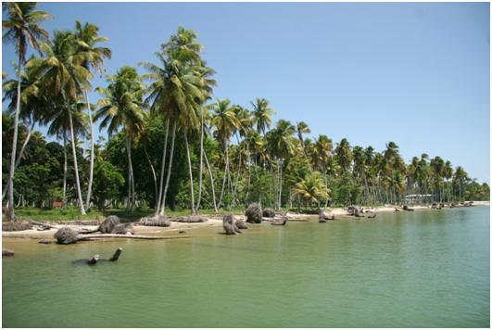
Key findings for the Coastal Zone Priority Area

Slide 9
Assessments
There does not appear to be a comprehensive national assessment regarding the vulnerability of coastal zones arising from climate change impacts.

Slide 10
Prioritisation
The National ICZM Steering Committee was appointed by Cabinet to recommend a national policy framework, strategy and action plan that would build the foundation for a permanent coastal zone management function in the country. (Considers climate adaptation)
The Steering Committee receives budgetary support from the IDB as well as from recurring funding under the IMA.

Slide 11
Coordination
The work of the ICZM Steering Committee represents the most significant efforts at coordination and collaboration regarding climate change adaptation for the coastal zone.
Multi-sectoral committee comprised of twelve (12) members from various government ministries, state agencies and civil society

Slide 12
Information Management
Information management was one of the weaker areas across all the priority areas assessed.
Access to reliable data/information?
Transforming data into useable information?
Unified platform for information sharing?

Slide 13
Mainstreaming
The GORTT received financing from the IDB for the institutional strengthening of the Environmental Management Authority (EMA) to improve its coordinating role in mainstreaming environmental management and climate change related priorities into all development sectors.

Slide 14
For more information contact CANARI
terrence@canari.org
http://www.canari.org/cm2.asp

