Slide 1
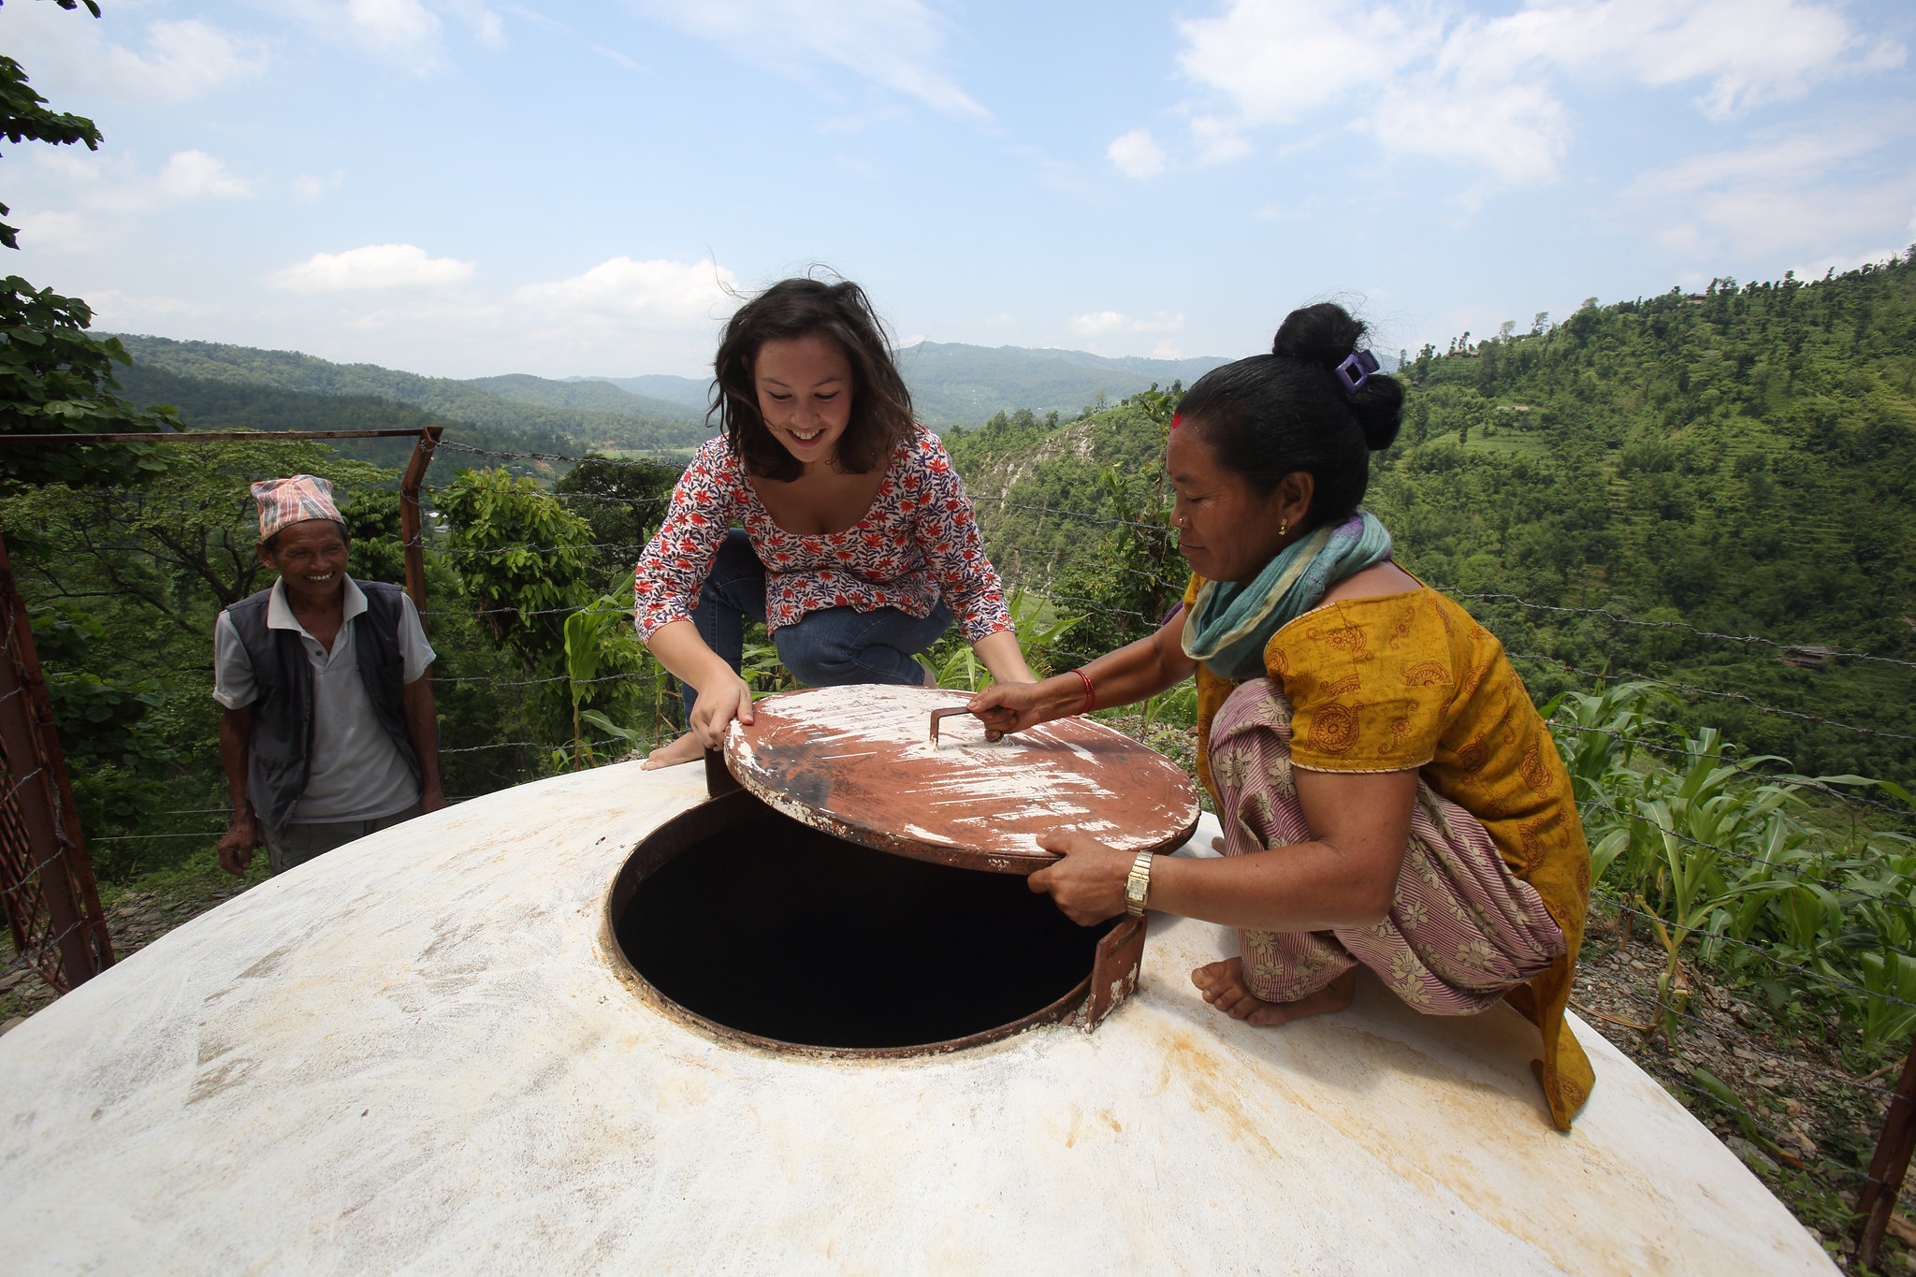
Extra! Slides for group work and discussion How women and men experience water insecurity differently Image: DFAT-Water tank, Nepal

Slide 2
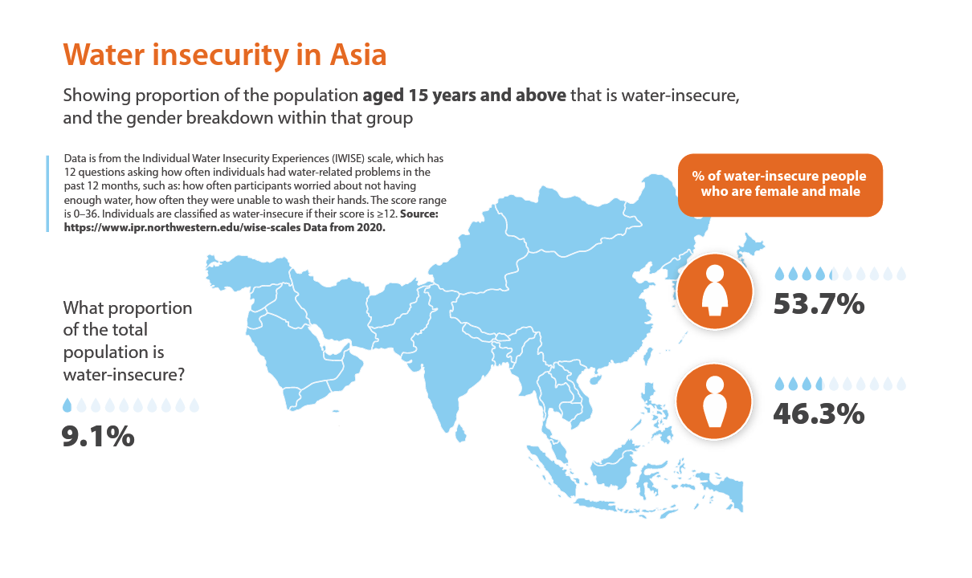

Slide 3
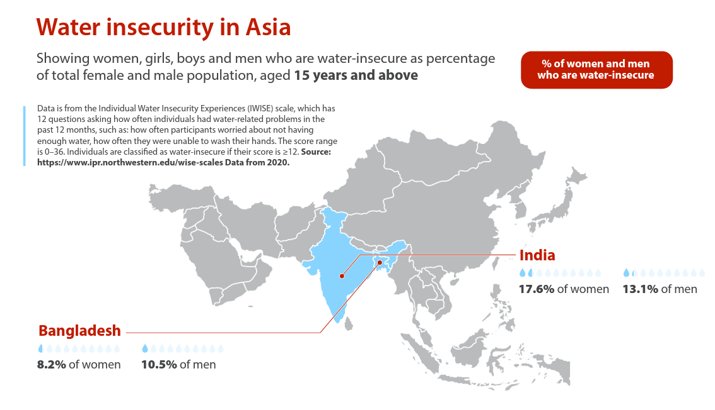

Slide 4
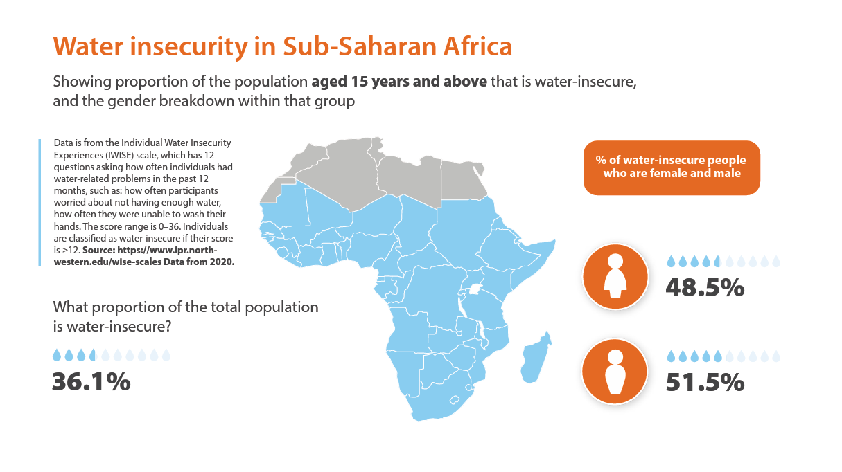

Slide 6
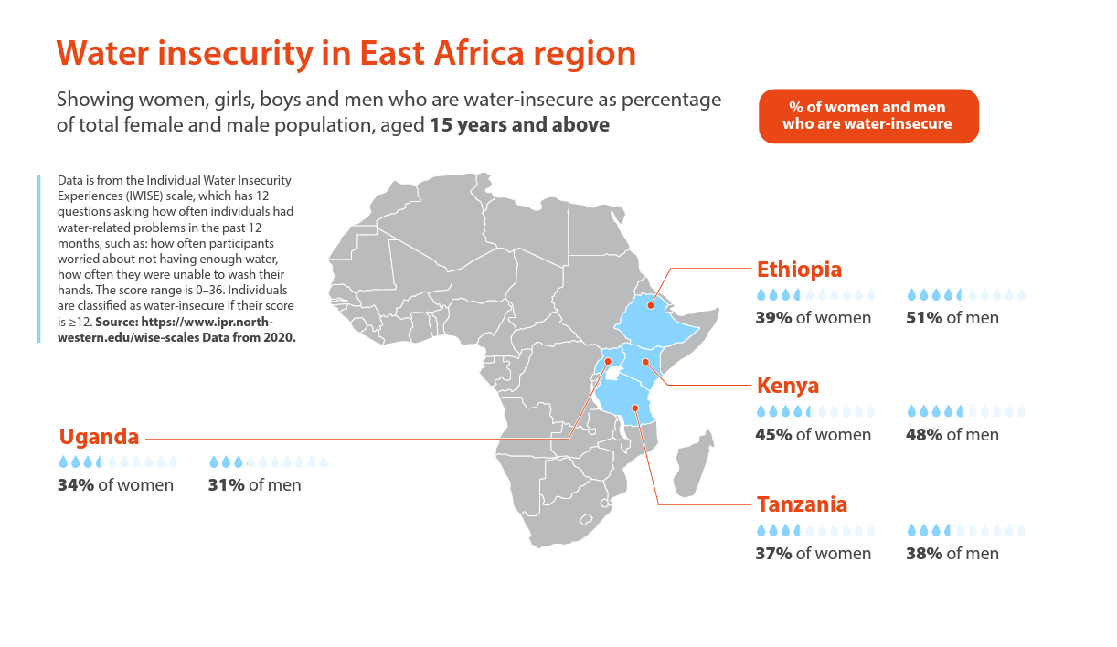

Slide 7
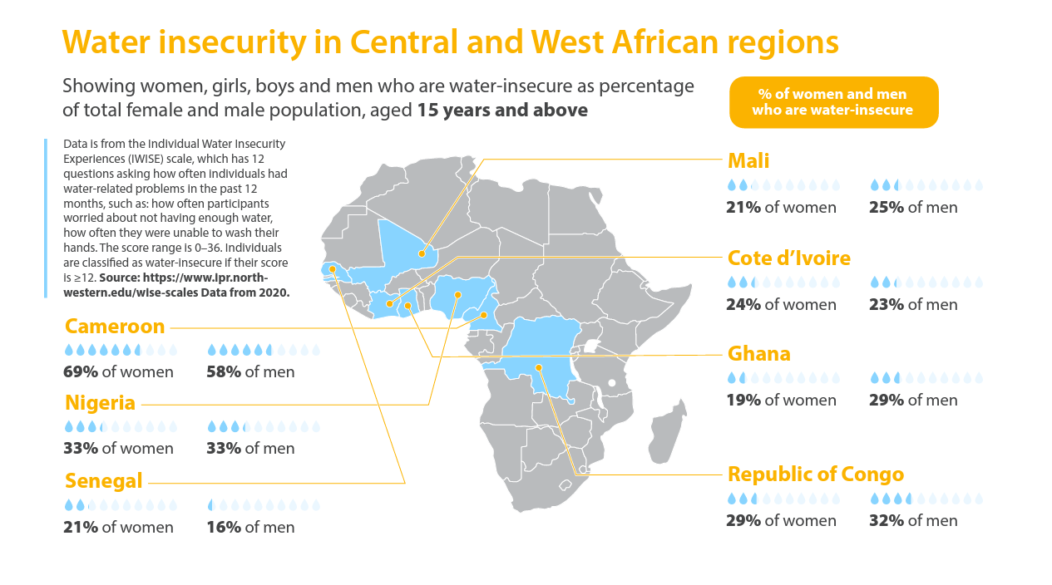

Slide 8
All infographics free to use under a Creative Commons licence CC-BY-4.0 Please attribute ©CDKN www.cdkn.org
@cdknetwork
Notes:
Facilitator: insert your name and email/contact here

